Slide 1




Admin portal to track agents

Slide 2

Our Team
PANDHI RENUKA --(6167)
SUSHMA SURESH --(61)
HARIPRIYA KUMAR --(61)
VORADI SAIVANI --(6164)
ARUNKUMAR CHOWDAPPA --(61)
BALA SUBRAMANIAN --(61)
ANUDEEP SURAGALA --(61)
AKIRI ANIL KUMAR --(61)

Slide 3


CONTENTS
Problem Statement
Introduction
Technology
Results
Future Enhancement

Slide 4
PROBLEM STATEMNT
We are developing an admin portal where we can handle agent details like- adding new agent, updating agent details, tracking the agent location and deleting agent details.

Slide 5

INTRODUCTION
This application is developed for admin who have complete rights of agents.
Here admin can add, update, delete agents and track the agent location using latitude and longitude.
And we can see the agent details which are stored in the database.

Slide 6



Technologies
Android Studio
XML
Java
API
Database(SQL lite)

Slide 7
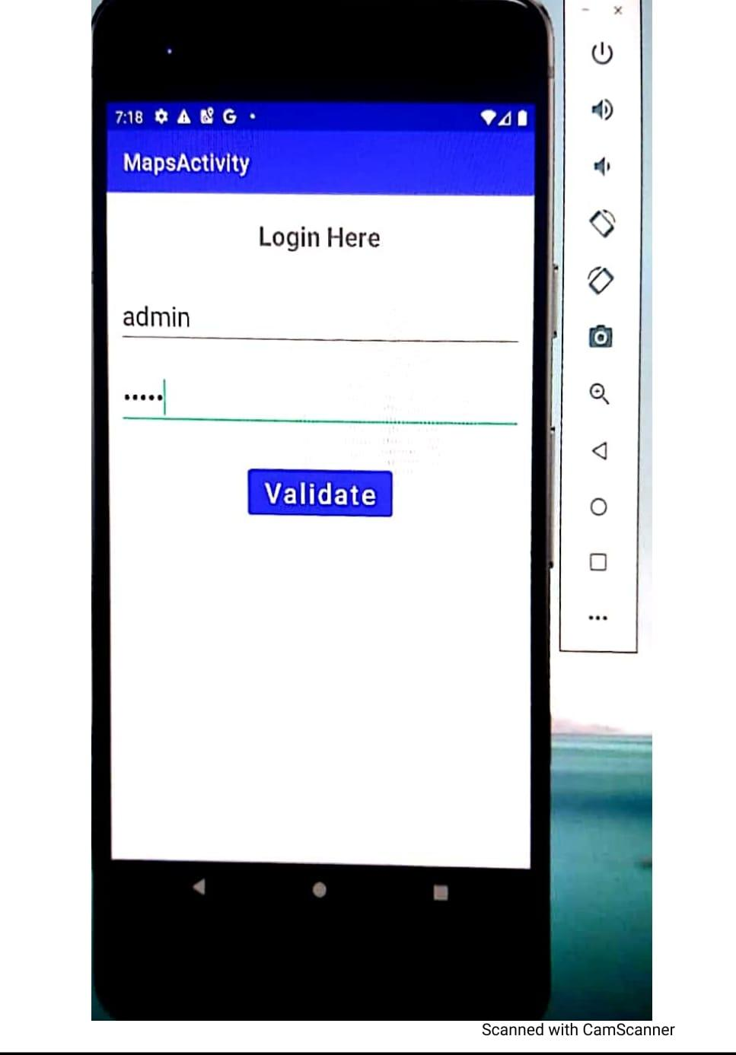
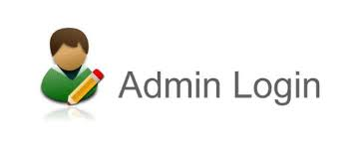
Result

Slide 8
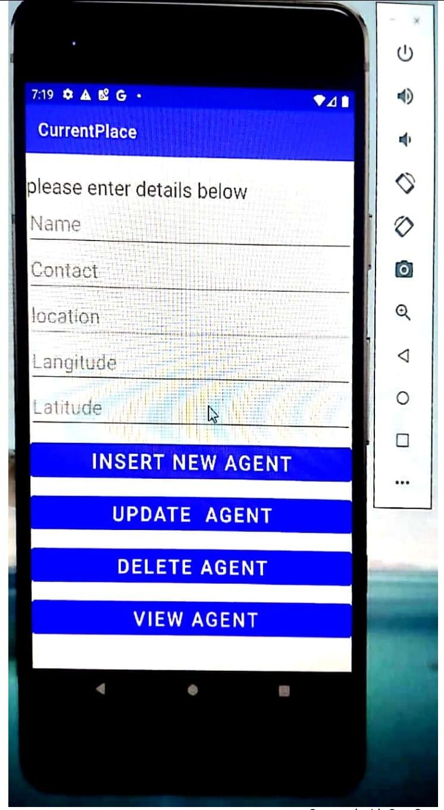
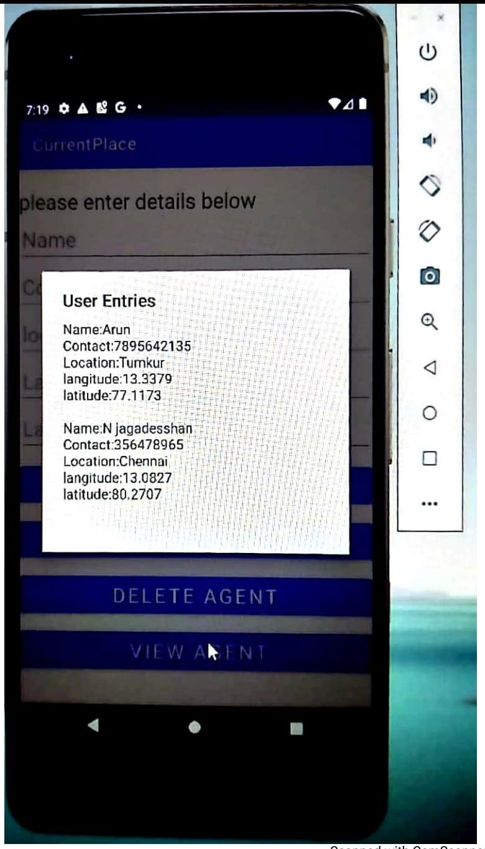

About agent page

Slide 9
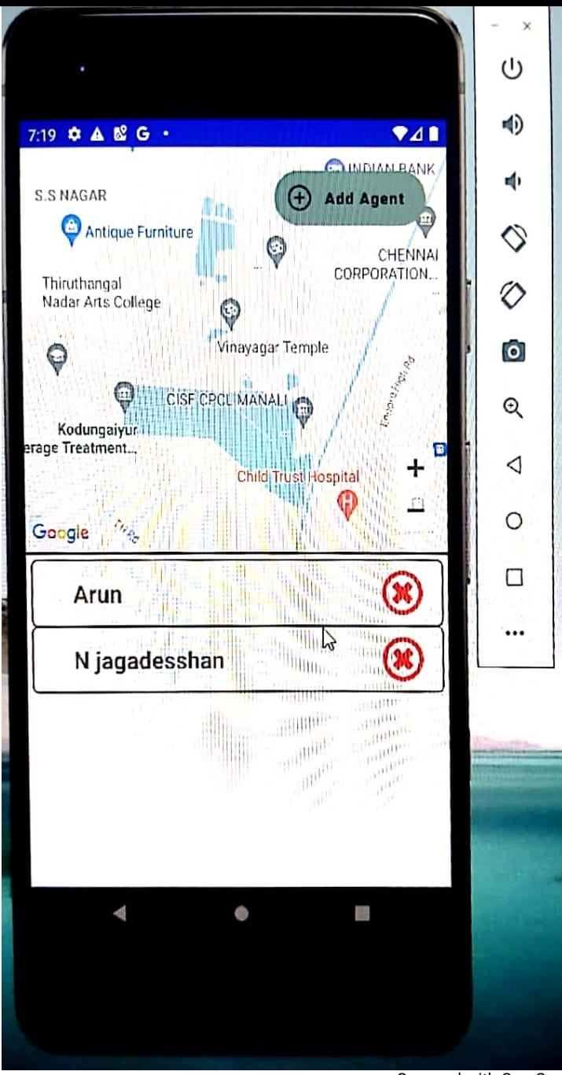
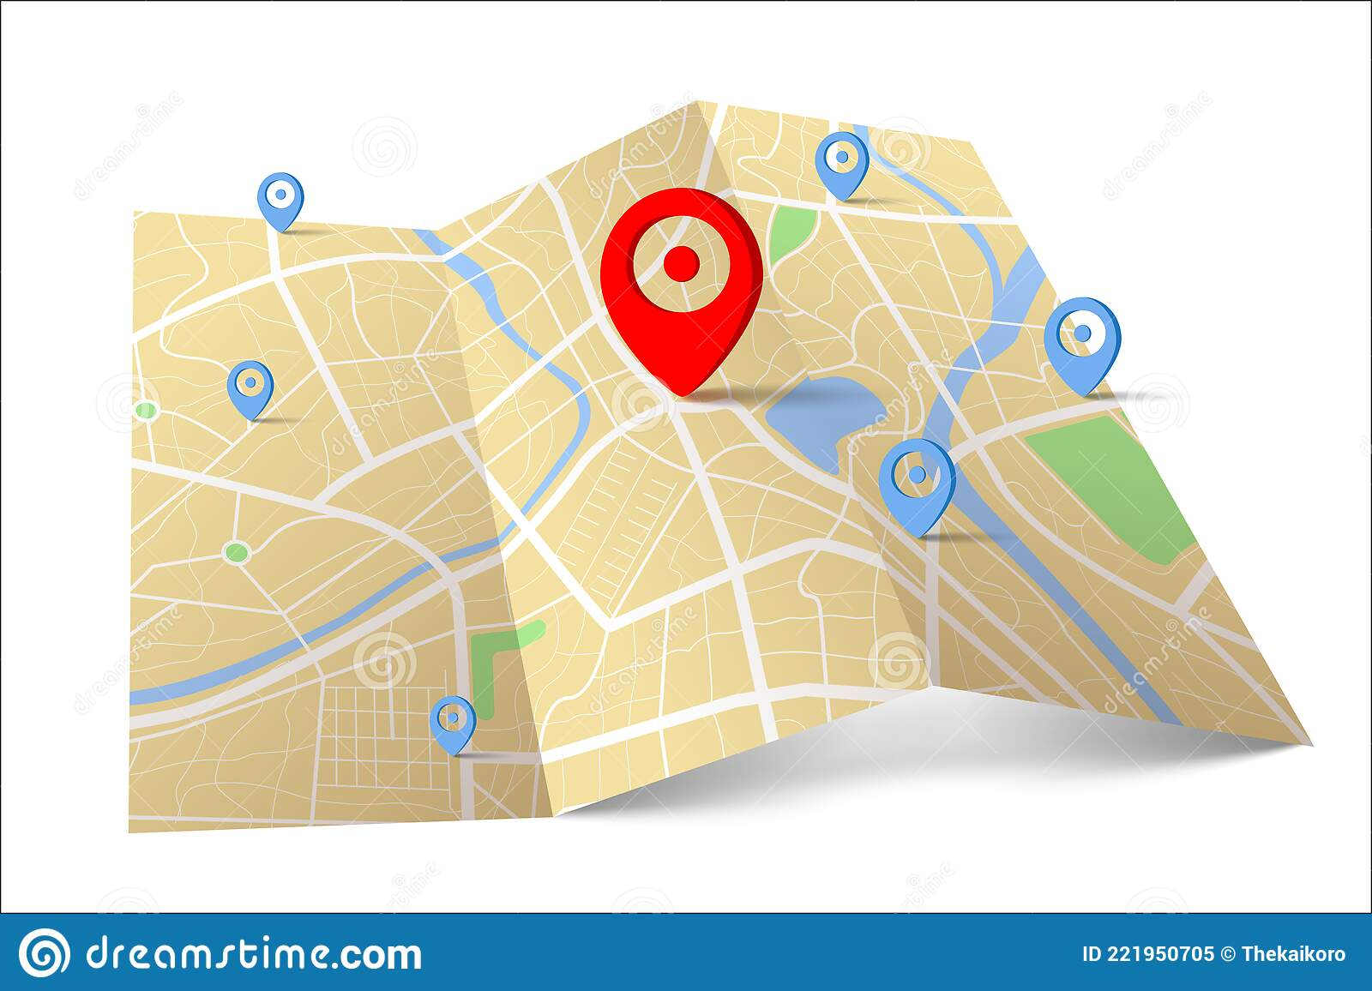
Mapping of agent

Slide 10
Future Enhancement
We will implement notification section
Gift voucher sending for agent based on the performance

Slide 11
THANK YOU

