Slide 1
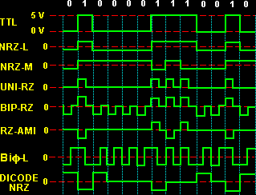
Experiments on unipolar, Polar and Bipolar Line Encoding Schemes
TEAM Kaabil
Anudit nagar (E18CSE024)
Abhimanyu banerjee (E18CSE005)
………………………………………..
Computer Science Engineering Department
Bennett University, Greater Noida, U.P.
Date:

Slide 2
Introduction
During Transmission of data from source to destination the transmitting signals may undergo attenuation and distortion.
Need to match the properties of transmitted signal as per the communication media for which digital data can be converted into digital signals.
Various Uni-polar, Polar and Bi-polar line encoding techniques are used for digital data to digital signal conversion.

Slide 3
Objectives
Implementation of various Line encoding techniques through a Virtual lab experience.
Providing a simple and optimized interface so that it can be used by people who are just starting to venture out in the field of signal encoding

Slide 4
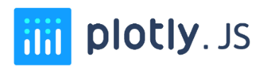
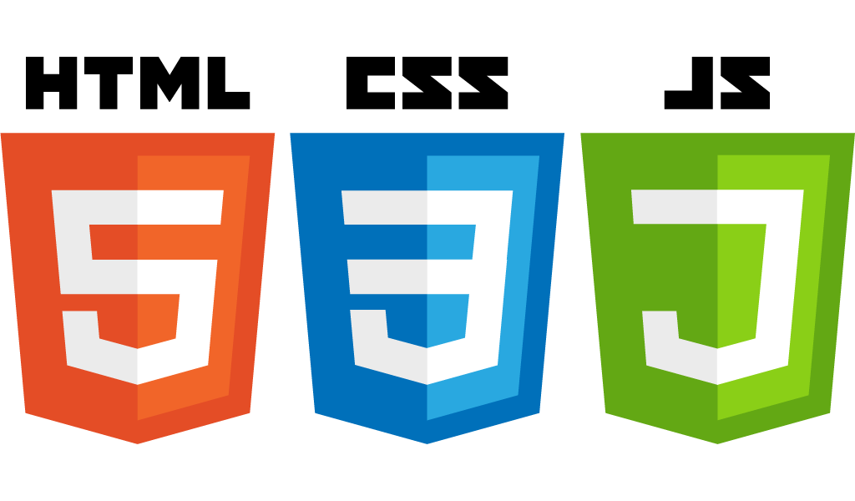
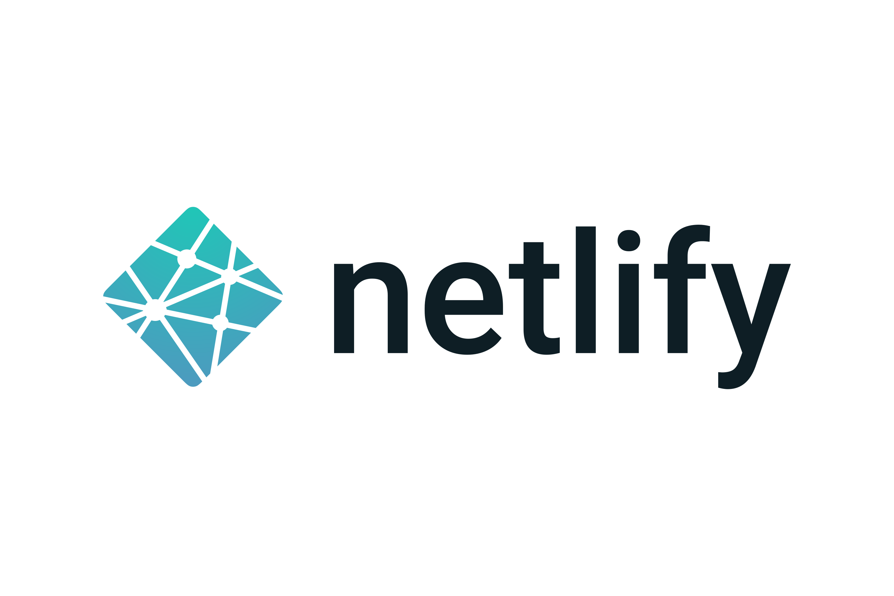
Technological resoUrces Used
Visual Representation
Project Stack
Deployment Strategy

Slide 5
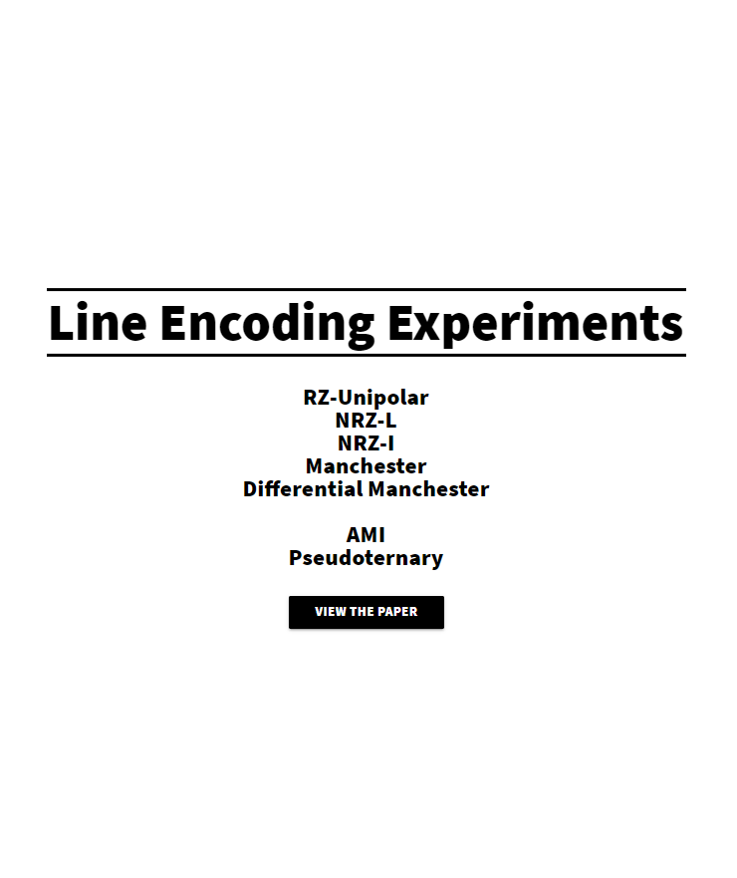
Methodology
When the user starts the application, they are presented with a central dashboard with various experiments listed that are available to perform. Here they can choose whichever encoding scheme they would like to experiment with and the application will take them to a dedicated space where the experiments for that specific encoding can be carried out.

Slide 6
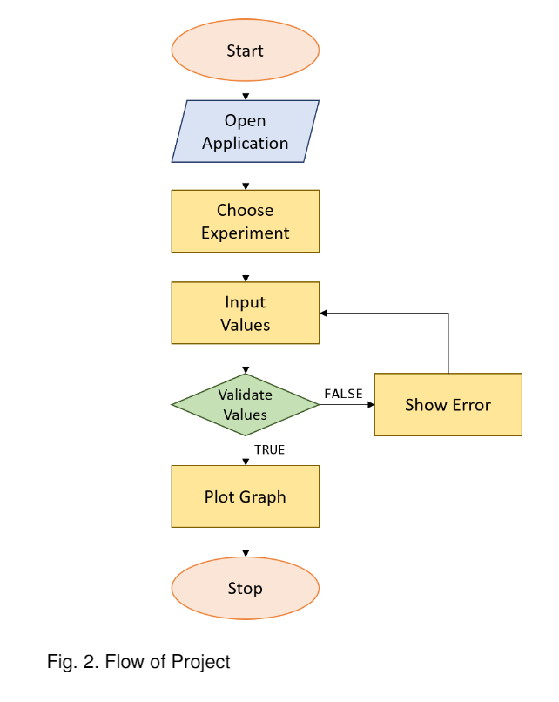
FLOW OF PROJECT

Slide 7


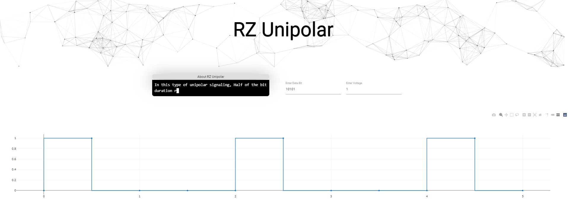
Results Achieved
Performance improvements and cross platform compatibility allowing anyone with an internet connection to perform experiments online using a virtual lab experience.
It removes the hassle of installing dependencies and configuring a development environment making the platform accessible to everyone.
It offers advanced features like live updates and in-browser voltage control
UNI-POLAR ENCODING SCHEMES

Slide 8
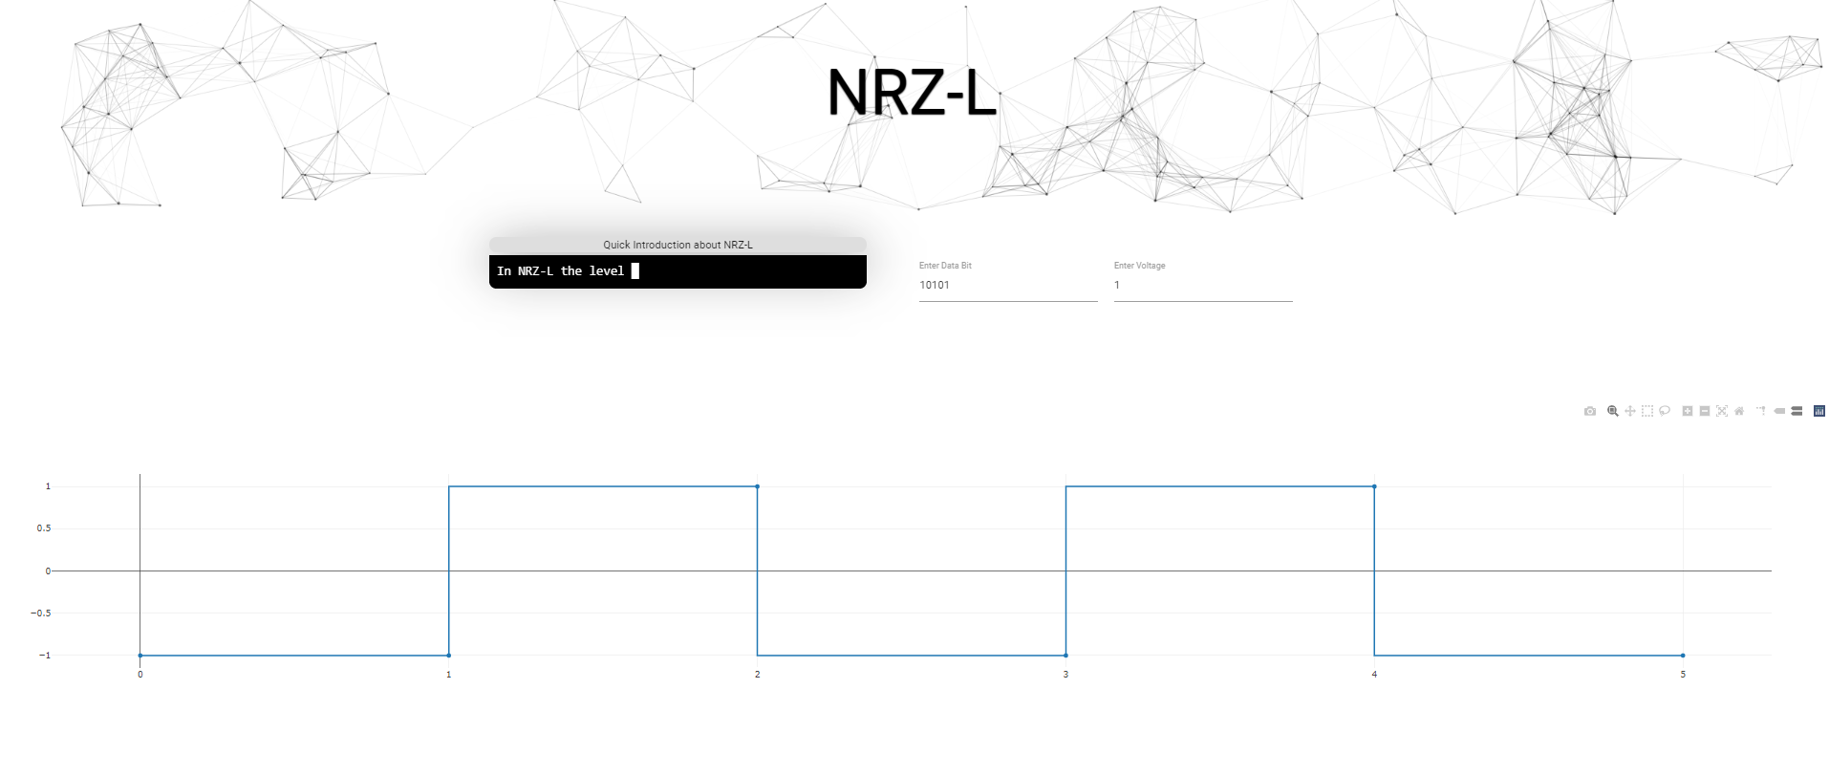
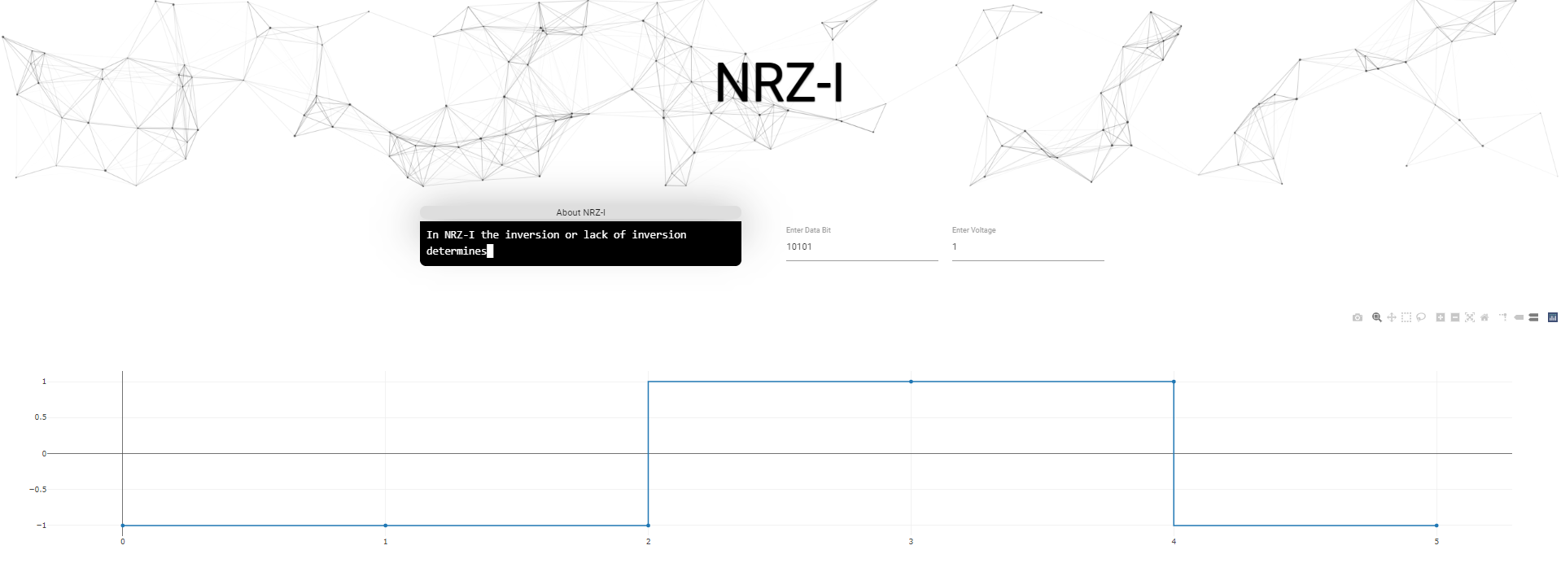
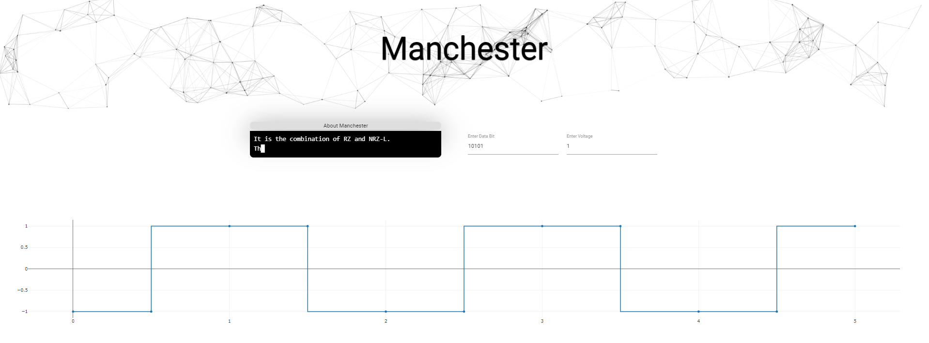
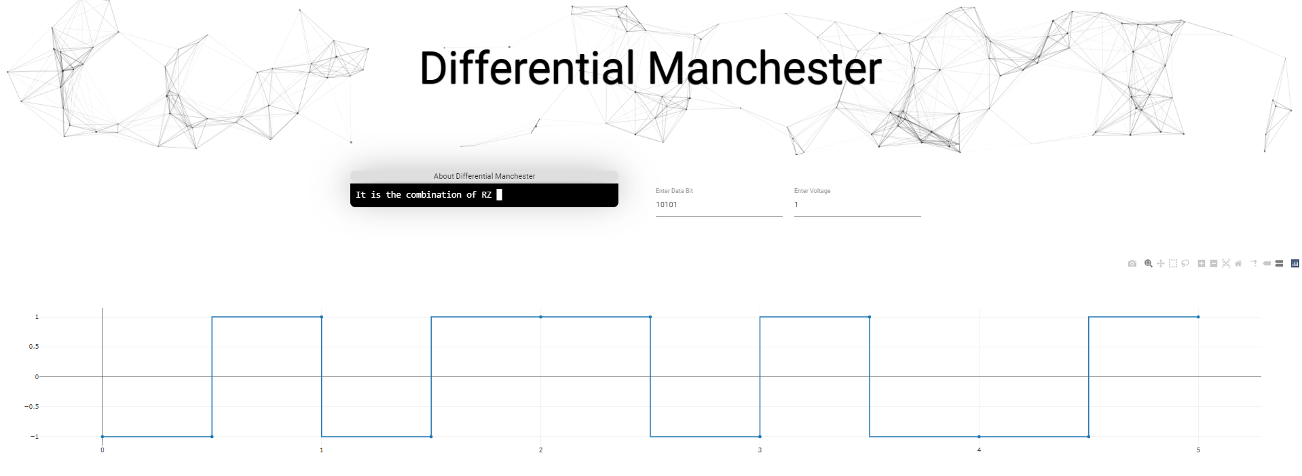
Results Achieved
POLAR ENCODING SCHEMES

Slide 9
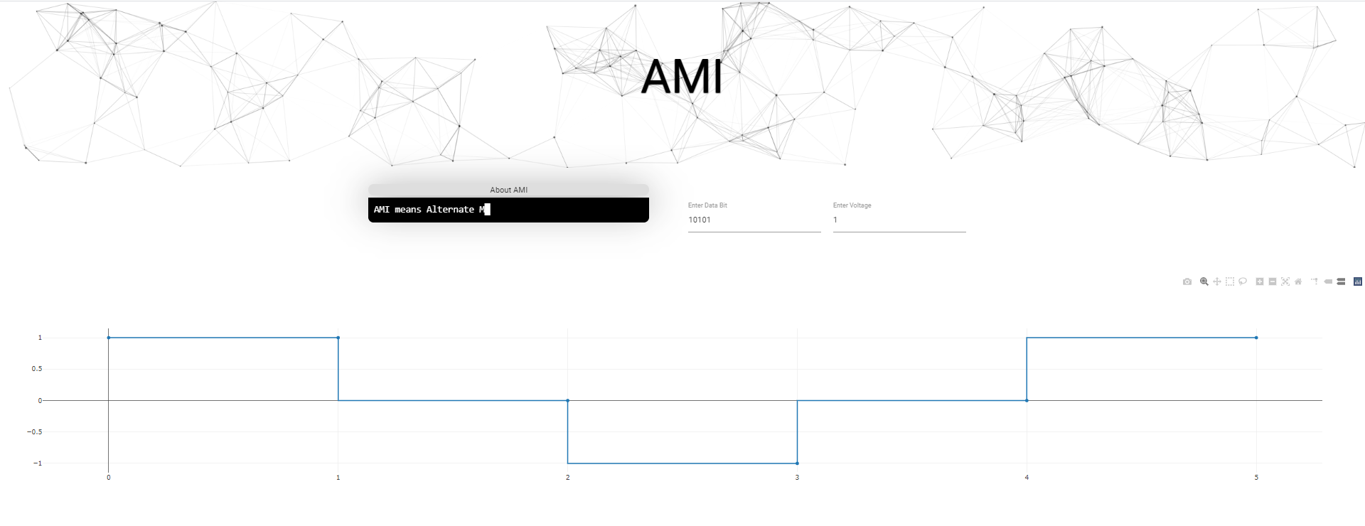
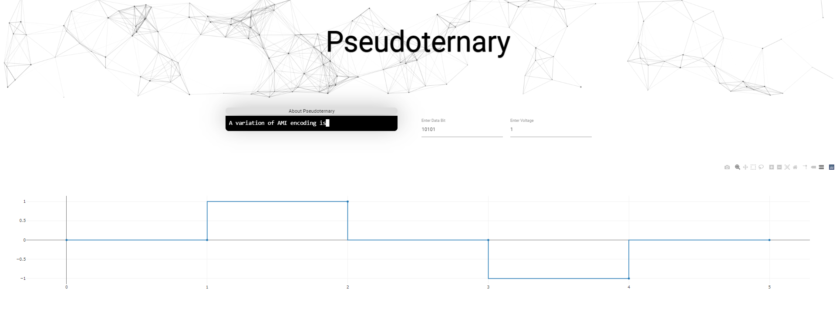
Results Achieved
BI-POLAR ENCODING SCHEMES

Slide 10
Conclusion
This project showcases an advanced mechanism for line encoding experimentation.
It brings features like cross-platform compatibility, live-updates, dynamic voltage control, modern plotting libraries with granular control of generated graphs and the ability to save results for future use.
These advanced features are presented in a simplistic manner to make them simple and accessible by everyone.
The platform takes the learnings from various previous works and creates a culmination of these to offer a modern experimentation platform that is available virtually.

Slide 11
References
https://www.arjournals.org/index.php/bjdmn/article/view/264
https://ieeexplore.ieee.org/document/7934310?denied=
http://sustech.edu/staff_publications/20140424053538550.pdf
http://iosrjen.org/Papers/vol5_issue2%20(part-4)/D5242023.pdf

Slide 12
Thank You

