Slide 1
Introduction to
Differential Privacy
Anudit Nagar

Slide 2
individuals have lots of interesting data...
12
37
-5
π

Slide 3
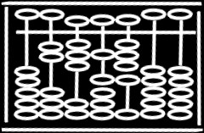
individuals have lots of interesting data...
12
37
-5
π
...we want to compute on it

Slide 4



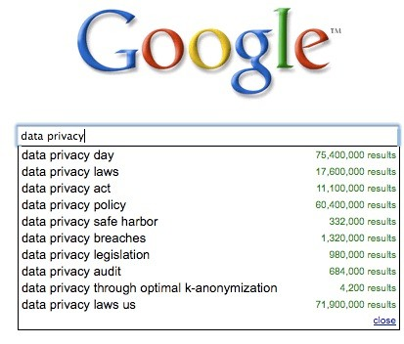








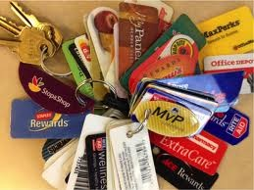

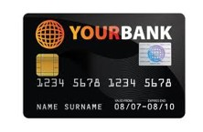



Slide 5

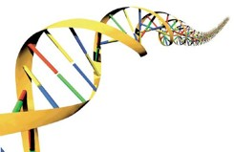

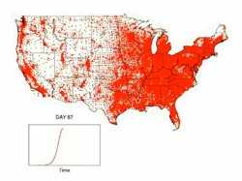
finding statistical correlations
genotype/phenotype associations
correlating medical outcomes with risk factors or events
publishing aggregate statistics
noticing events/outliers
intrusion detection
disease outbreaks
datamining/learning tasks
use customer data to update strategies

Slide 6
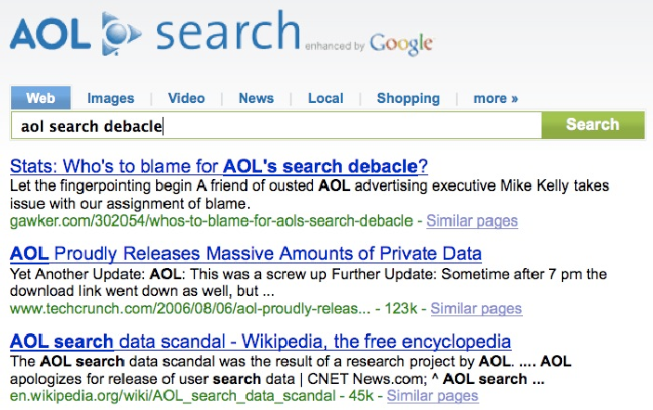

Slide 7
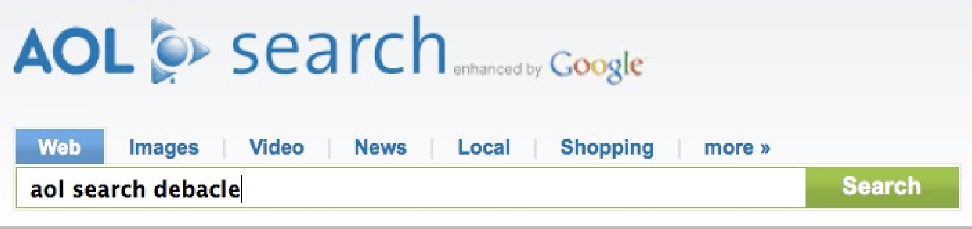

John Doe tax forms
No “personally identifiable information” was released
John Doe irs 1040
John Doe error in form 1099
Katrina Ligett data privacy
Katrina Ligett aol search debacle
Katrina Ligett Ligett DBLP
Katrina Ligett computer science news
Katrina Ligett Caltech rankings
Katrina Ligett weather Pasadena
Jane Smith youtube
Jane Smith free tv download
Jane Smith streaming tv
Chris Jones childrens books
Chris Jones dr seuss
Chris Jones “the cat and the hat”
Chris Jones gifts for children

Slide 8
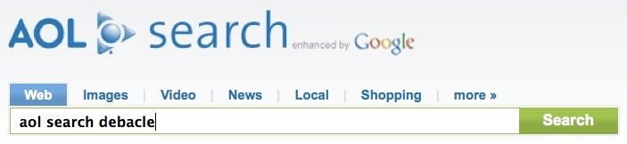
John Doe tax forms
No “personally identifiable information” was released
John Doe irs 1040
John Doe error in form 1099
user195023 data privacy
user195023 aol search debacle
user195023 Ligett DBLP
user195023 computer science news
user195023 Caltech rankings
user195023 weather Pasadena
Jane Smith youtube
Jane Smith free tv download
Jane Smith streaming tv
Chris Jones childrens books
Chris Jones dr seuss
Chris Jones “the cat and the hat”
Chris Jones gifts for children

Slide 9
John Doe tax forms
No “personally identifiable information” was released
John Doe irs 1040
John Doe error in form 1099
user195023 data privacy
user195023 aol search debacle
user195023 Ligett DBLP
user195023 computer science news
user195023 Caltech rankings
user195023 weather Pasadena
Jane Smith youtube
Jane Smith free tv download
Jane Smith streaming tv
Chris Jones childrens books
Chris Jones dr seuss
Chris Jones “the cat and the hat”
Chris Jones
gifts for children

Slide 10
This doesn’t apply to me! I don’t want to publish the whole dataset!

Slide 11
individuals hold data...
...what if it’s sensitive?
name | DOB | sex | weight | smoker | lung cancer
John Doe | 12/1/51 | M | 185 | Y | N
Jane Smith | 3/3/46 | F | 140 | N | N
Ellen Jones | 4/24/59 | F | 160 | Y | Y
Jennifer Kim | 3/1/70 | F | 135 | N | N
Rachel Waters | 9/5/43 | F | 140 | N | N

Slide 12
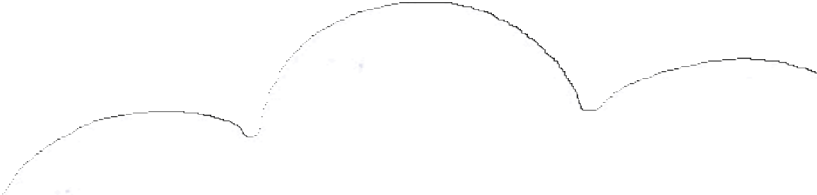

individuals hold data...
...what if it’s sensitive?
name | DOB | sex | weight | smoker | lung cancer
John Doe | 12/1/51 | M | 185 | Y | N
Jane Smith | 3/3/46 | F | 140 | N | N
Ellen Jones | 4/24/59 | F | 160 | Y | Y
Jennifer Kim | 3/1/70 | F | 135 | N | N
Rachel Waters | 9/5/43 | F | 140 | N | N
public

Slide 13

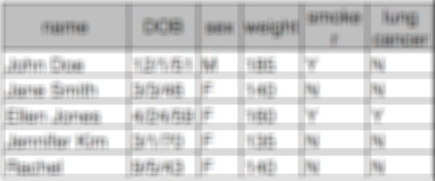
individuals hold data...
...what if it’s sensitive?
name | DOB | sex | weight | smoker | lung cancer
John Doe | 12/1/51 | M | 185 | Y | N
Jane Smith | 3/3/46 | F | 140 | N | N
Ellen Jones | 4/24/59 | F | 160 | Y | Y
Jennifer Kim | 3/1/70 | F | 135 | N | N
Rachel Waters | 9/5/43 | F | 140 | N | N
public

Slide 14
individuals hold data...
...what if it’s sensitive?
name | DOB | sex | weight | smoker | lung cancer
John Doe | 12/1/51 | M | 185 | Y | N
Jane Smith | 3/3/46 | F | 140 | N | N
Ellen Jones | 4/24/59 | F | 160 | Y | Y
Jennifer Kim | 3/1/70 | F | 135 | N | N
Rachel Waters | 9/5/43 | F | 140 | N | N

Slide 15

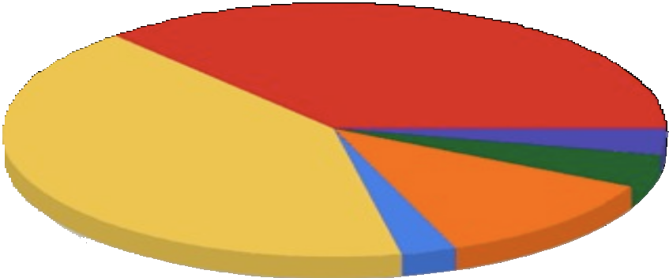
individuals hold data...
...what if it’s sensitive?
name | DOB | sex | weight | smoker | lung cancer
John Doe | 12/1/51 | M | 185 | Y | N
Jane Smith | 3/3/46 | F | 140 | N | N
Ellen Jones | 4/24/59 | F | 160 | Y | Y
Jennifer Kim | 3/1/70 | F | 135 | N | N
Rachel Waters | 9/5/43 | F | 140 | N | N
public

Slide 16
individuals hold data...
...what if it’s sensitive?
name | DOB | sex | weight | smoker | lung cancer
John Doe | 12/1/51 | M | 185 | Y | N
Jane Smith | 3/3/46 | F | 140 | N | N
Ellen Jones | 4/24/59 | F | 160 | Y | Y
Jennifer Kim | 3/1/70 | F | 135 | N | N
Rachel Waters | 9/5/43 | F | 140 | N | N

Slide 17

individuals hold data...
...what if it’s sensitive?
name | DOB | sex | weight | smoker | lung cancer
John Doe | 12/1/51 | M | 185 | Y | N
Jane Smith | 3/3/46 | F | 140 | N | N
Ellen Jones | 4/24/59 | F | 160 | Y | Y
Jennifer Kim | 3/1/70 | F | 135 | N | N
Rachel Waters | 9/5/43 | F | 140 | N | N
18%
public

Slide 18
individuals hold data...
...what if it’s sensitive?
name | DOB | sex | weight | smoker | lung cancer
John Doe | 12/1/51 | M | 185 | Y | N
Jane Smith | 3/3/46 | F | 140 | N | N
Ellen Jones | 4/24/59 | F | 160 | Y | Y
Jennifer Kim | 3/1/70 | F | 135 | N | N
Rachel Waters | 9/5/43 | F | 140 | N | N

Slide 19

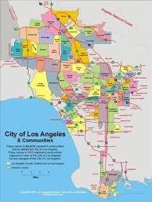
individuals hold data...
...what if it’s sensitive?
name | DOB | sex | weight | smoker | lung cancer
John Doe | 12/1/51 | M | 185 | Y | N
Jane Smith | 3/3/46 | F | 140 | N | N
Ellen Jones | 4/24/59 | F | 160 | Y | Y
Jennifer Kim | 3/1/70 | F | 135 | N | N
Rachel Waters | 9/5/43 | F | 140 | N | N
public
12

Slide 20
This doesn’t apply to me! I don’t want to publish the whole dataset!

Slide 21
This doesn’t apply to me! I don’t want to publish the whole dataset!
not so fast...

Slide 22
This doesn’t apply to me! I don’t want to publish the whole dataset!
not so fast...
see, e.g., Korolova 2011’s Facebook microtargeting attack

Slide 23
This doesn’t apply to me! I don’t want to publish the whole dataset!
not so fast...
see, e.g., Korolova 2011’s Facebook microtargeting attack
... must pay attention to all uses of sensitive data

Slide 24
Summing up.
an individual should not enable one to learn anything about another individual that could not be learned without access

Slide 25
is this possible?

Slide 26
what if wanted to do a study about smoking and cancer?
name | DOB | sex | weight | smoker | lung cancer
John Doe | 12/1/51 | M | 185 | Y | N
Jane Smith | 3/3/46 | F | 140 | N | N
Ellen Jones | 4/24/59 | F | 160 | Y | Y
Jennifer Kim | 3/1/70 | F | 135 | N | N
Rachel Waters | 9/5/43 | F | 140 | N | N

Slide 27
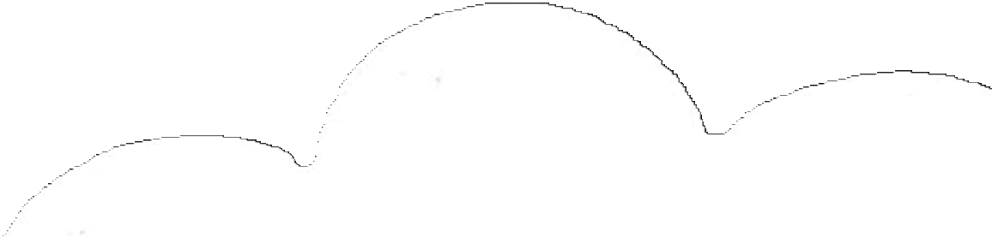
what if wanted to do a study about smoking and cancer?
name | DOB | sex | weight | smoker | lung cancer
John Doe | 12/1/51 | M | 185 | Y | N
Jane Smith | 3/3/46 | F | 140 | N | N
Ellen Jones | 4/24/59 | F | 160 | Y | Y
Jennifer Kim | 3/1/70 | F | 135 | N | N
Rachel Waters | 9/5/43 | F | 140 | N | N
public

Slide 28
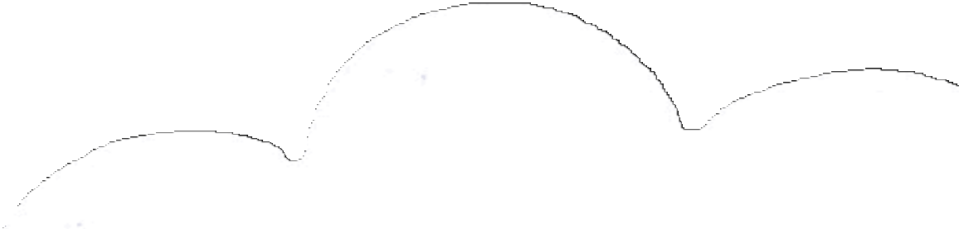
what if wanted to do a study about smoking and cancer?
name | DOB | sex | weight | smoker | lung cancer
John Doe | 12/1/51 | M | 185 | Y | N
Jane Smith | 3/3/46 | F | 140 | N | N
Ellen Jones | 4/24/59 | F | 160 | Y | Y
Jennifer Kim | 3/1/70 | F | 135 | N | N
Rachel Waters | 9/5/43 | F | 140 | N | N
there is a correlation of xxx
public

Slide 29
what if wanted to do a study about smoking and cancer?
name | DOB | sex | weight | smoker | lung cancer
John Doe | 12/1/51 | M | 185 | Y | N
Jane Smith | 3/3/46 | F | 140 | N | N
Ellen Jones | 4/24/59 | F | 160 | Y | Y
Jennifer Kim | 3/1/70 | F | 135 | N | N
Rachel Waters | 2/4/56 | F | 122 | N | N
what if someone knew Alice was a smoker?
there is a correlation of xxx
public

Slide 30
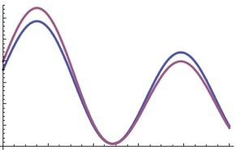
differential privacy
[DinurNissim03, DworkNissimMcSherrySmith06]
ε-Differential Privacy for mechanism M: for any two neighboring data sets D1, D2, any C < range(M),
Pr[M(D1) < C] ≤ e^{ε} Pr[M(D2) < C]

Slide 31
differential privacy
Pr[M(D1) < C] ≤ e^{ε} Pr[M(D2) < C]
Is a statistical property of mechanism behavior
unaffected by auxiliary information
independent of adversary's computational power

Slide 32

differential privacy
Pr[M(D1) < C] ≤ e^{ε} Pr[M(D2) < C]
promise: if you leave the database, no outcome will change probability by very
much
is this achievable?

Slide 33
yes!

Slide 34
sensitivity of a function f
∆f = maxD1, D2 |f(D1) – f(D2)| for neighboring data sets D1, D2
measures how much one person can affect output
sensitivity is 1 for counting queries that count number of rows satisfying a predicate

Slide 35
scale noise with sensitivity
∆f = maxD1, D2 |f(D1) – f(D2)|
on query f, can add scaled symmetric noise Lap(b) with b = ∆f/ε, to achieve ε-differential privacy.

Slide 36
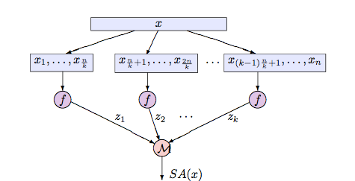
bootstrap for privacy = subsample and aggregate

Slide 37
summary
privacy easy to get wrong; DP provides compelling definition and useful dose of paranoia
powerful tools exist (some with no cost of privacy, and some with no noise!)
powerful intuition from notions of robustness
many nearly ready (and quite relevant) to common big data applications
no ready-to-use, commercial- grade applications: need demand!

Slide 38
Fin.

