Slide 1

Themis
An oracle enabling Purchasing Power Parity on Ethereum to allow for a
more equitable and dynamic pricing of products allowing you to
send and receive payments normalized to the
geolocation of the users.
themis.anudit.dev

Slide 2
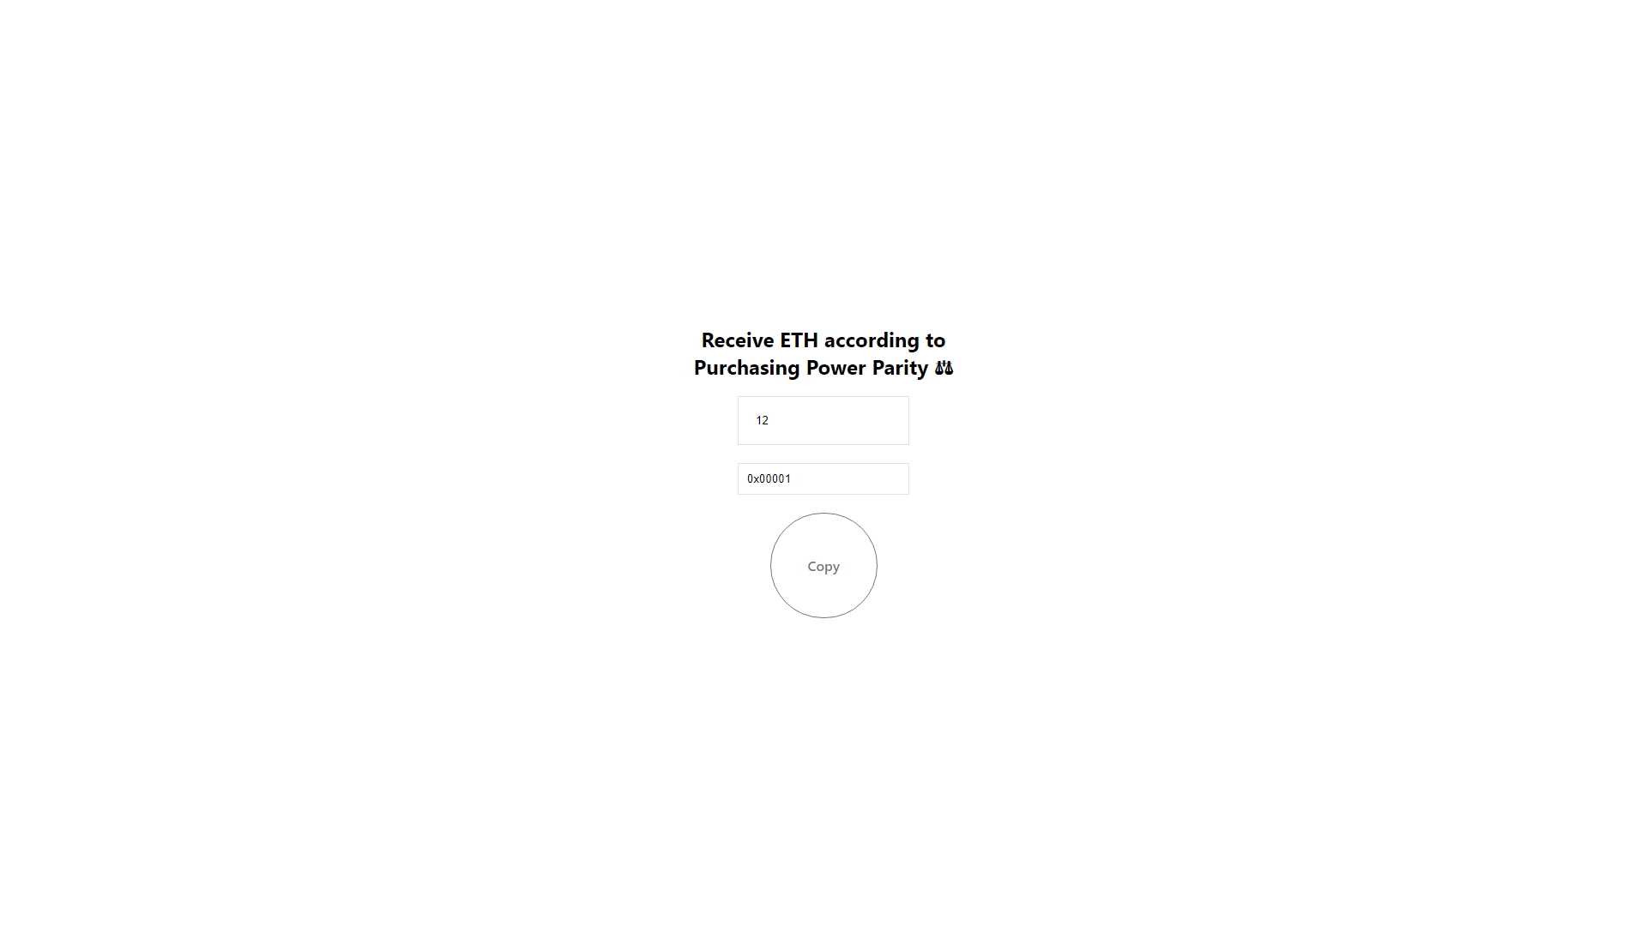

Slide 3
