Slide 1
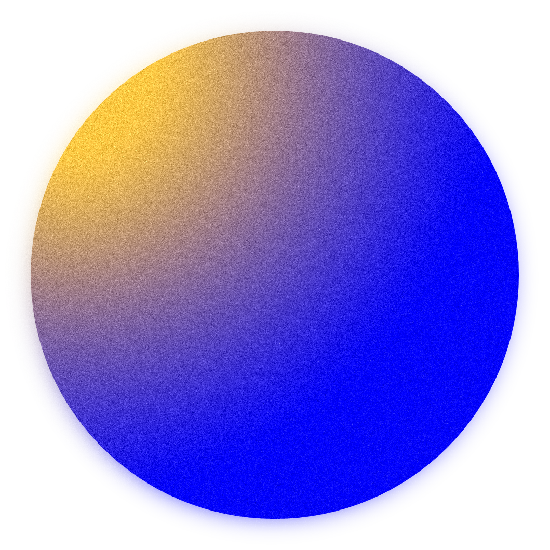

Themis
A Purchasing Power Parity Oracle

Slide 2
About Themis_
An oracle enabling Purchasing Power Parity on
Ethereum to allow for a more equitable and
dynamic pricing of products.
Themis can be used to send and receive payments
normalized to the geolocation of the users.
Smart Contracts can be integrated directly with Themis to better distribute funds and rewards to communities globally.

Slide 3
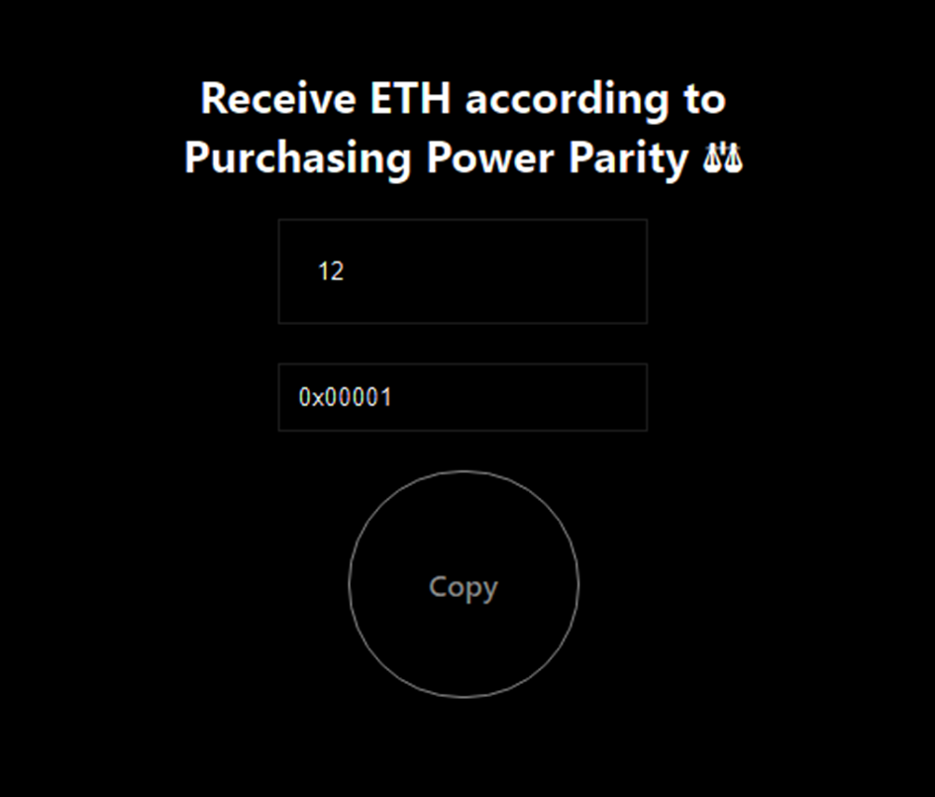
Create dynamic
Payment Links

Slide 4
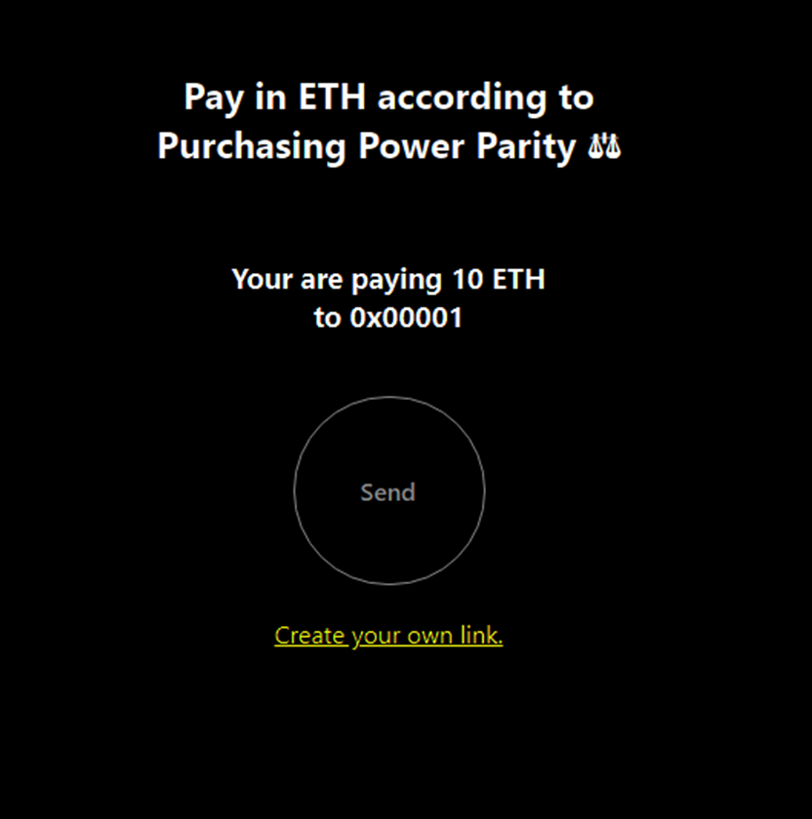
Send
Payments

