Slide 1
Digital Portfolio
STUDENT NAME: ANUPRIYA G
REGISTER NO AND NMID:41124134110500122004/BD964CBF5B82F4OBC1F45224C244
DEPARTMENT: BCA
COLLEGE: VIVEKANANDA COLLEGE OF ARTS AND SCIENCE FOR WOMEN/ANNAMALAI UNIVERSITY

Slide 2
PROJECT TITLE
Digital porfolio (To develop programming skills for student, ready for internships and higher studies applications)

Slide 3


AGENDA
Problem Statement
Project Overview
End Users
Tools and Technologies
Portfolio design and Layout
Features and Functionality
Results and Screenshots
Conclusion
Github Link
3/21/2024 Annual Review

Slide 4

PROBLEM STATEMENT
To create a Student porfolio platform becauseprovide an easy-to-navigate, visually appealing, and customizable way for students to present themselves, thereby improving career opportunities, self-assessment, and personal branding.

Slide 5

PROJECT OVERVIEW
The project aims to help students build a strong digital presence that can be shared with recruiters, mentors, and educational institutions This way to communicate with a student for programming languages including are Data Structures,Python and JavaScript
Contents of Porfolio are:
✅ Personal information/Profile
✅Skills
✅ Projects/Work Samples
✅Contact me( refers to some ideas)

Slide 6

WHO ARE THE END USERS?
The end users of a student porfolio are all the people who view, use or benefit from it.
BENEFITS:
⚡Students -to showcase their skills, achievements and growth
⚡Teachers/Mentors-to access learning process and guide Students
⚡Colleges/Universities -to review overall profile for admissions

Slide 7

TOOLS AND TECHNIQUES
TOOLS:
⏩Google sites,Word press,MS powerpoint, GitHub
⏩Multimedia tools
TECHNIQUES:
⏩The porfolio created in code with Html, Css and JavaScript.

Slide 8
POTFOLIO DESIGN AND LAYOUT
° Design = How it looks🎨
° Layout= How it is arranged are: Grid layout,Interactive layout and so on
‹#›

Slide 9
FEATURES AND FUNCTIONALITY
Features show what’s inside the portfolio, while Functionality defines how it works.
*HTML:to create details
*CSS: styling and colouring(student porfolio)
*JavaScript

Slide 10

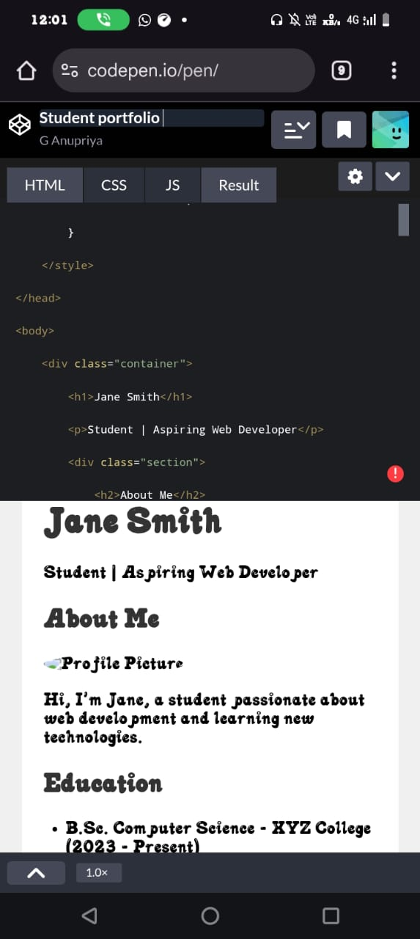
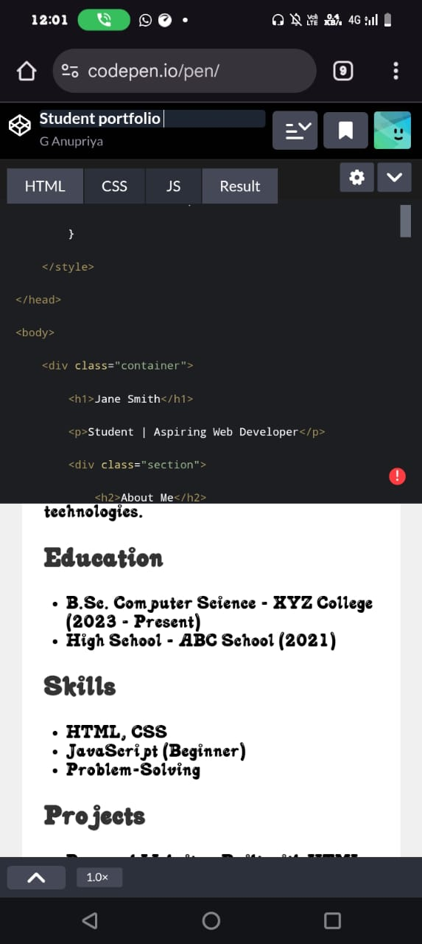
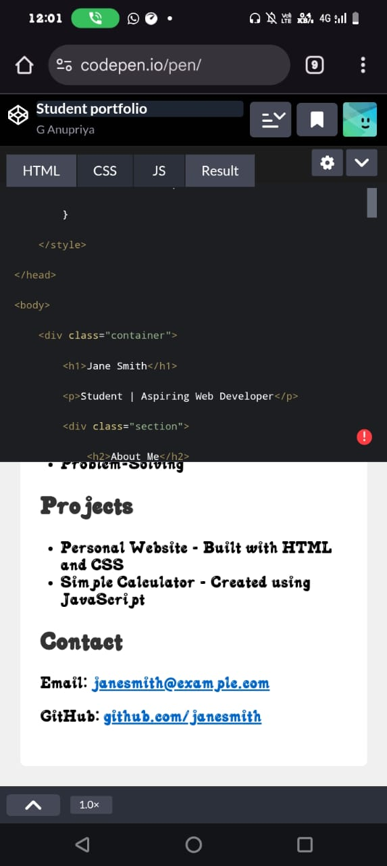
RESULTS AND SCREENSHOTS
3/21/2024 Annual Review
‹#›

Slide 11
CONCLUSION
🖥Many students benefit in a student porfolio.
🖥I am eager to continue learning, applying my knowledge,to future opportunities.
🖥 In this way, easy to handling the programming languages (Html,Css, JavaScript).
Website link :
https://github.com/anugbca/Anu_FWD.git
‹#›

