Slide 1
CAPSTONE PROJECT · JAVA FULL STACK DEVELOPMENT
AppVerse AI
Smart App Marketplace & AI-Powered Analytics Platform
A full-stack marketplace combining Spring Boot microservices, React,
JWT security, and Gemini AI for recommendations, sentiment analysis, and chat assistance.
Spring Boot 3.2
React 18
MySQL
Gemini AI
Gopidi Anugna Reddy | Java Full Stack Development

Slide 2
OVERVIEW
Project Objective
Build a complete app marketplace — like a mini Google Play Store — where developers publish apps, users discover and review them, and an AI layer powers recommendations, sentiment analysis, and a conversational assistant.
1
Role-Based Marketplace
2
AI Recommendation Engine
Separate experiences for User, Developer, and Admin with JWT-secured REST APIs.
Personalized suggestions using collaborative + content-based filtering.
3
Sentiment & Moderation
4
Analytics Dashboard
Automatic review sentiment detection, rating prediction, fake-review flagging.
Real-time downloads, revenue, and engagement insights for developers.
AppVerse AI | Java Full Stack Capstone Project
2

Slide 3
CORE MODULES
Six Core Modules
01
02
03
Authentication & User Roles
App Marketplace
AI Recommendation Engine
JWT auth, USER / DEVELOPER / ADMIN roles, secure password hashing
Browse, category filters, search, ratings & reviews, price sorting
Personalized suggestions, similar-app prediction, trending analysis
04
05
06
Developer Console
AI Review Sentiment Analysis
Analytics Dashboard
Upload/manage apps, version control, release notes, download analytics
Positive/negative detection, rating prediction, fake-review flagging
Downloads trend, revenue insights, user engagement reports
AppVerse AI | Java Full Stack Capstone Project
3

Slide 4
TECHNOLOGY STACK
Built With a Modern Full Stack
Frontend
React 18, React Router v6, Axios, Recharts, Lucide Icons
Backend
Spring Boot 3.2, Spring Security, Spring Data JPA, Swagger
Database
MySQL with normalized relational schema
Security
JWT-based stateless authentication, role-based access control
AI Layer
Google Gemini API for chat + rule-based ML for sentiment/ratings
Testing
JUnit 5, Mockito, AssertJ — service-layer unit tests with H2
AppVerse AI | Java Full Stack Capstone Project
4

Slide 5
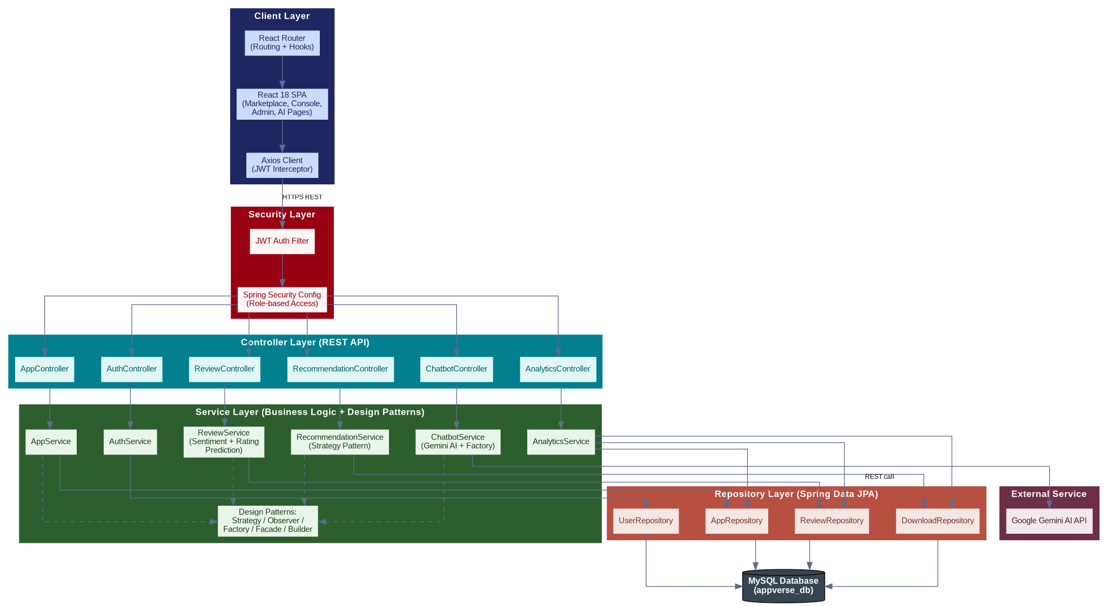
SYSTEM DESIGN
System Architecture
Layered architecture: Client → Security → Controller → Service (Design Patterns) → Repository → Database
AppVerse AI | Java Full Stack Capstone Project
5

Slide 6
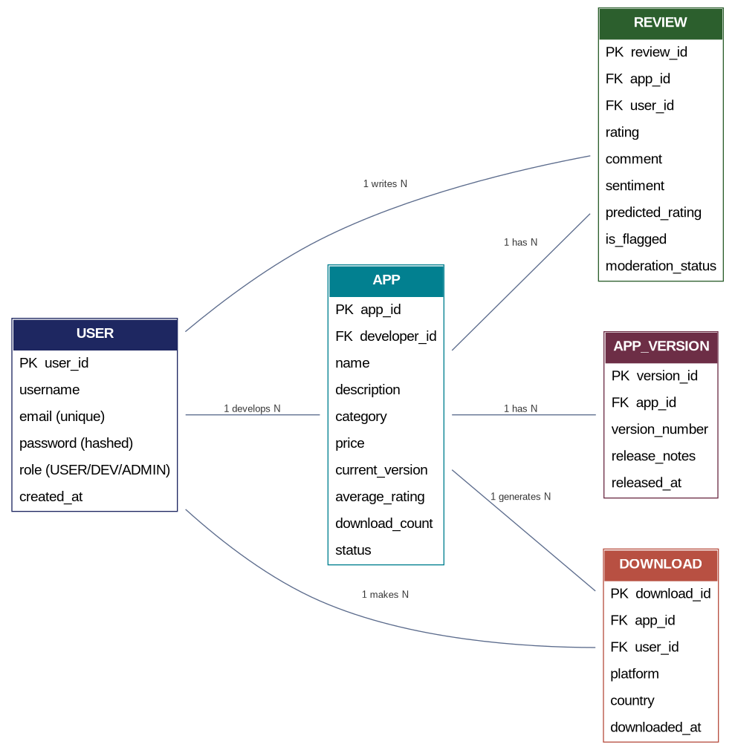
DATABASE DESIGN
Entity-Relationship Diagram
Core relational schema: User, App, Review, Download, and AppVersion entities with their key relationships
AppVerse AI | Java Full Stack Capstone Project
6

Slide 7
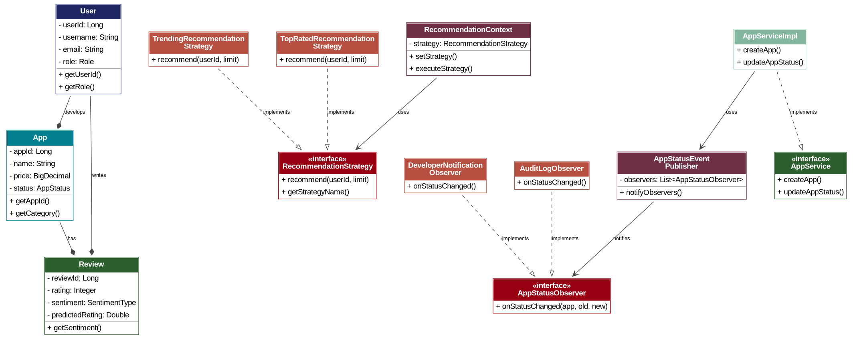
OBJECT-ORIENTED DESIGN
UML Class Diagram
Core domain classes plus Strategy and Observer design pattern implementations
AppVerse AI | Java Full Stack Capstone Project
7

Slide 8
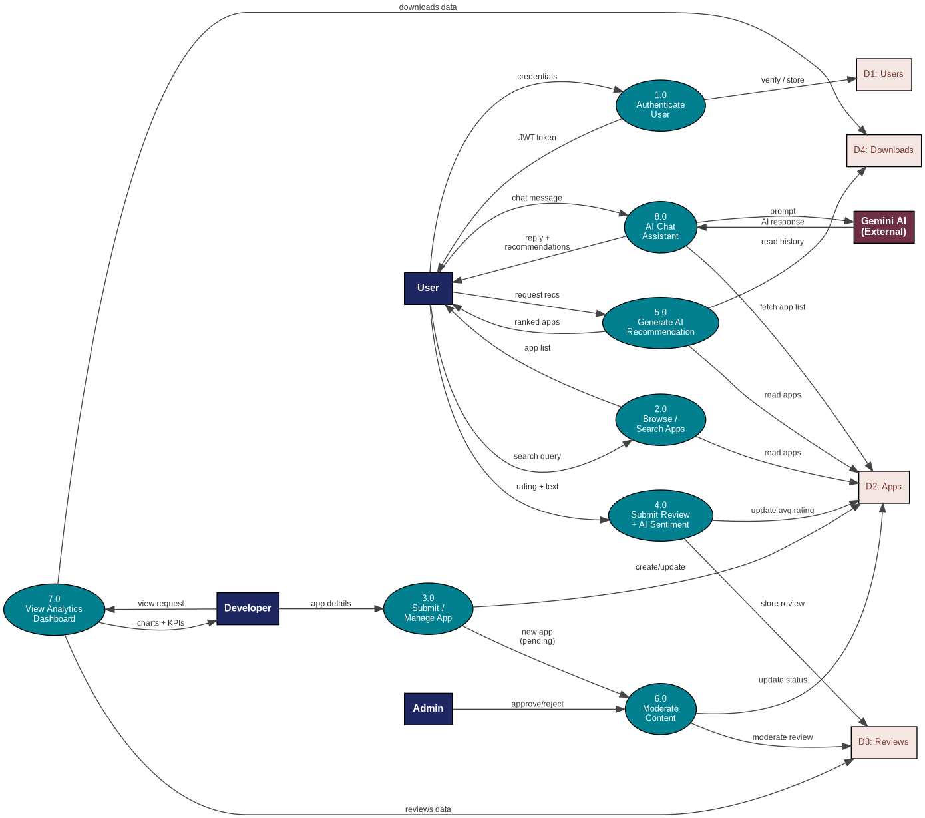
PROCESS FLOW
Data Flow Diagram (Level 1)
How data moves between users, core processes, the Gemini AI service, and data stores
AppVerse AI | Java Full Stack Capstone Project
8

Slide 9
SOFTWARE ENGINEERING
Design Patterns Implemented
Strategy
Observer
Factory
Swaps recommendation algorithm at runtime — Trending for new users, Top-Rated for active users
Notifies developer + audit log automatically when an app's approval status changes
Centralizes creation of chatbot response objects (success, error, fallback, greeting)
Facade
Builder
Singleton
Simplifies complex multi-service calls for homepage, app-detail, and dashboard data loading
Lombok @Builder across all entities and DTOs for safe, immutable object construction
All Spring @Service and @Component beans are managed as singletons by the IoC container
AppVerse AI | Java Full Stack Capstone Project
9

Slide 10
ARTIFICIAL INTELLIGENCE
AI Features Across the Platform
AppBot Chat Assistant
Personalized Recommendations
Gemini-powered conversational assistant with rule-based fallback when no API key is configured
Hybrid collaborative + content-based filtering tailored to each user's activity
Sentiment Analysis
Rating Prediction
Keyword + rating-weighted classification of reviews into positive / neutral / negative
Predicts the star rating implied by review text, flags mismatches with the given rating
Fake Review Detection
Download Prediction
Heuristics for short extreme reviews, sentiment mismatch, and spammy text patterns
30-day growth forecasting using rating and category growth coefficients
AppVerse AI | Java Full Stack Capstone Project
10

Slide 11
QUALITY & SECURITY
Security and Testing Approach
Security
Testing
JWT-based stateless authentication on every protected endpoint
JUnit 5 + Mockito + AssertJ for service-layer unit tests
BCrypt password hashing — plaintext passwords never stored
H2 in-memory database isolates tests from production data
@PreAuthorize role checks (USER / DEVELOPER / ADMIN) at the service layer
Coverage: CRUD operations, ownership checks, role assignment
CORS configuration restricting allowed origins
Sentiment classification and duplicate-review detection tests
Centralized exception handling via @RestControllerAdvice
Mocked repositories verify business logic independent of persistence
AppVerse AI | Java Full Stack Capstone Project
11

Slide 12
CONCLUSION
AppVerse AI delivers a complete,
production-style marketplace.
From secure role-based access to an AI recommendation engine, sentiment-aware reviews, and a live analytics dashboard — every capstone module is implemented, integrated, and tested end-to-end across a Spring Boot + React stack.
6 Core Modules
6 Design Patterns
AI-Powered Throughout
Fully Tested
Thank you.

