Slide 1
WIPRO CAPSTONE PROJECT
AppVerse AI
Smart App Marketplace & Review Intelligence Platform
Full-Stack Capstone Project · Spring Boot & React · Google Gemini AI
Gopidi Anugna Reddy | Mentor: Javeed Sir | Great Learning · Wipro
June 2026

Slide 2
INTRODUCTION
Project Overview & Objectives
AppVerse AI is a full-stack app marketplace where users discover and review apps, developers publish listings, and admins moderate content — enhanced with real Google Gemini AI for sentiment analysis, conversational recommendations, and fake-review detection.
USER
Browse, download, review, chat with AppBot
Key Objectives
DEVELOPER
Secure JWT auth strengthened with Gmail OTP verification
Real Gemini AI integration: sentiment, chatbot, recommendations
Full moderation workflow for apps and reviews
Strategy / Factory / Observer / Facade design patterns
Role-based experiences for User, Developer, and Admin
Publish apps, manage versions, view analytics
ADMIN
Approve apps, moderate flagged reviews
2

Slide 3
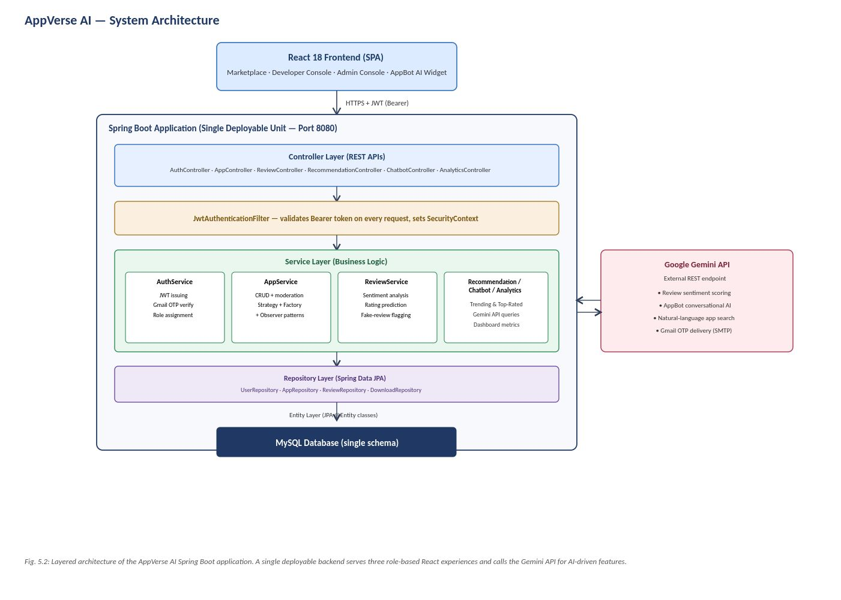
ARCHITECTURE
System Architecture
3

Slide 4
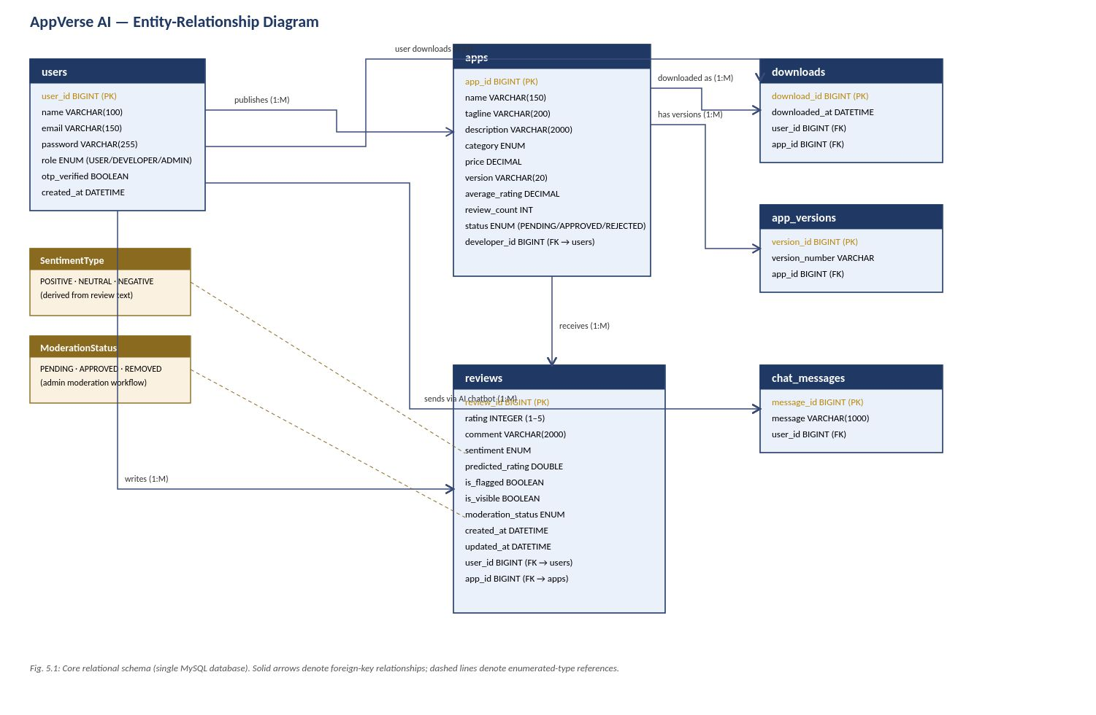
DATABASE DESIGN
Entity-Relationship Diagram
4

Slide 5
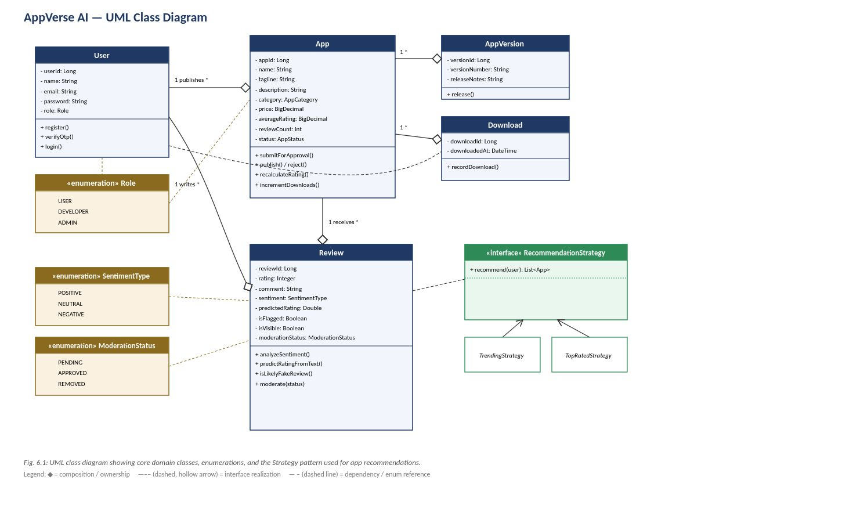
OBJECT-ORIENTED DESIGN
UML Class Diagram
5

Slide 6
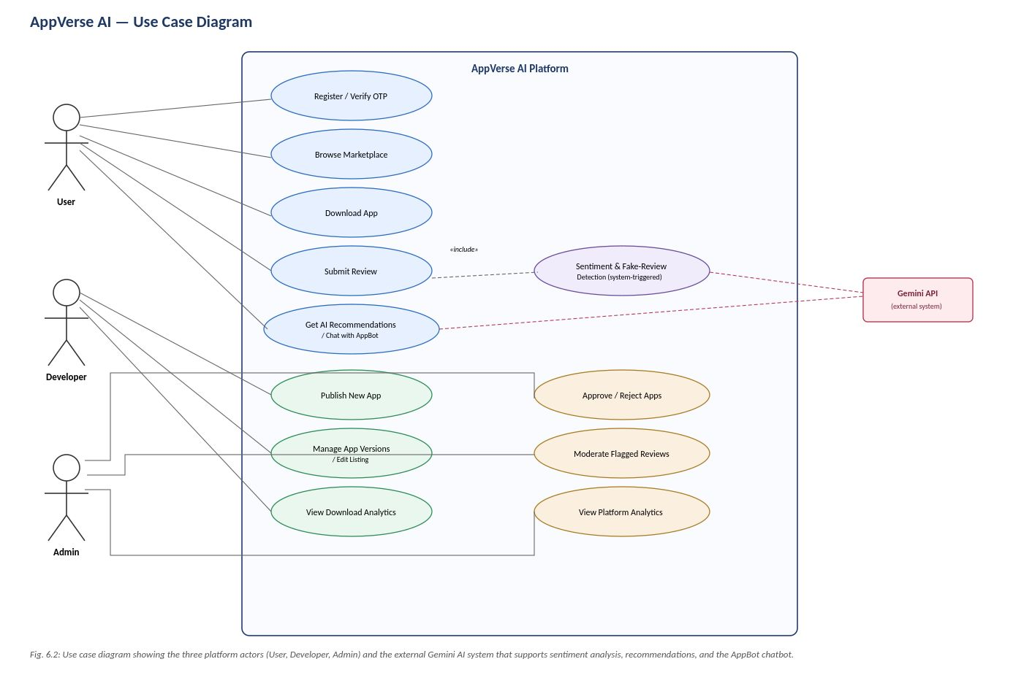
SYSTEM MODELLING
Use Case Diagram
6

Slide 7
ARTIFICIAL INTELLIGENCE
AI-Powered Features
1
Sentiment & Fake-Review Detection
Every review is classified POSITIVE / NEUTRAL / NEGATIVE, given a predicted rating, and screened for fake-review patterns before going live.
2
AppBot Conversational Assistant
A Gemini-powered chat widget answers natural-language questions and recommends apps with direct links, available across the marketplace.
3
Strategy-Based Recommendations
Switches between Trending and Top-Rated strategies depending on a user's download history, avoiding cold-start problems for new users.
7

Slide 8
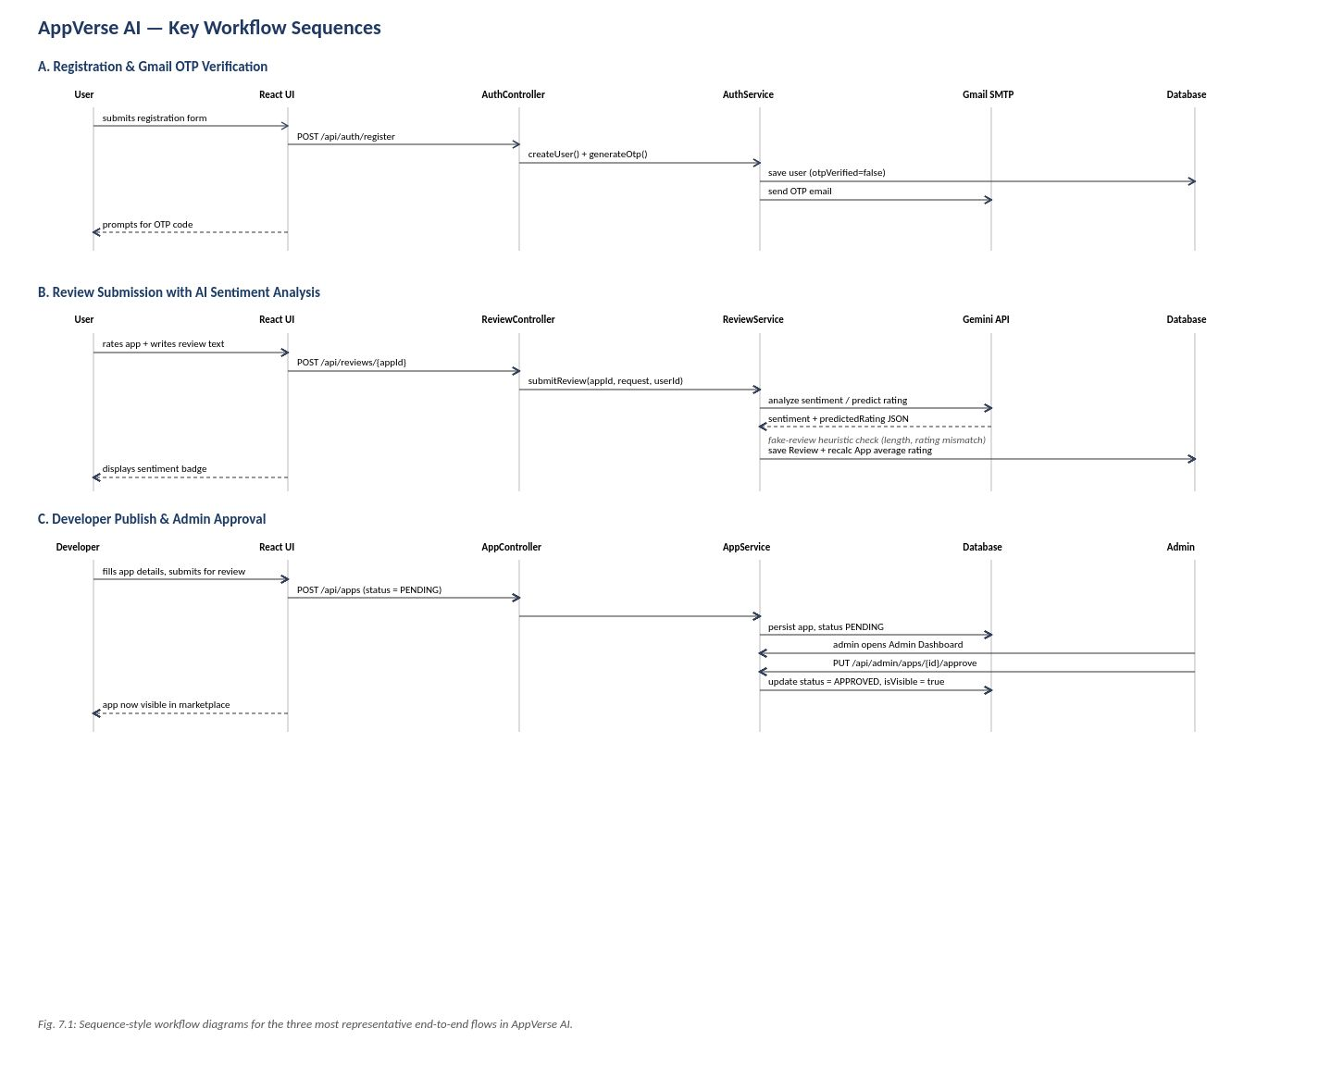
PROCESS FLOW
Key Workflow Sequences
8

Slide 9
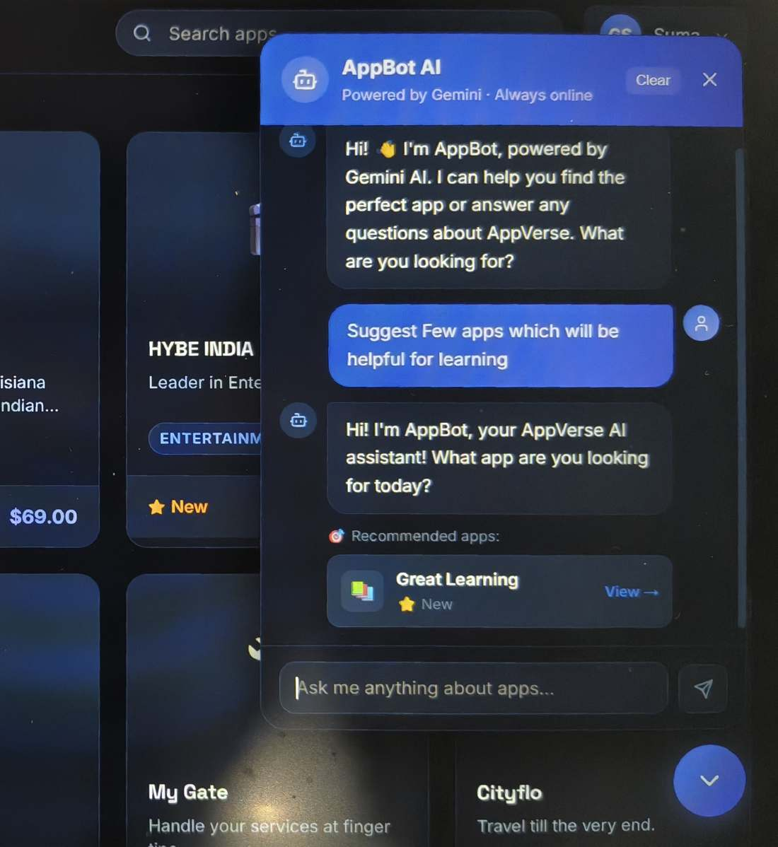
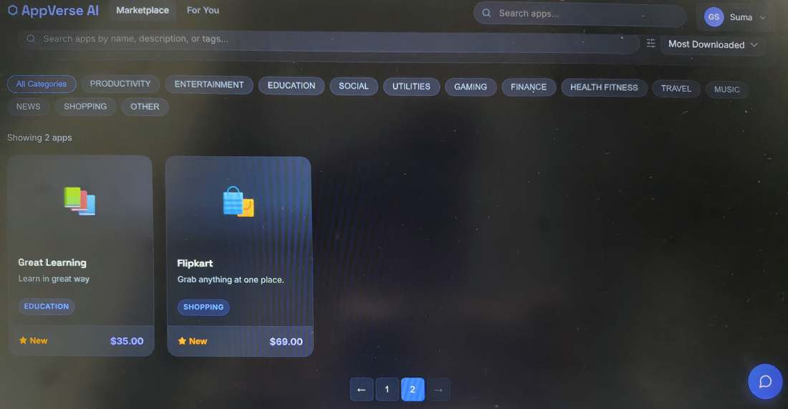
APPLICATION WALKTHROUGH
Marketplace & AppBot AI Assistant
Marketplace category browsing
AppBot AI assistant (Gemini-powered)
9

Slide 10
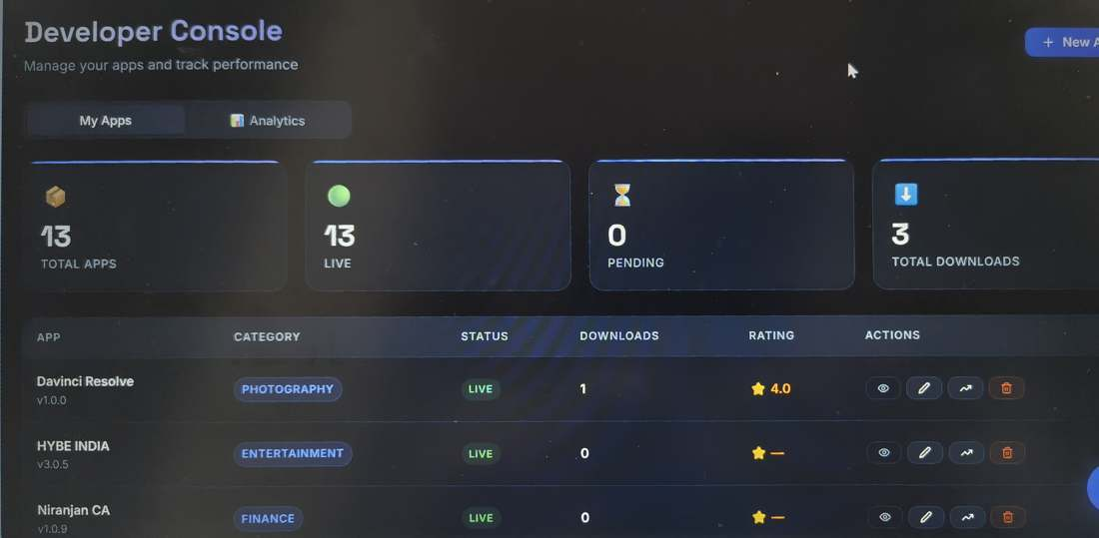
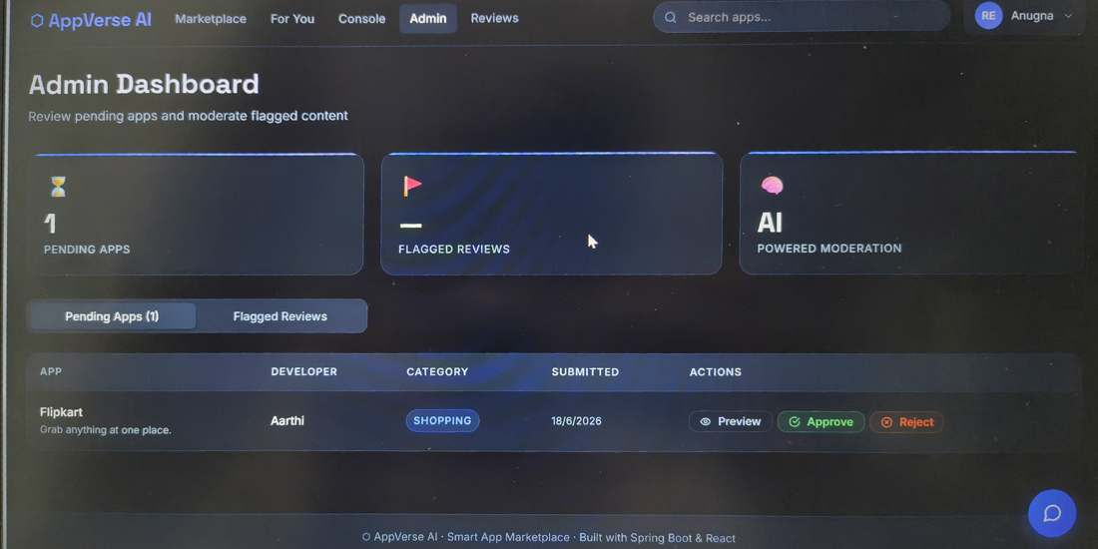
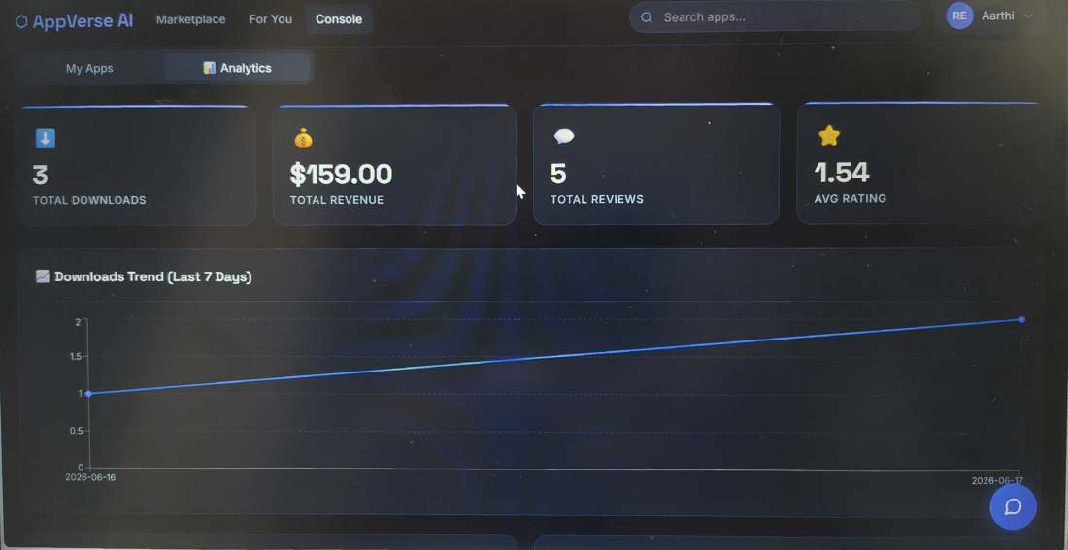
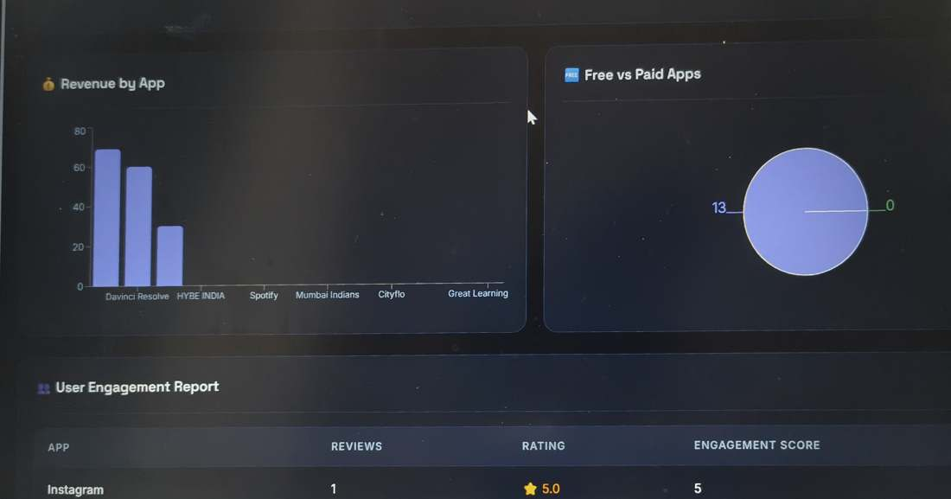
APPLICATION WALKTHROUGH
Developer Console & Admin Approval
Developer Console — My Apps
Admin Dashboard — pending approval
Developer Analytics — downloads trend
Platform analytics — revenue & engagement
10

Slide 11
SUMMARY
Conclusion & Tech Stack
React 18
Spring Boot 3
Spring Security + JWT
Spring Data JPA
MySQL
Google Gemini API
Gmail SMTP (OTP)
Maven
AppVerse AI demonstrates a complete, working marketplace with real generative-AI features embedded into its core workflows — sentiment-aware reviews, conversational recommendations, and a clean, pattern-driven backend.
Submitted By
Gopidi Anugna Reddy
Under Guidance of Javeed Sir | Great Learning | Wipro Capstone Project
Version 1.0.0 · June 2026
11

