Slide 1
Email Spam Classification
Team Members
Using NLP and Machine Learning
• Fidal Govind
• Arjun S
• ANU GOPAL V
Predictive Analytics Group Project | Academic Year 2025-26
Institution: Digital university kerala
1 / 20
Notes:
Introduce the project as an academic predictive analytics project. Mention that the system classifies email messages into spam or ham using NLP preprocessing, TF-IDF feature extraction, and supervised machine learning.

Slide 2
Introduction
Project Context
2
5,572
4
98.26%
Binary classes: ham and spam
Raw email records in notebook
Models compared
Best model accuracy
• Spam email causes phishing risk, financial fraud, malware exposure, productivity loss, and bandwidth waste.
• The project builds an automated filter that predicts whether an email is spam or legitimate ham.
• The implementation follows a complete ML workflow from dataset loading to Streamlit deployment.
Real-world relevance: reliable spam classification improves communication security and reduces manual filtering effort.
2 / 20
Notes:
Explain the practical need first: spam is also a security issue. Then connect that need to the project workflow.

Slide 3
Problem Statement & Objectives
What the project solves
Problem Statement
Expected Outcomes
• Classify email text automatically as spam or ham.
• Reduce false classification of legitimate and malicious messages.
• Use NLP to convert unstructured text into useful model features.
• Select the best-performing algorithm based on real metrics.
• Cleaned and transformed email messages.
• TF-IDF numerical feature matrix for model training.
• Comparison of Naive Bayes, Logistic Regression, SVM, and Random Forest.
• Streamlit app for real-time spam prediction.
3 / 20
Notes:
The problem is a binary classification task. Objectives include preprocessing, evaluation, model selection, and deployment.

Slide 4
Dataset Information
SpamAssassin / spam.csv workflow
Source documented in README: SpamAssassin Public Dataset. The notebook loads spam.csv using latin-1 encoding and keeps two columns.
Item
Actual value from files
Original columns
v1, v2
Renamed columns
label, message
Raw records
5,572
Missing values
0 in label, 0 in message
Duplicates removed
403
Usable records after cleaning
5,169
Class counts after duplicate removal
ham: 4,516 | spam: 653
Target variable
label: ham=0, spam=1
4 / 20
Notes:
The dataset is text-based and has only two useful columns in this notebook: label and message. There are no null values and 403 duplicates are removed.

Slide 5
Technologies & Tools Used
Implementation stack
Python
Pandas / NumPy
Core programming
Data handling and arrays
NLTK
Scikit-learn
Tokenization, stopword removal, stemming
TF-IDF, model training, metrics
Matplotlib / Seaborn
Pickle
EDA and evaluation visuals
Model serialization
Streamlit
Google Colab / Jupyter
Web deployment interface
Notebook development environment
5 / 20
Notes:
Describe each tool by responsibility: NLTK cleans text, Scikit-learn trains and evaluates models, and Streamlit deploys the application.

Slide 6
Project Workflow
End-to-end ML pipeline
Data Collection
→
Data Preprocessing
→
Feature Engineering
→
Model Training
→
Evaluation
→
Prediction / Deployment
• Data Collection: load spam.csv from notebook.
• Preprocessing: lowercase, tokenize, remove noise and apply Porter stemming.
• Feature Engineering: TF-IDF vectorization with max_features=3000.
• Training and Evaluation: compare four supervised classifiers and select SVM.
• Deployment: save models with Pickle and use Streamlit for live prediction.
6 / 20
Notes:
Walk left to right. This is the actual sequence used in the notebook.

Slide 7
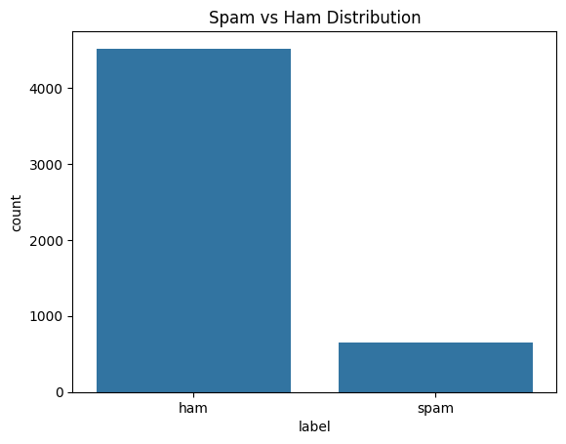
EDA: Spam vs Ham Distribution
Class balance
Key Observations
• Ham messages are much higher than spam messages.
• After duplicate removal: 4,516 ham and 653 spam messages.
• The task is slightly imbalanced, but still has enough spam samples for training.
• Evaluation should consider recall and F1-score, not accuracy alone.
7 / 20
Notes:
Explain class imbalance and why precision, recall, F1-score, and confusion matrix are important.

Slide 8
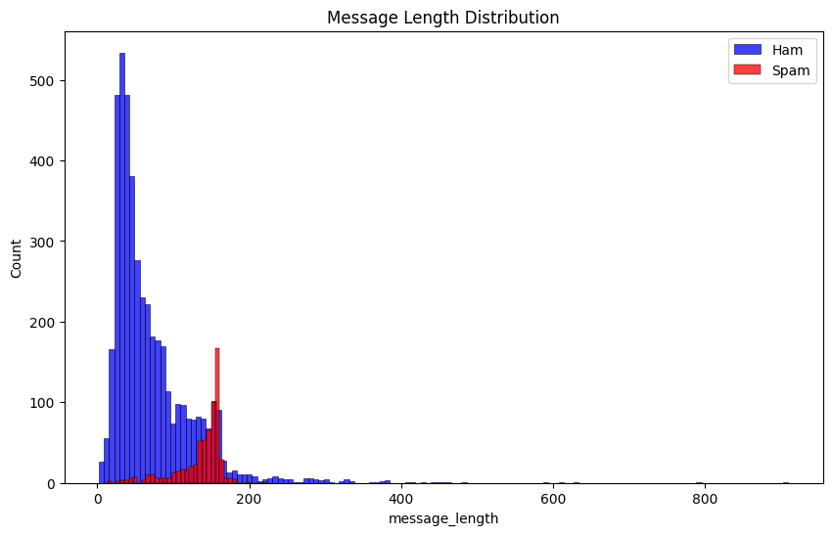
EDA: Message Length Distribution
Text behavior
Insights
• Notebook creates message_length using Python len().
• Spam messages tend to include longer promotional content.
• Ham messages are often shorter and conversational.
• Length patterns support the need for preprocessing and feature extraction.
8 / 20
Notes:
This visualization supports understanding of text patterns. The classifier itself uses TF-IDF features.

Slide 9
Data Preprocessing
Actual notebook steps
• Kept only required columns: v1 and v2, renamed to label and message.
• Removed 403 duplicate rows using drop_duplicates(keep="first").
• Converted labels: ham = 0 and spam = 1.
• Lowercased text and tokenized with NLTK word_tokenize.
• Removed non-alphanumeric tokens, English stopwords, and punctuation.
• Applied PorterStemmer to reduce words to root forms.
Example Transformed Output
Original label: ham = 0`rMessage length: 111`rTransformed text:`rgo jurong point crazi avail bugi n great world...
Cleaning reduces noise so TF-IDF can focus on meaningful spam-related terms.
9 / 20
Notes:
Stemming changes words into root forms. This prepares raw text for vectorization.

Slide 10
Feature Engineering & Split
Text to model-ready numbers
3,000
5169 x 3000
20%
TF-IDF max_features
Feature matrix shape
Test size
• TF-IDF Vectorizer converts each cleaned email into numerical feature vectors.
• X = tfidf.fit_transform(transformed_message).toarray().
• y stores the encoded labels from the label column.
• train_test_split uses test_size=0.2 and random_state=42.
• Evaluation is performed on 1,034 unseen test records.
10 / 20
Notes:
TF-IDF gives stronger weight to terms that are informative for a message and less common across all messages.

Slide 11
Model Building
Algorithms trained and compared
Multinomial Naive Bayes
Logistic Regression
Common baseline for TF-IDF NLP tasks.
Linear classifier with max_iter=1000.
Support Vector Machine
Random Forest
Linear-kernel SVC selected as best model.
Tree ensemble with n_estimators=100.
Training approach: fit each model on TF-IDF training vectors, predict on test vectors, then compare metrics.
11 / 20
Notes:
The same train-test split and TF-IDF features are used for all models.

Slide 12
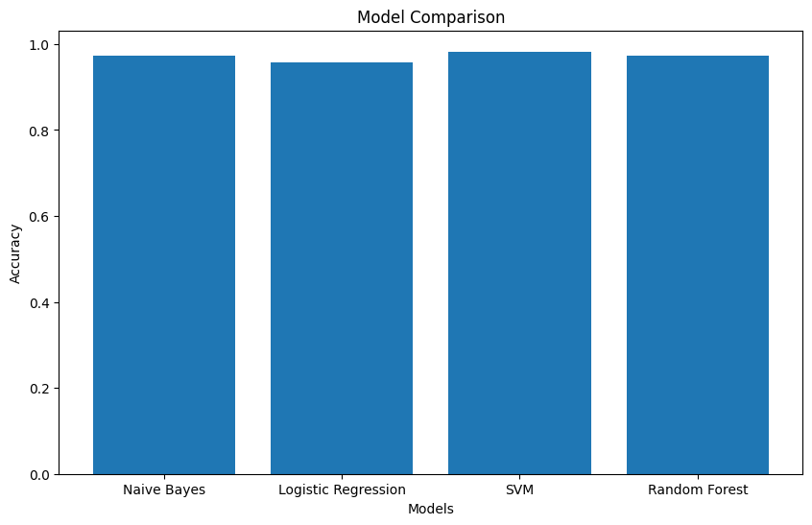
Model Comparison
Accuracy on test set
Model
Accuracy
Naive Bayes
97.29%
Logistic Regression
95.84%
SVM
98.26%
Random Forest
97.20%
Best-performing model: Support Vector Machine (linear kernel)
12 / 20
Notes:
SVM has the highest test accuracy at 98.26 percent.

Slide 13
Model Evaluation Metrics
Classification report summary
Metrics used in notebook: Accuracy, Precision, Recall, F1-score, and Confusion Matrix
Model
Accuracy
Spam class performance
Overall note
Naive Bayes
0.97
Spam: P 0.99 | R 0.81 | F1 0.89
Weighted F1 0.97
Logistic Regression
0.96
Spam: P 0.95 | R 0.74 | F1 0.83
Weighted F1 0.96
SVM
0.98
Spam: P 0.98 | R 0.89 | F1 0.93
Weighted F1 0.98
Random Forest
0.97
Spam: P 0.98 | R 0.81 | F1 0.89
Weighted F1 0.97
13 / 20
Notes:
SVM has the strongest spam F1-score among the compared models.

Slide 14
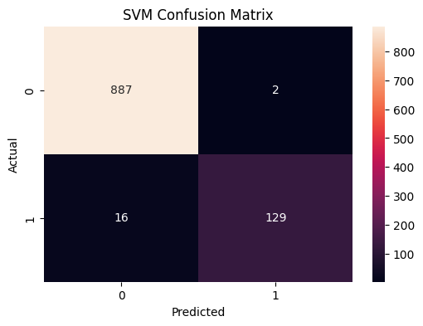
SVM Confusion Matrix
Best model error analysis
Actual Matrix Values
True Ham
887
False Spam
2
Missed Spam
16
True Spam
129
Total Test
1,034
Only 18 total test errors; SVM keeps false positives low and detects most spam messages.
14 / 20
Notes:
The SVM correctly classified 887 ham and 129 spam emails, with only 18 total errors.

Slide 15
Results & Prediction Output
Notebook final output
SVM
TF-IDF
[1] Spam
Selected model
Saved vectorizer
Prediction example
• All trained models were serialized with Pickle.
• Saved files: vectorizer.pkl, naive_bayes_model.pkl, logistic_regression_model.pkl, svm_model.pkl, random_forest_model.pkl.
• Final sample input: "URGENT! You have won a FREE lottery claim now".
• SVM output for the sample: [1], meaning spam.
15 / 20
Notes:
The notebook saves both the vectorizer and models so new input can be transformed in the same way before prediction.

Slide 16
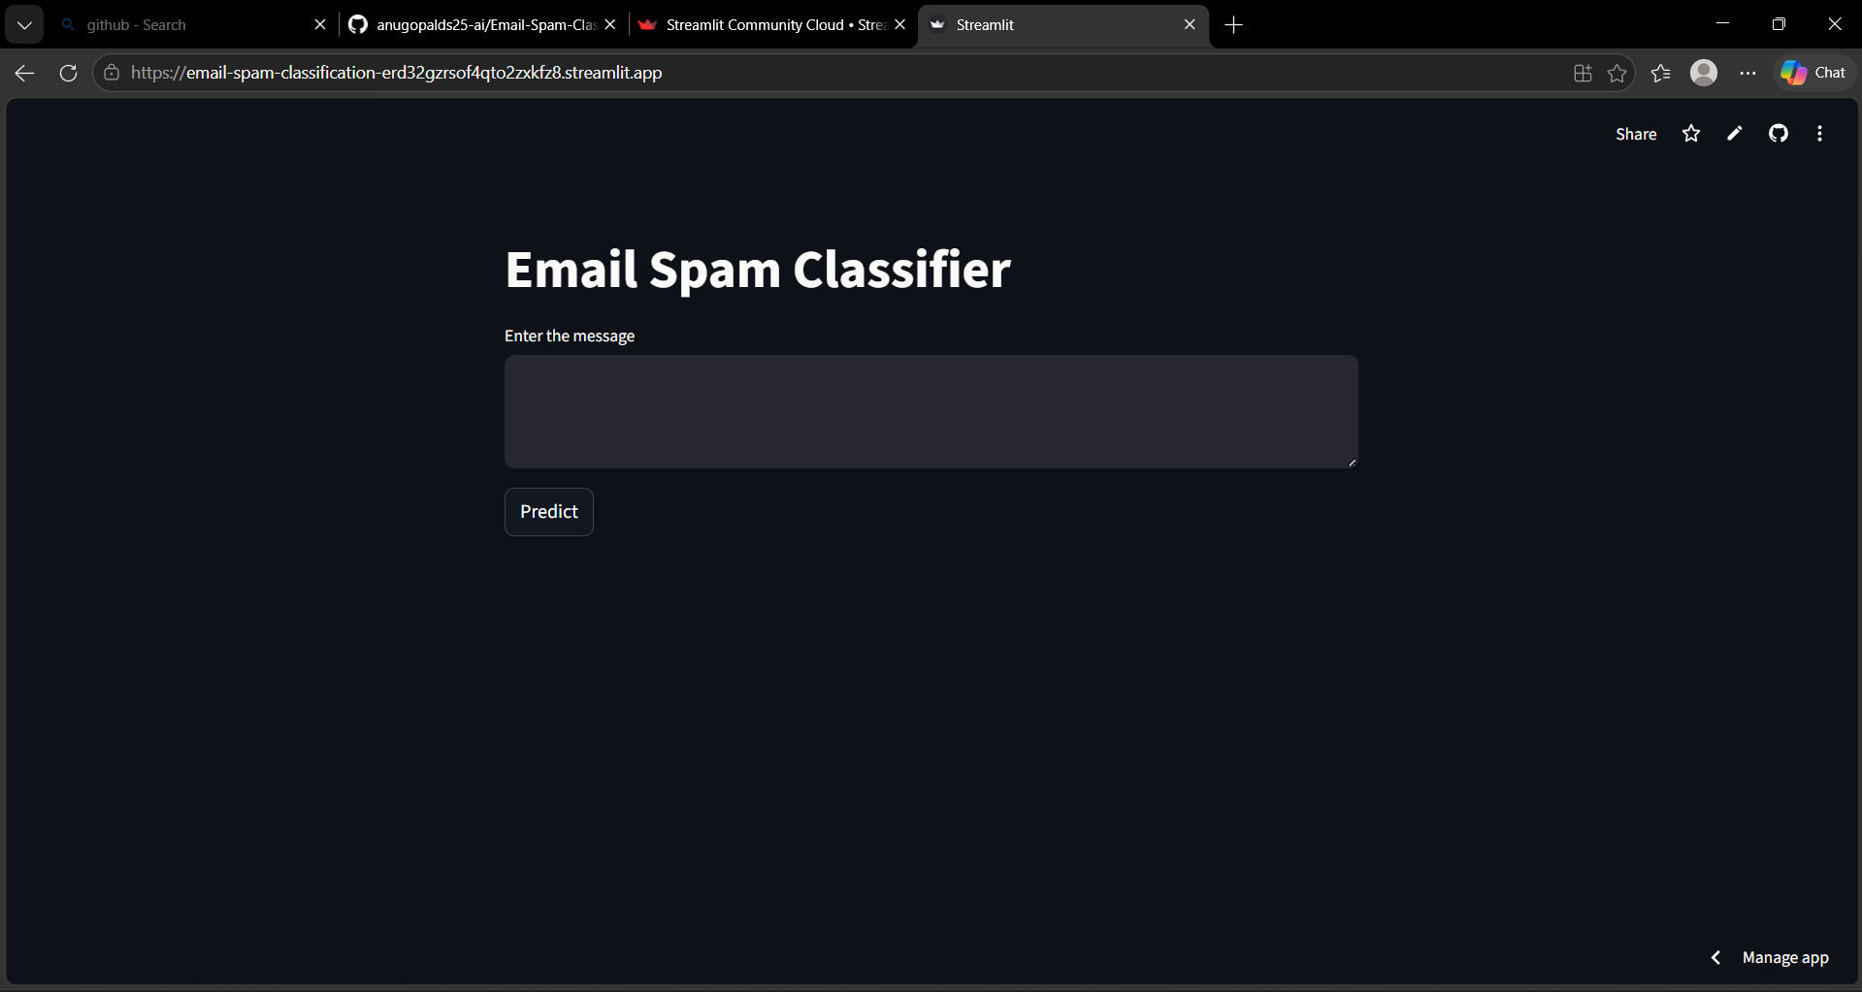
Deployment: Streamlit Application
User interface
Application Flow
• Enter email text
• Apply saved TF-IDF vectorizer
• Predict using trained SVM
• Display Spam or Ham result
Open Streamlit App
16 / 20
Notes:
The Streamlit interface makes the classifier usable for real-time prediction.

Slide 17
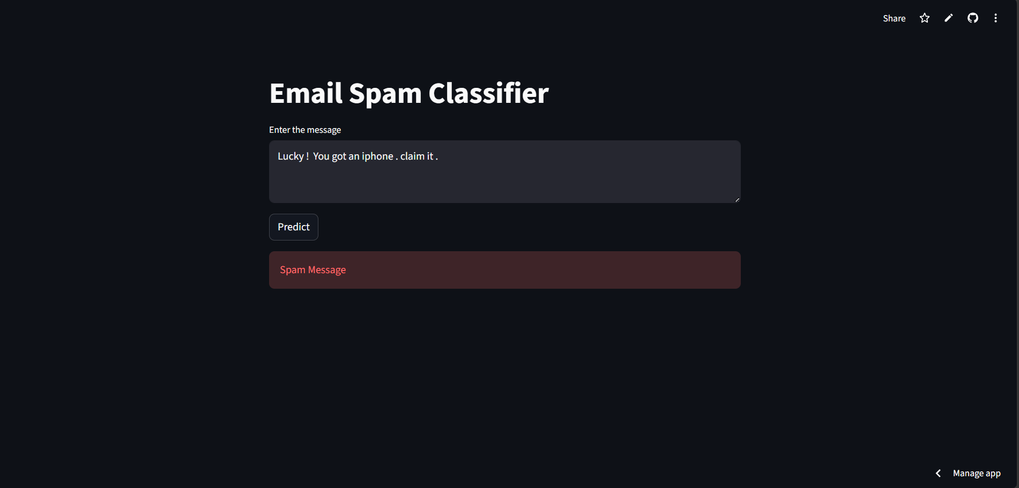
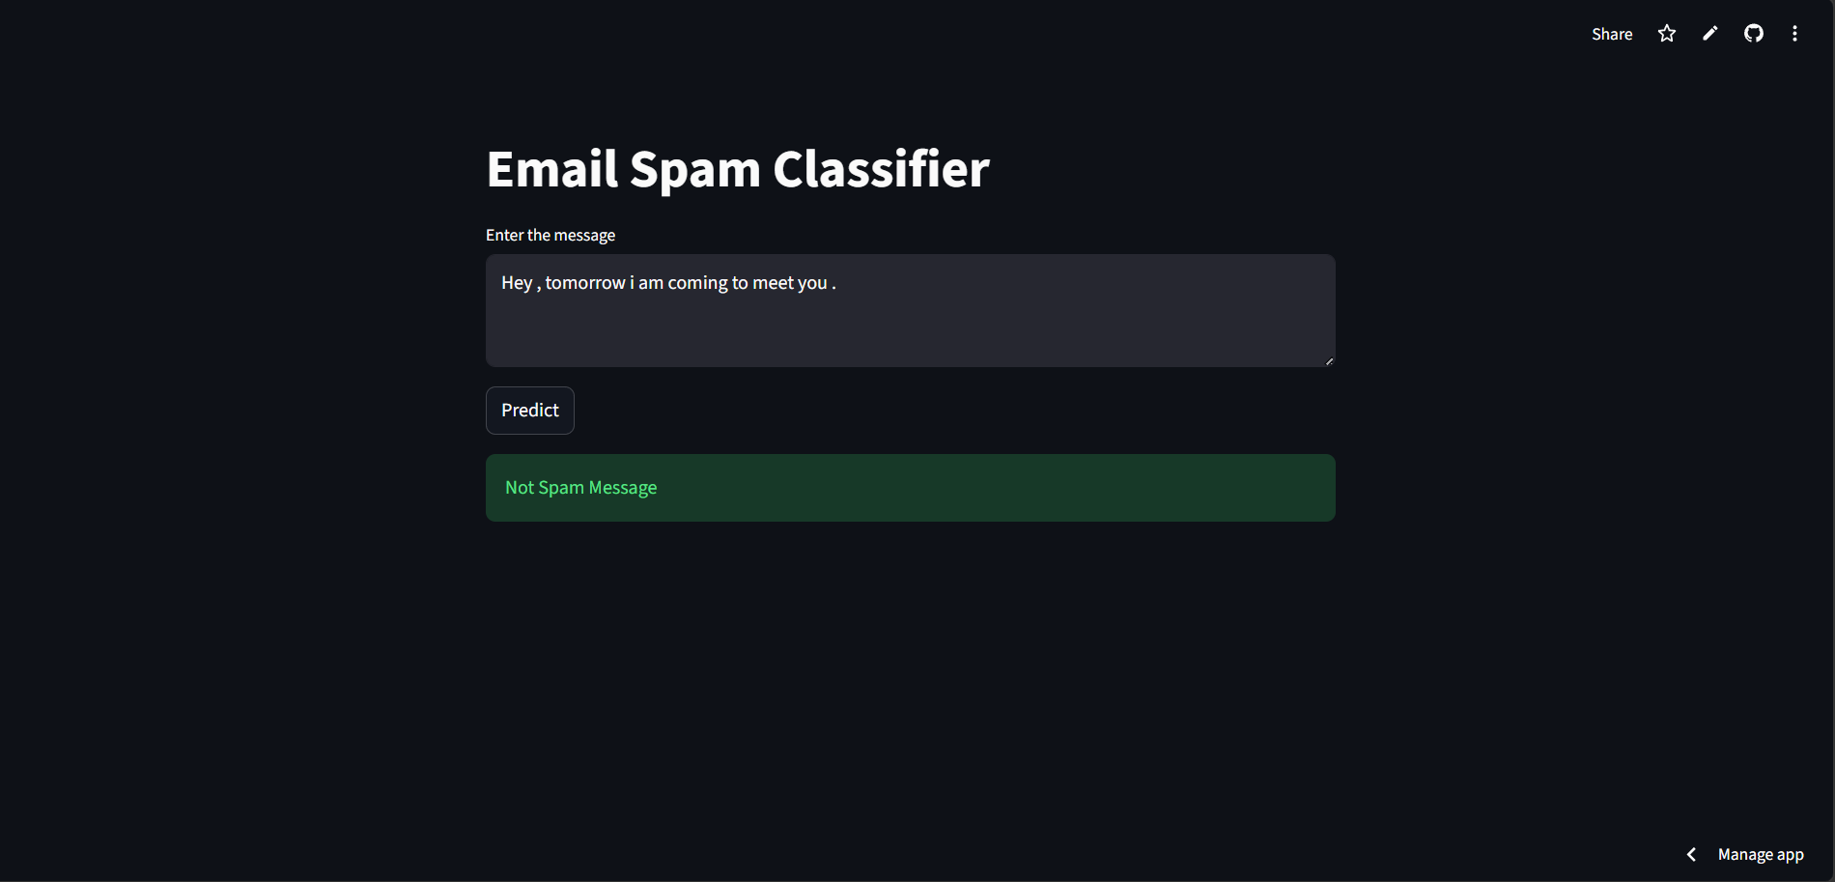
Application Prediction Screens
Spam and ham outputs
Spam result screen
Non-spam result screen
These screenshots validate that the deployed app returns both classes using the trained classifier.
17 / 20
Notes:
One screenshot shows spam and the other shows legitimate email prediction.

Slide 18
Challenges & Future Enhancements
Project reflection
Challenges Faced
Future Enhancements
• Class imbalance: ham messages are much more frequent than spam.
• Raw email text contains punctuation, stopwords, mixed cases, and noisy patterns.
• Choosing a model required comparing multiple algorithms using real metrics.
• Deployment required saving both vectorizer and model consistently.
• Add larger and more recent email datasets.
• Use advanced NLP models or embeddings.
• Add spam confidence score and explanation words.
• Improve deployment with logging and feedback.
• Extend to phishing URL and attachment-risk detection.
18 / 20
Notes:
Future work should focus on larger datasets, monitoring, and retraining.

Slide 19
Conclusion
Final summary
• Built an end-to-end email spam classification system using NLP and machine learning.
• Performed EDA, duplicate removal, label encoding, text preprocessing, TF-IDF feature extraction, model training, evaluation, and deployment.
• Compared Naive Bayes, Logistic Regression, SVM, and Random Forest using actual test metrics.
• Selected SVM as the best model with 98.26% accuracy and spam F1-score of 0.93.
• Deployed the final classifier with Streamlit for real-time email prediction.
Key achievement: a practical spam detection workflow from notebook analysis to working web application.
19 / 20
Notes:
Summarize the story from problem to deployment.

Slide 20
Thank You
Questions?
Email Spam Classification Using NLP and Machine Learning
Team: Fidal Govind | Arjun S | ANU GOPAL V
20 / 20
Notes:
Thank the faculty and invite questions.

