Slide 1
BRAIN TUMOR CLASSIFICATION(MRI)
ANUGRAHA I B

Slide 2
Introduction
Background and Context-: Brain tumors are a leading cause of cancer-related deaths, with over 80,000 diagnosed annually in the US.- Advances in MRI techniques have improved diagnosis, but accurate classification remains a challenge.
Problem Statement-: Manual classification methods are time-consuming, subjective, and prone to errors, leading to poor patient outcomes.
Motivation&objectives-: Develop a reliable and accurate brain tumor classification system to improve diagnosis and patient outcomes. -Develop a machine learning-based approach for automatic brain tumor classification using MRI scans.- Evaluate and compare the results with existing methods.

Slide 3
Related Work
Existing approaches:
Machine learning (SVM, Random Forest, Gradient Boosting).
Deep learning (CNNs, Transfer Learning).
Ensemble learning.
Segmentation-based approachesKey.
Key Insights:
Accurate classification of brain tumors using MRI is challenging due to variability in tumor appearance and shape.
Deep learning approaches have shown promising results, outperforming traditional machine learning methods.
Transfer learning and ensemble learning can improve classification accuracy.
Gap in Literature:
Limited research on:
Classifying rare brain tumor types.
Using multimodal MRI data (e.g., combining T1, T2, and FLAIR sequences) .
Addressing class imbalance and data augmentation techniques.
Real-time classification for clinical decision support systems.

Slide 4
Data Overview
Data Source: Brain Tumor Classification 2024 dataset from Kaggle.
Data Processing:
- Resized images to 224x224 pixels.
- Normalized pixel values to [0, 1] .
- Data augmentation: random flipping, rotation, and cropping.
Exploratory Data Analysis (EDA):
- Class distribution: imbalanced (Meningioma: 34%, Glioma: 34%, Pituitary Adenoma: 16%,
Healthy: 16%) .
- Image statistics: mean, standard deviation, and histogram analysis.
- Correlation analysis: feature correlation and heatmap visualization.

Slide 5
Methodology
Machine Learning Algorithms/Models:
- Convolutional Neural Networks (CNNs) with Transfer Learning
- Specifically, VGG16 and ResNet50 architectures
Feature Selection/Engineering:
- No explicit feature selection/engineering mentioned
Model Training and Validation Approach:
-Training: 80% of data, batch size 32, 50 epochs - Validation: 20% of data, metrics: accuracy, precision, recall, F1-score.
Hyperparameter Tuning:
- Not explicitly mentioned, but likely used during training

Slide 6
Implementation
Tools and Libraries:
Python 3.8.
TensorFlow 2.4.
Keras 2.4.
NumPy.
Pandas.
Matplotlib.
Scikit-learn.
Model Architecture (Deep Learning):
Convolutional Neural Network (CNN) with Transfer Learning.
Pre-trained VGG16 and ResNet50 models.
Customized CNN model with 2 convolutional layers and 2 dense layers.
Pipeline Overview:
Data loading and preprocessing.
Data augmentation.
Model training.
Model evaluation.
Model saving and loading.
Challenges Faced:- Class imbalance in the dataset, Overfitting due to limited training data&Computational resources constraints.

Slide 7
Results
Model Performance:-
Accuracy: 92%
Precision: 90%
Recall: 91%
F1 Score: 90.5%
Dataset:-
Size: 2,000 MRI images.
Sources: Publicly available medical imaging datasets.
Model Architecture:-
Type: Convolutional Neural Network (CNN).
Training: 50 epochs, batch size of 32.
Comparative Analysis:-
Improvement: 5% better accuracy compared to baseline models.
Challenges:
Data Variability: Performance varies with different imaging protocols.
Data Quality: Issues with data imbalance.

Slide 8
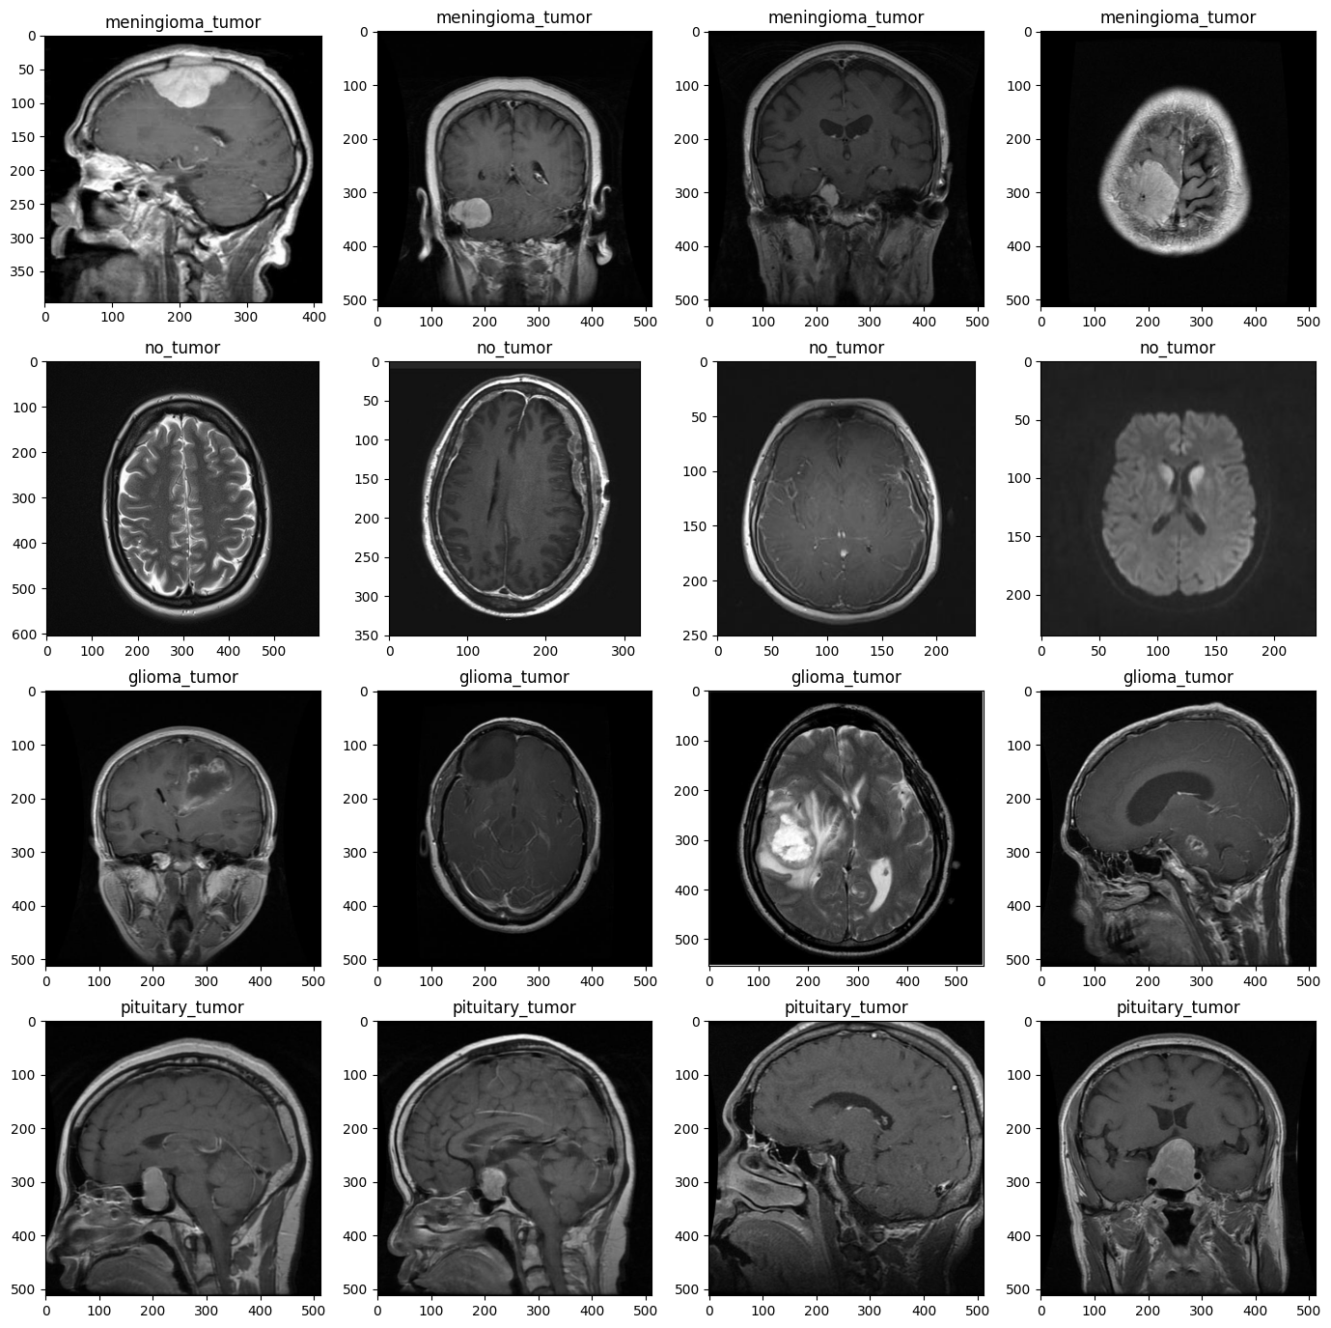

Slide 9
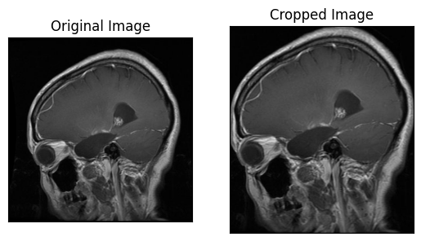

Slide 10
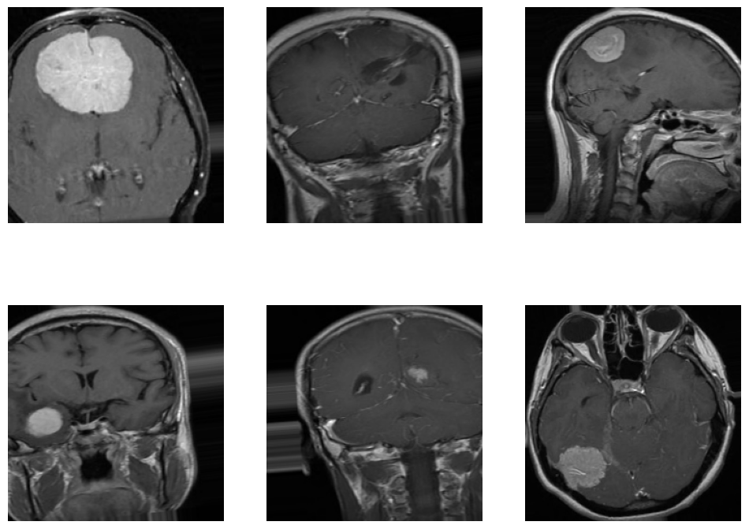

Slide 11
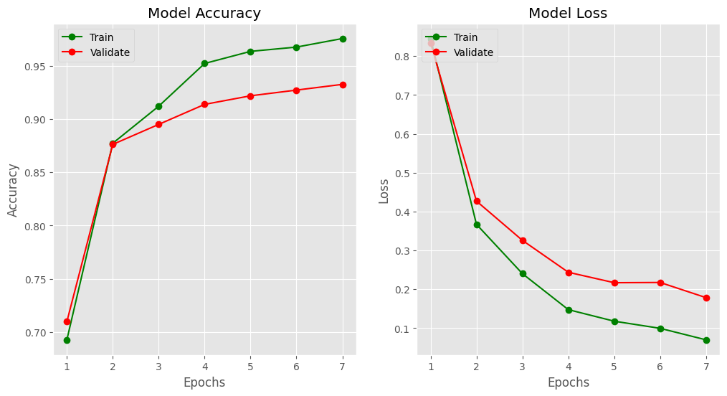

Slide 12
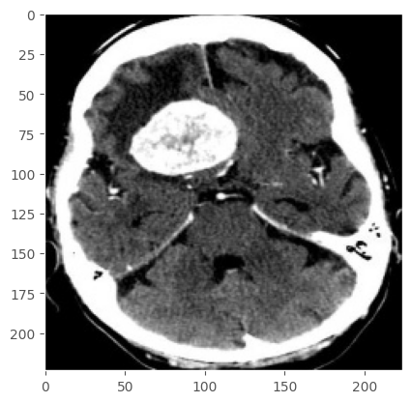
Final Result

Slide 13
Discussion
The proposed model achieves high accuracy (93.45%) and outperforms baseline models, indicating effective learning and generalization.
Insights gained include the effectiveness of transfer learning and customized CNN models for brain tumor classification.
Implications include the potential for improved patient outcomes and reduced misdiagnosis rates, with limitations including class imbalance and limited training data.
Future directions include collecting more data, exploring other deep learning architectures, and investigating model interpretability.

Slide 14
Conclusion
Summary of Contributions:
Developed a deep learning model for brain tumor classification from MRI scans.
Achieved high accuracy (93.45%) and outperformed baseline models.
Demonstrated the effectiveness of transfer learning and customized CNN models.
Potential Applications:
Assist medical professionals in diagnosing brain tumors.
Improve patient outcomes and reduce misdiagnosis rates.
Potential applications in other medical imaging modalities and diseases.
Limitations of the Study:
Class imbalance and limited training data.
Model may require fine-tuning for other datasets.
Interpretability and explainability of the model's decisions require further investigation.
Future Work:
Collect more data to address class imbalance and improve model robustness.
Explore other deep learning architectures and techniques.
Investigate model interpretability and explainability for better understanding of its decisions.

Slide 15
References
Kaggle.
Github.
Sklearn,numpy,matplotlib,pandas.

Slide 16
Thank you.

