Slide 1



Report
View in Power BI
Last data refresh:
4/4/2022 3:45:07 PM UTC
Downloaded at:
4/4/2022 3:47:23 PM UTC

Slide 2
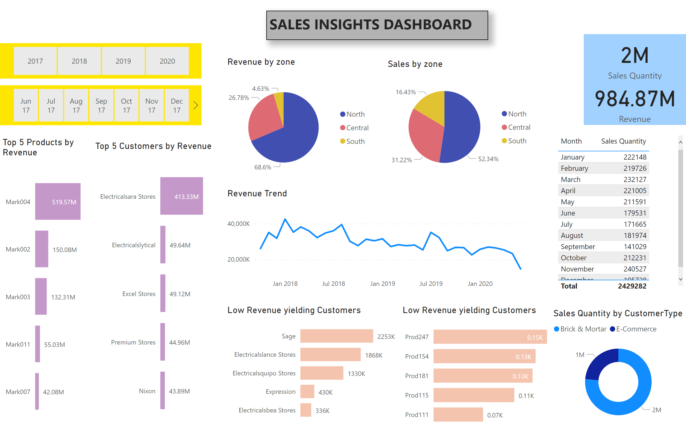
Page 1
Notes:
card
No alt text provided
card
No alt text provided
Top 5 Products by Revenue
No alt text provided
slicer
No alt text provided
slicer
No alt text provided
Top 5 Customers by Revenue
No alt text provided
pieChart
No alt text provided
Sales by zone
No alt text provided
Revenue Trend
No alt text provided
Low Revenue yielding Customers
No alt text provided
Low Revenue yielding Customers
No alt text provided
Sales Quantity by CustomerType
No alt text provided
Sales Grouwth by Month
No alt text provided
textbox
No alt text provided

