Slide 1
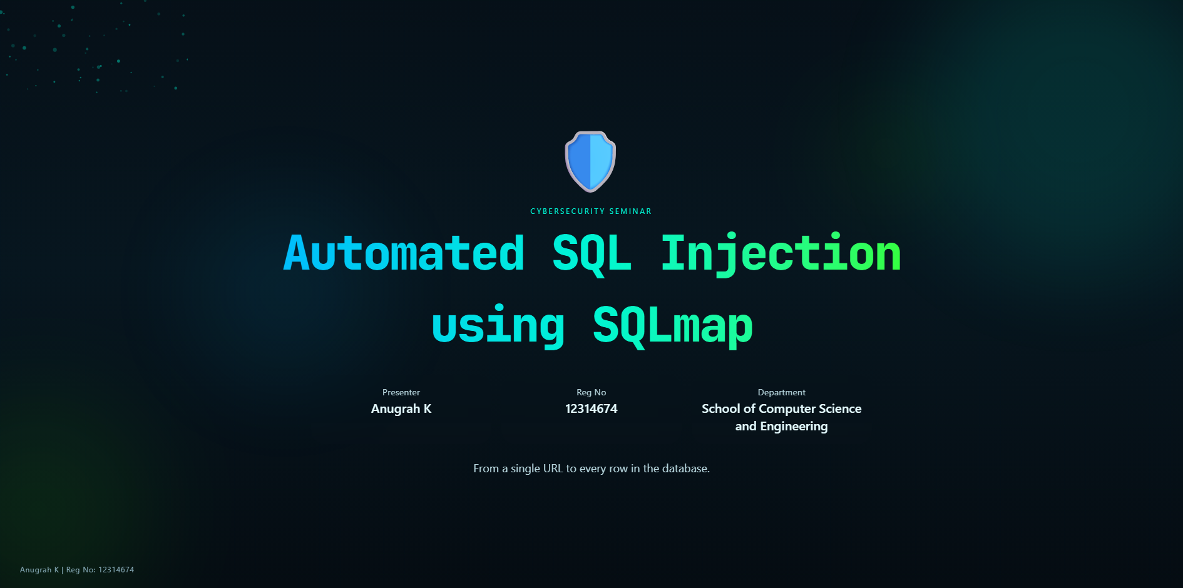
Notes:
Introduce the seminar, your identity, and the central idea: SQLmap is not magic. Explain that
the talk follows a real pentesting workflow from identifying inputs to testing and only then enumeration.
Mention that the seminar is educational and professional in tone.

Slide 2
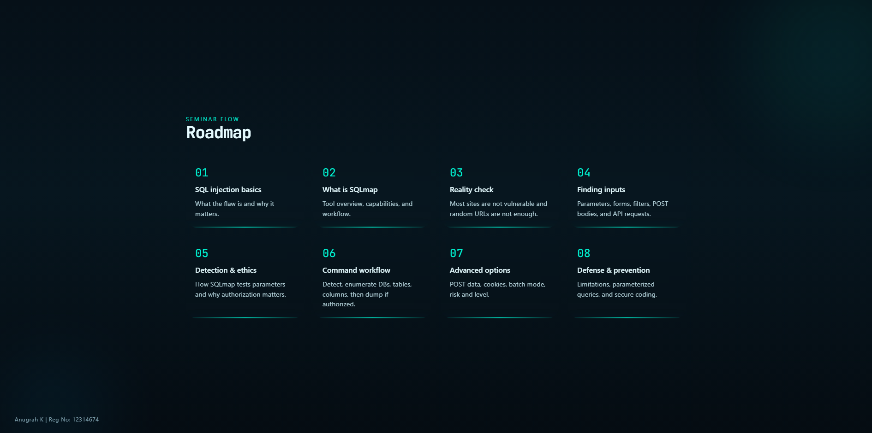
Notes:
Walk the audience through the agenda like a map. Emphasize that the flow intentionally starts
with finding input points, because that is where beginner confusion often begins.

Slide 3
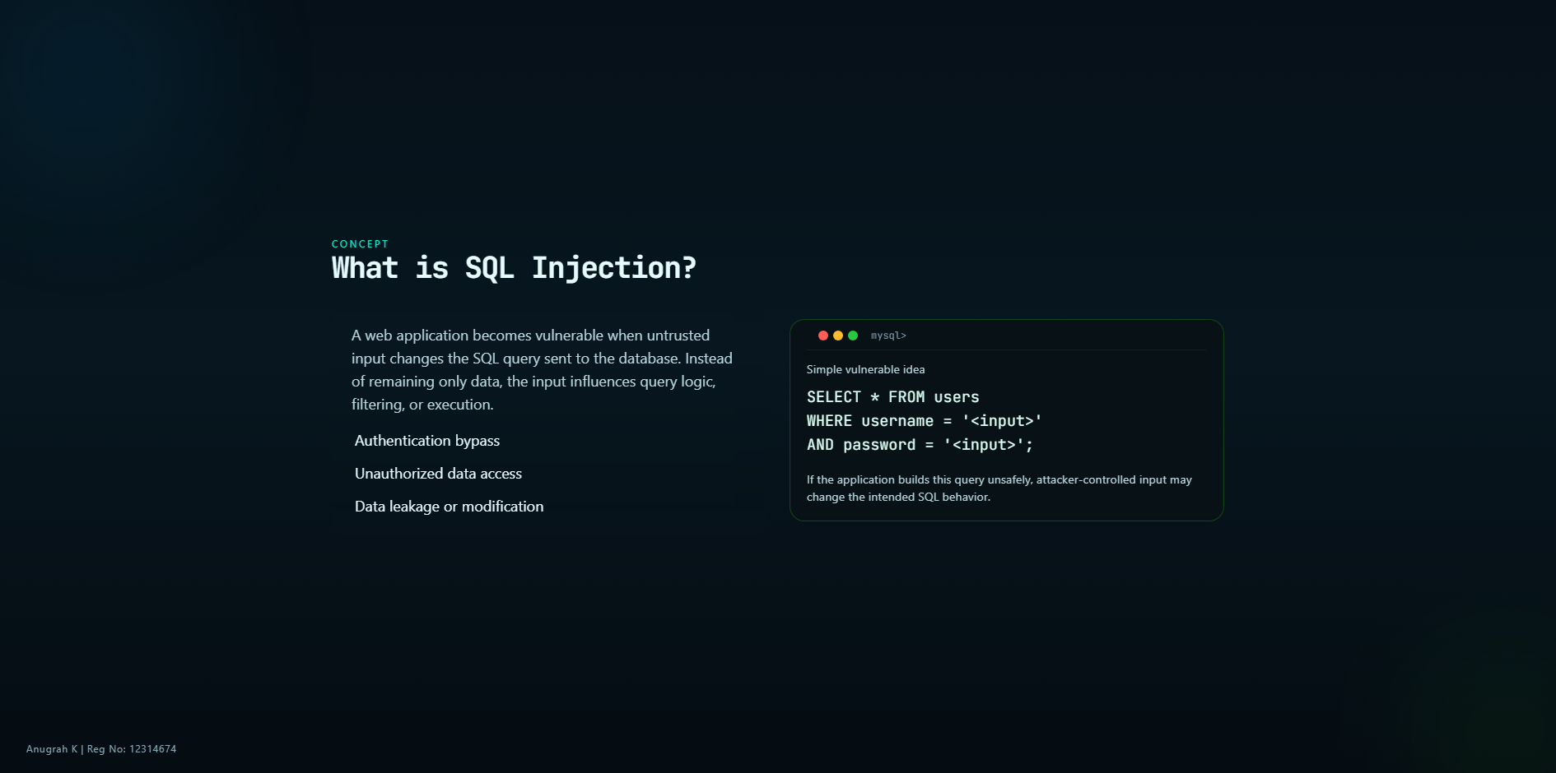
Notes:
Keep this slide conceptual. Do not overcomplicate syntax. The audience only needs the core
mental model: unsafe input reaches a SQL query and changes behavior.

Slide 4
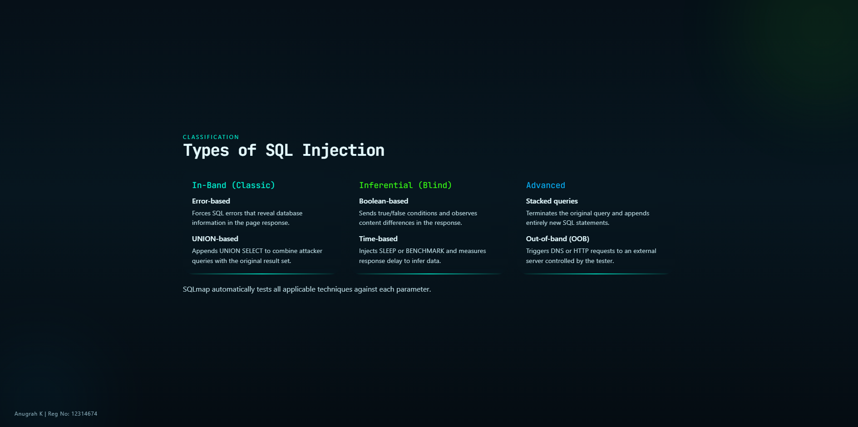
Notes:
Walk through each type briefly. Emphasize that SQLmap handles all these internally. The
audience does not need to memorize payload syntax, but should understand the categories.

Slide 5
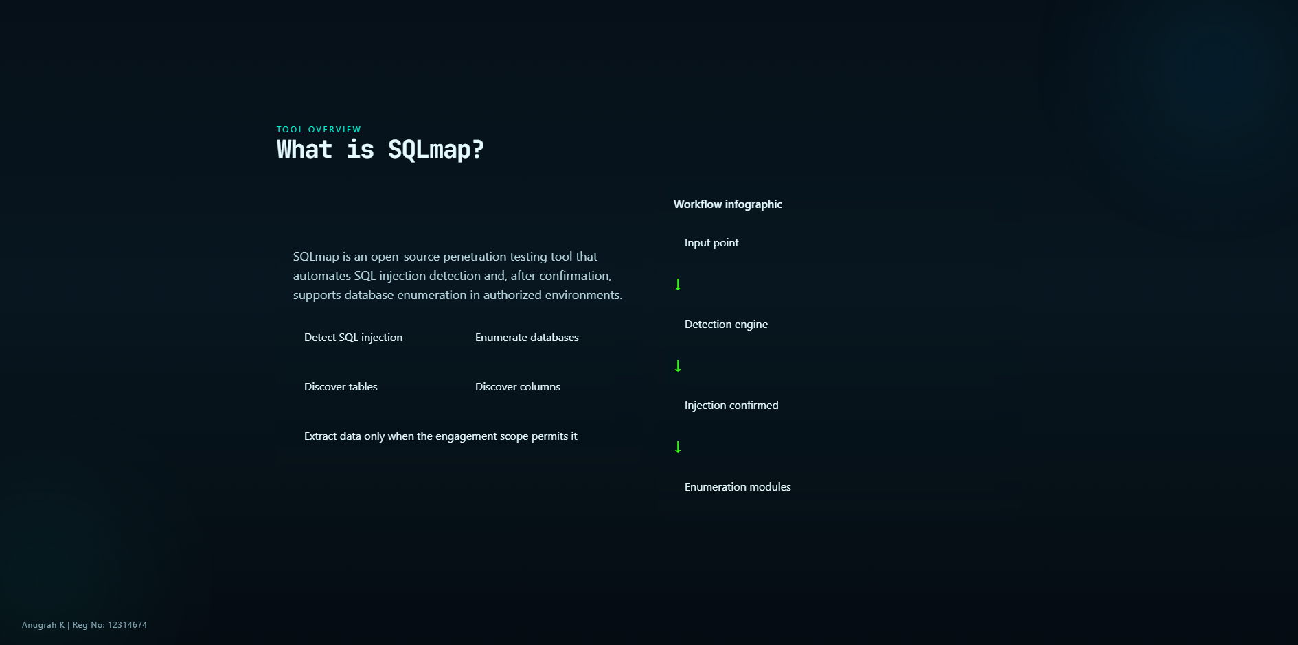
Notes:
Frame SQLmap as automation built on testing logic, not as a miracle exploit button. This
prepares the audience for the practical command slides.

Slide 6
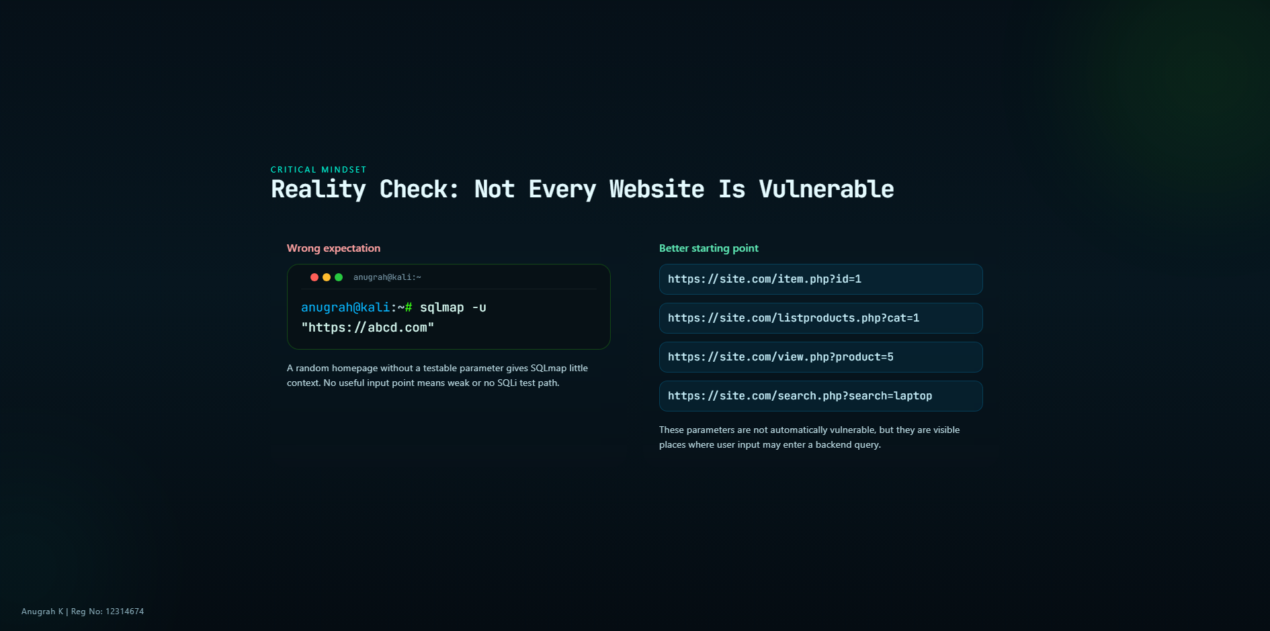
Notes:
This is one of the most important slides. State directly that SQLmap does not dump random
sites. A tester must first identify a candidate parameter or request field worth testing.

Slide 7
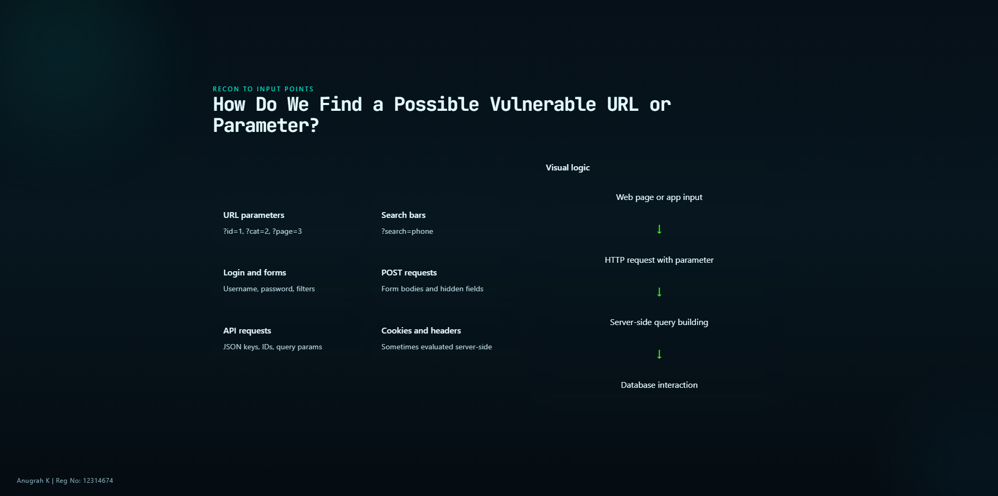
Notes:
Explain that testers inspect requests, forms, and application behavior. Mention proxies such
as Burp Suite conceptually without turning the talk into a Burp tutorial. The goal is to show where SQLmap gets
its starting point.

Slide 8
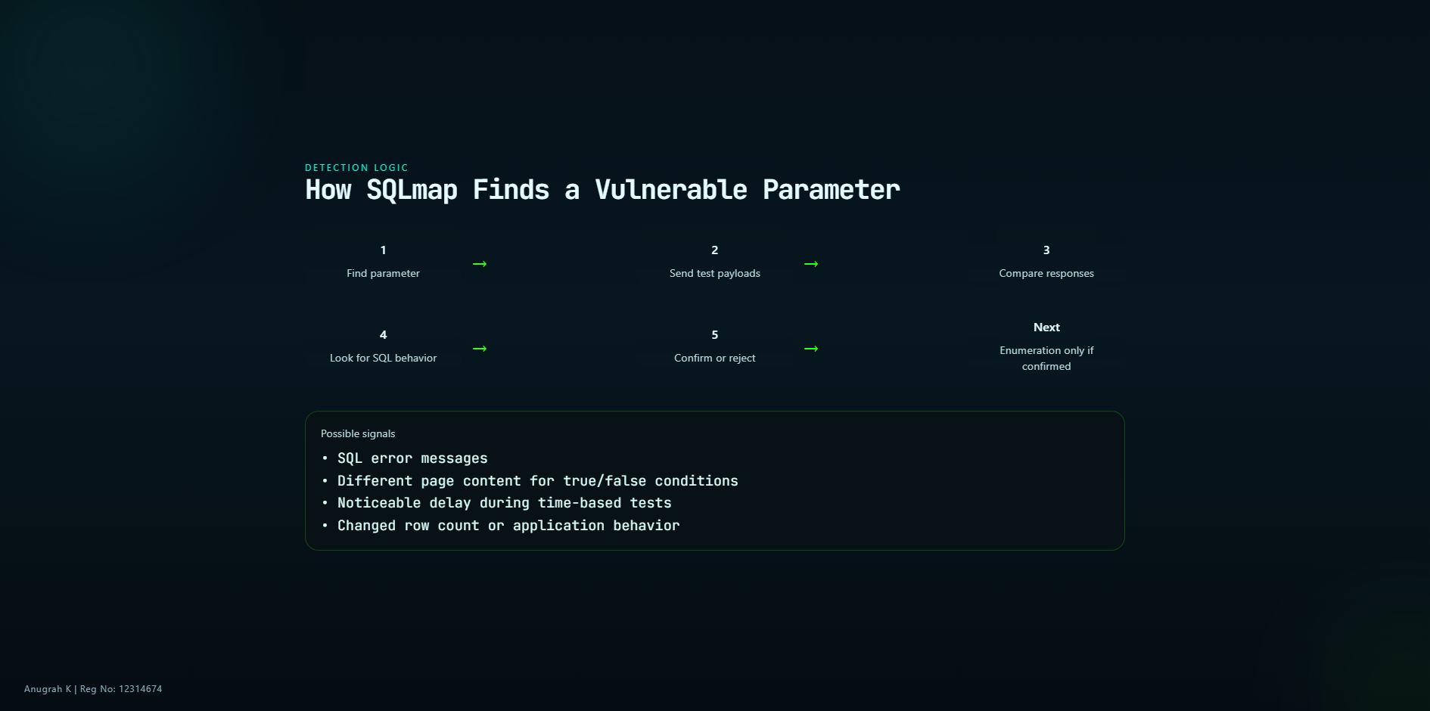
Notes:
Explain that SQLmap is effectively performing controlled experiments. It changes one thing,
observes the application, and decides whether the parameter is injectable.

Slide 9
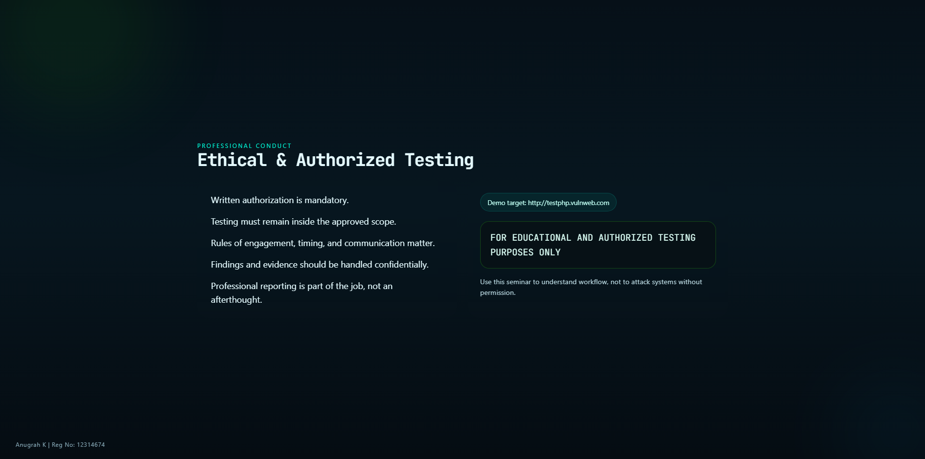
Notes:
Tie this slide to the CompTIA mindset: authorization, scope, rules of engagement,
confidentiality, and reporting. Make the legal boundary very explicit.

Slide 10
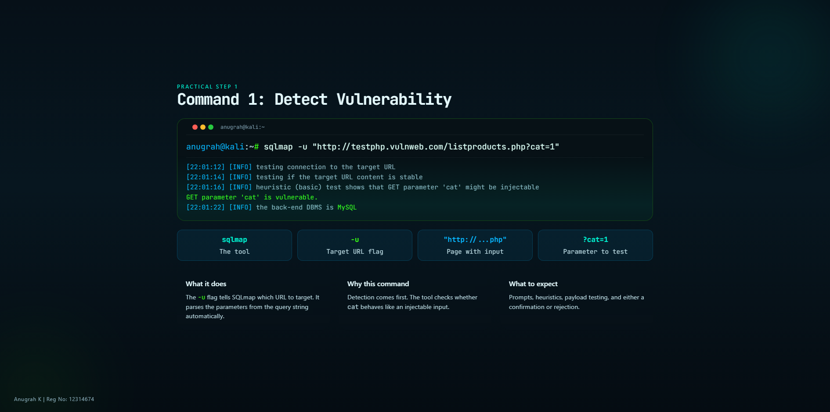
Notes:
Read the command slowly. Explain each part: sqlmap, -u, full URL, and the parameter. Clarify
that this is the first real command because it validates whether further steps make sense.

Slide 11
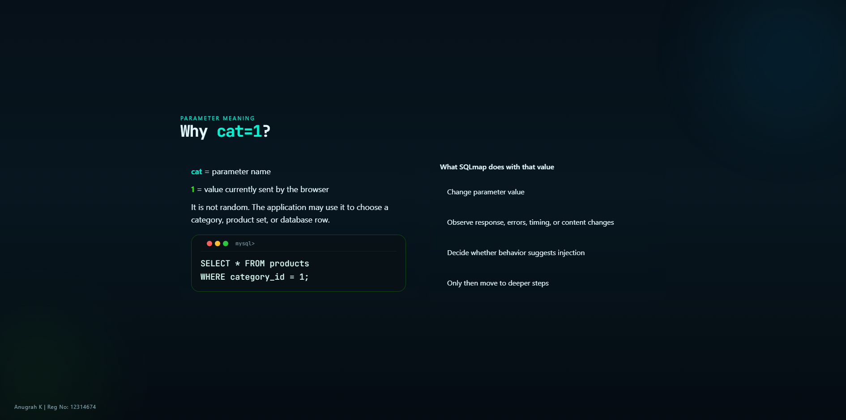
Notes:
Remove confusion around cat=1. Tell them the parameter name is simply a field label, and the
numeric value is the current input. SQLmap mutates this value to test how the application reacts.

Slide 12
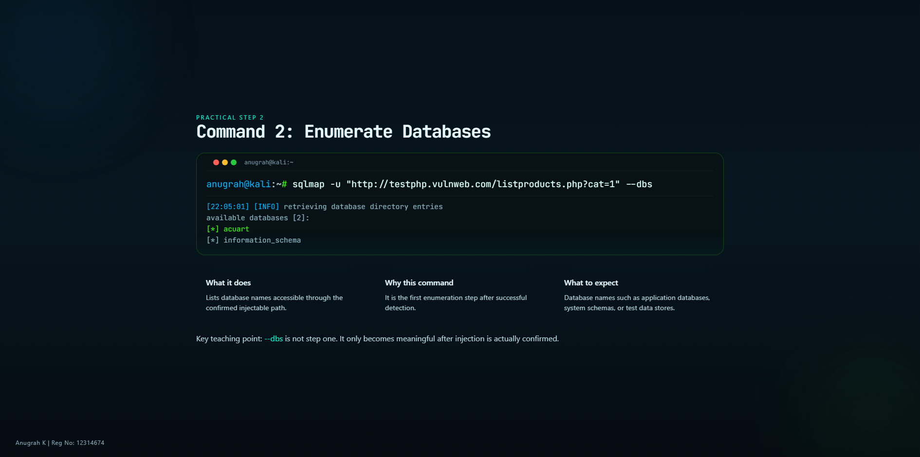
Notes:
Emphasize sequencing. Beginners often jump directly to --dbs because that command looks
exciting, but in a real workflow it is a post-confirmation step.

Slide 13
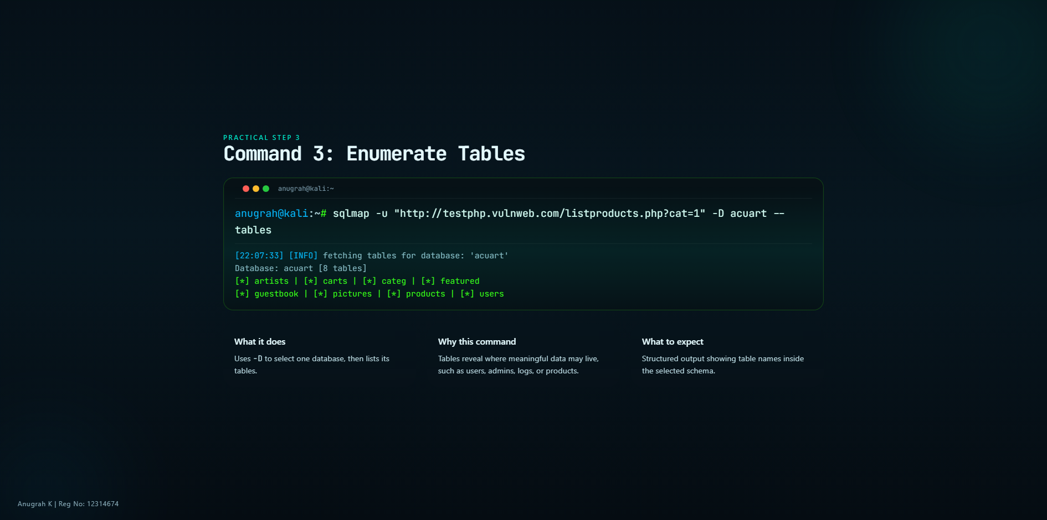
Notes:
Explain that SQLmap now narrows focus. Once a database is known, tables help the tester
understand structure and likely business functionality.

Slide 14
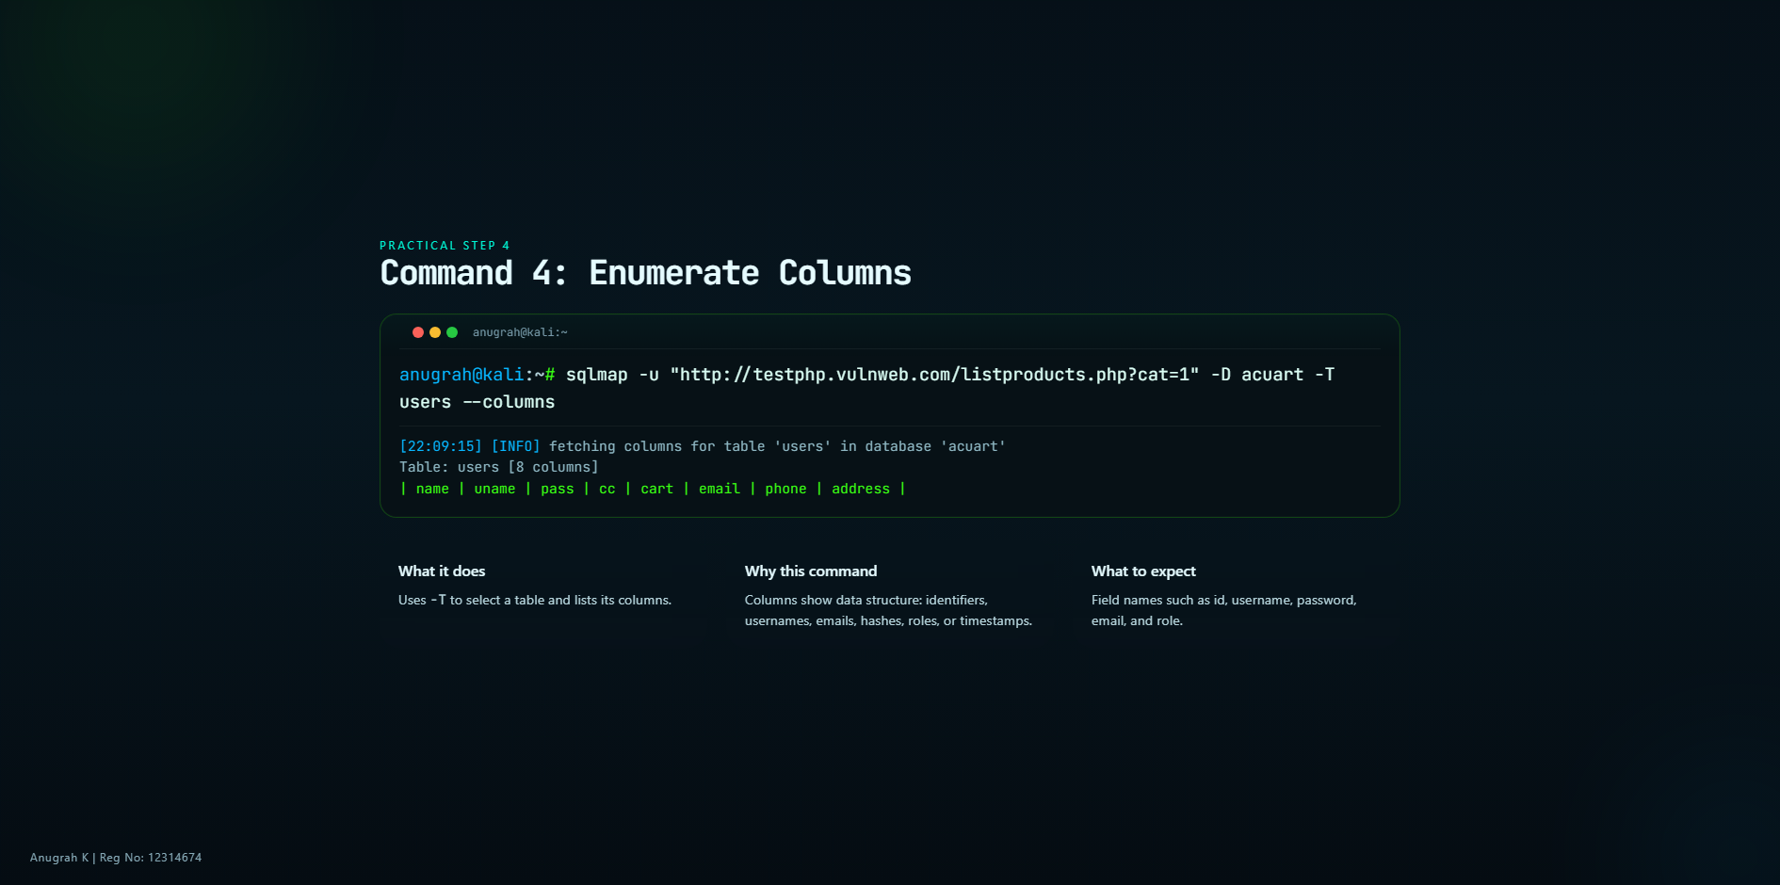
Notes:
Describe columns as metadata about the table. This is where a tester understands what kind of
data exists before thinking about extraction.

Slide 15
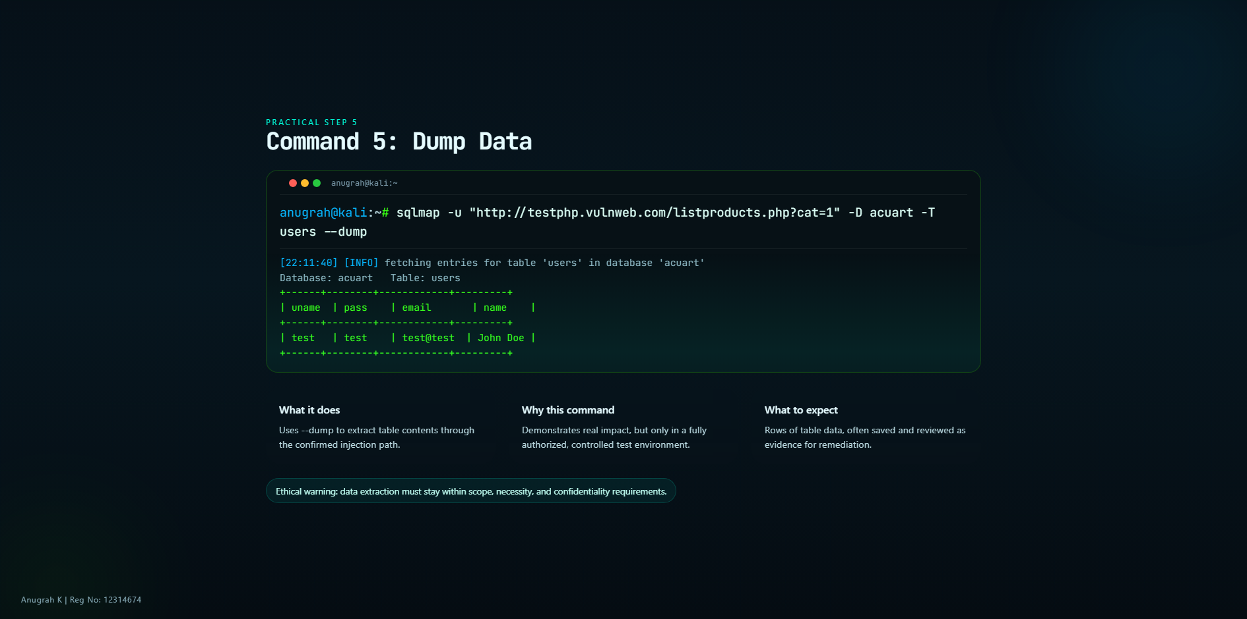
Notes:
Be very professional here. Avoid sensational language. State that dumping data is used to
prove impact for remediation, not for spectacle.

Slide 16
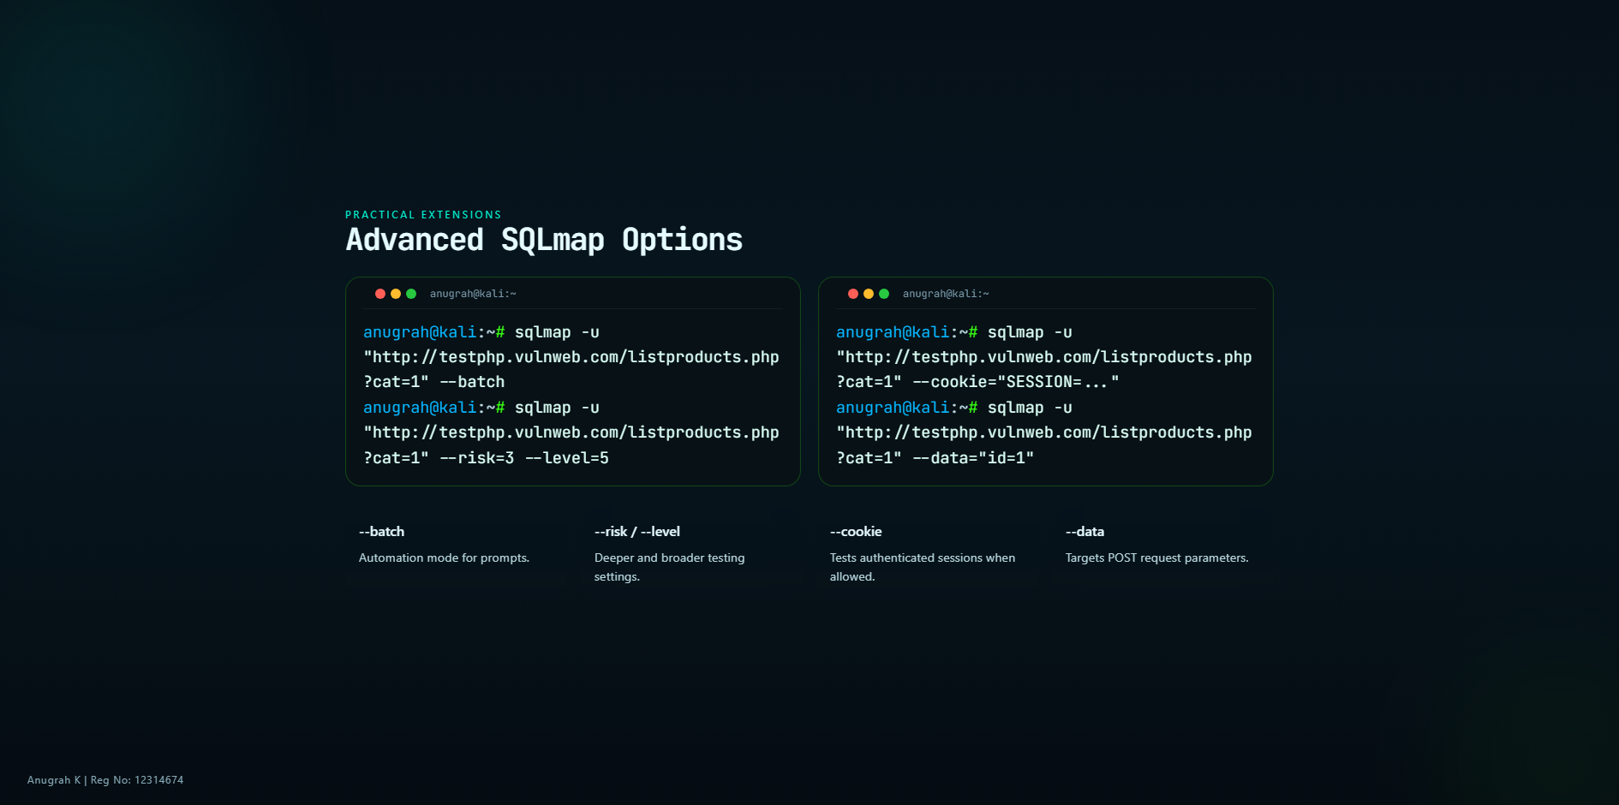
Notes:
Present these as practical enhancements after the basic flow is understood. Mention that
deeper testing should still respect scope and production safety.

Slide 17
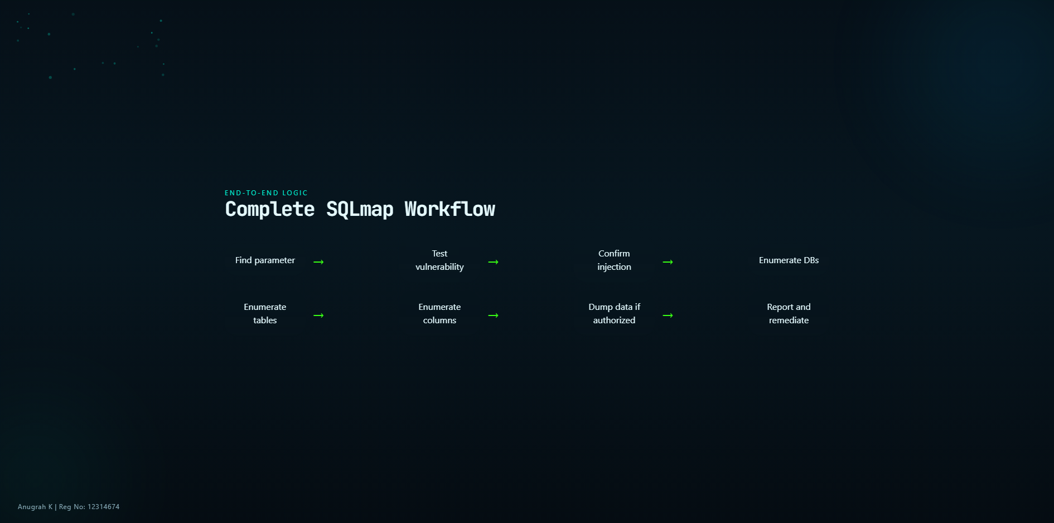
Notes:
Use this as the big-picture slide. Reconnect every earlier section into one clean mental
pipeline, ending with reporting and remediation rather than exploitation for its own sake.

Slide 18
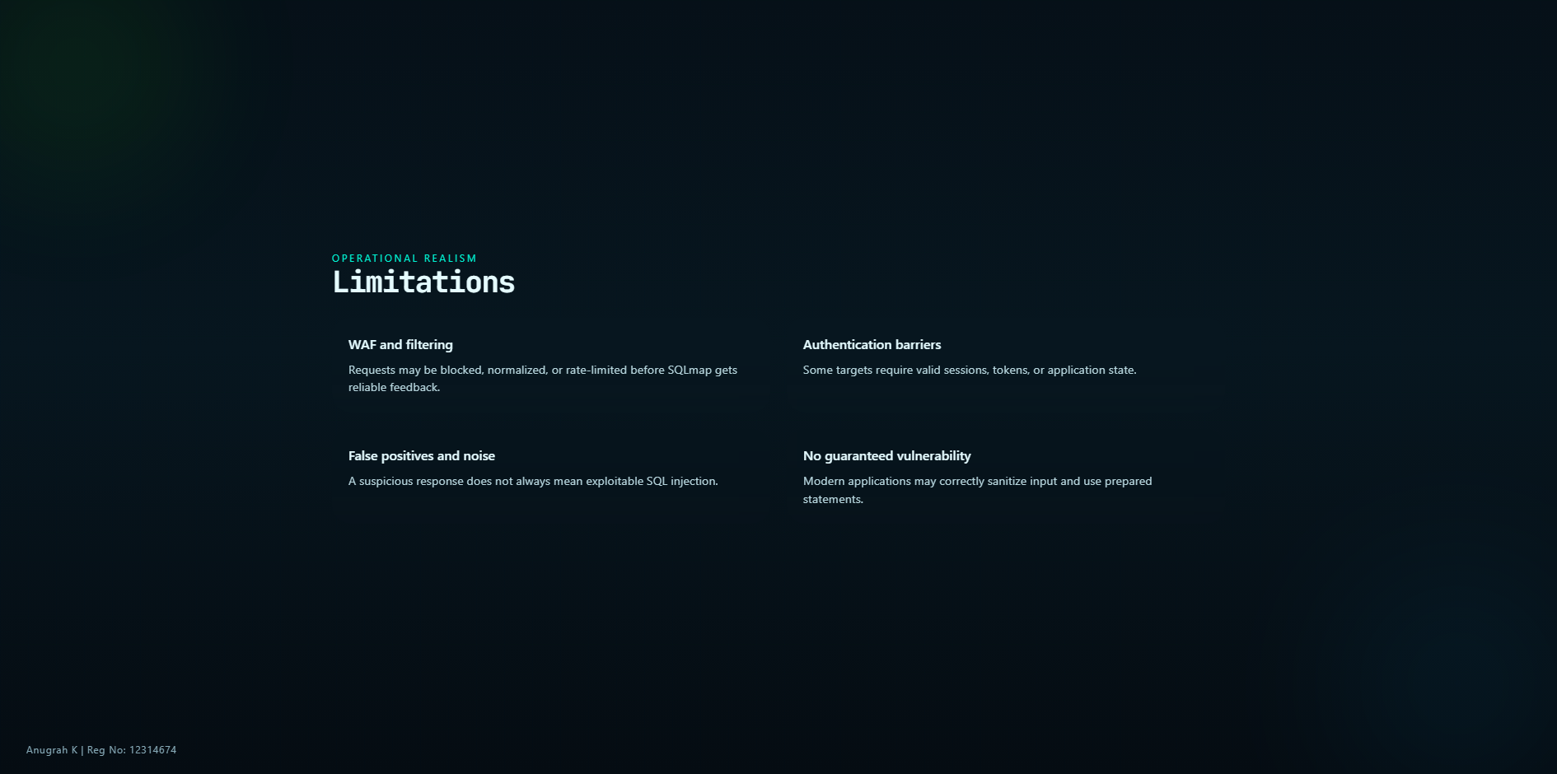
Notes:
Reinforce realism. Tools have constraints, and properly built applications resist this
workflow. This helps students avoid exaggerated assumptions.

Slide 19
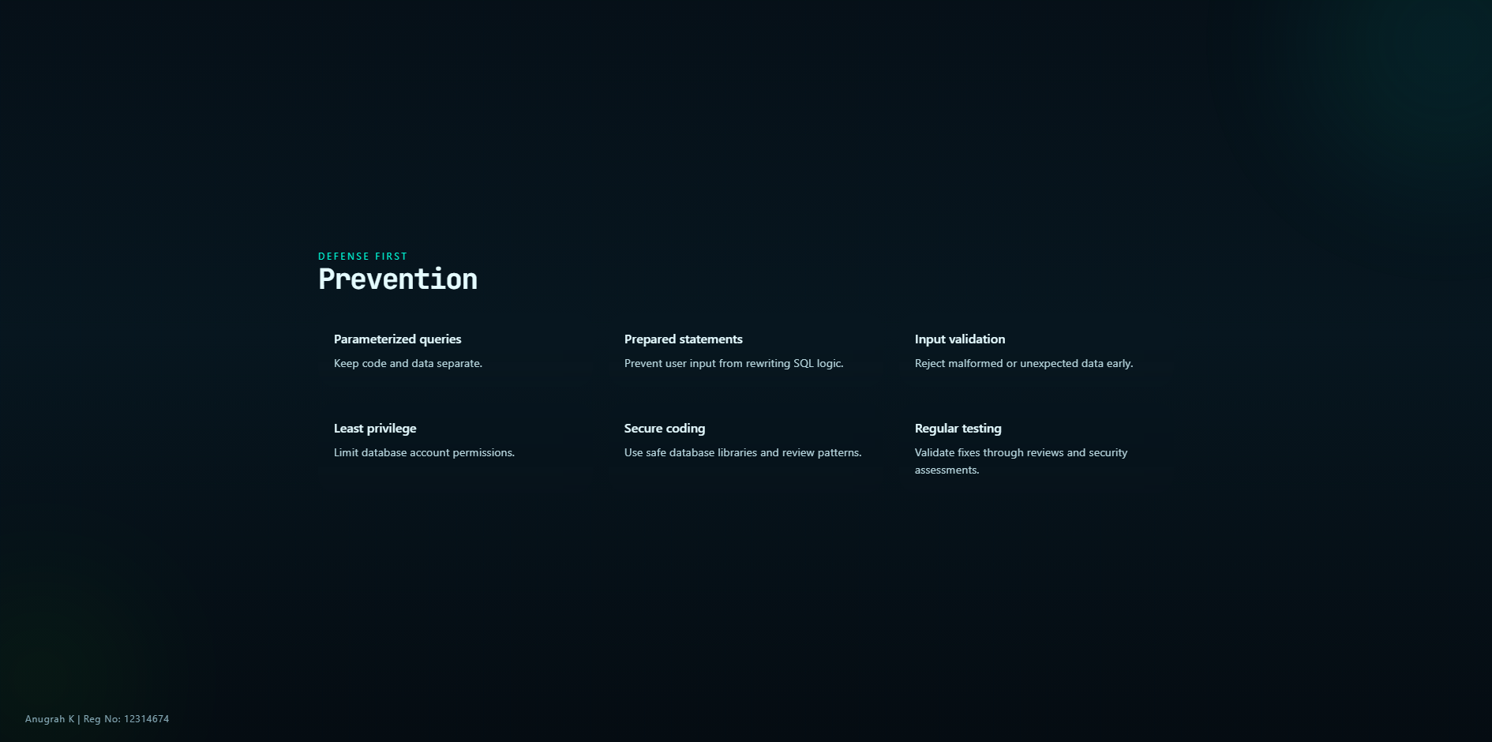
Notes:
This slide should end the exploitation discussion and pivot strongly toward secure
development and defense. Mention that prevention is more valuable than post-incident cleanup.

Slide 20
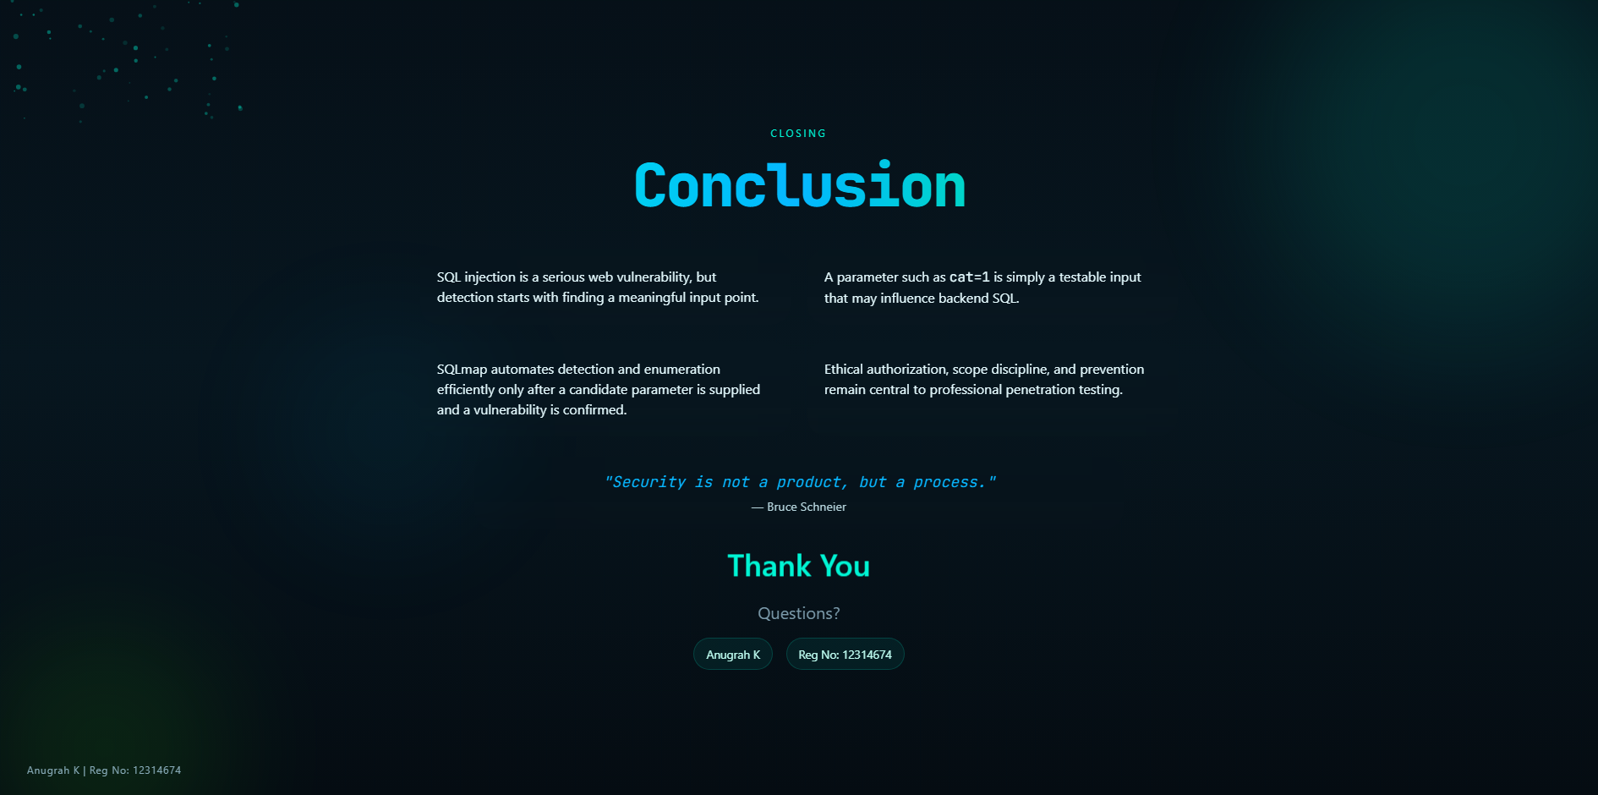
Notes:
Close confidently. Recap the key learning outcome: from normal website inputs to testable
parameters to verified SQLmap usage, always under ethics and scope. Invite questions.

