Slide 1
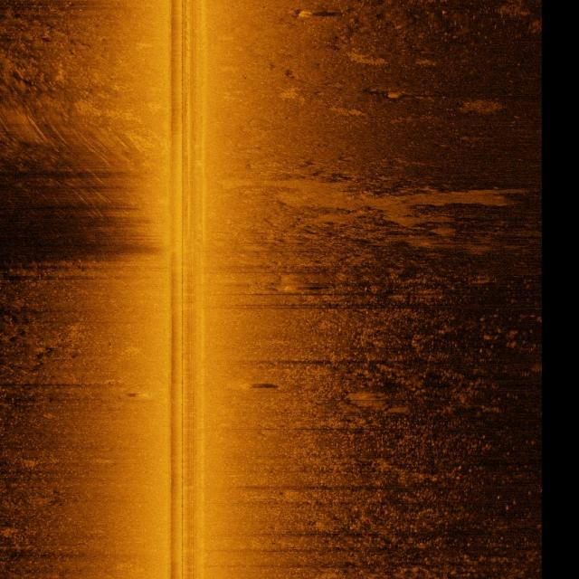
SONAR-SHIELD
Side-scan sonar candidate detection
and human review
PS 26057
Ministry of Earth Sciences / NIOT
Prototype submission
4 October 2026
Precomputed sonar sample
Notes:
PS26057 supplied by user. Current README and docs/PS26057_COMPLIANCE.md. Image: frontend/public/contact-105.jpg, paired historical sample, not a new experimental prediction.

Slide 2
System architecture
Browser
Vercel gateway
HF ZeroGPU
Human review
→
→
→
Upload and viewer
Server-only HF token
V6 and evidence
Notes and reports
Image bytes upload directly to HF. The gateway receives only a file reference.
Supabase stores private records, review revisions and shared admission limits.
Explicit paired examples remain interactive with no new inference.
Notes:
Sources: docs/ARCHITECTURE.md, frontend/api routes, ai/runtime/pipeline.py. Current public deployment remains V6-based; experimental M2.08 is not deployed.

Slide 3
Measured detector comparison
Candidate | Precision | Recall | FP | mAP50 | mAP50–95
D1 | 80.07% | 40.12% | 229 | 70.71% | 50.01%
M2.08 | 80.10% | 41.43% | 236 | 69.90% | 49.73%
M2.10 | 80.03% | 40.38% | 231 | 70.35% | 49.89%
M2.08 maximizes recall under global precision ≥80%.
Reused historical DEV: 1,129 images and 2,293 objects.
The 80/80 goal remains unmet. These weights are not deployed.
Notes:
Source: docs/metrics/module2-m211-selection-20261004.json and D1/M208/M210 evaluation JSON. Precision/recall are micro at selected global precision-floor thresholds, class-correct IoU0.5. mAP is standard validation sweep. 1129 images,2293 GT, reused historical DEV; synthetic ghost nets.

Slide 4
Training findings
Data audit excluded defective crops and invalid labels in a new revision.
User completed D1: 80 epochs, M2.08: 15, M2.10: 10.
M2.08 improved precision-floor recall slightly.
Small crab pots and wrecks remain difficult. Warmup correction did not win.
No further submission training. Compatible fusion/calibration remain missing.
Notes:
Sources: docs/MODULE2_CURATED_DATASET.md, MODULE2_D1_RESULTS.md, MODULE2_M208_RESULTS.md, MODULE2_M210_RESULTS.md and MODULE2_SOURCE_AUDIT.md. Automated screening does not certify semantic labels.

Slide 5
Judge walkthrough
1 Try live analysis on a JPG/PNG image.
2 If quota fails, explicitly confirm a precomputed sample.
3 Inspect a candidate and evidence, then save a separate human review.
4 Open Reports and export JSON/CSV or print with the source label.
5 Export a complete record or reopen an authorized cloud record.
Notes:
Source: docs/JUDGE_WALKTHROUGH.md and M2.11 browser evidence. Explicit examples do not infer on the uploaded image.

Slide 6
PS 26057 implementation scope
Requirement | Prototype status
Object detection | Five-class boxes and candidate evidence
Confidence / noise | Scores and quality fields; calibration unavailable
Geotagging / dimensions | Conditional estimates with reviewed metadata
Raw sonar / motion | Local bounded XTF; full correction incomplete
Dashboard / reports | Public image flow, human review, JSON/CSV/print
Edge deployment | Authenticated local API; hardware unverified
Public XTF remains gated by confirmed labels and independent evaluation.
Notes:
Source: docs/PS26057_COMPLIANCE.md and MODULE1_RELEASE_20261003.md. Raw/XTF processing local only, geometry conditional, full motion correction partial, no hardware certification.

Slide 7
Limits and future accuracy work
Finite shared HF quota. Reachability does not guarantee inference.
Independent field accuracy, real-net coverage and full motion handling are open.
Confirm real targets/backgrounds and reserve acquisition-disjoint test data.
Improve labels and small-target localization before controlled experiments.
Refit compatible fusion and calibration, then test one frozen operating point.
Notes:
Source: README.md, docs/XTF_ACCURACY_RELEASE.md and MODULE2_M211_RELEASE.md. Future numerical goals are not predictions or achieved results.

Slide 8
Submission and demo backup
sonarshield26.vercel.app/analysis
Local backup: paired examples, interactive review and report exports.
Hashed evidence package and editable deck accompany the prototype.
M2.08 warm GPU forward: 7.53 ms.
This excludes upload, queues and evidence fusion.
47 frontend tests, 52 backend tests and five browser scenarios passed.
Fresh real HF success and independent field accuracy remain unverified.
Notes:
Sources: docs/MODULE2_M212_SUBMISSION.md, JUDGE_WALKTHROUGH.md and M2.11 release evidence. Static backup has no live/cloud API. GPU timing from prior M208 warm batch1 FP32/640 measurement on RTX4060, not end-to-end.

