Slide 1

SakhyaPath
Evidence backed CCTV intelligence for Gujarat
HYBRID ARCHITECTURE · LOCAL PROTOTYPE
Notes:
Conceptual illustration generated for this deck; it is not a Government feed. Project status and scope: README.md and docs/SUBMISSION_READINESS.md.

Slide 2
PROBLEM AND BRIEF
The challenge
26 departments
Mandatory foundation
Existing CCTV spans different vendors, formats and locations.
A common camera registry and GIS view must precede selective analytics and cross camera search.
The live evaluation calls for roughly 50 heterogeneous feeds, vehicle history, watchlist alerts and a credible path to about 80,000 cameras.
SAKHYAPATH · GUJARAT CCTV HACKATHON
02
Notes:
Source: hackathon_source_index/README.md, especially background, Model 1, technical evaluation, and statewide scale plan.

Slide 3
PROTOTYPE
What we built locally
01
02
03
Camera grid
Evidence trail
Adaptive pursuit
Registry, map, Sentinel catalogue adapter, owned RTSP/HLS capture and controlled preview.
Plate reads, crops, watchlist alerts, historical search, journey map and reviewer corrections.
Measured analysis budget, camera ranking and a ledger that records what was viewed, missed or unavailable.
SAKHYAPATH · GUJARAT CCTV HACKATHON
03
Notes:
Source: README.md; docs/MODULE1_RUNBOOK.md; docs/MODULE2_RUNBOOK.md; docs/MODULE3_RUNBOOK.md; docs/MODULE4_RUNBOOK.md. These are locally implemented features.

Slide 4
USER WORKFLOW
A case follows the evidence
1 Register a vehicle of interest
2 Read authorised camera frames and save source timing
3 Confirm plate evidence and compare with the watchlist
4 Show the journey, uncertainty and coverage gaps
A human reviewer can correct detections and export the case report.
SAKHYAPATH · GUJARAT CCTV HACKATHON
04
Notes:
Source: SakhyaPath_technical_blueprint.md; docs/MODULE3_RUNBOOK.md; docs/MODULE4_RUNBOOK.md. Evidence and inference are distinct in the UI and reports.

Slide 5
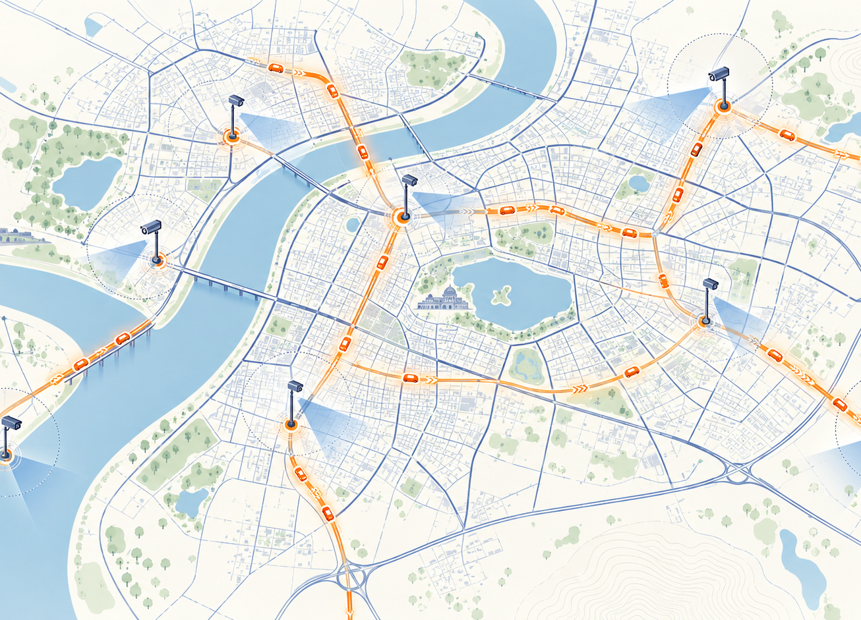
DISTINCTIVE APPROACH
Coverage is part of the answer
The ledger records:
Seen and analysed
Available but skipped
Temporarily unavailable
Unknown or unverified
A missing sighting is not proof that a vehicle was absent.
SAKHYAPATH · GUJARAT CCTV HACKATHON
05
Notes:
Conceptual map image generated for this deck, not real footage or GIS data. Source of product logic: docs/MODULE4_RUNBOOK.md and docs/MODULE4_HLD.md.

Slide 6
BENCHMARK
A measured local baseline
2
owned replay feeds
249
analysed frames in 20.634 seconds
12.067 fps observed across both feeds
Planning budget: 8.447 fps with a 30% reserve. This is a local, two feed test; it is not a statewide capacity result.
SAKHYAPATH · GUJARAT CCTV HACKATHON
06
Notes:
Source: output/benchmarks and docs/SUBMISSION_READINESS.md. Local owned replay test, not Sentinel or Indian-road holdout footage.

Slide 7
EXPERIMENT
Adaptive sampling has limits
Expected branch
Surprise branch
The adaptive allocator found more target observations under the same sample budget.
Uniform sampling found the unpredicted route more often in the controlled test.
Next validation: reset recorded routes, common clock checks and held out ground truth from multiple cameras.
SAKHYAPATH · GUJARAT CCTV HACKATHON
07
Notes:
Source: docs/MODULE4_RUNBOOK.md and output/benchmarks. The official sample comparison is controlled and cannot establish field performance. scripts/compare_recorded_sampling.py is ready for permission-cleared footage.

Slide 8
SCALE PLAN
Path to Government deployment
01
02
03
Authorised pilot
Regional services
Statewide expansion
Prove catalogue sync, mixed codecs, source timestamps, 50 feed onboarding and timestamped detections.
Add PostgreSQL/PostGIS, durable events, regional capture workers and encrypted evidence.
Size active analysis, bandwidth, retention and recovery from measured pilot data.
SAKHYAPATH · GUJARAT CCTV HACKATHON
08
Notes:
Source: docs/PRODUCTION_GATE.md; docs/MODULE4_HLD.md; output/benchmarks/capacity_50_assumptions.json; output/benchmarks/capacity_80000_assumptions.json. These are phases and assumptions, not completed deployments.

Slide 9
SUBMISSION GATES
Evidence still needed
Sentinel access
Permission cleared footage
Approve the registered account, give the catalogue origin and test the read only API.
Measure Indian plate accuracy, false alerts, misses and frame to alert latency.
Live submission evidence
Reproducible links
Record the own feed demo, Government feed demo and a real timestamped output report.
Publish the presentation, HLD, videos and code in reviewer accessible locations.
SAKHYAPATH · GUJARAT CCTV HACKATHON
09
Notes:
Source: hackathon_source_index/README.md; docs/SUBMISSION_READINESS.md. None of the pending gates should be described as complete before footage and authorised access are available.

