Slide 1
Classification of Fetal Cardiotogram using SVM

Slide 2
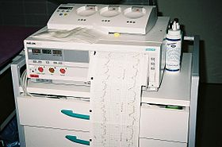
Fetal Cardiotocography: Introduction
Cardiotocography (CTG) is a method used for recording fetal heartbeat and uterine contractions during pregnancy
Device used to measure these is called Cardiotocograph.

Slide 3
The baseline rate is the average heart rate of the fetus within a 10-minute window.
Normal fetal heart rate is between 110-150 bpm.
Baseline variability refers to the variation of fetal heart rate from one beat to the next
Normal Variability is between 5-25 bpm

Slide 4
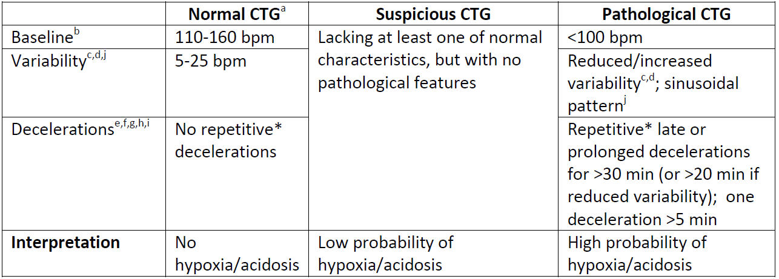
Classification Types

Slide 5
Machine Learning Concepts For Classification
CTG Dataset
Training Data
Test Data
Train the model
Test the model
Generating
Classification
report and
Confusion Matrix

Slide 6
Block Diagram
Input
Data Aquisition
Pre-processing
Feature Extraction
Class 1: Normal
Class 2: Suspect
Class 3: Pathological
Output
Classification
Training Set
Test Set

Slide 7
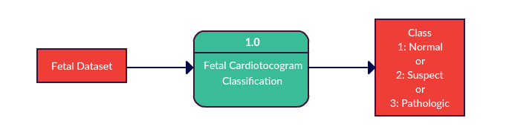
Data Flow Diagram
Level 0: Context Flow Diagram

Slide 8
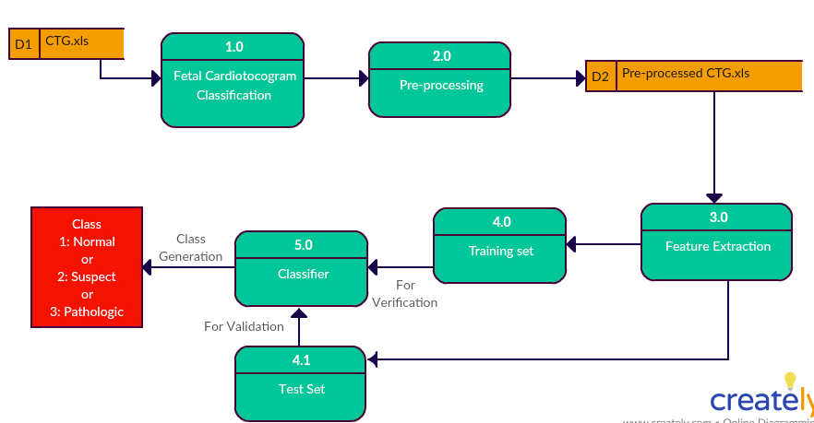
Data Flow Diagram
Level 1: Data Flow Diagram

Slide 9
Key Features
Classfication of the Data set is done using the SVM (Support Vector Machine) algorithm.
The given data set is divided into
  Training data (80%)
  Test data (20%)
The model trained using the training data and then tested.
Respective Confusion matrix and Classfication Report are generated.

Slide 10
Importance Of The Model
The model developed can be used effectively to classify the CTG data as normal, suspect and pathologic heart rate
This helps in identification of abnormalities in the development of the fetus which will helps in further treatments.

Slide 11
Tasks
Read and load dataset as an xls.
Choose atleast 25 attributes out of 40 (from col D to Z)
Extract these important features and store them into a numerical vector.
Let the output be a document vector matrix and input an xld sheet.
Filter out other columns and retain the 1st row names for analysis. (either manually or using dimensionality reduction algorithm)
Plot 3d bar chart for different features.
Apply SVM algorithm to classify the document vectirs using the column NSP.
Classify the same into 3 labels Normal, Suspect, and Pathological fetal heart rate.
Generate Confusion matrix and performance report.

Slide 12
Implementation

Slide 13
Thank You!!
        Presentation By
- Anushree Gudoor
- N Manjula

