Slide 1

Energy Consumption Analysis

Slide 2
About me
My name is Anugu Hruthik Reddy, and I hold a B.Tech degree in Computer Science And Engineering with specialization in AI&ML at Vignana Bharathi institute of Technology. I am passionate about expanding my skill set by learning Data Science, as it offers powerful tools to analyze complex data and derive meaningful insights that can drive innovation and decision-making in various industries. Though I do not have prior work experience, I am eager to apply my technical background and analytical mindset to master data science concepts and contribute effectively to future projects.
Connect with Me
LinkedIn:https : //www.linkedin.com/in/hruthikrdy03/
GitHub: https : //github.com/anuguhruthikreddy03
Mail : anuguhruthikreddy@gmail.com

Slide 3
Agenda
Objective of the Project
ER Diagram and schema explanation
Key analysis questions (use cases)
SQL query results with screenshots or summaries
Final business insights and recommendations
Conclusion (Key finding overall)
Q&A Slide
Your Experience/Challenges working on SQL – Data Analysis Project.

Slide 4
Objective of the Project
The objective of the Energy Consumption Analysis SQL project is to analyze worldwide energy consumption using data from the EIA organization, which tracks metrics such as energy consumption, emissions, production, population, and GDP for various countries. The project aims to derive meaningful insights by understanding correlations between economic power, consumption, and emissions. This comprehensive analysis is performed using structured datasets integrated into a MySQL database, enabling comparative, trend-based, and per capita assessments of global energy dynamics.

Slide 5
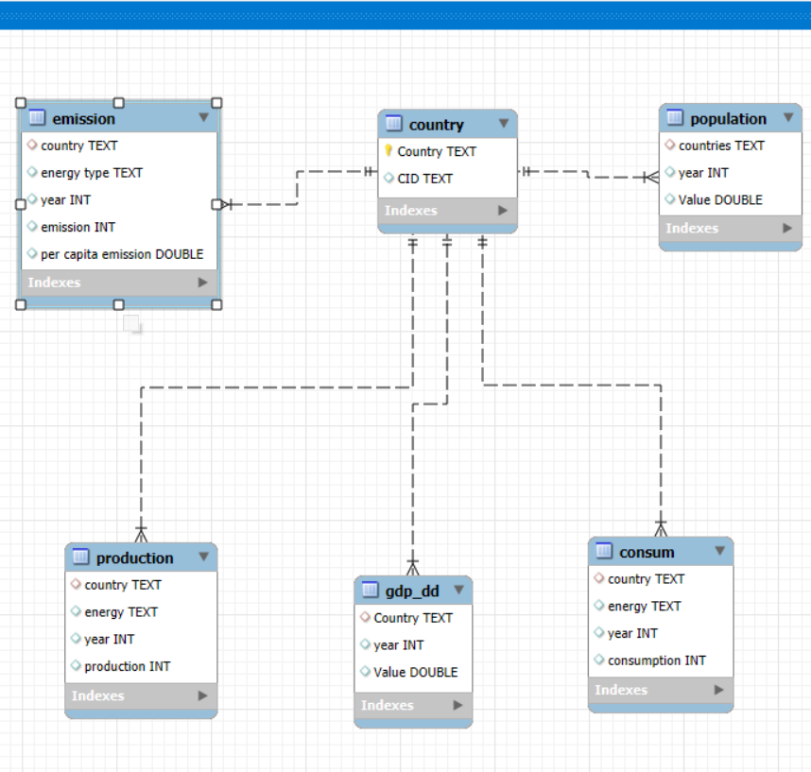
ER Diagram and schema explanation
ER Diagram Explanation
The ER diagram for the SQL project on energy consumption analysis consists of six interconnected tables: country, emission, population, production, GDP, and consum. The central "country" table is linked to all other tables through the country attribute, enabling relational integrity and structured queries across datasets.
Schema Explanation
The country table serves as the reference, containing fields for country name and a unique country ID. All other tables connect to this to maintain data consistency.
The emission table stores emission details, energy type, year, total emission, and per capita emission values for each country.
The population table tracks population values by country and year.
The production table contains data on energy production amounts by country, energy type, and year.
The gdp_dd table records GDP values by country and year.
The consum table keeps track of energy consumption data segmented by country, energy type, and year.

Slide 6
Key analysis questions
What is the total emission per country for the most recent year available?
What are the top 5 countries by GDP in the most recent year?
Which energy types contribute most to emissions across all countries?
How have global emissions, GDP, and population changed over time?
What is the emission-to-GDP and energy consumption per capita for each country?
Which countries have reduced their per capita emissions the most over the last decade?

Slide 7
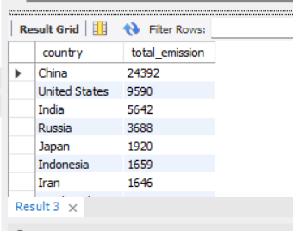
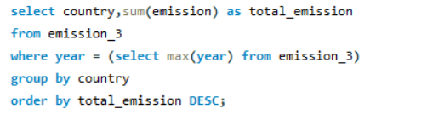
SQL query results with screenshots or summaries
1. What is the total emission per country for the most recent year available?
QUERY
OUTPUT

Slide 8
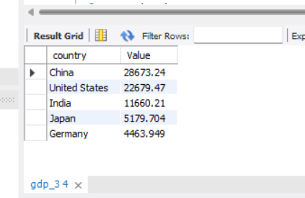
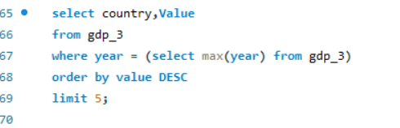
SQL query results with screenshots or summaries
2.What are the top 5 countries by GDP in the most recent year?
QUERY
OUTPUT

Slide 9
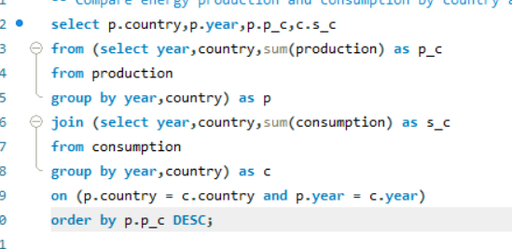
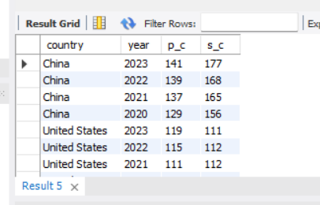
SQL query results with screenshots or summaries
3.Compare energy production and consumption by country and year
QUERY
OUTPUT

Slide 10
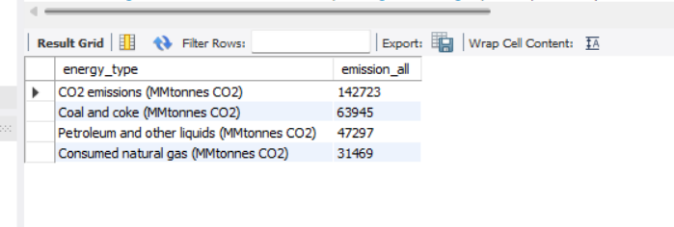
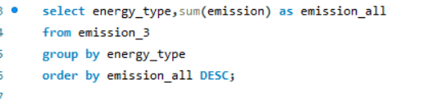
SQL query results with screenshots or summaries
4. Which energy types contribute most to emissions across all countries?
QUERY
OUTPUT

Slide 11
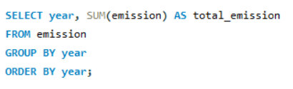
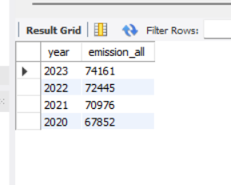
SQL query results with screenshots or summaries
5. How have global emissions changed year over year?
QUERY
OUTPUT

Slide 12
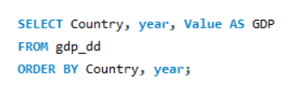
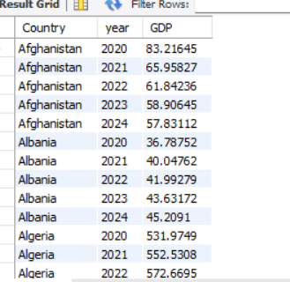
SQL query results with screenshots or summaries
6. What is the trend in GDP for each country over the given years?
QUERY
OUTPUT

Slide 13
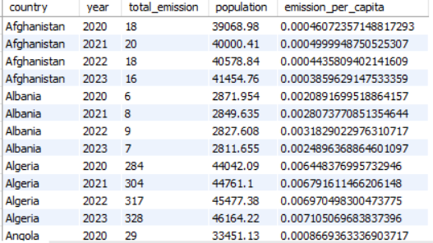
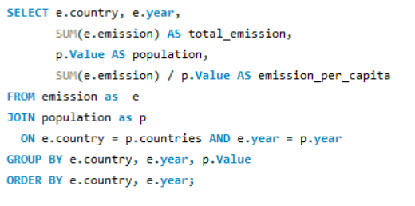
SQL query results with screenshots or summaries
7. How has population growth affected total emissions in each country?
QUERY
OUTPUT

Slide 14
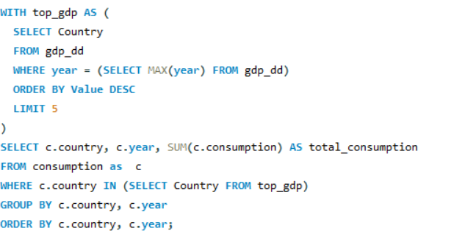
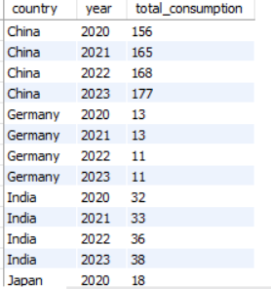
SQL query results with screenshots or summaries
8. Has energy consumption increased or decreased over the years for major economies?
QUERY
OUTPUT

Slide 15
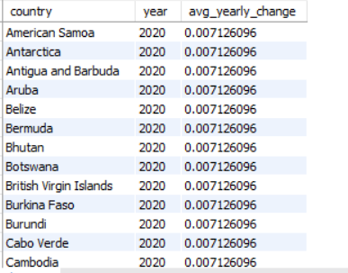
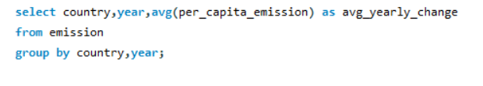
SQL query results with screenshots or summaries
9.What is the average yearly change in emissions per capita for each
country?
QUERY
OUTPUT

Slide 16
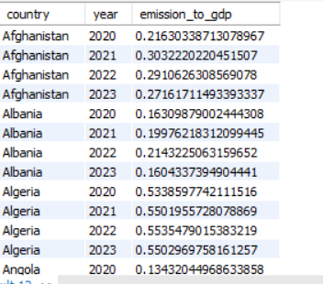
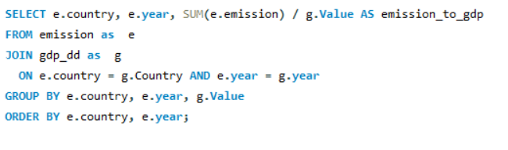
SQL query results with screenshots or summaries
10. What is the emission-to-GDP ratio for each country by year?
QUERY
OUTPUT

Slide 17
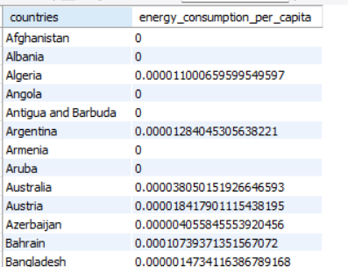
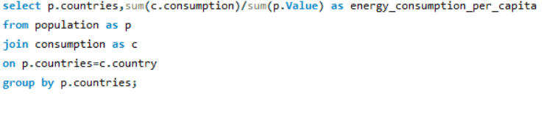
SQL query results with screenshots or summaries
11. What is the energy consumption per capita for each country over the last decade?
QUERY
OUTPUT

Slide 18
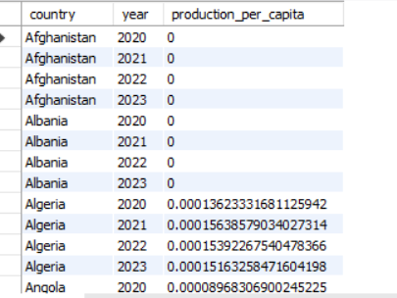
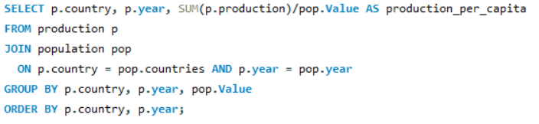
SQL query results with screenshots or summaries
12. How does energy production per capita vary across countries?
QUERY
OUTPUT

Slide 19
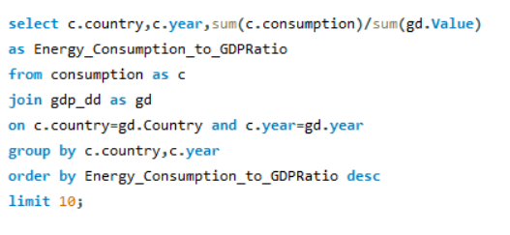
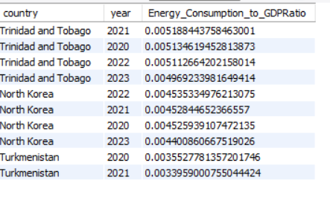
SQL query results with screenshots or summaries
13. Which countries have the highest energy consumption relative to GDP?
QUERY
OUTPUT

Slide 20
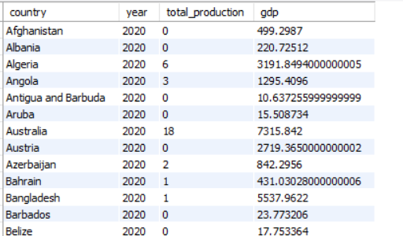
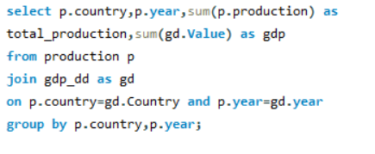
SQL query results with screenshots or summaries
14. What is the correlation between GDP growth and energy production growth?
QUERY
OUTPUT

Slide 21
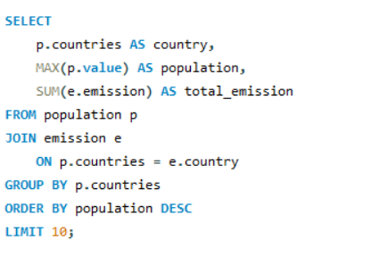
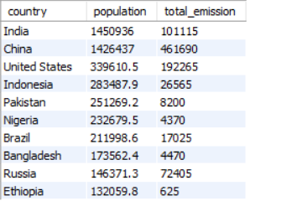
SQL query results with screenshots or summaries
15. What are the top 10 countries by population and how do their emissions compare?
QUERY
OUTPUT

Slide 22
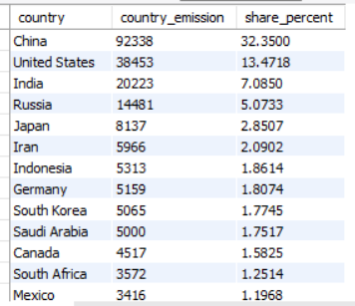
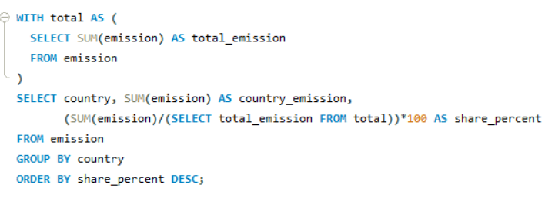
SQL query results with screenshots or summaries
16. What is the global share (%) of emissions by country?
QUERY
OUTPUT

Slide 23
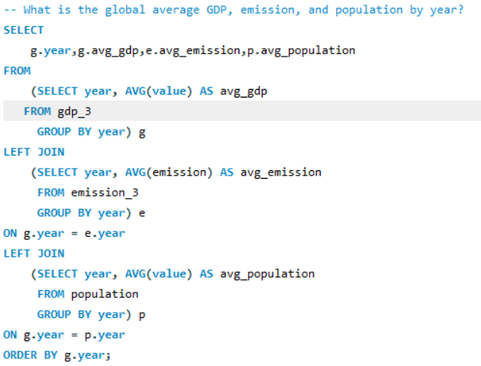
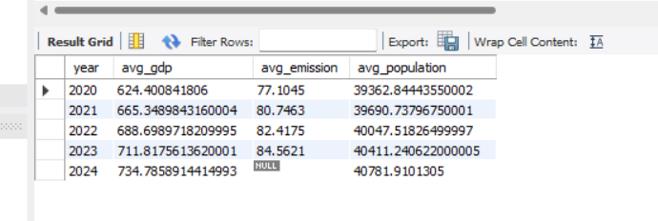
SQL query results with screenshots or summaries
17. What is the global average GDP, emission, and population by year?
QUERY
OUTPUT

Slide 24
Final business insights and recommendations
A strong, positive correlation exists between a nation's Gross Domestic Product (GDP) and its energy consumption. This suggests that economic expansion is a primary driver of escalating energy demand and, consequently, higher carbon emissions.
The emission-to-GDP ratio is a critical metric for assessing how efficiently an economy uses energy. Countries that exhibit a lower ratio are more successful at decoupling economic growth from environmental harm, demonstrating a more sustainable development model.
Rising emission levels are directly linked to population growth. This trend highlights the urgent need for scalable, sustainable energy frameworks to accommodate the environmental pressures of an expanding global population.
Analyzing historical trends in energy production and consumption identifies clear opportunities for strategic investment in cleaner technologies. The data points towards an imperative shift to more efficient and renewable energy sources.
The world's largest energy consumers have a critical responsibility to reduce their per capita emissions. The most effective pathways to achieve this involve accelerating the adoption of renewable energy and implementing robust energy efficiency initiatives.

Slide 25
Conclusion
The analysis confirms a strong positive correlation between a nation's economic growth and its energy consumption, leading to higher emissions.
The findings highlight a critical need for countries to improve energy efficiency and accelerate the transition to cleaner, renewable energy sources to decouple growth from environmental impact.
This project demonstrates how data analytics can provide the evidence needed to craft effective policies that successfully balance economic development with environmental sustainability.
Ultimately, this study shows that leveraging energy and economic data is essential for strategic planning and building a more energy-efficient and sustainable global future.

Slide 26
Your Experience/Challenges working on SQL
Experience
Successfully applied complex SQL queries to manipulate and analyze large-scale datasets, extracting key metrics and trends.
Demonstrated the ability to perform intricate joins across multiple tables to build a comprehensive view for analysis.
Understood real-world relationships between energy consumption, emissions, GDP, and population.
Challenges
A key challenge was architecting a logical database schema to manage and join multiple tables with diverse attributes, ensuring a cohesive structure for analysis.
Ensuring data consistency and avoiding errors during SQL querying was sometimes difficult.
The most demanding phase was interpreting the analytical results, which required bridging the gap between raw data and meaningful business conclusions through critical analysis and domain knowledge.

Slide 27

THANK YOU

