Slide 1
Machine Learning Part 1
BIOF475 New Technologies in Data Science
4/20/2020

Slide 2
Outline
1. What is machine learning?
2. Choosing algorithms: task type, data flow, learning type
3. Support Vector Machine
4. Scikit-learn diagram

Slide 3
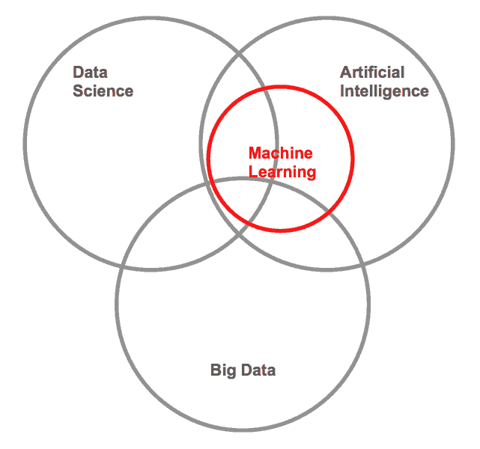
What is machine learning?
Computational field that consists of techniques allowing computers to learn from data and make data-driven predictions or decisions
Form of AI that lets us “learn” when we have lots of data to learn from
a nice visual

Slide 4



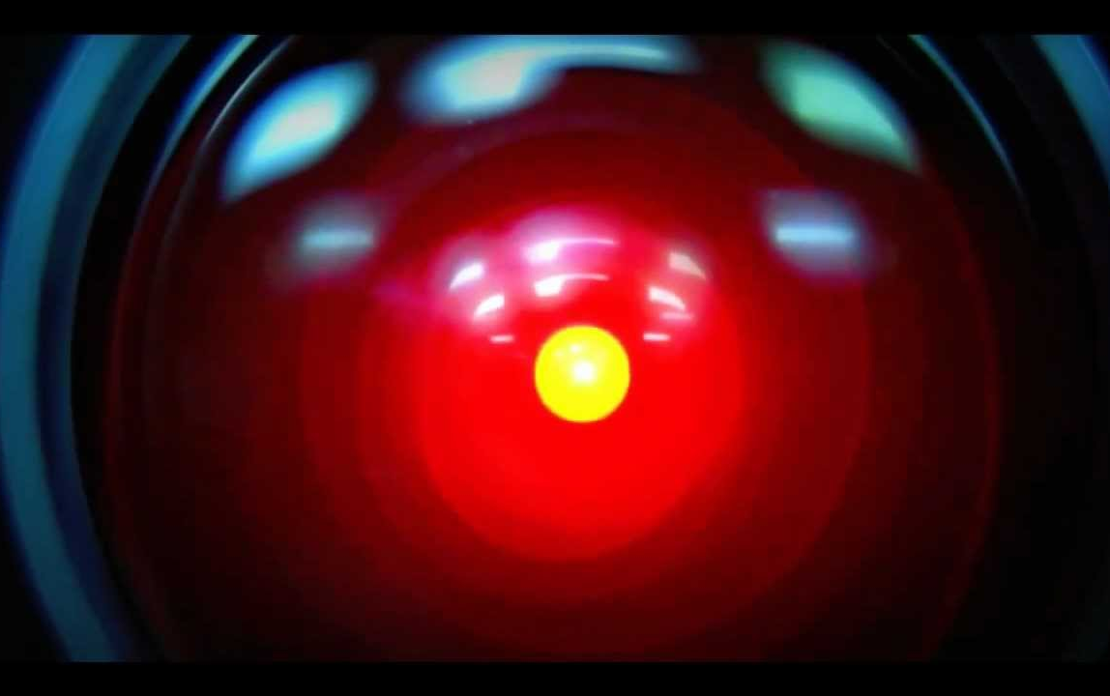

Artificial Intelligence
Intelligence demonstrated by machines
Perform human-like cognitive functions (learning, problem solving)
Correctly interpret external data, learn from data, and use learning to achieve specific goals and tasks through flexible adaptation

Slide 5
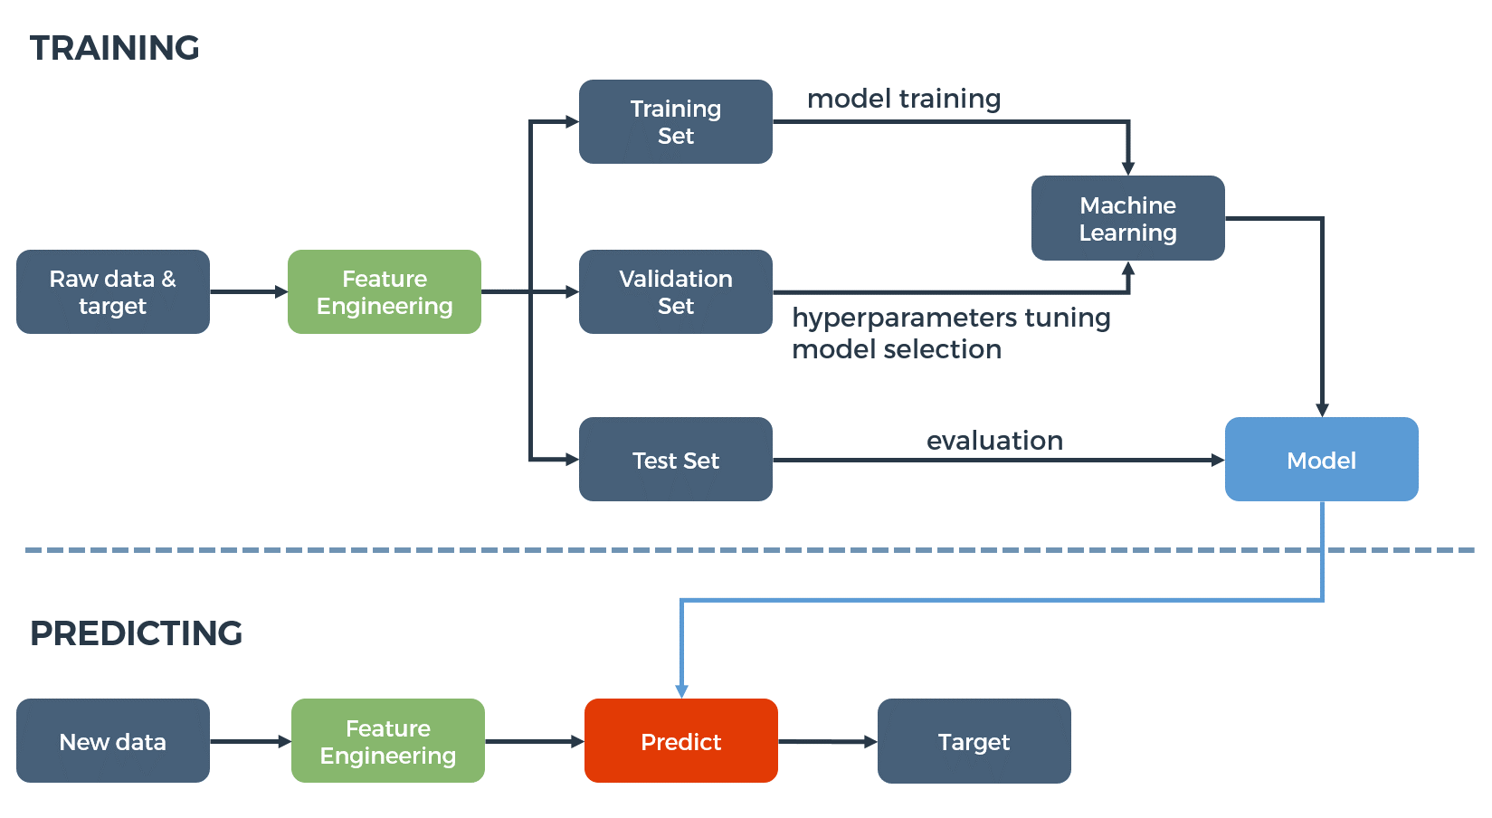
What is machine learning?
“Computational field that consists of techniques allowing computers to learn from data and make data-driven predictions or decisions”
ML algorithms: choose based on task
Improves with experience
Prepare data: normalize/standardize for effective training, evaluating, testing
Generalize (“intelligence”)
Reliable and repeatable!

Slide 6
Choosing algorithm: problem formulation
Type of task?
Batch vs. online
Supervision?

Slide 7
Type of task
Classification: algorithm assigns inputs to one of 2 (or more) classes
Regression: algorithm returns a value for each sets of inputs received
Clustering: algorithm divides the inputs into two or more subgroups
Dimensionality reduction: maps inputs on to a lower dimensional space
Density estimation: algorithm constructs an estimate for the population distribution based on a small subset of the whole

Slide 8
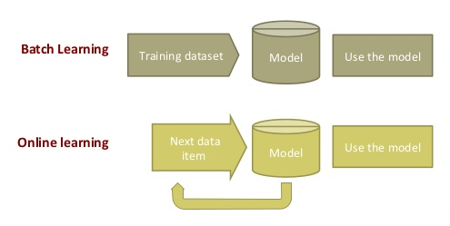
Batch vs. Online
In batch learning algorithms all the data is available and can be processed at one time
In online learning algorithms only part of the data is available for inclusion at any one time

Slide 9
Supervised vs. Unsupervised learning
In supervised learning each of the supplied inputs is labeled with the desired output
In unsupervised learning no labels are available and the algorithm must find the underlying structure in the data itself
Somewhere in the middle is semi-supervised learning in which only some of the supplied inputs also have the desired output
In reinforcement learning the algorithm must interact with an environment to perform certain actions that maximize reward

Slide 10
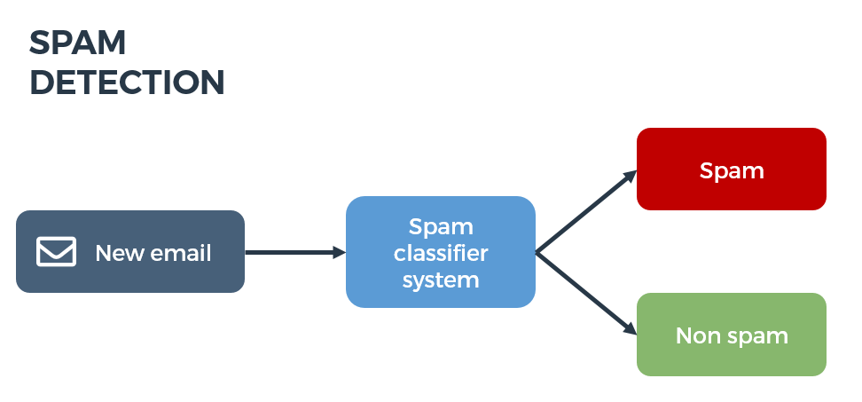
Classification
Algorithm assigns inputs to one of 2 (or more) classes
Supervised learning

Slide 11
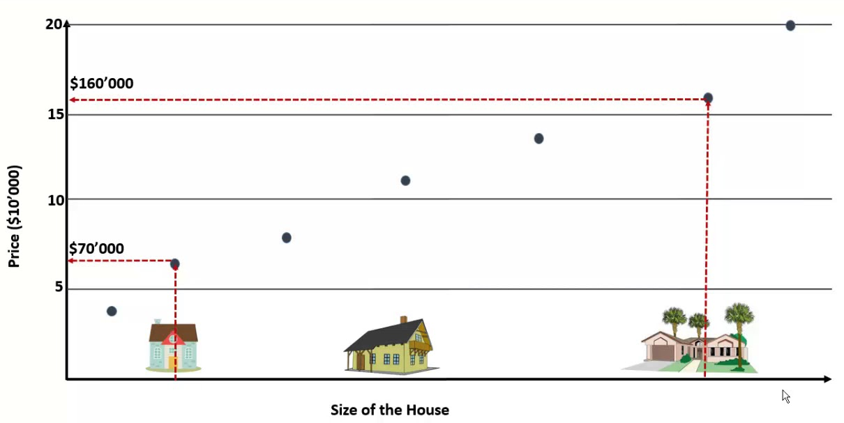
Regression
Algorithm returns a value for each sets of inputs received
Supervised learning
Predicted variable
Observed variable

Slide 12
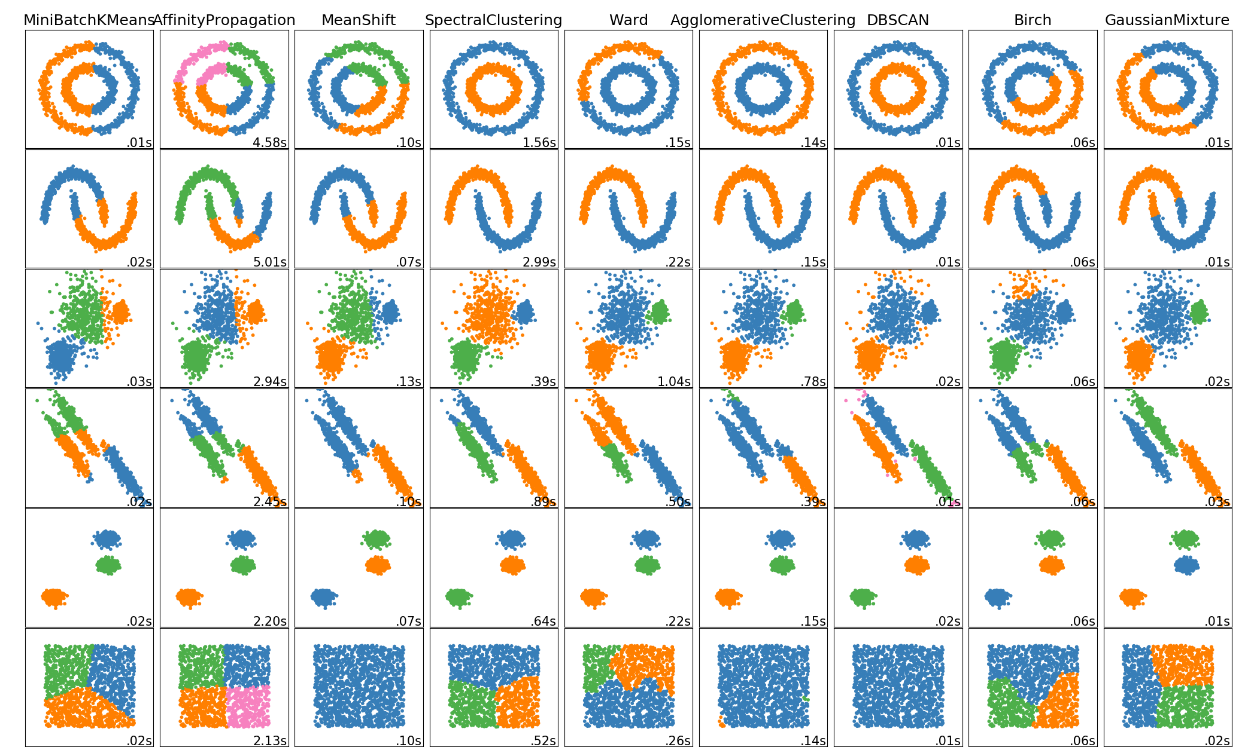
Clustering
Algorithm divides the inputs into two or more subgroups
Unsupervised learning
How to define similarity?

Slide 13
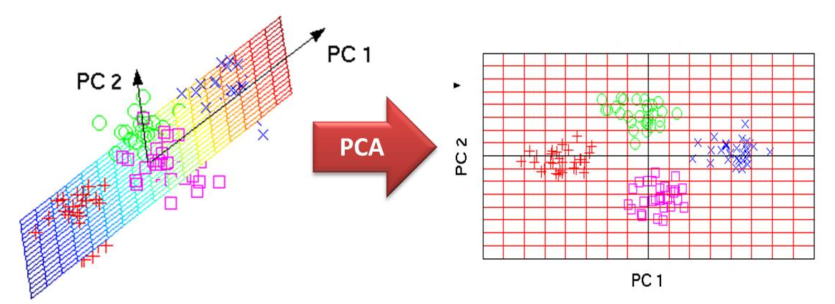
Dimensionality reduction
Maps inputs onto a lower dimensional space
Unsupervised learning
Avoid overfitting

Slide 14
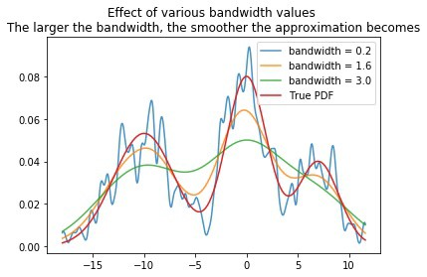
Density estimation
Algorithm constructs an estimate for the population distribution based on a small subset of the whole
Unsupervised learning

Slide 15
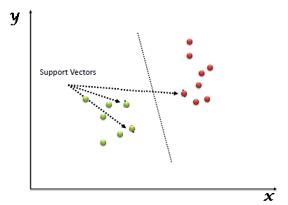
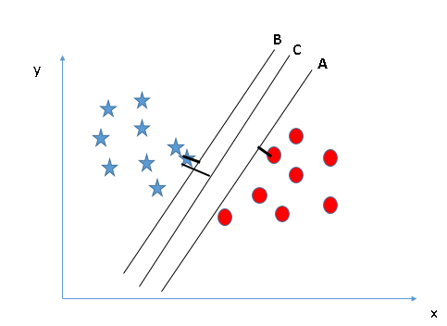
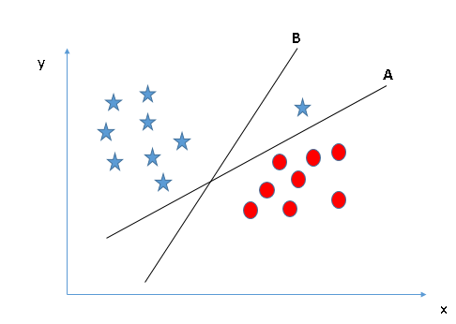
Support vector machines
Supervised learning algorithm that can be used in classification or regression problems
Plot point in n-dimensional space
Find hyperplane that differentiates data well

Slide 16
