Slide 1
Machine Learning
Overview
Support vector machines
Logistic regression
Decision trees
Neural networks
Examples

Slide 2
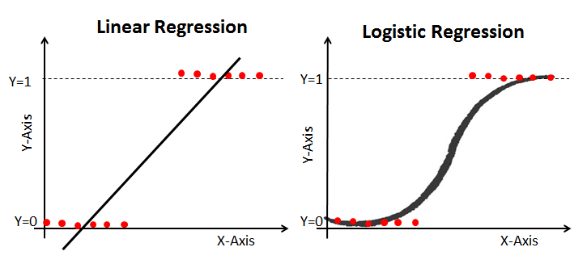
Logistic Regression
Predicts a binary outcome y (eg, diseased: yes/no)
Covariates x_{s} can be continuous or categorical

Slide 3
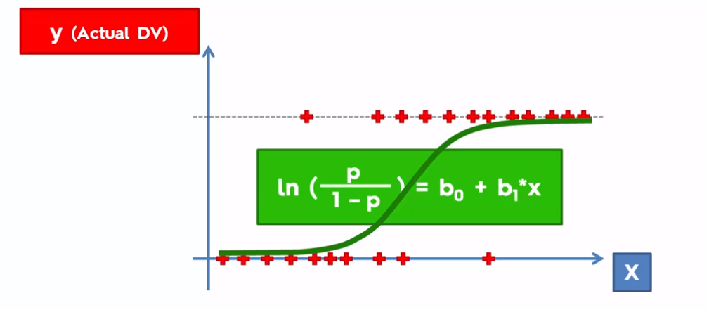
Logistic model equation

Slide 4
Decision Trees
Conceptually simple method that assigns values based on a series of splits in the data.
Can model non-linear relationships and interactions between features.

Slide 5
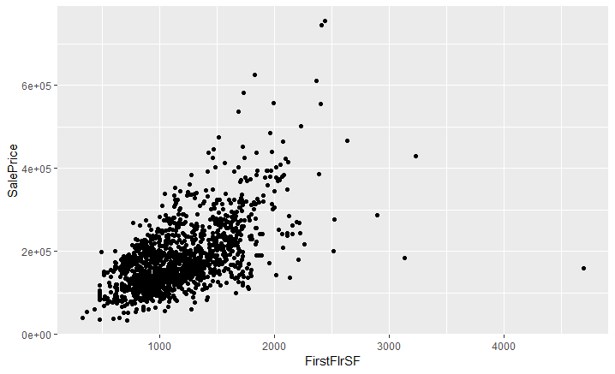
Example: housing price as a function of 1st and 2nd floor square footage

Slide 6
Thresholds of first floor square footage
1
2
3
4

Slide 7
Sample Decision Tree
1
2
3
4
X > 1500?
X < 1000?
X > 2000?
Mean Region 1
Mean Region 2
Mean Region 3
Mean Region 4

Slide 8
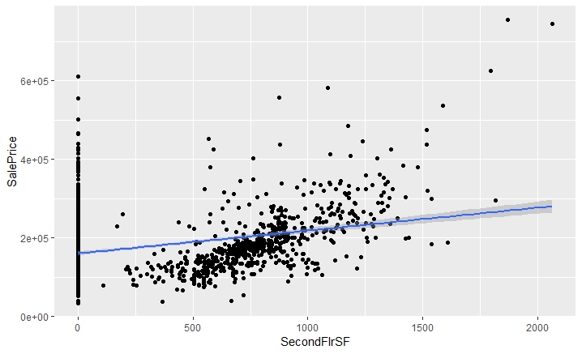
Sample Decision Tree: 2 variables
X1 > 1500?
X2 < 1000?

Slide 9
Decision Trees
Can model non-linear relationships and interactions between features.
No need for scaling
Generally interpretable
Prone to overfitting
Does not handle linear relationships well
Small changes in one variable can lead to major changes in outputs

Slide 10
Random Forest: ensemble predictions for decision trees
A collection of decision trees: each tree votes and the average is taken.
This helps reduce overfitting, but trade-off with interpretability.
Parameters: n_trees, criterion for splits, max_depth

Slide 11
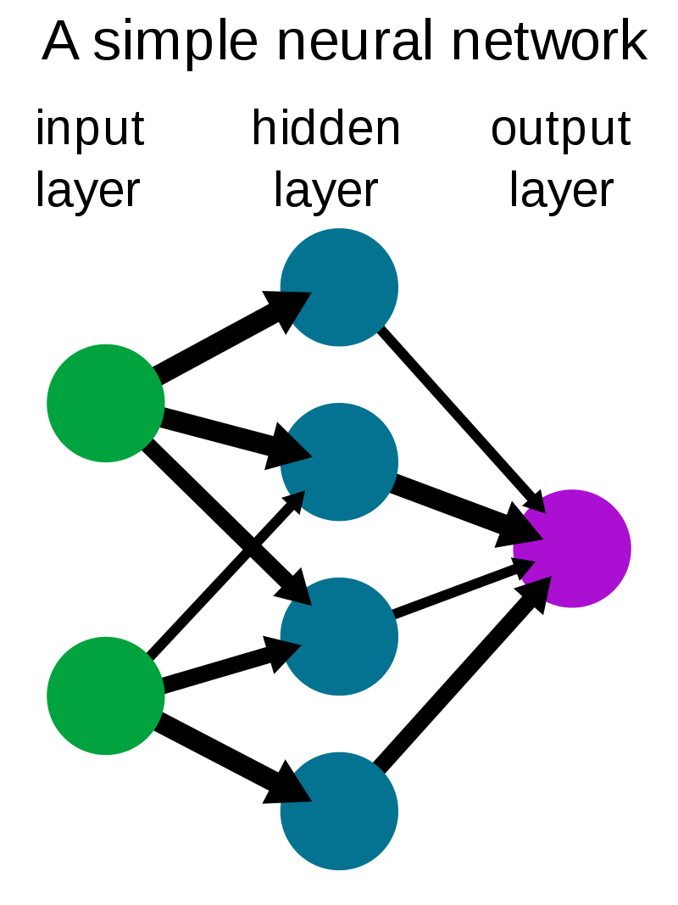
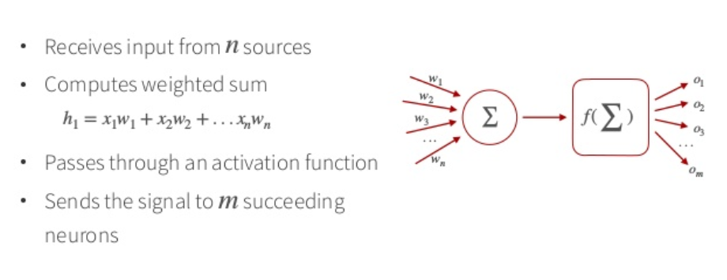
Neural networks: mathematical concepts

Slide 12
Neural Networks: Applications
Clustering and classification of vast amounts of data (eg, medical image analysis, pattern recognitions).
Real-Time Operations: self-driving cars and drone navigation.
Prognosis and Forecasts: weather, traffic, infectious diseases

Slide 13
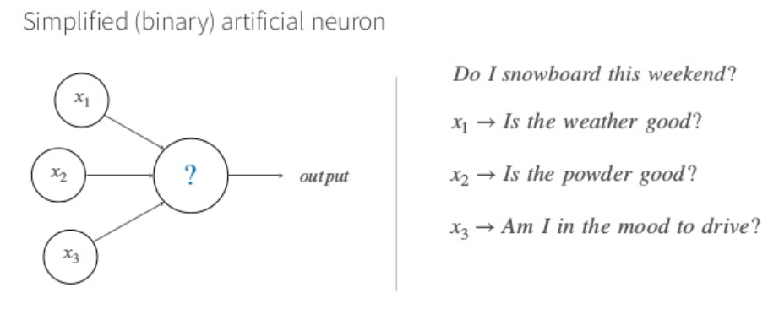
Perceptron

Slide 14
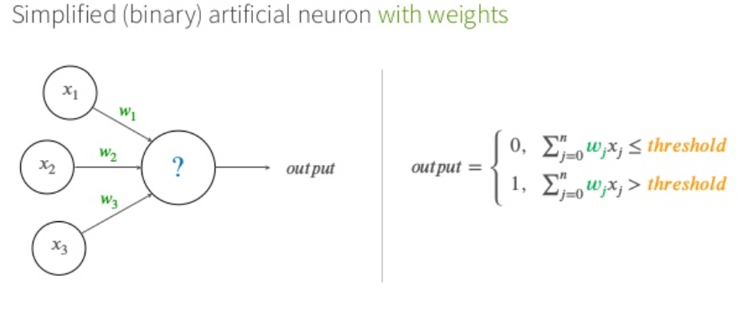
Computing inputs

Slide 15
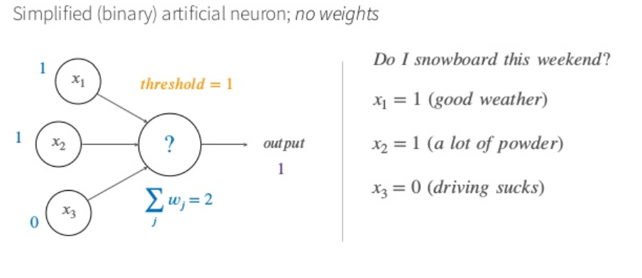
Computing inputs/output: a. no weights

Slide 16
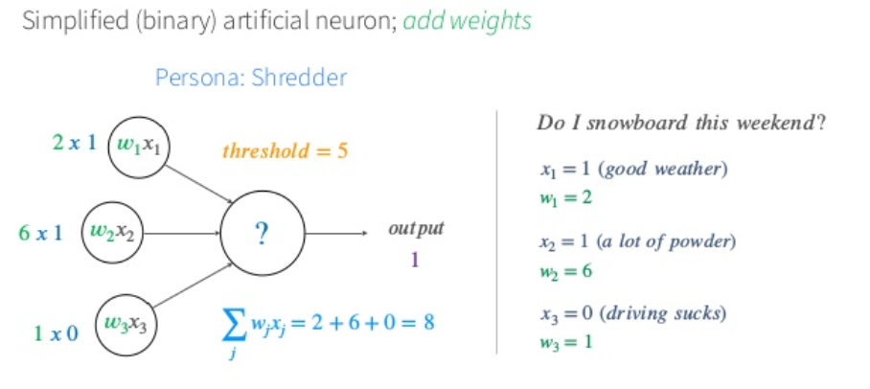
Computing inputs/output: b. w/ weights

Slide 17
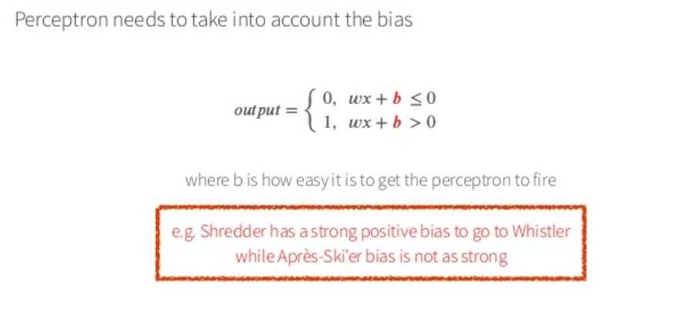
Adding bias (~intercept)

Slide 18
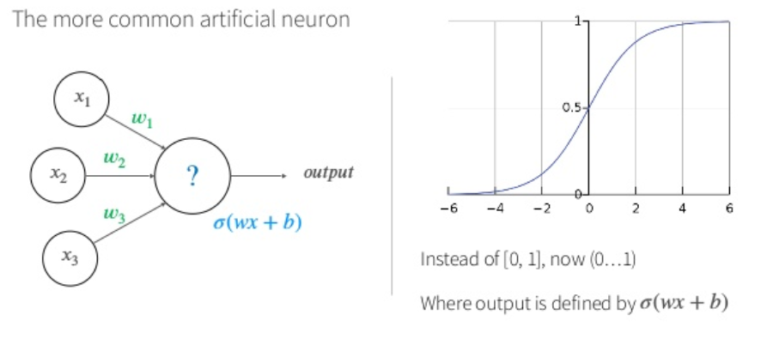
Sigmoid function

Slide 19
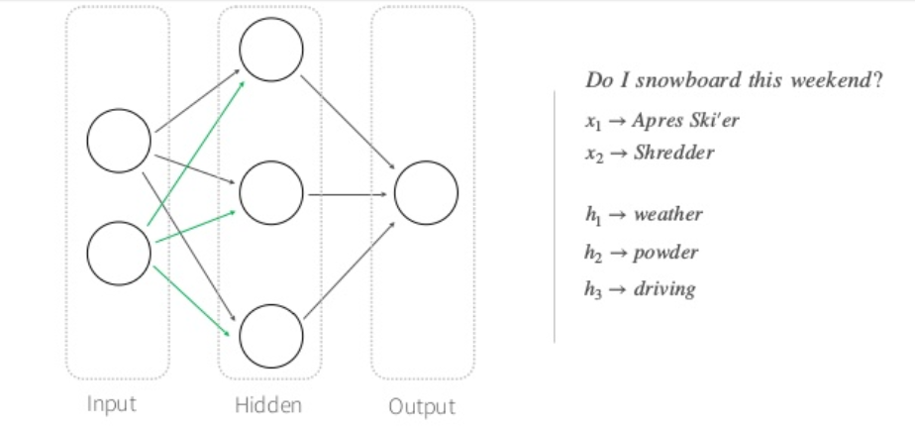
Multiple layers

Slide 20
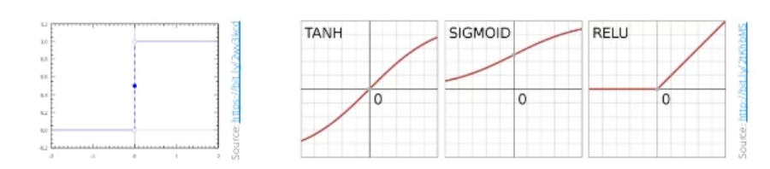
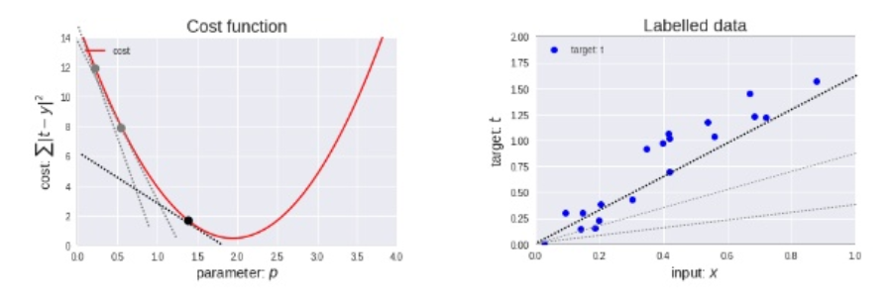
More technical details
Activation functions:
Optimization: gradient descent

Slide 21
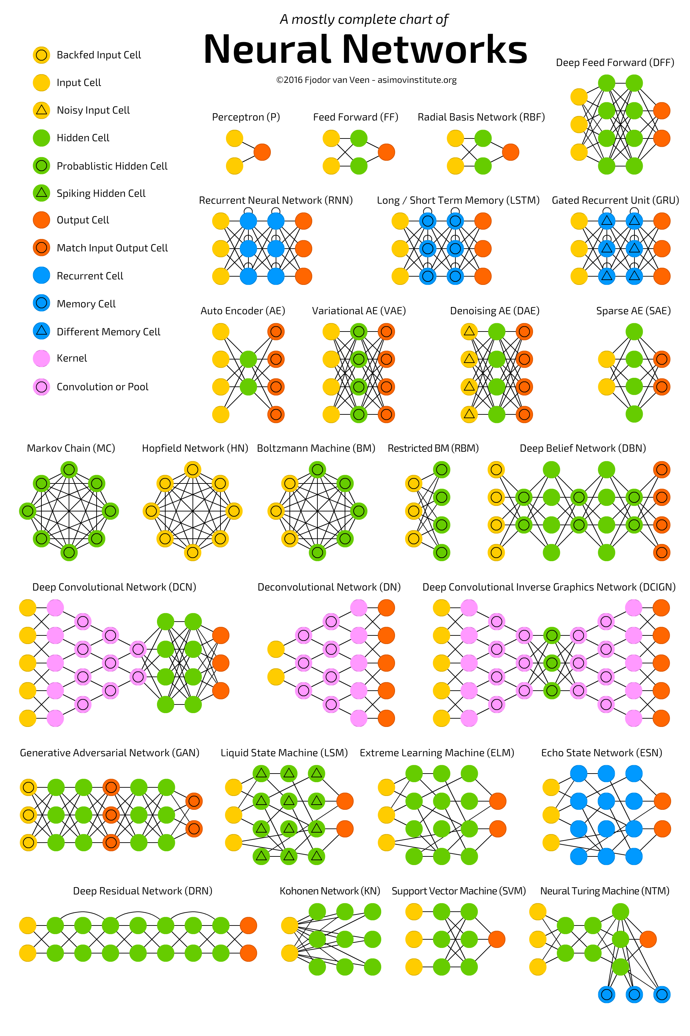
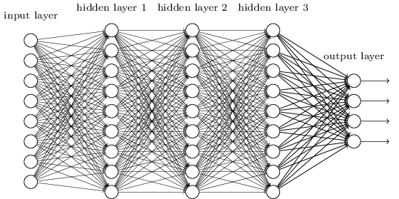
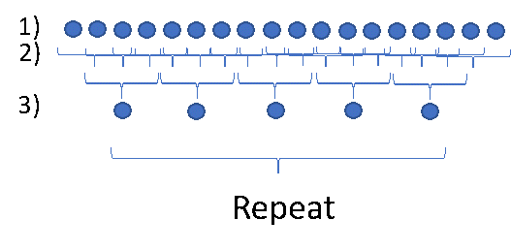

Types of neural networks
Many many!!
Feed Forward Network (FFN)
Convolutional Neural Network (images)
Recurrent Neural Network (RNN) (time series, language processing)

