Slide 1

ADVANCED C PROGRAMMING
Module 1 Part-2
Prepared by Dr. S. KANNIMUTHU, Professor, Department of CSE.
Notes:
NOTE:
To change the image on this slide, select the picture and delete it. Then click the Pictures icon in the placeholder to insert your own image.

Slide 2
Topic
Multiple indirection
Initializing pointers
Pointer comparisons
Using const in pointer declaration
Problems with pointers
Pointers and Arrays
Arrays of Pointers.

Slide 3
Common Uses of Pointers
Pointers can be used in a variety of ways. Here, we will examine different ways of using pointers, including:
Multiple levels of indirection
Constant pointers

Slide 4

Multiple indirection
A pointer to a pointer is a form of multiple indirection or a chain of pointers. Normally, a pointer contains the address of a variable.
When we define a pointer to a pointer, the first pointer contains the address of the second pointer, which points to the location that contains the actual value as shown below.

Slide 5
Multiple indirection
A variable that is a pointer to a pointer must be declared as such. This is done by placing an additional asterisk in front of its name. For example, following is the declaration to declare a pointer to a pointer of type int −
int **var;
When a target value is indirectly pointed to by a pointer to a pointer, accessing that value requires that the asterisk operator be applied twice, as is shown below in the example −

Slide 6
Multiple indirection
int main ()
{
int var;
int *ptr;
int **pptr;
var = 3000;
// take the address of var
ptr = &var;
// take the address of ptr using address of operator &
pptr = &ptr;
// take the value using pptr
printf("Value of var %u:“,var);
printf("Value available at *ptr : “,*ptr);
printf("Value available at **pptr : “,**pptr);
return 0;
}
Value of var :3000
Value available at *ptr :3000
Value available at **pptr :3000

Slide 7
Multiple indirection
Pointers can use different levels of indirection.
It is not uncommon to see a variable declared as a pointer to a pointer, sometimes called a double pointer.
A good example of this is when program arguments are passed to the main function using the traditionally named argc and argv parameters.
The example below uses three arrays. The first array is an array of strings used to hold a list of book titles:
char *titles[] = {"A Tale of Two Cities", "Wuthering Heights","Don Quixote", "Odyssey","Moby-Dick","Hamlet","Gulliver's Travels"};

Slide 8
Multiple indirection
Two additional arrays are provided whose purpose is to maintain a list of the “best books” and English books.
Instead of holding copies of the titles, they will hold the address of a title in the titles array.
Both arrays will need to be declared as a pointer to a pointer to a char.
The array’s elements will hold the addresses of the titles array’s elements.
This will avoid having to duplicate memory for each title and results in a single location for titles. If a title needs to be changed, then the change will only have to be performed in one location.

Slide 9
Multiple indirection
The two arrays are declared below. Each array element contains a pointer that points to a second pointer to char:
char **bestBooks[3];
char **englishBooks[4];
The two arrays are initialized and one of their elements is displayed, as shown here.
In the assignment statements, the value of the right hand side is calculated by applying the subscripts first, followed by the address-of operator.
For example, the second statement assigns the address of the fourth element of titles to the second element of bestBooks:
bestBooks[0] = &titles[0];
bestBooks[1] = &titles[3];
bestBooks[2] = &titles[5];
englishBooks[0] = &titles[0];
englishBooks[1] = &titles[1];
englishBooks[2] = &titles[5];
englishBooks[3] = &titles[6];
printf("%s\n",*englishBooks[1]); // Wuthering Heights

Slide 10
Multiple indirection (Pointers to Pointers)

Slide 11
Multiple indirection (Pointers to Pointers)
Using multiple levels of indirection provides additional flexibility in how code can be written and used. Certain types of operations would otherwise be more difficult.
In this example, if the address of a title changes, it will only require modification to the title array.
We would not have to modify the other arrays. There is not an inherent limit on the number of levels of indirection possible.
Of course, using too many levels of indirection can be confusing and hard to maintain.

Slide 12
Initializing pointers
The initializer is an = (equal sign) followed by the expression that represents the address that the pointer is to contain.
The following example defines the variables time and speed as having type double and amount as having type pointer to a double.
The pointer amount is initialized to point to total:
double time, speed, *amount = &total;

Slide 13
Initializing pointers : Example
The compiler converts an unsubscripted array name to a pointer to the first element in the array.
You can assign the address of the first element of an array to a pointer by specifying the name of the array.
The following two sets of definitions are equivalent.
Both define the pointer student and initialize student to the address of the first element in section:
int section[80];
int *student = section;
int section[80];
int *student = &section[0];

Slide 14
Initializing pointers: Example
You can assign the address of the first character in a string constant to a pointer by specifying the string constant in the initializer.
The following example defines the pointer variable string and the string constant "abcd".
The pointer string is initialized to point to the character a in the string "abcd".
char *string = "abcd";

Slide 15
Initializing pointers: Example
The following example defines weekdays as an array of pointers to string constants.
Each element points to a different string. The pointer weekdays[2], for example, points to the string "Tuesday".
static char *weekdays[ ] ={Sunday", "Monday", "Tuesday", "Wednesday","Thursday", "Friday", "Saturday"};

Slide 16
Initializing pointers: Example
A pointer can also be initialized to null with any integer constant expression that evaluates to 0, (C++11) or with the nullptr keyword (C++11). Such a pointer is a null pointer and it does not point to any object.
The following examples define pointers with null pointer values:
char *a = 0;
char *b = NULL;
char *ch = nullptr;

Slide 17
Pointer comparisons
Pointers can be compared using the standard comparison operators.
Normally, comparing pointers is not very useful.
However, when comparing pointers to elements of an array, the comparison’s results can be used to determine the relative ordering of the array’s elements.
Several comparison operators are applied to the pointers, and their results are displayed as 1 for true and 0 for false:
int vector[] = {28, 41, 7};
int *p0 = vector;
int *p1 = vector+1;
int *p2 = vector+2;
printf("p2>p0: %d\n",p2>p0); // p2>p0: 1
printf("p2<p0: %d\n",p2<p0); // p2<p0: 0
printf("p0>p1: %d\n",p0>p1); // p0>p1: 0

Slide 18
Using const in pointer declaration
Using the const keyword with pointers is a rich and powerful aspect of C.
It provides different types of protections for different problem sets.
Of particular power and usefulness is a pointer to a constant.

Slide 19
Pointers to a constant
A pointer can be defined to point to a constant.
This means the pointer cannot be used to modify the value it is referencing.
In the following example, an integer and an integer constant are declared.
Next, a pointer to an integer and a pointer to an integer constant are declared and then initialized to the respective integers:
int num = 5;
const int limit = 500;
int *pi; // Pointer to an integer
const int *pci; // Pointer to a constant integer
pi = &num;
pci = &limit;

Slide 20
Pointers to a constant
The following sequence will display the address and value of these variables:
printf(" num - Address: %p value: %d\n",&num, num);
printf("limit - Address: %p value: %d\n",&limit, limit);
printf(" pi - Address: %p value: %p\n",&pi, pi);
printf(" pci - Address: %p value: %p\n",&pci, pci);
When executed, this sequence will produce values similar to the following:
num - Address: 100 value: 5
limit - Address: 104 value: 500
pi - Address: 108 value: 100
pci - Address: 112 value: 104

Slide 21
Pointers to a constant
Dereferencing a constant pointer is fine if we are simply reading the integer’s value.
Reading is a perfectly legitimate and necessary capability, as shown below:
printf("%d\n", *pci);

Slide 22
Pointers to a constant
We cannot dereference a constant pointer to change what the pointer references, but we can change the pointer.
The pointer value is not constant. The pointer can be changed to reference another constant integer or a simple integer. Doing so will not be a problem.
The declaration simply limits our ability to modify the referenced variable through the
pointer.
This means the following assignment is legal:
pci = &num;

Slide 23
Pointers to a constant
We can dereference pci to read it; however, we cannot dereference it to modify it.
Consider the following assignment:
*pci = 200;
This will result in the following syntax error:
'pci' : you cannot assign to a variable that is const
The pointer thinks it is pointing to a constant integer; therefore, it does allow the modification of the integer using the pointer.
We can still modify num using its name. We just can’t use pci to modify it.

Slide 24
Pointers to a constant
Conceptually, a constant pointer can also be visualized as shown in the Following figure.
The clear boxes represent variables that can be changed. The shaded boxes represent variables that cannot be changed.
The shaded box pointed to by pci cannot be changed using pci.
The dashed line indicates that the pointer can reference that data type.
In the previous example, pci pointed to limit.
Pointer to a constant

Slide 25
Pointer to a constant
The declaration of pci as a pointer to a constant integer means:
pci can be assigned to point to different constant integers
pci can be assigned to point to different nonconstant integers
pci can be dereferenced for reading purposes
pci cannot be dereferenced to change what it points to
Note: The order of the type and the const keyword is not important. The following are equivalent:
const int *pci;
int const *pci;

Slide 26
Constant pointers to nonconstants
We can also declare a constant pointer to a nonconstant. When we do this, it means that while the pointer cannot be changed, the data pointed to can be modified.
An example of such a pointer follows:
int num;
int *const cpi = &num;
With this declaration:
cpi must be initialized to a nonconstant variable
cpi cannot be modified
The data pointed to by cpi can be modified
Conceptually, this type of pointer can be visualized as shown figure
Constant pointers to nonconstants

Slide 27
Constant pointers to nonconstants
It is possible to dereference cpi and assign a new value to whatever cpi is referencing.
The following are two valid assignments:
*cpi = limit;
*cpi = 25;
However, if we attempt to initialize cpi to the constant limit as shown below, we will get a warning:
const int limit = 500;
int *const cpi = &limit;
The warning will appear as follows:
warning: initialization discards qualifiers from pointer target type
If cpi referenced the constant limit, the constant could be modified. This is not desirable. We generally prefer constants to remain constant.

Slide 28
Constant pointers to nonconstants
Once an address has been assigned to cpi, we cannot assign a new value to cpi as shown below:
int num;
int age;
int *const cpi = &num;
cpi = &age;
The error message generated is shown below:
'cpi' : you cannot assign to a variable that is const

Slide 29
Constant pointers to constants
A constant pointer to a constant is an infrequently used pointer type. The pointer cannot be changed, and the data it points to cannot be changed through the pointer.
An example of a constant pointer to a constant integer follows:
const int * const cpci = &limit;
A constant pointer to a constant can be visualized as shown in Figure
Constant pointers to constants

Slide 30
Constant pointers to constants
As with pointers to constants, it is not necessary to assign the address of a constant to
cpci. Instead, we could have used num as shown below:
int num;
const int * const cpci = &num;
When the pointer is declared, we must initialize it. If we do not initialize it as shown below, we will get a syntax error:
const int * const cpci;
The syntax error will be similar to the following:
'cpci' : const object must be initialized if not extern

Slide 31
Constant pointers to constants
Given a constant pointer to a constant we cannot:
Modify the pointer
Modify the data pointed to by the pointer
Trying to assign a new address to cpci will result in a syntax error:
cpci = &num;
The syntax error follows:
'cpci' : you cannot assign to a variable that is const

Slide 32
Constant pointers to constants
If we try to dereference the pointer and assign a value as shown below, we will also get a syntax error:
*cpci = 25;
The error generated will be similar to the following:
'cpci' : you cannot assign to a variable that is const
expression must be a modifiable lvalue
Constant pointers to constants are rare.

Slide 33
Pointer to (constant pointer to constant)
Pointers to constants can also have multiple levels of indirection. In the following example, we declare a pointer to the cpci pointer explained in the previous section. Reading complex declarations from right to left helps clarify these types of declarations:
const int * const cpci = &limit;
const int * const * pcpci;
A pointer to a constant pointer to a constant can be visualized as shown in Figure
Pointer to (constant pointer to constant)

Slide 34
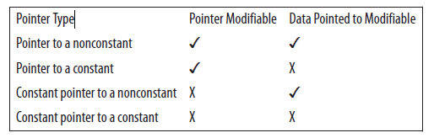
Pointer to (constant pointer to constant)
The following illustrates their use. The output of this sequence should display 500 twice:
printf("%d\n",*cpci);
pcpci = &cpci;
printf("%d\n",**pcpci);
The following table summarizes the first four types of pointers discussed in the previous sections:

Slide 35
Problems with pointers
Since pointers has many features but there are some disadvantages of pointers
Failed to protect memory addresses (locations) - Since pointer can access direct memory so memory cannot be protected.
Uninitialized pointers can cause of segmentation fault.
Pointers variables are slower than normal variables.
Pointers always required Free Memory for Dynamically Allocated Memory.

Slide 36
Problems with pointers
Since pointers has many features but there are some disadvantages of pointers
Failed to protect memory addresses (locations) - Since pointer can access direct memory so memory cannot be protected.
Uninitialized pointers can cause of segmentation fault.
Pointers variables are slower than normal variables.
Pointers always required Free Memory for Dynamically Allocated Memory.

Slide 37
Problems with pointers (Undefined Behaviour)
Undefined behaviour can be a common mistake for pogrammers when working with pointers.
Imagine we have two pointers pointing to the same memory address, and we release the shared memory using one of them. What happens to the other one? It will be pointing to an address that was released and can be allocated again if we use malloc.
pointer1 = (int*) malloc(sizeof(int));
*pointer1 = 5;
pointer2 = pointer1;
free(pointer1);
//Don't access pointer1 or pointer1 from here unless you assign them new values.

Slide 38
Problems with pointers (Undefined Behaviour)
If we try to use the other pointer after that, eventually we are going to have a problem.
The solution to avoid this is very easy.
Before freeing the memory allocated to a pointer, we can assign null to the other (s).
Then, before we try to use the pointer, we always check if the pointer is not null.

Slide 39
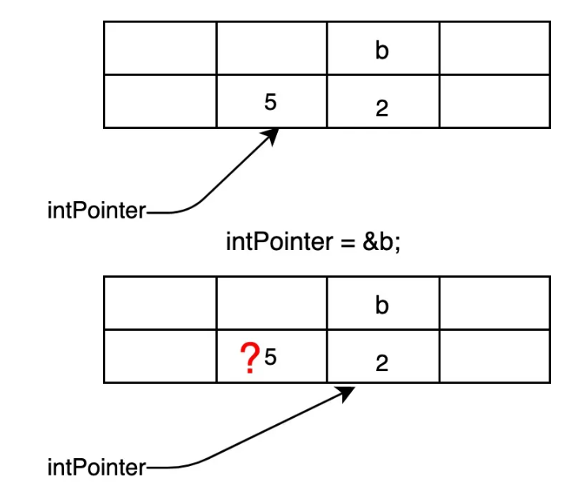
Problems with pointers (Garbage)
Garbage is another common problem a worst than the first one.
It is the one that can cause (the infamous) memory leaks.
It happens when we only have one pointer pointing to a memory address.
If we assign a new value to the pointer without releasing that memory, we will have data in memory that is inaccessible.

Slide 40
Problems with pointers (Garbage)
How to avoid this issue?
Make sure to know how many pointers you have pointing to each memory address.
When you assign a new value to a pointer, release the memory if there is only one pointer with a reference to that memory address.
If you release the data in that specific memory address, and there is another pointer pointing to it, then you will have the first problem, a null reference.

Slide 41
Pointers and Arrays
Pointers can be very useful when working with arrays.
We can use them with existing arrays or to allocate memory from the heap and then treat the memory as if it were an array.
Array notation and pointer notation can be used somewhat interchangeably.

Slide 42
Pointer Notation and Arrays
When an array name is used by itself, the array’s address is returned. We can assign this address to a pointer as illustrated below:
int vector[5] = {1, 2, 3, 4, 5};
int *pv = vector;
The variable pv is a pointer to the first element of the array and not the array itself.
When we first assigned a value to pv, we assigned the address of the array’s first element.

Slide 43
Pointer Notation and Arrays
We can use either the array name by itself or use the address-of operator with the array’s first element as illustrated below. These are equivalent and will return the address of vector.
Using the address-of operator is more verbose but also more explicit:
printf("%p\n",vector);
printf("%p\n",&vector[0]);
The expression &vector is sometimes used to obtain the address of an array. It differs from the other notations in that it returns a pointer to the entire array.
The other two approaches yield a pointer to an integer. Instead of returning a pointer to an integer, it returns a pointer to an array of integers.

Slide 44
Pointer Notation and Arrays
We can also use array subscripts with pointers. Effectively, the notation pv[i] is evaluated as:
*(pv + i)
The pointer pv contains the address of a block of memory.
The bracket notation will take the address contained in pv and adds the value contained in the index i using pointer arithmetic.
This new address is then dereferenced to return its contents.

Slide 45
Pointer Notation and Arrays
Adding an integer to a pointer will increment the address it holds by the product of the integer and the data type’s size. The same is true if we add an integer to the name of an array.
The following two statements are equivalent:
*(pv + i)
*(vector + i)
Assume the vector is located at address 100 and pv is located at address 96.

Slide 46
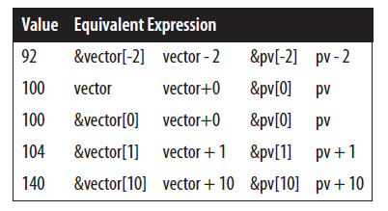
Pointer Notation and Arrays
The following Table and Figure illustrate the use of array subscripts and pointer arithmetic with both the array name and the pointer for various values.
Array/pointer notation
Array/pointer notation

Slide 47
Pointer Notation and Arrays
When we add 1 to the array address we effectively add 4, the size of an integer, to the address since this is an array of integers.
With the first and last operations, we addressed locations outside the array’s bounds.
While this is not a good practice, it does emphasize the need to be careful when using indexes or pointers to access elements of an array.
Array notation can be thought of as a “shift and dereference” operation.
The expression vector[2] means start with vector, which is a pointer to the beginning of the array, shift two positions to the right, and then dereference that location to fetch its value.
Using the address-of operator in conjunction with array notation, as in &vector[2], essentially cancels out the dereferencing. It can be interpreted as go left two positions and then return that address.

Slide 48
Pointer Notation and Arrays
The following demonstrates the use of pointers in the implementation of the scalar addition operation.
This operation takes a value and multiplies it against each element of the vector:
pv = vector;
int value = 3;
for(int i=0; i<5; i++) {
*pv++ *= value;
}

Slide 49
Differences Between Arrays and Pointers
There are several differences between the use of arrays and the use of pointers to arrays.
In this section, we will use the vector array and pv pointer as defined below:
int vector[5] = {1, 2, 3, 4, 5};
int *pv = vector;
The code generated by vector[i] is different from the code generated by vector+i.
The notation vector[i] generates machine code that starts at location vector, moves i positions from this location, and uses its content.
The notation vector+i generates machine code that starts at location vector, adds i to the address, and then uses the contents at that address.
While the result is the same, the generated machine code is different. This difference is rarely of significance to most programmers.

Slide 50
Differences Between Arrays and Pointers
There is a difference when the sizeof operator is applied to an array and to a pointer to the same array. Applying the sizeof operator to vector will return 20, the number of bytes allocated to the array. Applying the sizeof operator against pv will return 4,the pointer’s size.
The pointer pv is an lvalue. An lvalue denotes the term used on the lefthand side of an assignment operator. An lvalue must be capable of being modified. An array name such as vector is not an lvalue and cannot be modified. The address assigned to an array cannot be changed . A pointer can be assigned a new value and reference a different section of memory.
Consider the following:
pv = pv + 1;
vector = vector + 1; // Syntax error
We cannot modify vector, only its contents. However, the expression vector+1 is fine, as demonstrated below:
pv = vector + 1;

Slide 51
Arrays of Pointers
In C, a pointer array is a homogeneous collection of indexed pointer variables that are references to a memory location.
It is generally used in C Programming when we want to point at multiple memory locations of a similar data type in our C program.
We can access the data by dereferencing the pointer pointing to it.
Syntax:
pointer_type *array_name [array_size];
Here,
pointer_type: Type of data the pointer is pointing to.
array_name: Name of the array of pointers.
array_size: Size of the array of pointers.

Slide 52
Arrays of Pointers: Example
// C program to demonstrate the use of array of pointers
#include <stdio.h>
int main()
{
// declaring some temp variables
int var1 = 10;
int var2 = 20;
int var3 = 30;
// array of pointers to integers
int* ptr_arr[3] = { &var1, &var2, &var3 };
// traversing using loop
for (int i = 0; i < 3; i++) {
printf("Value of var%d: %d\tAddress: %p\n", i + 1, *ptr_arr[i], ptr_arr[i]);
}
return 0;
}
Output
Value of var1: 10 Address: 0x7fff1ac82484
Value of var2: 20 Address: 0x7fff1ac82488
Value of var3: 30 Address: 0x7fff1ac8248c

Slide 53
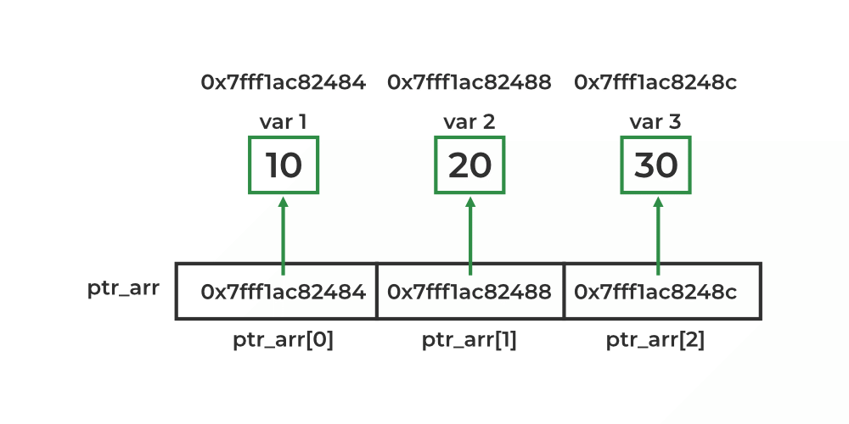
Arrays of Pointers: Example

Slide 54
Array of Pointers to Character
One of the main applications of the array of pointers is to store multiple strings as an array of pointers to characters.
Here, each pointer in the array is a character pointer that points to the first character of the string.
Syntax:
char *array_name [array_size];
After that, we can assign a string of any length to these pointers.

Slide 55
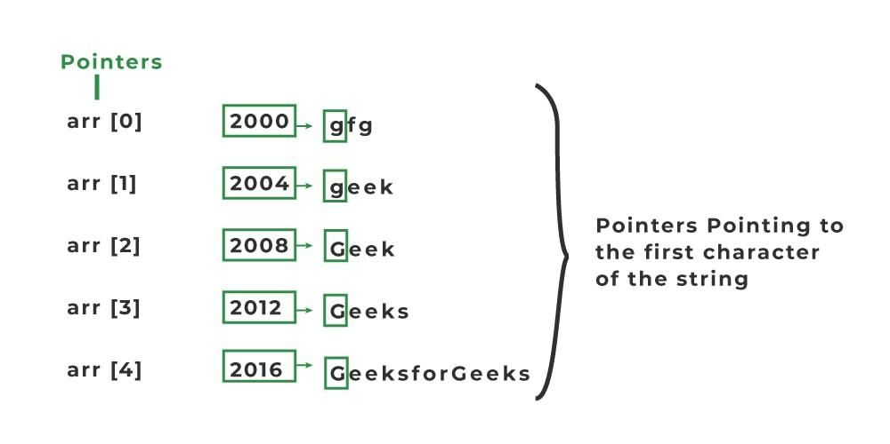
Array of Pointers to Character: Example
char* arr[5]= { "gfg", "geek", "Geek", "Geeks", "GeeksforGeeks" }

Slide 56
Array of Pointers to Character Vs Traditional Array
// C Program to print Array of strings without array of pointers
#include <stdio.h>
int main()
{
char str[3][10] = { "Geek", "Geeks", "Geekfor" };
printf("String array Elements are:\n");
for (int i = 0; i < 3; i++) {
printf("%s\n", str[i]);
}
return 0;
}
// C program to illustrate the use of array of pointers to characters
#include <stdio.h>
int main()
{
char* arr[3] = { "geek", "Geeks", "Geeksfor" };
for (int i = 0; i < 3; i++) {
printf("%s\n", arr[i]);
}
return 0;
}

Slide 57
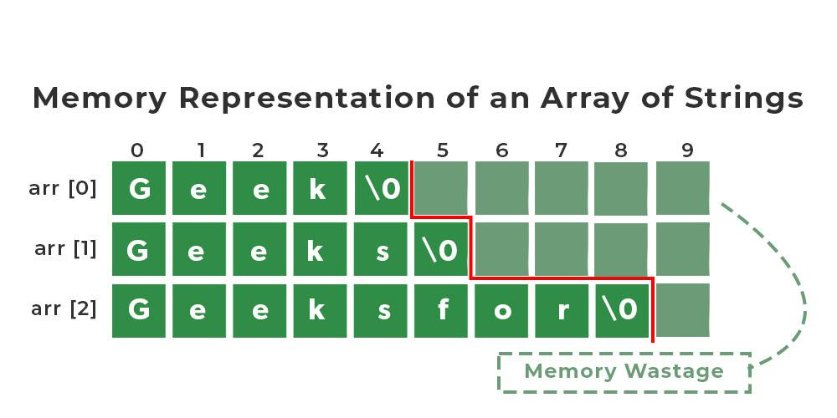
Memory Representation

Slide 58
Application of Array of Pointers
An array of pointers is useful in a wide range of cases. Some of these applications are listed below:
It is most commonly used to store multiple strings.
It is also used to implement LinkedHashMap in C and also in the Chaining technique of collision resolving in Hashing.
It is used in sorting algorithms like bucket sort.
It can be used with any pointer type so it is useful when we have separate declarations of multiple entities and we want to store them in a single place.

Slide 59
Disadvantages of Array of Pointers
The array of pointers also has its fair share of disadvantages and should be used when the advantages outweigh the disadvantages. Some of the disadvantages of the array of pointers are:
Higher Memory Consumption: An array of pointers requires more memory as compared to plain arrays because of the additional space required to store pointers.
Complexity: An array of pointers might be complex to use as compared to a simple array.
Prone to Bugs: As we use pointers, all the bugs associated with pointers come with it so we need to handle them carefully.

