Slide 1

ADVANCED C PROGRAMMING
Module 2 Part-1
Prepared by Dr. S. KANNIMUTHU, Professor, Department of CSE.
Notes:
NOTE:
To change the image on this slide, select the picture and delete it. Then click the Pictures icon in the placeholder to insert your own image.

Slide 2
Topics
Pointer to an array
Variable length array (VLA)
Introduction to Strings
String handling functions
Arrays and strings
Functions and strings
Pointers and strings
Static and dynamic memory allocation

Slide 3
Pointer to an array
#include<stdio.h>
int main()
{
int arr[5] = { 1, 2, 3, 4, 5 };
int *ptr = arr;
printf("%p\n", ptr);
return 0;
}
In this program, we have a pointer ptr that points to the 0th element of the array.

Slide 4
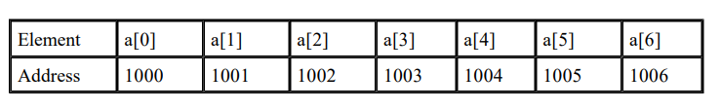
Generating a Pointer to an Array
You can generate a pointer to the first element of an array by simply specifying the array name, without any index. For example, given
int a[7];
A seven-element character array beginning at location 1000
You can generate a pointer to the first element by using the name ‘a’. Thus, the following program fragment assigns p the address of the first element of sample:
int *p;
int sample[7];
p = sample;

Slide 5
Generating a Pointer to an Array
You can also specify the address of the first element of an array by using the & operator. For example, sample and &a[0] both produce the same results. However, in professionally written C code, you will almost never see &a[0].

Slide 6
Pointer to an Array
Similarly, we can also declare a pointer that can point to whole array instead of only one element of the array. This pointer is useful when talking about multidimensional arrays.
data_type (*var_name)[size_of_array];
Example:
int (*ptr)[10];
Here ptr is pointer that can point to an array of 10 integers.
Since subscript have higher precedence than indirection, it is necessary to enclose the indirection operator and pointer name inside parentheses.
Here the type of ptr is ‘pointer to an array of 10 integers’.

Slide 7
Pointer to an Array: An Example
#include<stdio.h>
int main()
{
// Pointer to an integer
int *p;
// Pointer to an array of 5 integers
int (*ptr)[5];
int arr[5];
// Points to 0th element of the arr.
p = arr;
// Points to the whole array arr.
ptr = &arr;
printf("p = %p, ptr = %p\n", p, ptr);
p++;
ptr++;
printf("p = %p, ptr = %p\n", p, ptr);
return 0;
}

Slide 8
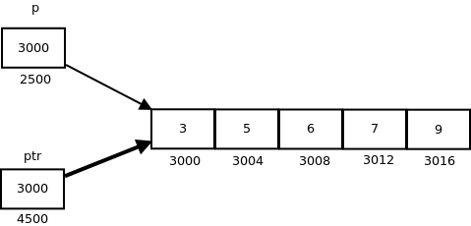
Pointer to an Array: An Example
#include<stdio.h>
int main()
{
// Pointer to an integer
int *p;
// Pointer to an array of 5 integers
int (*ptr)[5];
int arr[5];
// Points to 0th element of the arr.
p = arr;
// Points to the whole array arr.
ptr = &arr;
printf("p = %p, ptr = %p\n", p, ptr);
p++;
ptr++;
printf("p = %p, ptr = %p\n", p, ptr);
return 0;
}
p: is pointer to 0th element of the array arr, while ptr is a pointer that points to the whole array arr.
The base type of p is int while base type of ptr is ‘an array of 5 integers’.
We know that the pointer arithmetic is performed relative to the base size, so if we write ptr++, then the pointer ptr will be shifted forward by 20 bytes.

Slide 9
MCQ Practice

Slide 10
Q. No. 1
Consider a compiler where int takes 4 bytes, char takes 1 byte and pointer takes 4 bytes.
#include <stdio.h>
int main()
{
int arri[] = {1, 2 ,3};
int *ptri = arri;
char arrc[] = {1, 2 ,3};
char *ptrc = arrc;
printf("sizeof arri[] = %d ", sizeof(arri));
printf("sizeof ptri = %d ", sizeof(ptri));
printf("sizeof arrc[] = %d ", sizeof(arrc));
printf("sizeof ptrc = %d ", sizeof(ptrc));
return 0;
}
A. sizeof arri[] = 3 sizeof ptri = 4 sizeof arrc[] = 3 sizeof ptrc = 4
B. sizeof arri[] = 12 sizeof ptri = 4 sizeof arrc[] = 3 sizeof ptrc = 1
C. sizeof arri[] = 3 sizeof ptri = 4 sizeof arrc[] = 3 sizeof ptrc = 1
D. sizeof arri[] = 12 sizeof ptri = 4 sizeof arrc[] = 3 sizeof ptrc = 4

Slide 11
Q. No. 1
Consider a compiler where int takes 4 bytes, char takes 1 byte and pointer takes 4 bytes.
#include <stdio.h>
int main()
{
int arri[] = {1, 2 ,3};
int *ptri = arri;
char arrc[] = {1, 2 ,3};
char *ptrc = arrc;
printf("sizeof arri[] = %d ", sizeof(arri));
printf("sizeof ptri = %d ", sizeof(ptri));
printf("sizeof arrc[] = %d ", sizeof(arrc));
printf("sizeof ptrc = %d ", sizeof(ptrc));
return 0;
}
A. sizeof arri[] = 3 sizeof ptri = 4 sizeof arrc[] = 3 sizeof ptrc = 4
B. sizeof arri[] = 12 sizeof ptri = 4 sizeof arrc[] = 3 sizeof ptrc = 1
C. sizeof arri[] = 3 sizeof ptri = 4 sizeof arrc[] = 3 sizeof ptrc = 1
D. sizeof arri[] = 12 sizeof ptri = 4 sizeof arrc[] = 3 sizeof ptrc = 4

Slide 12
Q. No. 2
Predict the output.
#include<stdio.h>
int main()
{
int a;
char *x;
x = (char *) &a;
a = 512;
x[0] = 1;
x[1] = 2;
printf("%dn",a);
return 0;
}
A. Machine dependent
B. 513
C. 258
D. Compiler Error

Slide 13
Q. No. 2
Predict the output.
#include<stdio.h>
int main()
{
int a;
char *x;
x = (char *) &a;
a = 512;
x[0] = 1;
x[1] = 2;
printf("%d\n",a);
return 0;
}
A. Machine dependent
B. 513
C. 258
D. Compiler Error

Slide 14
Q. No. 3
int f(int x, int *py, int **ppz)
{
int y, z;
**ppz += 1;
z = **ppz;
*py += 2;
y = *py;
x += 3;
return x + y + z;
}
void main()
{
int c, *b, **a;
c = 4;
b = &c;
a = &b;
printf("%d ", f(c, b, a));
return 0;
}
What is the output of the program?
A.18
B.19
C.21
D.22

Slide 15
Q. No. 3
int f(int x, int *py, int **ppz)
{
int y, z;
**ppz += 1;
z = **ppz;
*py += 2;
y = *py;
x += 3;
return x + y + z;
}
void main()
{
int c, *b, **a;
c = 4;
b = &c;
a = &b;
printf("%d ", f(c, b, a));
return 0;
}
What is the output of the program?
A.18
B.19
C.21
D.22

Slide 16
Q. No. 4
#include <stdio.h>
int main()
{
int arr[] = {1, 2, 3, 4, 5};
int *p = arr;
++*p;
p += 2;
printf("%d", *p);
return 0;
}
What is the output of the program?
A.2
B.3
C.4
D. Compiler Error

Slide 17
Q. No. 4
#include <stdio.h>
int main()
{
int arr[] = {1, 2, 3, 4, 5};
int *p = arr;
++*p;
p += 2;
printf("%d", *p);
return 0;
}
What is the output of the program?
A.2
B.3
C.4
D. Compiler Error

Slide 18
Q. No. 5
#include <stdio.h>
void f(char**);
int main()
{
char *argv[] = { "ab", "cd", "ef", "gh", "ij", "kl" };
f(argv);
return 0;
}
void f(char **p)
{
char *t;
t = (p += sizeof(int))[-1];
printf("%sn", t);
}
A. ab
B. cd
C. ef
D. gh

Slide 19
Q. No. 5
#include <stdio.h>
void f(char**);
int main()
{
char *argv[] = { "ab", "cd", "ef", "gh", "ij", "kl" };
f(argv);
return 0;
}
void f(char **p)
{
char *t;
t = (p += sizeof(int))[-1];
printf("%sn", t);
}
A. ab
B. cd
C. ef
D. gh

Slide 20
Variable length array (VLA)
Variable length arrays are also known as runtime sized or variable sized arrays. The size of such arrays is defined at run-time.
Variably modified types include variable length arrays and pointers to variable length arrays. Variably changed types must be declared at either block scope or function prototype scope.

Slide 21
Variable length array (VLA)
Variable length arrays is a feature where we can allocate an auto array (on stack) of variable size. It can be used in a typedef statement. C supports variable sized arrays from C99 standard. For example, the below program compiles and runs fine in C.
void fun(int n)
{
int arr[n];
// ......
}
int main()
{
fun(6);
}

Slide 22
Introduction to Strings
A string is a sequence of characters terminated with the ASCII NULL character.
The ASCII character NULL is represented as \0.
Strings are commonly stored in arrays or in memory allocated from the heap.
However, not all arrays of characters are strings.
An array of char may not contain the NULL character.
Arrays of char have been used to represent smaller integer units, such as boolean, to conserve memory space in an application.

Slide 23
Introduction to Strings
There are two types of strings in C:
Byte string-Consists of a sequence of char data type
Wide string-Consists of a sequence of wchar_t data type
The wchar_t data type is used for wide characters and may be either 16 or 32 bits in width.
Byte string functions are found in the string.h file.
Wide string functions are found in the wchar.h file

Slide 24
Introduction to Strings
Character constants are character sequences enclosed in single quotes.
Normally, they consist of a single character but can contain more than one character, as found with escape sequences. In C, they are of type int. This is demonstrated as follows:
printf("%d\n",sizeof(char));
printf("%d\n",sizeof('a'));
When executed, the size of char will be 1 while the character literal’s size will be 4. This anomaly is an artifact of the language design.

Slide 25
String Declaration
String declarations are supported in one of three ways: either as a literal, as an array of characters, or using a pointer to a character.
The string literal is a sequence of characters enclosed in double quotes.
String literals are frequently used for initialization purposes.
String literals are not to be confused with characters enclosed in single quotes—these are character literals.

Slide 26
String Declaration
An array of characters is illustrated below where we declare a ‘name’ array whose size may hold up to 31 characters. Since a string requires the NULL termination character, an array declared to have 32 characters can only use 31 elements for the actual string’s text. The string’s location depends on where the declaration is placed.
char name[32];
A pointer to a character is illustrated below. Since it has not been initialized, it does not reference a string. The string’s length and location are not specified at this time.
char *nameptr;

Slide 27
String Initialization
When we initialize a string, the approach we use depends on whether the variable is declared as an array of characters or as a pointer to a character.
The memory used for a string will be either an array or a memory pointed to by a pointer.
When a string is initialized, we can use a string literal or a series of characters, or obtain the characters from a different source such as standard input.

Slide 28
Initializing an array of char
An array of char can be initialized using the initialization operator.
In the following example, a name array is initialized to the character contained in a string literal:
char Name[] = “Arjun Karthik";
Since the literal “Arjun Karthik” is 13 characters in length, 14 bytes are required to represent the literal.
The array is allocated 14 bytes to hold the string.
The initialization will copy these characters to the array terminated by the NULL character.

Slide 29
Initializing an array of char
An array can also be initialized using strcpy function
In the following sequence, the string literal is copied to the array.
char name[14];
strcpy(name,“Arjun Karthik");

Slide 30
Initializing a pointer to a char
Using dynamic memory allocation provides flexibility and potentially allows the memory to stay around longer.
The following declaration will be used to illustrate this technique:
char *name;
A common way to initialize this string is to use the malloc and strcpy functions to allocate and copy a literal to the string, as illustrated below:
char *name = (char*) malloc(strlen(“Arjun Karthik")+1);
strcpy(name," Arjun Karthik ");

Slide 31
Initializing a string from standard input
A string can also be initialized from some external source such as standard input.
However, potential initialization errors can occur when reading in a string from standard input, as shown below.
The problem exists because we have not assigned memory to the command variable before attempting to use it:
char *name;
printf("Enter Name: ");
scanf("%s",name);

Slide 32
List of some Common String Handling Functions in C
Function | Description
strlen() | It returns the string's length.
strnlen() | It returns the specified value if the value specified is less than the string length, otherwise the string length.
strcmp() | It compares two strings and returns 0 if the strings are the same.
strncmp() | It compares two strings only to n characters.
strcat() | It concatenates two strings and returns the concatenated string.
strncat() | It concatenates n characters of one string to another string.

Slide 33
List of some Common String Handling Functions in C
Function | Description
strcpy() | It copies one string into another.
strncpy() | It copies the first n characters of one string into another.
strchr() | It finds out the first occurrence of a given character in a string.
strrchr() | It finds out the last occurrence of a given character in a string.
strstr() | It finds out the first occurrence of a given string in a string.
strnstr() | It finds out the first occurrence of a given string in a string where the search is limited to n characters.

Slide 34
List of some Common String Handling Functions in C
Function | Description
strcasecmp() | It compares two strings without sensitivity to the case.
strncasecmp() | It compares n characters of one string to another without sensitivity to the case.
strrev() | It is used to reverse the string.
strlwr() | It can convert the string to lowercase
strupr() | It is used to convert the letters of string to uppercase
strtok() | It splits str[] according to given delimiters and returns the next token. It needs to be called in a loop to get all tokens. It returns NULL when there are no more tokens.

Slide 35
strlen() function
Syntax:
size_t strlen(const char *str)
Output string is: Length of string string1: 3
#include <stdio.h>
#include <string.h>
int main() {
char string1[20] = “KCE";
printf("Length of string string1: %ld", strlen(string1));
return 0;
}

Slide 36
strnlen() function
Syntax:
size_t strnlen(const char *str, size_t maxlen)
Length of string string1 when maxlen is 25: 19.
Length of string string1 when maxlen is 5: 5
#include <stdio.h>
#include <string.h>
int main() {
char string1[20] = “AdvancedCProgramming";
printf("Length of string string1 when maxlen is 25: %ld \n", strnlen(string1, 19));
printf("Length of string string1 when maxlen is 5: %ld", strnlen(string1, 5));
}

Slide 37
strcmp() function
Syntax:
int strcmp(const char *str1, const char *str2)
string 1 and 2 are different
#include <stdio.h>
#include <string.h>
int main() {
char s1[20] = “kce.ac.in"; // string1
char s2[20] = “kce.com"; // string2
// comparing both the strings
if (strcmp(s1, s2) == 0) {
printf("string 1 and string 2 are equal");
} else {
printf("string 1 and 2 are different");
}

Slide 38
strncmp() function
string 1 and string 2 are equal
Syntax:
int strncmp(const char *str1, const char *str2, size_t n)
#include <stdio.h>
#include <string.h>
int main() {
char s1[20] = “kce.ac.in";
char s2[20] = “kce.com";
/* it only compares first 5 characters of both strings*/
if (strncmp(s1, s2, 3) == 0) {
printf("string 1 and string 2 are equal");
} else {
printf("string 1 and 2 are different");
}
}

Slide 39
strcat() function
Syntax:
char *strcat(char *str1, char *str2)
Output string after concatenation: HelloWorld
#include <stdio.h>
#include <string.h>
int main() {
char string1[10] = "Hello";
char string2[10] = "World";
strcat(string1, string2);
printf("Output string after concatenation: %s", string1);
}

Slide 40
strncat() function
Syntax:
char *strncat(char *str1, char *str2, int n)
Concatenation using strncat: HelloWor
#include <stdio.h>
#include <string.h>
int main () {
char string1[10] = "Hello";
char string2[10] = "World";
strncat(string1,string2, 3);
printf("Concatenation using strncat: %s", string1);
}

Slide 41
strcpy() function
Syntax:
char *strcpy( char *str1, char *str2)
String s1 is: I'll be copied to string 1.
#include <stdio.h>
#include <string.h>
int main() {
char s1[35] = "string 1"; // string1
char s2[35] = "I'll be copied to string 1."; // string2
strcpy(s1, s2); // copying string2 to string1
printf("String s1 is: %s", s1); // printing string1
}

Slide 42
strncpy() function
Syntax:
char *strncpy( char *str1, char *str2, size_t n)
String s1 is: Only 12 char
#include <stdio.h>
#include <string.h>
int main() {
char string1[30] = "string 1";
char string2[40] = "Only 12 characters will be copied.";
strncpy(string1, string2, 12);
printf("String s1 is: %s", string1);
}

Slide 43
strchr() function
Syntax:
char *strchr(char *str, int ch)
Output string is: write.
#include <stdio.h>
#include <string.h>
int main() {
char string1[30] = "I love to write.";
printf("%s", strchr(string1, 'w'));
}

Slide 44
strrchr() function
Syntax:
char *strrchr(char *str, int ch)
Output string is: write blogs.
#include <stdio.h>
#include <string.h>
int main() {
char string1[30] = "I love to write blogs.";
printf("%s", strrchr(string1, 'w'));
}

Slide 45
strstr() function
Syntax:
char *strstr(char *str, char *srch_term)
Output string is: string functions.
#include <stdio.h>
#include <string.h>
int main() {
char string1[70] = "You are reading string functions.";
printf("Output string is: %s", strstr(string1, "string"));
}

Slide 46
strnstr() function
Syntax:
char *strnstr(char *str, char *srch_term, int n)
const char *largestring = "Foo Bar Baz";
const char *smallstring = "Bar";
char *ptr;
ptr = strstr(largestring, smallstring);

Slide 47
strcasecmp() function
Syntax:
char *strcasecmp(char *str1, char *str2);
#include <stdio.h>
#include <string.h>
int main () {
char string1[70] = "STRING";
char string2[70]= "string";
int result;
result = strcasecmp(string1, string2);
//checking the result using conditional statements.
if (result == 0)
printf("Strings are equal.\n");
else if (result < 0)
printf("\"%s\" is less than \"%s\".\n", string1, string2);
else
printf("\"%s\" is greater than \"%s\".\n", string1, string2);
}
Strings are equal.

Slide 48
strncasecmp() function
Syntax:
char *strncasecmp(char *str1, char *str2, int n);
"STRING" is greater than "steing".
#include <stdio.h>
#include <string.h>
int main() {
char string1[70] = "STRING";
char string2[70] = "steing";
int result;
result = strncasecmp(string1, string2, 3);
//checking the result using conditional statements.
if (result == 0)
printf("Strings are equal.\n");
else if (result < 0)
printf("\"%s\" is less than \"%s\".\n", string1, string2);
else
printf("\"%s\" is greater than \"%s\".\n", string1, string2);
}

Slide 49
strrev() function
Syntax:
char *strrev(char *str);
#include<stdio.h>
#include<string.h>
int main()
{
char temp[20]=”Reverse”;
printf(“String before reversing is : %s\n”, temp);
printf(“String after strrev() :%s”, strrev(temp));
return 0;
}

Slide 50
strlwr() function
Syntax:
char *strlwr(char *str);
#include<string.h>
int main()
{
char str[]=”CONVERT me To the Lower Case”;
printf(“%s\n”, strlwr(str));
return 0;
}
Output: convert me to the lower case

Slide 51
strupr() function
Syntax:
char *strupr(char *str);
#include<string.h>
int main()
{
char str[]=”convert ME THE UPPERCASE”;
printf(“%s\n”, strupr(str));
return 0;
}
Output: CONVERT ME THE UPPERCASE

Slide 52
strtok() function
Syntax:
char * strtok(char str[], const char *delims);
int main()
{
char str[] = “Advanced-C-Programming";
// Returns first token
char* token = strtok(str, "-");
// Keep printing tokens while one of the delimiters present in str[].
while (token != NULL) {
printf(" %s\n”,token);
token = strtok(NULL, " - ");
}
return 0;
}

Slide 53
Arrays and strings
An array is a collection of like variables that share a single name.
The individual elements of an array are referenced by appending a subscript, in square brackets, behind the name.
The subscript itself can be any legitimate C expression that yields an integer value, even a general expression.
Therefore, arrays in C may be regarded as collections of like variables.
Although arrays represent one of the simplest data structures, it has wide-spread usage in embedded systems.

Slide 54
Arrays and strings
Strings are similar to arrays with just a few differences.
Usually, the array size is fixed, while strings can have a variable number of elements. Arrays can contain any data type (char short int even other arrays) while strings are usually ASCII characters terminated with a NULL (0) character.
In general, we allow random access to individual array elements.
On the other hand, we usually process strings sequentially character by character from start to end.
Since these differences are a matter of semantics rather than specific limitations imposed by the syntax of the C programming language, the descriptions in this chapter apply equally to data arrays and character strings

Slide 55
Arrays and Strings
Array Declaration
Array References
Pointers and Array Names
Negative Subscripts

Slide 56
Negative Subscripts
Since a pointer may point to any element of an array, not just the first one, it follows that negative subscripts applied to pointers might well yield array references that are in bounds.
This sort of thing might be useful in situations where there is a relationship between successive elements in an array and it becomes necessary to reference an element preceding the one being pointed to.
In the following example, data is an array containing time-dependent (or space-dependent) information. If pt points to an element in the array, pt[-1] is the previous element and pt[1] is the following one. The function calculates the second derivative using a simple discrete derivative.

Slide 57
Negative Subscripts
short *pt,data[100]; /* a pointer and an array */
void CalcSecond(void)
{ short d2Vdt2;
for(pt=data+1; pt<data+99; pt++)
{
d2Vdt2 = (pt[-1]-2*pt[0]+pt[1]);
}
}

Slide 58
Functions and Strings
Here, we will learn how to pass and use strings in functions in C programming language.
We know that a string is a sequence of characters enclosed in double quotes.
For example, "Hello World" is a string and it consists of a sequence of English letters in both uppercase and lowercase and the two words are separated by a white space. So, there are total 11 characters.
We know that a string in C programming language ends with a NULL \0 character. So, in order to save the above string we will need an array of size 12. The first 11 places will be used to store the words and the space and the 12th place will be used to hold the NULL character to mark the end.

Slide 59
Function declaration to accept one dimensional string
We know that strings are saved in arrays so, to pass an one dimensional array to a function we will have the following declaration.
returnType functionName(char str[]);
Example:
void displayString(char str[]);
In the above example we have a function by the name displayString and it takes an argument of type char and the argument is an one dimensional array as we are using the [] square brackets.

Slide 60
Passing one dimensional string to a function
To pass a one dimensional string to a function as an argument we just write the name of the string array variable.
In the following example we have a string array variable message and it is passed to the displayString function.
#include <stdio.h>
void displayString(char []);
int main(void) {
// variables
char message[] = "Hello World";
// print the string message
displayString(message);
return 0;
}
void displayString(char str[]) {
printf("String: %s\n", str);
}
String: Hello World

Slide 61
Passing one dimensional string to a function
Another way we can print the string is by using a loop like for or while and print characters till we hit the NULL character.
In the following example we have redefined the displayString function logic.
String: Hello World
#include <stdio.h>
void displayString(char []);
int main(void) {
// variables
char
message[] = "Hello World";
// print the string message
displayString(message);
return 0;
}
void displayString(char str[]) {
int i = 0;
printf("String: ");
while (str[i] != '\0') {
printf("%c", str[i]);
i++;
}
printf("\n");
}

Slide 62
Function declaration to accept two dimensional string
In order to accept two dimensional string array the function declaration will look like the following.
returnType functionName(char [][C], type rows);
Example:
void displayCities(char str[][50], int rows);
In the above example we have a function by the name displayCities and it takes a two dimensional string array of type char.
The str is a two dimensional array as because we are using two [][] sqaure brackets.

Slide 63
Function declaration to accept two dimensional string
It is important to specify the second dimension of the array and in this example the second dimension i.e., total number of columns is 50.
The second parameter rows tell us about the total number of rows in the give two dimensional string array str.
The return type for this function is set to void that means it will return no value.

Slide 64
Passing two dimensional string to a function
To pass a two dimensional string to a function we just write the name of the string array variable as the function argument.
In the following example we have the name of 5 cities saved in an array cities of type char. We will be using the displayCities function to print the names.
#include <stdio.h>
void displayCities(char [][50], int rows);
int main(void) {
char
cities[][50] = {"Bangalore","Chennai","Kolkata", "Mumbai","New Delhi"};
int rows = 5;
// print the name of the cities
displayCities(cities, rows);
return 0;
}
void displayCities(char str[][50], int rows) {
// variables
int r, i;
printf("Cities:\n");
for (r = 0; r < rows; r++) {
i = 0;
while(str[r][i] != '\0') {
printf("%c", str[r][i]);
i++;
}
printf("\n");
}
}

Slide 65
Pointers and strings
Accessing string using pointer
Using char* (character pointer), we can access the string.
Example
Declare a char pointer
Assign the string base address(starting address) to the char pointer.
char str[6] = "Hello";
char *ptr;
//string name itself base address of the string
ptr = str; //ptr references str
Where,
ptr - is a character pointer which points the first character of the string. i.e. &str[0]
Like normal pointer arithmetic, if we move the ptr by 1 (ptr+1) position it will point the next character.

Slide 66
Printing each character address of a string using pointer variable
#include<stdio.h>
int main()
{
char str[6] = "Hello";
char *ptr;
int i;
//string name itself a base address of the string
ptr = str; //ptr references str
for(i = 0; ptr[i] != '\0'; i++)
printf("&str[%d] = %p\n",i,ptr+i);
return 0;
}

Slide 67
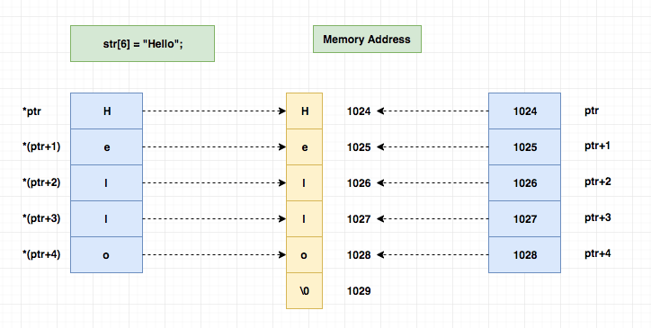
Printing each character of a string using the pointer
To print the value stored at each char address, we have to dereference the memory address.
Like below,
*(ptr+i)

Slide 68
Printing each character of a string using the pointer
#include<stdio.h>
int main()
{
char str[6] = "Hello";
char *ptr;
int i;
//string name itself a base address of the string
ptr = str; //ptr references str
for(i = 0; ptr[i] != '\0'; i++)
printf("str[%d] = %c\n",i,*(ptr+i));
return 0;
}

Slide 69
Manipulating characters of a string using the pointer
Let's change the 4th(index 3) character 'l' as 'o'.
The new string will be "Heloo".
#include<stdio.h>
int main()
{
char str[6] = "Hello";
char *ptr;
int i;
printf("String = %s\n", str);
//string name itself a base address of the string
ptr = str; //ptr references str
//change the 4th char as 'o'
*(ptr+3) = 'o';
printf("Updated string = %s\n",str);
return 0;
}

Slide 70
Static and Dynamic Memory Allocation
Memory Allocation: Memory allocation is a process by which computer programs and services are assigned with physical or virtual memory space.
The memory allocation is done either before or at the time of program execution. There are two types of memory allocations:
Compile-time or Static Memory Allocation
Run-time or Dynamic Memory Allocation

Slide 71
Static Memory Allocation
Static Memory is allocated for declared variables by the compiler.
The address can be found using the address of operator and can be assigned to a pointer.
The memory is allocated during compile time.

Slide 72
Dynamic Memory Allocation
Memory allocation done at the time of execution(run time) is known as dynamic memory allocation.
Functions calloc() and malloc() support allocating dynamic memory.
In the Dynamic allocation of memory space is allocated by using these functions when the value is returned by functions and assigned to pointer variables.

Slide 73
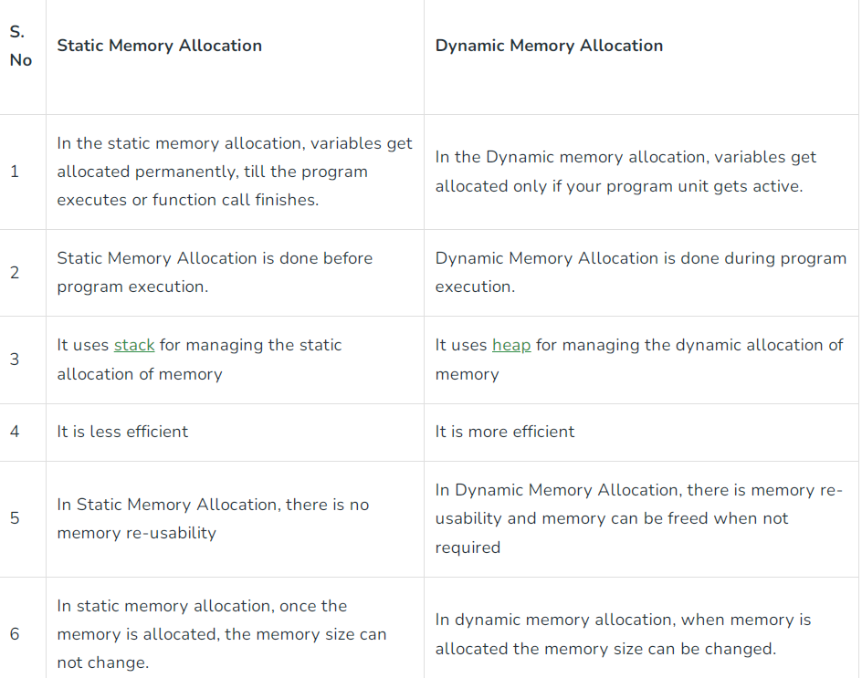
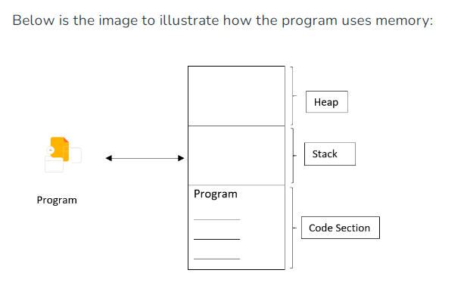

Slide 74
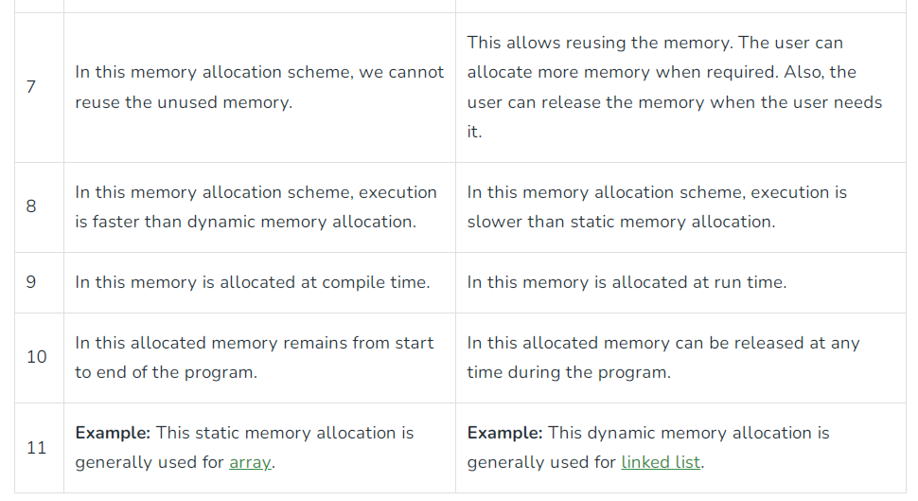

Slide 75
Static Memory Allocation
Key Features:
Allocation and deallocation are done by the compiler.
It uses a data structures stack for static memory allocation.
Variables get allocated permanently.
No reusability.
Execution is faster than dynamic memory allocation.
Memory is allocated before runtime.
It is less efficient.
#include <stdio.h>
void main()
{
int a; // 4 bytes
double b; // b bytes
}
#include <stdio.h>
void main()
{
int n; // 4 bytes
scanf(“%d”,&n);
int a[n];
}

Slide 76
Static Memory Allocation
Advantages:
Simple usage.
Allocation and deallocation are done by the compiler.
Efficient execution time.
It uses stack data structures.
Disadvantages:
Memory wastage problem.
Exact memory requirements must be known.
Memory can’t be resized once after initialization.

Slide 77
Dynamic Memory Allocation
Key Features:
Dynamic allocated at runtime
We can also reallocate memory size if needed.
Dynamic Allocation is done at run time.
No memory wastage

Slide 78
Dynamic Memory Allocation
There are some functions available in the stdlib.h header which will help to allocate memory dynamically.
malloc(): The simplest function that allocates memory at runtime is called malloc(). There is a need to specify the number of bytes of memory that are required to be allocated as the argument returns the address of the first byte of memory that is allocated because you get an address returned, a pointer is the only place to put it.
Syntax:
int *p = (int*)malloc(No of values*size(int));

Slide 79
Dynamic Memory Allocation
The argument to malloc() above clearly indicates that sufficient bytes for accommodating the number of values of type int should be made available.
Also notice the cast (int*), which converts the address returned by the function to the type pointer to int. malloc() function returns a pointer with the value NULL.

Slide 80
Dynamic Memory Allocation
calloc(): The calloc() function offers a couple of advantages over malloc(). It allocates memory as a number of elements of a given size. It initializes the memory that is allocated so that all bytes are zero.
calloc() function requires two argument values:
The number of data items for which space is required.
Size of each data item.
It is very similar to using malloc() but the big plus is that you know the memory area will be initialized to zero.
Syntax:
int *p = (int*)calloc(Number of data items, sizeof(int));

Slide 81
Dynamic Memory Allocation
realloc(): The realloc() function enables you to reuse or extend the memory that you previously allocated using malloc() or calloc().
A pointer containing an address that was previously returned by a call to malloc(), calloc(). The size in bytes of the new memory that needs to be allocated.
It allocates the memory specified by the second argument and transfers the contents of the previously allocated memory referenced by the pointer passed as the first argument to the newly allocated memory.
Syntax:
int *np = (type cast) realloc (previous pointer type, new number of elements * sizeof(int));

Slide 82
Dynamic Memory Allocation
free(): When memory is allocated dynamically it should always be released when it is no longer required.
Memory allocated on the heap will be automatically released when the program ends but is always better to explicitly release the memory when done with it, even if it’s just before exiting from the program.
A memory leak occurs memory is allocated dynamically and reference to it is not retained, due to which unable to release the memory.
Syntax:
free(pointer);

Slide 83
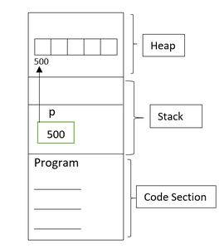
Example
// C program to illustrate the concept of memory allocation
#include <stdio.h>
void main()
{
int* p; // 4 bytes
p = (int*)malloc(5 * sizeof(int));
}
In this code, a pointer p is declared. Assume that pointer p will take 2 bytes of memory and again it depends upon the compiler.
This pointer will store in the stack section and will point to the array address of the first index which is allocated in the heap. Heap memory cannot be used directly but with the help of the pointer, it can be accessed.

Slide 84
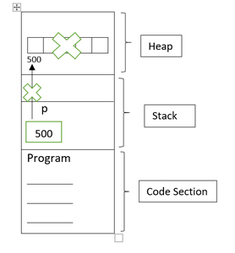
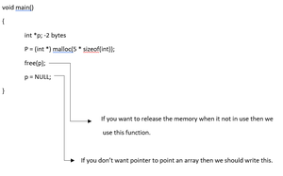
Example
When the program is not in use, the memory should be deallocated. Otherwise, it will cause a memory leak.
After deallocating the memory allocated in the heap. Below is the image to illustrate the main memory after deallocation.

Slide 85
DMA Advantages and Disadvantages
Advantages:
Dynamic Allocation is done at run time.
We can allocate (create) additional storage whenever we need them.
Memory can be deallocated (free/delete) dynamic space whenever we are done with them.
Thus, one can always have exactly the amount of space required – no more, no less.
Memory size can be reallocated if needed.
Disadvantages:
As the memory is allocated during runtime, it requires more time.
Memory needs to be freed by the user when done. This is important as it is more likely to turn into bugs that are difficult to find.

Slide 86
Example
#include <stdio.h>
#include <stdlib.h>
int main()
{
int size, resize;
char* str = NULL;
printf("Enter limit of the text: \n");
scanf("%d", &size);
str = (char*)malloc(size * sizeof(char));
// If str is not NULL
if (str != NULL) {
printf("Enter some text: \n");
gets(str);
printf("Inputted text by allocating memory using malloc() is:%s\n",str);
}

Slide 87
Example
// Free the memory
free(str);
str = (char*)calloc(50, sizeof(char));
// If str is not NULL
if (str != NULL) {
printf("Enter some text: \n");
gets(str);
printf("Inputted text by allocating memory using calloc() is:%s\n",str);
}

Slide 88
Example
printf("Enter the new size: \n");
scanf("%d", &resize);
str = (char*)realloc(str, resize * sizeof(char));
printf("Memory is successfully reallocated by using realloc() \n");
// If str is not NULL
if (str != NULL) {
printf("Enter some text: \n");
gets(str);
printf("Inputted text by reallocating memory using realloc()is:%s\n",str);
}
// Free the memory
free(str);
str = NULL;
return 0;
}

