Slide 1

ADVANCED C PROGRAMMING
Module 2 Part-2
Prepared by Dr. S. KANNIMUTHU, Professor, Department of CSE.
Notes:
NOTE:
To change the image on this slide, select the picture and delete it. Then click the Pictures icon in the placeholder to insert your own image.

Slide 2
Topics
Introduction to Structures
Nested structures
Typedef
Structure padding
Enumeration data type
Pointer variables in structures
Pointers to structures
Bit fields
Union

Slide 3
Introduction to Structures
A structure is a collection of variables under a single name.
These variables can be of different types, and each has a name that is used to select it from the structure.
There can be structures within structures, which is known as nesting of structures.
Arrays of structures can be formed and initialized as required. Pointers may also be used with structures.
Structures may be passed as function arguments and they may also be returned by functions.

Slide 4
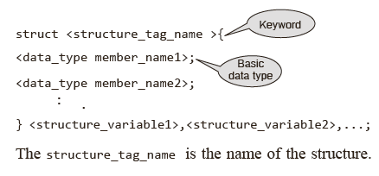
Declaring Structures & Structure Variables
A structure is declared by using the keyword struct followed by an optional structure tag followed by the body of the structure.
The variables or members of the structure are declared within the body.
The general format of declaring a simple structure is given as follows :

Slide 5
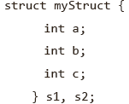
Declaring Structures & Structure Variables
The structure_tag_name is the name of the structure. The structure_variables are the list of variable names separated by commas.
There are three different ways to declare and/or define a structure. These are
Variable structure
Tagged structure
Type-defined structure
A variable structure may be defined as follows:
struct
{
member_list
}variable_identifier;

Slide 6
More on Structures
A structure can be defined as a user-defined data type that is capable of holding heterogeneous data of basic data type.
The structure is simply a type template with no associate storage.
The proper place for structure declarations is in the global area of the program before main().
It is not possible to compare structures for equality using ‘==’, nor is it possible to perform arithmetic on structures.

Slide 7
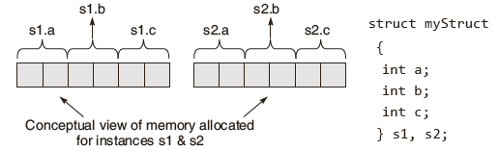
Accessing the Members of a Structure
The members of a structure can be accessed in three ways.
One of the ways consists of using the ‘.’, which is known as the ‘dot operator’.
The members are accessed by relating them to the structure variable with a dot operator.
The general form of the statement for accessing a member of a structure is as follows:
< structure_variable >.< member_name > ;

Slide 8
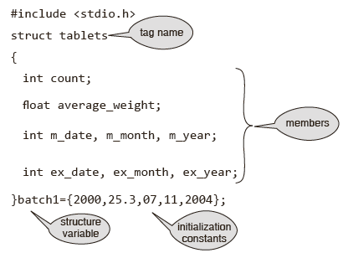
Initialization of Structures
Structures that are not explicitly initialized by the programmer are, by default, initialized by the system.
In most of the C compilers, for integer and float data type members, the default value is zero .
For char and string type members the default value is ‘\0’.
Example:

Slide 9
Initialization of Structures
The general construct for initializing a structure can be any of the two forms given as follows.
struct <structure_tag_name>
{
<data_type member_name1>;
<data_type member_name2>;
}<structure_variable1> = {constant1,constant2, . .};
or
struct <structure_tag_name> <structure_variable> ={constant1,constant2,..};

Slide 10
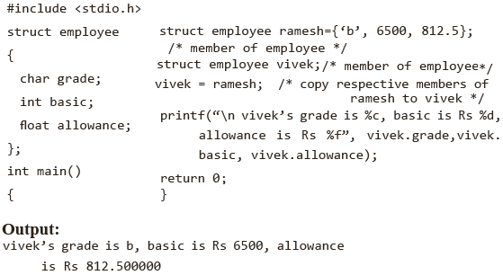
Copying & Comparing Structures
A structure can be assigned to another structure of the same type.
Here is an example of assigning one structure to another.
Comparing one structure variable with another is not allowed in C.
However, when comparing two structures, one should compare the individual fields in the structure. Example:

Slide 11
Nested structures
A structure can be placed within another structure.
In other words, structures can contain other structures as members.
A structure within a structure means nesting of structures.
In such cases, the dot operator in conjunction with the structure variables are used to access the members of the innermost as well as the outermost structures.
It must be noted that an innermost member in a nested structure can be accessed by chaining all the concerned structure variables, from outermost to innermost, with the member using the dot operator.

Slide 12
Arrays of Structures
The structure variable would be an array of objects, each of which contains the member elements declared within the structure construct.
The general construct for declaration of an array structure is given as follows:
struct <structure_tag_name >
{
<data_type member_name1>;
<data_type member_name2>;
.. .
}<structure_variable>[index];
Or
struct <structure_tag_name> <structure_variable>[index];

Slide 13
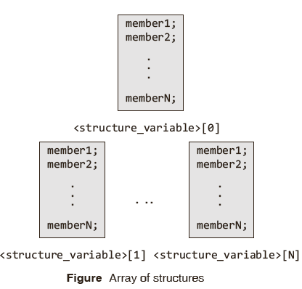
Arrays of Structures: An Example

Slide 14
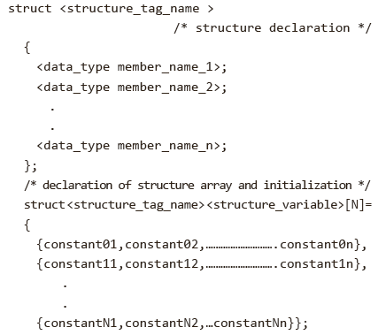
Initializing Arrays of Structures
Initializing arrays of structures is carried out in much the same way as arrays of standard data types.
A typical construct for initialization of an array of structures would appear as follows:

Slide 15
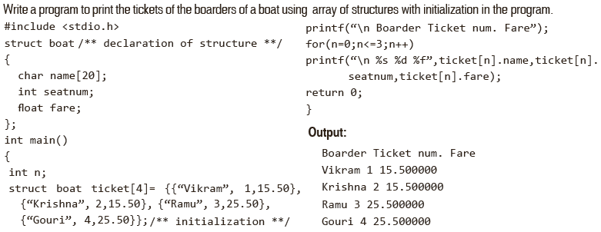
Arrays within the Structure
An innermost member in a nested structure can be accessed by chaining all the concerned structure variables, from outermost to innermost, with the member using the dot operator.
Example:

Slide 16
Typedef
The typedef keyword allows the programmer to create a new data type name for an existing data type.
The general form of the declaration statement using the typedef keyword is given as follows.
typedef <existing data type> <new data type ,….>;
The typedef statement does not occupy storage; it simply defines a new type.
typedef statements can be placed anywhere in a C program as long as they come prior to their first use in the code.
The following examples show the use of typedef.
typedef int id_number;
typedef float weight;
typedef char lower_case;

Slide 17
Typedef & its Use in Structure Declarations
Using typedef struct results in a cleaner, more readable code, and saves the programmer keystrokes​.
However, it also leads to a more cluttered global namespace which can be problematic for large programs.

Slide 18
Example:Variable declaration without using typedef:
#include<stdio.h>
struct Point{
int x;
int y;
};
int main() {
struct Point p1;
p1.x = 1;
p1.y = 3;
printf("%d \n", p1.x);
printf("%d \n", p1.y);
return 0;
}

Slide 19
Example: Using the typedef keyword
#include<stdio.h>
struct Point{
int x;
int y;
};
typedef struct Point Point;
int main() {
Point p1;
p1.x = 1;
p1.y = 3;
printf("%d \n", p1.x);
printf("%d \n", p1.y);
return 0;
}
Note that there is no longer a need to type struct again and again with every declaration of the variable of this type.

Slide 20
Another Example: Using the typedef keyword
#include<stdio.h>
typedef struct Point{
int x;
int y;
} Point;
int main() {
Point p1;
p1.x = 1;
p1.y = 3;
printf("%d \n", p1.x);
printf("%d \n", p1.y);
return 0;
}

Slide 21
Structure padding
Structure padding mainly tells us about memory allocation for variables that are aligned in sequence based on the size of the variable.
For example, let us assume a “char” of 1-byte memory can be assigned anywhere between 0x5000 to 0x5001. Here comes the concept of "Structure padding in C".
It manipulates the memory allocation for different data types and reduces the CPU cycle of a system.
Structure padding adds one or more empty bytes between the memory addresses to align the data in memory.

Slide 22
Syntax of Structure Padding in C
Lets us see an example for understanding the syntax of Structure Padding in C.
struct student
{
char name;
int roll_number;
double marks;
}
Explanation:
In the above example, we can see a structure is declared in which there are three structure members namely- 'char' which will take 1 byte, there is int type so, padding will be done here and three empty blocks will be assigned then 'int' take 4 bytes. And then the remaining 'int' and 'double' will take 4 and 8 bytes respectively.

Slide 23
How Does Structure Padding Work in C?
Let us take an example to understand the concept of structure padding in C: First, we will create a structure of type "bag" and declare its members of different data types.
After creating the object, memory will be allocated to the structure members in sequence.
Variable 'x' will be allocated by first memory, then variable 'y', and then variable 'z'.
Here the two char 'x' and 'y' will take 1 byte and 1 byte respectively. And the int 'z' will take 4 bytes in the memory.
But this memory allocation will not be in a structured manner.
Since 32-bit processor takes 4 bytes at a time and 64-bit processor takes 8 bytes at a time.
struct bag
{
char x;
char y;
int z;
} bag1;

Slide 24
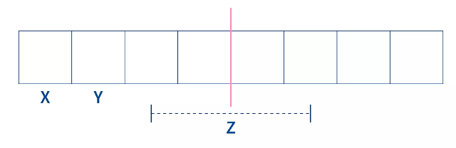
Why Structure Padding?
Suppose we have a 32-bit processor and we have a structure in which there are three structure members char, char, and int type.
The memory block allocation will be contiguous: '1 byte' for char x, '1 byte' for char y, and '4 bytes' for int z.
We know that 32-bit architecture reads 4 bytes in a single CPU cycle.
For accessing the remaining 2 bytes of int, the processor needs one more CPU cycle.

Slide 25
Why Structure Padding?
Now let us assume a situation in which we want to access only the int variable.
And the int variable is divided into two portions here. The processor should access int 'z' in one CPU cycle but the CPU will access int 'z' in two CPU cycles. Here the unnecessary wastage of the CPU cycle appears.
For avoiding this problem, the concept of 'Structure Padding' was introduced. This process is done automatically by the compiler to reduce the number of CPU cycles.

Slide 26
How is Structure Padding Done?
Let us take an example to understand the concept of structure padding in C: First, we will create a structure of type "bag" and declare its members of different data types.
After creating the object, memory will be allocated to the structure members in sequence.
Variable 'x' will be allocated by first memory, then variable 'y', and then variable 'z'.
Here the two char 'x' and 'y' will take 1 byte and 1 byte respectively. And the int 'z' will take 4 bytes in the memory.
But this memory allocation will not be in a structured manner.
Since 32-bit processor takes 4 bytes at a time and 64-bit processor takes 8 bytes at a time.
struct bag
{
char x;
char y;
int z;
} bag1;

Slide 27
Changing Order of the Variables
We have seen how the memory size duffers when we take structure members order-wise. Now we will see if changing the order of variables affect the result or not. We will take the same example for better understanding.
But change the order of variables.
#include <stdio.h>
struct bag
{
char x;
int z;
char y;
};
int main()
{
struct bag bag1; // variable is declared of the object types. size of the structured bag is displayed.
printf("The size of the bag structure is %d", sizeof(bag1)); // size of bag is printed
return 0;
}

Slide 28
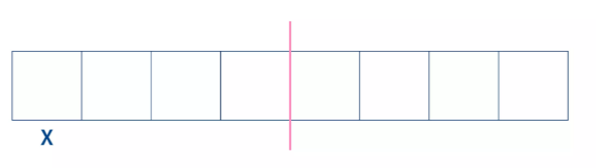
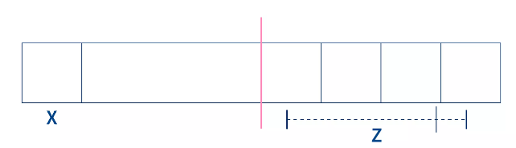
Changing Order of the Variables
Here we can see the result is changed to 12 bytes when we change the order of variables inside the structure. Now let us discuss why the result is different in the two cases.
When the variables are in an ordered manner inside the structure, the memory allocation will be like this
When the variables are not in an ordered manner inside the structure, the memory allocation will be like this:

Slide 29
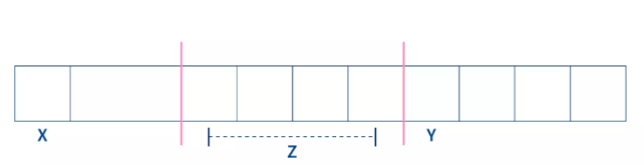
Changing Order of the Variables
The first variable is of char type so 'x' will occupy 1 byte of memory.
Then the second variable is of int type so 'z' will occupy 4 bytes of memory.
Since the int variable occupies 4 bytes and there are only 3 bytes remaining on the left side so the 'int' type will shift to the next 4-byte space and an 'empty' space will be added after the char type variable. By doing this integer variable will be accessed by a single CPU cycle.

Slide 30
Changing Order of the Variables
Now it's time to allocate memory for char 'z'. We know that the CPU can access 4 bytes at a time so the next 4 bytes will be allocated to type char 'y'.
And hence the total memory allocated to access these three variables will be (4 + 4 + 4 = 12 bytes).

Slide 31
How to Avoid the Structure Padding in C?
There comes a time when structure padding should be avoided.
We know that Structure padding in C language is an automatic process that is done by a compiler.
Sometimes the size of the structure becomes greater than the size of the structure members, so we need to stop structure padding in this case.
Following are the various ways in which we can avoid structure padding in C language. Each of them is explained with suitable examples.

Slide 32
Using #pragma pack(1) Directive
#pragma pack(1) directive is used to avoid structure padding by forcing the compiler not to use structure padding and align the structure members end to end during the memory allocation process.
#include <stdio.h>
#pragma pack(1)
struct bag
{
int x;
char y;
double z;
};
int main()
{
struct bag var; // variable declaration of type bag size of the structure bag is displayed
printf("The size of the var when structure padding is avoided is : %d", sizeof(var));
return 0;
}

Slide 33
Using #pragma pack(1) Directive
Here, we can see the size of structure padding is 16 bytes by default but after avoiding structure padding, the result is 13 bytes. In this way, #pragma pack(1) directive can be used to avoid structure padding and reduce memory wastage.

Slide 34
Using Attribute
#include <stdio.h>
struct bag // structure is declared namely 'bag'
{
int x;
char y;
double z;
}__attribute__((packed)); ; // attribute is used to avoid padding
int main()
{
struct bag var; // variable declaration of type base Displaying the size of the structure base
printf("The size of the bag after using attributes is : %d", sizeof(var));
return 0;
}

Slide 35
Enumeration data type
Enumeration data types are data items whose values may be any member of a symbolically declared set of values.
The symbolically declared members are integer constants.
The keyword enum is used to declare an enumeration type. The general construct used to declare an enumeration type is enum :
tag_name{member1, member2,…, memberN}
variable1,...,variableX; In this declaration, either tag_name or variable may be omitted or both may be present.
But at least one of them must exist in this declaration construct.

Slide 36
Enumeration data type
The enum tag_name specifies the user-defined type.
The members are integer constants. By default, the first member, that is, member1, is given the value 0.
The second member, member2, is given the value 1.
Members within the braces may be initialized, in which case, the next member is given a value one more than the preceding member. So, each member is given the value of the previous member plus 1

Slide 37
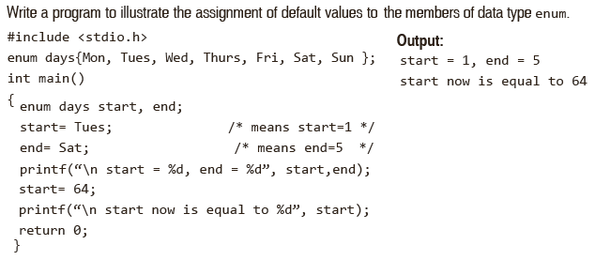
Enumeration data type: An Example

Slide 38
Pointer variables in structures
We can also have a pointer as a member of the structure.
For example:
struct test
{
char name[20];
int *ptr_mem;
};
struct test t1, *str_ptr = &t1;
Here ptr_mem is a pointer to int and a member of structure test.

Slide 39
Pointer variables in structures
There are many ways in which we can access the value of ptr_mem:
Using structure variable - t1.ptr_mem
Using pointer variable - str_ptr->ptr_mem
Using structure variable – (*str_ptr).ptr_mem

Slide 40
Pointer variables in structures: An Example
#include<stdio.h>
struct student
{
char *name;
int age;
char *program;
char *subjects[5];
};

Slide 41
Pointer variables in structures: An Example
int main()
{
struct student stu = {"Lucy",25,"CS",{"CS-01", "CS-02", "CS-03", "CS-04", "CS-05" } };
struct student *ptr_stu = &stu;
int i;
printf("Accessing members using structure variable: \n\n");
printf("Name: %s\n", stu.name);
printf("Age: %d\n", stu.age);
printf("Program enrolled: %s\n", stu.program);

Slide 42
Pointer variables in structures: An Example
for(i = 0; i < 5; i++)
{
printf("Subject : %s \n", stu.subjects[i]);
}
printf("\n\nAccessing members using pointer variable: \n\n");
printf("Name: %s\n", ptr_stu->name);
printf("Age: %d\n", ptr_stu->age);
printf("Program enrolled: %s\n", ptr_stu->program);

Slide 43
Pointer variables in structures: An Example
for(i = 0; i < 5; i++)
{
printf("Subject : %s \n", ptr_stu->subjects[i]);
}
return 0;
}

Slide 44
Structures & Pointers
At times it is useful to assign pointers to structures.
A pointer to a structure is not itself a structure, but merely a variable that holds the address of a structure.
This pointer variable takes four bytes of memory just like any other pointer in a 32-bit machine.
Declaring pointers to structures is basically the same as declaring a normal pointer.
There are many reasons for using a pointer to a struct. One of them is to make a two-way communication possible within functions.
This aspect is explained with examples in the following section.
A pointer to a structure is not itself a structure, but merely a variable that holds the address of a structure.

Slide 45
Structures & Pointers
A typical construct for declaring a pointer to a structure will appear as follows:
struct <structure_tag_name >
/* structure declaration */
{
<data_type member_name_1>;
<data_type member_name_2>;
. . .
<data_type member_name_n>;
}*ptr;
struct <structure_tag_name>
{
<data_type member_name_1>;
<data_type member_name_2>;
…
<data_type member_name_n>;
};
struct <structure_tag_name> *ptr;

Slide 46
Pointers to structures
Pointer to structure holds the add of the entire structure.
It is used to create complex data structures such as linked lists, trees, graphs and so on.
The members of the structure can be accessed using a special operator called as an arrow operator ( -> ).

Slide 47
Pointers to structures
We have seen how to create structure in C language using struct keyword. So creating a pointer to a structure in C is known as Structure Pointer.
struct Student {
int id;
char name[40];
int age;
};
This is our structure for a student in which id is the student roll number, name is the student name and age is the student's age.
So how to create a structure pointer to student ?
Syntax :
(struct keyword) (Name_of_struct) *(pointer_name)

Slide 48
Example
struct Employee {
int id;
char name[100];
float salary;
};
// declare a pointer to Employee
struct Employee *ptr_to_structure ;
// ptr_to_structure can store the address of variable
// of type struct Employee
struct Employee employee1;
ptr_to_structure = &employee1; // store the address of employee structure variable

Slide 49
Accessing Pointers to Structures (With Examples)
To access members of the structure using a pointer, we have two methods :
Using Indirection Operator(*) and Dot (.) operator
Using Arrow Operator (->)

Slide 50
Using Indirection Operator (*) and Dot Operator (.)
Indirection Operator is used to dereference the value present at a particular memory address. And the dot operator is used to access the data members of a structure.
struct Employee {
int id;
char name[100];
int salary;
};
struct Employee employee1;
struct Employee *ptr;
ptr = &employee1; // pointer store the address of employee1
employee1.id = 1;
employee1.salary = 10000;
strcpy(employee1.name , "Amandeep");
(*ptr).name // gives us name of employee1
(*ptr).id // gives us id of employee1
(*ptr).salary // gives us salary of employee1

Slide 51
Using Arrow Operator (->)
To access the members of the structure, we have another method ARROW OPERATOR METHOD. And using this operator, we could directly access the data members of struct and its don't need dereferencing (see example 2).
Syntax : pointer_name -> member_of_structure.
struct Employee {
int id;
char name[100];
float salary;
};
// lets create a pointer
struct Employee *ptr;
// accessing member of struct using -> operator be like
ptr->id // refers to the id of employee
ptr->name // refers to the name member

Slide 52
Example-1
#include<stdio.h>
struct student{
int sno;
char sname[30];
float marks;
};
main ( ){
struct student s;
struct student *st;
printf("enter sno, sname, marks:");
scanf ("%d%s%f", & s.sno, s.sname, &s. marks);
st = &s;
printf ("details of the student are");
printf ("Number = %d", st ->sno);
printf ("name = %s", st->sname);
printf ("marks =%f", st ->marks);
getch ( );x
}

Slide 53
Example-2
#include<stdio.h>
struct person{
int age;
float weight;
};
int main(){
struct person *personPtr, person1;
personPtr = &person1;
printf("Enter age: ");
scanf("%d", &personPtr->age);
printf("Enter weight: ");
scanf("%f", &personPtr->weight);
printf("Displaying:");
printf("Age: %d", personPtr->age);
printf("weight: %f", personPtr->weight);
return 0;
}

Slide 54
Bit fields
There are two ways to manipulate bits in C.
One of the ways consists of using bitwise operators.
The other way consists of using bit fields in which the definition and the access method are based on structure.
The general format for declaring bit field using a structure is given as follows.
struct bitfield_tag
{
unsigned int member1: bit_width1;
unsigned int member2: bit_width2;
.. .
unsigned int memberN: bit_widthN;
};

Slide 55
Bit fields
With reference to bitfields, it should be noted that a field in a word has no address.
In this construct, the declaration of variable name is optional. The construct for individually declaring the variables to this structure is given by
struct bitfield_tag variable_name;
Each bitfield, for example, ‘unsigned int member1: bit_ width1’, is an integer that has a specified bit width.

Slide 56
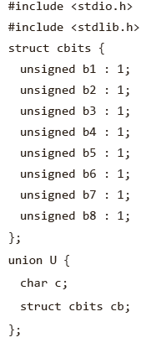
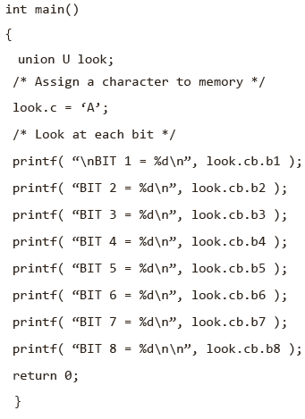

Bit fields: An Example

Slide 57
Union
A union is a structure all of whose members share the same storage.
The amount of storage allocated to a union is sufficient to hold its largest member.
At any given time, only one member of the union may actually reside in that storage.
A union is identified in C through the use of the keyword union in place of the keyword struct.
Virtually all other methods for declaring and accessing unions are identical to those for structures.
Declaring a Union and its Members : The general construct for declaring a union is given as follows.
union tag_name
{
member1;
. . .
memberN;
}variable1,variable2,variable3,…,variableX;

Slide 58
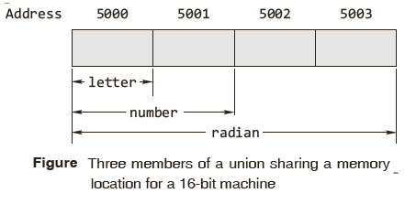
Union
The general construct of declaring the individual union variables is
union tag_name variable1,variable2,…,variableX;
As an example, consider the following declarations for a union that has a tag named mixed.
union mixed
{
char letter;
float radian;
int number;
};
union mixed all;
The first declaration consists of a union of type mixed, which consists of a char, float, or int variable as a member.

Slide 59
Union
The union data type was created to prevent the computer from breaking its memory up into several inefficiently sized pieces, which is called memory fragmentation.
Accessing and Initializing the Members of a Union :
Consider, the general declaration construct of a union.
union tag_name
{
member1;
member2;
.. .
memberN;
}variable1,variable2,variable3,…,variableX;

Slide 60
Accessing & Initializing the Members of a Union
For accessing members of, say, variable1 to N of the union tag_name, the following constructs are used.
variable1.member1
variable2.member2
.. .
variableX.memberN
Only a member that exists at the particular instance in storage should be accessed.
The general construct for individual initialization of a union member is
variableX.memberN = constant;
where X is any value 1 to X and N is any value 1 to N.

Slide 61
Structure versus Union
At any given time, only one member of the union may actually reside in the storage.
In a union, the amount of memory required is same as that of the largest member.
It is important to remember which union member is being used. If the user fills in a member of one type and then tries to use a different type, the results can be unpredictable.
Performing arithmetical or logical operations on union variables is not allowed.

Slide 62
Structure versus Union
The following operations on union variables are valid:
A union variable can be assigned to another union variable.
A union variable can be passed to a function as a parameter.
The address of a union variable can be extracted by using & operator.
A function can accept and return a union or pointer to a union.
No attempt should be made to initialize more than one union member.

Slide 63
Do’s & Don’ts for Unions
It is important to remember which union member is being used.
If the user fills in a member of one type and then tries to use a different type, the results can be unpredictable.
The following operations on union variables are valid.
A union variable can be assigned to another union variable.
A union variable can be passed to a function as a parameter.
The address of a union variable can be extracted by using & operator.
A function can accept and return a union or a pointer to a union.
Don’t try to initialize more than the first union member.
Don’t forget that the size of a union is equal to its largest member.
Don’t perform arithmetical or logical operations on union variables.

