Slide 1
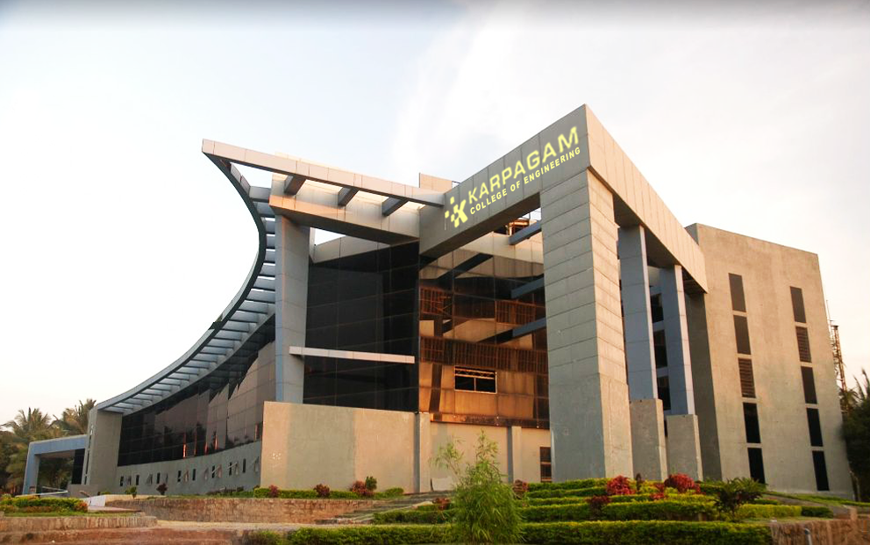

ADVANCED C PROGRAMMING MODULE 3: PART 1
Kannimuthu Subramanian

Slide 2
Topics
Function pointers
Pointer and function
Function returning pointer
File system basic
The file pointer
File operations: fopen() – fgetc() – fputc() – fclose() – feof() – fputs() – fgets() – fprintf() – fscanf()
Erasing files
Random access file
Command line arguments
Multiple source files
Static and dynamic libraries
Code optimization
Optimization with loops
Fast mathematics in loops
Optimization by functions

Slide 3
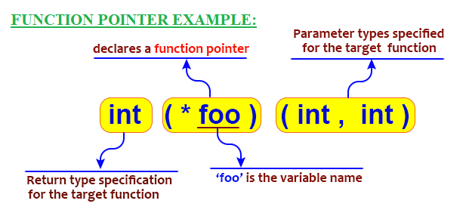
FUNCTION POINTERS
Function pointers in C are variables that can store the memory address of functions
These can be used in a program to create a function call to functions pointed by them.
Function pointers in C need to be declared with an asterisk symbol and function parameters (same as the function they will point to) before using them in the program.
Declaration of function pointers in C includes the return type and data type of different function arguments.
Syntax: function_return_type (*Pointer_name) (function argument list)

Slide 4
FUNCTION POINTERS
#include<stdio.h>
void fun(int a) // A normal function with an int parameter and void return type
{
printf("Value of a is %d\n", a);
}
void main()
{
void (*fun_ptr)(int) = &fun; // fun_ptr is a pointer to function fun()
(*fun_ptr)(10); // Invoking fun() using fun_ptr
}
NOTE: void (*fun_ptr)(int) = &fun;
is equivalent to
void (*fun_ptr)(int);
fun_ptr = &fun;

Slide 5

FUNCTION POINTERS
#include<stdio.h>
int areaRectangle(int, int);
void main() {
int length, breadth, area;
int (*fp)(int, int);
printf("Enter length and breadth of a rectangle\n");
scanf("%d%d", &length, &breadth);
fp = areaRectangle; // pointing the pointer to functions memory address
area = (*fp)(length, breadth); // calling the function using function pointer
printf("Area of rectangle = %d", area);
}
int areaRectangle(int l, int b)
{
int area_of_rectangle = l * b;
return area_of_rectangle;
}

Slide 6
FUNCTION POINTERS
Unlike normal pointers, a function pointer points to code, not data. Typically a function pointer stores the start of executable code.
Unlike normal pointers, we do not allocate de-allocate memory using function pointers.
A function’s name can also be used to get functions’ address.

Slide 7
ARRAY OF FUNCTION POINTERS
Like any other data types we can create an array to store function pointers in C.
Function pointers can be accessed from their indexes like we access normal array values, say, arr[i].
This way we are creating an array of function pointers, where each array element stores a function pointer pointing to different functions.

Slide 8
ARRAY OF FUNCTION POINTERS
#include<stdio.h>
float add(int, int);
float multiply(int,int);
float divide(int,int);
float subtract(int,int);
int main() {
int a, b;
float (*operation[4])(int, int);
operation[0] = add;
operation[1] = subtract;
operation[2] = multiply;
operation[3] = divide;
printf("Enter two values ");
scanf("%d%d", &a, &b);
float result = (*operation[0])(a, b);
printf("Addition (a+b) = %.1f\n", result);
result = (*operation[1])(a, b);
printf("Subtraction (a-b) = %.1f\n", result);
result = (*operation[2])(a, b);
printf("Multiplication (a*b) = %.1f\n", result);
result = (*operation[3])(a, b);
printf("Division (a/b) = %.1f\n", result);
return 0;
} //main
float add(int a, int b) {
return a + b;
}
float subtract(int a, int b) {
return a - b;
}
float multiply(int a, int b) {
return a * b;
}
float divide(int a, int b) {
return a / (b * 1.0);
}
OUTPUT:
Enter two values 3 2 Addition (a+b) = 5.0 Subtraction (a-b) = 1.0 Multiplication (a*b) = 6.0 Division (a/b) = 1.5

Slide 9
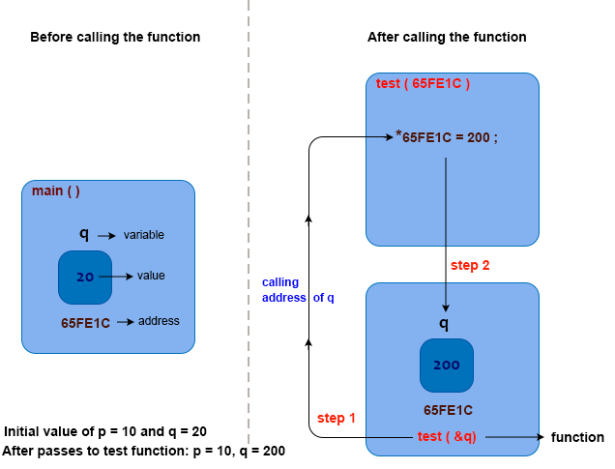
POINTERS & FUNCTIONS
#include <stdio.h>
void test( int x, int *ptry )
{
x = 200;
*ptry = 200;
return;
}
void main( )
{
int p = 10, q = 20;
printf( "Initial value of p = %d and q = %d\n", p, q );
test( p, &q );
printf( “Test function: p = %d, q = %d\n", p, q );
}
OUTPUT:
Initial value of p = 10 and q = 20
Test function:
p = 10, q = 200

Slide 10
FUNCTION RETURNING POINTER
We can pass pointers to the function as well as return pointer from a function.
But it is not recommended to return the address of a local variable outside the function as it goes out of scope after function returns.
Syntax:
returnType *functionName(param list);

Slide 11
FUNCTION RETURNING POINTER
#include <stdio.h>
void main()
{
int x = 100; int y = 200;
int *max = NULL;
max = getMax(&x, &y);
printf("Max value: %d\n", *max);
}
int *getMax(int *m, int *n)
{
if (*m > *n) return m;
else return n;
}
OUTPUT:
Max value: 200

Slide 12
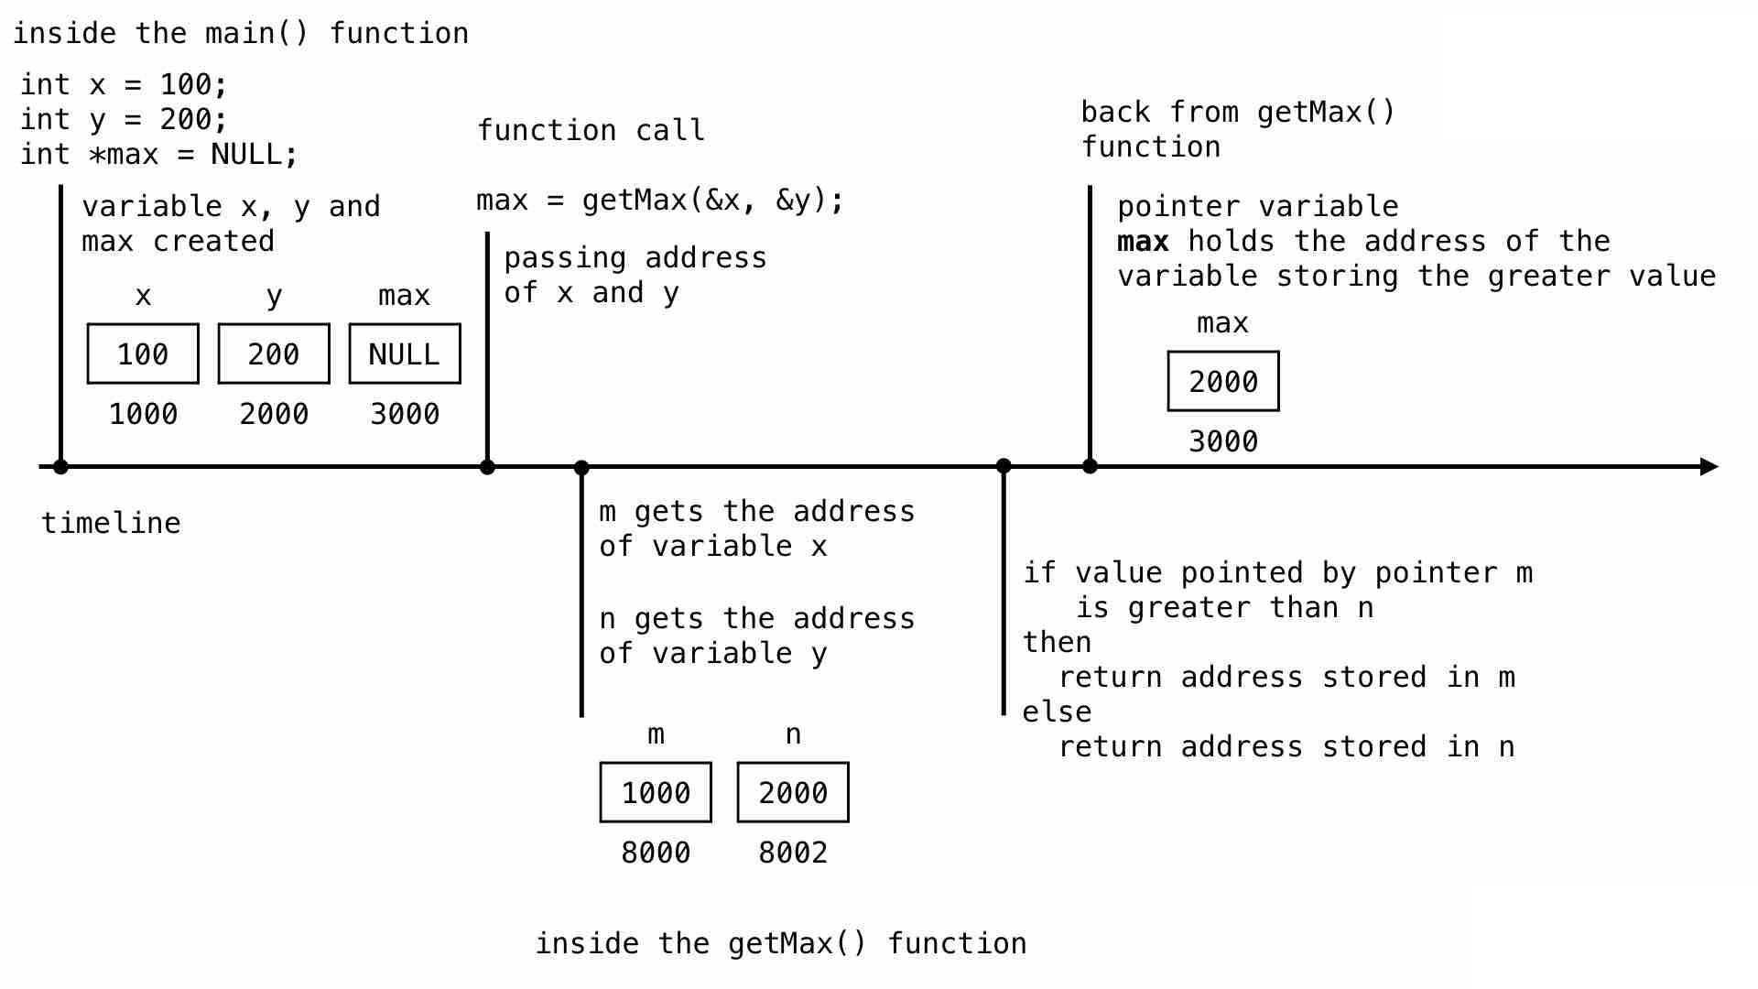
FUNCTION RETURNING POINTER

Slide 13
FUNCTION RETURNING POINTER
#include <stdio.h>
int * getVal( ) {
static int r[5]; int i;
for ( i = 0; i < 5; ++i) {
r[i] = i+2;
printf( “ r[%d] = %d\n", i, r[i]);
}
return r;
}
void main () {
int *p, i;
p = getVal();
for ( i = 0; i < 5; i++ )
printf( "*(p + %d) : %d\n", i, *(p + i));
}
OUTPUT:
r[0] = 2
r[1] = 3
r[2] = 4
r[3] = 5
r[4] = 6
*(p + 0) : 2
*(p + 1) : 3
*(p + 2) : 4
*(p + 3) : 5
*(p + 4) : 6

Slide 14
FILE SYSTEM BASICS
File handing in C is the process in which we create, open, read, write, and close operations on a file.
C language provides different functions such as fopen(), fwrite(), fread(), fseek(), fprintf() to perform input, output, and many different C file operations in our program.
Why do we need File Handling in C?
When a console is used to display the output,
the output is deleted when the program is closed
But in the software industry, most programs are written to store the information fetched from the program.

Slide 15
FILE SYSTEM BASICS
FEATURES OF USING FILES:
Reusability: The data stored in the file can be accessed, updated, and deleted anywhere and anytime providing high reusability.
Portability: Without losing any data, files can be transferred to another in the computer system. The risk of flawed coding is minimized with this feature.
Efficient: A large amount of input may be required for some programs. File handling allows you to easily access a part of a file using few instructions which saves a lot of time and reduces the chance of errors.
Storage Capacity: Files allow you to store a large amount of data without having to worry about storing everything simultaneously in a program.

Slide 16
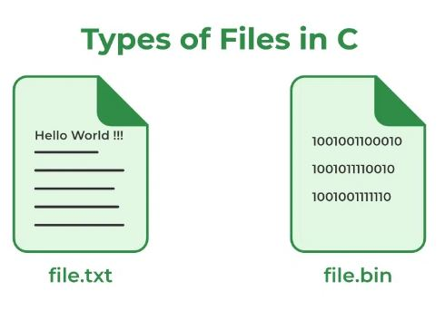
FILE SYSTEM BASICS
TYPES OF FILES IN C
Text Files
Binary Files

Slide 17
FILE SYSTEM BASICS
Text Files | Binary Files
A text file contains data in the form of ASCII characters and is generally used to store a stream of characters. Each line in a text file ends with a new line character (‘\n’). | A binary file contains data in binary form (i.e. 0’s and 1’s) . They contain data that is stored in a similar manner to how it is stored in the main memory.
It can be read or written by any text editor. | The binary files can be created only from within a program and their contents can only be read by a program.
They are generally stored with .txt file extension | They are generally stored with .bin file extension.
Text files can also be used to store the source code. | More secure as they are not easily readable.

Slide 18
THE FILE POINTER
A file pointer in C is a data type that is used to point to a file.
A file pointer is a reference to a particular position in the opened file.
It is used in file handling to perform all file operations such as read, write, close, etc.
It is a structure that holds information such as the name of the file, its location, and the mode in which the file is accessed.
A file pointer is used to read from and write to files, as well as to control its position inside the file.
Syntax: FILE *filePointer;
FILE macro is used to declare the file pointer variable. The FILE macro is defined inside <stdio.h> header file.

Slide 19
FILE OPERATIONS
The file pointer in C is used in various functions that perform file input/output operations. Some of the commonly used functions in which file pointer is used are
fopen()
fgetc()
fputc()
fclose()
feof()
fputs()
fgets()
fprintf()
fscanf()

Slide 20
fopen()
Creating a new file – fopen() with attributes as “a” or “a+” or “w” or “w+”
Opening an existing file – fopen()

Slide 21
THANK YOU

