Slide 1
VINHACK
TEAM ENIGMA

Slide 2
Problem statement
Understanding the pulse of the city through social media.

Slide 3
WHAT IS SOCIAL MEDIA
Social media is computer-based technology that facilitates the sharing of ideas, thoughts, and information through the building of virtual networks and communities. By design, social media is internet-based and gives users quick electronic communication of content. Content includes personal information, documents, videos, and photos. Users engage with social media via computer, tablet or Smartphone via web-based software or web application, often utilizing it for messaging.
According to the PEW RESEARCH CENTER, social media users tend to be younger. Nearly 90 percent of people between the ages of 18 and 29 used at least one form of social media.

Slide 4
The Impact of Social Media on Society
Almost a quarter of the world’s population is now on Facebook. In the USA nearly 80% of all internet users are on this platform. Because social networks feed off interactions among people, they become more powerful as they grow.
Some argue that social sharing has encouraged people to use computers and mobile phones to express their concerns on social issues without actually having to engage actively with campaigns in real life. Their support is limited to pressing the ‘Like’ button or sharing content.
Social media has been blamed for promoting social ills such as:
Cyber bullying
Lack of Privacy

Slide 5
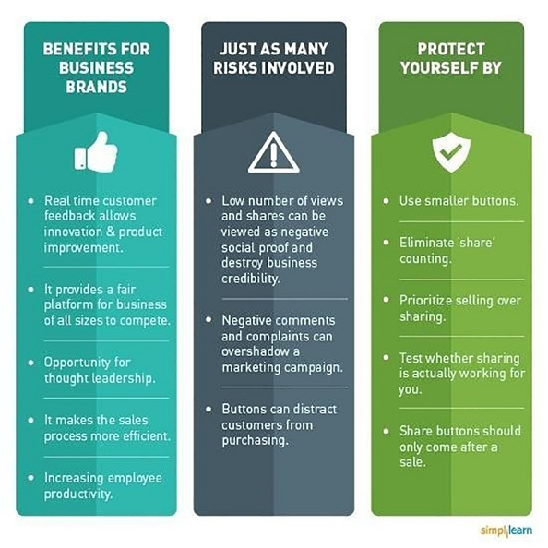

Slide 6
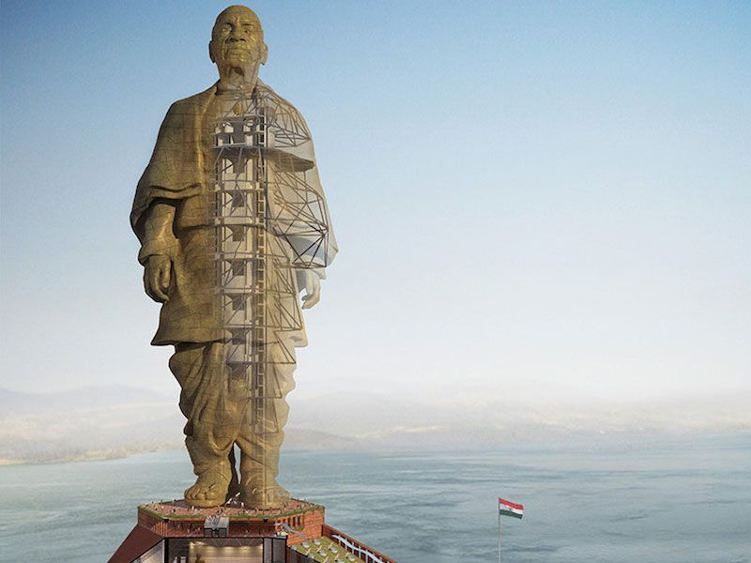
Example
Lets take an example :
Statue of Unity: Symbol of Pride or Wastage of Public Money?

Slide 7
Pride of India: Pros
According to many tweets on social media –some people appreciated this public service.
A sense of patriotism and united India is infused within the hearts of the people who visit the Statue of Unity or even have a glimpse of it
Thousands of people in Narmada District and nearby areas will get employment opportunity directly or indirectly

Slide 8
It is estimated that more than 10 Lakh tourists will visit the Statue of Unity every year. This will help in generating huge income from tourism and transportation and other services. Entire money spent on the construction is expected to be recovered in the next 35-40 years.

Slide 9
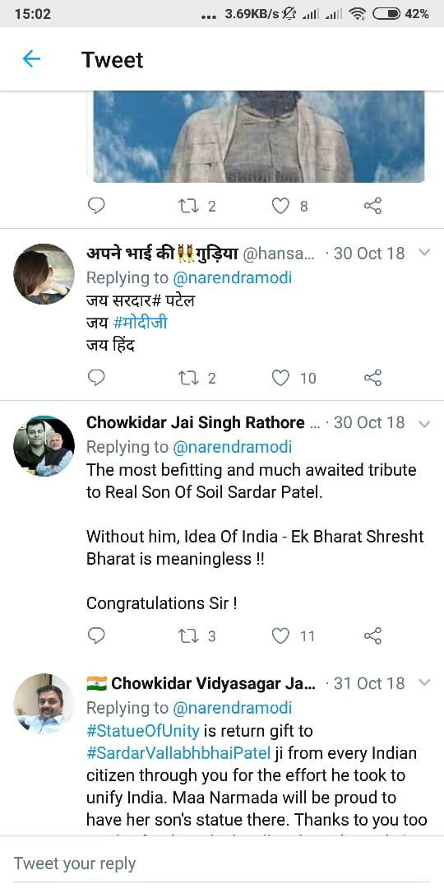
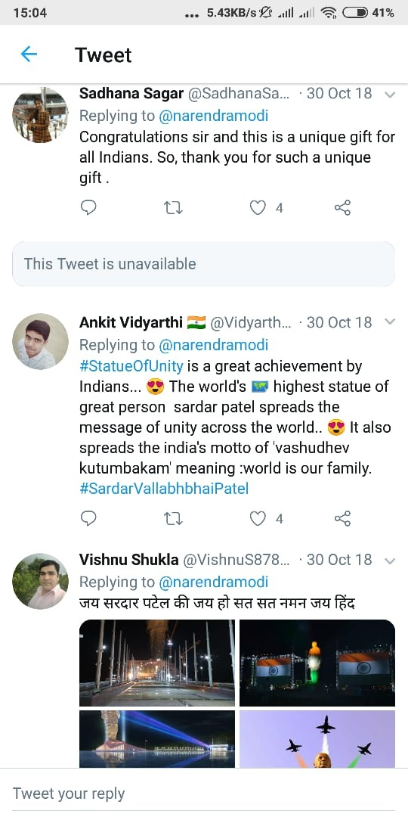
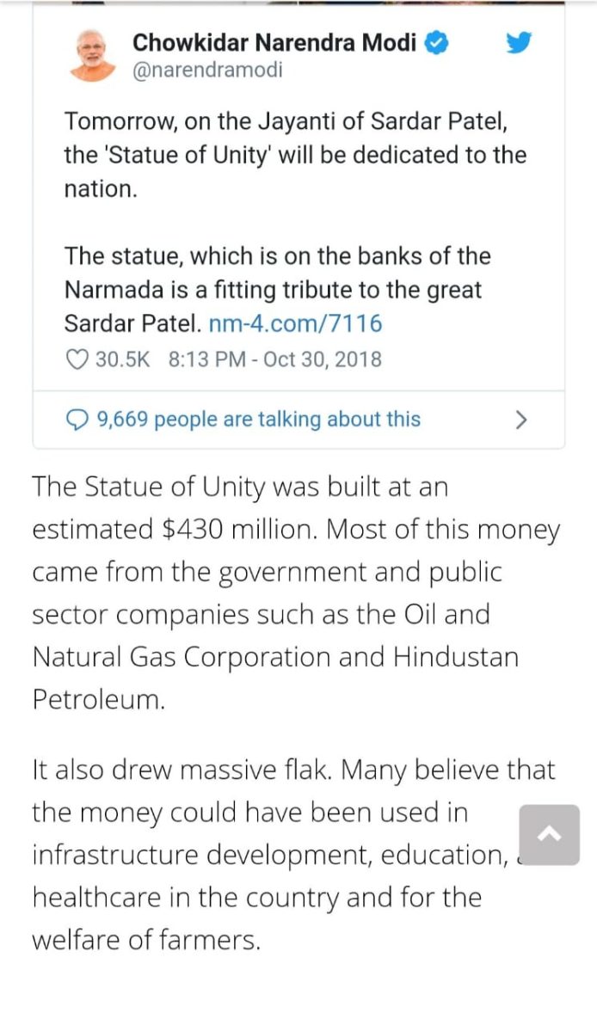

Slide 10
Wastage of Money: Cons
Many Social Activists, environment activists and political parties despite agreeing that the Statue of Unity is a pride of nation are of the view that it is wastage of Money especially for a country like India.

Slide 11
Local Tribals were dislocated as their land was acquired for the construction of the statue. The Tadvi tribe opposed land acquisition for the development of tourism infrastructure around the statue. However, they were offered cash and land compensation, and have been provided jobs before land acquisition

Slide 12
Environmental activists wrote a letter to the central government contending that project implementation started without clearance from the Environment Ministry.
Social Activists have opposed the project on the ground that India is suffering from natural calamities like floods and cyclones in many parts of the country e.g. Kerala, Orissa. Accordingly instead of putting in the money in the construction of statue, the money could have gone to address these problems of common people

Slide 13
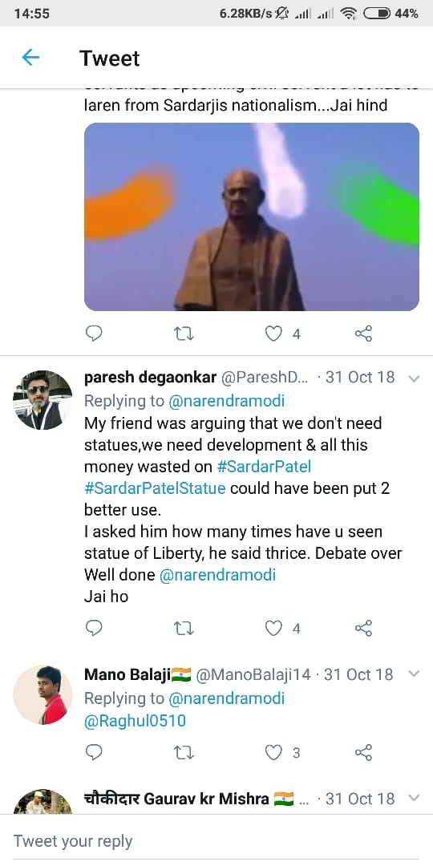
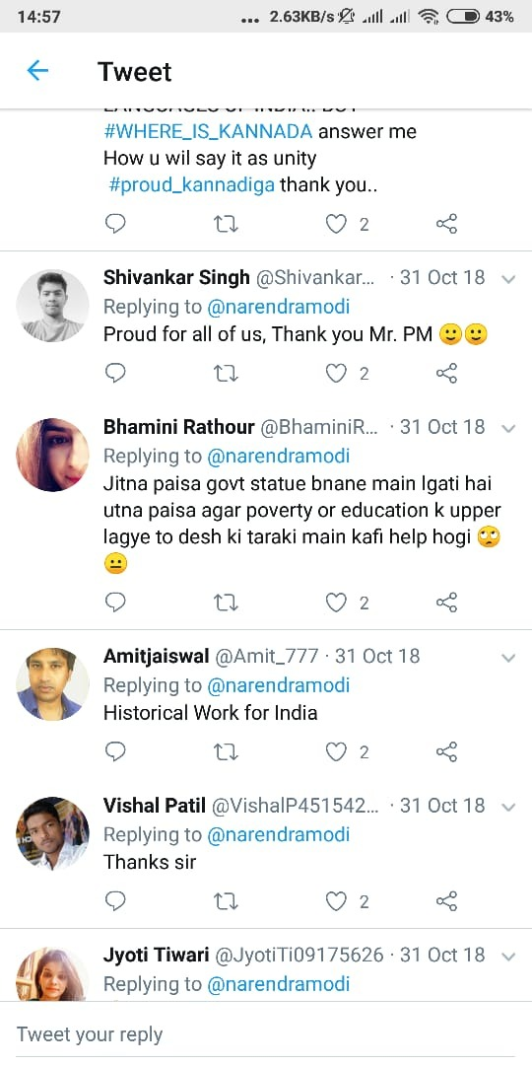

Slide 14
Approach
We can create a webpage using HTML,CSS and Java script.
Apps can be developed providing polling system so that no public service implemented by the government could be criticised.
Every official government post should contain a watermark approved by the government so that they don’t manipulate the original content.

Slide 15
SOLUTIONS
Look for fake images :
Modern editing software has made it easy for people to create fake images that look professional and real
however,, there are some warning signs you can look out for such as strange shadows on the image you can use tools such as Google Reverse Image Search to check whether the image has been altered or used in the wrong context.

Slide 16
Using Block chain:
All the social media accounts and handles can be linked to blockchain.
Once data entered in block chain cannot be deleted or manipulated as it is authorised by only trusted people.
A universally accepted website can be created. The entire documentation of the public services provided by the government will be stored and linked to blockchain.

Slide 17
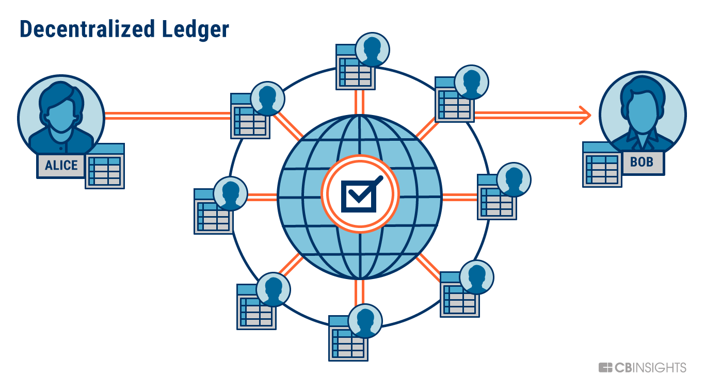
A separate link box can be generated in that website where we can check whether a particular site contains the right information or not.

