Slide 1
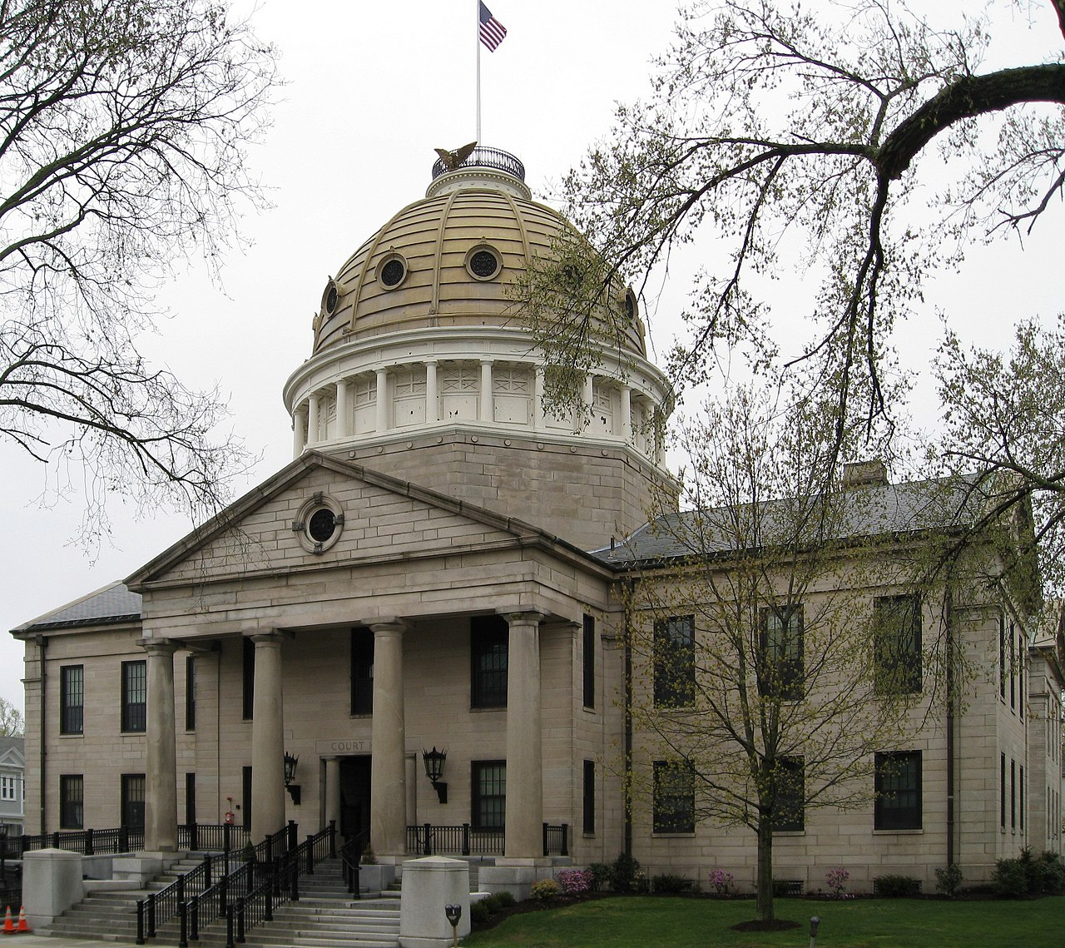
NORFOLK COUNTY
MASSACHUSETTS
ANUHYA BHAGAVATULA
Picture from Wikipedia
Notes:
Norfolk is made up of one city and twenty seven towns with a population of 724,505 and the employed population is 370,471 (as of 2021).

Slide 2



MOTIVATION
This Photo by Unknown Author is licensed under CC BY-NC
This Photo by Unknown Author is licensed under CC BY-SA-NC
Notes:
Motivation: The period of Covid 19, especially the onset of the pandemic, was a tough time for all us. But it was harder for some of us than others. I wanted to explore this side of the pandemic, it’s effect on employment and how if effected the communities in the county.

Slide 3
PROBLEM STATEMENT
How did the increase in COVID-19 cases impact employment in Norfolk County in 2020-2021?
Was there an increase in the unemployment claims as COVID-19 progressed in 2020-2021?
What proportion of unemployment claims to the population for gender, race/ethnicity to understand how much such demographic groups were impacted?

Slide 4



HUMAN-CENTEREDNESS
This Photo by Unknown Author is licensed under CC BY-SA
This Photo by Unknown Author is licensed under CC BY-SA-NC
Notes:
Human Centeredness of this project come from being able to apply the fundamentals of data science and statistics to create an ethical, reproducible work that listens to the problems of the people showcased in data and presents results that demonstrate the societal impact of data science.

Slide 5
DATASET
SOURCES:
Weekly unemployment claims data : Initial and continued weekly Unemployment Insurance claims by county. Includes claimant demographics (gender, race and ethnicity), industry, occupation, and education.
Labor and Unemployment Data : Information on the labor force, employment, unemployment, and unemployment rates for each county in Massachusetts.
John Hopkins University COVID-19 data : The list of confirmed COVI D cases by county.

Slide 6
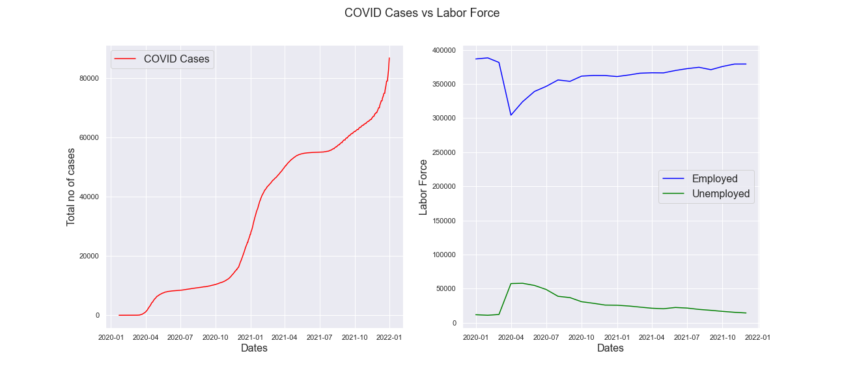
COVID CASES AND EMPLOYMENT

Slide 7
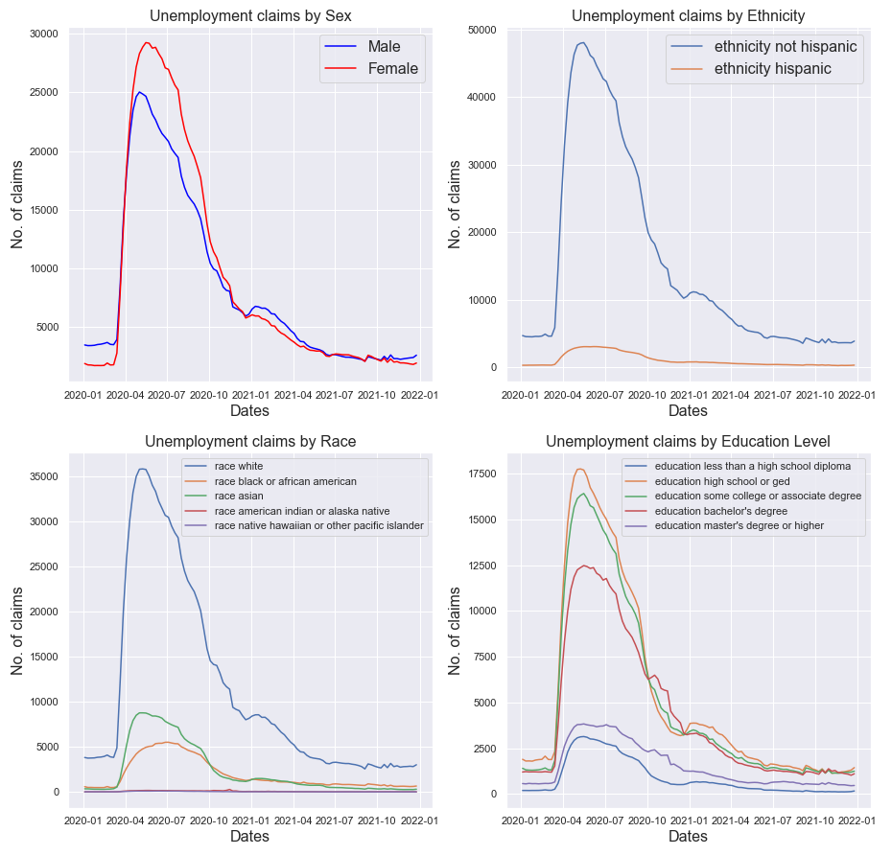
UNEMPLOYMENT CLAIMS BY DEMOGRAPHICS

Slide 8
NORFOLK COUNTY DEMOGRAPHICS

Slide 9
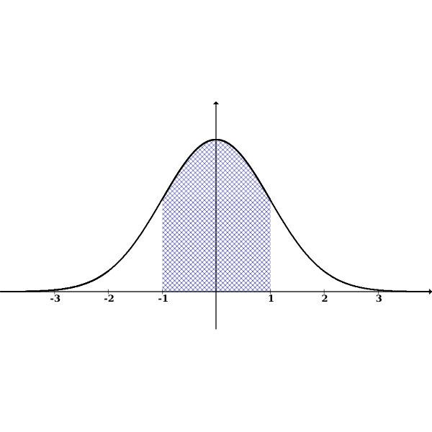

METHODS
This Photo by Unknown Author is licensed under CC BY-NC-ND
Z-Test, Pairwise Tests

Slide 10
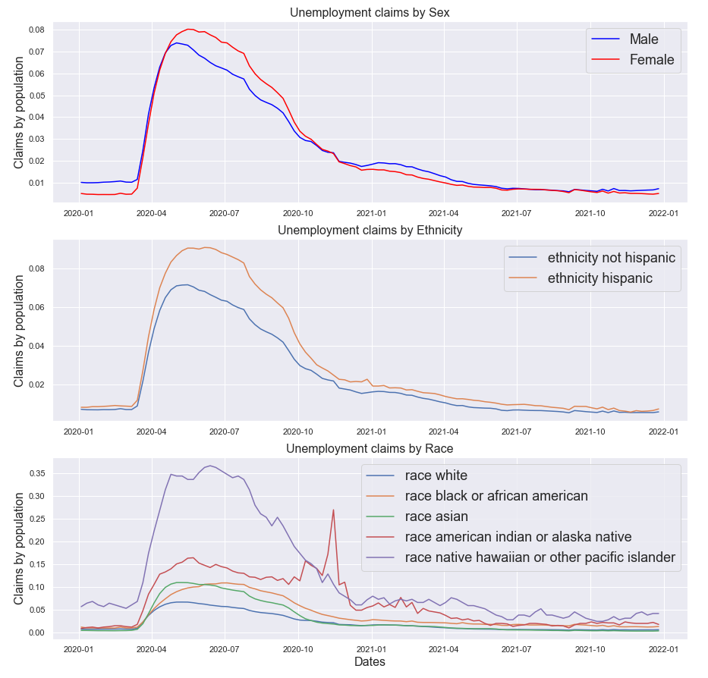
RESULTS

Slide 11
WHY RESULTS MATTER?
Marginalized communities are impacted more at the onset of an unexpected disaster.
Steps can be taken by the government in the face of such disasters to help communities beforehand.
These results help us understand what unemployment looks like during a pandemic and help plan the future much better.

Slide 12
THANK YOU!
QUESTIONS?

