Slide 1

From Bean to Brew: Analyzing Coffee Ratings and Market Trends
Anumol Issac

Slide 2
Objectives
Understand the Dataset:
Explore the structure and quality of the data.
Identify data issues (e.g., missing values, duplicates).
Prepare a clean and structured dataset.
Answer Key Business Questions:
Identify popular products, roasters and get insights about seasonal trends.
Compare average ratings across regions.
Identify popular roast types and their regional distribution.
Analyze correlations between sensory attributes and ratings.
Create Visualizations for Data Interpretation:
Develop interactive dashboard using tableau to visualize the key findings.
Develop and Deploy Predictive Models :
Develop machine learning models to predict ratings and classify products into popularity tiers.
Provide Insights for Business Strategy:
Offer actionable recommendations for marketing, sales, and product strategies.

Slide 3
Analytical Approach
Data Exploration and Quality Check
Understand the structure and identify data quality issues.
Explore relationships between columns across datasets and verify unique identifiers.
Data Cleaning and Transformation
Prepare a clean and structured dataset
Handle missing data and impute values where necessary.
Standardize ratings, add derived columns (review_year, review_month, normalized_rating, popularity_tier) and calculate averages.
Exploratory Data Analysis (EDA)
Analyze trends and distributions (ratings, product popularity, roast preferences, etc.).
Time-Series Analysis
Analyze seasonal or yearly trends based on ratings.
Regional Analysis
Compare ratings and preferences across different regions.

Slide 4
Analytical Approach(Cont.)
Roast Preference Analysis
Determine the most popular roast types and their distribution.
Correlation Analysis
Investigate relationships between sensory attributes (e.g., flavor, aroma etc.) and ratings.
Predictive Modeling
Build regression models to predict ratings based on roast type and region.
Use decision trees to classify products into popularity tiers.
Advanced Reporting and Visualization
Create interactive dashboards to visualize trends and forecast ratings.
Business Strategy Recommendations
Provide actionable insights and recommendations for marketing and sales strategies.

Slide 5

Data Summary

Slide 6
Data schemas
coffee_id.csv
slug: Product identifier
coffee_clean.csv
roast types: (medium-light, medium, dark)
name: Product name
roaster: Coffee roaster
rating: Product rating
review_date: Review date
regions: Africa, Asia pacific etc,
type attributes: Organic, Fair Trade, Decaffeinated, etc.
coffee.csv
all_text: Web-scraped text
rating: Product ratings
review_date: Date of the review
roast: (medium-light, dark etc.)
sensory attributes: Sensory details like aroma and aftertaste
slug: Product identifier
sensory attributes: Sensory details like aroma and aftertaste
name: Product name
roaster: Coffee roaster
slug: Product identifier
regions: Africa, Asia pacific etc.
type attributes: Organic, Fair Trade etc.
location and origin
est_price: estimated price
clean_text

Slide 7
Create a Structured Dataset
coffee_id
coffee_clean
coffee
Merged_df
Data Preparation:
Cleaned slug column in ‘coffee’ to remove unnecessary text.
Removed duplicate column (type_with_milk.1) and unwanted columns from ‘coffee_clean’.
Data Merging:
Merged ‘coffee_id’ and ‘coffee_clean’ on slug.
Filtered and cleaned extra entries in ‘coffee’.
Combined these datasets into a single structured ‘merged_df’.
Final Output:
structured dataset for analysis by integrating and cleaning all three datasets.

Slide 8
Data Cleaning and Transformation
Handle Missing Data
Impute missing ratings using average rating by roaster
Impute missing values in 'aftertaste' column with mean
Normalize ratings
Normalize ratings to a 1-10 scale using min-max normalization
Derived Columns
review_month and review_year form review date
Drop rows where 'roast' column has missing values
normalized_rating = ((rating - min_rating) / (max_rating - min_rating)) * (new_max - new_min) + new_min
new_max=10 , new_min=1
normalized_rating based on min-max normalization
popularity_tier based on normalized rating
origin_derived from origin

Slide 9
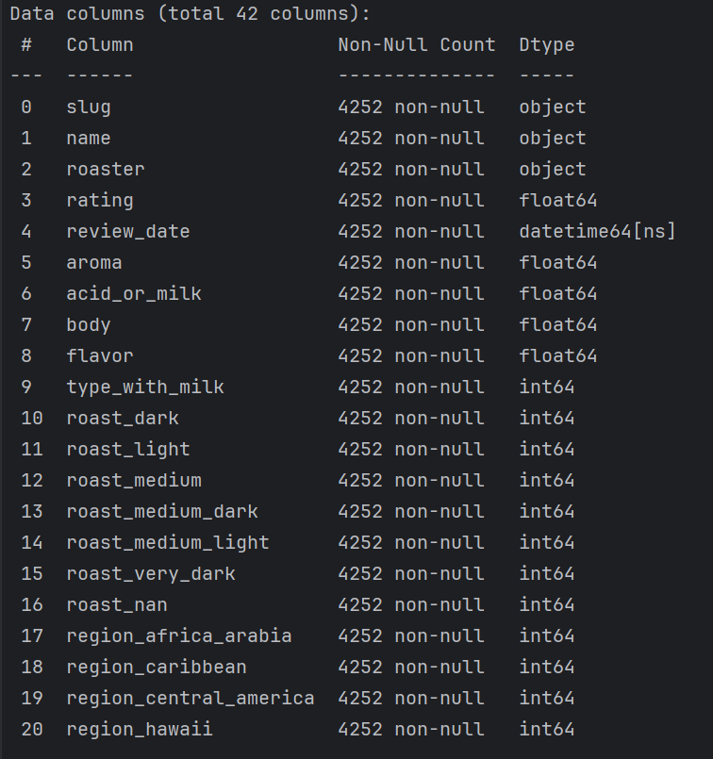
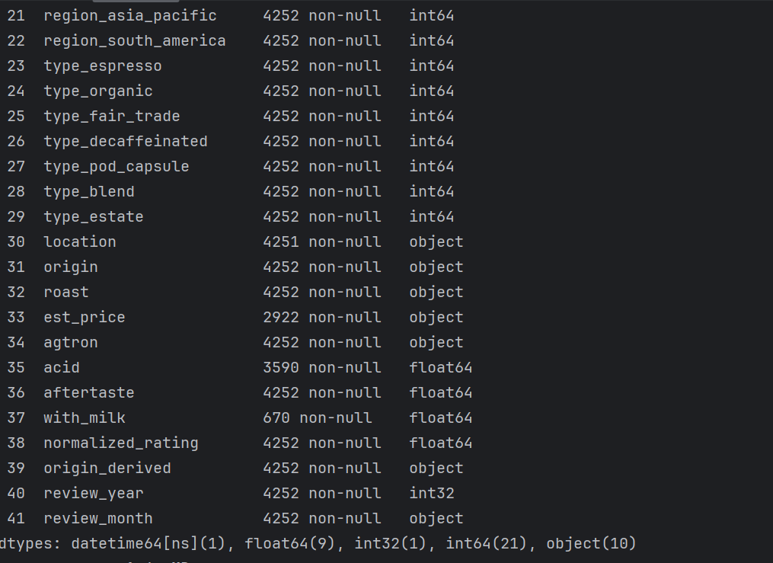
Final Dataset Overview
Total records: 4252
Total variables: 42

Slide 10

Business Questions and Insights

Slide 11
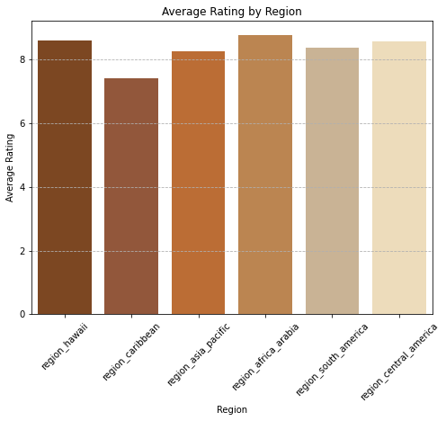
Average Rating Per Region
Africa Arabia has highest average rating of 8.78.
Hawaii comes next with an average rating of 8.59.
Central America follows with a rating of 8.59.

Slide 12
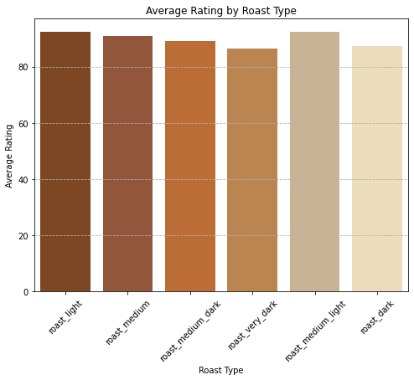
Average Rating Per Roast Type
Light roast type has the highest rating of 92.42
Medium-light roast comes next with a rating of 92.38

Slide 13
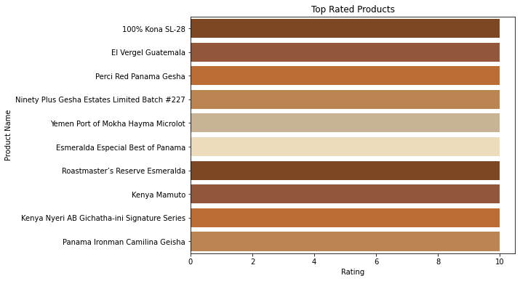
Top Rated Products
Top-rated products with a perfect rating of 10 include 100% Kona SL-28, El Vergel Guatemala, Perci Red Panama Gesha, and others, reflecting their exceptional quality.

Slide 14
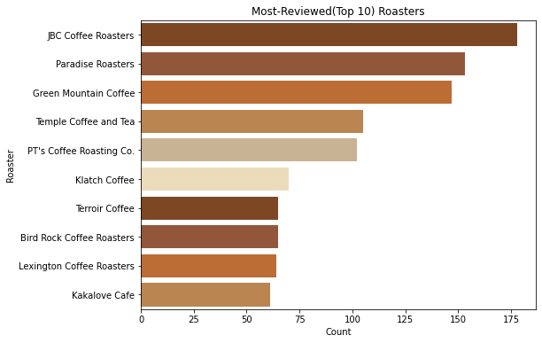
Most Reviewed Roasters
JBC Coffee Roasters leads with the highest number of reviews (178).
Paradise Roasters got second highest reviews (153).
Green Mountain Coffee comes next with 147 reviews.

Slide 15
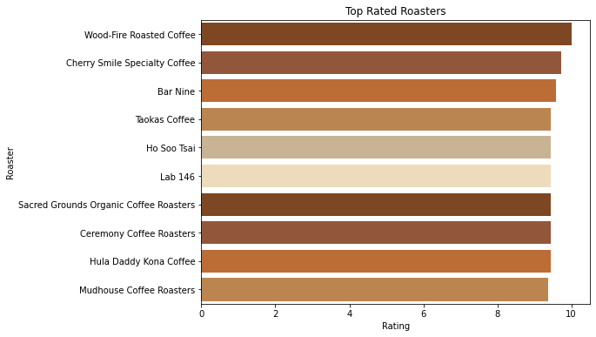
Top Rated Roasters
Wood-Fire Roasted Coffee achieved the highest average rating of 10.
Cherry Smile Specialty Coffee got second highest rating, 9.71.
Bar Nine comes next with 9.57 as average rating.

Slide 16
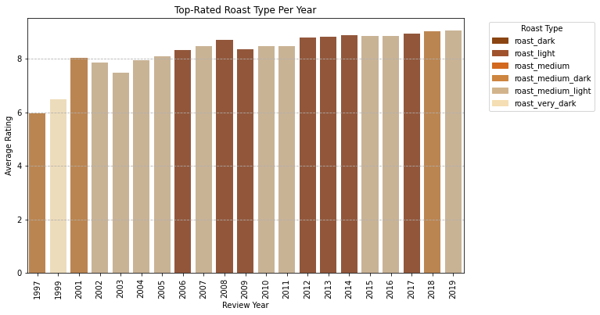
Top Rated Roast Type Per Year
Medium Light Roast has consistently received the highest ratings in most years.
Light Roast follows closely as the second most highly rated roast type over the years.

Slide 17
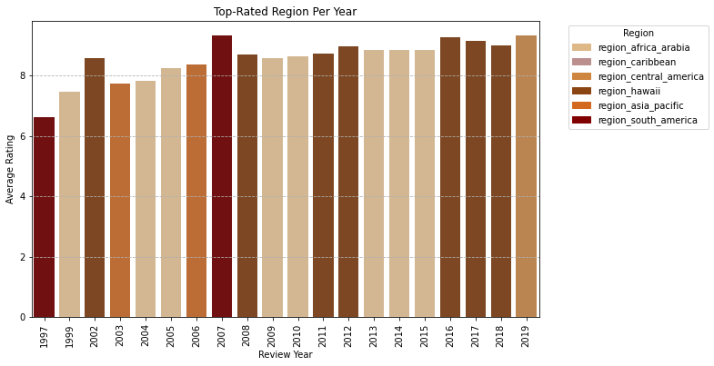
Top Rated Region Per Year
Africa-Arabia region has maintained the highest ratings in most years.
Hawaii region ranks as the second highest-rated over the years.

Slide 18
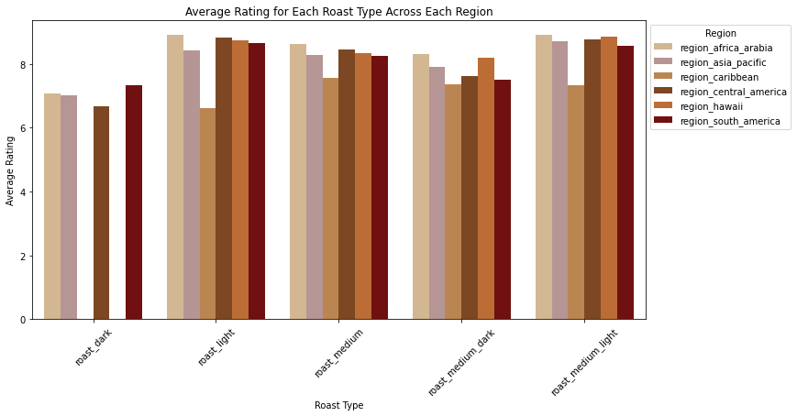
Average Rating For Each Roast Type Across Each Region
Africa-Arabia region: All roast type from this region has exceptionally high rating.
Caribbean region: All roast types from this region got comparatively lower rating.

Slide 19
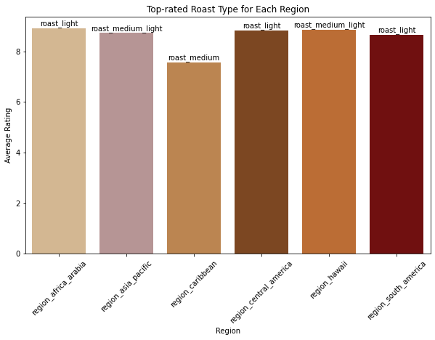
Top Rated Roast Type For Each Region
Africa-Arabia: This region got light roast as the best roast type with an average rating of 8.91.
Asia-Pacific: This region got medium light as the best roast type with an average rating of 8.71.
Caribbean: Medium roast is the best roast type for this region.
Central America: Light roast is the top-rated roast with an average rating of 8.82.
Hawaii: Medium light is the best roast type.
South America: Light roast is the top-rated roast type for South America.

Slide 20
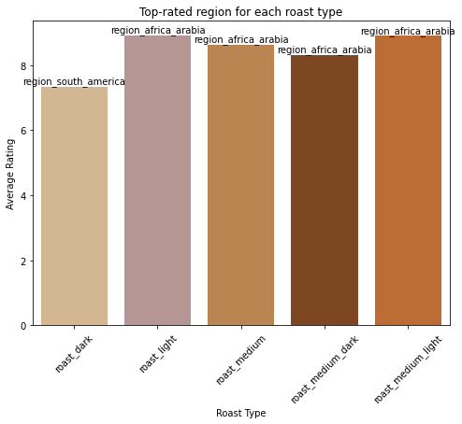
Top Rated Region For Each Roast Type
Light Roast: The top-rated is from Africa Arabia region (8.91).
Medium Roast: Africa Arabia is again the top-rated region (8.63).
Medium-Dark Roast: Africa Arabia leads with a rating of (8.31).
Medium-Light Roast: Africa Arabia tops the list with a rating of (8.90).
Dark Roast: The top-rated is from South America region with a rating of (7.32)

Slide 21
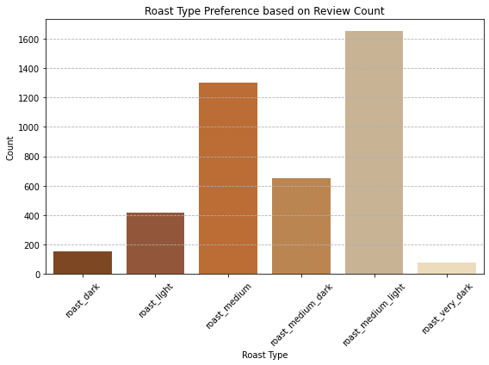
Most Popular Roast Type based on Review Count
Medium Light Roast is the most popular roast type based on review count.

Slide 22
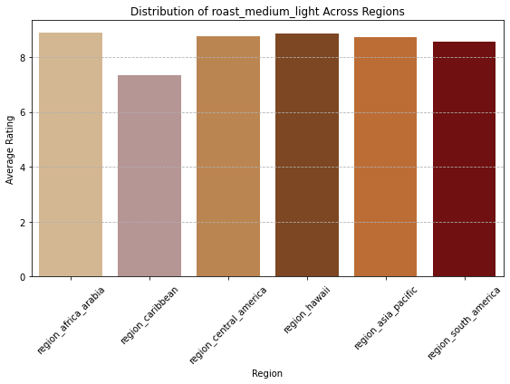
Distribution of Most Popular (Review Count) Roast Type
Medium Light Roast got highest average rating(8.89) from Africa-Arabia region and the lowest (7.32) from Caribbean region.

Slide 23
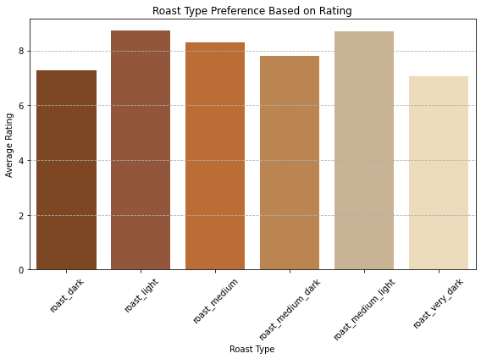
Most Popular Roast Type based on Rating
Light Roast is the most popular roast type based on rating.

Slide 24
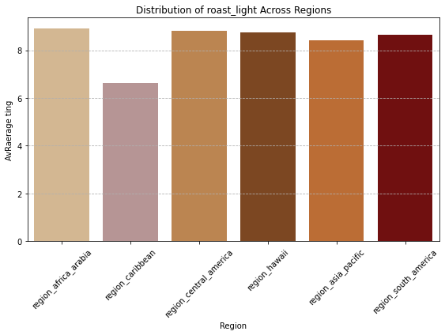
Distribution of Most Popular (Rating) Roast Type
Light Roast got highest average rating(8.91) from Africa-Arabia region and the lowest (6.62) from Caribbean region.

Slide 25
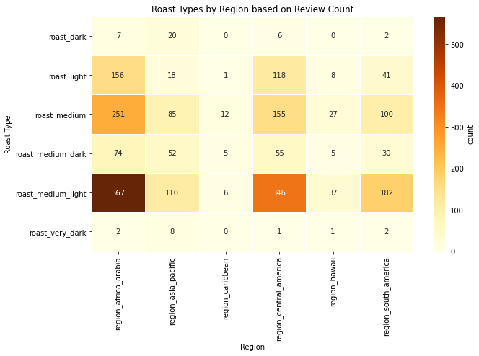
Distribution of Roast Types by Region
Medium Light Roast from africa-arabia region got highest number of reviews, followed the by Medium Light Roast from central America.

Slide 26
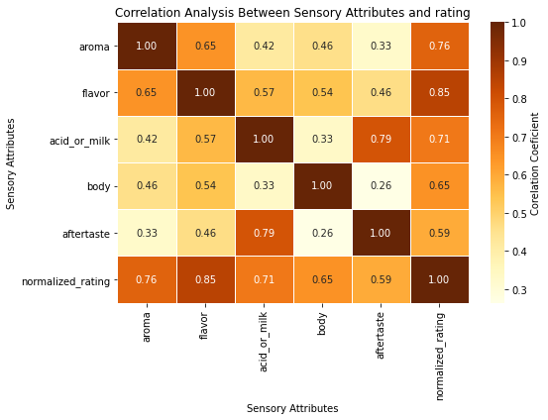
Relationship Between Sensory Attributes And Rating
Sensory attributes showing a strong correlation with rating, exceptionally aroma and flavor.
Aroma has a correlation of 0.76, while flavor exhibits the highest correlation at 0.85.

Slide 27
Regression Model To Predict Ratings

Slide 28

Feature Set
And Target
Feature Set
Roast Types
Regions
Sensory attributes
Target
normalized_rating
roaster

Slide 29

Roaster
Encoding Techniques
One Hot Encoder
One-hot encoding is a method used to convert categorical data into a numerical format by creating binary columns for each category, where 1 represents the presence of a category and 0 represents its absence.
Applied One-Hot Encoding to convert categorical 'roaster' values into binary features for machine learning model input.

Slide 30
Models And Parameters
Linear Regression
No parameters
Kneighbors Regressor
n_neighbors = 5
Decision Tree Regressor
max_depth = 5
min_samples_split = 10
min_samples_leaf = 2
random_state = 42
Random Forest Regressor
n_estimators=100
random_state=42

Slide 31
Regression Model Evaluation
Linear Regression
Mean squared error: 0.077
Random Forest
Mean squared error: 0.082
Decision Tree
Mean squared error: 0.113
R2: 0.879
R2: 0.871
R2: 0.822
Linear Regression: lowest MSE (0.077) and highest R2 (0.879) indicating the best predictive accuracy.
Random Forest Regressor: shows strong performance with a high R2 (0.871) and relatively low MSE (0.082)
Decision Tree Regressor: Moderate performance with an R2 of 0.822 and an MSE of 0.113
Kneighbors Regressor: The lowest performance with an R2 of 0.637 and a an MSE of 0.232.
Knn
Mean squared error: 0.232
R2: 0.637

Slide 32

Classification Model to Categorize Products into Popularity Tiers

Slide 33

Feature Set
And Target
Feature Set
Roast Types
Regions
Sensory attributes
Target
popularity_tier
roaster

Slide 34
Techniques For Class Balancing In Classification Model
Data Stratification:
Ensured balanced class representation across the popularity tiers (Highly Popular, Moderately Popular, Less Popular) by setting stratify=Y during data splitting.
Addressing Class Imbalance:
Applied SMOTE (Synthetic Minority Oversampling Technique) to oversample minority classes, improving model performance.
Implementation:
Used SMOTE(random_state=42) for synthetic data generation.
Resampled training data: X_resampled and Y_resampled.

Slide 35
Encoding Techniques and Model Parameters
One-Hot Encoding:
Applied One-Hot Encoding to convert categorical 'roaster' values into binary features for machine learning model input.
Decision Tree Classifier :
Employed decision tree classifier to categorize coffee products into ‘Highly Popular’ ,’Moderately Popular’, and ‘Less Popular’ tiers based on ratings.
max_depth=10
min_samples_split=10
min_samples_leaf=2
random_state=42
class_weight='balanced'
Decision Tree Classifier

Slide 36
Classification Model Evaluation
Precision
The percentage of correctly predicted positive cases out of all predicted positive cases.
F1 Score
Recall
The percentage of correctly predicted positive cases out of all actual positive cases.
The harmonic mean of precision and recall.
Focuses on minimizing false positives.
Focuses on minimizing false negatives.

Slide 37
Classification Model Evaluation (Cont.)
Classification Report
Class | Precision | Recall | F1-Score | Support
Highly Popular | 0.96 | 0.94 | 0.95 | 665
Less | 0.71 | 0.83 | 0.77 | 6
Moderately | 0.79 | 0.87 | 0.83 | 180
Accuracy | 0.92
Macro avg | 0.82 | 0.88 | 0.85 | 851
Weighted avg | 0.93 | 0.92 | 0.92851 | 851
Highly Popular : Excellent performance with high precision (0.96), recall (0.94) and F1 score (0.95)
Moderately Popular : Strong recall (0.87), good precision (0.79) and F1 score (0.83)
Less Popular : Moderate precision (0.71),and and F1 score (0.77), but good recall (0.83)
Model Summary: High accuracy (92%) and strong performance (ROC-AUC: 0.94)

Slide 38
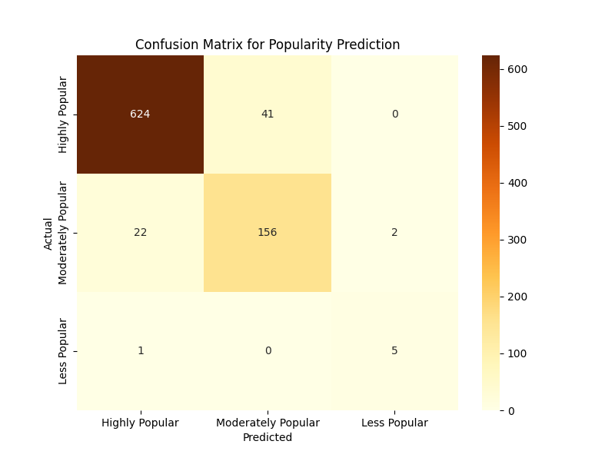
Classification Model Evaluation (Cont.)
Confusion Matrix
Highly Popular : Most instances correctly predicted (624), minor misclassifications as Medium (41).
Moderately Popular : Predicted well (156), small misclassifications into High (22) and Low (2).
Less Popular : Correctly predicted 5 instances, with negligible misclassifications.
Summary: Correctly predicted most instances with some minor misclassifications.

Slide 39
Model Deployment

Slide 40
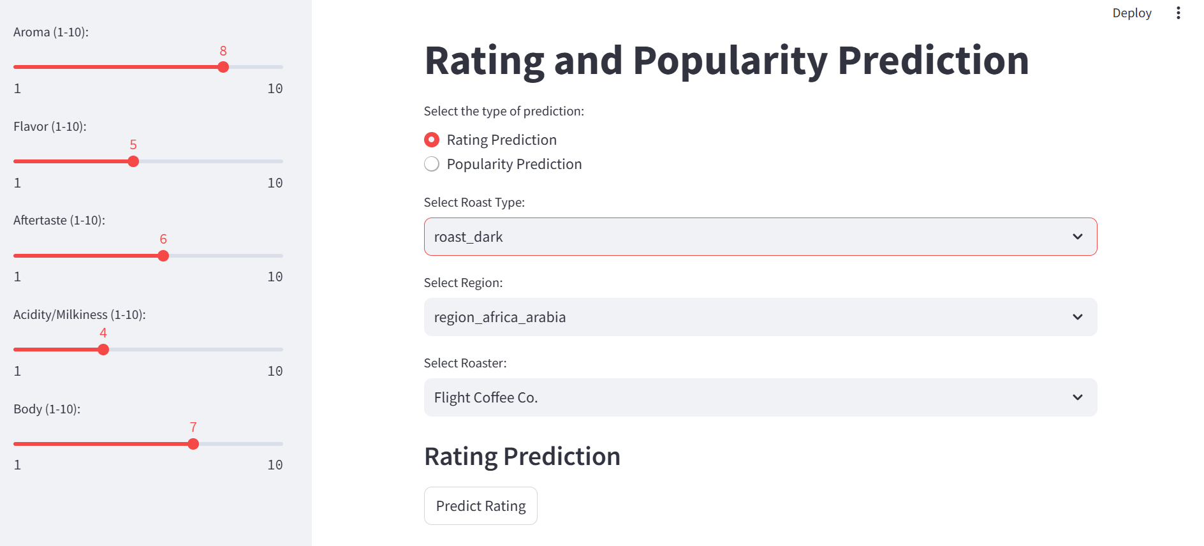
Regression Model To Predict Rating
Deployed the best model (Linear regression) for real-time predictions using Streamlit

Slide 41
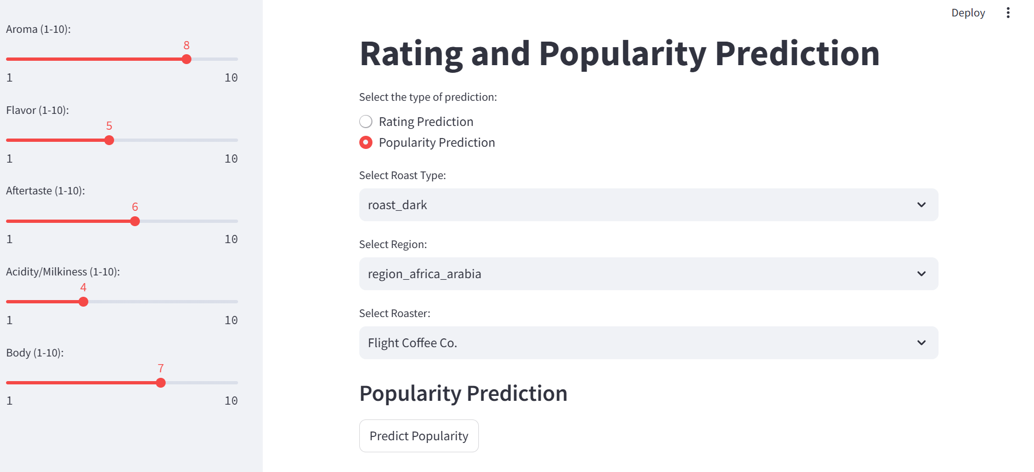
Classification Model to Categorize Products into Popularity Tier
Decision tree classifier is deployed for real-time predictions using Streamlit

Slide 42

Key Insights And Recommendations

Slide 43
Key Insights
Top-rated products include 100% Kona SL-28, El Vergel Guatemala, and Perci Red Panama Gesha.
Attributes such as high-quality sourcing, unique flavor profiles, and exclusive origins drive high ratings.
Light and medium-light are the most highly rated roast types, indicating strong consumer preference.
Coffee from Africa-Arabia and Hawaii regions consistently holds the top spot for highest ratings.

Slide 44
Product Recommendations
Replicate success attributes:
Focus on replicating the characteristics of top-rated products, such as premium sourcing, unique flavor profiles, and origins.
Prioritize medium-light and light roasts:
Prioritize medium-light and light roasts to align with consumer preferences and capitalize on their popularity.
Explore blends inspired by top-rated regions:
Develop special blends using beans from high-rated regions like Africa-Arabia and Hawaii to offer unique experiences that reflect the top-rated roast types.
Introduce limited-edition products:
Offer exclusive, limited-edition coffee releases with medium –light and light roast options, maintaining a sense of rarity and desirability that attracts niche coffee enthusiasts.

Slide 45
Regional Focus
Focus on Africa-Arabia Region:
Since the Africa-Arabia region consistently receives the highest ratings, coffee businesses should prioritize sourcing and promoting beans from this region to appeal to quality-conscious consumers.
Highlight Hawaiian Coffee:
The Hawaii region follows closely in ratings, indicating a strong preference for coffee from this origin. Marketers can position Hawaiian coffee as a premium alternative to Africa-Arabia varieties.
Promote Regional Blends:
Create unique blends using beans from Africa-Arabia and Hawaii region to offer a curated selection that showcases the strengths of each region.
Regional blends can provide consumers with a taste experience that combines the best attributes of each origin, providing both variety and exclusivity.

Slide 46
Marketing Campaigns
Target Popular Roast Types:
Focus on promoting light and medium-light roasts, which consistently receive higher ratings.
Target Key Regions:
Considering the strong ratings for coffee from Africa-Arabia and Hawaii origins, specialty coffee brands should focus on premium markets that prioritize high-quality beans from these regions.
Leverage storytelling:
Highlight the unique origin, cultivation process, and roast profile of coffees in marketing campaigns to emphasize their exclusivity and appeal.
Leverage seasonal offerings:
Introduce seasonal or limited-edition releases based on regional harvests, offering customers something unique at specific times of the year, such as holiday blends or harvest-specialty coffees.

Slide 47


