Slide 1

Nigerian_Road_Traffic_Crashes_2020_2024
By Anumol Issac

Slide 2
Objectives
Analyse crash trends over time by examining the data on a yearly basis and quarterly (seasonal) basis to identify patterns and seasonal variations.
Analyse regional trends in crashes to identify which state experiences the highest and lowest number of crashes.
Analyse the severity of crashes (e.g., total injuries and total killed) and how it varies by state or time.
Analyse the impact of vehicle involvement on crash severity.
Analyse the impact of human and weather factors, including speed violations (SPV),Driving Under Alcohol/Drug Influence (DAD), poor weather (PWR), fatigue (FTQ), and other factors on crash severity

Slide 3
Analytical Approach
Data Collection and Loading:
Acquiring the dataset and loading it into the Jupyter notebook using Pandas for analysis
Exploratory Data Analysis (EDA):
Basic Dataset Analysis: Analysing dataset structure, variables and summary statistics
Handling Missing Values: Identifying and addressing missing values
Univariate Analysis: Analysing individual variables for identify their distribution
Bivariate Analysis: Analysing how two variables are related to each other
Multivariate Analysis: Examining how multiple variables related to each other.

Slide 4
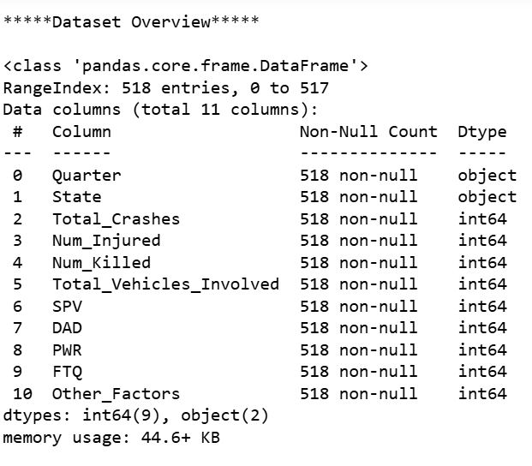
Data Summary
Dataset Overview:
Total records: 518
Total variables: 11
Missing values: No missing values
Data source: Kaggle

Slide 5
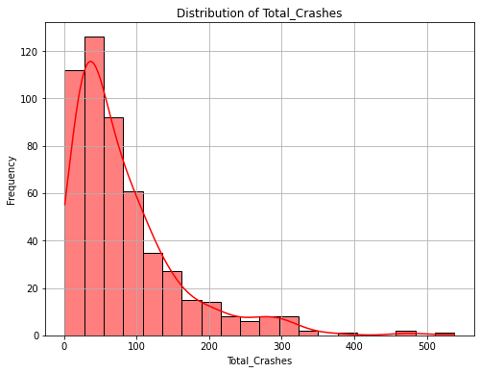
Distribution Of Total Crashes
Most of the states experience moderate number of crashes in each quarter

Slide 6
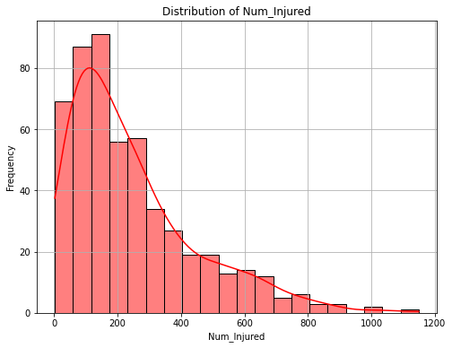
Distribution Of Injuries
Most of the states experience moderate number of injures per quarter

Slide 7
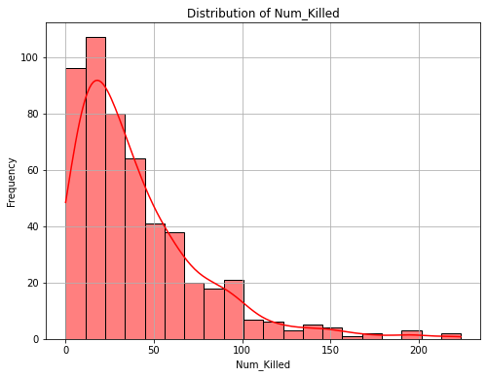
Distribution Of Fatalities
The number of fatalities across states are generally moderate per quarter

Slide 8
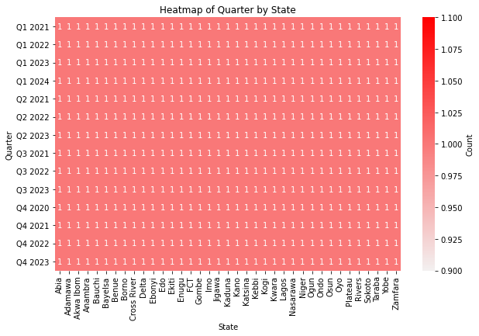
Quarter-state Relationship In Dataset
Each Quarter-state combination is unique in this dataset

Slide 9
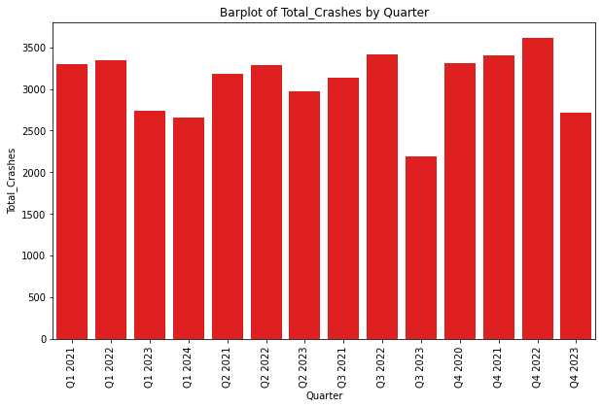
Quarterly Trends In Total Crashes
Q4 2022
Highest number of crashes
Q3 2023
Lowest number of crashes

Slide 10
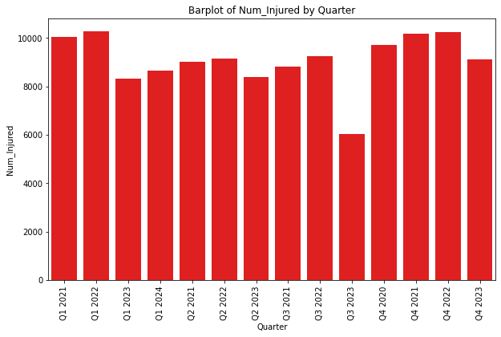
Quarterly Trends In Number of Injuries
Highest
Q1 2022, Q4 2022
Lowest
Q3 2023

Slide 11
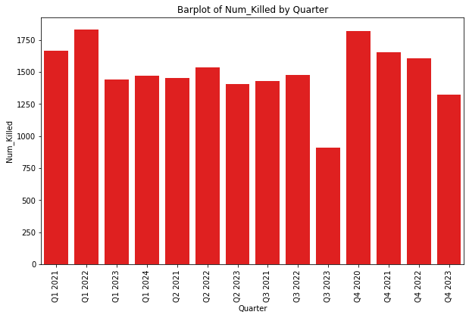
Quarterly Trends In Number of Fatalities
Highest
Q1 2022,Q4 2020
Lowest
Q3 2023

Slide 12
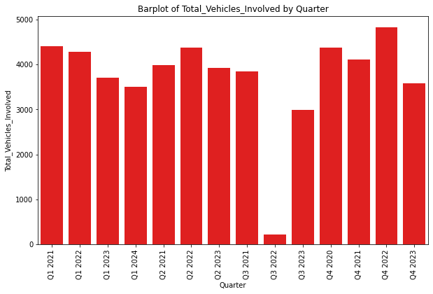
Quarterly Trends In Vehicles Involved
Highest
Q4 2022,Q1 2021
Lowest
Q3 2022

Slide 13
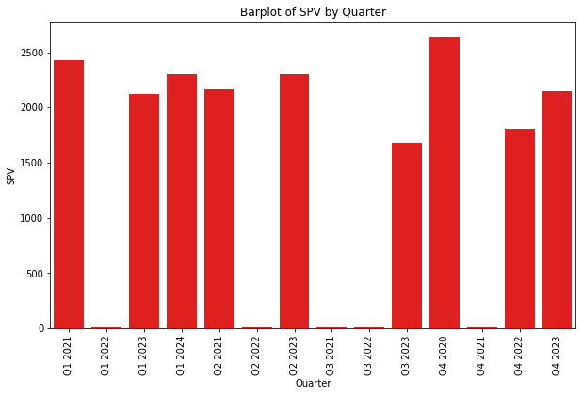
Quarterly Trends In Speed Violation
Highest
Q4 2020, Q1 2021
Lowest
Q1 2022,Q3 2021, Q3 2022,Q4 2021,Q2 2022

Slide 14
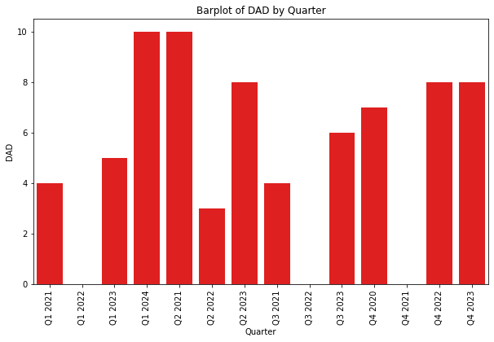
Quarterly Trends In Driving Under Alcohol/Drug Influence
Highest
Q1 2024, Q2 2021
Lowest
Q1 2022, Q3 2022, Q4 2021

Slide 15
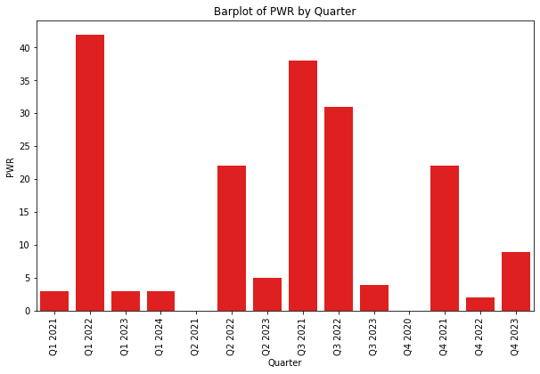
Quarterly Trends In Poor Weather
Highest
Q1 2022, Q3 2021
Lowest
Q2 2021, Q4 2020

Slide 16
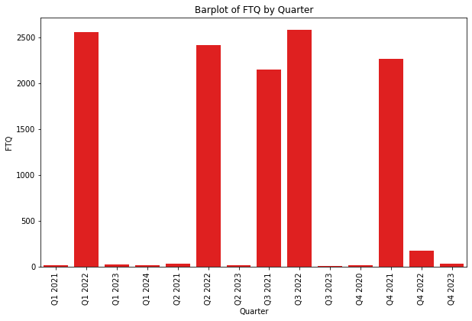
Quarterly Trends In Fatigue
Highest
Q3 2022, Q1 2022
Lowest
Q3 2023

Slide 17
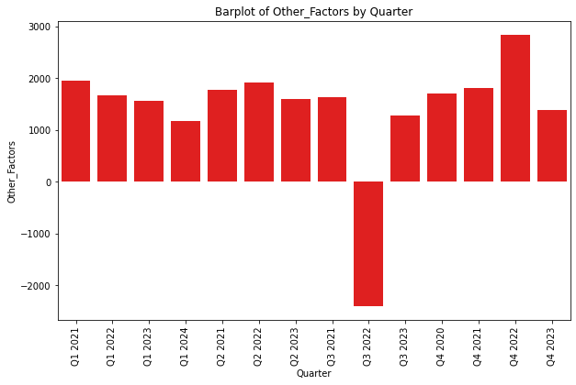
Quarterly Trends Due to Other Factors
Highest in Q4 2022

Slide 18
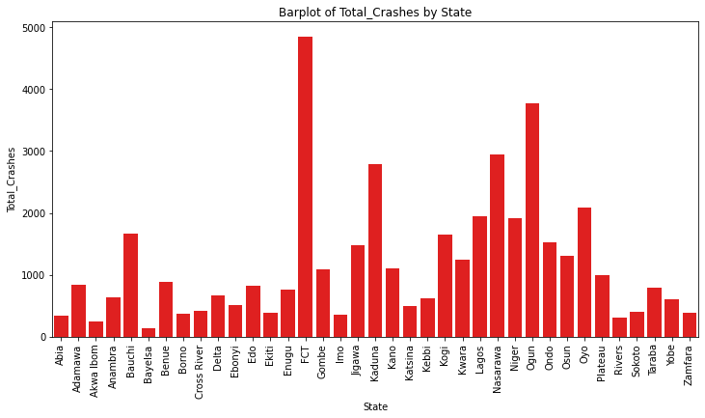
Total Crashes By State
FCT
highest number of crashes
BAYELSA
Least number of crashes

Slide 19
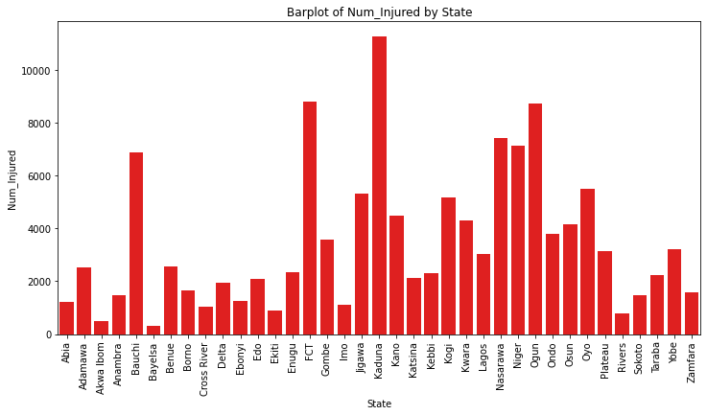
Total Injuries By State
KADUNA
State having highest number of injuries
BAYELSA
State having lowest number of injuries

Slide 20
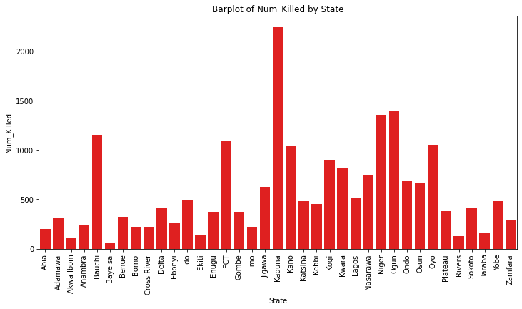
Total Death By State
KADUNA
Highest number of deaths reported
BAYELSA
Lowest number of deaths reported

Slide 21
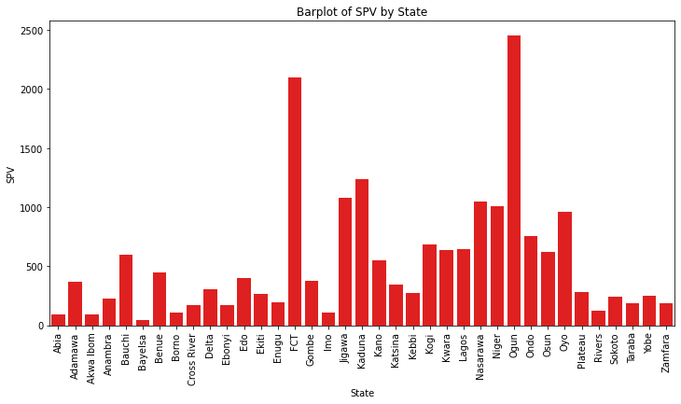
Speed Violation (SPV) By State
OGUN
Highest number of speed violation cases, followed by FCT
BAYELSA
Lowest number of speed violation cases

Slide 22
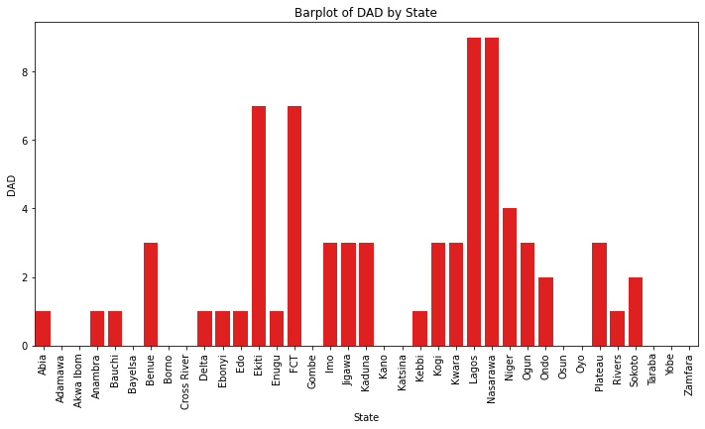
Driving Under Alcohol/Drug Influence (Dad) By State
LAGOS & NASARAWA
Reports highest number of vehicles involved in crashes due to DAD, followed by FCT and EKITI

Slide 23
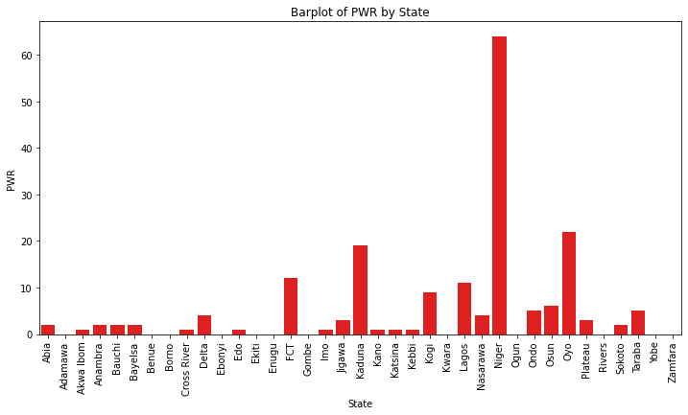
Poor Weather By State
NIGER
Reports highest number of vehicles involved in crashes due to poor weather conditions

Slide 24
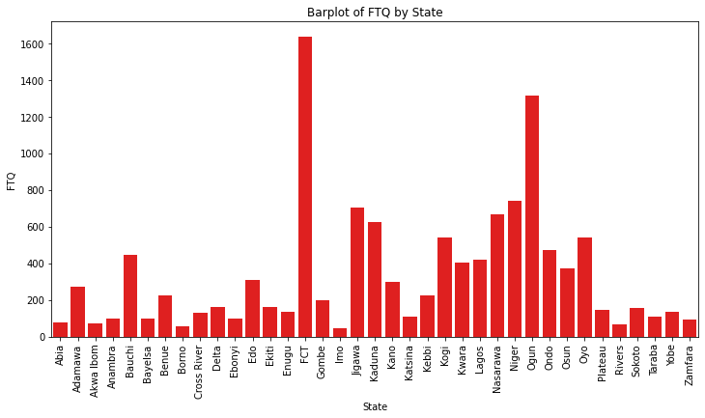
Fatigue By State
FCT
Highest number of cases reported
IMO
Lowest number of cases reported

Slide 25
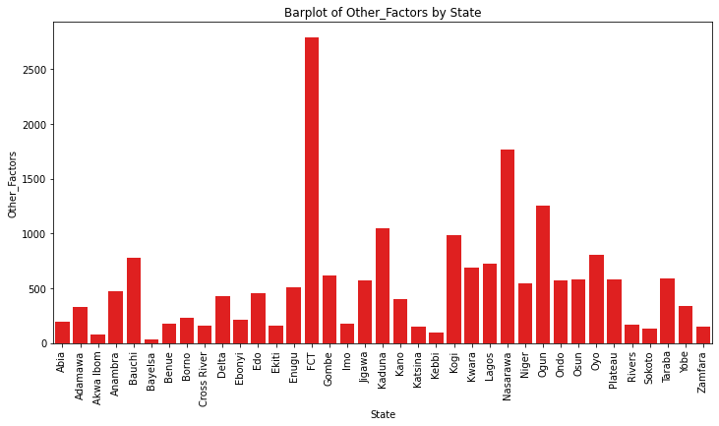
Other Factors By State
FCT
Highest cases of vehicles involved in crashes due to other factors
BAYELSA
Lowest cases of vehicles involved in crashes due to other factors

Slide 26
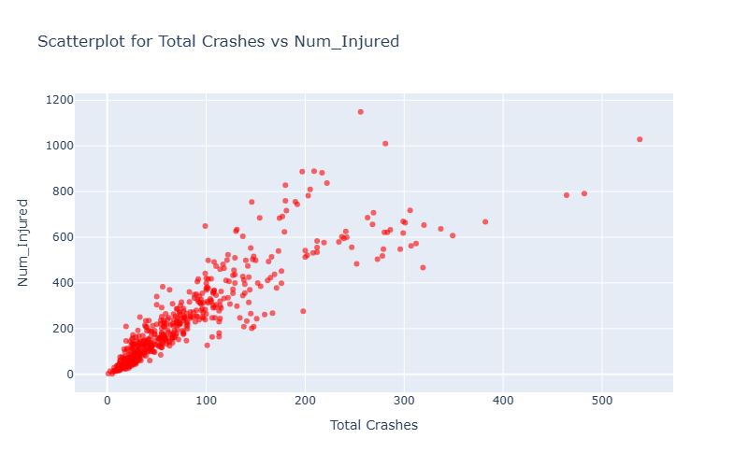
Total Crashes Vs Injuries
Increase in the number of crashes is leading to a higher number of injuries

Slide 27
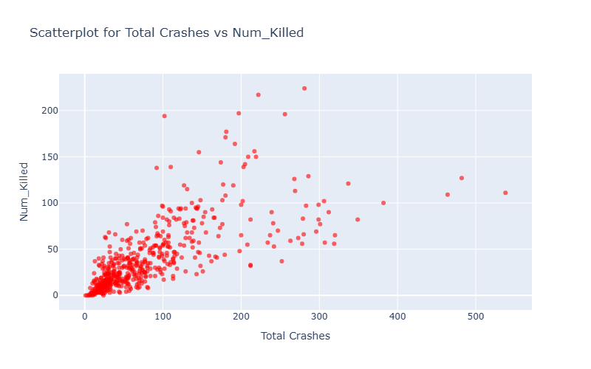
Total Crashes Vs Deaths
Higher number of crashes generally leads to higher number of fatalities

Slide 28
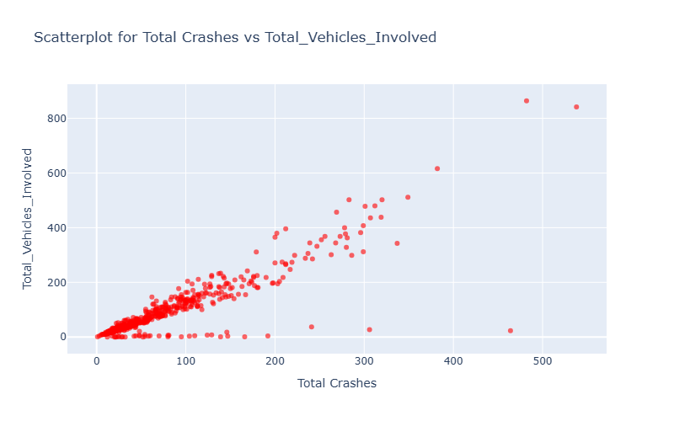
Total Crashes Vs Total Vehicles Involved
As the number of crashes increases, number of vehicles involved also tends to increase

Slide 29
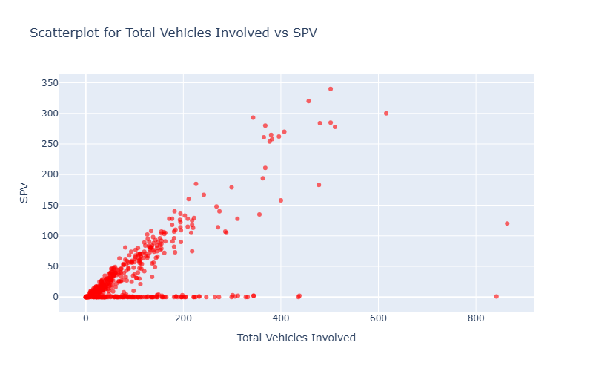
Total Vehicles Involved Vs Speed Violation
Positive corelation suggests speed violation is a significant factor in vehicles involving crashes.

Slide 30
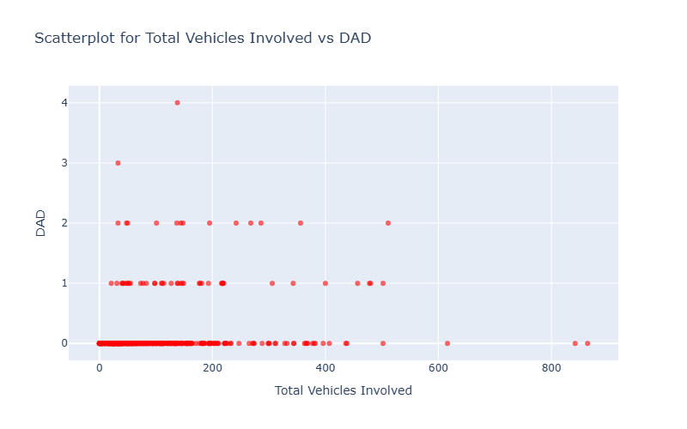
Total Vehicles Involved Vs Driver Under Drug/Alcohol
The influence of DAD on the Total Vehicles Involved in crashes is minimal.

Slide 31
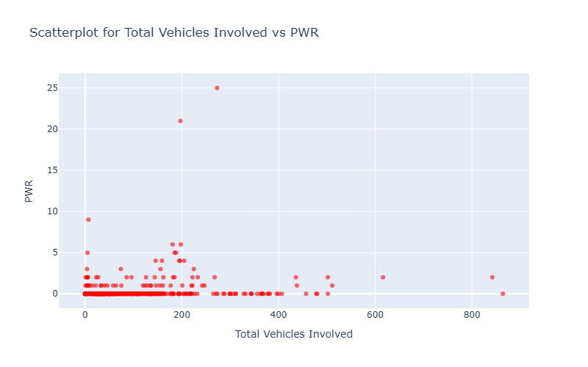
Total Vehicles Involved Vs Poor Weather
Poor weather does not significantly increase vehicle involvement in crashes.

Slide 32
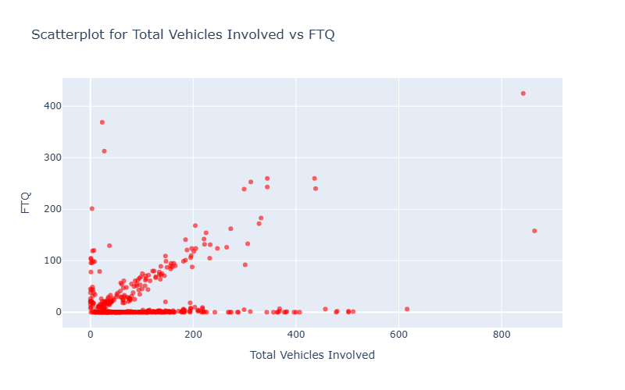
Total Vehicles Involved Vs Driver Fatigue
Driver fatigue can be considered as a significant factor in vehicles involved in crashes.

Slide 33
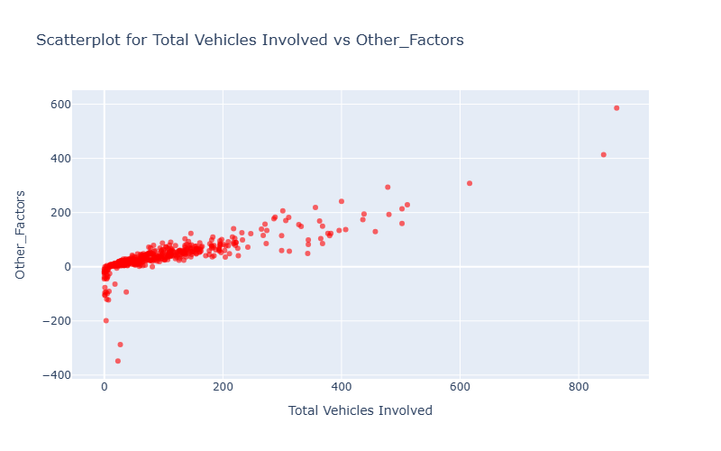
Total Vehicles Involved Vs Other Factors
Other factors significantly increase the vehicle involvement in crashes.

Slide 34

Analysing Crash Trends Over Time

Slide 35
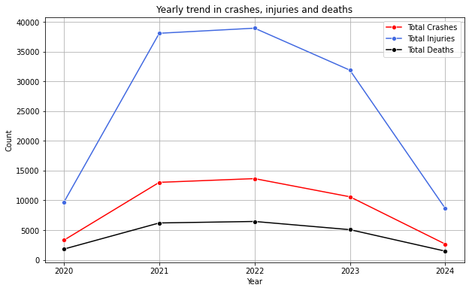
Yearly Trend In Crashes, Injuries And Deaths
Total Crashes: The number of total crashes has been fluctuating over the years, with a peak in 2022 and a significant decrease in 2024.
Total Injuries: Similar to total crashes, injuries have shown a fluctuating trend, with a peak in 2022 and a decline in 2024.
Total Deaths: Deaths have also been fluctuating, with a peak in 2022 and a decrease in 2024.
Year 2022 recorded the highest crash severity, while 2024 showed a notable decrease

Slide 36
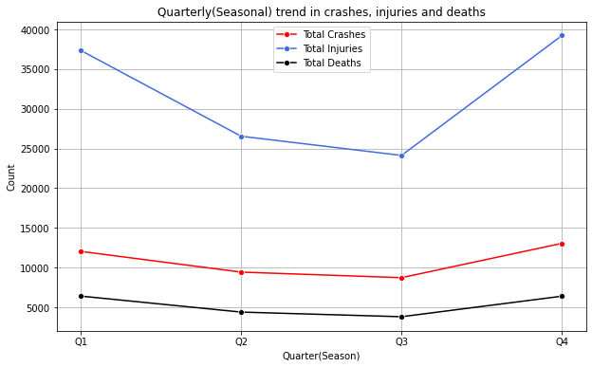
Quarterly Trend In Crashes, Injuries And Deaths
Total Crashes: peaked in Q4, while Q3 experienced the lowest number of crashes.
Total Injuries: peaked in Q4 while while Q3 had the lowest cases.
Total Deaths: Q1 and Q4 reported higher death rates, while Q3 had the lowest.
Crash severity was higher in Q1 and Q4, likely due to extreme weather and the increased holiday traffic.

Slide 37
Analysing Crash Trends By Region

Slide 38
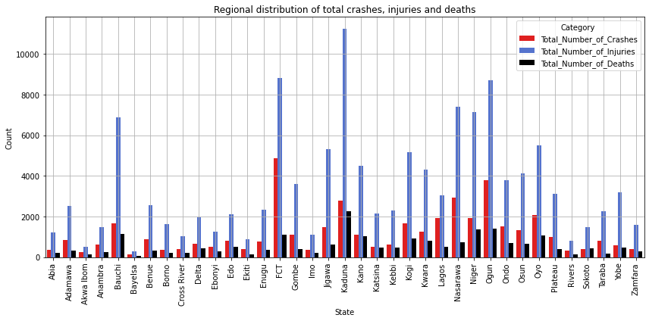
Regional Crash Impact Based On Total Crashes, Injuries And Deaths
FCT: highest number of total crashes
KADUNA : Highest in total injuries and death cases

Slide 39
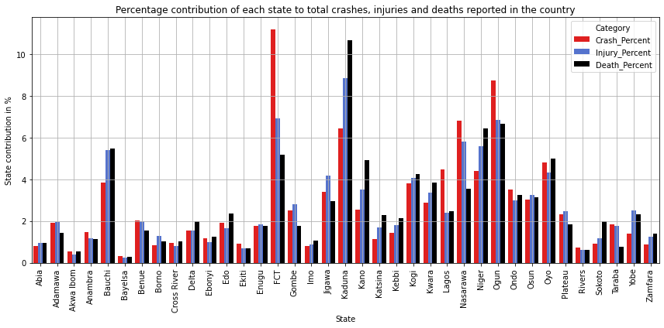
Contribution Of Each State To Total Crashes, Injuries And Deaths Reported In The Country
Crash % | Injury % | Death %
FCT(11.2%) | Kaduna(8.8%) | Kaduna(10.6%)
Ogun(8.7%) | FCT(6.9%) | Ogun(6.6%)
Nasarawa(6.8%) | Ogun(6.8%) | Niger(6.4%)
Kaduna(6.4%) | Nasarawa(5.8%) | Bauchi(5.4%)
Oyo(4.8%) | Niger(5.6%) | FCT(5.1%)

Slide 40
Analysing Severity Of Crashes

Slide 41
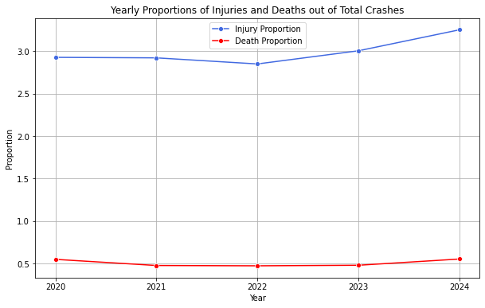
Crash Severity Over Years
Injury Proportion: shows a relatively stable pattern from 2020 to 2022 and slight upward trend from 2022 to 2024.
Death Proportion: shows a relatively stable trend over these years and a slight increase in 2024.

Slide 42
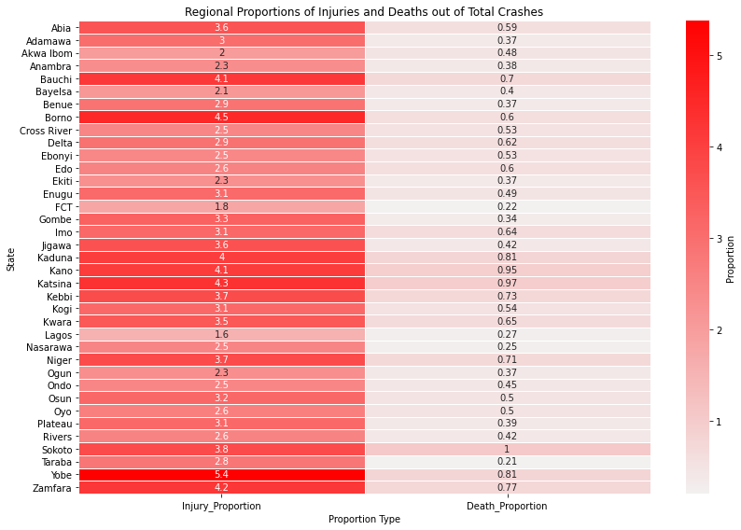
Crash Severity Across States
Injury Proportion: Yobe has a high injury proportion, whereas Lagos and FCT have lower values.
Death Proportion: Sokoto has a high death proportion, while FCT has lowest.

Slide 43
Analysing The Impact Of Vehicle Involvement

Slide 44
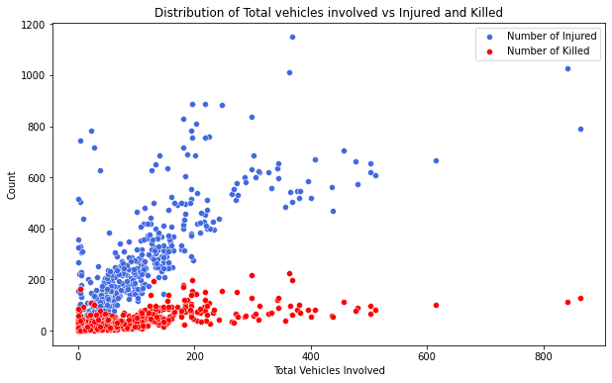
Relationship Between Vehicle Involvement And Crash Severity
As the number of vehicles involved increases, the likelihood of severe accidents also increases.

Slide 45
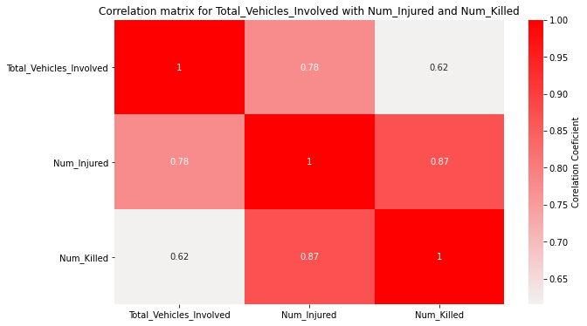
Correlation Between Number Of Vehicles Involved In Crashes With Total Number Of Injuries And Deaths
Strong positive correlation highlights significant impact of vehicle involvement on accident severity

Slide 46
Analysing Impact of Human and Weather factors

Slide 47
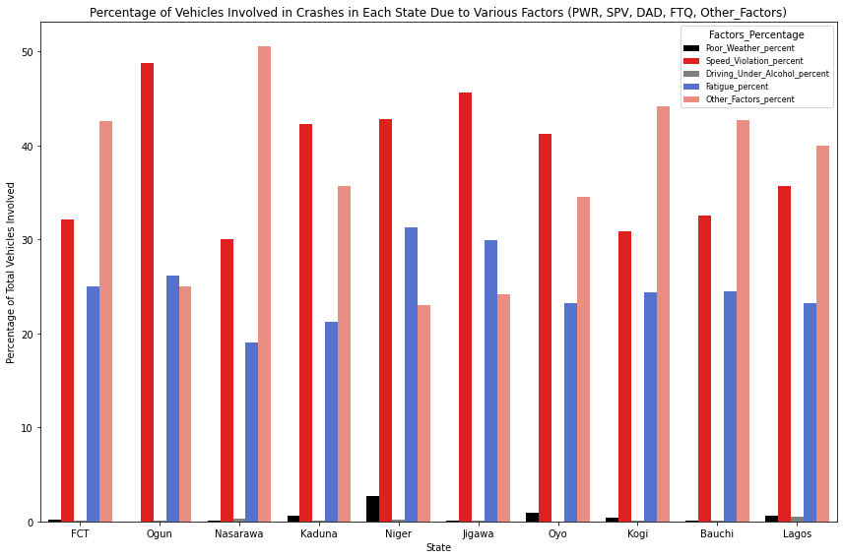
Impact of Human and Weather Factors on Vehicle Involvement Across Top 10 States
Significant Contributors To Crashes:
Speed Violation
Fatigue
Other Factors
Speed Violation
Ogun reports nearly 50% of its vehicles involved in crashes due to speed violation
Fatigue
Niger and Jigawa got above 30% vehicles involved in crashes due to fatigue
Other Factors
Nasarawa repots above 50% vehicles involvement due to other factors

Slide 48
Key Insights
High Crash Severity in 2021-2022: Severity peaked in 2021-2022 but significantly reduced by 2024.
Quarterly(Seasonal) Trends: Q4 and Q1 had higher crash severity, while Q2 and Q3 showed comparatively lower rates.
FCT vs. Kaduna: FCT reported the highest number of crashes, but Kaduna had more injuries and fatalities due to higher speed violations, leading to increased crash severity.
Regional Severity: Despite fewer crashes, Yobe has a higher injury proportion, likely due to higher crash severity and limited safety infrastructure. FCT has more crashes and injuries but a lower injury proportion, indicating better safety measures and emergency response systems.
Vehicle Involvement: Higher vehicle involvement leads to increased crash severity.
Major Factors: Speed violation, fatigue, and other factors are the key contributors to crashes.

Slide 49
Recommendations
Focus on High-Risk Quarters: Implement measures such as increased traffic monitoring, high penalties for traffic violation and awareness campaigns, during Q4 and Q1 to reduce crash severity.
Address Speed Violations: Strengthen speed limit controls and implement more speed cameras especially in states like Kaduna, to reduce crash severity.
State-Specific Strategies: Focus on safety measures in states like Yobe and Sokoto, where injury proportion and death proportion are higher despite fewer crashes. Promote safe driving practices and improve emergency response.
Address Fatigue and Other Factors: Promote regular rest breaks for drivers and implement regulations to address the other contributing factors.

Slide 50
THANK YOU

