Slide 1

Predicting User Satisfaction from Medicine Data: An In-Depth Analysis
Anumol Issac

Slide 2
Objectives
Analyze factors influencing user satisfaction:
Explore the dataset to identify key features that impact user satisfaction.
Predict user satisfaction Rating:
Apply machine learning models to predict user satisfaction rating based on the identified features and data insights.
Deploy the model:
Select the best performing model and deploy it using Streamlit for practical usability and user interaction.

Slide 3
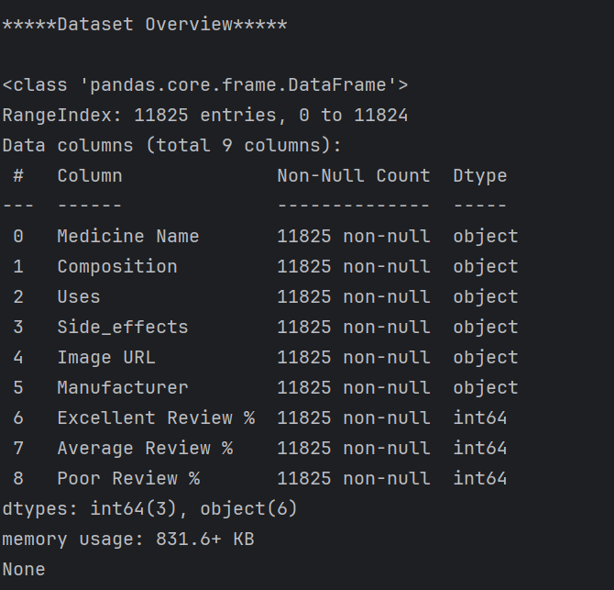
Data Summary
Dataset Overview:
Total records: 11825
Total variables: 9
Missing values: No missing values
Data source: Kaggle

Slide 4
Analytical Approach
Data Exploration and Preprocessing:
Clean and preprocess the dataset, handling missing values and duplicate entries.
Create new feature 'Rating' based on review percentages.
Understanding Features:
Analyze the data through visualization and understand the relationship between different features.
Encoding techniques:
Apply encoding techniques to convert categorical features into numerical form.
Feature Engineering and Target Set Creation:
Create a feature and target set for prediction by selecting relevant input variables and defining the target variable.
Train-Test Split:
Split the dataset into training and testing sets.
Apply Machine Learning Techniques:
Apply machine learning techniques to predict user satisfaction and compare performance of different models based on metrics like MSE and R2.
Deploy the best model:
Select the best-performing model based on evaluation metrics and deploy it for future predictions.
Rating = ((5* ['Excellent Review %'] + 3* ['Average Review %'] + 1* ['Poor Review %'])/100)

Slide 5
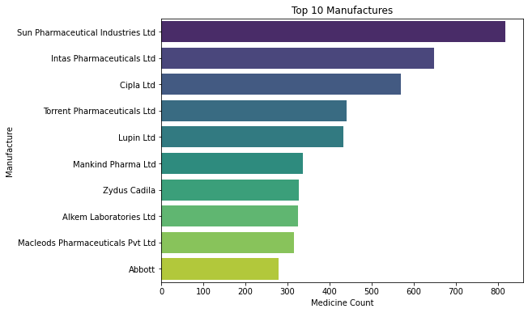
Top 10 Manufactures By Product Count
Sun Pharmaceutical Industries Ltd has the highest product count of 819.
Intas Pharmaceuticals Ltd follows with 648 products.
Cipla Ltd ranks third with 569 products

Slide 6
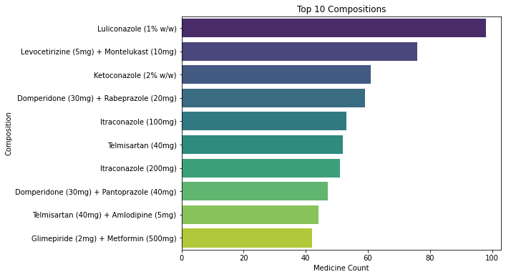
Top 10 Compositions
Luliconazole (1% w/w) appears in the highest number of medicines (98 products).
Levocetirizine (5mg) + Montelukast (10mg) is the second most common composition, found in 76 medicines.
Ketoconazole (2% w/w) and Domperidone (30mg) + Rabeprazole (20mg) are present in 61 and 59 medicines, respectively.

Slide 7

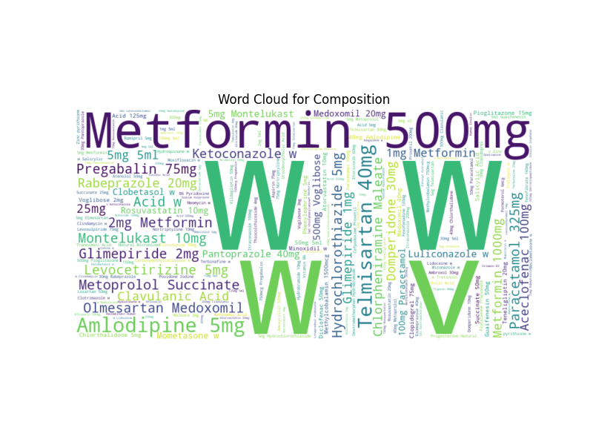
Word Cloud For Composition

Slide 8
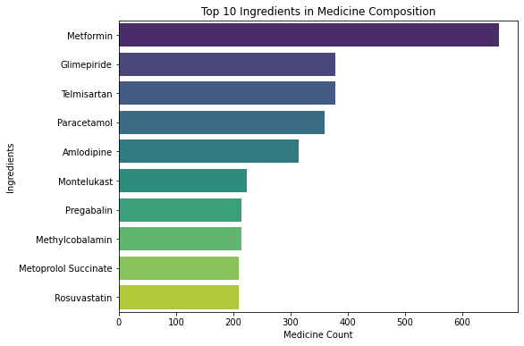
Most Commonly Used(top 10) Ingredients In Medicine Composition
Metformin is the most common ingredient, present in 664 medicines, commonly used for diabetes management.
Glimepiride and Telmisartan are the next most frequent ingredients, appearing in 379 medicines each.
Paracetamol ranks fourth, found in 359 medicines

Slide 9
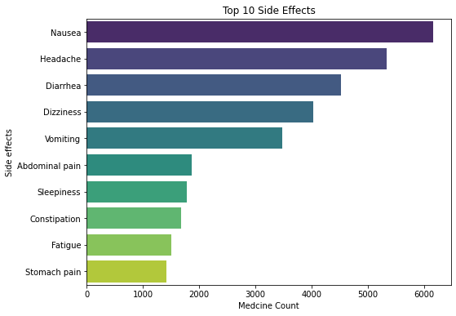
Top 10 (Most Common) Side Effects
Nausea is the most frequently reported side effect, found in 6,170 medicines.
Headache occurs in 5,336 medicines, making it the second most common side effect.
Diarrhea is reported in 4,520 medicines.

Slide 10
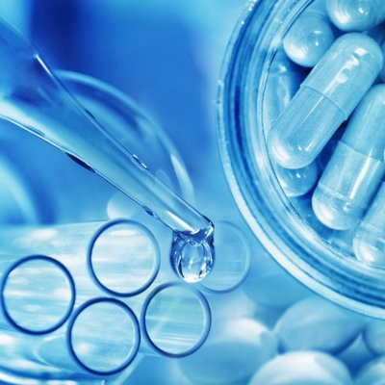
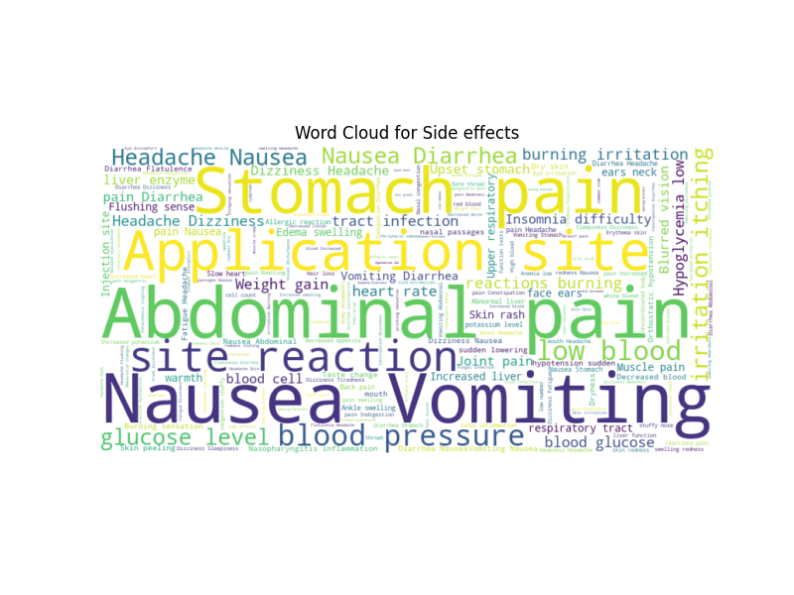
Word Cloud For Side Effects

Slide 11
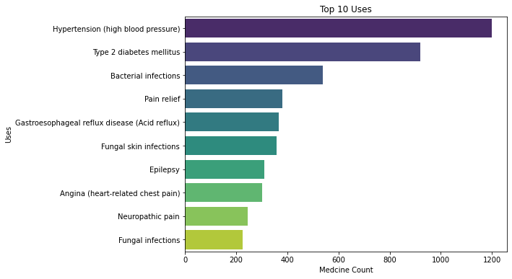
Top 10 Uses
Treatment of hypertension (high blood pressure) is the most common use, with 1200 medicines used for this condition.
Treatment of type 2 diabetes mellitus is treated by 920 medicines.
Treatment of bacterial infections are third most common use, with 540 medicines used for this condition.

Slide 12
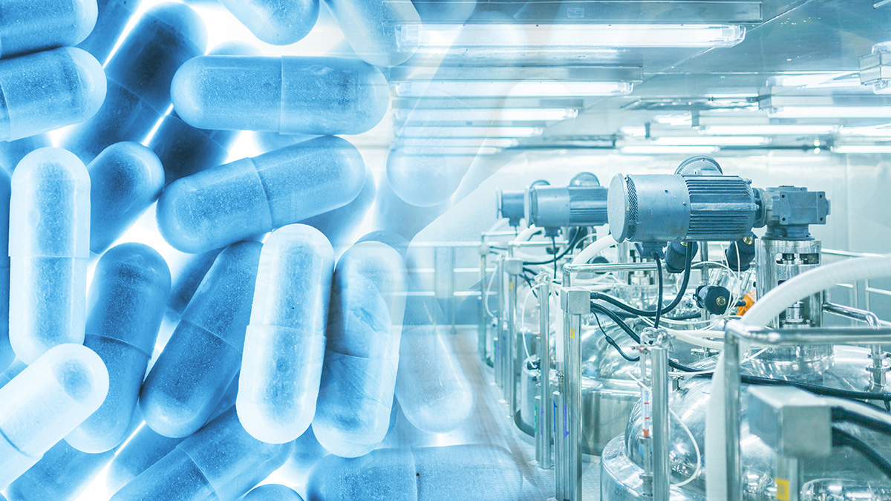
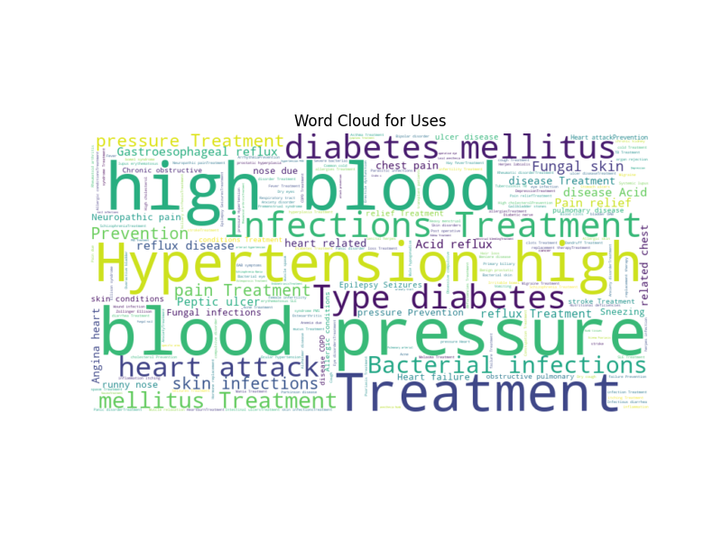
Word Cloud For Uses

Slide 13
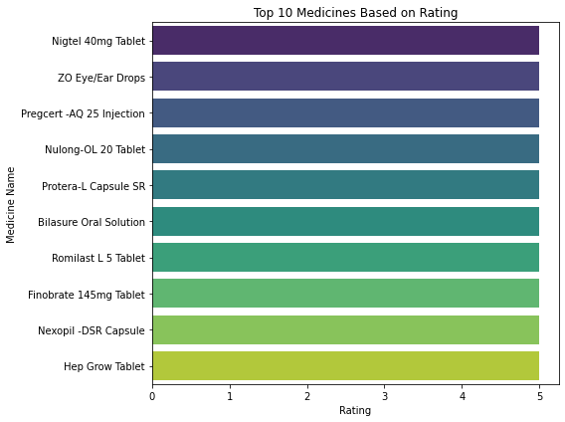
Top 10 Medicines Based On Rating
Top 10 medicines with rating 5 includes Nigtel 40mg Tablet, ZO Eye/Ear Drops, Pregcert -AQ 25 Injection etc.

Slide 14
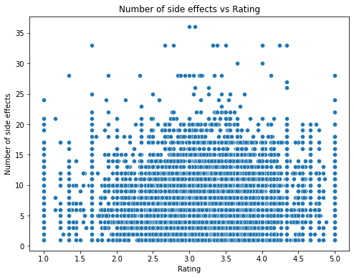
Number Of Side Effects Vs Rating For A Medicine
There is no clear or consistent correlation between the number of side effects and the rating.

Slide 15
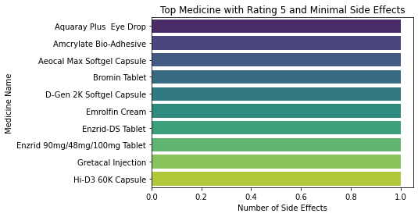
Top 10 Medicine with Rating 5 and Minimal Side Effects
The top-rated medicines (rating 5) with fewer side effects includes, Aquaray Plus Eye Drop, Amcrylate Bio-Adhesive, Aeocal Max Softgel Capsule etc.
All these have rating 5 and side effects less than 2.

Slide 16
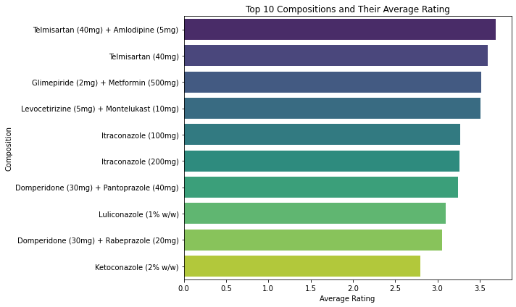
Top 10 Compositions And Their Average Rating
Telmisartan (40mg) + Amlodipine (5mg): Composition with highest average rating, 3.69
Telmisartan (40mg) : Composition with second highest average rating ,3.59
Glimepiride (2mg) + Metformin (500mg): Composition with the third-highest average rating, 3.52

Slide 17
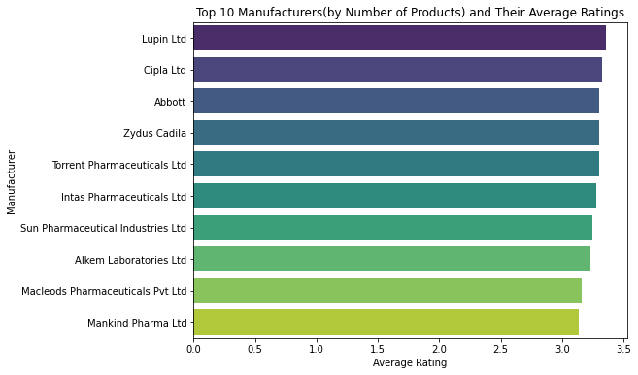
Top 10 Manufactures(Based On Number Of Products) And Their Average Ratings
Lupin Ltd: Manufacturer with the highest average rating, 3.36
Cipla Ltd: Manufacturer with the second-highest average rating, 3.32
Abbott: Manufacturer with the third-highest average rating, 3.30

Slide 18
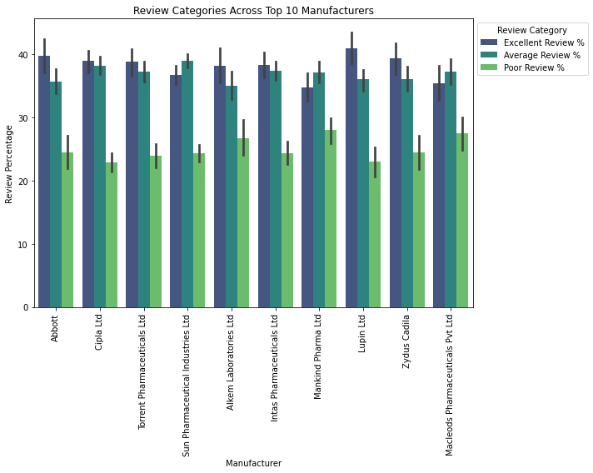
Review Category Of Top 10 Manufactures (Manufactures With Highest Number Of Products)
All top manufacturers have a higher proportion of Excellent and Average reviews compared to Poor reviews.
Lupin Ltd: Manufacturer with the highest proportion of excellent review, suggesting a strong positive perception of their products among consumers.
Abbott: Also has a notably high percentage of Excellent reviews.

Slide 19
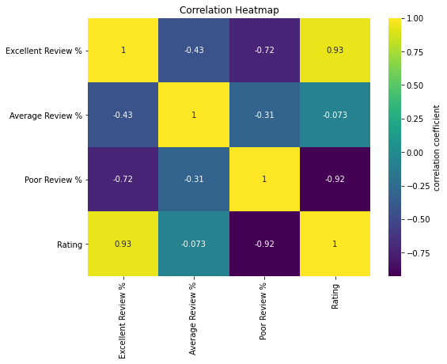
Correlation Between Excellent Review, Average Review, Poor Review, Rating
Excellent Review % and Rating (0.93): A strong positive correlation exists between Excellent Review and Rating, indicating that a higher percentage of excellent reviews tends to result in a higher rating.
Excellent Review % and Poor Review % (-0.72): A strong negative correlation exists between Excellent Review and Poor Review, suggesting that an increase in excellent reviews is associated with a decrease in poor reviews.
Poor Review % and Rating (-0.92): A very strong negative correlation between Poor Review and Rating, indicating that a higher percentage of poor reviews leads to a lower rating.

Slide 20

Feature Set
Medicine Name
Target Variable
Rating
Manufacturer
Composition
Excellent Review %
Average Review %
Poor Review %
Feature And Target Set

Slide 21
Encoding Techniques
Label Encoder
Medicine Name
TF-IDF
Manufacturer
Composition
Label Encoding: converts categorical values into numeric labels, simplifying the representation of data for machine learning models.
TF-IDF: assesses the relevance of a word in a document based on its frequency in the document and its rarity across all documents.

Slide 22
Models And Parameters
KNeighborsRegressor
n_neighbors=5
DecisionTreeRegressor
max_depth=3
min_samples_leaf=2
RandomForestRegressor
n_estimators=100
max_depth=3
min_samples_split=10
random_state=42
random_state=42

Slide 23
Model Evaluation
Random Forest
Mean squared error: 0.029
Decision Tree
Mean squared error: 0.055
KNN
R2: 0.934
Mean squared error: 0.214
R2: 0.745
R2: 0.964
Random Forest Regressor: lowest MSE (0.0296) and the highest R2 (0.9647), indicating the best predictive accuracy.
Decision Tree Regressor: shows strong performance with a high R2 (0.9345) and relatively low MSE (0.0550).
Kneighbors Regressor: slightly less effective with an R² of 0.745 and a higher MSE of 0.214.

Slide 24
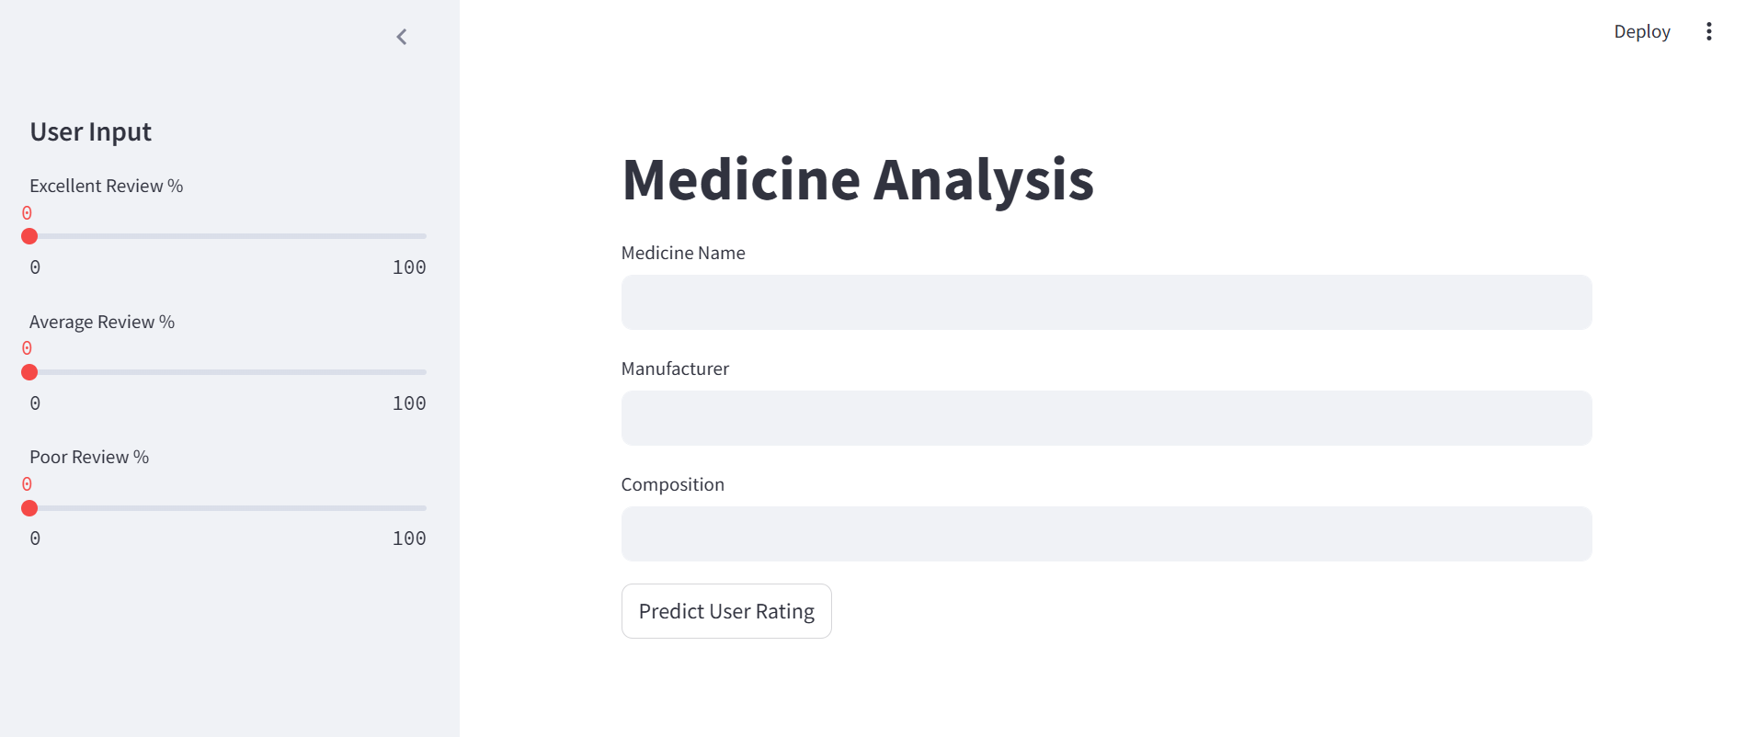
Model Deployment
Deployed the best model (Random Forest Regressor) for real-time predictions using Streamlit

Slide 25
Key Insights
Strong Correlations: The analysis revealed strong correlations between the Excellent Review % and Rating, suggesting that higher percentages of excellent reviews are often associated with higher ratings.
Impact of Side Effects: The relationship between side effects and rating was analyzed, though it was found that the number of side effects does not strongly influence the rating.
Top Performers: Certain compositions and manufacturers consistently received higher ratings, with Telmisartan (40mg) + Amlodipine (5mg) and Lupin Ltd standing out as top performers in terms of average ratings.
Review Categories: Excellent Reviews and Poor Reviews showed a clear inverse relationship, where higher excellent reviews correlate with fewer poor reviews, highlighting the significance of positive feedback in user satisfaction.
Prediction: Medicine Name, Manufacturer, Composition, and Review Categories (Excellent Review %, Average Review %, Poor Review %) were used as key features to predict the user satisfaction rating of medicines.

Slide 26


