Slide 1
Privacy Enabled Noise Free Data Collection in Vehicle Networks
MS Thesis Proposal
Anuj Dimri
Committee Members
Prof. Sneha Kasera (Chair)
Prof. Neal Patwari
Prof. Aditya Bhaskara

Slide 2
Ease of Collecting Location Data
Networked users and devices are interested in participating in distributed sensing and data collection for the purpose of betterment of human society or for earning some monetary rewards.
Mobile devices, sensors and now even vehicles serve as a reliable source of collecting large amounts of location data.
Location data can be collected effectively with the help of these devices and can be used for societal good.

Slide 3
Dynamic Congestion map of a city
Route Planning
Travel Demand Modeling
Different Applications tied to Location Data
Validating transportation data from other sources
Emissions and air pollution modeling
Climatic change impact studies
City Infrastructure Modeling
Homeland Security Evacuation

Slide 4
Importance of Preserving Privacy
Adversary can come to know personal information about the users thereby making them uncomfortable.
Adversary over the period of time can come to know the following things about a user if privacy is lost-
Driving patterns
Frequently visited places
Track a user
Religious beliefs
Political affiliations
If privacy is not preserved the users would stop collecting data.

Slide 5
How to preserve privacy
Using pseudonyms ID’s
Group pseudonyms
Adding noise to data samples
Leads to decrease in utility commonly known as utility-privacy trade-off.
Have to compromise on accuracy because of privacy
Can we preserve the privacy without adding noise to the data samples?
If noise is not added to the data samples then there would be no decrease in utility.

Slide 6
Focus of our work
Privacy Enabled Noise Free data collection approach in Vehicle Networks by introducing temporal and spatial variations using the concept of Random Delays and Indirections

Slide 7
How does mobility helps us
If an adversary receives a data sample after some delay it cannot be associated with the vehicle which is currently at the location where the data was collected.
This is because the vehicle which collected the data would have moved to a new location of which the adversary has no idea.
This approach gives us a two fold benefit of preserving the privacy and getting the data samples in a noise free form.

Slide 8
Protocol for vehicle communication
Dedicated Short Range Communication (DSRC)
Broadcasting protocol
Operates in 5.9 GHz band
Maximum range is 1000 meters
Typical range used is 100-300 meters based on application type.

Slide 9
Our Contributions
Introduce Random Delays and Indirections in the data collection process.
Implement different ways to cause Indirections and experiment with different Random Delays.
Run simulations based on above techniques to get vehicle traces.
Based on application type explore the trade-off between privacy and total delay which is acceptable for the message to be delivered.
Evaluate our methods based on user defined privacy levels.

Slide 10
Challenges
To simulate real vehicular environment and make the vehicles communicate with each other.
To keep track of large number of vehicles and the messages which are being transmitted.
Scaling issues due to broadcast nature of the protocol.
Deciding on the value of random delay and the indirection probability.
Changing random delay and indirection parameters from a freeway/highway environment to a downtown environment.

Slide 11
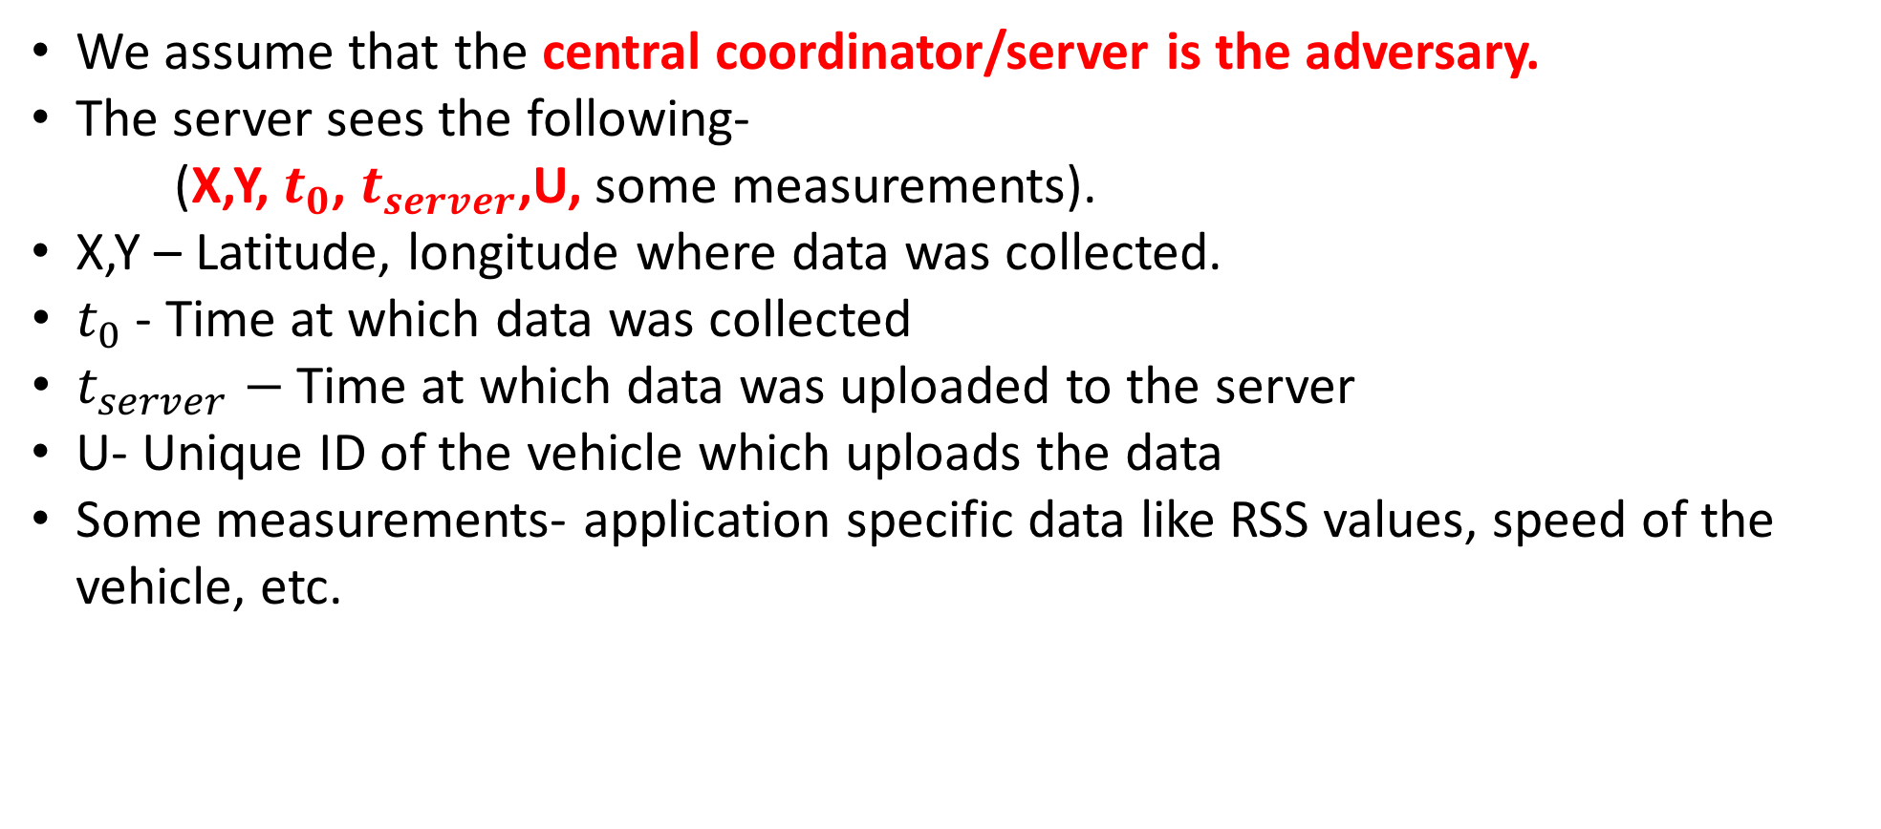
Adversary Model
We assume that the central coordinator/server is the adversary.
The server sees the following-
(X,Y, $t_{0}$, $t_{server}$,U, some measurements).
X,Y – Latitude, longitude where data was collected.
$t_{0}$ - Time at which data was collected
$t_{server}−$Time at which data was uploaded to the server
U- Unique ID of the vehicle which uploads the data
Some measurements- application specific data like RSS values, speed of the vehicle, etc.

Slide 12
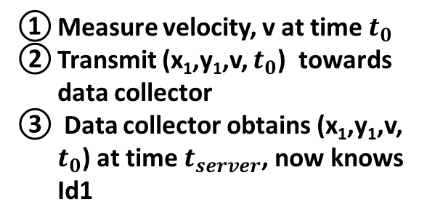
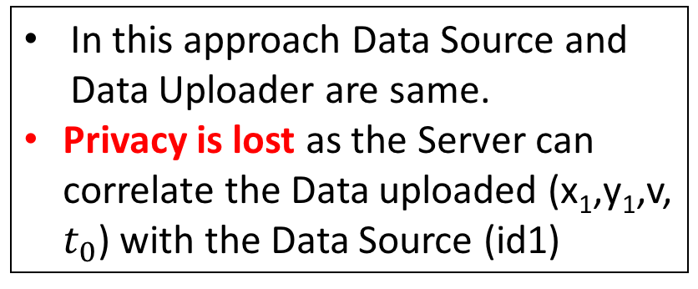

Basic Approach
In this approach Data Source and Data Uploader are same.
Privacy is lost as the Server can correlate the Data uploaded (x₁,y₁,v, $t_{0}$) with the Data Source (id1)
Computing
cloud
Measure velocity, v at time $t_{0}$
Transmit (x₁,y₁,v, $t_{0}$) towards data collector
Data collector obtains (x₁,y₁,v, $t_{0}$) at time $t_{server}$, now knows Id1
Data Collector
(Server)
3
Communication Network
(x₁, y₁)
2
Id1
Data source ($S_{0}$)
1

Slide 13
Indirections
Data not uploaded to the server directly.
Each node has an option of uploading the data to the server with some probability or forward the data to one of its neighboring node.
Let p(I) be the probability of indirections.
If p(I) = 1 then the node always uploads the data to the server.
If p(I) = 0.2 then the node uploads the data to the server with probability 0.2 and with probability 1−p(I) it forwards the data to one of its neighbors.
Thus the data would reach the server after multiple hops.

Slide 14
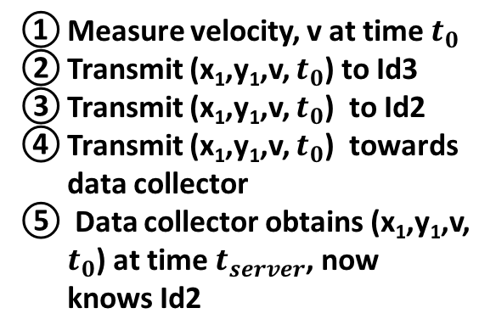
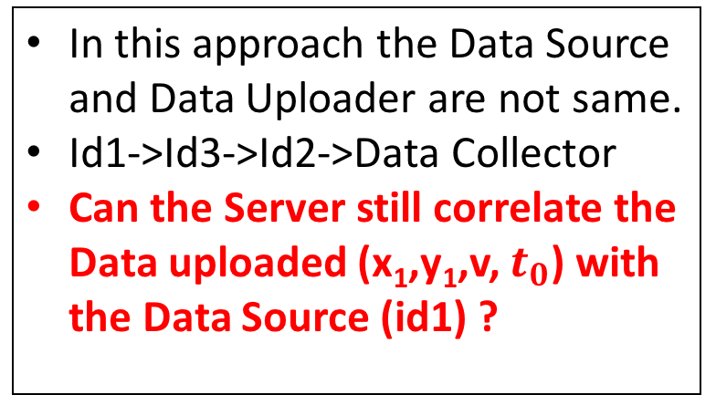

Introducing Indirections
Computing
cloud
Measure velocity, v at time $t_{0}$
Transmit (x₁,y₁,v, $t_{0}$) to Id3
Transmit (x₁,y₁,v, $t_{0}$) to Id2
Transmit (x₁,y₁,v, $t_{0}$) towards data collector
Data collector obtains (x₁,y₁,v, $t_{0}$) at time $t_{server}$, now knows Id2
Data Collector
(Server)
In this approach the Data Source and Data Uploader are not same.
Id1->Id3->Id2->Data Collector
Can the Server still correlate the Data uploaded (x₁,y₁,v, $t_{0}$) with the Data Source (id1) ?
5
Communication Network
4
Id2
Id3
(x₃, y₃)
(x₅, y₅)
3
Id5
(x₂, y₂)
(x₁, y₁)
Id4
2
Id1
Data source ($S_{0}$)
(x₄, y₄)
1

Slide 15

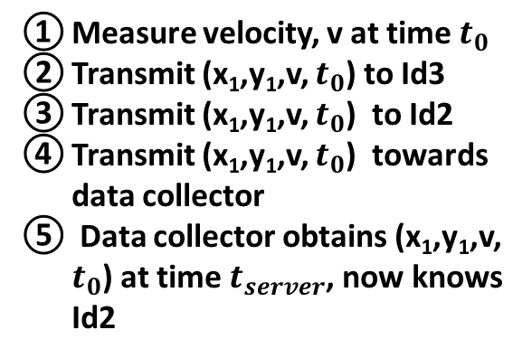
Introducing Indirections
Computing
cloud
Measure velocity, v at time $t_{0}$
Transmit (x₁,y₁,v, $t_{0}$) to Id3
Transmit (x₁,y₁,v, $t_{0}$) to Id2
Transmit (x₁,y₁,v, $t_{0}$) towards data collector
Data collector obtains (x₁,y₁,v, $t_{0}$) at time $t_{server}$, now knows Id2
YES
The time taken to transmit the data from one node to other is only 100 ms
The total delay after which data is uploaded is 300 ms
In 300 ms the distance traveled by Id1 is very less (5.36 meters if traveling at 40 mph)
Thus the server has an idea of new location of the Data Source.
Data Collector
(Server)
5
Communication Network
4
Id2
Id3
(x₃, y₃)
(x₅, y₅)
3
Id5
(x₂, y₂)
(x₁, y₁)
Id4
2
Id1
Data source ($S_{0}$)
(x₄, y₄)
1

Slide 16
Can we do better ?

Slide 17
Random Delays
Random Delays are used to introduce temporal variations.
Not to send the data directly to the other node rather introduce some delay before sending.
For each message hop this delay would be chosen between 1 to ‘x’ seconds.
When the data reaches the server after some time say ‘t’, the original data collector could have traveled away from its original position in any direction and the data would be uploaded by some other node.
Thus the adversary has no idea who the original data collector is.

Slide 18

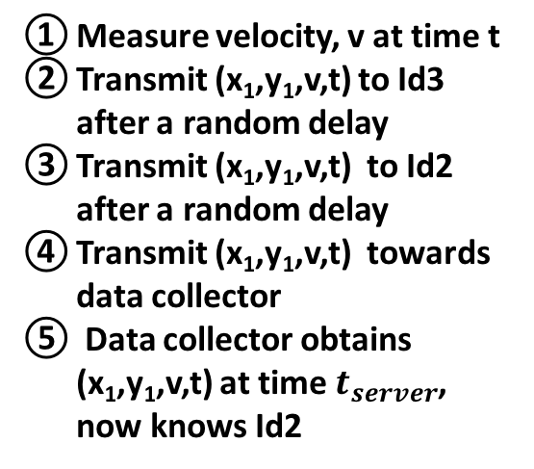
Introducing Random Delays
In this approach the Data Source and Data Uploader are not same.
Id1->Id3->Id2->Data Collector
Before each transmission a Random Delay is being added
Can the Server still correlate the Data uploaded (x₁,y₁,v,t) with the Data Source (id1) ?
NO
The time taken to transmit the data from one node to other is only 100 ms
The total delay after which data is uploaded is 300 ms + Random Delays
The distance traveled by Id1 would be large.
The greater the delay the more would be the distance traveled by Id1
Thus the server has no idea of new location of the Data Source.
Computing
cloud
Measure velocity, v at time t
Transmit (x₁,y₁,v,t) to Id3 after a random delay
Transmit (x₁,y₁,v,t) to Id2 after a random delay
Transmit (x₁,y₁,v,t) towards data collector
Data collector obtains (x₁,y₁,v,t) at time $t_{server}$, now knows Id2
Data Collector
(Server)
5
Communication Network
4
Id2
Id3
(x₃, y₃)
(x₅, y₅)
3
Id5
(x₂, y₂)
(x₁, y₁)
Id4
2
Id1
Data source ($S_{0}$)
(x₄, y₄)
1

Slide 19
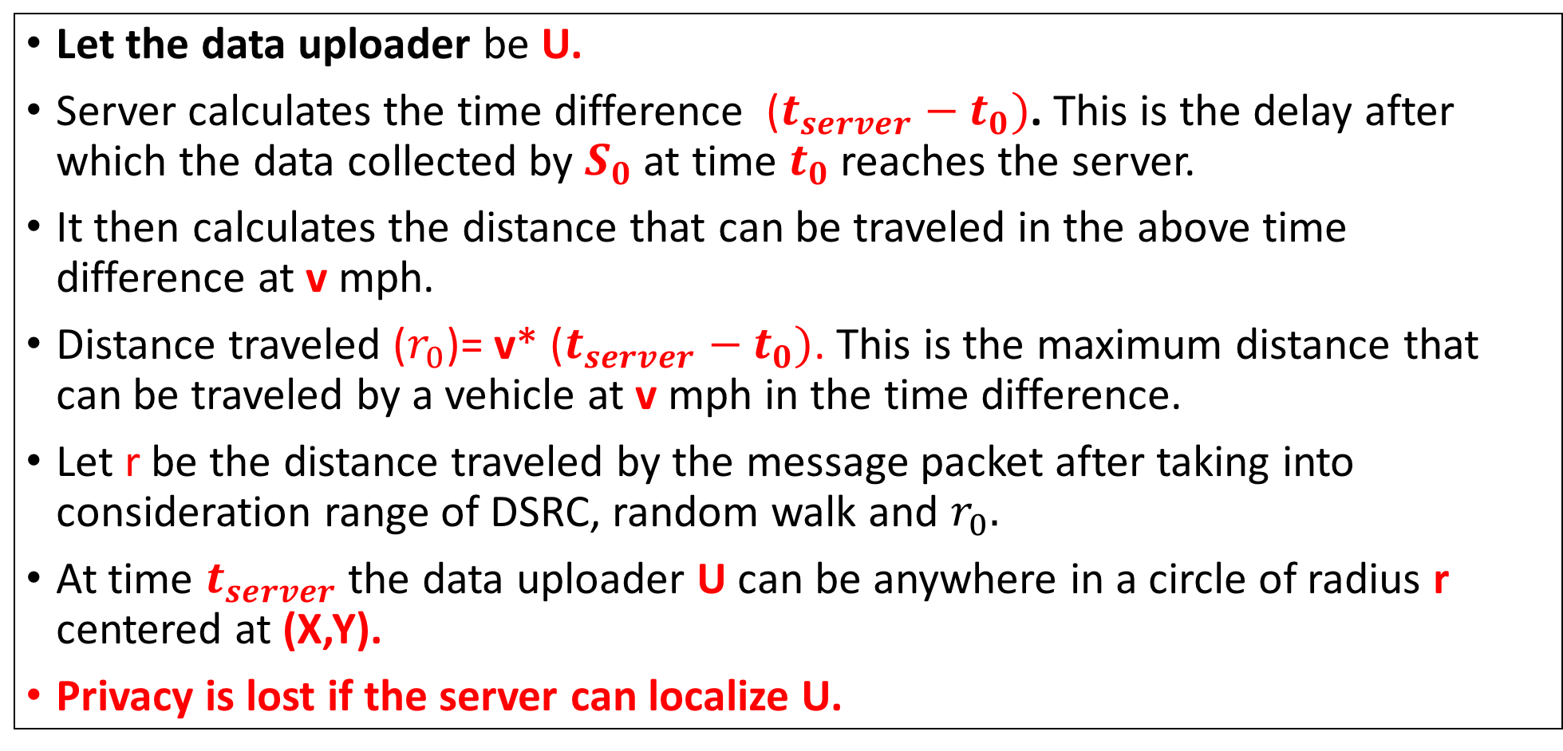
Can the adversary localize the Data Uploader?
Let the data uploader be U.
Server calculates the time difference ($t_{server}−t_{0})$. This is the delay after which the data collected by $S_{0}$ at time $t_{0}$ reaches the server.
It then calculates the distance that can be traveled in the above time difference at v mph.
Distance traveled ($r_{0}$)= v* ($t_{server}−t_{0})$. This is the maximum distance that can be traveled by a vehicle at v mph in the time difference.
Let r be the distance traveled by the message packet after taking into consideration range of DSRC, random walk and $r_{0}.$
At time $t_{server}$ the data uploader U can be anywhere in a circle of radius r centered at (X,Y).
Privacy is lost if the server can localize U.

Slide 20
Scenario at time T1
When U uploads the data first time the server draws a circle of some radius r (using the strategy told in the previous slides). Let the center of this circle be z1 and let us name this circle C1. This happens at some time say T1.
z1 is the point where data is collected by the source. (Same as X,Y in previous slide)
r
z1
C1

Slide 21
After multiple uploads by the same U
r
z3
r
r
z1
z2
r
z4
r
C3
r
z6
z5
C1
C2
C4
C6
C5
6 second scenario of a particular uploader U

Slide 22


We are trying to find the location of an uploader U.
Based on the speed of U and time = t seconds (6 in previous slide) the server can calculate the distance traveled by U in t seconds ($D_{U}^{t}$).
At $t^{th}$ second, circle $C_{t}$ would be formed.
So U could have traveled only $D_{U}^{t}$ distance from circle $C_{t}$ to $C_{1}$.
r
r
z1
zt
All lines are of distance $D_{U}^{t}$
These lines need not be straight and would vary on intermediate circles and road segments also.
The lines should pass through all the intermediate circles (C2, C3,…Ct-1)
C1
Ct

Slide 23
When does loss of privacy occurs?
The general idea is that if the same U uploads more and more data (more circles will be formed), the number of possible points to reach a previous circle (say C1) keeps on decreasing.
Privacy is said to be lost if the adversary comes to know at which point the uploader U was in the past.
The adversary can then correlate the data collected from that point with U.

Slide 24

Example
Let us assume a vehicle is traveling at 40 mph.
The data is reached to the server after 10 seconds. ($t_{server}−t_{0})$=10
r=180 m
r
z3
r
r
r
z1
r
z2
z4
r
z6
C3
z5
C1
C2
C4
C6
6 second scenario
C5

Slide 25

Example
Let us assume a vehicle is traveling at 40 mph.
The data is reached to the server after 10 seconds. ($t_{server}−t_{0})$=10
r=180 m
In 6 seconds U could have traveled 108 m
$D_{U}^{6}=108$
From C6 draw 108 m lines to C1.
These are the potential points U could have been in C1.
As time increases the set of potential points would keep decreasing in C1.
At some time (t+m) the set of potential points will be very small. [Privacy Loss]
r
z3
r
r
r
z1
r
z2
z4
r
z6
C3
z5
C1
C2
C4
C6
6 second scenario
C5

Slide 26
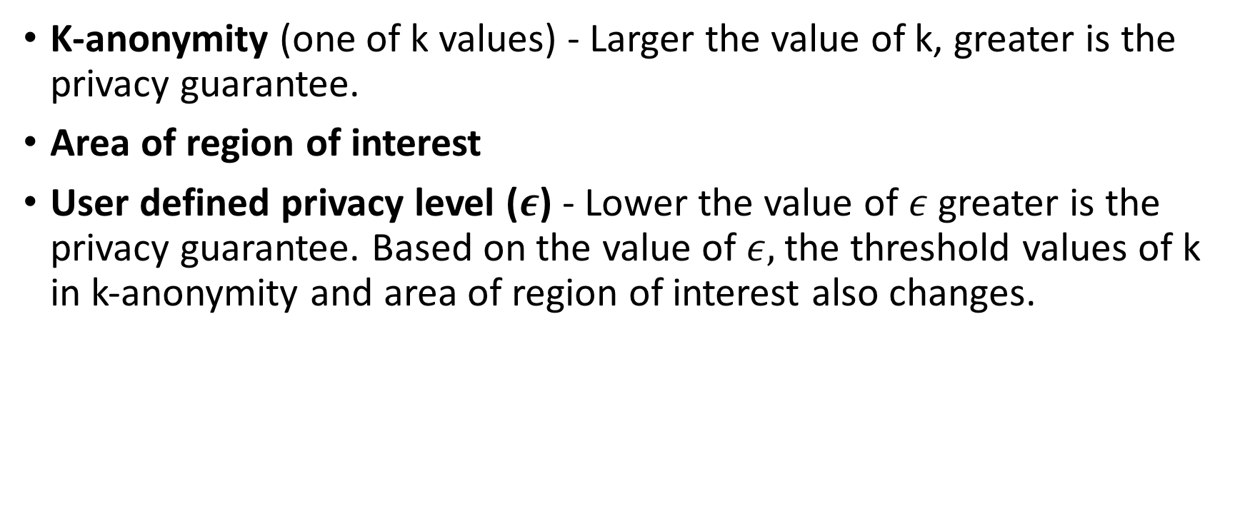
Privacy evaluation metrics
K-anonymity (one of k values) - Larger the value of k, greater is the privacy guarantee.
Area of region of interest
User defined privacy level ($ε$) - Lower the value of $ε$ greater is the privacy guarantee. Based on the value of $ε,$the threshold values of k in k-anonymity and area of region of interest also changes.

Slide 27
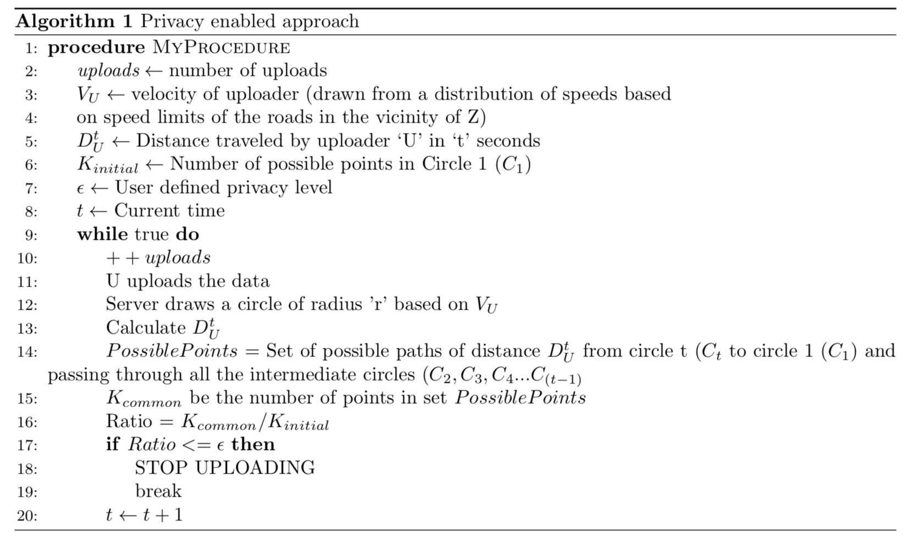
Algorithm

Slide 28
Simulations
SUMO- Simulation of Urban Mobility
Used for Vehicle simulations
OMNeT++
Used for network simulations
Veins
It is a framework which interacts with SUMO and OMNeT++.
As the vehicles move in SUMO the updates of their positions are made in the OMNet++ simulator as movement of nodes with the help of Veins.

Slide 29
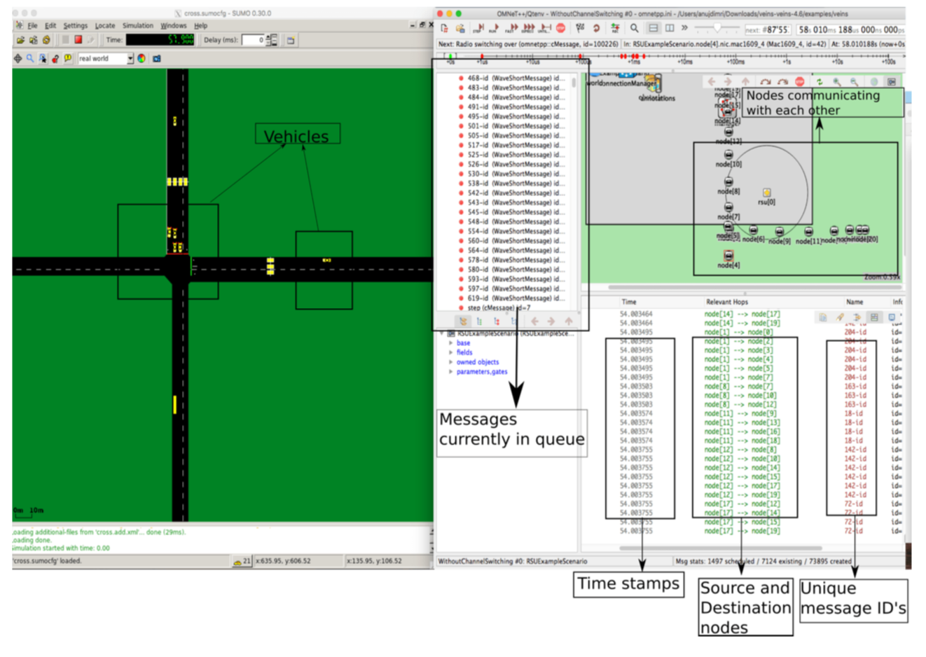
Simulation Demo

Slide 30
Initial Results

Slide 31
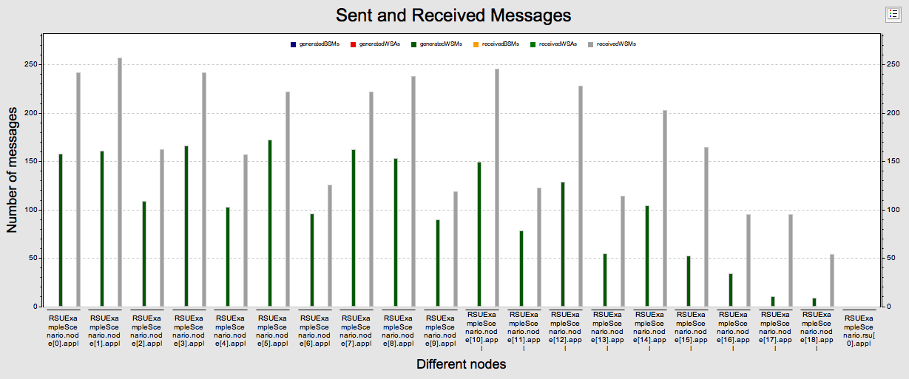
Sent and Received Messages

Slide 32
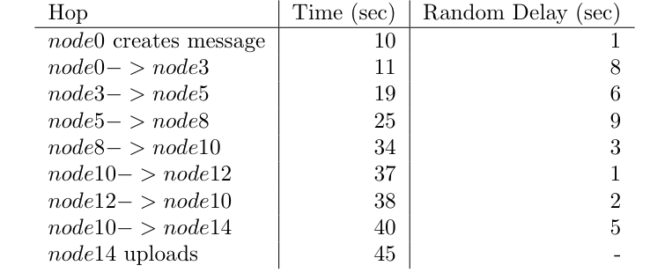
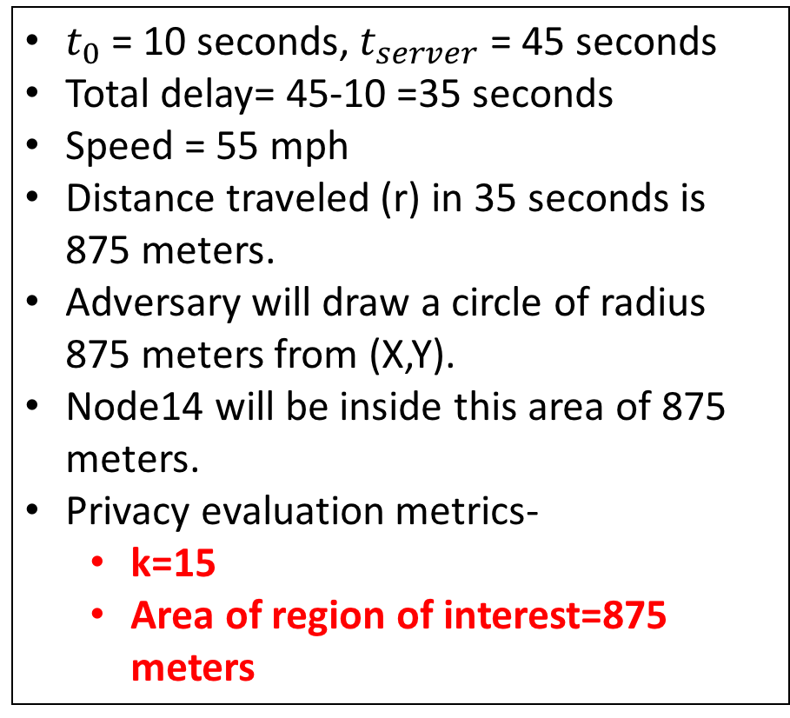
Scenario after 1 upload
$t_{0}$ = 10 seconds, $t_{server}$ = 45 seconds
Total delay= 45-10 =35 seconds
Speed = 55 mph
Distance traveled (r) in 35 seconds is 875 meters.
Adversary will draw a circle of radius 875 meters from (X,Y).
Node14 will be inside this area of 875 meters.
Privacy evaluation metrics-
k=15
Area of region of interest=875 meters

Slide 33
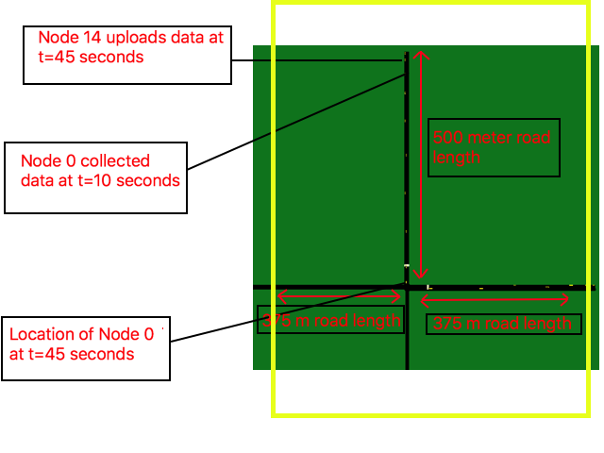

Slide 34
Work done till now
Simulation setup complete.
Vehicles can generate new messages and can forward old messages to other vehicles with some probability
Random delay is added before every transmission
After one upload the adversary has a large area under consideration which has a large number of vehicles. [Privacy preserved]

Slide 35
Future Work
Experiment with different values Random Delays
Apply different algorithms to choose the neighboring nodes for Indirections.
Choose the neighboring nodes at random, choose the node which is traveling in the opposite direction of the source node, choose the node which is at the maximum distance from the source node, etc.
How the parameters would change in case of freeways and downtown areas.
After how many uploads the adversary can localize uploader

Slide 36
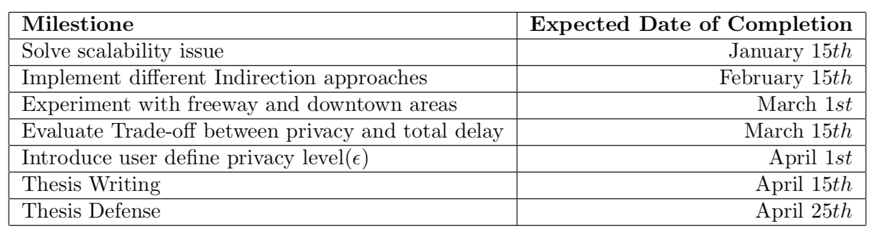
Timeline of Future Work

Slide 37

Conclusion
Initial results show that after introducing Random Delays and Indirections the privacy of the uploader is preserved after 1 upload.
The privacy of the data source is also preserved as adversary has no idea of the location of the source node at time $t_{server}$
The privacy is preserved without adding any noise to the data sample.

Slide 38
Thank you. Questions?

