Slide 1
Privacy Enabled Noise Free Data Collection in Vehicle Networks
MS Thesis Proposal
Anuj Dimri
Committee Members
Prof. Sneha Kasera (Chair)
Prof. Neal Patwari
Prof. Aditya Bhaskara

Slide 2
Ease of Collecting Location Data

Slide 3

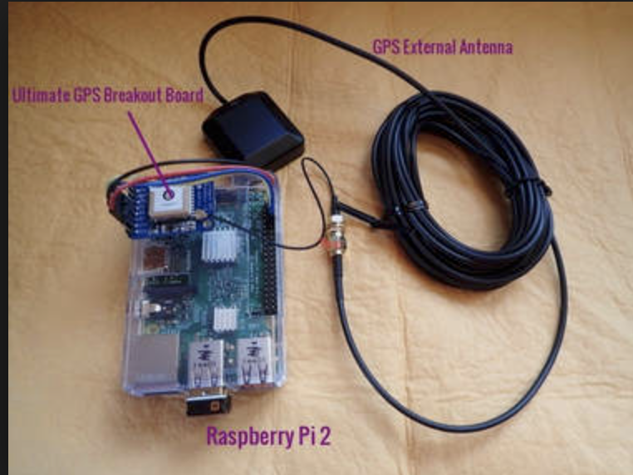
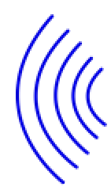
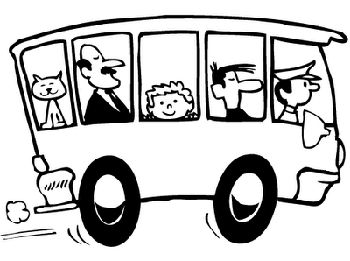

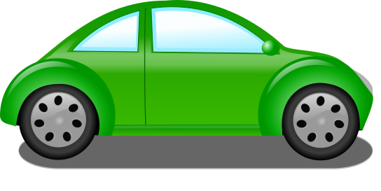

Computing
cloud
Data Collector
(Server)

Slide 4
Need for collecting Location Data

Slide 5
Dynamic Congestion map of a city
Route Planning
Travel Demand Modeling
Different Applications tied to Location Data
Validating transportation data from other sources
Emissions and air pollution modeling
Climatic change impact studies
City Infrastructure Modeling
Homeland Security Evacuation

Slide 6
Location Data is tied with Privacy Issues
Adversary can come to know personal information about users thereby making them uncomfortable.
Adversary over period of time can come to know following things about users if privacy is lost-
Driving patterns
Frequently visited places
Track a user
Religious beliefs
Political affiliations

Slide 7
Would you still collect the data if privacy is not preserved??
NO!
NO!
NO!
NO!

Slide 8
How To Preserve Privacy?

Slide 9
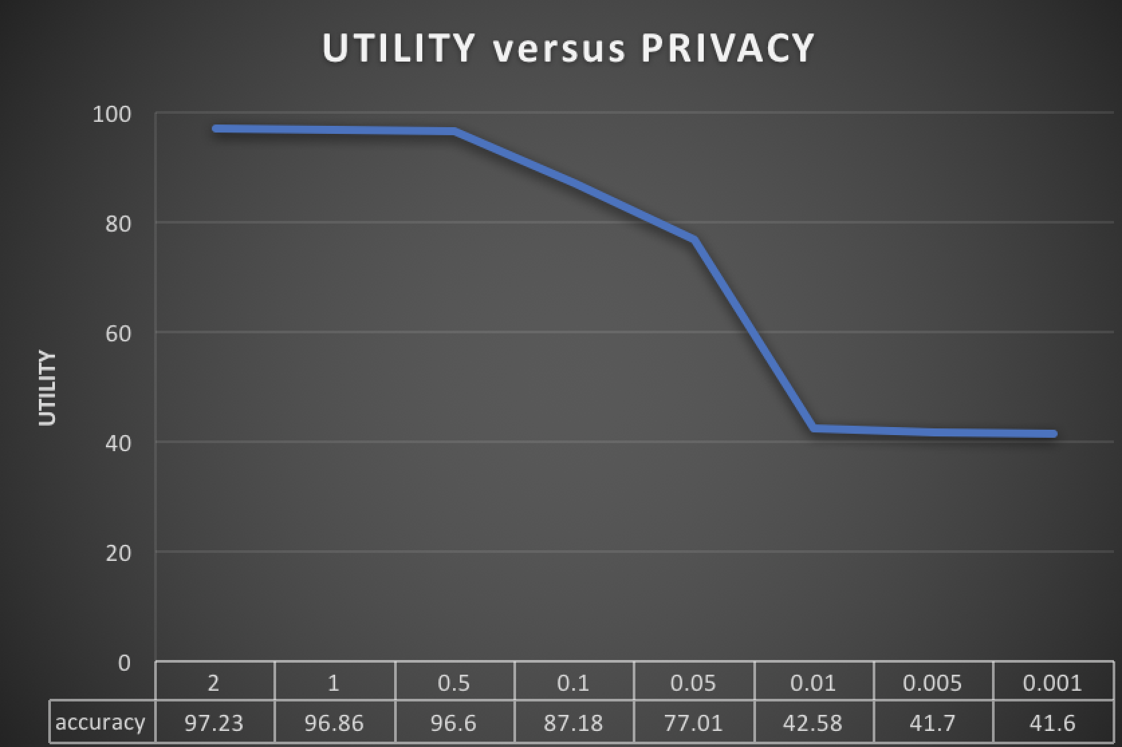
Use of pseudonym IDs
Group Pseudonym
Adding noise to data samples
Privacy Preserving Techniques
Preserve privacy without adding noise to data samples
Compromise on accuracy because of privacy
No decrease in utility
Utility privacy trade-off
OUR WORK!!

Slide 10
Focus of our work
Privacy Enabled Noise Free data collection approach in Vehicle Networks by introducing temporal and spatial variations using the concept of Random Delays and Indirections

Slide 11
How does mobility helps us
Within short time large distance can be covered by vehicles.
Protocol for vehicle communication already exists. (DSRC)
Two fold benefit of preserving privacy and getting data samples in noise free form.

Slide 12
Outline
Our Contributions
Adversary Model
Methodology
Privacy Evaluation Metrics
Initial Simulation Results
Challenges
Future Work and Conclusion

Slide 13
Our Contributions
Introduce Random Delays & Indirections in data collection process.
Implement different ways to cause Indirections & experiment with different Random Delays.
Run simulations based on above techniques to get vehicle traces.
Based on application type explore trade-off between privacy & total delay which is acceptable for the message to be delivered.
Evaluate our methods based on user defined privacy levels.

Slide 14
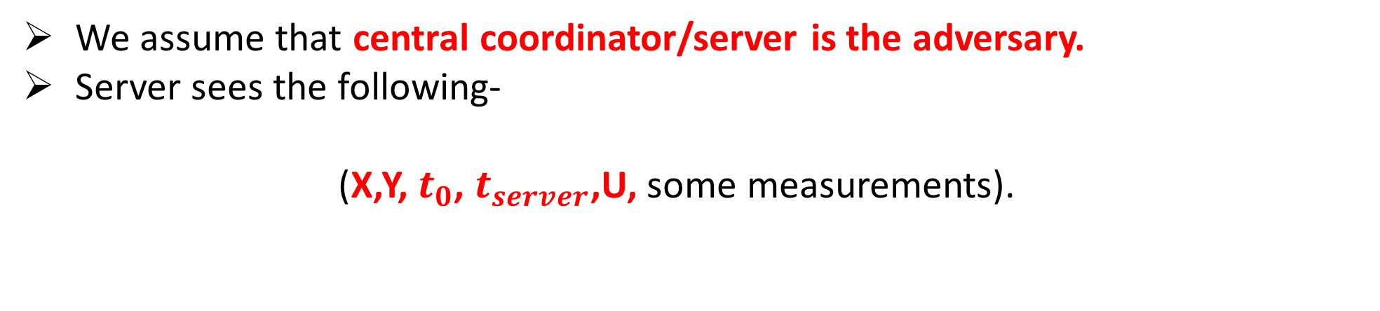
Adversary Model
We assume that central coordinator/server is the adversary.
Server sees the following-
(X,Y, $t_{0}$, $t_{server}$,U, some measurements).
Unique ID of the vehicle which uploads the data
Latitude, longitude where data was collected
Time at which data was uploaded to the server
Application specific data RSS values, speed of the vehicle,etc.
Time at which data was collected

Slide 15
Methodology

Slide 16

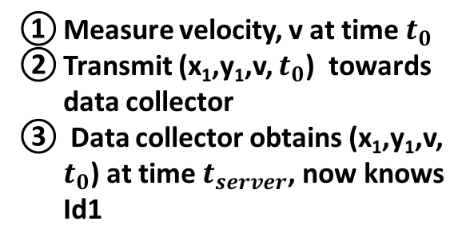
Basic Approach
Computing
cloud
Measure velocity, v at time $t_{0}$
Transmit (x₁,y₁,v, $t_{0}$) towards data collector
Data collector obtains (x₁,y₁,v, $t_{0}$) at time $t_{server}$, now knows Id1
Data Collector
(Server)
Data uploaded directly.
Privacy is lost
3
Communication Network
(x₁, y₁)
2
Id1
Data source ($S_{0}$)
1

Slide 17
Indirections
Data not uploaded to server directly.
Each node has an option of uploading data to server with some probability or forward data to one of its neighboring node.

Slide 18

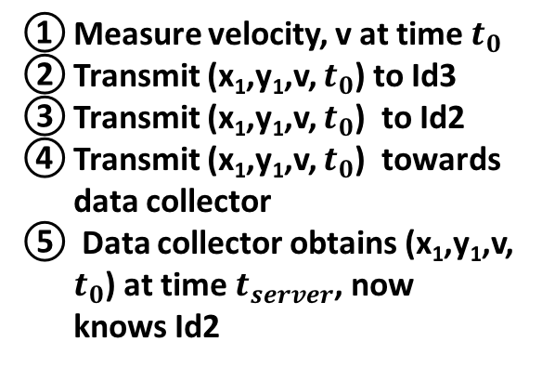

Introducing Indirections
Computing
cloud
Measure velocity, v at time $t_{0}$
Transmit (x₁,y₁,v, $t_{0}$) to Id3
Transmit (x₁,y₁,v, $t_{0}$) to Id2
Transmit (x₁,y₁,v, $t_{0}$) towards data collector
Data collector obtains (x₁,y₁,v, $t_{0}$) at time $t_{server}$, now knows Id2
Data uploaded after multiple hops
Privacy is lost
Data Collector
(Server)
5
Communication Network
4
Id2
Id3
(x₃, y₃)
(x₅, y₅)
3
Id5
Total delay after which data is uploaded is 300 ms
In 300 ms distance traveled by Id1 is very less (5.36 meters if traveling at 40 mph)
(x₂, y₂)
(x₁, y₁)
Id4
2
Id1
Data source ($S_{0}$)
(x₄, y₄)
1

Slide 19
Can we do better ?

Slide 20
Random Delays
Not to send data directly to other node rather introduce some delay before sending.
This gives data source time window to travel away from its original position.

Slide 21
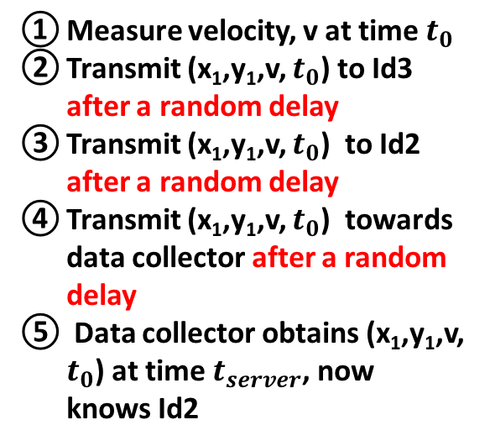

Random Delays + Indirections
Computing
cloud
Measure velocity, v at time $t_{0}$
Transmit (x₁,y₁,v, $t_{0}$) to Id3 after a random delay
Transmit (x₁,y₁,v, $t_{0}$) to Id2 after a random delay
Transmit (x₁,y₁,v, $t_{0}$) towards data collector after a random delay
Data collector obtains (x₁,y₁,v, $t_{0}$) at time $t_{server}$, now knows Id2
Data uploaded after multiple hops
Privacy is preserved
Data Collector
(Server)
5
Communication Network
4
Id2
Id3
(x₃, y₃)
(x₅, y₅)
3
Id5
(x₂, y₂)
Greater delay more would be distance traveled by Id1
Server has no idea of new location of Data Source.
(x₁, y₁)
Id4
2
Id1
Data source ($S_{0}$)
(x₄, y₄)
1

Slide 22
Can adversary localize the Data Uploader?

Slide 23
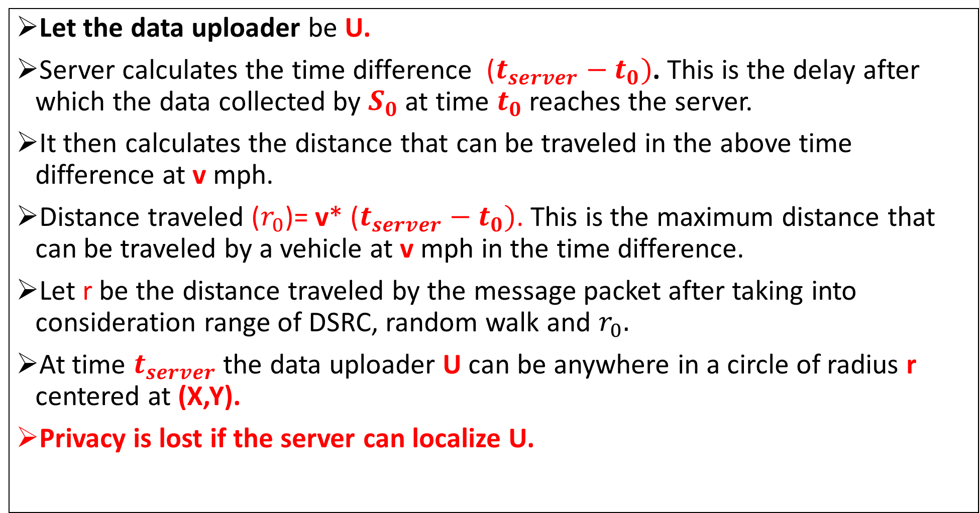
Let the data uploader be U.
Server calculates the time difference ($t_{server}−t_{0})$. This is the delay after which the data collected by $S_{0}$ at time $t_{0}$ reaches the server.
It then calculates the distance that can be traveled in the above time difference at v mph.
Distance traveled ($r_{0}$)= v* ($t_{server}−t_{0})$. This is the maximum distance that can be traveled by a vehicle at v mph in the time difference.
Let r be the distance traveled by the message packet after taking into consideration range of DSRC, random walk and $r_{0}.$
At time $t_{server}$ the data uploader U can be anywhere in a circle of radius r centered at (X,Y).
Privacy is lost if the server can localize U.

Slide 24
Scenario at time T1
When U uploads data first time server draws circle of some radius r.
Center of this circle be z1, let us name this circle C1.
z1 is point where data is collected by source. (Same as X,Y in previous slide)
r
z1
C1

Slide 25
After multiple uploads by the same U
r
z3
r
r
z1
z2
r
z4
r
C3
r
z6
z5
C1
C2
C4
C6
C5
6 second scenario of a particular uploader U

Slide 26
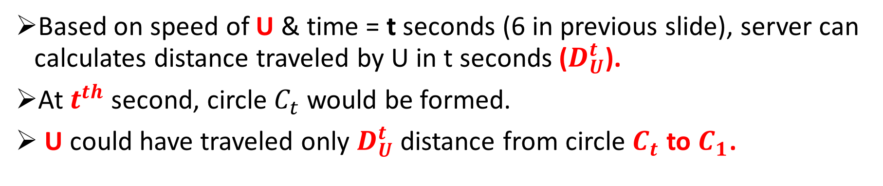

Based on speed of U & time = t seconds (6 in previous slide), server can calculates distance traveled by U in t seconds ($D_{U}^{t}$).
At $t^{th}$ second, circle $C_{t}$ would be formed.
U could have traveled only $D_{U}^{t}$ distance from circle $C_{t}$ to $C_{1}$.
r
r
z1
zt
All lines are of distance $D_{U}^{t}$
These lines need not be straight and would vary on intermediate circles and road segments also.
Lines should pass through all intermediate circles (C2, C3,…Ct-1)
C1
Ct

Slide 27
When does loss of privacy occurs?
General idea is, if same U uploads more and more data (more circles will be formed), number of possible points to reach previous circle (say C1) keeps on decreasing.
Privacy is said to be lost if adversary comes to know at which point uploader U was in the past.
Adversary can then correlate data collected from that point with U.

Slide 28


Example
Let us assume vehicle is traveling at 40 mph.
Data is reached to the server after 10 seconds. ($t_{server}−t_{0})$=10
r=180 m
In 6 seconds U could have traveled 108 m
$D_{U}^{6}=108$
From C6 draw 108 m lines to C1.
These are potential points U could have been in C1.
As time increases set of potential points would keep decreasing in C1.
At some time (t+m) set of potential points will be very small. [Privacy Loss]
r
z3
r
r
r
z1
r
z2
z4
r
z6
C3
z5
C1
C2
C4
C6
6 second scenario
C5

Slide 29
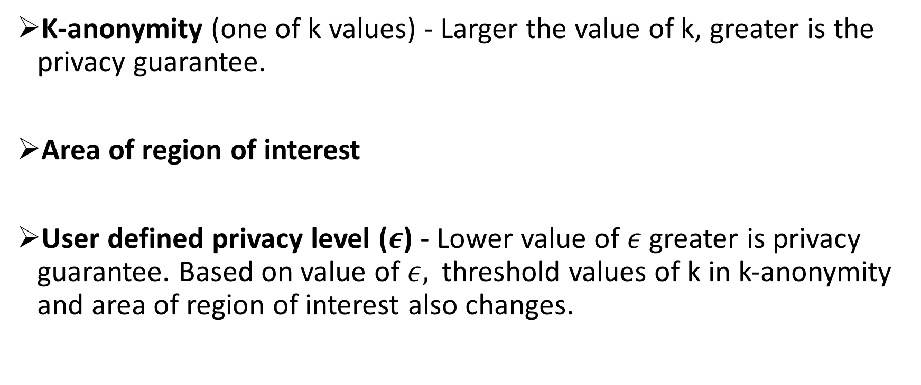
Privacy evaluation metrics
K-anonymity (one of k values) - Larger the value of k, greater is the privacy guarantee.
Area of region of interest
User defined privacy level ($ε$) - Lower value of $ε$ greater is privacy guarantee. Based on value of $ε,$threshold values of k in k-anonymity and area of region of interest also changes.

Slide 30
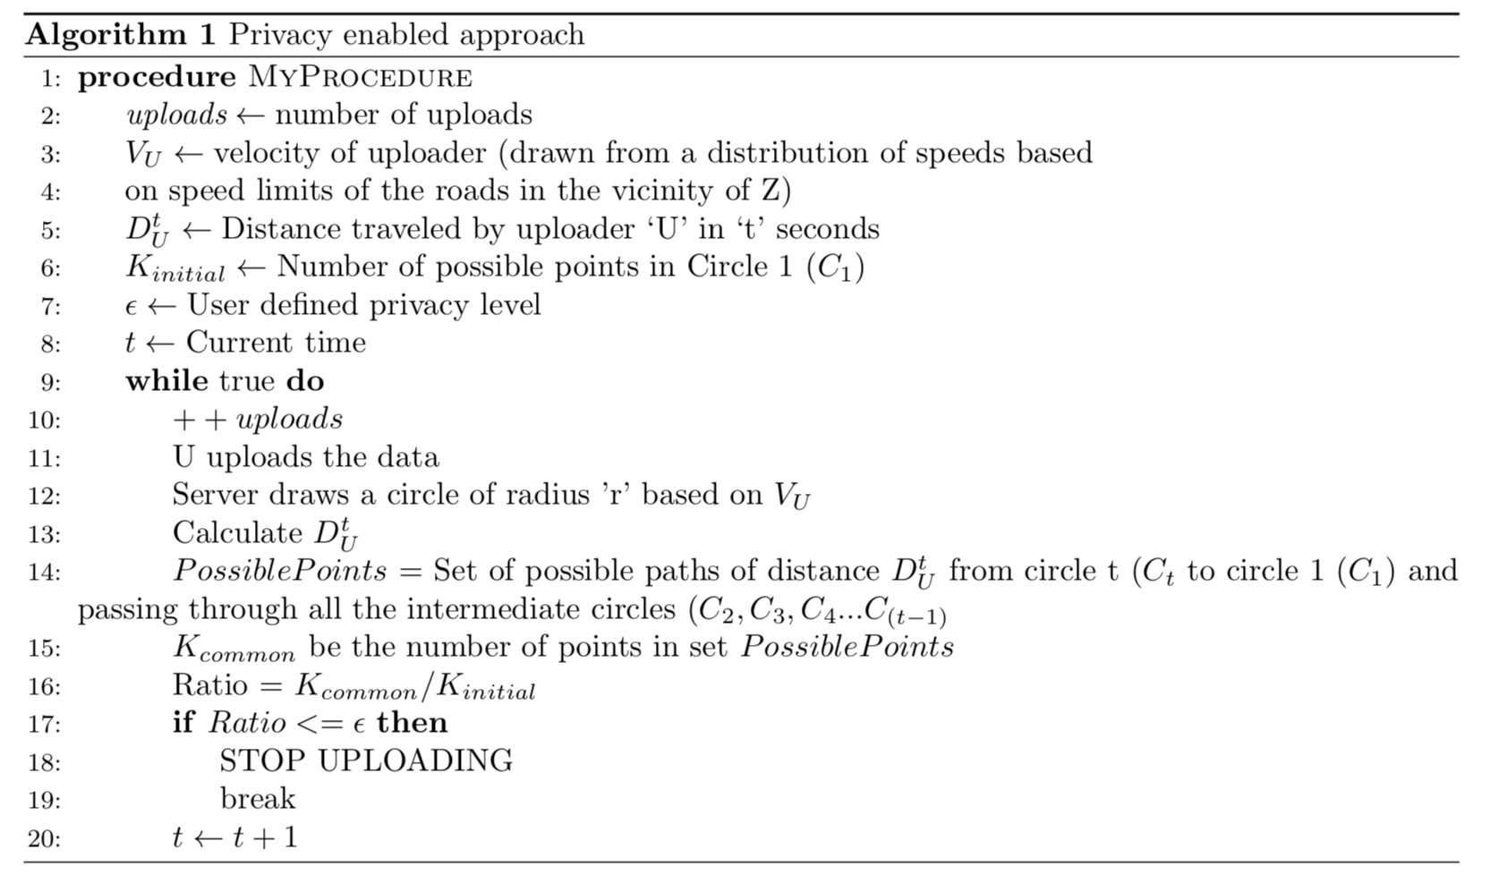
Algorithm

Slide 31
Simulations
SUMO- Simulation of Urban Mobility
Used for Vehicle simulations
OMNeT++
Used for network simulations
Veins
Framework which interacts with SUMO and OMNeT++.
As vehicles move in SUMO, updates of their positions are made in OMNet++ simulator as movement of nodes with help of Veins.

Slide 32
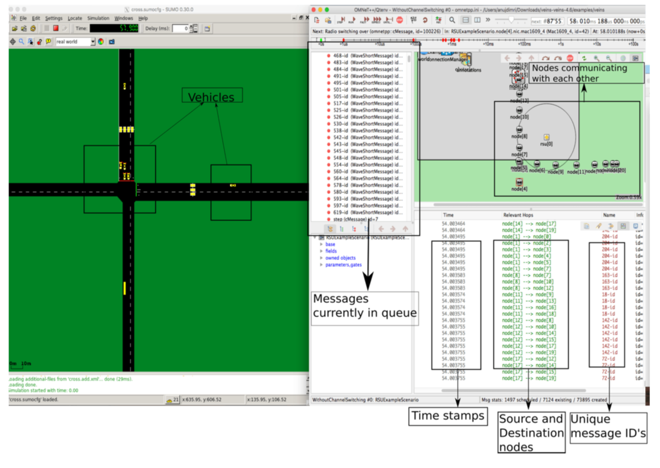
Simulation Demo

Slide 33
Initial Results

Slide 34
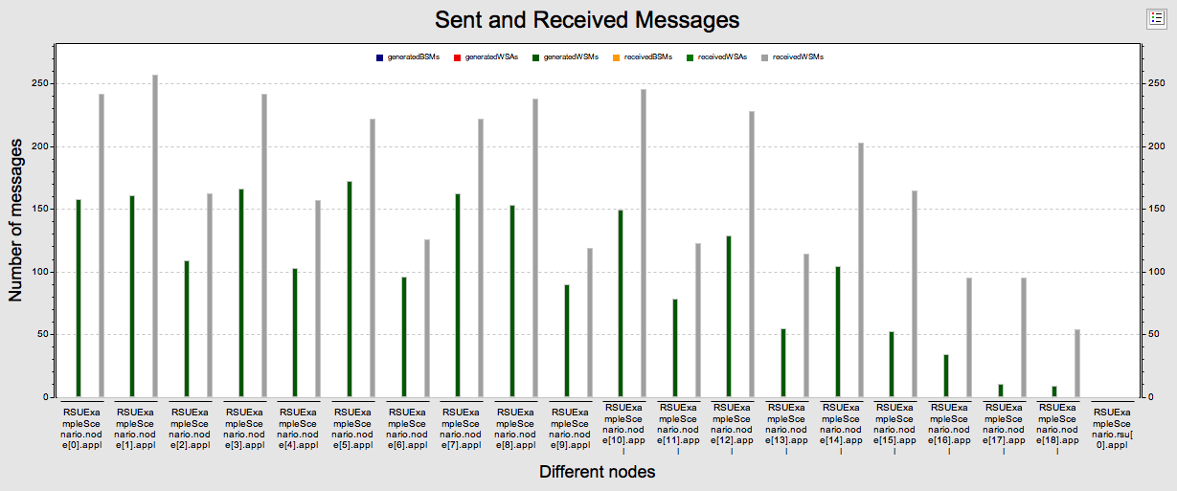
Sent and Received Messages
Received messages greater than sent messages

Slide 35
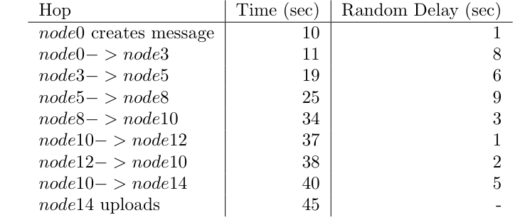
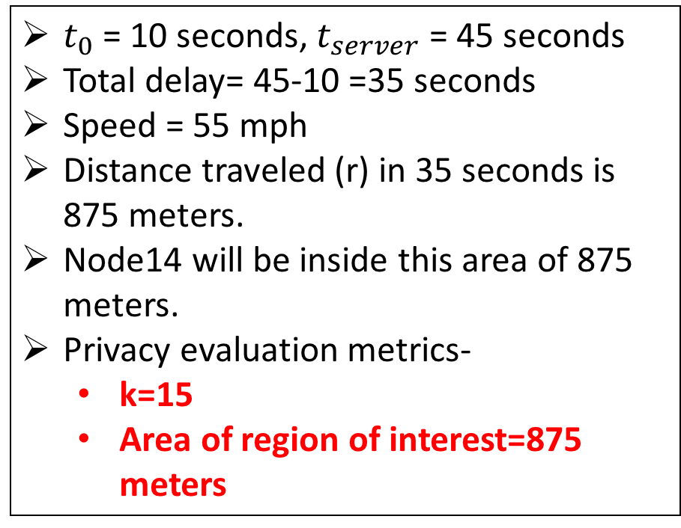
Scenario after 1 upload
$t_{0}$ = 10 seconds, $t_{server}$ = 45 seconds
Total delay= 45-10 =35 seconds
Speed = 55 mph
Distance traveled (r) in 35 seconds is 875 meters.
Node14 will be inside this area of 875 meters.
Privacy evaluation metrics-
k=15
Area of region of interest=875 meters

Slide 36
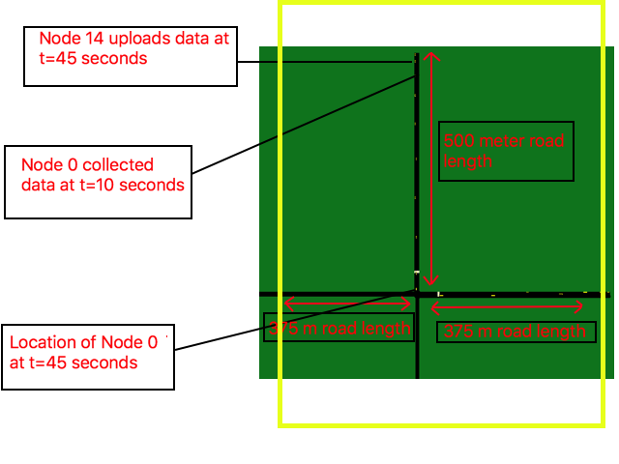
2
1
3

Slide 37
Challenges
To simulate real vehicular environment & make vehicles communicate with each other.
Keep track of large number of vehicles & messages which are being transmitted.
Scaling issues due to broadcast nature of protocol.
Deciding on value of random delay & indirection probability.
Changing random delay & indirection parameters from freeway/highway environment to downtown environment.

Slide 38
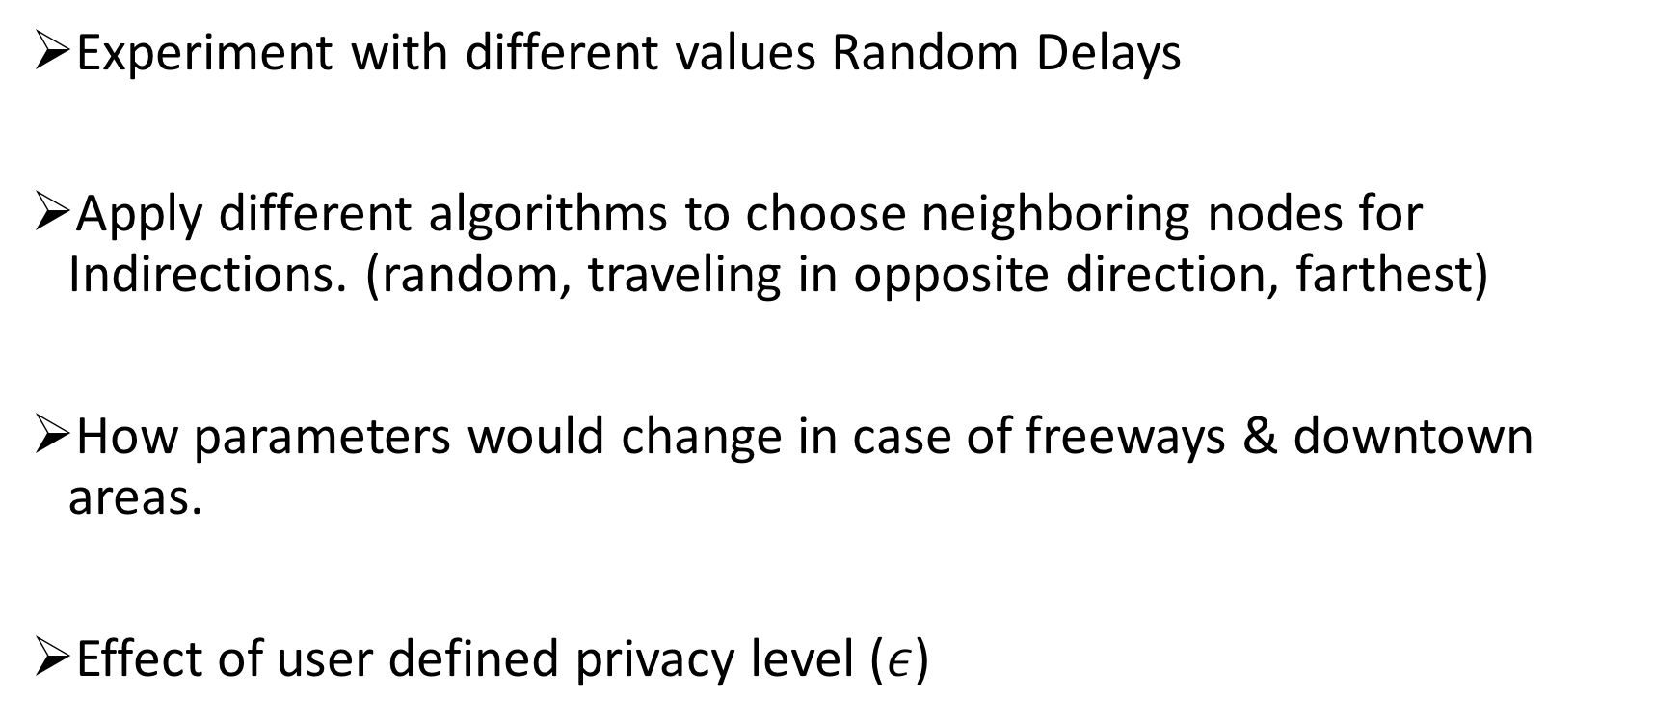
Future Work
Experiment with different values Random Delays
Apply different algorithms to choose neighboring nodes for Indirections. (random, traveling in opposite direction, farthest)
How parameters would change in case of freeways & downtown areas.
Effect of user defined privacy level ($ε$)

Slide 39
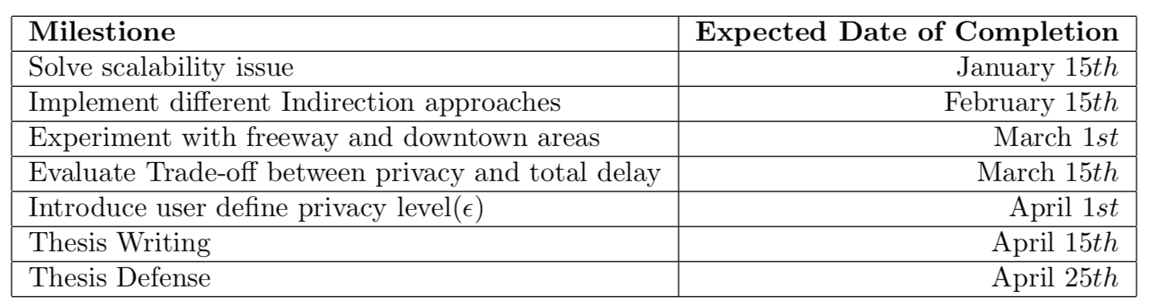
Timeline of Future Work

Slide 40
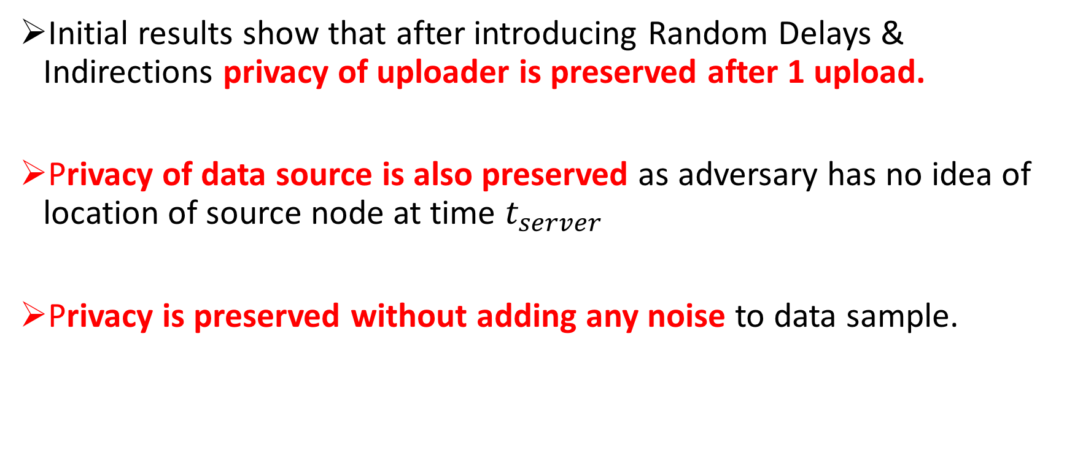
Conclusion
Initial results show that after introducing Random Delays & Indirections privacy of uploader is preserved after 1 upload.
Privacy of data source is also preserved as adversary has no idea of location of source node at time $t_{server}$
Privacy is preserved without adding any noise to data sample.

Slide 41
Thank you. Questions?

