Slide 1
Privacy Enabled Noise Free Data Collection in Vehicle Networks
MS Thesis Proposal
Anuj Dimri
Committee Members
Prof. Sneha Kasera (Chair)
Prof. Neal Patwari
Prof. Aditya Bhaskara

Slide 2
Importance of data

Slide 3
Different applications

Slide 4
What if Privacy is lost

Slide 5
How to preserve privacy

Slide 6
Focus of our work

Slide 7
How does mobility helps us

Slide 8
Vehicle protocol- some quick facts

Slide 9
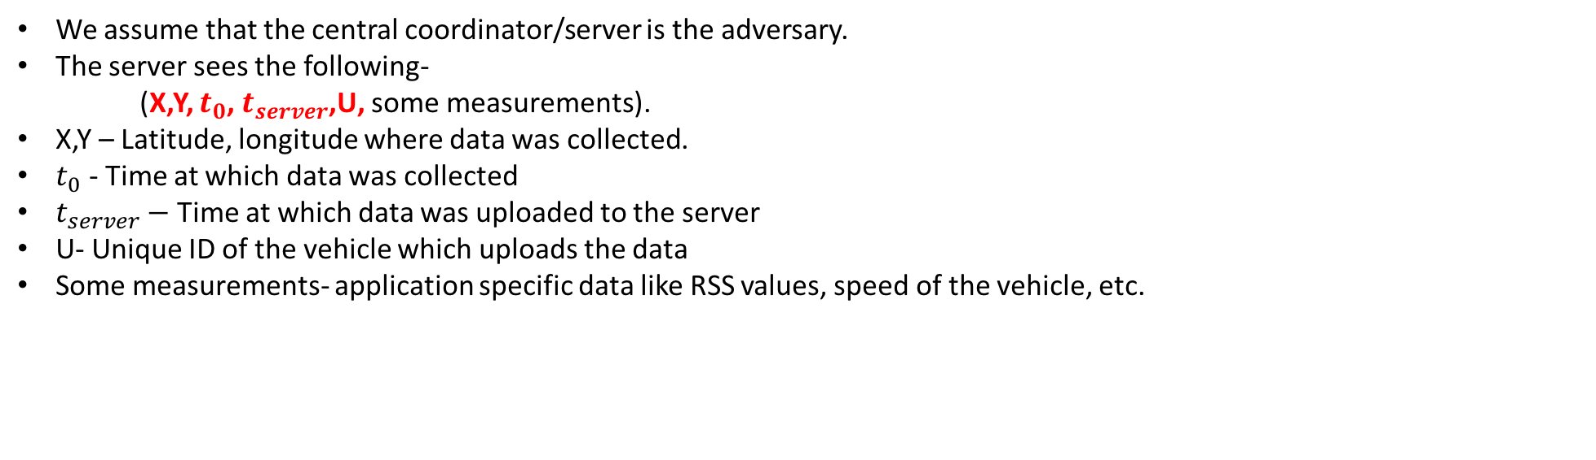
Adversary Model
We assume that the central coordinator/server is the adversary.
The server sees the following-
(X,Y, $t_{0}$, $t_{server}$,U, some measurements).
X,Y – Latitude, longitude where data was collected.
$t_{0}$ - Time at which data was collected
$t_{server}−$Time at which data was uploaded to the server
U- Unique ID of the vehicle which uploads the data
Some measurements- application specific data like RSS values, speed of the vehicle, etc.

Slide 10
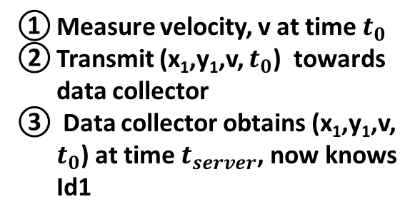
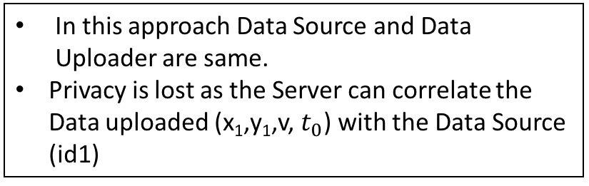

Direct Approach
In this approach Data Source and Data Uploader are same.
Privacy is lost as the Server can correlate the Data uploaded (x₁,y₁,v, $t_{0}$) with the Data Source (id1)
Computing
cloud
Measure velocity, v at time $t_{0}$
Transmit (x₁,y₁,v, $t_{0}$) towards data collector
Data collector obtains (x₁,y₁,v, $t_{0}$) at time $t_{server}$, now knows Id1
Data Collector
(Server)
3
Communication Network
(x₁, y₁)
2
Id1
Data source ($S_{0}$)
1

Slide 11
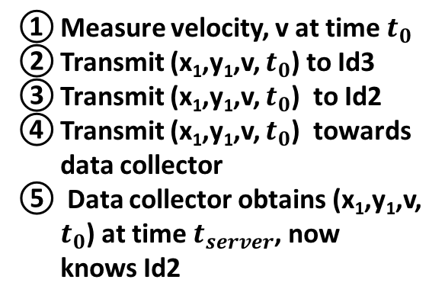
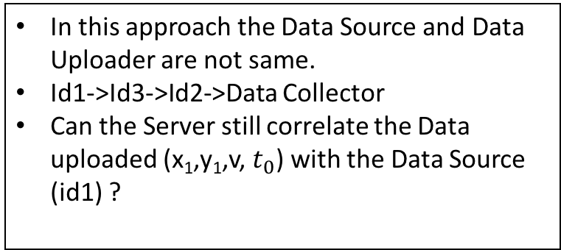

Introducing Indirections
Computing
cloud
Measure velocity, v at time $t_{0}$
Transmit (x₁,y₁,v, $t_{0}$) to Id3
Transmit (x₁,y₁,v, $t_{0}$) to Id2
Transmit (x₁,y₁,v, $t_{0}$) towards data collector
Data collector obtains (x₁,y₁,v, $t_{0}$) at time $t_{server}$, now knows Id2
Data Collector
(Server)
In this approach the Data Source and Data Uploader are not same.
Id1->Id3->Id2->Data Collector
Can the Server still correlate the Data uploaded (x₁,y₁,v, $t_{0}$) with the Data Source (id1) ?
5
Communication Network
4
Id2
Id3
(x₃, y₃)
(x₅, y₅)
3
Id5
(x₂, y₂)
(x₁, y₁)
Id4
2
Id1
Data source ($S_{0}$)
(x₄, y₄)
1

Slide 12
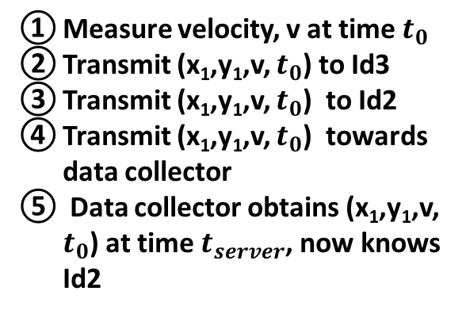
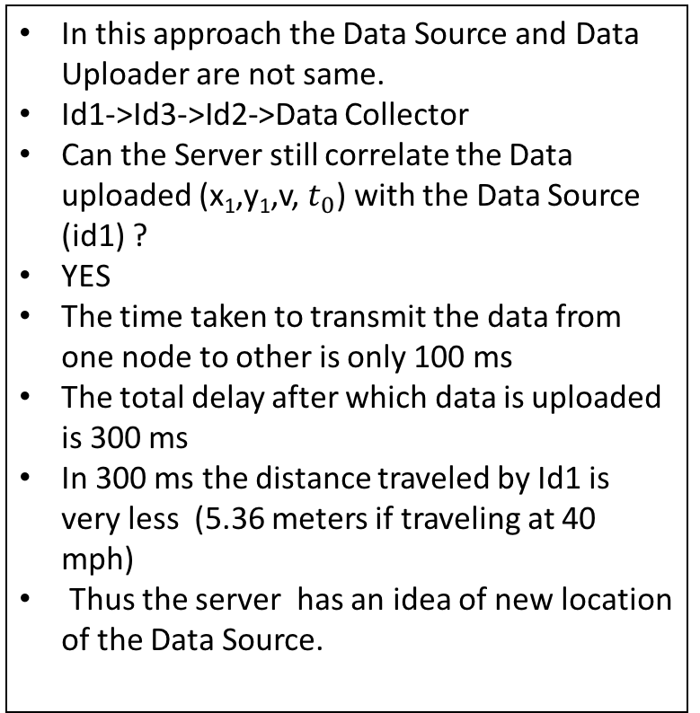

Introducing Indirections
Computing
cloud
Measure velocity, v at time $t_{0}$
Transmit (x₁,y₁,v, $t_{0}$) to Id3
Transmit (x₁,y₁,v, $t_{0}$) to Id2
Transmit (x₁,y₁,v, $t_{0}$) towards data collector
Data collector obtains (x₁,y₁,v, $t_{0}$) at time $t_{server}$, now knows Id2
In this approach the Data Source and Data Uploader are not same.
Id1->Id3->Id2->Data Collector
Can the Server still correlate the Data uploaded (x₁,y₁,v, $t_{0}$) with the Data Source (id1) ?
YES
The time taken to transmit the data from one node to other is only 100 ms
The total delay after which data is uploaded is 300 ms
In 300 ms the distance traveled by Id1 is very less (5.36 meters if traveling at 40 mph)
Thus the server has an idea of new location of the Data Source.
Data Collector
(Server)
5
Communication Network
4
Id2
Id3
(x₃, y₃)
(x₅, y₅)
3
Id5
(x₂, y₂)
(x₁, y₁)
Id4
2
Id1
Data source ($S_{0}$)
(x₄, y₄)
1

Slide 13
Can we do better ?

Slide 14

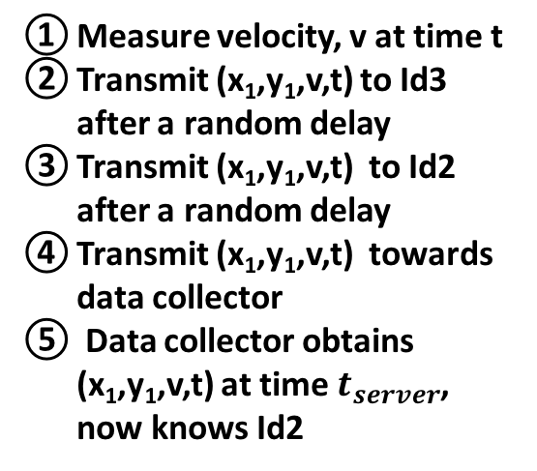
Introducing Random Delays
In this approach the Data Source and Data Uploader are not same.
Id1->Id3->Id2->Data Collector
Before each transmission a Random Delay is being added
Can the Server still correlate the Data uploaded (x₁,y₁,v,t) with the Data Source (id1) ?
NO
The time taken to transmit the data from one node to other is only 100 ms
The total delay after which data is uploaded is 300 ms + Random Delays
The distance traveled by Id1 would be large.
The greater the delay the more would be the distance traveled by Id1
Thus the server has no idea of new location of the Data Source.
Computing
cloud
Measure velocity, v at time t
Transmit (x₁,y₁,v,t) to Id3 after a random delay
Transmit (x₁,y₁,v,t) to Id2 after a random delay
Transmit (x₁,y₁,v,t) towards data collector
Data collector obtains (x₁,y₁,v,t) at time $t_{server}$, now knows Id2
Data Collector
(Server)
5
Communication Network
4
Id2
Id3
(x₃, y₃)
(x₅, y₅)
3
Id5
(x₂, y₂)
(x₁, y₁)
Id4
2
Id1
Data source ($S_{0}$)
(x₄, y₄)
1

Slide 15
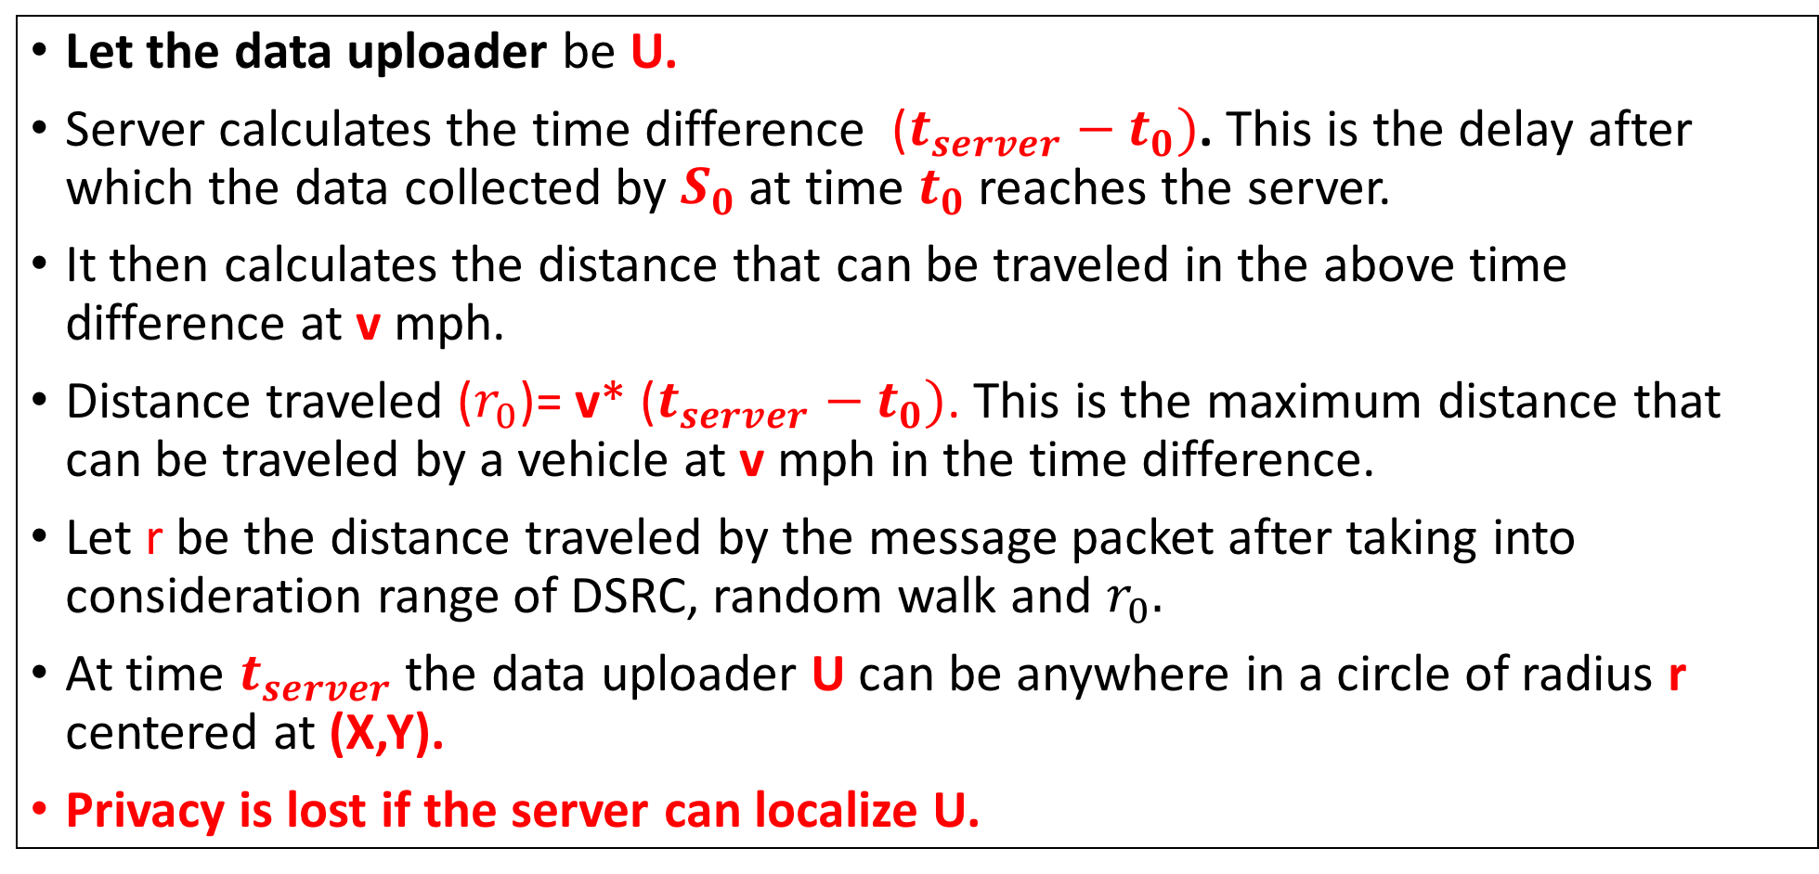
Can the adversary localize the Data Uploader?
Let the data uploader be U.
Server calculates the time difference ($t_{server}−t_{0})$. This is the delay after which the data collected by $S_{0}$ at time $t_{0}$ reaches the server.
It then calculates the distance that can be traveled in the above time difference at v mph.
Distance traveled ($r_{0}$)= v* ($t_{server}−t_{0})$. This is the maximum distance that can be traveled by a vehicle at v mph in the time difference.
Let r be the distance traveled by the message packet after taking into consideration range of DSRC, random walk and $r_{0}.$
At time $t_{server}$ the data uploader U can be anywhere in a circle of radius r centered at (X,Y).
Privacy is lost if the server can localize U.

Slide 16
Scenario at time T1
When U uploads the data first time the server draws a circle of some radius r (using the strategy told in the previous slides). Let the center of this circle be z1 and let us name this circle C1. This happens at some time say T1.
z1 is the point where data is collected by the source. (Same as X,Y in previous slide)
r
z1
C1

Slide 17
After multiple uploads by the same U
r
z3
r
r
z1
z2
r
z4
r
C3
r
z6
z5
C1
C2
C4
C6
C5
6 second scenario of a particular uploader U

Slide 18


We are trying to find the location of an uploader U.
Based on the speed of U and time = t seconds (6 in previous slide) the server can calculate the distance traveled by U in t seconds ($D_{U}^{t}$).
At $t^{th}$ second, circle $C_{t}$ would be formed.
So U could have traveled only $D_{U}^{t}$ distance from circle $C_{t}$ to $C_{1}$.
r
r
z1
zt
All lines are of distance $D_{U}^{t}$
These lines need not be straight and would vary on intermediate circles and road segments also.
The lines should pass through all the intermediate circles (C2, C3,…Ct-1)
C1
Ct

Slide 19
When does privacy loss occurs?
The general idea is that if the same U uploads more and more data (more circles will be formed), the number of possible points to reach a previous circle (say C1) keeps on decreasing.
Privacy is said to be lost if the adversary comes to know at which point the uploader U was in the past.
The adversary can then correlate the data collected from that point with U.

Slide 20

Example
Let us assume a vehicle is traveling at 40 mph.
The data is reached to the server after 10 seconds. ($t_{server}−t_{0})$=10
r=180 m
r
z3
r
r
r
z1
r
z2
z4
r
z6
C3
z5
C1
C2
C4
C6
6 second scenario
C5

Slide 21

Example
Let us assume a vehicle is traveling at 40 mph.
The data is reached to the server after 10 seconds. ($t_{server}−t_{0})$=10
r=180 m
In 6 seconds U could have traveled 108 m
$D_{U}^{6}=108$
From C6 draw 108 m lines to C1.
These are the potential points U could have been in C1.
As time increases the set of potential points would keep decreasing in C1.
At some time (t+m) the set of potential points will be very small. [Privacy Loss]
r
z3
r
r
r
z1
r
z2
z4
r
z6
C3
z5
C1
C2
C4
C6
6 second scenario
C5

Slide 22
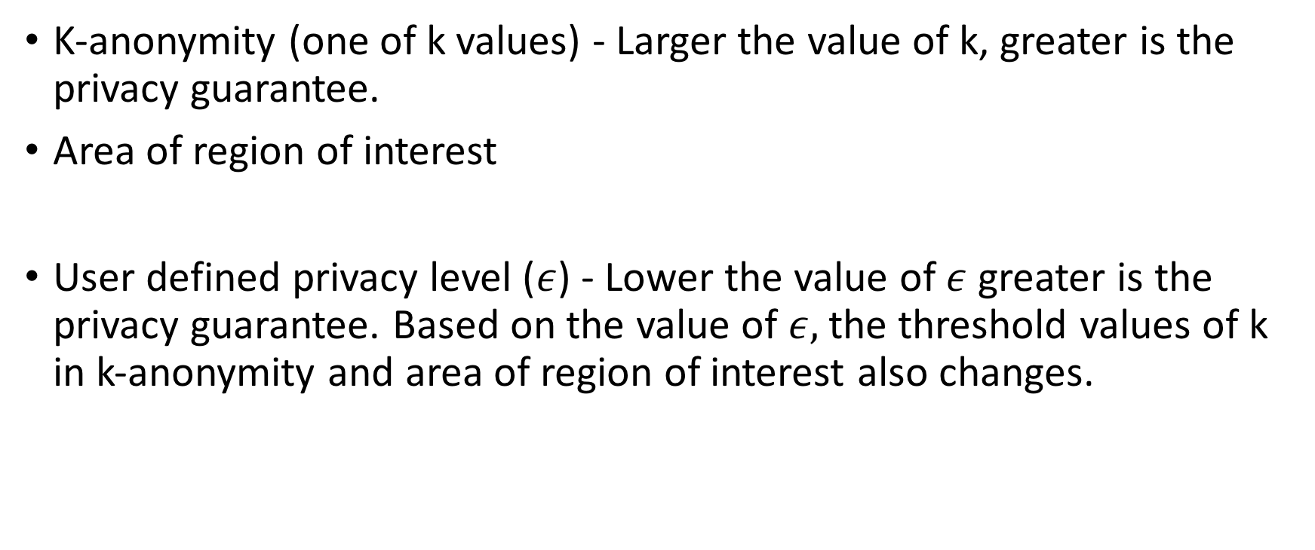
Privacy evaluation metrics
K-anonymity (one of k values) - Larger the value of k, greater is the privacy guarantee.
Area of region of interest
User defined privacy level ($ε$) - Lower the value of $ε$ greater is the privacy guarantee. Based on the value of $ε,$the threshold values of k in k-anonymity and area of region of interest also changes.

Slide 23
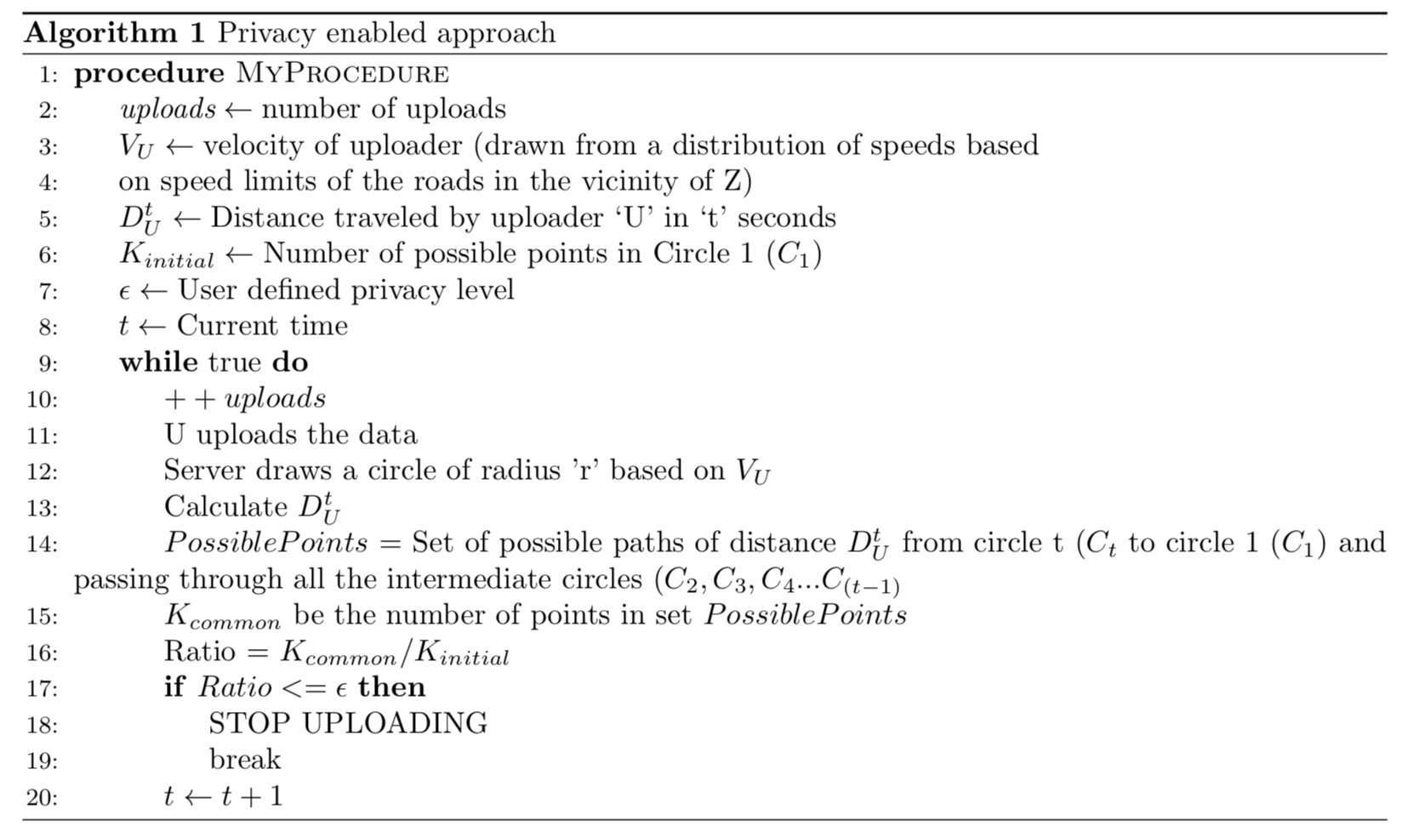
Algorithm

Slide 24
Simulations
SUMO- Simulation of Urban Mobility
Used for Vehicle simulations
OMNeT++
Used for network simulations
Veins
It is a framework which interacts with SUMO and OMNeT++.
As the vehicles move in SUMO the updates of their positions are made in the OMNet++ simulator as movement of nodes with the help of Veins.

Slide 25
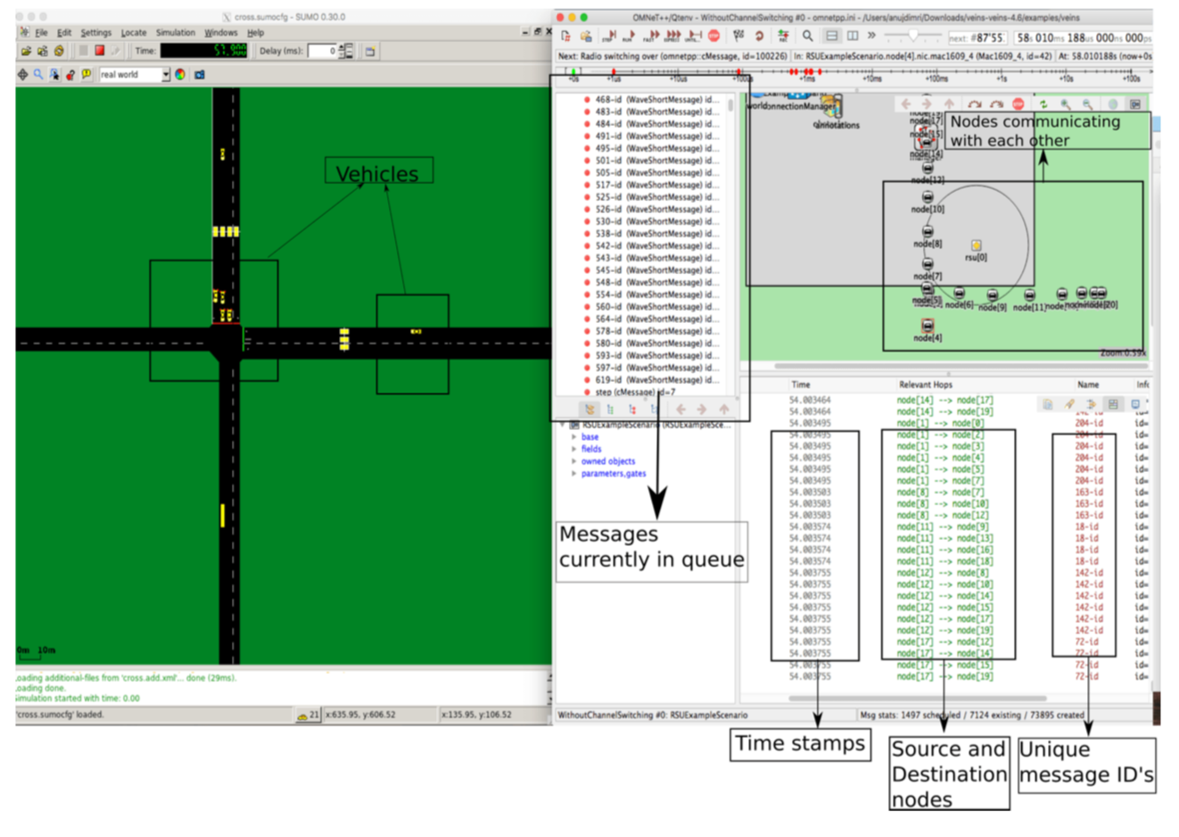
Simulation Demo

Slide 26
Initial Results

Slide 27
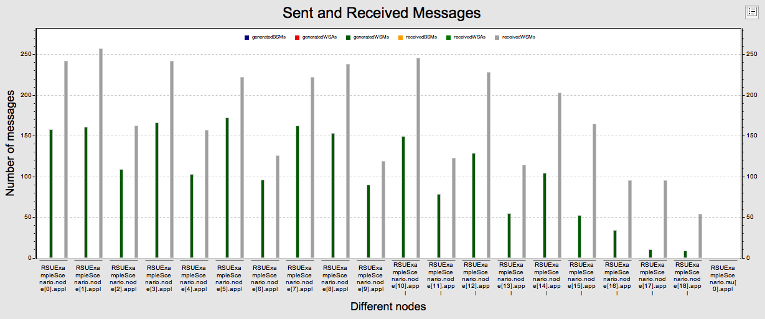
Sent and Received Messages

Slide 28
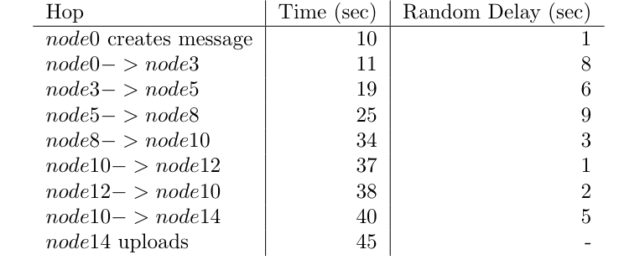
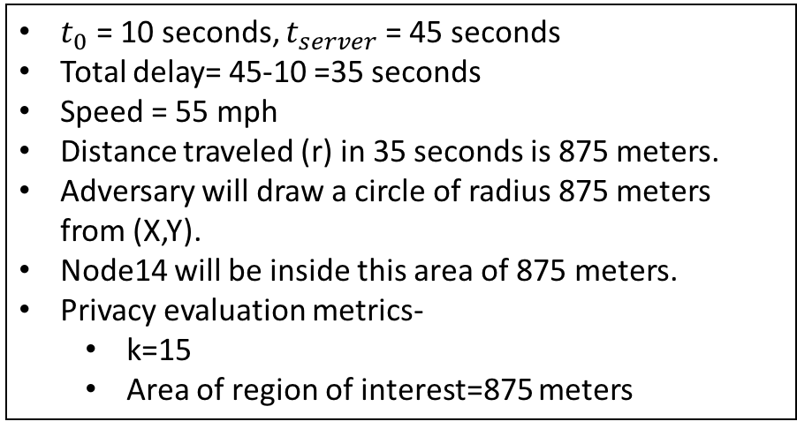
Scenario after 1 upload
$t_{0}$ = 10 seconds, $t_{server}$ = 45 seconds
Total delay= 45-10 =35 seconds
Speed = 55 mph
Distance traveled (r) in 35 seconds is 875 meters.
Adversary will draw a circle of radius 875 meters from (X,Y).
Node14 will be inside this area of 875 meters.
Privacy evaluation metrics-
k=15
Area of region of interest=875 meters

Slide 29
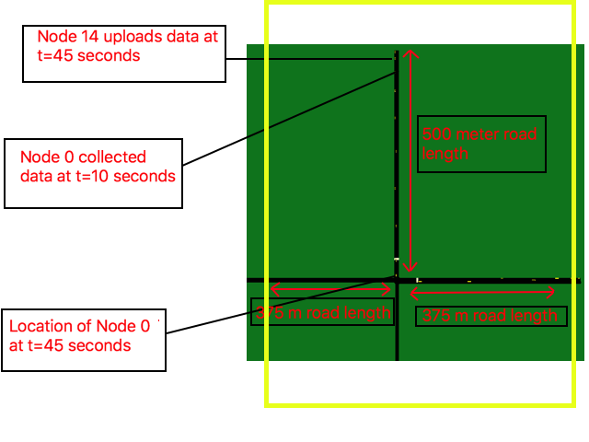

Slide 30
Future Work

