Slide 1
Multivariate Data Analysis
Multiple Regression
Anuj Kapil
12678708

Slide 2
Agenda
Problem Overview
Dataset
Solution
Result
Q/A

Slide 3
Problem Statement
Predicting the property price is a complex task. The value of a property is an important piece of information and is often required by
Banks, for lending money against a property
Insurance providers, for quoting home insurance premiums and servicing claims
Real estate market, for listing a property for sale

Slide 4
Dataset
The dataset is about properties in King County which were sold between May 2014 to May 2015.
It consists of hedonic characteristics of properties like bed, bath, living area etc and includes the last sold price
The data consists of 21 features and 21597 property observations
Looking at the summary statistics, there are no null or missing values in the dataset
Dataset: https://www.kaggle.com/harlfoxem/housesalesprediction

Slide 5
Solution
We will choose 3 independent variables from that dataset to predict one dependent variable (price)
We will take the stepwise approach for choosing a best model for predicting the property price.
We will start with 0 independent variables and start adding independent variables to perform simple linear regression and multiple regression

Slide 6
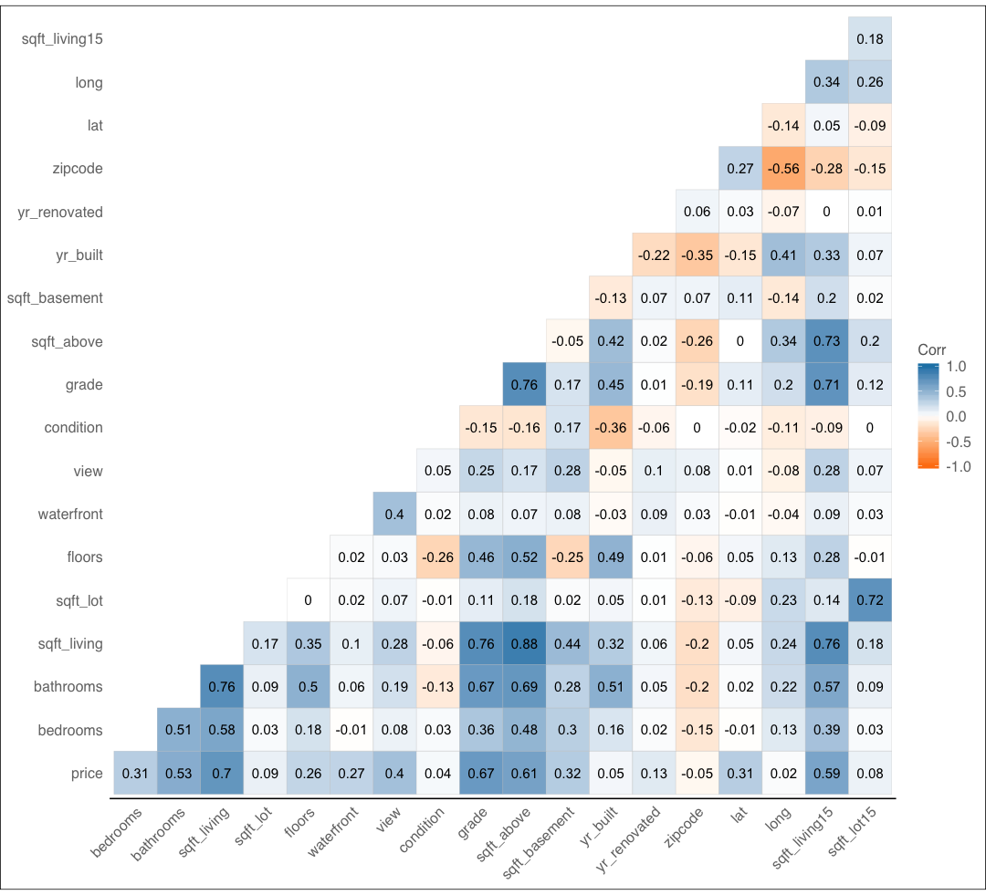
Multicollinearity
price

Slide 7
Variables
Dependent Variable
Price
Independent Variables
Square Feet Living (square footage of the home)
Grade (overall grade given to the housing unit, based on King County grading system. 1 poor ,13 excellent.)
Square Feet Above (square footage of house apart from basement)

Slide 8
Step 1: What if we just have data about property prices?
The best model in this case is the mean or the average of all the property prices.*
* In case of large datasets having outliers, median is better than mean

Slide 9
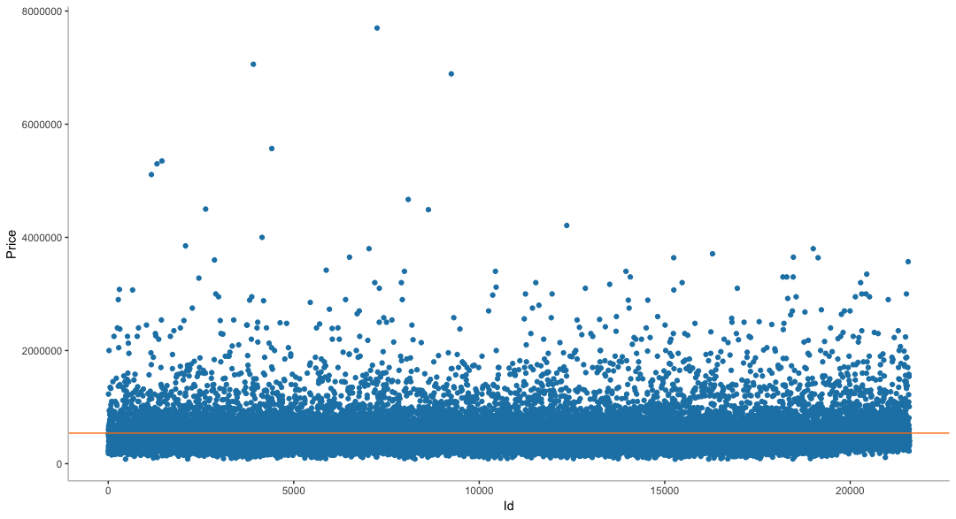
Univariate

Slide 10


Univariate
In case of only one variable, the best-fit line is the mean of the dependent variable.
In this case total Sum of Squares SSt = SSm =
Sum of Squares of Residuals/Errors = 2914582130408200
In the next steps, we will try to achieve a best-fit line that will reduce the SSm
$540,296.6

Slide 11

Step 2: Add an independent variable and perform linear regression
In simple linear regression, we try to fit a line that is described as:
In the previous case, since the slope of line was 0, b1 = 0, the y-hat was equal to b0 (y-intercept) which was the mean of the ‘price’ dependent variable
Let us look at the impact of adding 1 independent variable on the dependent variable
Before that let’s try to visualize the relationship between the independent and dependent variable

Slide 12
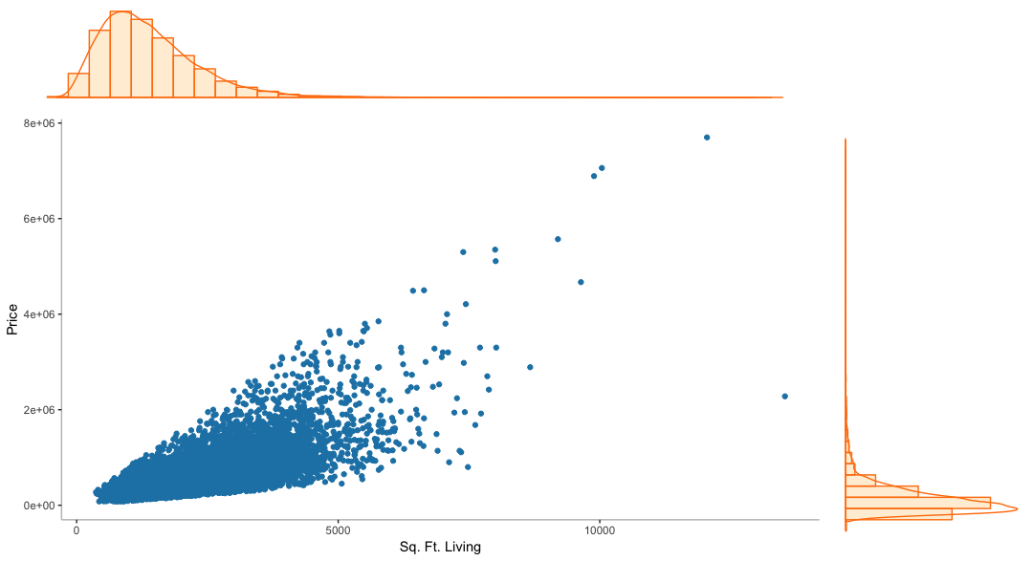
Scatter Plot: Living Area vs Price

Slide 13
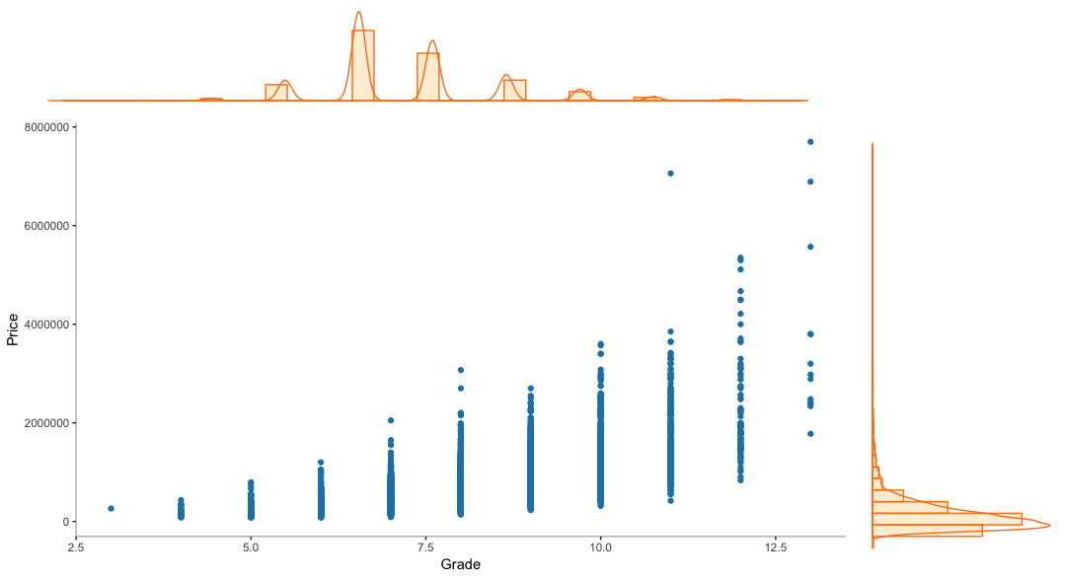
Scatter Plot: Grade vs Price

Slide 14
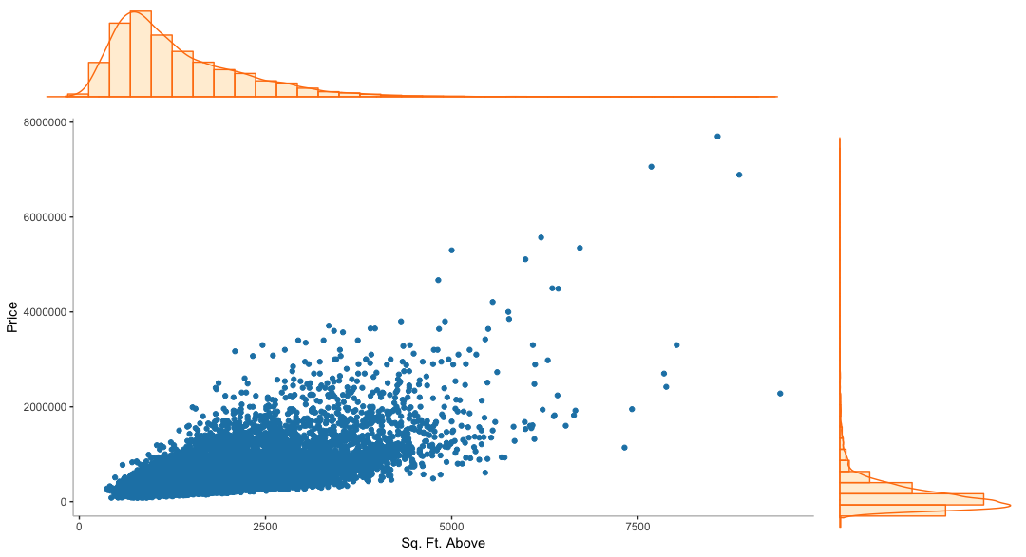
Scatter Plot: Area Above vs Price

Slide 15
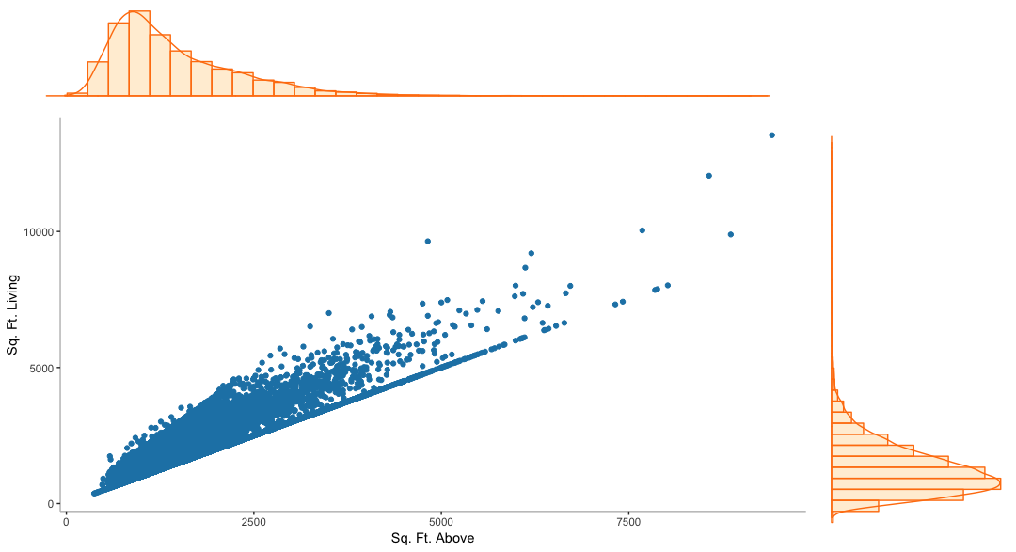
Independent Variables: Area Above vs Living Area

Slide 16
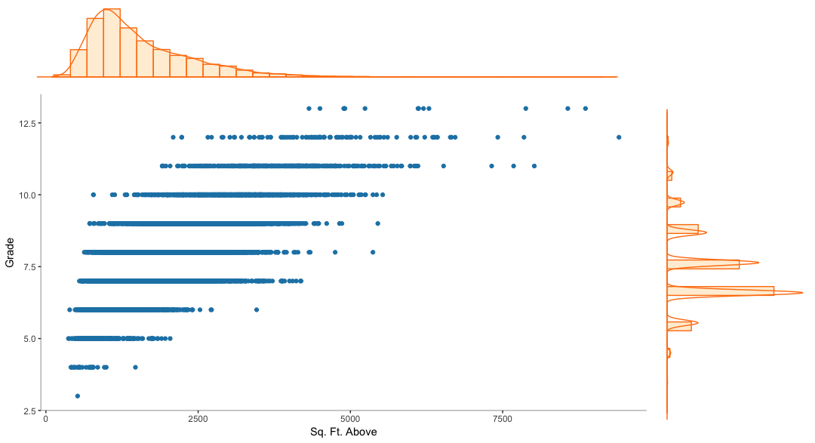
Independent Variables: Area Above vs Grade

Slide 17
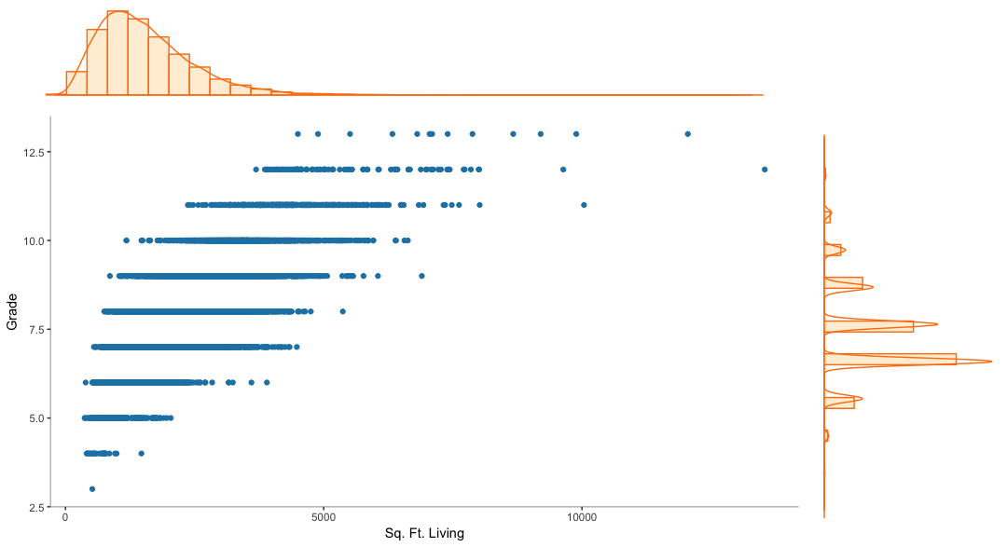
Independent Variables: Living Area vs Grade

Slide 18
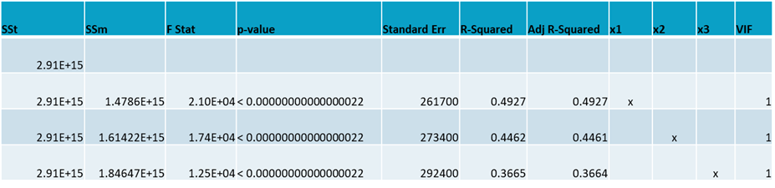
Coefficient of Determination & Analysis of Variance
x1 = Sq. Ft. Living x2 = Grade x3 = Sq. Ft. Above
Sq. Ft Living: y = 280.863 x - 43988.892
Grade: y = 209158 x - 1061416
Sq. Ft Above: y = 268.668 x + 59757.111

Slide 19
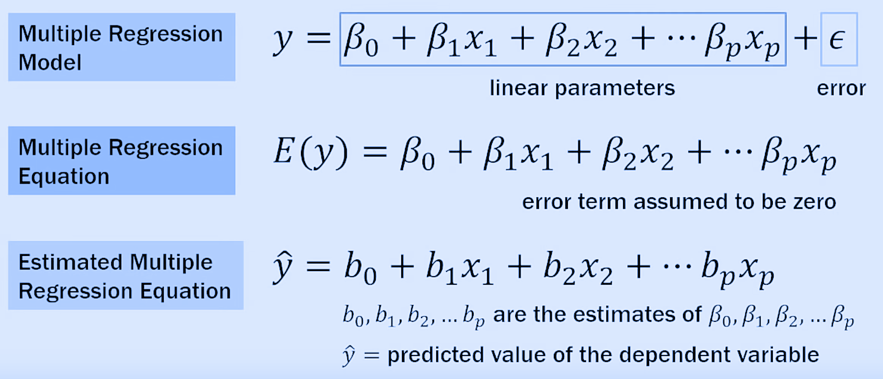
Step 3: Add 2 Independent Variables and perform multiple linear regression

Slide 20
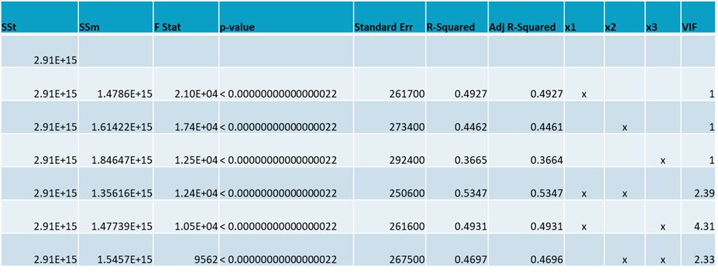
Coefficient of Determination & Analysis of Variance

Slide 21
Interpreting the multiple linear regression equation
Sq. Ft Living + Grade : y = 184.121 x1 + 99251.094 x2 - 602791.788
Sq. Ft Living + Sq. Ft Above: y = 295.726 x1 -18.810 x2 - 41266.657
Grade + Sq. Ft Above: y = 153695.00 x1 + 103.97 x2 - 822646.15

Slide 22
Step 3: Add 3 Independent Variables and perform multiple linear regression

Slide 23
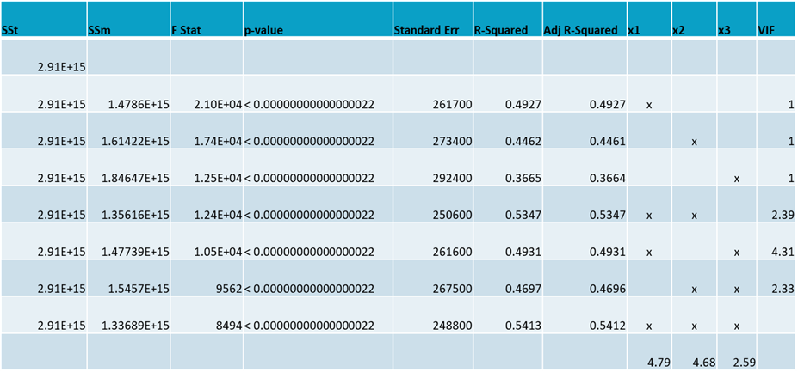
Coefficient of Determination & Analysis of Variance

Slide 24
Interpreting the multiple linear regression equation
Sq. Ft Living + Sq. Ft Above + Grade: y = 234.590 x1 + 110785.608 x2 - 78.096 x3 - 656430.921

Slide 25
Result
Prices are linearly dependent on the living area, grade and the living area of the above (excluding basement)
Best linear regression model is explained by the relationship of price with the living area and grade
The model is chosen based on the best coefficient of determination after considering the effects of overfitting and multicollinearity

Slide 26
References
King County, WA 2019, viewed 20 August 2019,<https://info.kingcounty.gov/assessor/esales/Glossary.aspx?type=r#g>
Minitab Blog Editor, 2013, 'Enough Is Enough! Handling Multicollinearity in Regression Analysis', The Minitab Blog, Minitab.com, 16 April, viewed 20 August 2019, <https://blog.minitab.com/blog/understanding-statistics/handling-multicollinearity-in-regression-analysis>

Slide 27
Q/A

Slide 28
Thank You

