Slide 1

EMPLOYEE ATTRITION PREDICTION SYSTEM
Proactive Human Capital Retention using Machine Learning & People Analytics
Prepared by: Anuj Kumar Maurya
June 2026

Slide 2
Problem Statement
Employee Attrition incurs significant financial and operational damage to modern Co-Voluntary operations.
Traditional HR strategies are reactive—sentiment is measured through rear-view exit interviews and periodic surveys, failing to flag early-stage exit risks.
The financial implications accumulate through multiple costly channels:
• Direct Costs: Recruitment advertising, screening, and agency fees.
• Onboarding & Training: Resource-intensive learning curves for new hires.
• Opportunity Costs: Reduced productivity and project delays in vacant roles.
• Cultural Disruption: Team instability leading to cascading turnover.
Challenge: Build an analytical, predictive system that identifies at-risk employees and highlights negative workplace drivers to enable preemptive retention.
THE REPLACEMENT COST
50% - 200%
of an employee's annual salary is required to replace them, depending on their specialization level. Preemptive retention strategies preserve institutional knowledge and save substantial corporate capital.
Employee Attrition Prediction System | People Analytics

Slide 3
Project Objectives
1. Develop a Robust Preprocessing Pipeline
Establish an automated data pipeline to clean records, drop useless constants, clip numerical outliers, standardize scales, and encode categorical data.
2. Address Class Imbalance via SMOTE
Apply Synthetic Minority Over-sampling Technique to training features to resolve the majority-class bias towards staying employees (16% attrition baseline).
3. Benchmarking Baseline Classifier Algorithms
Train and optimize four classifiers: Logistic Regression, Linear Regression (thresholded), Random Forest, and XGBoost.
4. Highlight Key Attrition Drivers & Interpretability
Rank feature importances and interpret coefficients to provide actionable insights for management (burnout, compensation benchmarks).
5. Create Interactive Deployment Portal
Build a responsive Streamlit dashboard allowing HR professionals to run real-time predictions and simulate retention adjustments.
Employee Attrition Prediction System | People Analytics

Slide 4
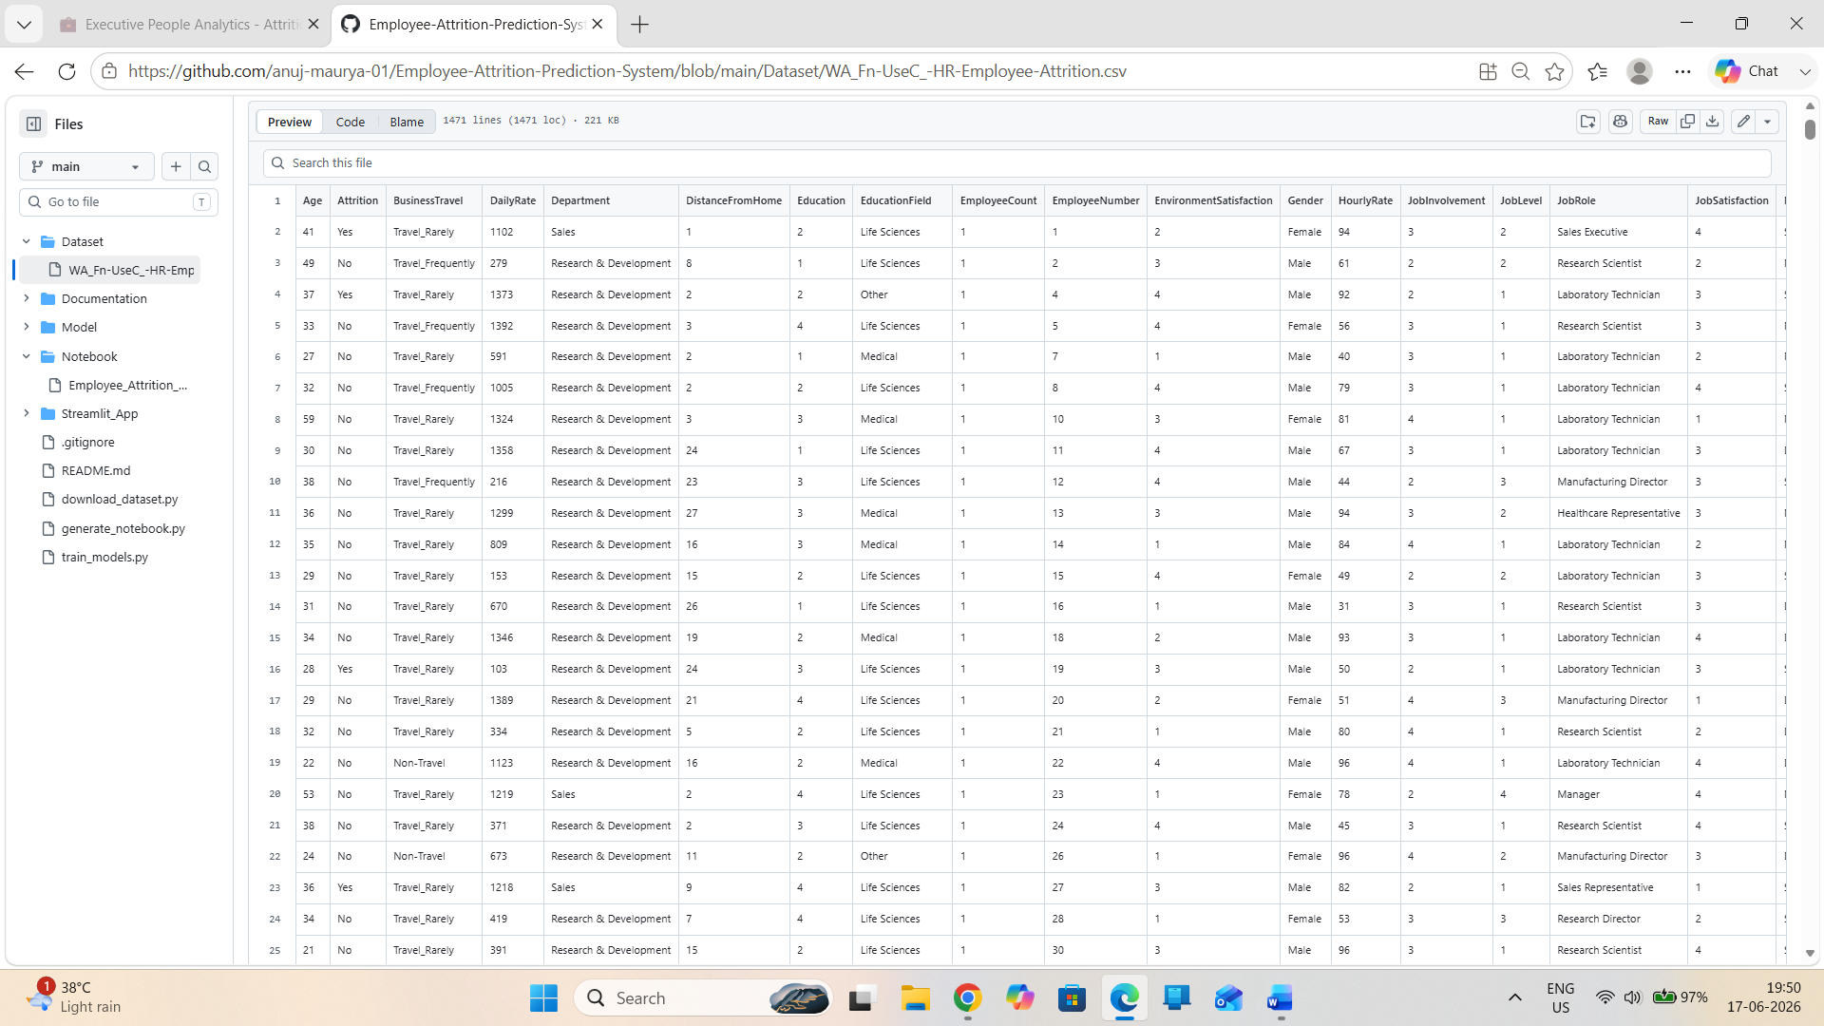
Dataset Description
The study utilizes the IBM HR Analytics Employee Attrition & Performance dataset.
Contains 1,470 employee records across 35 attributes. Target variable is Attrition (Yes/No).
Feature Space Dimensions:
• Demographic Profile: Age, Gender, MaritalStatus, Education, EducationField.
• Work Character & History: BusinessTravel, Department, JobRole, JobLevel, JobInvolvement, NumCompaniesWorked, YearsAtCompany, YearsSinceLastPromotion.
• Environment & Satisfaction: EnvironmentSatisfaction, JobSatisfaction, RelationshipSatisfaction, WorkLifeBalance, DistanceFromHome.
• Compensation & Training: MonthlyIncome, DailyRate, HourlyRate, PercentSalaryHike, StockOptionLevel, TrainingTimesLastYear, PerformanceRating.
Class Distribution is highly imbalanced: 83.9% Stayed (1,233 records) vs 16.1% Left (237 records).
Employee Attrition Prediction System | People Analytics

Slide 5
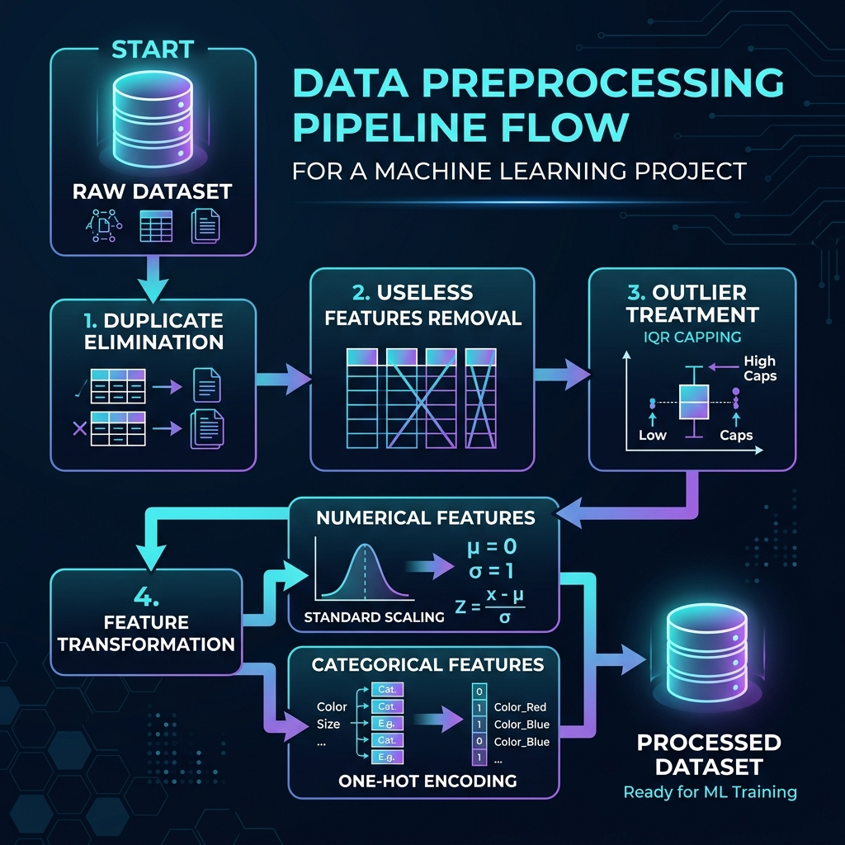
Methodology Overview
The project follows the standard Machine Learning Lifecycle:
1. Data Collection: Read and stream CSV files securely.
2. Data Preprocessing: Handle duplicates, constant columns, and clip outlier bounds.
3. Feature Engineering: ColumnTransformer integration (Scaling and One-Hot Encoding).
4. Data Balancing: Over-sampling minority classes using SMOTE.
5. Model Training: Train baselines on balanced sets.
6. Evaluation: Analyze Precision-Recall tradeoffs.
7. Deployment: Serialize model assets and launch interactive simulation dashboard.
Employee Attrition Prediction System | People Analytics

Slide 6
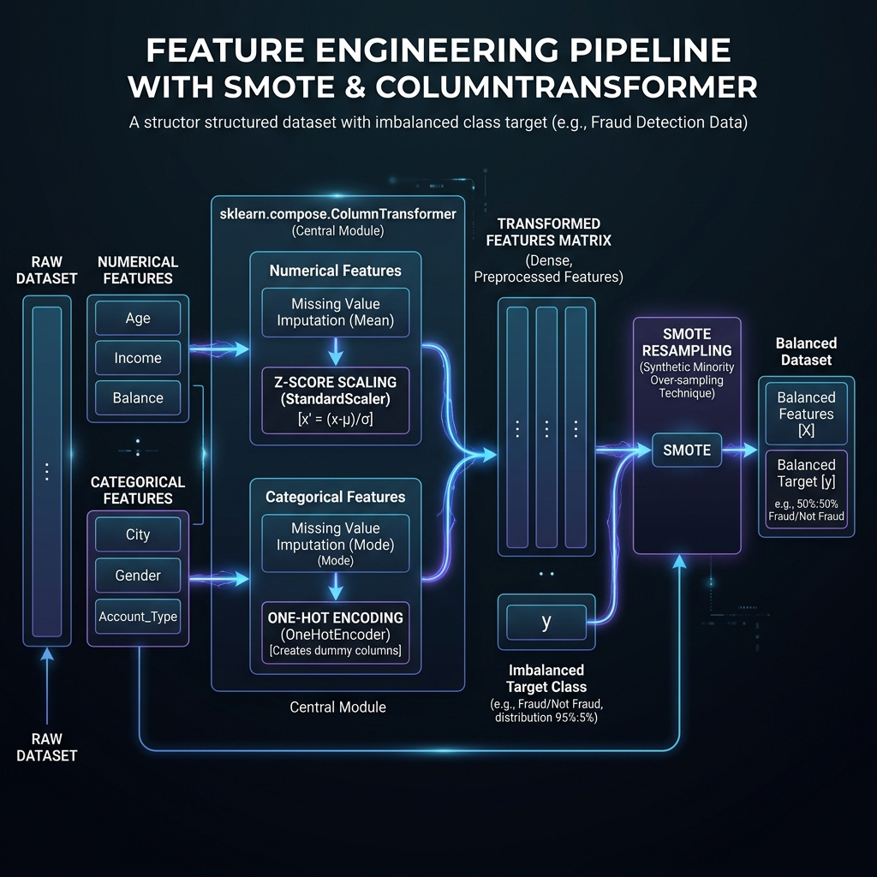
Data Preprocessing Details
To ensure clean mathematical gradients, raw data is passed through a unified pipeline:
• Duplicate Elimination: Validated zero duplicates.
• Useless Column Dropping: Columns with zero variance (EmployeeCount, StandardHours, Over18) and unique identifiers (EmployeeNumber) are removed.
• Outlier Treatment (IQR Capping): Continuous variables (e.g. MonthlyIncome, YearsAtCompany) are capped at Q3 + 1.5 * IQR to prevent skewing linear models.
• Numerical Standardization: Z-score scaling standardizes features to center mean=0 and variance=1.
• Categorical One-Hot Encoding: Columns (e.g. Department, OverTime) are dummy encoded. Drop='first' is applied to prevent multicollinearity (dummy variable trap).
• Training Split: 80% Train / 20% Test stratified split.
Employee Attrition Prediction System | People Analytics

Slide 7
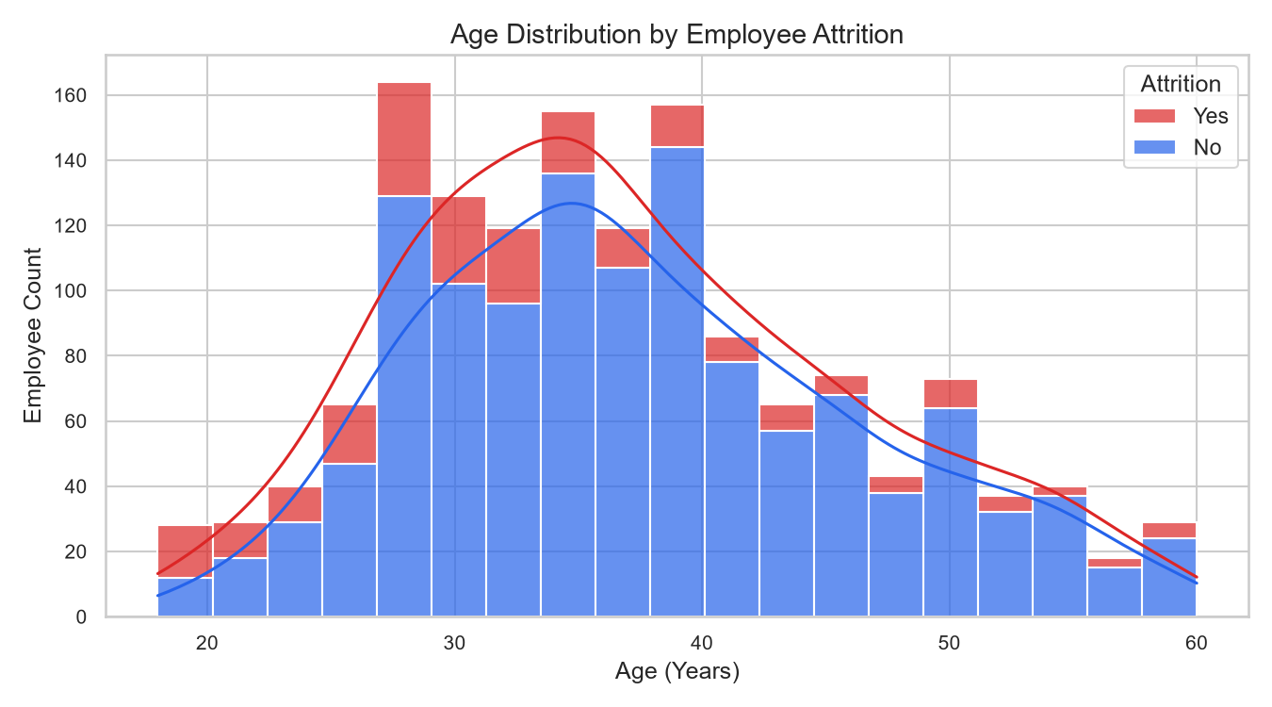
EDA - Demographic Analysis
Analysis of employee demographics reveals a clear correlation between age and attrition rates:
• Early-career employees (ages 18-30) demonstrate a disproportionately higher attrition rate.
• The attrition likelihood drops steadily as employee age increases, stabilizing above age 35.
• Implications: Early integration, career path alignment, and mentorship are critical for junior staff retention.
• The stacked age distribution shows a high density of leaving employees peaking around age 28-31.
Employee Attrition Prediction System | People Analytics

Slide 8
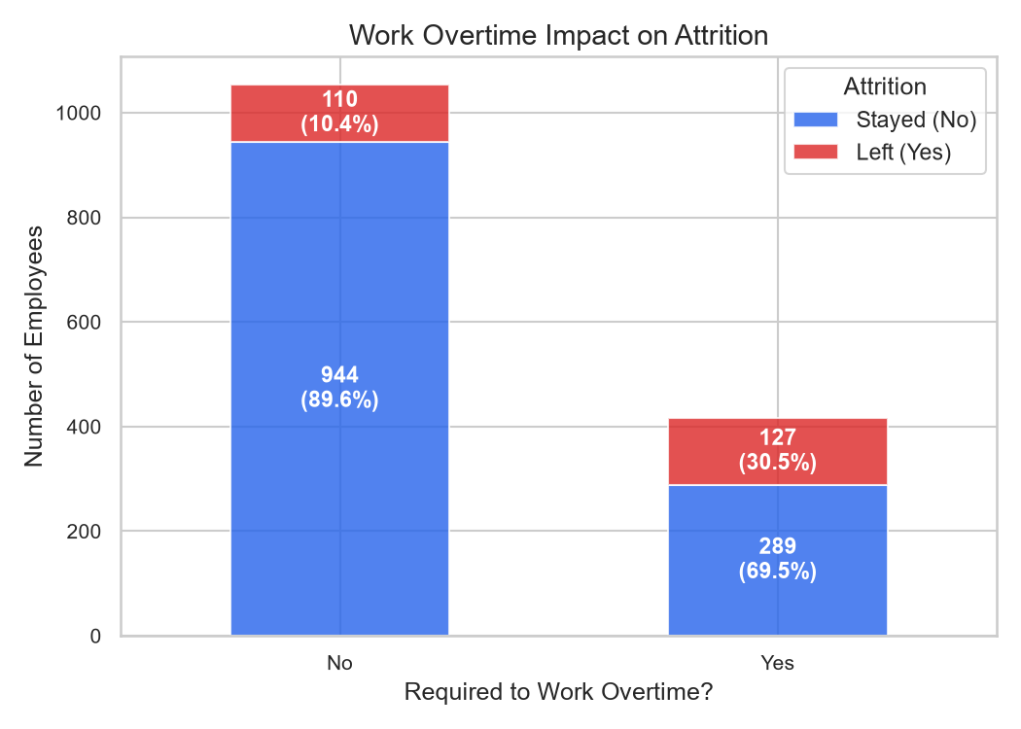
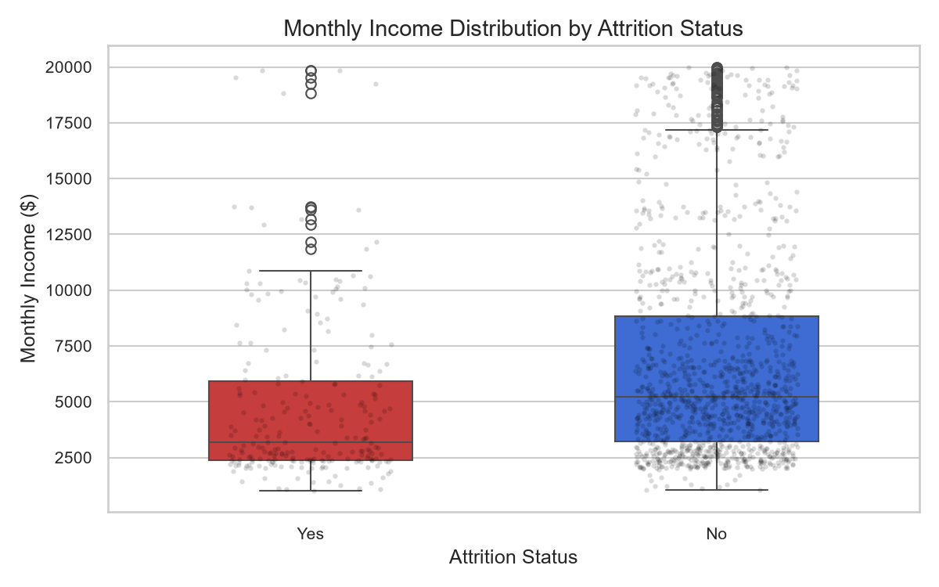
EDA - Workload & Compensation
Workload and monthly income represent the two strongest operational indicators of exit behavior:
1. Overtime Impact:
• Employees working overtime experience an attrition rate of nearly 30%, compared to only 10% for non-overtime staff.
• This signals a strong relationship between workload, fatigue, and resignation.
2. Income Distribution:
• At-risk employees are concentrated heavily in lower-income brackets (below $3,000/month).
• High-income brackets (above $10,000/month) exhibit extremely stable retention rates.
Employee Attrition Prediction System | People Analytics

Slide 9
Classification Algorithms Evaluated
To establish baseline models and pick the optimal predictor, we evaluated four algorithms:
1. Logistic Regression:
• Models the log-odds of attrition using the sigmoid function. Highly interpretable coefficients.
2. Linear Regression (Thresholded):
• Ordinary Least Squares regressor fitted on {0, 1} targets. Continuous outputs are clipped to [0,1] and thresholded at 0.5. Acts as a baseline linear hyperplane classifier.
3. Random Forest Classifier:
• Ensemble bagging of 150 independent decision trees. Captures non-linear feature splits and reduces variance.
4. XGBoost Classifier (Extreme Gradient Boosting):
• Sequential gradient boosting that trains trees to predict residuals of predecessor ensembles. Incorporates L1 and L2 regularization to prevent overfitting.
Employee Attrition Prediction System | People Analytics

Slide 10
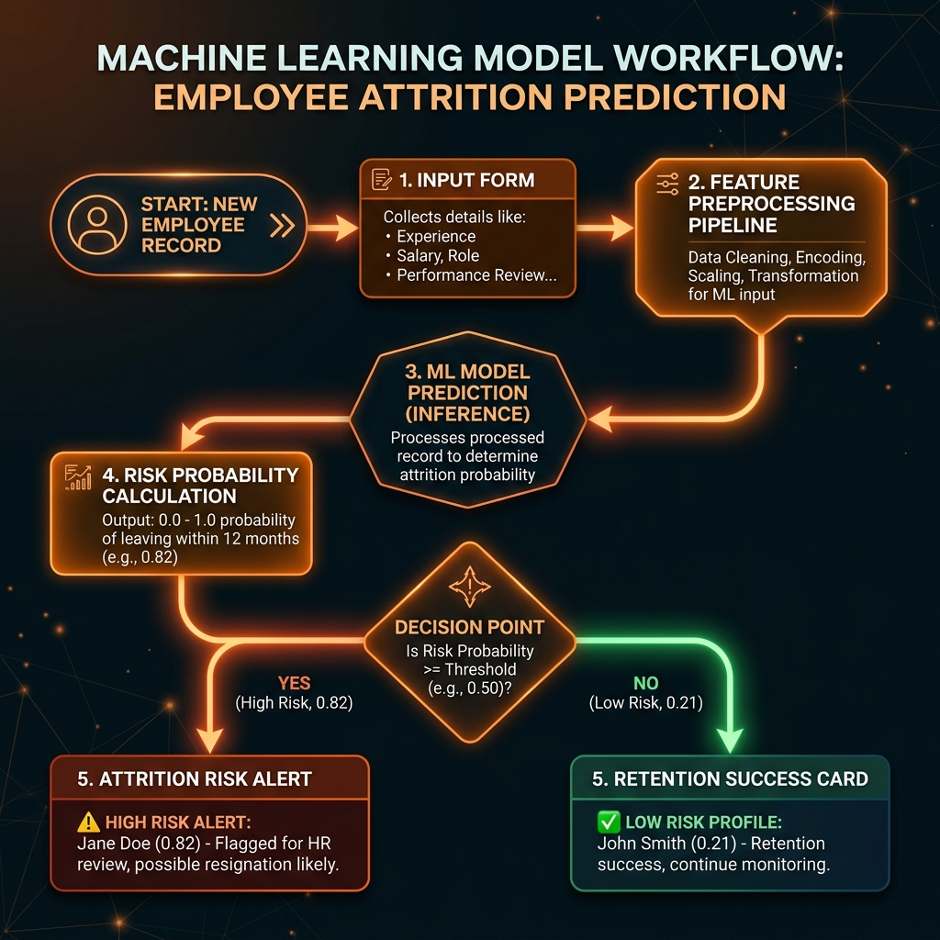
System Workflow & Balance
1. Handling Class Imbalance:
• With 16% attrition, standard classifiers optimize for overall accuracy by defaulting to 'No Attrition' (high accuracy, zero recall).
• SMOTE is applied only to the processed training split, generating synthetic minority samples to create a balanced 50/50 training set.
2. Preprocessor & Model Serialization:
• Fitted ColumnTransformer and trained models are serialized using joblib.
3. Dynamic Inference Pipeline:
• New simulation records are sent to the preprocessor pipeline and then mapped to the active model for attrition risk classification.
Employee Attrition Prediction System | People Analytics

Slide 11
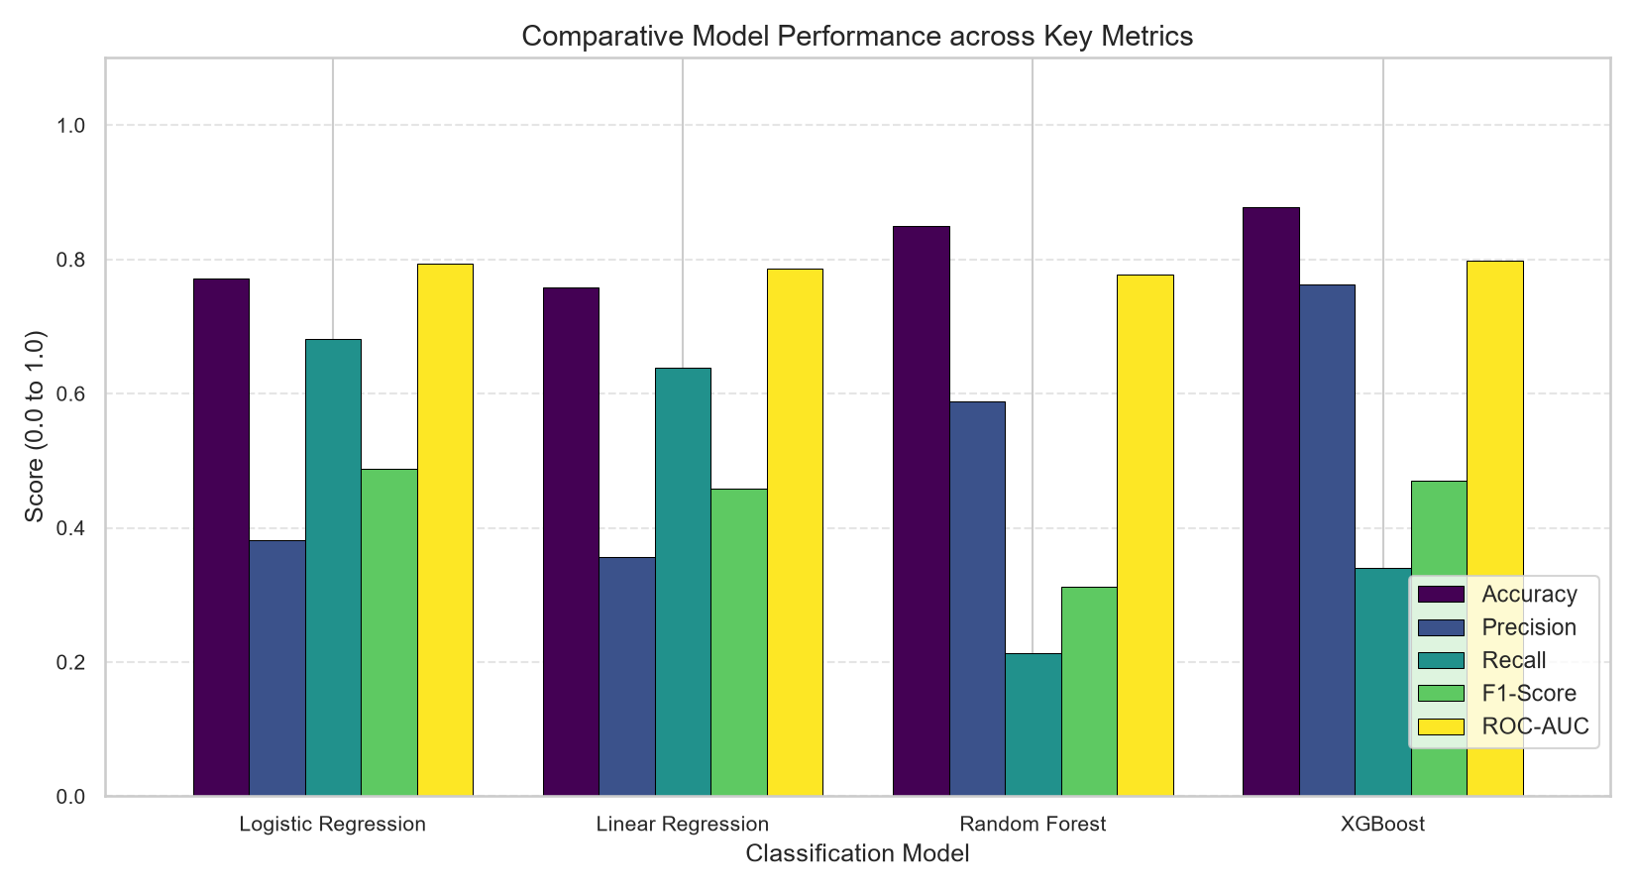
Results - Performance Comparison
Comparative Performance on Unseen Test Set:
• XGBoost achieved the highest overall Accuracy (87.76%) and Precision (76.19%).
• Linear models (Logistic & Linear Regression) achieved the highest Recall (~68% and ~64% respectively).
• The accuracy-recall trade-off is critical in HR: linear models act as better early warning alerts, while ensemble models make fewer false alerts.
Employee Attrition Prediction System | People Analytics

Slide 12
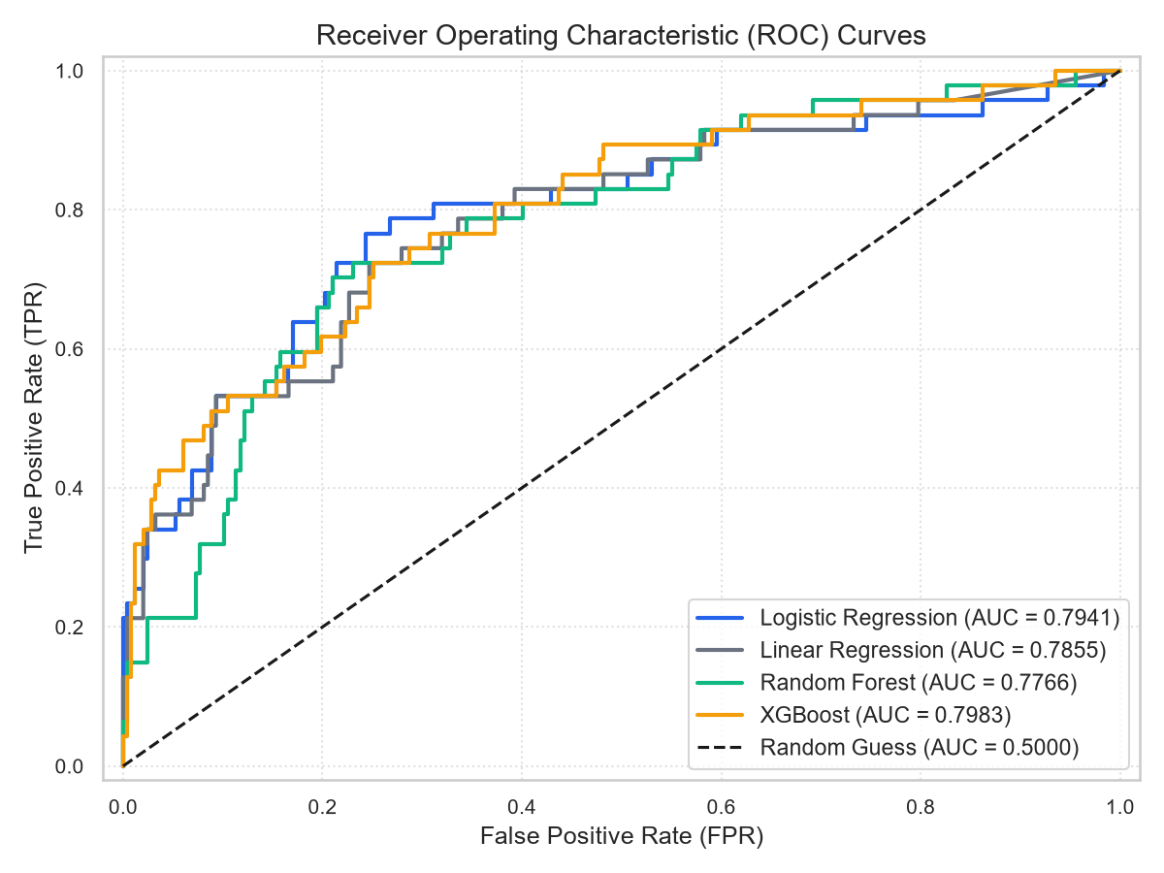
Results - Evaluation Visualization
1. ROC-AUC Performance:
• All four models clustered closely in ROC space (AUC ranging from 0.776 to 0.798).
• XGBoost leads with AUC = 0.7983.
2. The HR Error Cost Tradeoff:
• False Negatives (missing a leaving employee) are highly costly due to replacement costs.
• False Positives (flagging a staying employee) simply result in supportive check-ins.
• A high-recall model (like Logistic Regression) is ideal for employee intervention programs.
Employee Attrition Prediction System | People Analytics

Slide 13
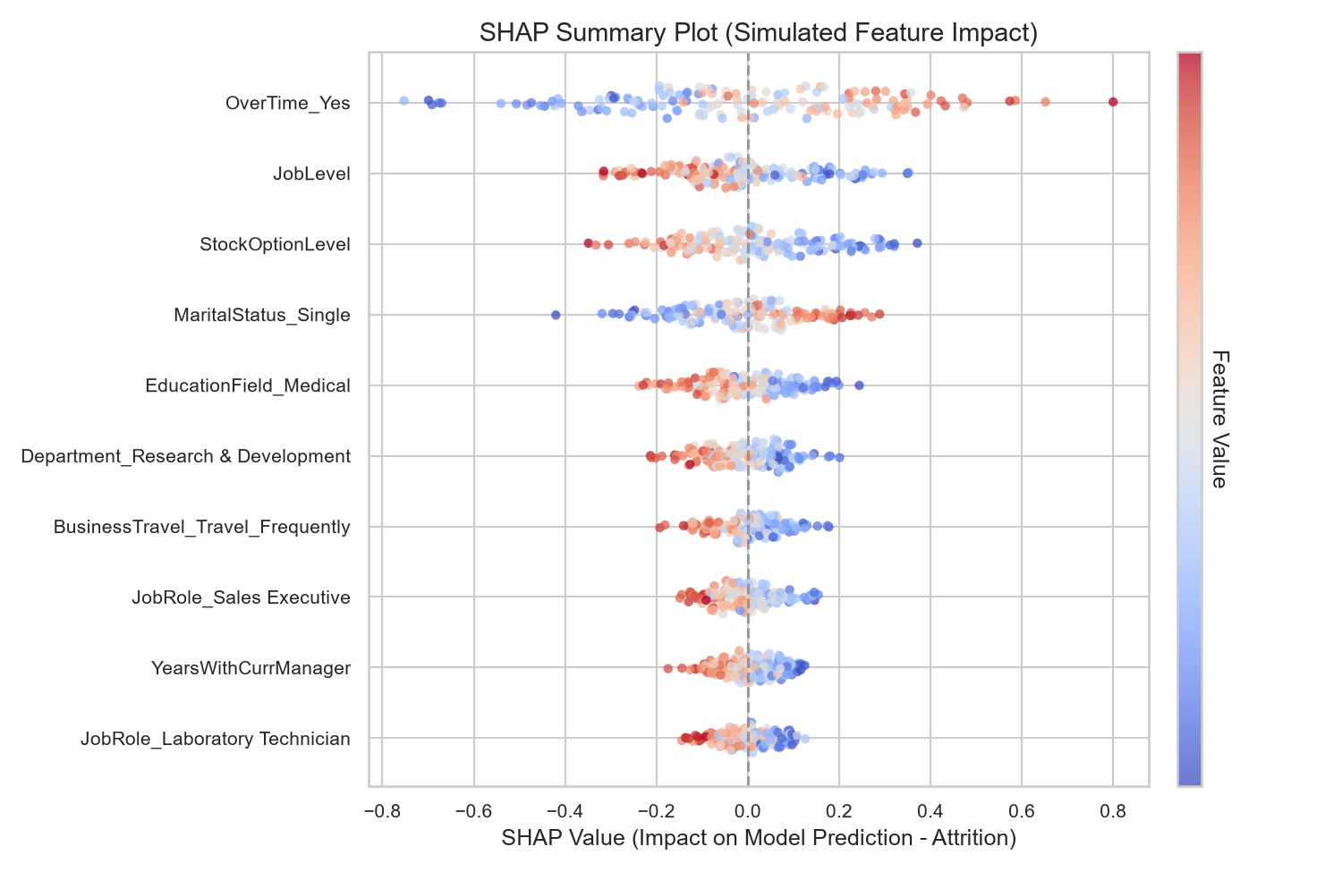
Feature Importance & SHAP Interpretation
Predictive features were analyzed across all classifiers:
1. Overtime Status (OverTime_Yes):
• The single most dominant positive predictor of attrition, reflecting workload and burnout.
2. Income and Experience (MonthlyIncome, YearsAtCompany):
• Strongly negative predictors; higher wages and organizational tenure correlate with stability.
3. Demographics (MaritalStatus_Single):
• Single status is positively correlated with attrition.
4. Role Specifics (JobRole_SalesRepresentative):
• Sales roles show elevated turnover compared to others.
Employee Attrition Prediction System | People Analytics

Slide 14
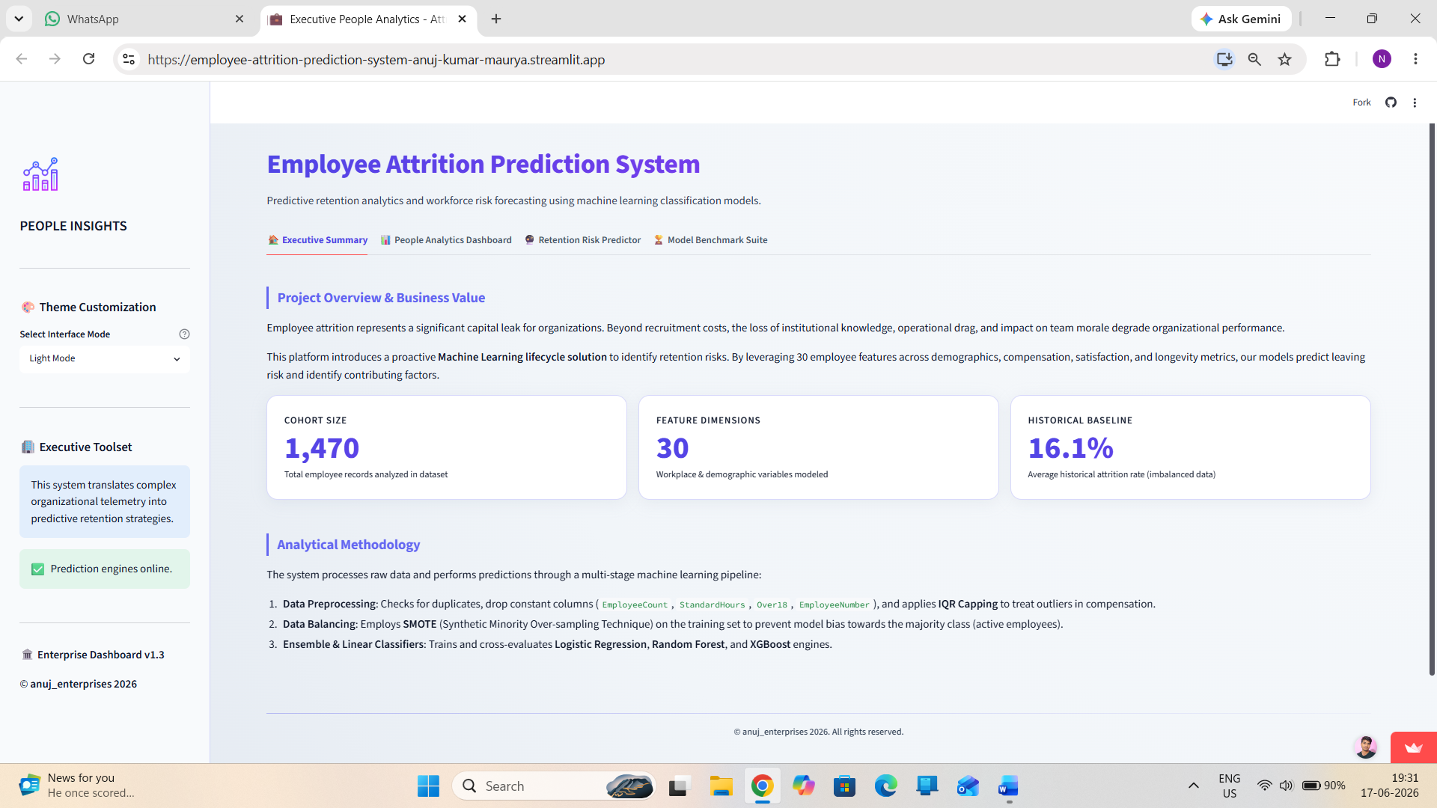
System Deployment - Streamlit App
The predictive models are deployed as an interactive Streamlit web dashboard:
• Sidebar Controls: HR professionals select the classification model (e.g. XGBoost, Logistic Regression) and toggle Light/Dark color themes.
• Parameters Inputs: Slider controls and select fields are grouped in a clean grid to easily construct employee profile simulations.
• Dynamic Styling: Theme engine dynamically updates CSS colors based on user sidebar selections (Slate slate background, glassmorphism cards).
Employee Attrition Prediction System | People Analytics

Slide 15
Deployment - Real-Time Predictions
• Simulated Inference: Gathers active slider values, converts inputs to a single-row dataframe, matches training column order, and executes preprocessing.
• Risk Classification: Predicts exit probability in real-time.
• Actionable Outputs: Renders color-coded warning alert cards (red gradient for risk, green for stable) detailing active risk coefficients.
• Intervention Indicators: Focuses managers on specific trigger items (such as overtime status) to construct targeted retention programs.
Employee Attrition Prediction System | People Analytics

Slide 16
Conclusion & Future Directions
Conclusion:
• Successfully transitioned HR operations from reactive post-exit reporting to proactive risk classification.
• Standardized pipelines and SMOTE balancing ensure robust classification on highly imbalanced datasets.
• Recommending Logistic Regression for alert filters (high recall), and XGBoost for overall audit reports.
Future Scope:
• Survival Analysis: Transition to Cox Proportional Hazards to predict *when* an employee will leave, not just if.
• Qualitative Sentiment Analysis: Integrate NLP algorithms to analyze Slack/Teams messaging metadata and exit text transcripts.
• API Decoupling: Package the joblib models as RESTful microservices to load directly into ERP systems like Workday or SAP.
Employee Attrition Prediction System | People Analytics

