Slide 1
Problem Statement: Address Formatting Issue
Team Members:
                Anuj Padhiyar
                Shreenivas Choudhary
                Anshumali Gaur
                Itisha Kumari
                Indu Kumari

Slide 2
Introduction
Problem statement denote the problem it-self as we have to remove discrepancy and duplication from the given address.
we make an iterable solution that remove the duplicates from the given sub-parts(like locality, address etc.)
anyone can easily implement an API with Json interface.
we make a system that takes input from csv file and gives output on browser in form of JSON.

Slide 3
Goals
    To provide neat and clear address
    To provide json that can be used in any insterface
    because of Json, system is scalable.

Slide 4
Development Tools
File For Read: csv or csv based with proper formate of input
Technology: Flask framework of python

Slide 5
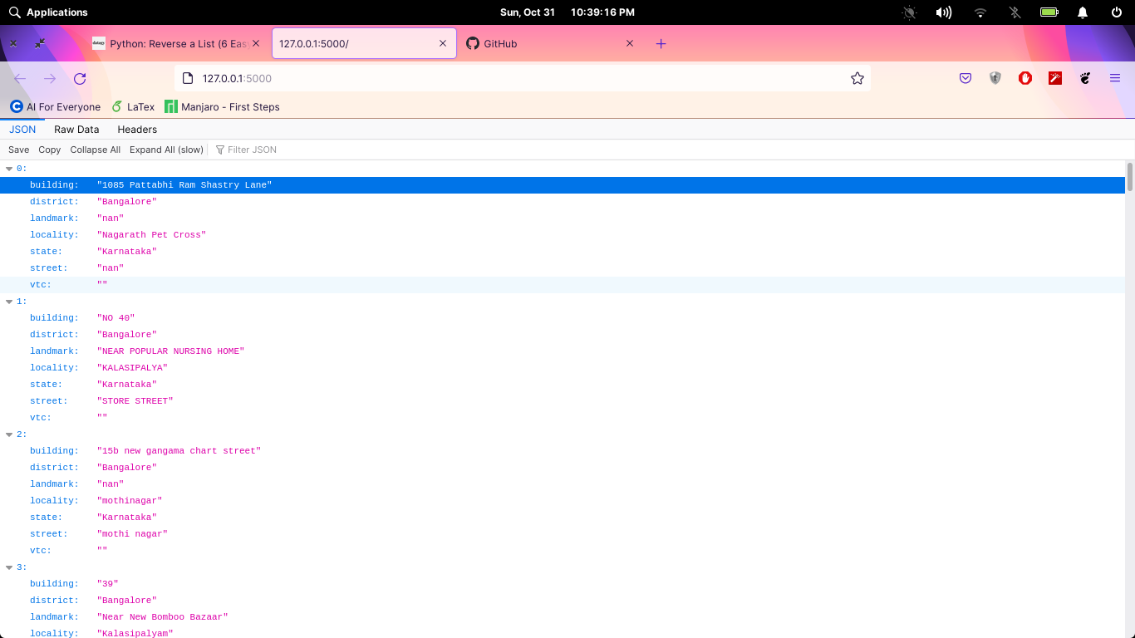
Snapshots
Home Page

Slide 6
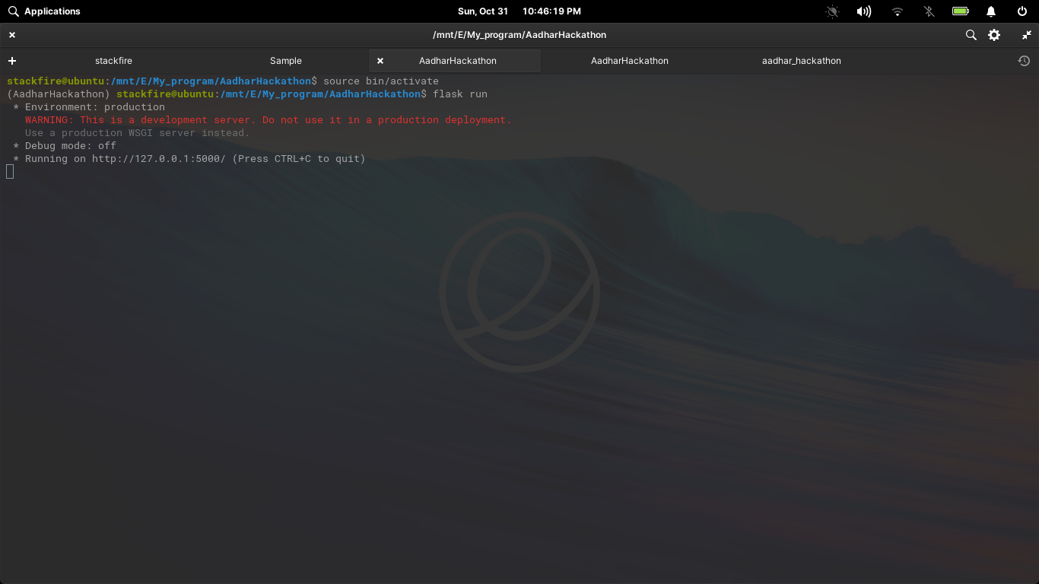
Start server for API
Blogs

Slide 7
Future Improvement
We can add new features to our API like
  we can modify it for best implement for all the other local languages like tamil,telugu,gujarati,hindi

