Slide 1

Clustering and Classification using Python
Understanding K-Means Clustering & Decision Tree Classification

Slide 2
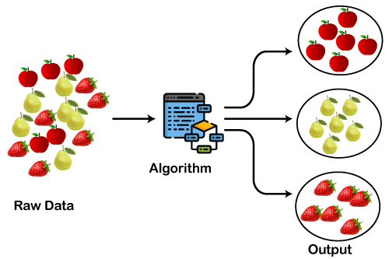


Clustering : k-means Clustering
Clustering
Clustering is a machine learning technique used to group similar data points together based on their characteristics.
Example :
E-commerce websites like Amazon group customers based on their shopping habits (e.g. tech lovers, fashion shoppers).
K-Means Clustering
K-means Clustering is a simple and commonly used algorithm that groups the data into k-distinct clusters

Slide 3

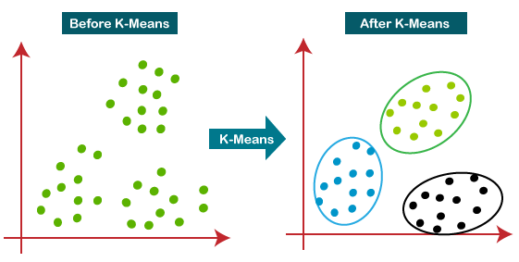
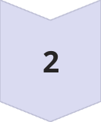

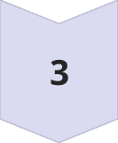
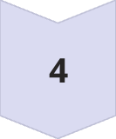
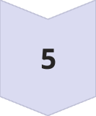


K-Means Clustering Steps
Choose K
Specify the number of clusters
Initialize Centroids
Randomly select K no of centroids
Calculate Distances and Assign data Points
Assign each point to the nearest cluster
Recalculate Centroids
Compute the mean of each cluster
Repeat
Repeat until convergence

Slide 4
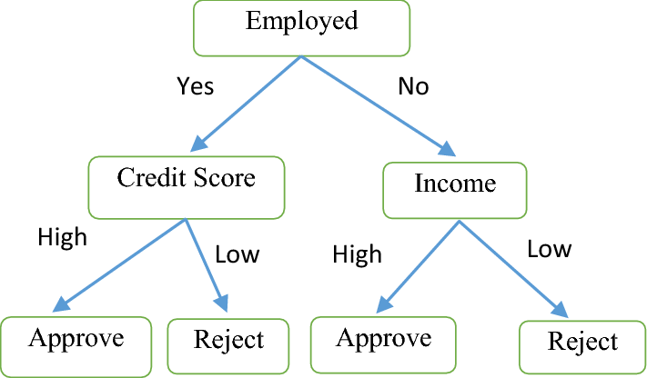






Classification – Decision Tree Algorithm
Classification
Classification is a technique in machine learning where a model is trained to categorize data into predefined classes or labels.
The model learns from historical data and predicts the class of new data points.
Example :
A bank can use classification model to classify and check whether a customer’s loan application is risky or safe.
Decision Tree classification:
A decision tree is a classification algorithm that uses a tree-like structure to make decisions.
Each internal node represents a test on the attribute, each branch represents a test result , and each leaf node represents a class label.

Slide 5




Essential Packages for implementation
Tkinter : Python’s built-in library for creating graphical user interfaces (GUIs).
Pandas (pd) – It is used for reading, processing, and analyzing numeric data.
Scikit-learn (sklearn) – provides Machine Learning algorithms.
KMeans: Performs K-Means clustering.
DecisionTreeClassifier: Implements a Decision Tree algorithm for classification.
Matplotlib (plt) – Creates plots for clustering and decision tree visualization.
SciPy (arff) – Used to load the .arff files.
OS (os) – Used to Extract file names from paths for display.

Slide 6


