Slide 1
B.Tech Project Presentation
Development of a mathematical model of GAGAN
(GPS Aided GEO Augmented Navigation System)
and use it for navigation purposes
  Name: Anuj Sharma
  Roll No.: Y5100
  Supervisor: Prof. Dr. Hari Hablani

Slide 2
FEATURES OF GAGAN
It is an implementation of Satellite Based Augmentation Systems (SBAS),
being developed by ISRO and Airports Authority of India
It monitors the GPS signals for errors and generates correction messages to
improve positioning accuracy for the users
It is inclusive of ground and on board segments.
Ground segment: 8 Indian Reference Stations (INRES), 1 Indian Master
Control Center (INMCC), 1 Indian Navigation Land Uplink
System (INLUS)
Onboard Segment: Navigation payload onboard Indian Geostationary
satellite GSAT-4

Slide 3
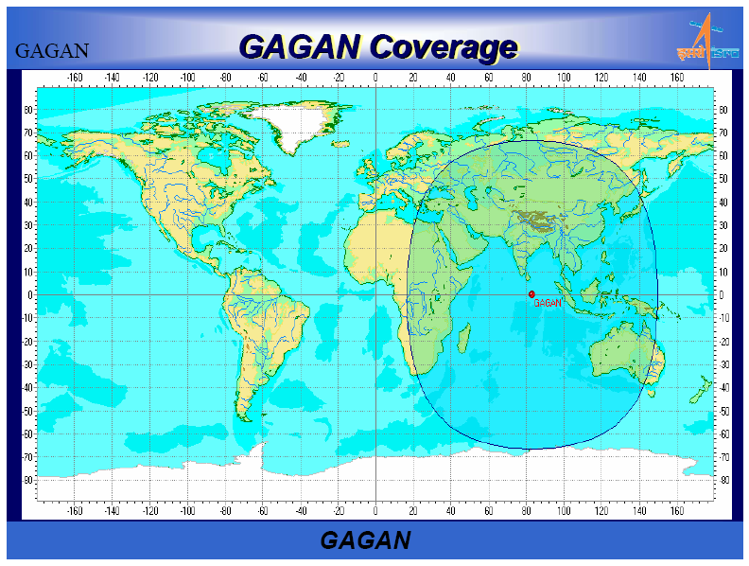
(Courtesy: www.isro.org)

Slide 4
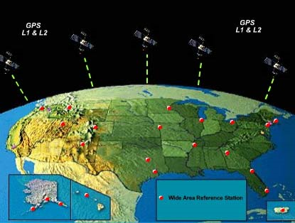
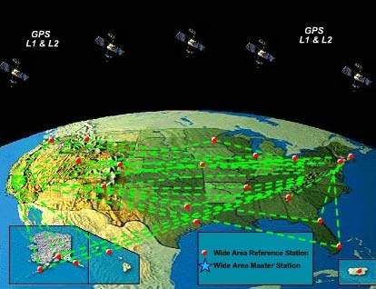
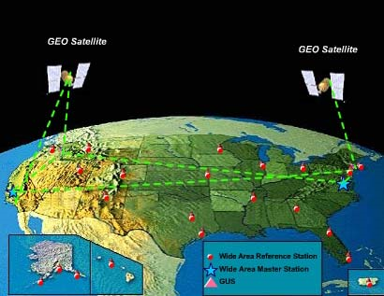
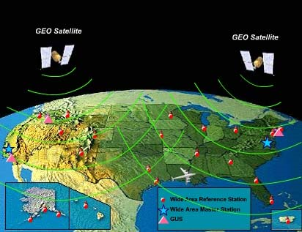
WORKING OF GAGAN
GAGAN’s working is similar to that of the WAAS (Wide Area Augmentation System), a satellite based augmentation system developed by the USA. The working of WAAS is demonstrated by the following figures:
(Courtesy: www.faa.gov)

Slide 5
PROPAGATION ERRORS IN THE GPS SIGNALS
Ionospheric: Presence of clouds of free electrons in the ionosphere act as
a dispersive medium for GPS signals and the signal propagation speed
changes (dependent on frequency) compared to that of free space.
Tropospheric: The troposphere is composed of dry gases and water vapor,
which lengthen the propagation path of GPS due to refraction. The delay is
frequency independent.
Multipath Problem: Objects in the vicinity of a receiver antenna can
easily reflect the GPS signals resulting in secondary propagation paths.
These secondary paths have a longer propagation time and can significantly
distort the direct-path signal affecting the amplitude and the phase.

Slide 6
OBJECTIVES OF THE PROJECT
To develop a mathematical model of GAGAN and use it for navigation purposes:
To develop a mathematical model of the constellation of GPS satellites and use it to
determine the position of a user
To develop a mathematical model of the flight path of a Regional Transport Aircraft
connecting two Indian airports
To use the model of GPS to determine the position of the aircraft during its flight
To develop full-state error models for aircraft navigation
To study the propagation of the errors for the following cases:
  Only INS is used
  Only GPS is used
  GPS/INS have been integrated into one system for aircraft navigation
To analyze the errors in the propagation of the GPS signals and develop algorithms to
mitigate these errors.
To integrate all the above mathematical models into one model to enable autonomous
navigation of an aircraft

Slide 7
INTRODUCTION TO THE GPS
The GPS constellation has 24 satellites placed in 6 orbits around the earth with
each orbit having 4 satellites. The altitude of these satellites is 20181.66 km
The orbits are placed at 55˚ inclination and with 60˚ difference between the
ascending node angles of the orbits
Eccentricity of the orbits = 0
GPS signal contains three types of data:
Pseudorandom code: It is unique for every GPS satellite. It contains data which
gives information of which of the satellites’ signal has
been received
Almanac data: It is used to determine the position of the satellite at the instant
at which it sent the signal
Ephemeris data: It contains information about the health of the satellite, date
and time

Slide 8
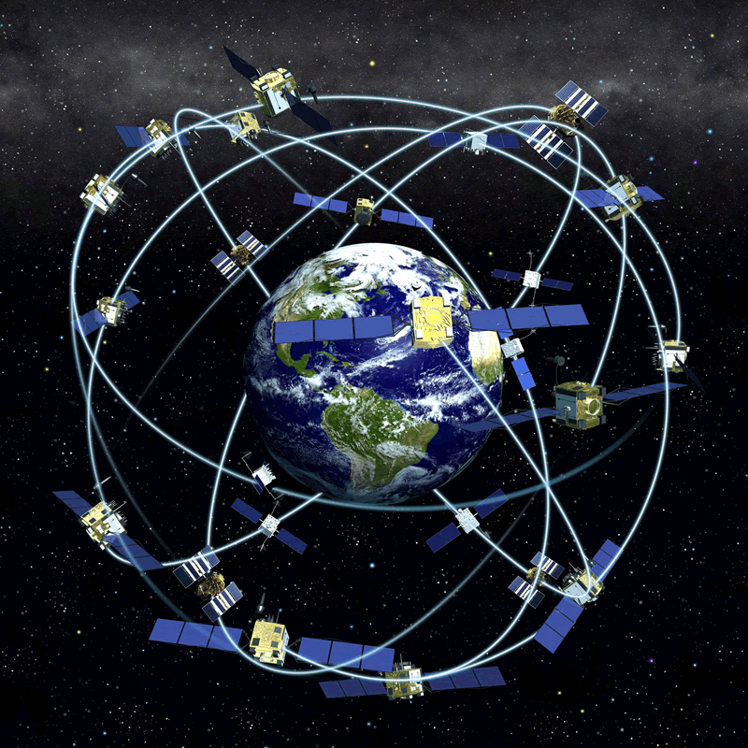
Courtesy: http://www.defenseindustrydaily.com/images/SPAC_GPS_NAVSTAR_IIA_IIR_IIF_Constellation_lg.gif

Slide 9
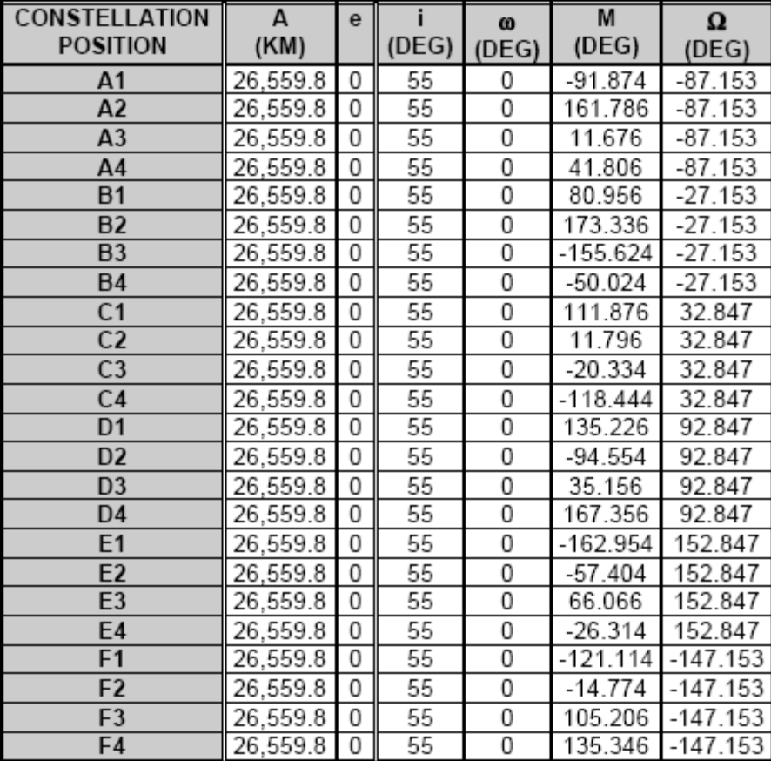
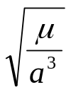

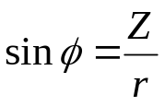
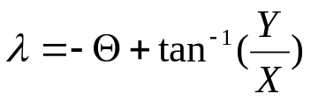



MATHEMATICAL MODELING OF GPS
Epoch on July 1, 1993 at 00:00 hours
Orbit perturbations have not been considered in the modeling , thus a, e, i, ω and Ω remain constant
Formulae used
M = M (at epoch time t₀) + n (t-t₀),
n = mean motion = ,
X, Y and Z are in ECI frame
and are the latitudes and longitudes in Greenwich meridian frame
is the right ascension angle of the Greenwich meridian
(Courtesy : Current GPS Constellation by Dr. A.J.Van Dierendonck , A J Systems)

Slide 10


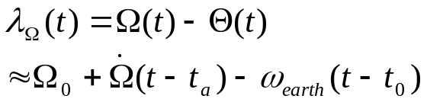


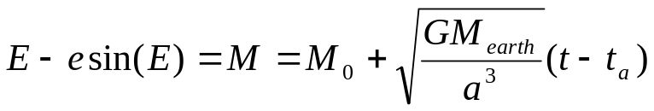


DETERMINATION OF THE SATELLITE POSITION
The satellite position is determined from the almanac data. It contains the following information
Parameter | Description
WN_{oa} | Almanac reference epoch (part 1) : GPS week number
t_{oa} | Almanac reference epoch (part 2) : Fraction of current GPS week
 | Square root of semi-major axis
E | Eccentricity
 | Inclination offset from reference value of i_{ref}
 | Longitude of the ascending node at the weekly epoch
 | Rate of change of the right ascension of the ascending node
 | Argument of perigee
 | Mean Anomaly at reference epoch
a₀ | Spacecraft clock offset from GPS time
a₁ | Clock frequency offset
=-0.04˚/day

Slide 11
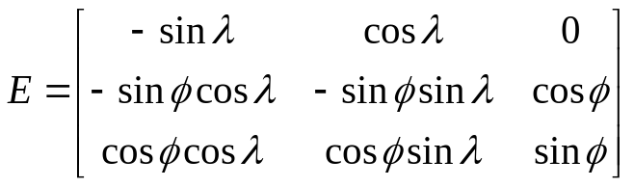
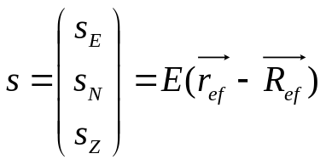
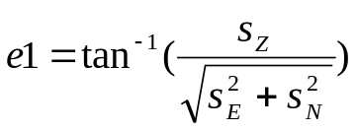


SELECTION OF THE SATELLITES FOR THE DETERMINATION OF POSITION OF GPS RECEIVER
In practical situation, a receiver receives GPS signals, but in mathematical
modeling, in order to generate the GPS signal, it is assumed that the receiver’s
position is known and then the satellites’ whose signals are required are determined.
All the 24 satellites are checked and it is found out which of them lie above the
horizon at the receiver’s location at that particular instant.
The data of those satellites is considered that lie at elevation angle > 5˚.
Formulae used
, and
E : Matrix of transformation from the ECI frame to the local ENZ (East, North and
Zenith) frame.
s : Vector from the receiver’s location to the GPS satellite’s position
e1 : Elevation angle that the GPS satellite makes with the receiver’s location
and denote the receiver’s and the satellite’s location in ECI frame

Slide 12

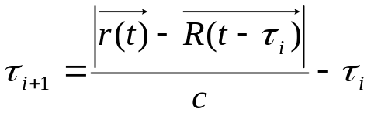




MATHEMATICAL MODELING OF THE GPS SIGNALS
To make a mathematical model of the transmission of the GPS signals, it is
assumed that the receiver’s location is known and then using this information,
the time instant at which the particular GPS signal was transmitted is computed.
The propagation time for the GPS signal to be received by a GPS receiver after it
has been transmitted from the GPS satellite is denoted as .
The following iterative process is carried out to determine
, is the assumption for initial value of
and are the position locations of the receiver at time instant t and the satellite at time instant respectively

Slide 13






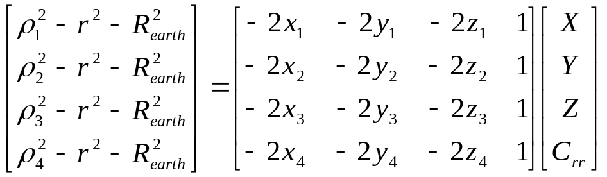
DETERMINATION OF THE RECEIVER’S POSITION
Once the propagation time of the GPS signal and the position of the
corresponding satellite has been determined for four or more satellites, the
receiver computes its own position using these data.
, denotes the distance of the i^{th} satellite from the receiver
Also,
Thus, we get

Slide 14
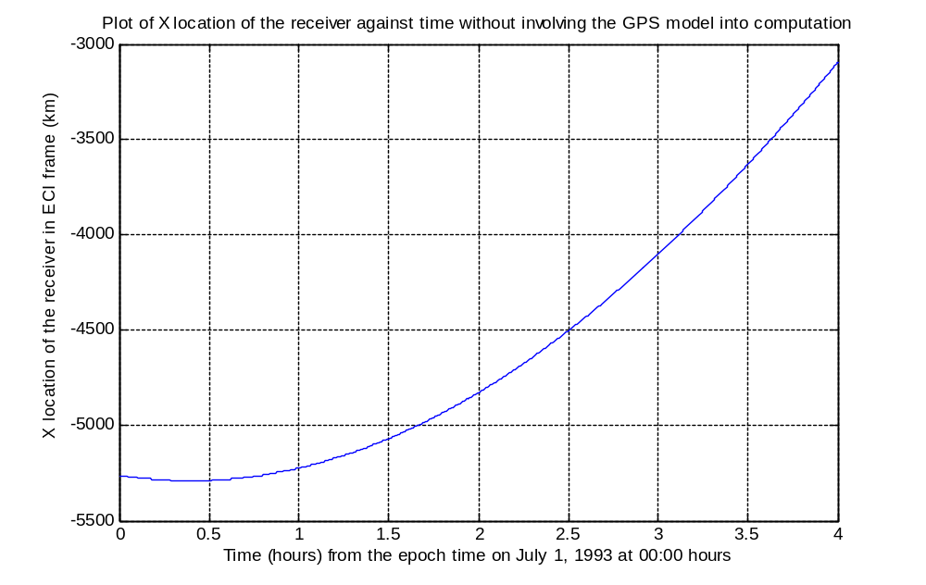
Plot of X location against time without involving the GPS

Slide 15
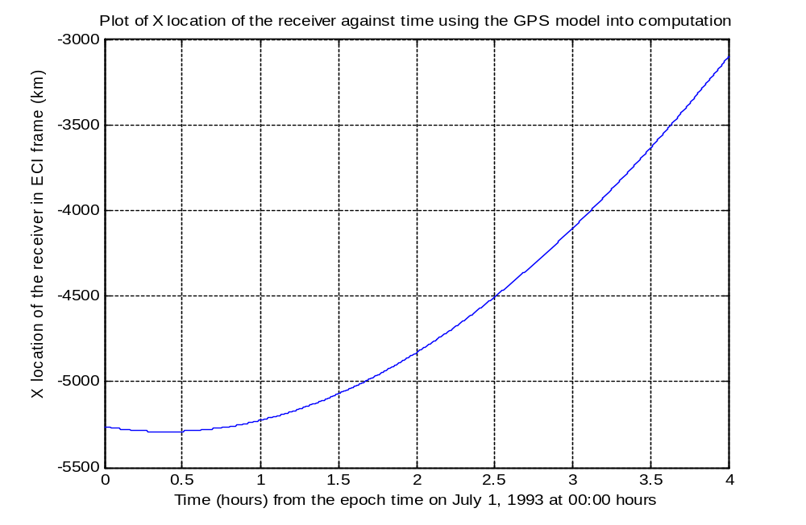
Plot of X location against time using the GPS

Slide 16
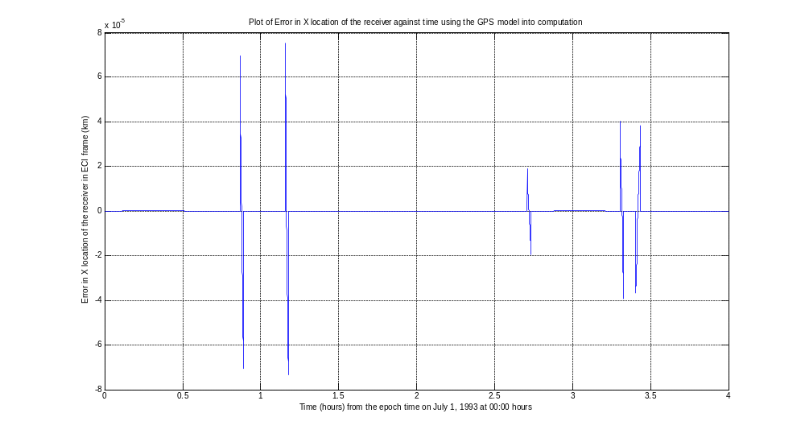
Plot of Error in X location against time using the GPS

Slide 17
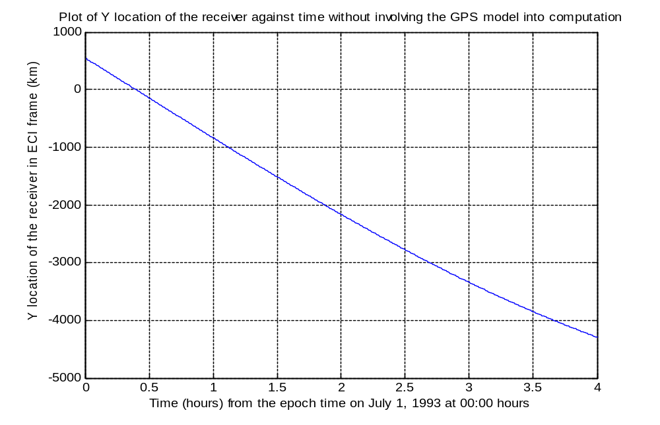
Plot of Y location against time without involving the GPS

Slide 18
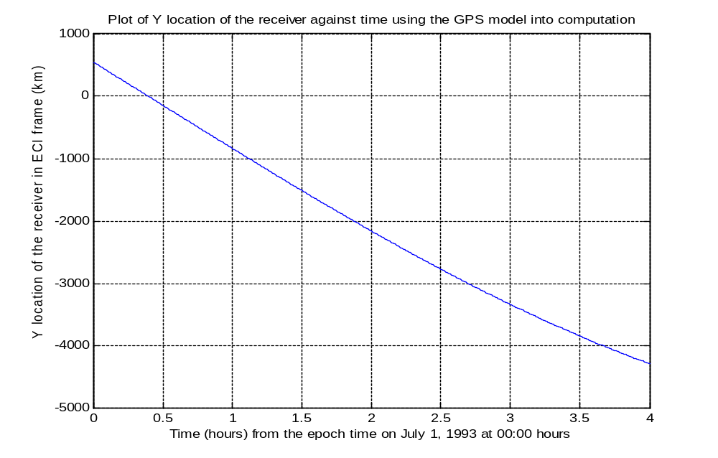
Plot of Y location against time using the GPS

Slide 19
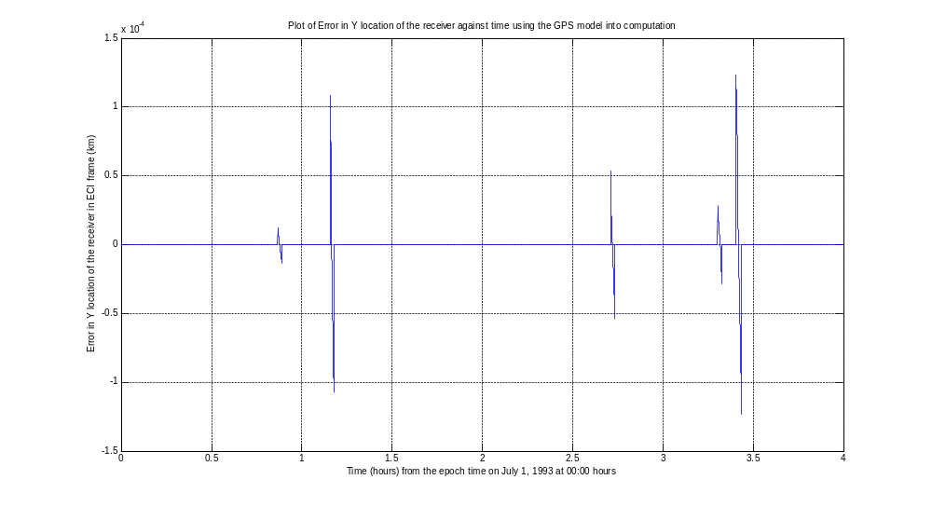
Plot of Error in Y location against time using the GPS

Slide 20
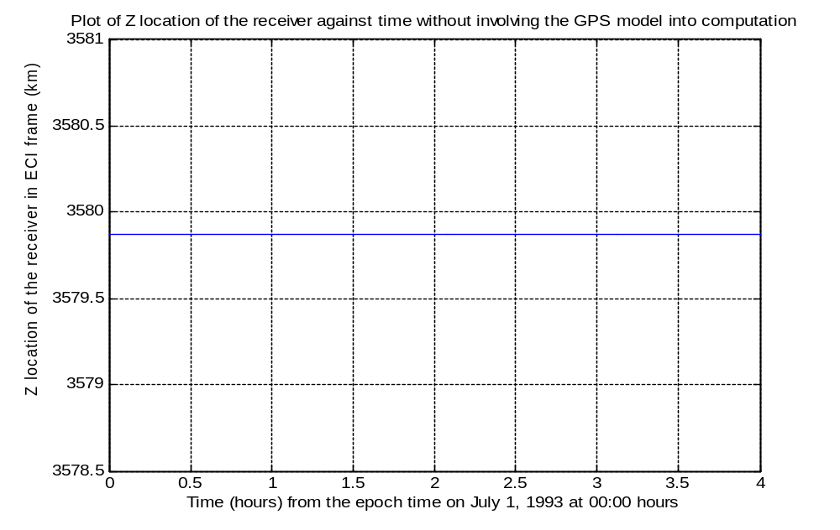
Plot of Z location against time without involving the GPS

Slide 21
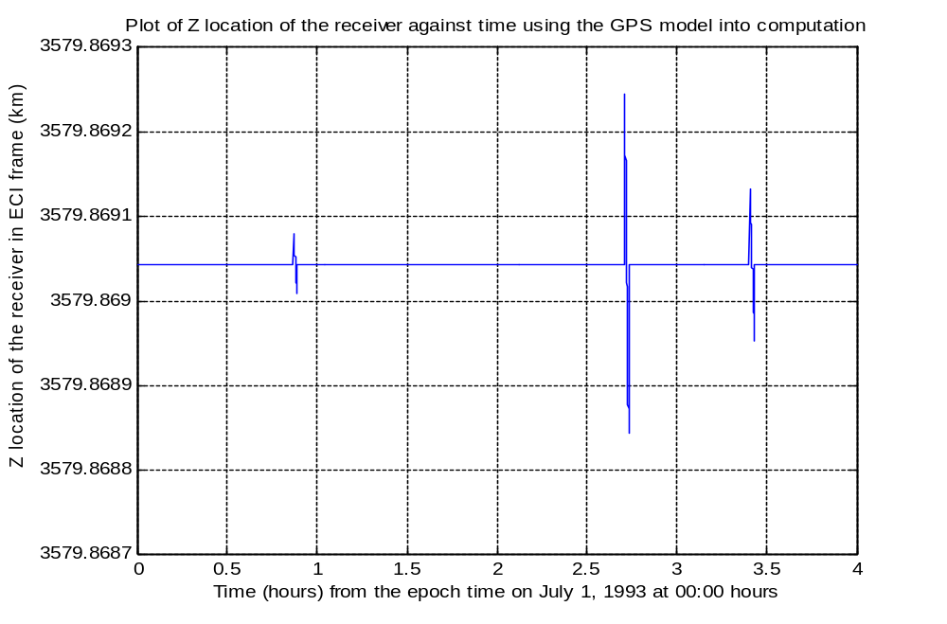
Plot of Z location against time using the GPS

Slide 22
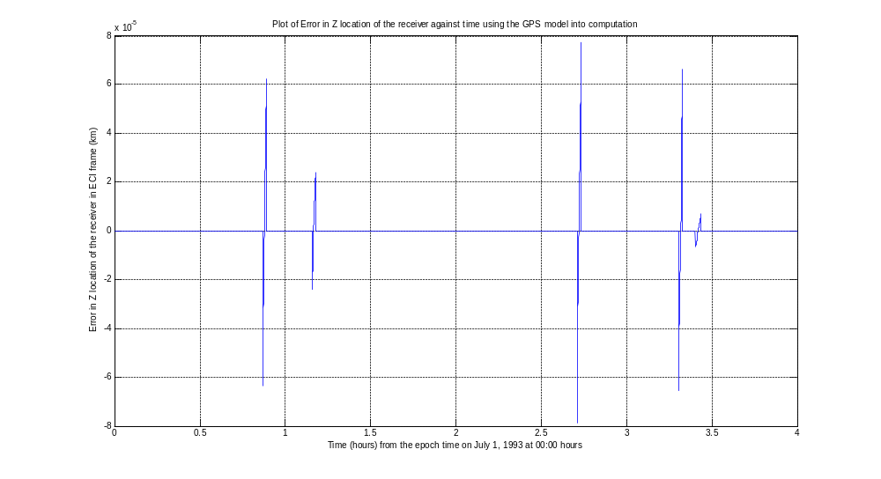
Plot of Error in Z location against time using the GPS

Slide 23
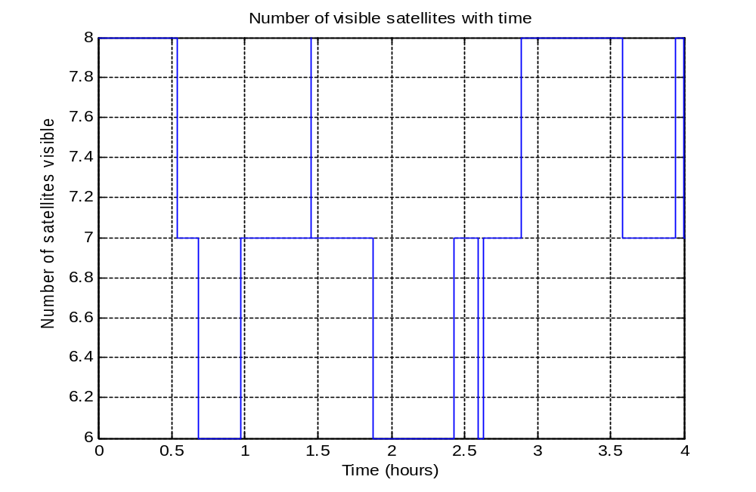
Plot of the Number of GPS Satellites visible with time

Slide 24
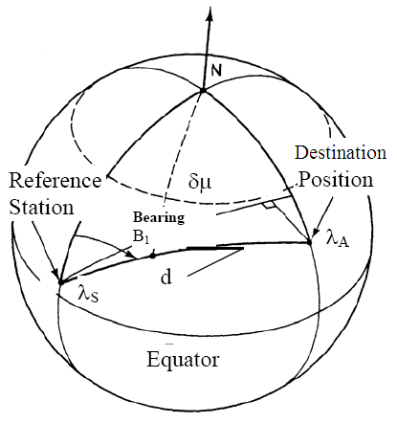
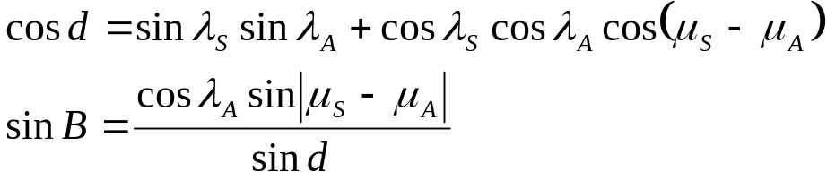
FLIGHT PATH OF AN AIRCRAFT USING THE BEARING ANGLE METHOD
λ_{S}: latitude of S; μ_{S}: longitude of S
λ_{A}: latitude of A; μ_{A}: longitude of A
(Courtesy: Integrated Navigation and Guidance Systems by Daniel J. Biezad)

Slide 25
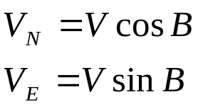
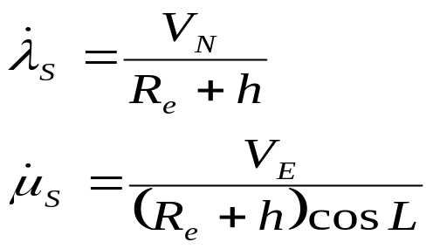
V_{N}: North velocity
V_{E}: East Velocity
h: altitude of flight

Slide 26
Simulation of the flight path of a Regional Transport Aircraft from
Srinagar to Kanyakumari
Srinagar: 34.083˚ N, 74.8167˚ E
Kanyakumari: 8.083˚ N, 77.567˚ E
Flight conditions:
Cruise flight
10 km altitude
0.7 Mach speed = 209.6 m/sec
Range = 2912.58 km
Time of flight = 3 hours 50 min

Slide 27
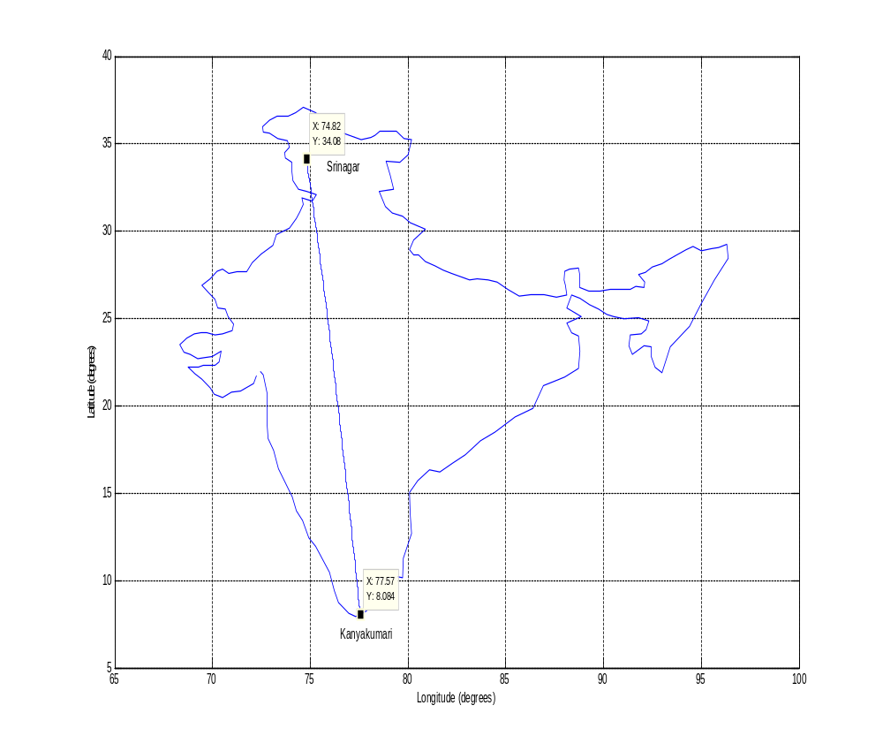
Flight path on the map of India
Courtesy: http://www.gorissen.info/Pierre/maps/googleMapLocation.php?lat=28&lon=82&setLatLon=Set

Slide 28
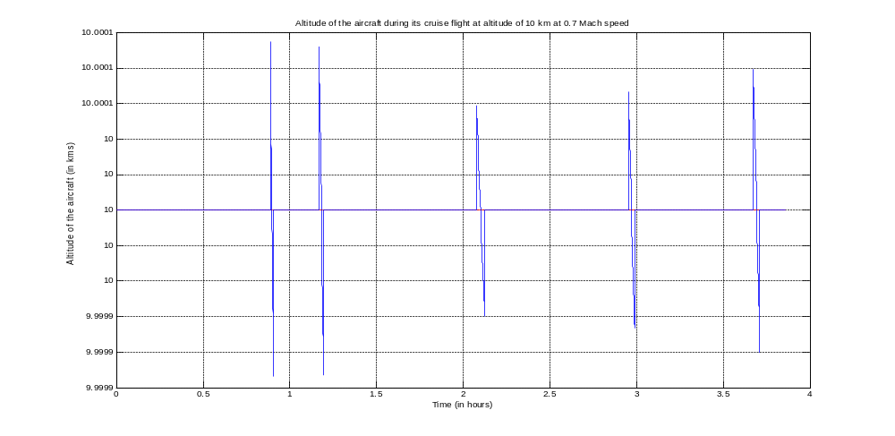
Plot of altitude of the aircraft against time

Slide 29
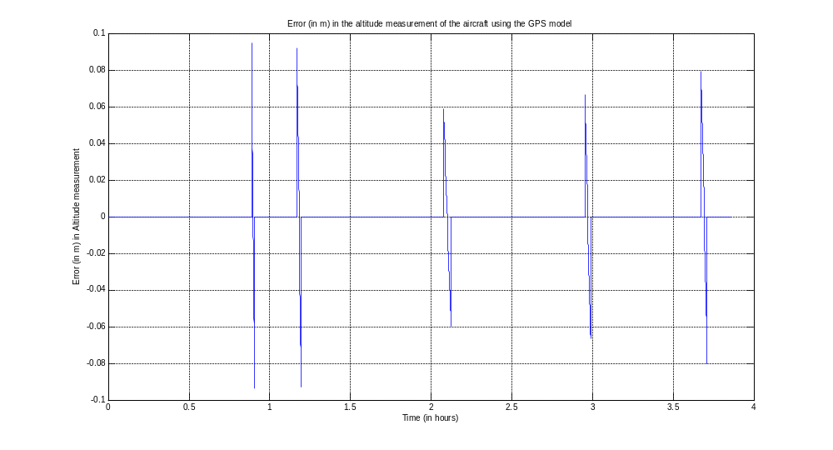
Plot of error in the altitude measurement of the aircraft using the GPS model

Slide 30
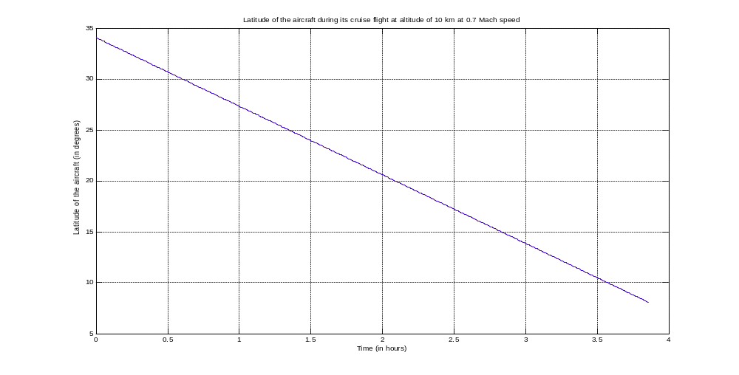
Plot of latitude of the aircraft against time

Slide 31
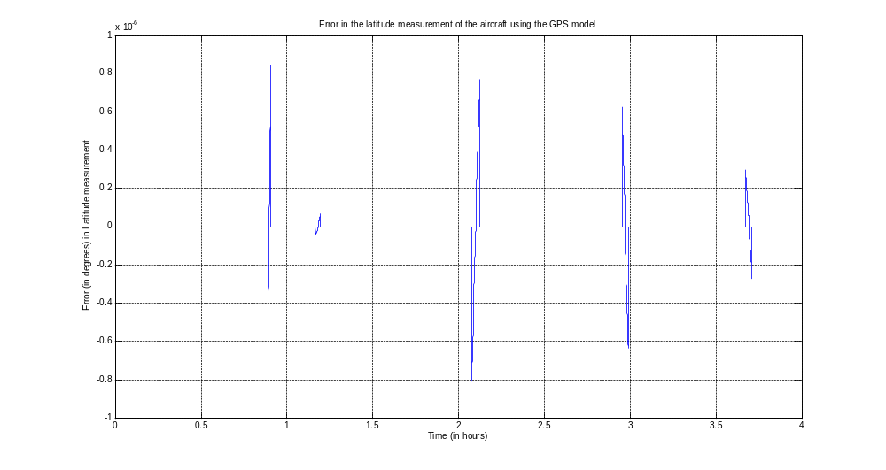
Plot of the error in the latitude measurement using the GPS model

Slide 32
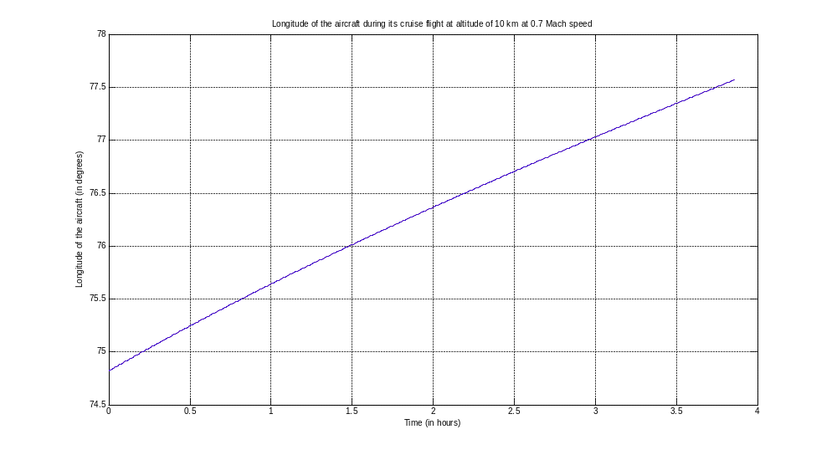
Plot of longitude of the aircraft against time

Slide 33
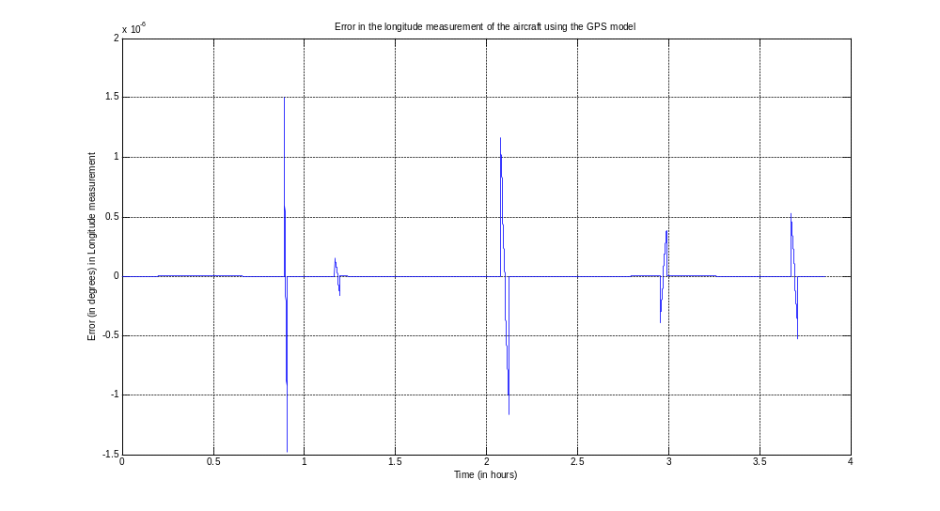
Plot of the error in the longitude measurement using the GPS model

Slide 34
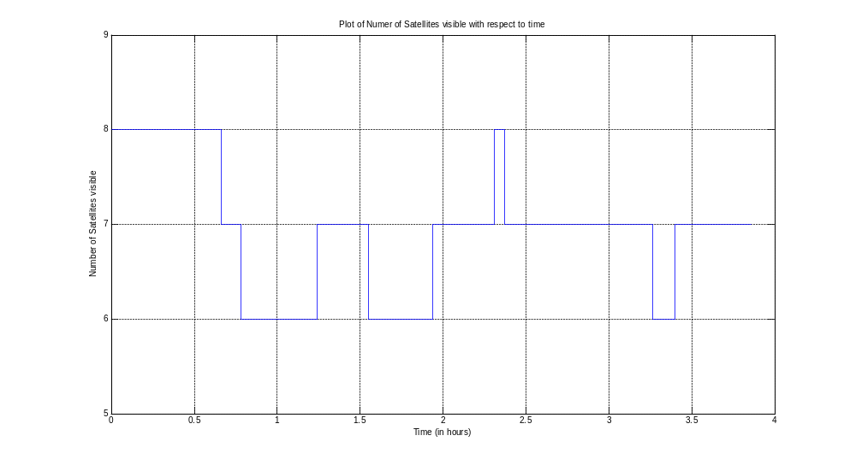
Plot of the Number of GPS satellites visible with time

Slide 35
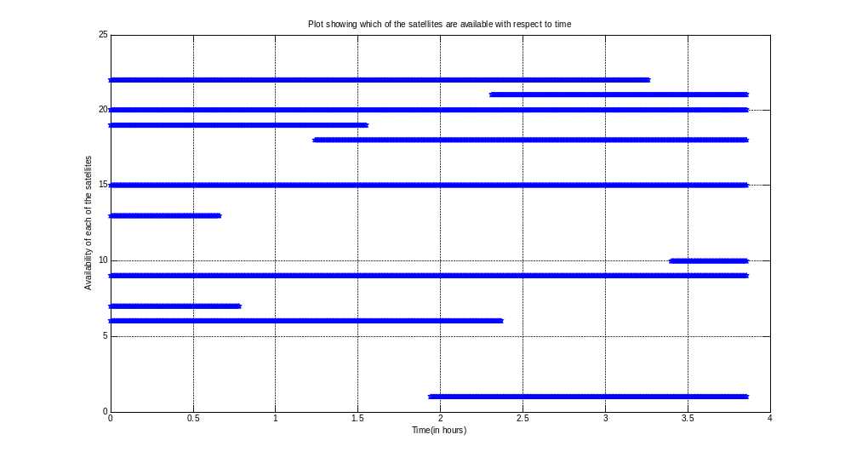
Plot showing the availability of the GPS satellites with time

Slide 36
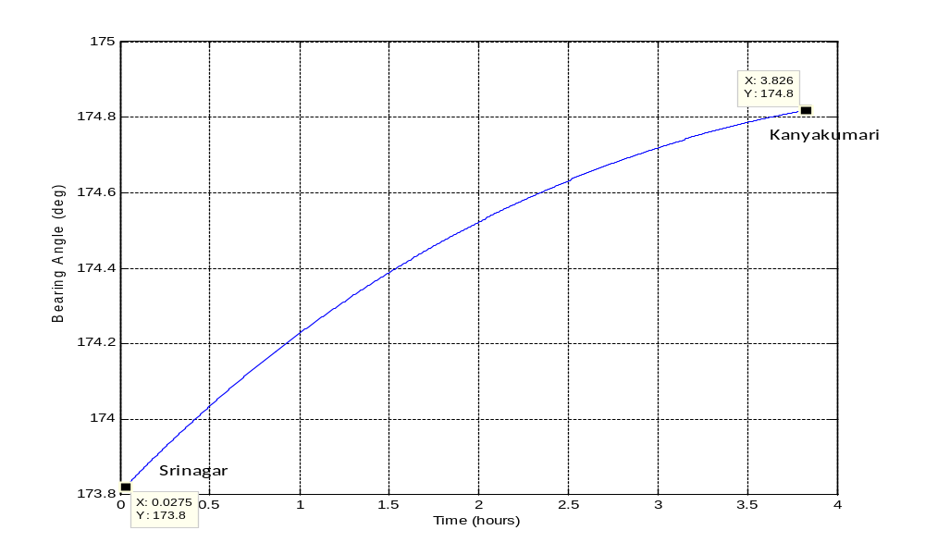
Plot of the bearing angle ‘B’ against time

Slide 37
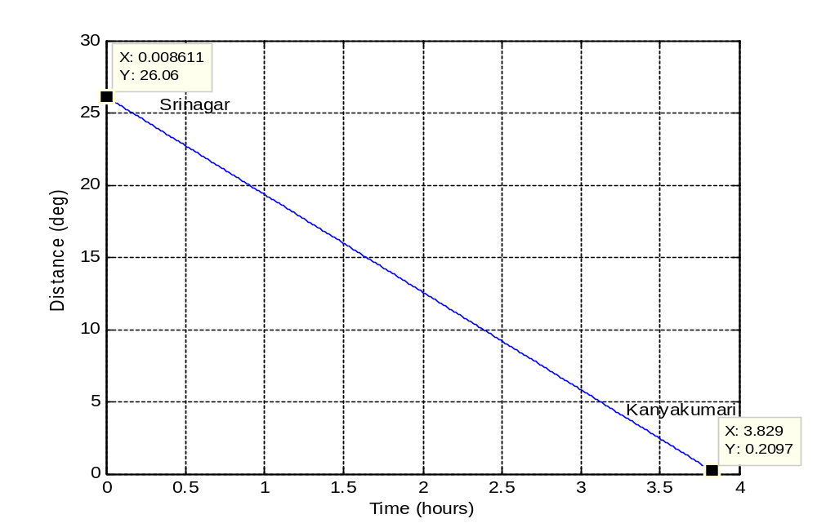
Plot of the distance angle ‘d’ against time

Slide 38

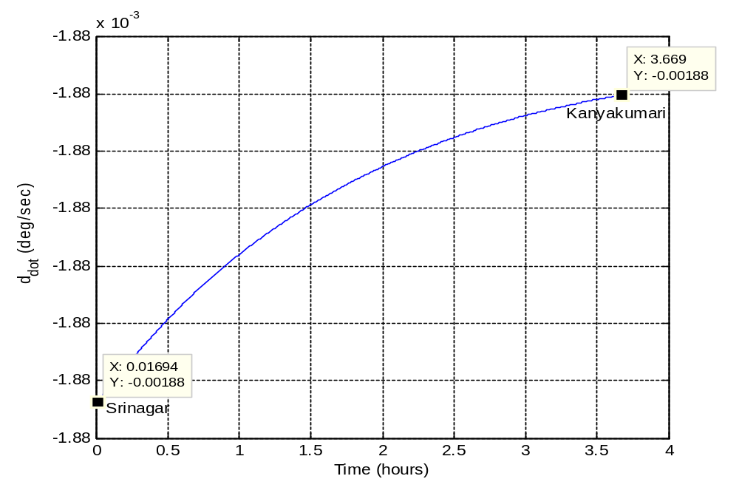
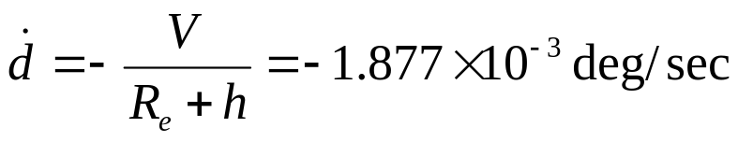
Plot of rate of change of the distance angle, with time

Slide 39

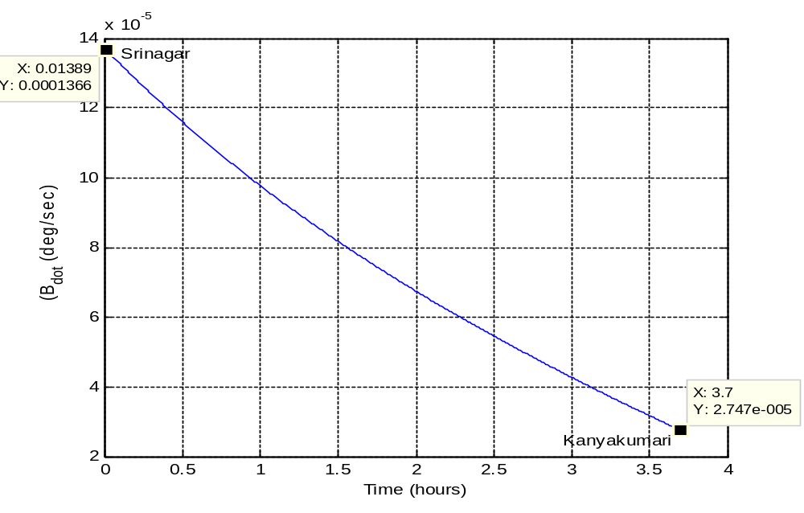
Plot of rate of change of the bearing angle, with time

Slide 40
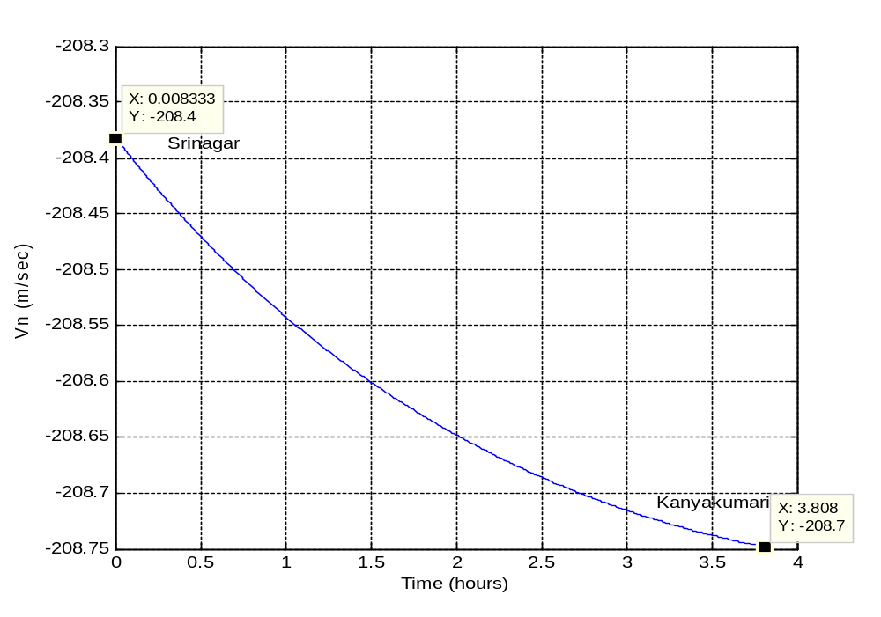
Plot of North Velocity against time

Slide 41
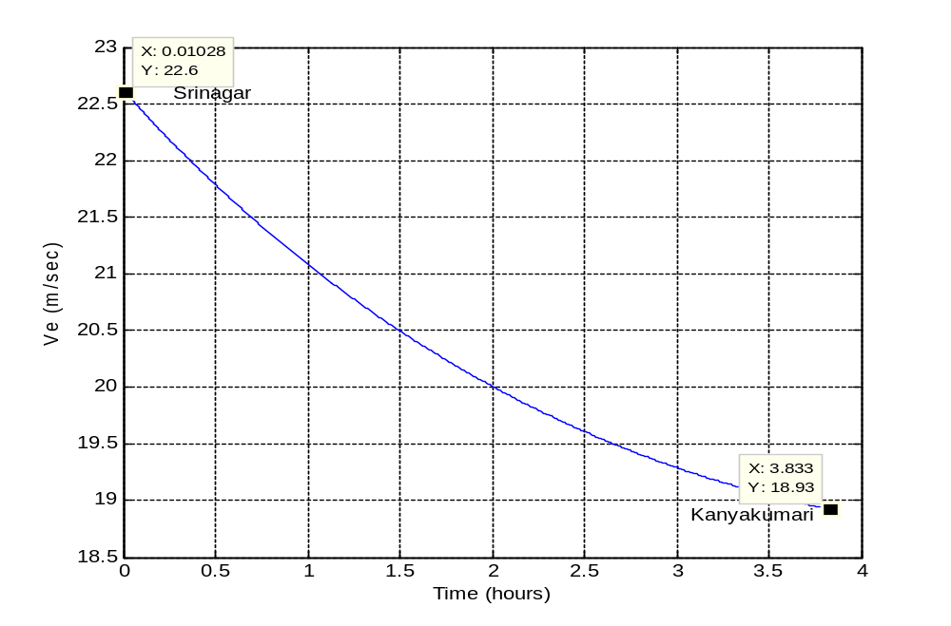
Plot of East Velocity against time

Slide 42
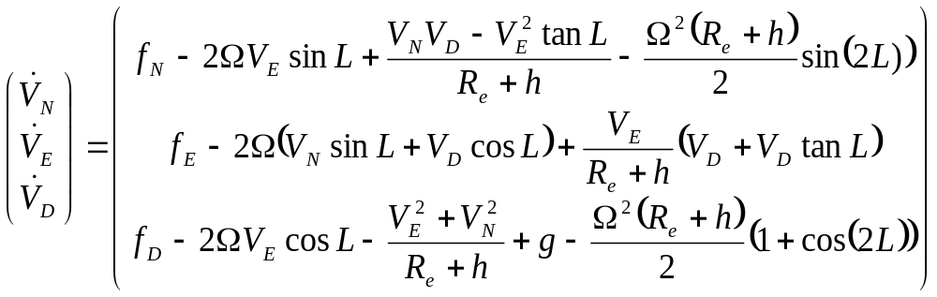
EQUATIONS OF MOTION OF AN AIRCRAFT IN NAVIGATION FRAME
L: latitude
l: longitude
h: altitude
Ω: rate of earth’s rotation about its spin axis
f_{N}, f_{E}, f_{D}: specific body forces in North, East and Down directions respectively
measured by the accelerometers in the inertial frame

Slide 43
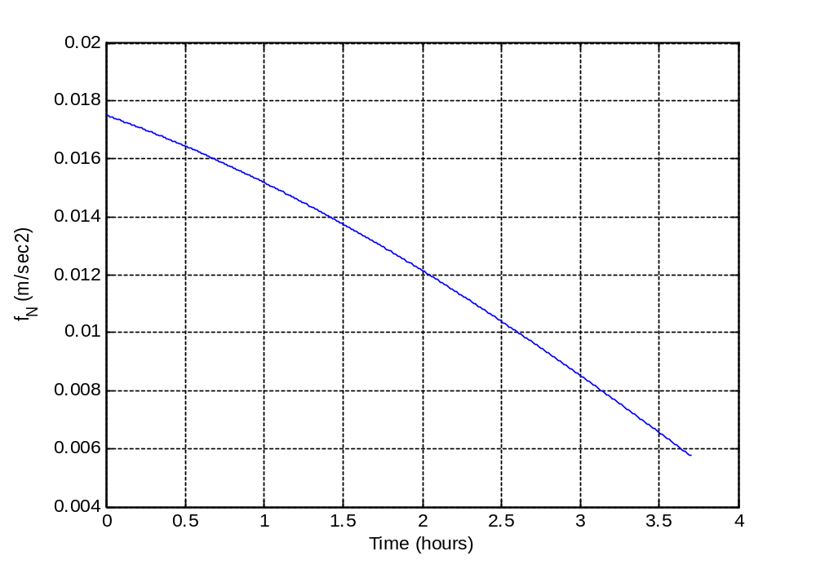
Plot of f_{N} against time

Slide 44
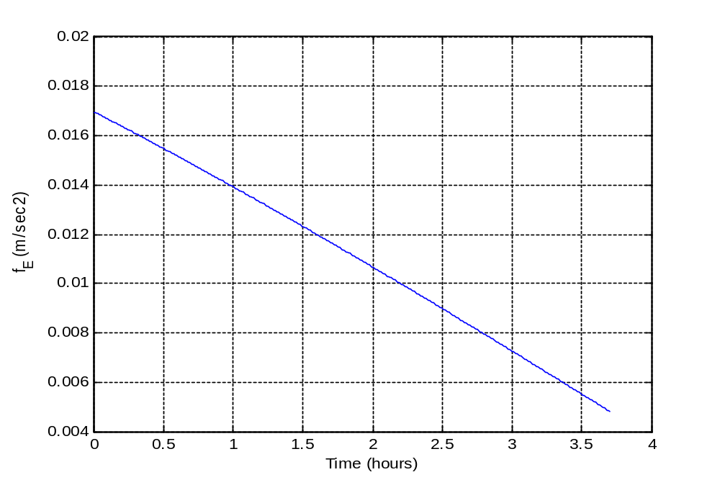
Plot of f_{E} against time

Slide 45

Plot of f_{D} against time

Slide 46

FULL-STATE ERROR MODEL
δx = [δα δβ δγ δV_{N} δV_{E} δV_{D} δL δl δh]^{T}
u = [δω_{x} δω_{y} δω_{z} δf_{x} δf_{y} δf_{z}]^{T}
δα, δβ, δγ : attitude errors
δV_{N}, δV_{E}, δV_{D}: velocity errors
δL, δl, δh: latitude, longitude and altitude errors
δω_{x}, δω_{y}, δω_{z}: gyroscopic biases
δf_{x}, δf_{y}, δf_{z}: accelerometer biases

Slide 47



Slide 48
Case I: Aircraft Navigation using INS only with constant gyroscope and
accelerometer biases
The flight path from Srinagar to Kanyakumari developed earlier has been used for this error model
Initial state errors:
δα₀ = 0.1 mrad
δβ₀ = 0.1 mrad
δγ₀ = 1.0 mrad
δV_{N} = δV_{E} = δV_{D} = δL = δl = δh = 0
Gyroscopic bias:
δω_{x} = 0.01˚/h
δω_{y} = 0.01˚/h
δω_{z} = 0.01˚/h
Accelerometer bias:
δf_{x} = 0.1 milli-g
δf_{y} = 0.1 milli-g
δf_{z} = 0.1 milli-g

Slide 49

Plot of attitude errors variation with time

Slide 50

Plot of velocity errors variation with time

Slide 51

The periodic oscillations in the horizontal channels i.e. North and East channels are known as the Schuler oscillations.
Frequency = ω_{s} =
The Schuler oscillation manifests itself as an oscillation in each horizontal channel.
T = 84.4 min = 1.407 hours
From the plots, Time period of the oscillations in the horizontal channel = 1.39 hours

Slide 52

Plot of latitude and longitude errors variation with time

Slide 53


Plot of altitude error variation with time

Slide 54






Case II: Aircraft Navigation using INS only with gyroscopic and accelerometer
errors being white noise
Accelerometer white-noise spectral density = 0.0036 (m/sec²)²/(rad/sec)
Gyro white-noise spectral density = 2.35 (10⁻¹¹) (rad/sec)²/(rad/sec)
The error equation is now represented as
x_{k}: error at t_{k}; x_{k+1} : error at t_{k+1}
For being very small ,

Slide 55



δ is a dirac-delta function
The initial errors are the same as in the earlier example.

Slide 56

Plot of δα variation with time

Slide 57

Plot of δβ variation with time

Slide 58

Plot of δγ variation with time

Slide 59

Plot of δV_{N} variation with time

Slide 60

Plot of δV_{E} variation with time

Slide 61

Plot of δV_{D} variation with time

Slide 62

Plot of Latitude error variation with time

Slide 63

Plot of Longitude error variation with time

Slide 64

Plot of altitude error variation with time

Slide 65

APPLICATION OF DISCRETE KALMAN FILTERING TO AIRCRAFT NAVIGATION
x_{k+1} = φ_{k} * x_{k} + w_{k}
z_{k} = H_{k} * x_{k} + v_{k}
where E[w_{k}w_{k}^{T}] = Q_{k} and E[v_{k}v_{k}^{T}] = R_{k}
m²
x_{k} represents the INS model
z_{k} represents the GPS model

Slide 66

The GPS model measures the pseudoranges to the visible satellites to determine the position of the user
ψ_{i}: pseudorange from the user to the i^{th} visible GPS satellite
(X_{i}, Y_{i}, Z_{i}): position of the i^{th} visible GPS satellite in the ECEF frame
(x, y, z): position of the user in the ECEF frame
Δt: Receiver clock bias with respect to the GPS time

Slide 67


The error in the measurement ψ_{i} is approximately related to ‘x’ by
z_{k} = H_{k} x_{k}
And E[x x^{T}] = σ²(H_{k}^{T} H_{k})⁻¹
The error in the measurement of the user position is minimised by making the trace of the (H_{k}^{T}H_{k})⁻¹ minimum.
Geometric Dilution of Precision is given by:

Slide 68

X_{ECEF} = (R_{e}+h) cos L cos l
Y_{ECEF} = (R_{e}+h) cos L sin l
Z_{ECEF} = (R_{e}+h) sin L

Slide 69



The Kalman Filter Algorithm
The error state vector x_{k} is calculated using x_{k-1} as shown earlier.
The z_{k}, i.e. the error in the measurement of the GPS is calculated using x_{k}.
There is an estimate of x_{k} just prior to the measurement at tk and is denoted as
A better estimate of x_{k} is calculated using , Kalman Gain (K_{k}) and the difference between the measurement z_{k} and . The new estimate is represented as
This new, better estimate, is used to calculate the error state vector x_{k+1} at the next time instant t_{k+1}
The above steps from 1 to 5 are repeated for the propagation of the errors with time.

Slide 70








Step 1:
Step 2:
P_{k} = E[e_{k}e_{k}^{T}]
Step 3:
Step 4:
Step 5:
Step 6:

Slide 71
REFERENCES
1. Grewal, Mohinder S., Weill, Lawrence R., Andrews, Angus P. (2007) : Global
Positioning Systems, Inertial Navigation, and Integration, Second Edition, John Wiley
& Sons, Ltd
2. Montenbruck, Oliver, Gill, Elberhard (2000) : Satellite Orbits : Models, Methods and
Applications, Springer-Verlag
3. Misra, Pratap, Enge, Per (2006): Global Positioning System : Signals, Measurements,
and Performance, Second Edition, Ganga-Jamuna Press
4. Titterton, D. H., Weston, J. L. (2004): Strapdown Inertial Navigation Technology,
Second Edition, AIAA
5. Biezad, Daniel J. (1999): Integrated Navigation and Guidance Systems, AIAA
Education Series
6. Stevens, Brian L., Lewis, Frank L. (2003): Aircraft Control and Simulation, Second
Edition, John Wiley & Sons, Inc.
7. Brown, Robert Grover, Hwang, Patrick Y.C. (1983): Introduction to Random Signals
And Applied Kalman Filtering, Second Edition, John Wiley & Sons, Inc.

Slide 72
THANK YOU

