Slide 1
संवाद · SAMVAAD
An AI coaching copilot that turns every school visit into one coaching step that gets followed up
For CRPs, BRPs, ARPs and NIPUN mentors · Rajasthan-first · Hindi (Hinglish) + English · works offline
395
42
81
6
0
unit tests passing
browser tests passing
API endpoints
AI tasks, all human-approved
teacher scores, ever
Live demo: https://samvaad-fl55.onrender.com/ Code: github.com/anuj-sharma7/SAMVAAD
Working prototype on fictional sample data. AI output is labelled simulated unless a live model is connected. Pilot figures are targets, never results.
Notes:
Hinglish note: SAMVAAD ek AI coaching copilot hai jo mentor ki har school visit ko ek chhote, follow-up hone wale coaching step me badalta hai. Ye 10 slide ka saar hai: problem, solution, architecture, AI, guardrails, offline, testing aur roadmap. Abhi working prototype hai, data fictional hai, pilot figures sirf targets hain.

Slide 2
1 · WHY IT MATTERS
The problem: learning gaps start early, vary widely and recover slowly
18.6%
of Std III read a Std II text
4.6×
district spread: 12.9% to 58.8%
7 of 8
Rajasthan's rank in reading among 8 states
What the data shows | What we built because of it
Std III: 18.6% read a Std II text; 2024 is only back to about the 2018 level | One small coaching step on early reading and numeracy, followed up at the next visit
Districts range from 12.9% to 58.8% | Coach from what the mentor saw in the room; district data is context only, never a priority score
6,117 single-teacher schools; pupil–teacher ratio 20 : 1 | Exactly one strength, one focus, one next step; scripts of 3 to 10 minutes
Internet in 70.6% of schools, computers in 55.4% | Offline-first field mode, 238 KB first load, text-first sync
Source: ASER 2018, 2022, 2024 (rural Rajasthan; 95% interval about ±1.7 points); ASER district and state tables; UDISE+ 2025-26 (internet, computers, single-teacher schools). Context only, never used to rank anyone.
2
Notes:
Hinglish note: ASER ke hisaab se Std III ke sirf 18.6% bachche Std II ka text padh paate hain; 2024 ka level 2018 ke aas-paas wapas aaya hai. Districts me 12.9% se 58.8% tak ka farak hai, 6,117 single-teacher schools hain, aur internet sirf ~70% schools me hai. Isliye hamne chhota coaching step, mentor ki dekhi evidence aur offline-first banaya. Ye data sirf context hai.

Slide 3
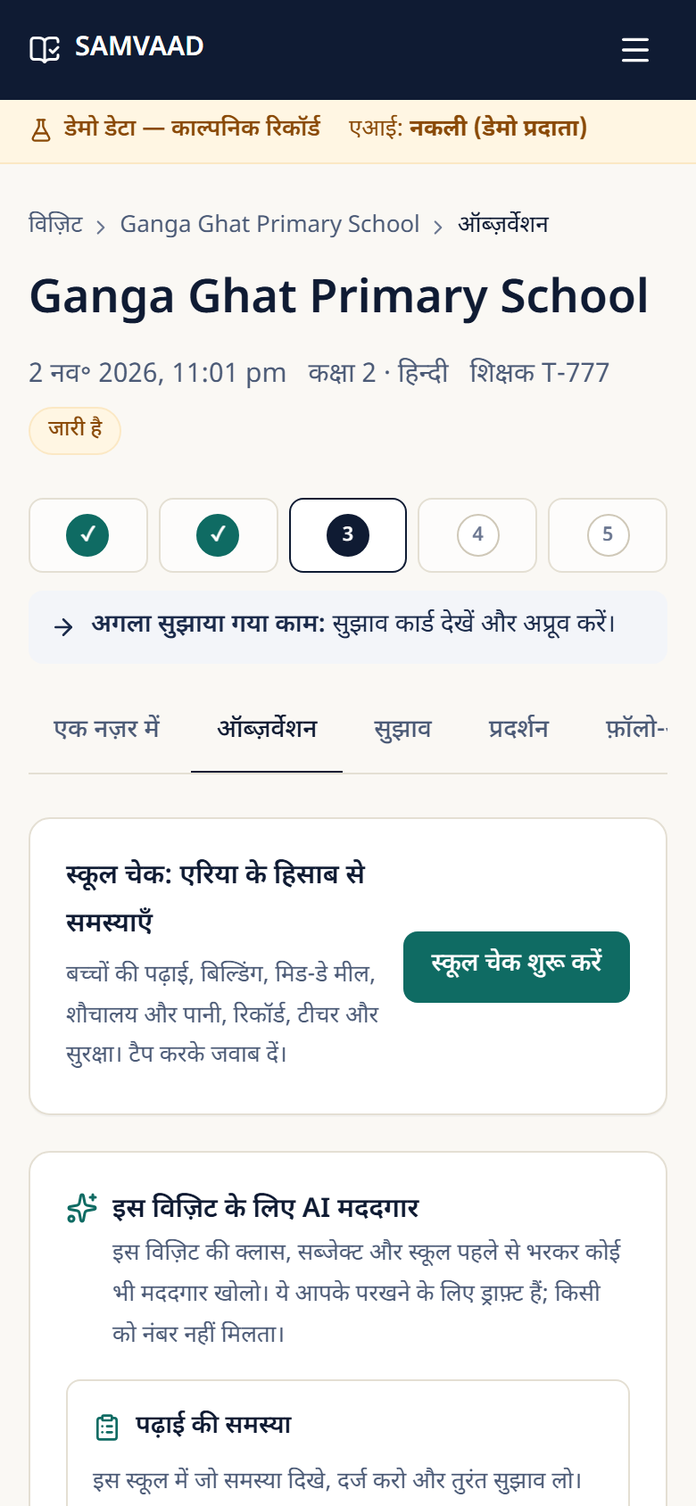
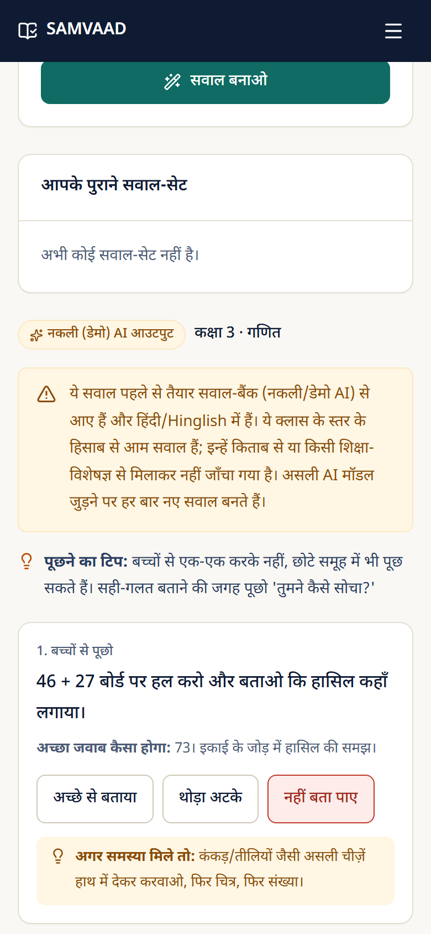
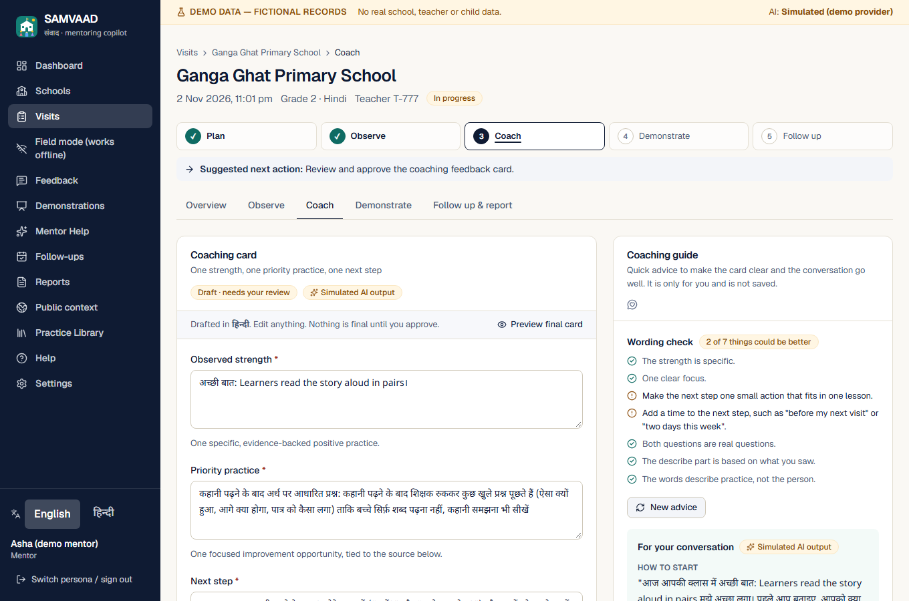
2 · WHAT IT IS
The solution: one coaching loop, built for the mentor's phone
1 Plan
2 Observe
3 Coach
4 Demonstrate
5 Follow up
Pre-visit brief with last visit's agreed step
Tap or speak what you saw; school check; photo of a problem
AI drafts one strength, one focus, one next step, with a cited source
A 3 to 10 minute Hinglish script to model the step
Step checked at the next visit; report and teacher summary
Hindi first, English one tap away; everyday Hinglish.
Tap answers instead of typing; speak to fill a box.
No children's names, ever; nobody is scored.
Mentor Help: academic problems with photos, class × subject questions, mid-day meal and ground checks.
Works offline in field mode.
Observe: tap-to-answer, school check, AI helpers
Class × subject questions with an instant fix
Coaching card, wording check and conversation guide
Source: SAMVAAD working prototype, fictional demo data, screenshots taken 2026-11-01. Hindi interface on the phones; English on the desktop view.
3
Notes:
Hinglish note: loop ye hai: plan, observe, coach, demonstrate, follow-up. Neeche asli app ke screenshots hain: observe page, bachchon ke sawal aur coaching card ke saath wording check aur conversation guide.

Slide 4
2 · SCOPE
What is built and working today
81
31
2,127
6
395
REST API endpoints
database tables, 9 migrations
UI strings, English + Hindi
AI tasks
unit tests (+42 browser)
Area | What a mentor can do | Where it works
Visit workflow | Plan, observe, draft feedback, approve, demonstrate, commit, follow up, report; enforced state machine | Web, tested end to end
Guided input | Tap-to-answer with 'something else'; voice typing in Hindi and English | Web (voice needs a connection)
School check | Seven areas (learning, building, meal, toilets, records, teachers, safety) plus a free note | Web, offline, Android
Mentor Help | Problems with status, photos and instant AI suggestion; class 1–8 × 6 subjects; mid-day meal and ground; opens from the Observe page prefilled | Web
Coaching guide | Live wording check on the feedback card; advice to open, handle disagreement and close the conversation | Web
Practice library | Approved cards with versions and verbatim NIPUN Bharat excerpts; every AI suggestion must cite one | Web
Public context | Real ASER and UDISE+ data (4,844 values, 25 sources) with source, period and limits | Web
Field mode | Record with no internet; idempotent sync with conflict handling | Web PWA; Android debug build
Source: Counted from the repository on 2026-11-01 (handlers.ts, i18n files, migrations, test runs).
4
Notes:
Hinglish note: ye slide batati hai ki aaj kya sach me bana hua aur test hua hai. Android app abhi debug build hai, asli device pe nahi chalaya gaya.

Slide 5
3 · TECHNICAL STRENGTH
Architecture: one small server, three clients, a guarded AI gateway
CLIENTS
SAMVAAD SERVER · one Next.js app, one REST router (/api/v1)
DATA
Web app
Next.js, Hindi + English,
tap-to-answer, voice typing
SQLite (node:sqlite)
9 migrations, 31 tables,
foreign keys, CHECK constraints
Edge guards: session cookie, CSRF origin check, rate limits, 256 KiB body cap, CSP + security headers
Policy: role + object-level checks on every record; append-only audit log (counts, never words)
Field mode (PWA)
IndexedDB + outbox,
service worker (public shell only)
Practice library
approved cards + verbatim
NIPUN Bharat excerpts
Services: visits · observations · school check · feedback · demonstrations · commitments · reports · Mentor Help · coaching guide · sync
Public data store
ASER + UDISE+ with source,
period, limits
Native Android app
Kotlin + Compose,
SQLite outbox
AI gateway: typed task → prompt (user text wrapped as untrusted data) → provider call (25 s, one attempt) → Zod schema → citations rebuilt from the database → evaluative-language filter → saved as a draft
AI PROVIDERS (one interface)
Simulated
(default, offline)
Anthropic API
(only with a key)
Source: Repository: src/app, src/lib/api, src/lib/services, src/lib/ai, src/lib/offline. The native Android app lives in a separate project.
5
Notes:
Hinglish note: teen clients (web, offline PWA, Android) ek hi chhote server se baat karte hain. Server me edge guards, policy, services aur AI gateway hai. Data SQLite me hai. AI gateway ke do providers hain: simulated (default) aur Anthropic (sirf key ke saath).

Slide 6
3 · TECHNICAL STRENGTH · LLM USAGE
Effective AI use: six tasks, one request flow, a human at the end
AI task | Input | Output (validated JSON) | Who decides
Feedback card | Observations + retrieved approved cards | Strength, focus, next step, Ask–Describe–Ask, citations | Mentor edits, approves
Demonstration script | Approved feedback + one cited card | Objective, timed steps, script, example talk | Mentor edits, approves
Student questions | Class 1–8 and subject, or meal / ground topic | Questions, good-answer hint, a fix if stuck | Mentor chooses
Review of answers | Questions + tapped outcomes | Summary, suggestion per problem, next step | Mentor decides
Problem advice | Category, class, subject, description | Three suggestions and a first step | Mentor decides
Coaching guide | Live card wording + failed checks | Opening line, tips, if they disagree, how to close | Never changes the card
One request, eight steps: a failure at step 5, 6 or 7 saves nothing and tells the mentor why
1 Evidence in
observations, no names
2 Retrieve
approved cards only
3 Prompt
user text marked untrusted
4 Provider
25 s, one attempt
5 Schema
strict Zod check
6 Sources
citations rebuilt from the DB
7 Language
no judging a teacher
8 Draft
mentor edits, approves
Two providers, one interface: a deterministic simulated provider (default, offline, always labelled) and a live Anthropic provider used only with a server key. The live provider has not yet been run against the real API: no key and no spending permission so far.
Source: src/lib/ai (schemas, prompts, providers), src/lib/services. Live model: Anthropic Messages API, one attempt per call, no automatic retry.
6
Notes:
Hinglish note: AI 6 jagah use hota hai, har jagah input typed, output Zod se validate, aur faisla mentor ka. Ek request ke 8 steps hain; step 5, 6, 7 me kuch bhi fail ho to kuch save nahi hota. Live Anthropic provider ka code likha hai par asli API pe abhi chalaya nahi gaya.

Slide 7
3 · TECHNICAL STRENGTH · GUARDRAILS
Guardrails: wrong or unsafe AI output is stopped by code, not by trust
Risk | Guardrail enforced in code
Invented source or citation | Cited cards must be in the retrieved approved set; text rebuilt from the database; official cards need an approved excerpt
Prompt injection in mentor text | All user text sent as untrusted data; it cannot make the AI cite or approve anything
Judging a teacher | Evaluative-language filter on every AI text; the whole output is discarded if it trips
Malformed model output | Strict Zod schemas; bad output is refused and nothing is saved
Unreviewed AI reaching a teacher | Mentor approval required; approved cards are locked and versioned
Privacy and misuse | No names in AI input or audit; photo location removed; role and object checks; rate limits; CSP; CSRF
9 / 9
0
404
red-team cases blocked
teacher scores or ranks exist
for another mentor's records (not 403)
Red-team cases tried: fake citation, injection in an observation, 'poor teacher' / '3/5 rating', broken JSON, cross-mentor access, XSS and SQL-injection input, a renamed text file as a photo, requests for the database and secrets. Not yet done: independent security review, live-model red-teaming, screen-reader audit.
Source: tests/safety, ai-provider-security, security-*, mentor-help, coaching tests and e2e/security.spec.ts; all pass in the latest run (2026-11-01).
7
Notes:
Hinglish note: guardrails code me enforce hote hain: citations database se rebuild, evaluative language filter, mentor approval. 9 attack cases hamne try kiye aur sab block hue. Independent security review aur live model red-teaming abhi baaki hai.

Slide 8
4 · REAL SCENARIOS
Built for low connectivity, low data and low-cost phones
238 KB
9.2 MB
0 bytes
81
first load of the offline field app (gzip)
native Android APK (debug build)
needed to record a visit once cached
offline and sync tests
No signal
Weak (2G, patchy)
Good mobile data
Wi-Fi or office
Record visits, observations, school check, next step
Tap-to-answer and typing
Local draft report
Everything waits in the outbox, marked not sent yet
Small text-only sync, safe to retry
AI draft may time out at 25 s: nothing saved, try again
Voice may fail: type or tap
AI card, demo script, coaching guide
Mentor Help questions and review
Photo (170 KB or less), voice typing
First install and app updates
Public data refresh
Reports, CSV export, resolve conflicts
How sync stays safe
Honest limits
Save + outbox entry in one transaction. Each change has an op id, so a retry gives the same result (idempotent). A record shows 'synced' only after the server acknowledges it. Conflicts are per record.
Phone data is not yet encrypted, there is no app lock, and unsynced records are lost if browser data is cleared. Main acceptance test (offline, restart, reconnect, sync once, no duplicates) passes in the browser tests.
Source: Measured against the production build on this machine (gzip). Not yet tested on a real low-end phone or a throttled network. Mentor Help, live AI, photos and voice typing need a connection.
8
Notes:
Hinglish note: offline app ka pehla load ~238 KB gzip hai, uske baad visit record karne ke liye internet nahi chahiye. Signal ke har level par mentor kya kar sakta hai wo dikhaya hai. Sync idempotent hai. Phone par data abhi encrypted nahi hai, ye hum saaf bata rahe hain.

Slide 9
5 · EVIDENCE
User inputs and testing: the evidence today, and what is missing
Evidence we do have
What we do NOT have yet
• The product owner's requests, each built and tested: Rajasthan focus, Hinglish, tap-to-answer, school check, Mentor Help, photos, more subjects, coaching guide.
• Their phone screenshots, used to fix layouts.
• Public sources reviewed: ASER, UDISE+, NIPUN Bharat.
• No usability session with real mentors, teachers or supervisors.
• No real-device or throttled-network test.
• Hindi text and question bank not reviewed by an educator.
• Live AI never run. No learning improvement is claimed.
Check (latest run) | Result
Unit and integration (Vitest) | 395 / 395 passed, 29 files
Browser end to end (Playwright) | 42 / 42 passed
Typecheck and lint | 0 errors, 0 problems
Public-data validation | 53 / 53 checks, 2 documented warnings
Accessibility (axe, WCAG A/AA) | No serious or critical issues on key pages, EN + HI
Live AI · real device · real users | NOT RUN
Next: a supervised session with real mentors, Hindi and content review, then the live AI run against a golden set; every target above stays 'not measured yet' until then. One older browser test fails occasionally under load and passes alone (timing flake).
Source: Session history of this build; commands run on this machine on 2026-11-01. Product-owner requests are not field-mentor data. Targets are from the project deck.
9
Notes:
Hinglish note: ye slide ईमानदारी se batati hai ki kis cheez ka evidence hai aur kiska nahi. Asli mentors ke saath testing abhi nahi hui. Saare pilot targets 'not measured yet' hain. Ek purana browser test kabhi-kabhi load me fail hota hai aur akele chalane par pass hota hai.

Slide 10
6 · FUTURE AND CONCLUSION
Roadmap, what we ask for, and the conclusion
Now: prototype done
0–3 months: safe to test
3–9 months: field pilot
9+ months: integrate
Full coaching loop, tested
Hindi + English, offline, Android debug app
Mentor Help, coaching guide, guardrails
Real authentication, per-user roles
Encrypt phone data, app lock, backup
Live AI run; educator review; usability session
Pilot blocks with a comparison group
Measure the targets honestly
Postgres, monitoring, signed release app
*Shala Darpan / ShalaSamblan link
*Supervisor dashboards (groups of 5+)
More reviewed languages
A few real mentors
for a supervised usability session on their own phones
Educator review
of Hindi text, the question bank and 9 card drafts
A live AI key and budget
to run and measure the real model
Permission to integrate*
with Shala Darpan / ShalaSamblan
Conclusion. SAMVAAD turns a school visit into one evidence-backed, followed-up coaching step. The AI drafts, the mentor decides; sources are verified by code; it works without internet; nobody is scored. The prototype is complete and tested, but it is not yet proven with real mentors: that is the next step.
Try it: https://samvaad-fl55.onrender.com/ · Android APK: /downloads/SAMVAAD.apk · Code and README: github.com/anuj-sharma7/SAMVAAD
Source: Sequencing is a proposal, not a commitment. Items marked * depend on permission or funding outside the team's control.
10
Notes:
Hinglish note: roadmap ke 4 phase hain. Humein chahiye: kuch asli mentors, educator review, live AI key aur department ki permission. Conclusion: SAMVAAD ek school visit ko ek evidence-backed, follow-up hone wale coaching step me badalta hai. AI draft banata hai, mentor faisla karta hai, kisi ko score nahi diya jata. Prototype complete aur tested hai, par asli mentors ke saath abhi proven nahi hai; wo agla step hai.

