Slide 1
Introduction to Data Organization and Retrieval
Virendra Singh
Professor, Indian Institute of Technology Bombay
And
Adjunct Professor, Indian Institute of Technology Jammu
http://www.ee.iitb.ac.in/~viren/
E-mail: viren@ee.iitb.ac.in, virendra.singh@iitjammu.ac.in
CSPL201: Data Organization & Retrieval
Lecture 1 (11 Aug 2019)

Slide 2

Why Information Retrieval?
Information overload
“… The world produces between 1 and 2 exabytes (10¹⁸ bytes) of unique information per year, which is roughly 250 megabytes for every man, woman, and child on earth. …“ (Lyman & Hal 03)

Slide 3
Information Retrieval
Information Retrieval (IR) mainly studies unstructured data: Merrill Lynch estimates that more than 85 percent of all business information exists as unstructured data - commonly appearing in emails, memos, notes from call centers and support operations, news, user groups, chats, reports, … and Web pages. Text in Web pages or emails; image; audio; video; protein sequences.. Unstructured data: No structure: no primary key as in RDBMS Semantic meaning unknown: natural language processing systems try to find the meaning in the unstructured text

Slide 4
Databases vs Information Retrieval
Databases | Information Retrieval
Structured Data | Unstructured Data
Schema Driven | No fixed schema; various data models (i.e, vector space model)
Relational (or object, hierarchical, and network) model is predominant
Structured query model | Free-form query model
Rich matadata operation | Rich data operation
Query returns data | Search request returns list or pointers to document
Results are based on exact matching (always correct) | Results are based on approximate matching and measures of effectiveness (may be imprecise and ranked)

Slide 5
Search Engines
One widely used example of retrieval system is Web search engine
Search engines have great impact on society
For example : a study was conducted for Vaccination. The search results were altered, i.e. one set of people were shown only pro vaccination results. And the other was shown anti vaccination results.
Pro vaccination group acknowledged the benefit of vaccination. Whereas, other group first hesitated in believing the anti vaccination side, but after some more exposure they started getting worried about the vaccines.
So the experiment shows that as a search engine user, it believe the information provided by search engine is more or less accurate.
In resume search engines, they give high ranking to male candidate. Though the algorithm was not directly differentiating the candidate based on gender but because recruiters were clicking the male candidate profiles more. Hence biased recruiters resulted in biased search engine
https://www.ncbi.nlm.nih.gov/pmc/articles/PMC4004139/
https://dl.acm.org/citation.cfm?id=3174225

Slide 6
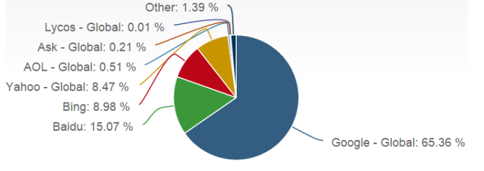
Global market: Desktop

Slide 7
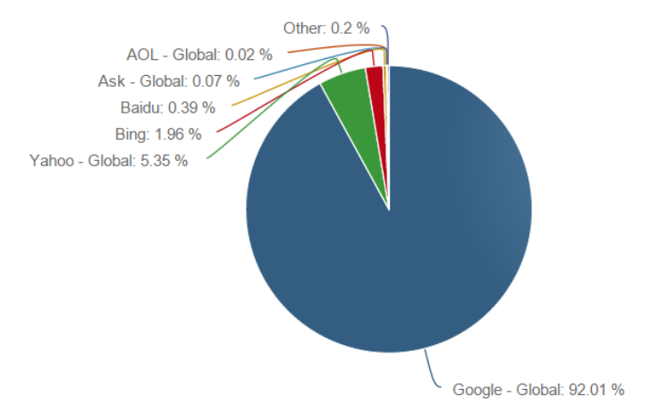
Global market: Mobile

Slide 8
Information Retrieval (1955-1992)
Primary Users
Law Clerks
Reference Librarians
(Some) News organizations, product research, congressional committees, medical/chemical abstract searches
Primary Search Models
Boolean keyword searches on Abstract, Title, keyword
Vendors
Mead Data Central(Lexis – Nexis)
Dialog
Westlaw
Total searchable online data : O(10 terabytes)

Slide 9
Information Retrieval (1993+)
Primary users
1st time computer users
novices
Primary search modes
Still Boolean keyword searches with limited probabilistic models
But FULL TEXT Retrieval
Vendors
Lycos, Infoseek, Yahoo, Excite, AltaVista, Google
Total online data : ???
Searching FTPable documents on internet
Archie
WAIS

Slide 10
Information Retrieval (2000’s)
Multimedia IR
Image
Video
Audio and music
Cross-Language IR
DARPA Tides
Document Summarization
Learning to Rank

Slide 11
Information Retrieval (2010’s)
Intelligent Personal Assistants
Siri
Cortana
Google Now
Alexa
Complex Question Answering
IBM Watson
Distributional Semantics
Deep Learning

Slide 12
Growth of the Web
# of web sites
or
Volume of web
traffic
?
Mosaic Netscape
Exponential
Growth
1992 1993 1994 1995 1996 1997 1998
Volume doubling every 6 months

Slide 13
Information Retrieval
Early IR system basically extended library catalog systems, allowing
Keyword searches,
Limited abstract searches
in addition to Author/Title/Subject and including Boolean combination functionality
IR was seen as reference retrieval
(full documents still had to be ordered/delivered by hand)

Slide 14
Information Retrieval View
Old View
Function of IR :
Map queries to relevant documents
New View
Satisfy user’s information need
Infer goals/information need from:
query itself
past user query history
User profiling
Collective analysis of other user feedback on similar queries

Slide 15
Information Retrieval View
Returns information in a format useful/intelligible to the user
weighted orderings
clustering of documents by different attributes
visualization tools
Text Understanding techniques to extract answer to questions or at least subregion of text
Who is the current mayor of Jammu?
don’t need full article on city/state,
just the answer(and available source for proof)

Slide 16
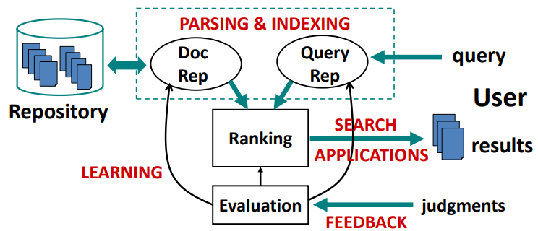
Information Retrieval System

Slide 17
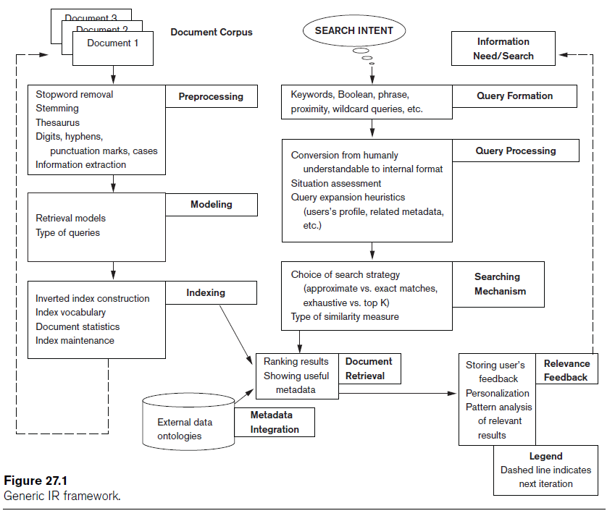
Information Retrieval System

Slide 18
Major Topics in IR
Indexing : for retrieving faster
Ranking: to present most relevant results at the top
Compression: to store efficiently
Error tolerating search
Machine learning: when fixed rule-based approaches fail
Knowledge bases: how to organize the structured data
Evaluation
NLP

Slide 19
Modern Information Retrieval Systems
Demand of accuracy
Demand of efficiency
Demand of understanding
Demand of diversity
Demand of convivence

Slide 20
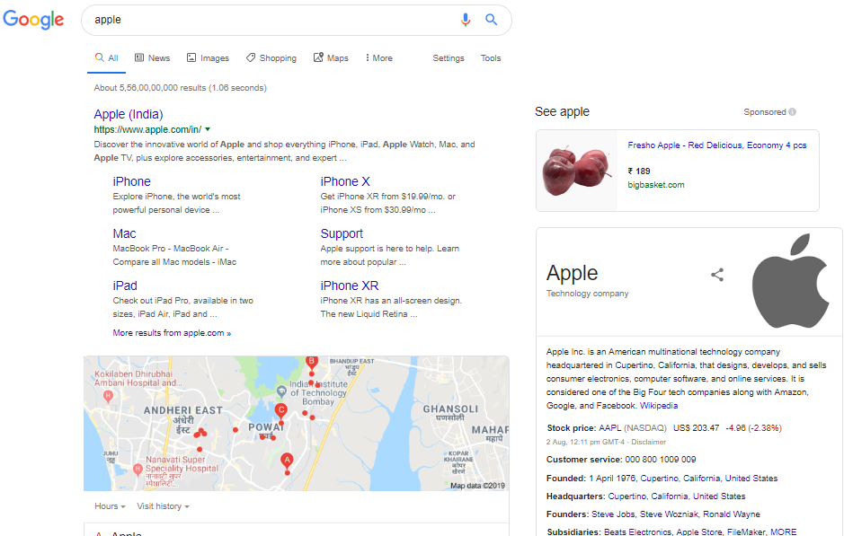
Modern Information Retrieval Systems
Understanding
Efficiency
Accuracy
Diversity
Convivence

Slide 21
Relevance
Relevance is a subjective judgment and may include:
Being on the proper subject.
Being timely (recent information).
Being authoritative (from a trusted source).
Satisfying the goals of the user and his/her intended use of the information (information need).

Slide 22
More than Web Search
IR is more than web search
Example
Recommendation systems
Question answering systems
Text mining
Online advertising

Slide 23
Related Areas
Database Management
Library and Information Science
Artificial Intelligence
Natural Language Processing
Machine Learning

Slide 24
Database Management
Focused on structured data stored in relational tables rather than free-form text
Focused on efficient processing of well-defined queries in a formal language (SQL)
Clearer semantics for both data and queries
Recent move towards semi-structured data (XML) brings it closer to IR

Slide 25
Library and Information Science
Focused on the human user aspects of information retrieval (human-computer interaction, user interface, visualization)
Concerned with effective categorization of human knowledge
Concerned with citation analysis and bibliometrics (structure of information)
Recent work on digital libraries brings it closer to CS & IR

Slide 26
Artificial Intelligence
Focused on the representation of knowledge, reasoning, and intelligent action
Formalisms for representing knowledge and queries
First-order Predicate Logic
Bayesian Networks
Recent work on web ontologies and intelligent information agents brings it closer to IR

Slide 27
Natural Language Processing
Focused on the syntactic, semantic, and pragmatic analysis of natural language text and discourse
Ability to analyze syntax (phrase structure) and semantics could allow retrieval based on meaning rather than keywords

Slide 28
Natural Language Processing: IR Directions
Methods for determining the sense of an ambiguous word based on context (word sense disambiguation)
Methods for identifying specific pieces of information in a document (information extraction)
Methods for answering specific NL questions from document corpora or structured data like FreeBase or Google’s Knowledge Graph.

Slide 29
Machine Learning
Focused on the development of computational systems that improve their performance with experience.
Automated classification of examples based on learning concepts from labeled training examples (supervised learning).
Automated methods for clustering unlabeled examples into meaningful groups (unsupervised learning).

Slide 30
Machine Learning: IR Directions
Text Categorization
Automatic hierarchical classification (Yahoo).
Adaptive filtering/routing/recommending.
Automated spam filtering.
Text Clustering
Clustering of IR query results.
Automatic formation of hierarchies (Yahoo).
Learning for Information Extraction
Text Mining
Learning to Rank

Slide 31
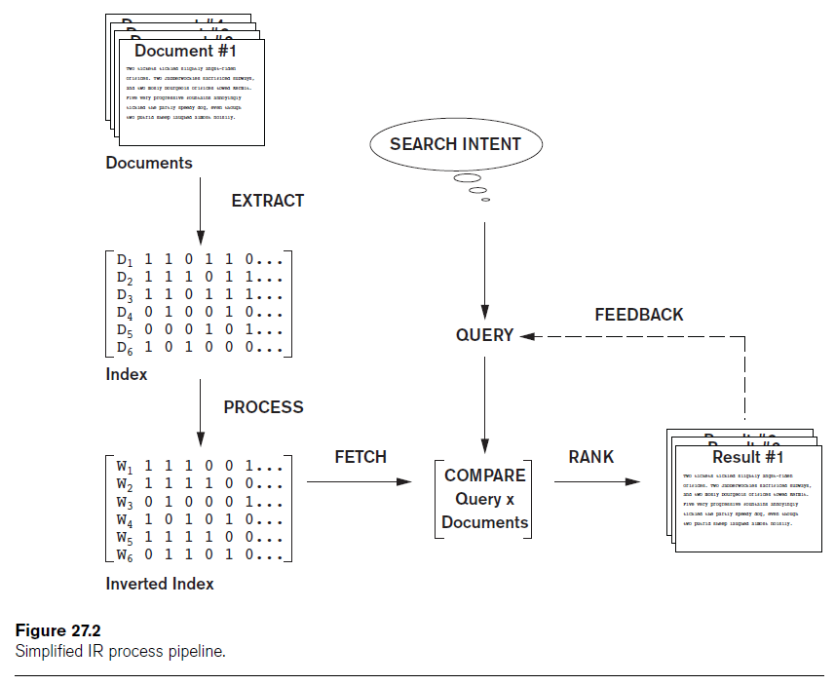
Generic IR Pipeline

Slide 32
Retrieval Models
Three main statistical models
Boolean
Vector space
Probabilistic
Semantic model

Slide 33
Boolean Model
Documents represented as a set of terms
Form queries using standard Boolean logic set-theoretic operators
AND, OR and NOT
Retrieval and relevance
Binary concepts
Lacks sophisticated ranking algorithms

Slide 34
Vector Space Model
Documents
Represented as features and weights in an n-dimensional vector space
Query
Specified as a terms vector
Compared to the document vectors for similarity/relevance assessment

Slide 35
Probabilistic Model
Probability ranking principle
Decide whether the document belongs to the relevant set or the nonrelevant set for a query
Conditional probabilities calculated using Bayes’ Rule
BM25 (Best Match 25)
Popular probabilistic ranking algorithm
Okapi system

Slide 36
Semantic Model
Include different levels of analysis
Morphological
Syntactic
Semantic
Knowledge-based IR systems
Based on semantic models
WordNet

Slide 37
Types of Queries in IR Systems
Keywords
Consist of words, phrases, and other characterizations of documents
Used by IR system to build inverted index
Queries compared to set of index keywords
Most IR systems
Allow use of Boolean and other operators to build a complex query

Slide 38
Keyword Queries
Simplest and most commonly used forms of IR queries
Keywords implicitly connected by a logical AND operator
Remove stopwords
Most commonly occurring words
a, the, of
IR systems do not pay attention to the ordering of these words in the query

Slide 39
Boolean Queries
AND: both terms must be found
OR: either term found
NOT: record containing keyword omitted
( ): used for nesting
+: equivalent to and
– Boolean operators: equivalent to AND NOT
Document retrieved if query logically true as exact match in document

Slide 40
Phrase Queries
Phrases encoded in inverted index or implemented differently
Phrase generally enclosed within double quotes
More restricted and specific version of proximity searching

Slide 41
Proximity Queries
Accounts for how close within a record multiple terms should be to each other
Common option requires terms to be in the exact order
Various operator names
NEAR, ADJ(adjacent), or AFTER
Computationally expensive

Slide 42
Wildcard Queries
Support regular expressions and pattern matching-based searching
‘Data*’ would retrieve data, database, datapoint, dataset
Involves preprocessing overhead
Not considered worth the cost by many Web search engines today
Retrieval models do not directly provide support for this query type

Slide 43
Natural Language Queries
Few natural language search engines
Active area of research
Easier to answer questions

Slide 44
Evaluation Measures of Search Relevance
Topical relevance
Measures extent to which topic of a result matches topic of query
User relevance
Describes “goodness” of a retrieved result with regard to user’s information need
Web information retrieval
Must evaluate document ranking order

Slide 45
Web Search and Analysis
Vertical search engines
Topic-specific search engines
Metasearch engines
Query different search engines simultaneously
Digital libraries
Collections of electronic resources and services

Slide 46
Web Analysis and Its Relationship to IR
Goals of Web analysis:
Improve and personalize search results relevance
Identify trends
Classify Web analysis:
Web content analysis
Web structure analysis
Web usage analysis

Slide 47
More Information
http://www.ee.iitb.ac.in/~viren/Courses/2019/CSPL210.htm

Slide 48
Thank You

