Slide 1
HOSPIZONE
Represented By:-
Anuj Jain
Ashish Benjamin
Apoorva Agarwal
Anjali Sharma

Slide 2
INTRODUCTION:-
HOSPIZONE will be an application which will make it convenient for patient to get information about hospitals near them, check doctors availability, book appointment and to do payment and all this will be done on a single platform.It will be blockchain based.

Slide 3
FEATURES
NearBy Hospital
Specification
Doctor’s
Current Availability
Appointment Booking
Payment

Slide 4
Hospizone
NearBy Hospitals
Specification
Doctors
Current Availability
Appointment Booking
Payment

Slide 5

NearBy Hospital

Slide 6
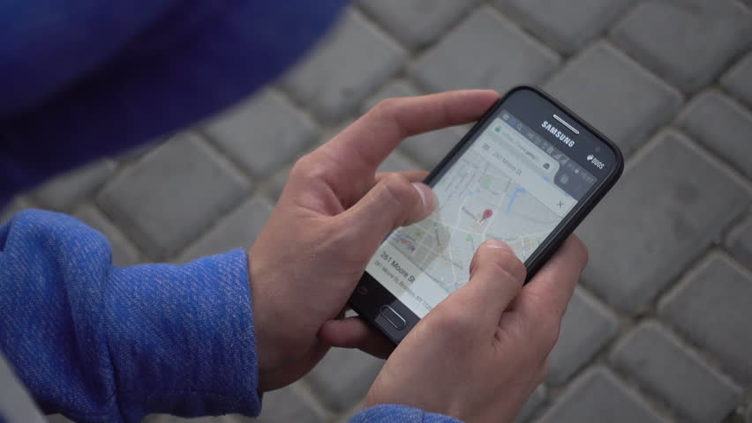
NEARBY HOSPITALS
.
Give all details about NearBy Hospitals

Slide 7
Specification:-
Anaesthetics
Emergency Medicine
General Medicine
General Surgery
Obstetrics and Gynaecology
Peadiatrics
Psychiatry
Trauma and Orthopaedics

Slide 8

Doctor’s Descriptions:-
Age
Name
Qualification
Experience
Schedual’s

Slide 9

Current Availibility

Slide 10


Slide 11


Available
Not Available

Slide 12


Slide 13

Notification
Appointment Reminder
Booking
Doctor’s Availability
Notify
Appointment
Remind
Shift
Refund
Confirm Booking
One Day Before
Alternate
Doctor’s

Slide 14

SECURITY

Slide 15
One Person

