Slide 1
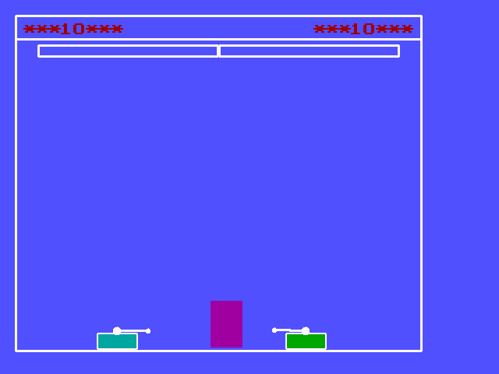
Battle tank
Presented by
Ansu Man Singh
Anuj Gurwacharya

Slide 2
Snap shots of BattleTank
Source code
Algorithms
Classes
Executable file
Equation used
Header files
Exit

Slide 3
Snap shot of BattleTank-Mode1

Slide 4
Algorithms
Start of main body function
Declaration of objects of three class enterscreen, playscreen, exitscreen
Ask for user names
Ask for mode for playing
If choice is mode1 then start mode1 operation
If choice is mode 2 then start mode2 operation
If the choice is to exit the game then exit the game
In the both mode background is created
Keyboard hit is checked if the keyboard hit is not found then fire() function is called.
Home
Next

Slide 5
Algorithms
In the fire function bomb[count] is checked
If bomb[count]=1 then bomb is moved using motion of trajectory
If the coordinate of bomb match with opponent player then point of the respective player is increased.
If key board hit is found then the key that was hit is send to control() function of both object of both the class
In the control function tank is moved forward ,back,nose of the tank is moved up or down according to the key passed in it.
Back
Home

Slide 6
Algorithms
Step no from 9 to 15 is repeated until both the bomd[count] of both the player is 0
Player with most point is declared as winner.
Program is terminated
For the mode 1 wall is made in between two tank and in mode 2 both the player are initialized in different height.
Back
Home

Slide 7
Classes
Enterscreen :it has functions that are used to enter name of player and also used to set screen
Exitscreen : it has functions that are called at the time exiting the game
Player : it is the main class of this game it is used to create object of the player where tank are created fire function are also included in this class
Mode1player :it is inherited from player it is used in mode1
Mode2player :it is also inherited from player it is used in mode2
Playscreen:it defines background to play the games
Home

Slide 8
Header files
Enterscr.h defines enterscreen class and its member function
Exitscr.h defines exitscreen class and its member functions
Playscr1.h defines playscreen class and its member function
Playscr.h defines player class and its function it also defination class mode1 player and mode2 player
Home

Slide 9
Equation used
y=u*sin(ang)*t + 0.5*g*t*t
x = u*cos(ang)*t
home

Slide 10
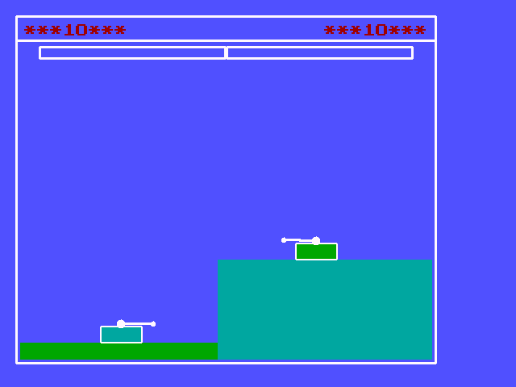
Snap shot of BattleTank-Mode2

Slide 11
Mode 1
Mode 2

