Slide 1
Project On
Light Effects on Moving Ball
Submitted by:
Rajendra banjade(059bct530)
Shankar Subedi(059bct542)

Slide 2
Introduction
This project implements different graphics algorithms as studied in our course, like geometric transformations,
lighting model, back-face detection etc.
Built in Borland C++ Builder

Slide 3
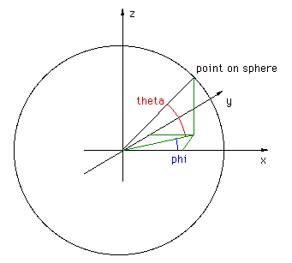
Algorithms
For sphere
facet approximation

Slide 4
Algorithms..
The equations of the points on the surface of the sphere are
x = cos(theta) cos(phi)
y = cos(theta) sin(phi)
z = sin(theta)
where
-90 <= theta <= 90
0 <= phi <= 360

Slide 5
Algorithms….
Back face detection
simple object-space method for identifying the back faces
If (V.N>0)
back face
else
visible

Slide 6
Algorithms….
Illumination and rendering
1. Ambient light
Iamb=Ka*Ia
2.Diffused Reflection
Idiff=Kd*Id(N.L)
3. specular reflection
Ispec=Ks*I1(N.H)^{ns}

Slide 7
Algorithms….
Multiple light source and intensity attenuation
fd=1/(a0+a1*d+a2*d*d)
I_{TOTAL}=Iamb+Σ_{(i=1 to n)}[fdi(Idiff+Ispec)]

Slide 8
Limitations
Unable to implement better hidden face detection model
Intensity attenuation
Unable to implement better rendering algorithm

Slide 9
Thanks!

