Slide 1
Wave propagation in 2D elastic and poroelastic solids
Anuj Guruacharya
M.S. Physics Thesis defense presentation, November 2011
Advisor:
Dr. Neven Simicevic
Advisory committee members:
Dr. John Shaw, Dr. Steven Jones

Slide 2
Outline
Statement of the problem
Introduction to Biots model and FDTD-CPML
Computational procedure/method
Results
Analysis of speed of wave in the material
Conclusion

Slide 3
Statement of Problem
To develop a software that can simulate the wave propagation in 2D poroelastic solids

Slide 4
Approaches to the problem
Different PDE models to be used to simulate wave propagation in poroelastic solids: Hicks model, Biots model
Different approaches to programming the PDE: FDTD and boundary layers ( ABC, PML, CPML)

Slide 5
Biot’s model
Equations of linear elasticity for the solid matrix,
Navier–Stokes equations for the viscous fluid, and
Darcy's law for the flow of fluid through the porous matrix.

Slide 6
Biots model: The four variables used in the model
Stress tensor in solid
Velocity vector in solid
Pressure scalar in fluid
Velocity vector in fluid

Slide 7




Biots model: The governing equations

Slide 8
Biots model: Expanded equations contain
 | Velocity in fluid | Velocity in solid | Pressure in fluid | Stress in solid
One dimensional | 1 | 1 | 1 | 1
Two dimensional | 2 | 2 | 1 | 3
Three dimensional | 3 | 3 | 1 | 6

Slide 9
FDTD and CPML
Perfectly Matched Layer proposed to reduce reflections by Berenger(1954)
Convolutional Perfectly Matched Layer proposed by Rodney and Gedney(2001)

Slide 10
Methods
Geometry of the material
Parameters of the material
Source of the wave
Biots equation for the wave
FDTD formulation of the wave
CPML-FDTD formulation of the wave
Analysis of the speed of the waves
Computation of 1D elastic wave
Computation of 2D elastic wave in pressure velocity
Computation of 2D elastic wave in stress velocity
Computation of 1D poroelastic wave
Computation of 2D poroelastic wave

Slide 11
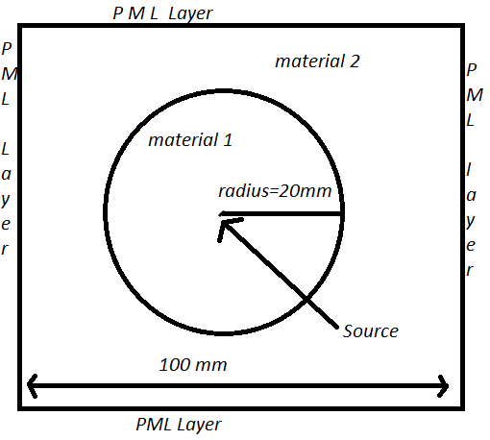
Geometry of the elastic material

Slide 12
Parameters of the material
Inside the circle (Iron)
Cp= 5956 m/s
Cs = 3227.07 m/s
Density = 0.007874 Kgm/s2
Outside the circle
Cp= 500000
Cs= 1000000
Density= 0.002000 kgm/s2

Slide 13

Source type

Slide 14





Physical and FDTD equations for elastic wave in pressure velocity

Slide 15
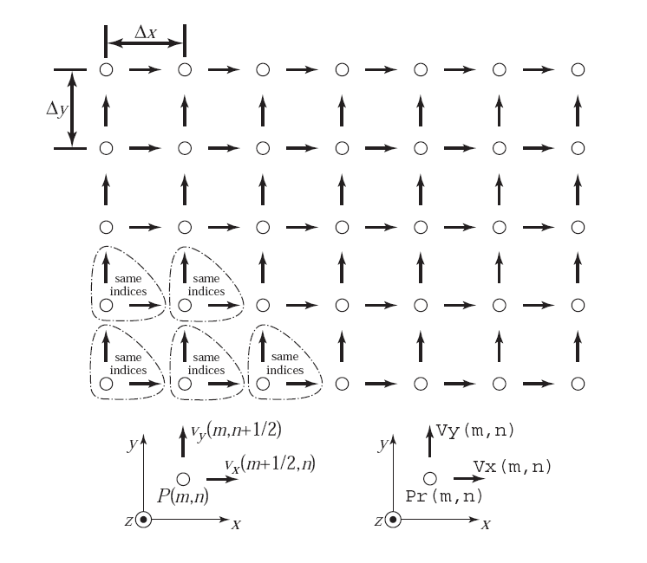
FDTD 2D grid for elastic in pressure velocity

Slide 16


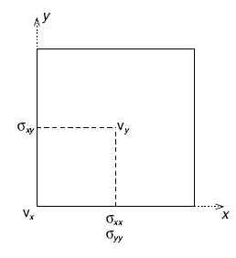



Physical and FDTD equations for 2 D elastic wave in stress velocity

Slide 17
(cont..) FDTD equations for 2D elastic wave in stress and velocity

Slide 18




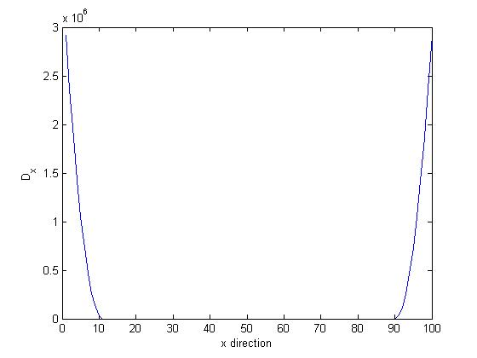

CPML parameters

Slide 19

Other considerations
Dirichlets condition
Receivers
Courant number :
C_{p}= 1921000 mm/sec
dt= 10⁻⁷ sec
dx =1mm
dy = 1 mm

Slide 20
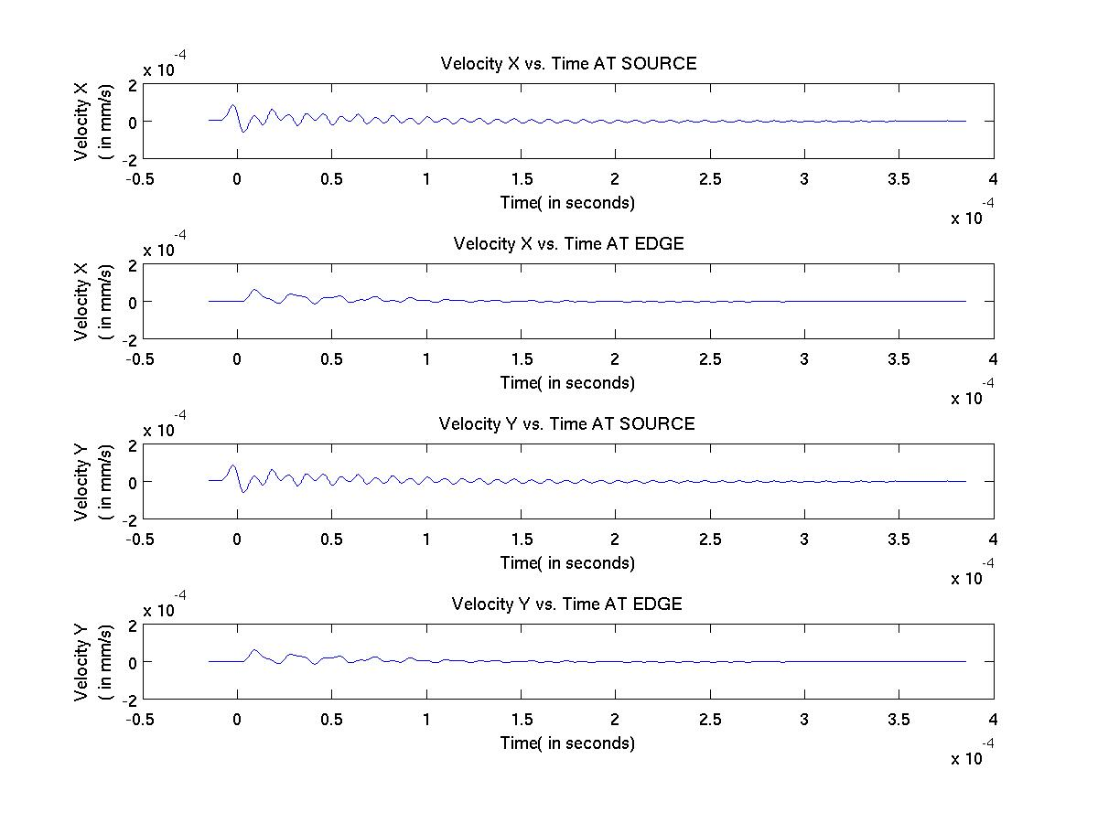
Results Gaussian

Slide 21
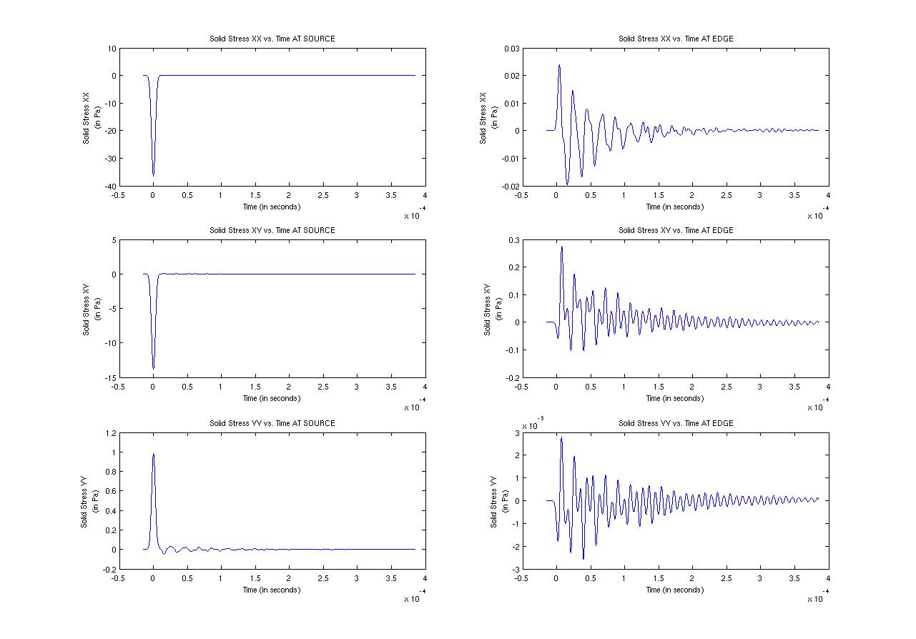
Results Gaussian

Slide 22
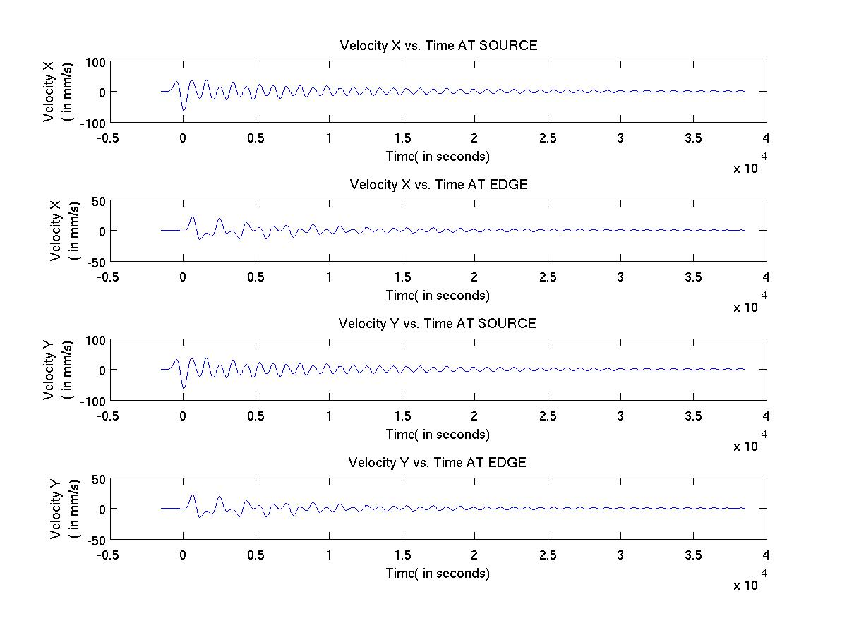
Results: Derivative of Gaussian

Slide 23
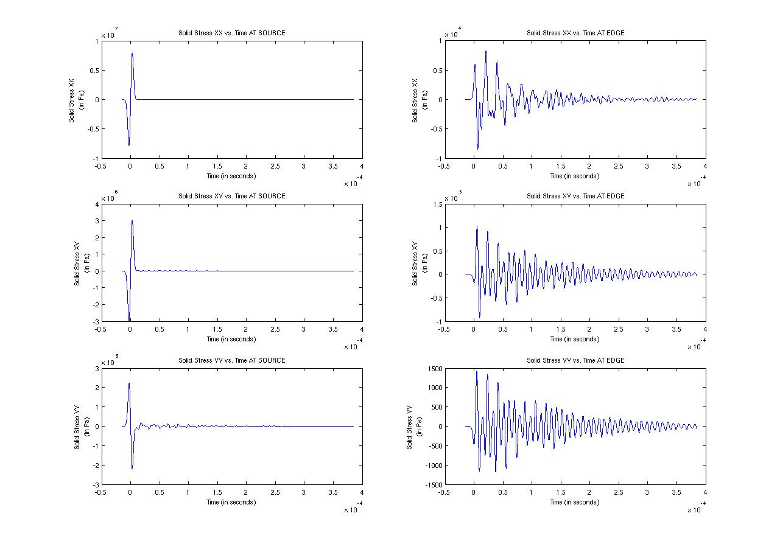
Results: Derivative of Gaussian

Slide 24
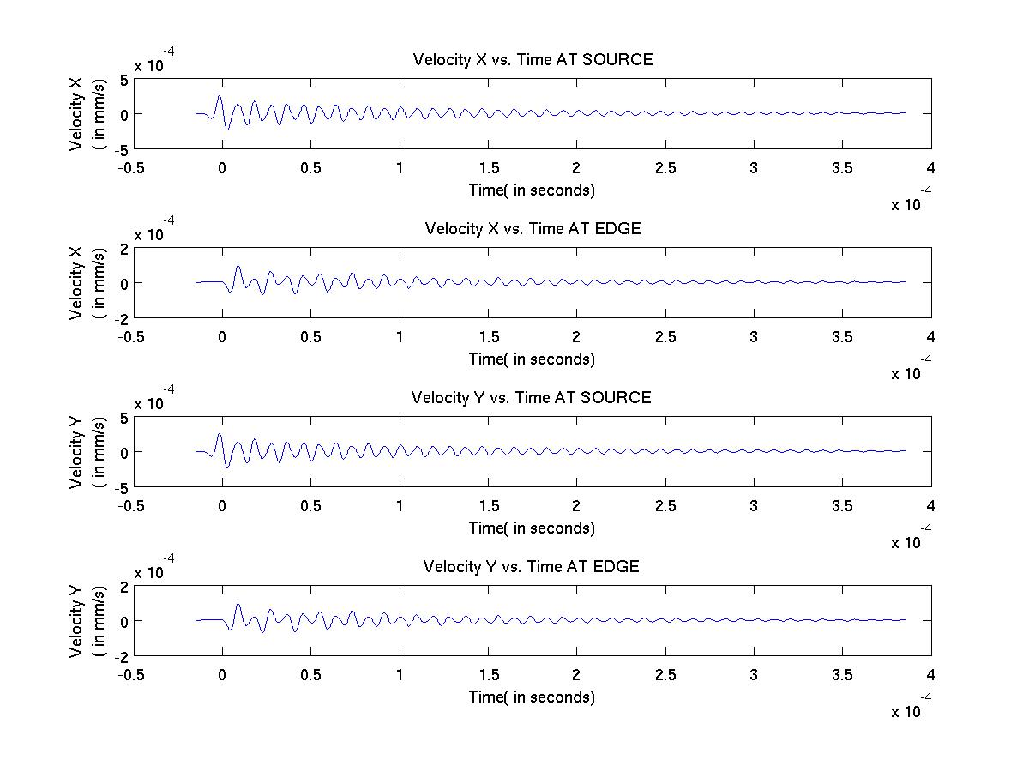
Results: Second derivative of Gaussian

Slide 25
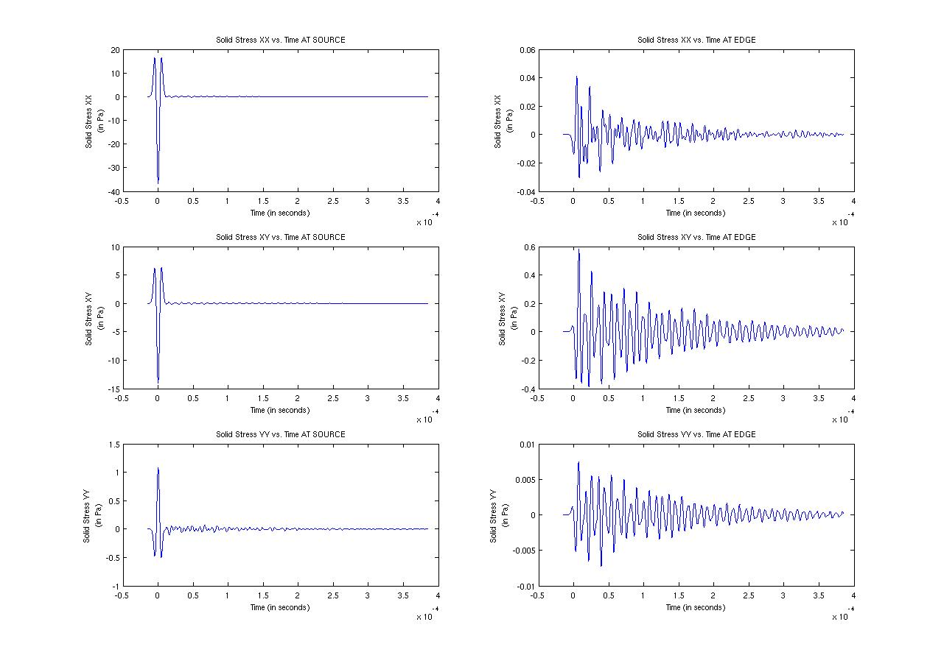
Results: Second derivative of Gaussian

Slide 26
Analysis of wave speed
Since the length of the elastic material considered was 60mm and the time difference between the first wave peaks that transmitted from the source and then was received back at the source was 11.42 x 10⁻⁶ sec, the velocity was calculated as 5253.9m/sec
This value matches the value that we originally entered into the program which was 5956 m/sec with an accuracy of 11% .

Slide 27
Geometry of the 2D poroelastic solid

Slide 28
Parameters of the material

Slide 29
Source type

Slide 30








Biots equation for 2D poroelastic in stress velocity

Slide 31
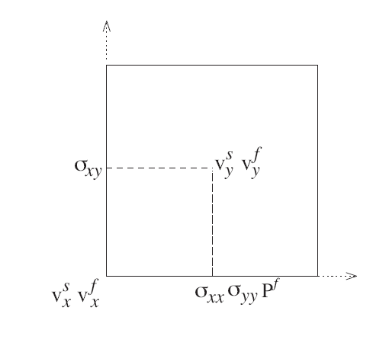
FDTD 2D poroelastic in stress velocity

Slide 32


FDTD 2D poroelastic in stress velocity

Slide 33


(cont..) FDTD 2D poroelastic in stress velocity

Slide 34
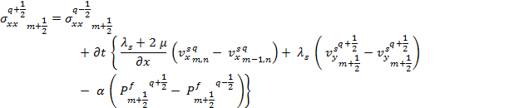


(cont..) FDTD 2D poroelastic in stress velocity

Slide 35

(cont..) FDTD 2D poroelastic in stress velocity

Slide 36
CPML parameters

Slide 37
Other considerations
Dirichlets condition
Receivers
Courant number :
C_{p}= 1921000 mm/sec
dt= 10⁻⁷ sec
dx =1mm
dy = 1 mm

Slide 38
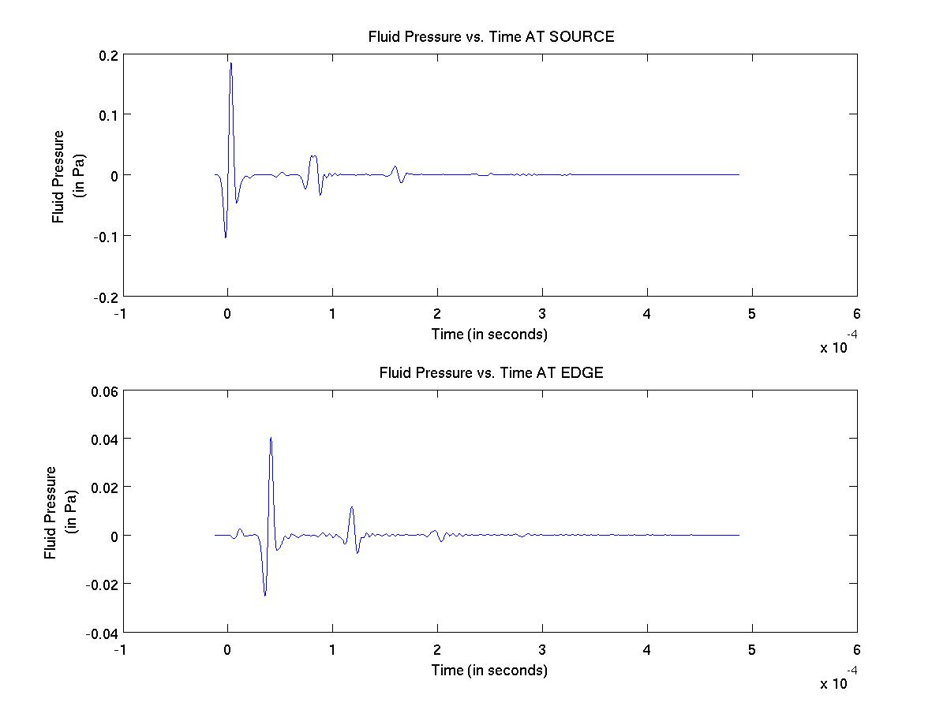
Results: Fluid Pressure

Slide 39
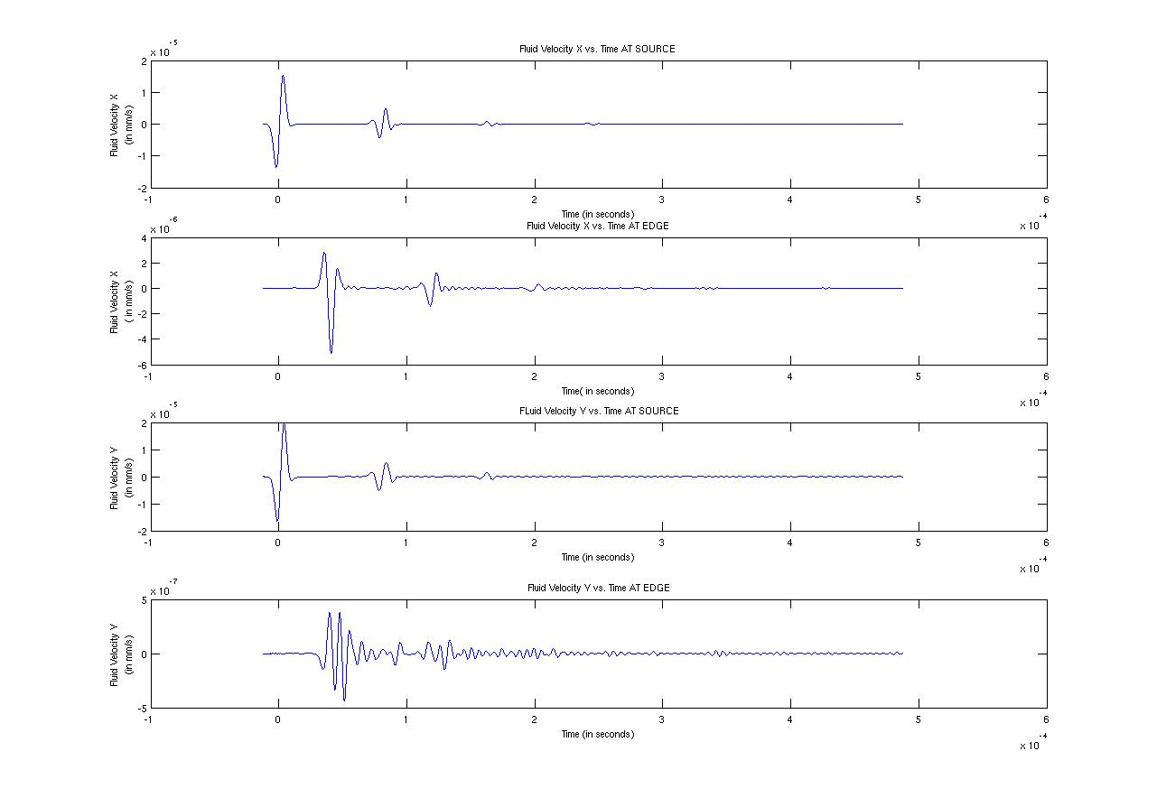
Results: Fluid velocity

Slide 40
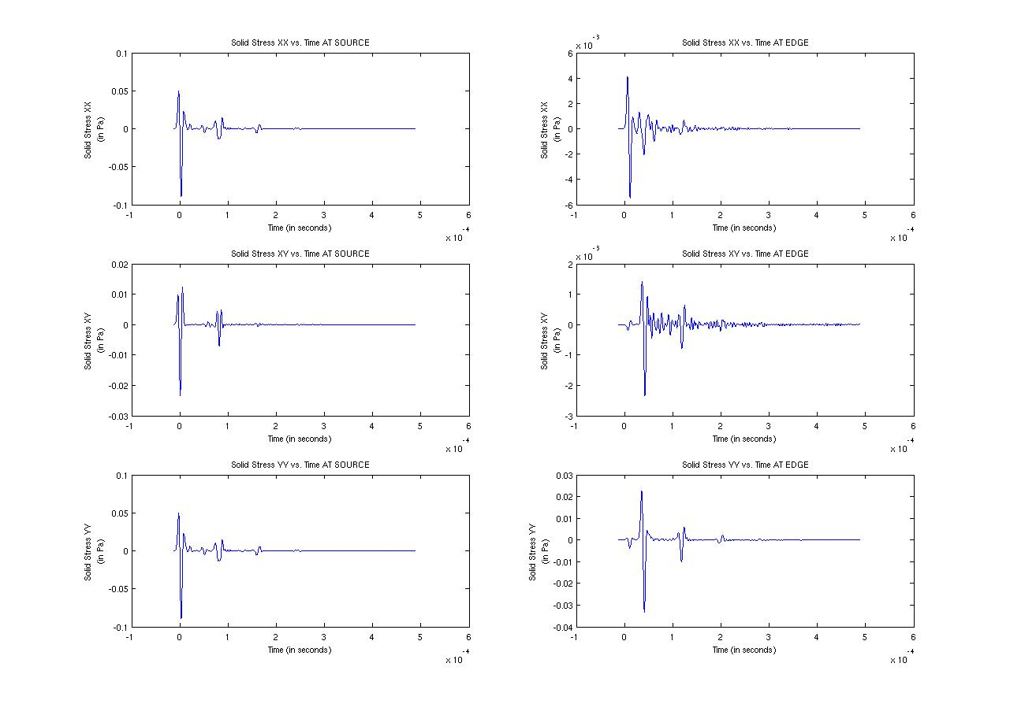
Results: Solid Stress

Slide 41
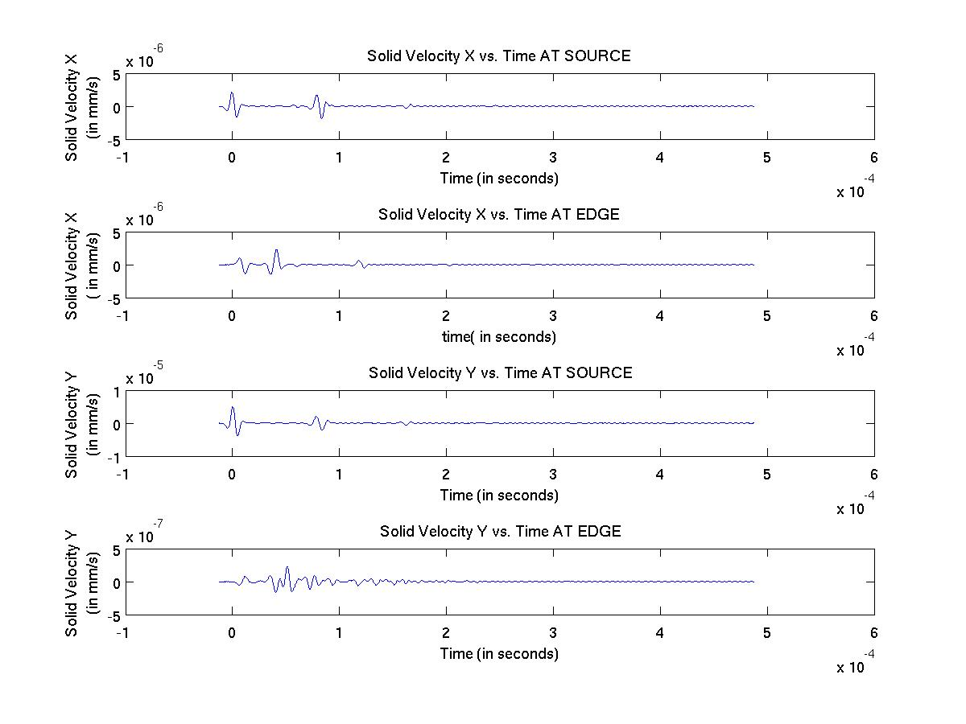
Results: Solid velocity

Slide 42
Analysis of the waves: Fast and slow P waves
The fast P wave velocity is calculated by dividing the distance travelled by the first wave from the source to the edge of the material by the time it takes for the first wave to hit the edge of the poroelastic material. From the velocity of the solid graph this value was obtained to be 1886.2 m/sec.
The slow P wave velocity is calculated by dividing the distance travelled by the second slower wave from the source to the edge of the material by the time it takes for the first wave to hit the edge of the poroelastic material. From the velocity of the solid graph this value was obtained to be 413.22 m/sec.
The theoretical values of the fast and slow P waves in our computation were taken to be 1921 m/sec and 452.73 m/s. Comparing the results obtained with these values, the accuracy of 1.8% is obtained for the fast P wave and an accuracy of 8.6% is obtained for the slow P wave.

Slide 43
Conclusion
Thus a software able to accurately predict velocity and stress variables at different points in a cylindrical 2D poroelastic pipe and a cylindrical 2D elastic pipe was made.

