Slide 1

USABILITY EVALUATION OF FOOD LOGGING
REPORT
GROUP 3
SOMESHA SRIDHARA,
SHILPA SHETTY,
ARUN PRASAD,
ANUJ CHOPRA,
OSHIN DSOUZA,
DANIEL CHAN BOON
COMP5427 Usability Engineering
Assignment 2 - 20 Oct 2015

Slide 2

CONTENTS
Initial Food Logging Summary
Design Rationale
Think Alouds
Cognitive Walkthrough
Appendices

Slide 3

Initial Food Logging

Slide 4
INITIAL FOOD LOGGING - HIGHLIGHTS
Cumbersome as one needs to remember the number of serves and food consumed
Very tedious - too many fields to record eg. date, time, meal type, food name, food class, number of serves, taking a photo
Always forget to take a picture before having a meal
Average time taken to record one log: 3-4 mins

Slide 5
INITIAL FOOD LOGGING - CONCLUSION
Too much of manual work involving typed information, taking pictures and formatting the document
Had to input a lot of information since there was no common template provided
Multiple tools being used by different group members based on preference - Text editor, word processor (word), spreadsheets
Logging for longer periods - too much information to analyse

Slide 6
INITIAL FOOD LOGGING - LESSONS
Need a simple logging system/tool
Enable less effort for the user for logging
  Avoid typing but clicks only, keeping it minimal
  Less information to remember and recall
Key features needed for design
  View all info in one screen
  Automated, avoid typing but minimal clicks
  Only log/input most important details
  Static contents (common features for logging present in system)
  Simple and scalable history view
  Take less time, target: 5 -10 sec for one log entry

Slide 7
Design - UI

Slide 8

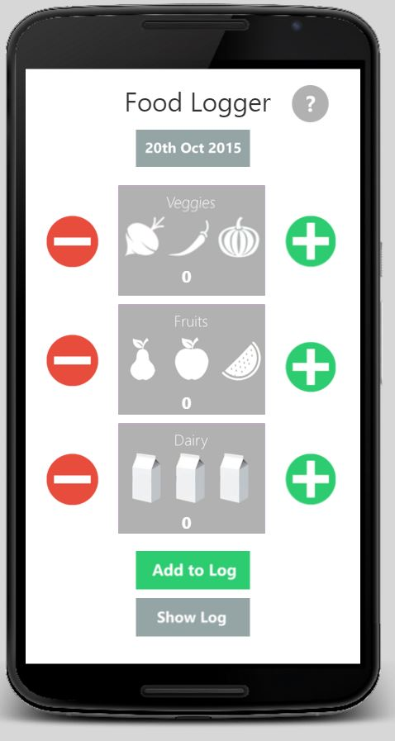
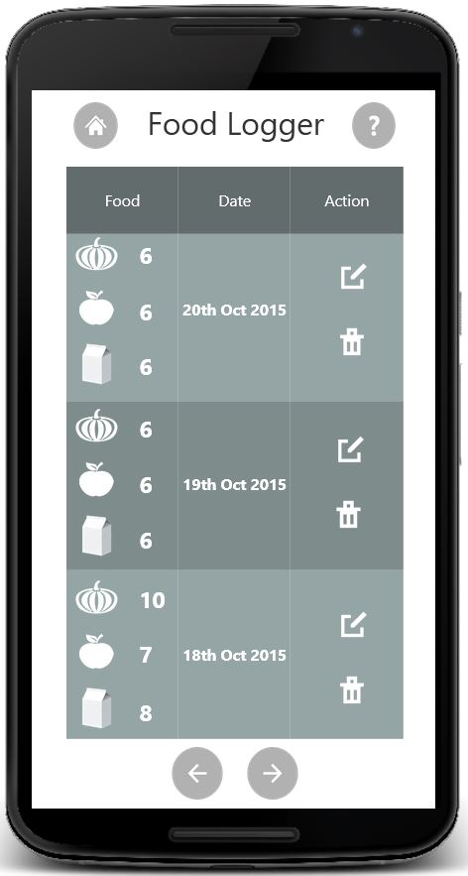
DESIGN - UI

Slide 9
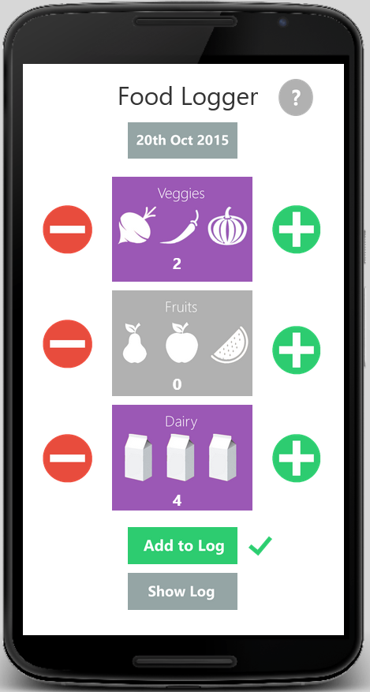
DESIGN RATIONALE - PROCESS/INFLUENCES
MAIN WINDOW
To utilize the touch interface of a phone or tablet
Colour change to indicate addition of servings
To notify the user of successful addition to the log

Slide 10
DESIGN RATIONALE - PROCESS/INFLUENCES
LOG HISTORY WINDOW
Commonly used icon to represent navigation to home screen
Commonly used icons for Edit and Delete functions
Listing the three categories to make better use of the limited screen
space
Buttons to access previous and next pages

Slide 11
DESIGN RATIONALE - PROCESSES/INFLUENCES
A 2-page UI app, maintaining simplicity and ensuring that the user doesn’t get distracted with unwanted features as noticed in the initial versions.
As seen in Appendix 2, the initial versions of the prototype, the date and courses had to be typed in by the user making it tedious. The inputs from Think-Alouds and Cognitive Walkthroughs influenced the decision of using a DatePicker and Increase/Decrease buttons.
The interface is touch based rather than the type-in as used in our previous versions. Using color-change scheme to indicate the user of the selection feature, since it will be a indication to them of a successful selection.

Slide 12
DESIGN RATIONALE - PROCESSES/INFLUENCES
As seen in many real world systems, having a Help functionality lets the user understand the design/features of the system. Hence we have included the Help icon on the top right.
Pictorial representation of the Food classes, enabling the user to ‘Recall rather than memorize’
Implementing the commonly used Edit/Delete icons will enable the system maintain consistency and standards.
In the previous versions, Logs showed all the entries in a single page which made it congested. To make it clear, we have included just the recent 3 entries onto a single page and also provided a functionality for the user to navigate through history using the next and previous buttons.

Slide 13
DESIGN RATIONALE - KEY FEATURES
Simple and clear design implementing the basic functionalities required by the tasks
No typing involved
Labeled pictorial representation for easier understanding
Help icon to guide the user through the working of the application
‘Show log’ button to provide the log of food intake. The last three entries are displayed and older entries can be accessed by scrolling
Color scheme for no serves and any number of serves
Functionality to edit existing log information
By default, the current date is shown. Calendar date picker for easier selection

Slide 14
Tasks

Slide 15
TASKS
Updating serves intake (Abstract)
You recall that you ate 1 serve of fruit today. Log that.
You recall that you ate 3 serves of vegetables today. Log that
You realise that was a mistake and you actually ate only 2 serves of vegetables. Update the logger for that.
Rationale: These tasks test the basic functionality of the system

Slide 16
Think Alouds

Slide 17

THINK ALOUD METHOD (5 USERS)
USERS | GENDER | BACKGROUND | AGE | COMPUTER LITERACY
1 | M | Working | 33 | High
2 | M | Working | 30 | High
3 | F | Working | 30 | Moderate
4 | M | Student | 18 | High
5 | M | Working | 33 | High

Slide 18

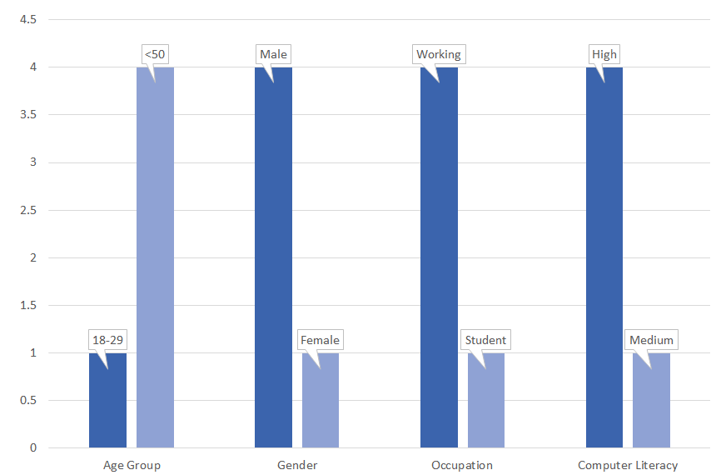
THINK ALOUD METHOD (USER DEMOGRAPHICS)

Slide 19
THINK ALOUD METHOD - User 1 (M,W,33,H)
TASK | TASK DESC. | OBSERVATION | USER COMMENTS
1 | You recall that you ate 1 serve of fruit today. Log that. | The user clicked on the + button, and assumed it was logged. They later noticed the Add to log button and put in the entry. (15 seconds) | Quite easy to use
2 | You recall that you ate 3 serves of fruit today. Log that | Since the user was familiar with the system, they now made use of the Add to log option immediately. (5 seconds) | Simple way to log
3 | You realize that was a mistake and you actually ate only 2 serves of vegetables. Update the logger for that | It was fairly easy, they updated the value in the main screen as it was the entry of the same day. (5 seconds) | Fairly easy

Slide 20
THINK ALOUD METHOD - User 2 (M,W,30,H)
TASK | TASK DESC. | OBSERVATION | USER COMMENTS
1 | You recall that you ate 1 serve of fruit today. Log that. | It looks good. (10 seconds) | Task achieved easily.
2 | You recall that you ate 3 serves of fruit today. Log that | Easily done. (5 seconds) | Veggies, Fruits and Dairy could've been in different colors. Not easily visible(number). Color combination could be better(purple and white).
3 | You realize that was a mistake and you actually ate only 2 serves of vegetables. Update the logger for that | Achieved. (5 seconds) | Dynamic entry is cool. Log page can be a little colorful.

Slide 21
THINK ALOUD METHOD - User 3 (F,W,30,M)
TASK | TASK DESC. | OBSERVATION | USER COMMENTS
1 | You recall that you ate 1 serve of fruit today. Log that. | The user was able to add the fruit serving very easily and quickly. (5 seconds) | Very easy to perform the task
2 | You recall that you ate 3 serves of fruit today. Log that | Again the user could add vegetables very easily just like fruits. (5 seconds) | Very easy to perform the task
3 | You realize that was a mistake and you actually ate only 2 serves of vegetables. Update the logger for that | User only thought of viewing the history when he was confused as to how to edit/update the food log. Needed some guidance. (20 seconds) | Easy to find the history.

Slide 22
THINK ALOUD METHOD - User 4 (M,S,18,H)
TASK | TASK DESC. | OBSERVATION | USER COMMENTS
1 | You recall that you ate 1 serve of fruit today. Log that. | The user completed task but took some time. (15 seconds) | Quite comfortable to make entry
2 | You recall that you ate 3 serves of fruit today. Log that | User completed the task quickly. (5 seconds) | Again very easy to add something
3 | You realize that was a mistake and you actually ate only 2 serves of vegetables. Update the logger for that | User tried to delete instead of editing the entry. Took some time to complete the task. (40 seconds) | Easy to add and then modify the log. Initially clicked on delete then realised it doesn’t work. finally completed task.

Slide 23
THINK ALOUD METHOD - User 5 (M,W,33,H)
TASK | TASK DESC. | OBSERVATION | USER COMMENTS
1 | You recall that you ate 1 serve of fruit today. Log that. | The user clicked on the + button, and assumed it was logged. They later noticed the Add to log button and put in the entry. (15 seconds) | Quite easy to use
2 | You recall that you ate 3 serves of fruit today. Log that | Since the user was familiar with the system, they now made use of the Add to log option immediately. (5 seconds) | Simple way to log
3 | You realize that was a mistake and you actually ate only 2 serves of vegetables. Update the logger for that | It was fairly easy, they updated the value in the main screen as it was the entry of the same day. (5 seconds) | Fairly easy

Slide 24
SUMMARY OF KEY PROBLEMS
The log page looks dull.
Different colours could be provided for each of the food class instead of having them all purple.
A few users felt the need for ‘Add to log’ button unnecessary.

Slide 25
CRITIQUE
Could have made use of more tasks
The Think Alouds are performed by 5 users with similar demographic background
The tasks are not covering the entire functionality of the system
The system is just a prototype and not a working application making it difficult for the user to think-aloud the tasks

Slide 26
SUS Results
 | USER 1 |  | USER 2 |  | USER 3 |  | USER 4 |  | USER 5
Description | Result | Calculation | Result | Calculation | Result | Calculation | Result | Calculation | Result | Calculation
I think that I would like to use this system. | 4 | 3 | 4 | 3 | 5 | 4 | 3 | 2 | 4 | 3
I found the system unnecessarily complex. | 2 | 3 | 1 | 4 | 1 | 4 | 2 | 3 | 2 | 3
I thought the system was easy to use. | 4 | 3 | 4 | 3 | 5 | 4 | 3 | 2 | 4 | 3
I think that I would need the support of a technical person to be able to use this system. | 1 | 4 | 1 | 4 | 1 | 4 | 2 | 3 | 1 | 4
I found the various functions in the system were well integrated. | 5 | 4 | 5 | 4 | 5 | 4 | 3 | 2 | 4 | 3
I thought there was too much inconsistency in the system. | 1 | 4 | 1 | 4 | 1 | 4 | 2 | 3 | 1 | 4
I would imagine that most people would learn to use this system very quickly. | 2 | 1 | 1 | 0 | 2 | 1 | 3 | 2 | 2 | 1
I found this system very cumbersome to use. | 1 | 4 | 1 | 4 | 1 | 4 | 2 | 3 | 2 | 3
I felt very confident using the system. | 4 | 3 | 5 | 4 | 5 | 4 | 3 | 2 | 4 | 3
I needed to learn alot of things before I could get going with this system. | 1 | 4 | 1 | 4 | 1 | 4 | 2 | 3 | 1 | 4
 | Sum | 33 | Sum | 34 | Sum | 37 | Sum | 25 | Sum | 31
 | Score | 82.5 | Score | 85 | Score | 92.5 | Score | 62.5 | Score | 77.5
 | Key: | 1 - Strongly disagree, 5 - Strongly agree

Slide 27
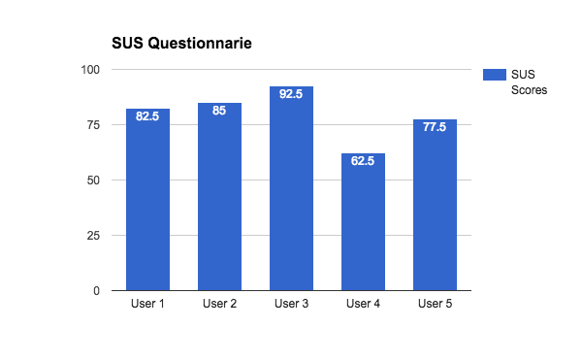
SUS Results

Slide 28
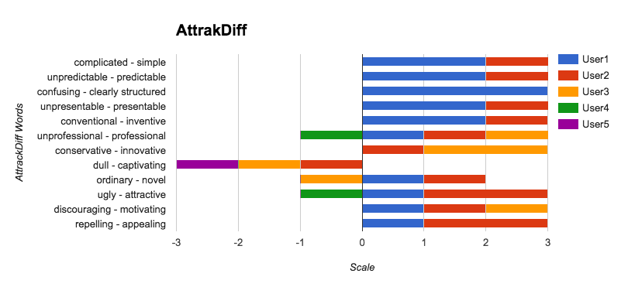
AttrakDiff Results

Slide 29
Cognitive Walkthrough

Slide 30
COGNITIVE WALKTHROUGH - TASK 1
You recall that you ate 1 serve of fruit today. Log that.
Step 1: The user would check for the date displayed to see if it is the current day.
Step 2: The user would check for the option of a food class fruit.
Step 3: They would press the ‘+’ sign once to input the value 1. Each of the food class have a pair of ‘+’ and ‘-’ signs next to it, so the user would know that they have to press the corresponding buttons.
Step 4: The user sees the value 1 shown on the fruits icon. They could assume that the value has been updated automatically.
Step 5: The user would expect for an indication of the successful update. Since they don’t receive any they would see the whole of the system and notice the ‘Add to log’ button.
Step 6: The user would then click on ‘Add to log’ button, the green tick confirms that the entry has been updated.

Slide 31
Cognitive Walkthrough - Task 1
Correct action obvious? | Yes, It is fairly simple to perform the task. And the system has a straightforward terminology helping the user do the task.
Will user understand instructions? | Yes, the task is straightforward
Will user interpret machine action correctly? | Yes, the system lets the user know of the updates.

Slide 32
COGNITIVE WALKTHROUGH - TASK 2
You recall that you ate 3 serves of vegetables today. Log that
Step 1: The user would check for the date displayed to see if it is the current day.
Step 2: The user would check for the option of a food class vegetables.
Step 3: After finding the veggies tab the user would press the corresponding ‘+’ sign thrice.
Step 4: The user would expect for the value to be shown as they update. The system shows the value 3 on the veggies tab.
Step 5: The user would press the ‘Add to Log’ button and this entry would be updated in the log.

Slide 33
Cognitive Walkthrough - Task 2
Correct action obvious? | Yes.
Will user understand instructions? | Yes, the task is straightforward
Will user interpret machine action correctly? | Yes, the system behaves as the user expects

Slide 34
COGNITIVE WALKTHROUGH - TASK 3
You realise that was a mistake and you actually ate only 2 serves of vegetables. Update the logger for that.
Step 1: The user would again press the ‘+’ sign twice to update the value to 2.
Step 2: They would then press ‘Add to log’. The green tick would provide a validation that the task is done.
Step 3: The user would check the log by pressing on ‘Show log’ option to see if the value has been updated.

Slide 35
Cognitive Walkthrough - Task 3
Correct action obvious? | Not completely, as the user would have to go to another page for the task. So a first time user may have difficulty
Will user understand instructions? | Partially, the user would perform the action in the same page
Will user interpret machine action correctly? | The system behaves the way the user expects

Slide 36
COGNITIVE WALKTHROUGH - PROBLEMS
DESCRIPTION | ACTION TAKEN
Typing input for number of serves is tedious | Touch-enabled/One-click method of inputting
Reading text - time consuming | Pictorial representation along with labels for easy interpretation
Dropdown for date input tedious as it required the user to continually scroll through | Simple date picker for easy date selection
Multiple features and pages | Simple 2-page UI, skimming all the unnecessary features

Slide 37

COGNITIVE WALKTHROUGH - CRITIQUE
Biased towards the system
Fewer number of tasks on which CW is performed
Will not be possible to have a clear view of the mental model for users of different demographics

Slide 38
Appendix 1

Slide 39
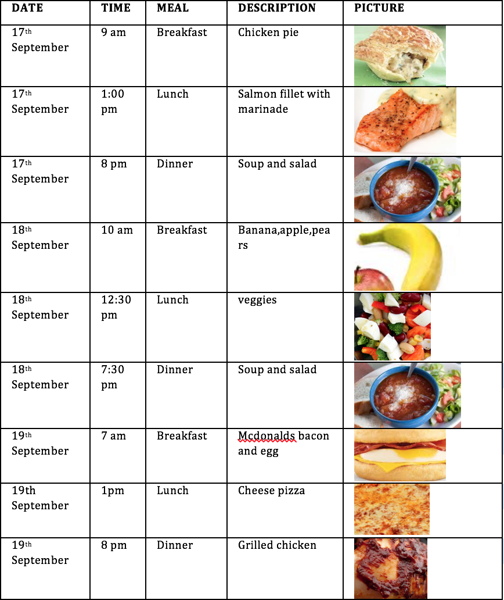
APPENDIX 1 - FOOD LOGS
Student 1: Food log

Slide 40
APPENDIX 1 - FOOD LOGS
Student 1: Reflection
Looking at this task, i believe firstly that logging food for every meal is not easy, as you tend to forget to do so. However, I was able to manage to log my food for 3 days.
I observed that i ate a lot of junk food during the weekend when compared to weekdays. My diet was more balanced and well spread out covering almost all classes of the food

Slide 41
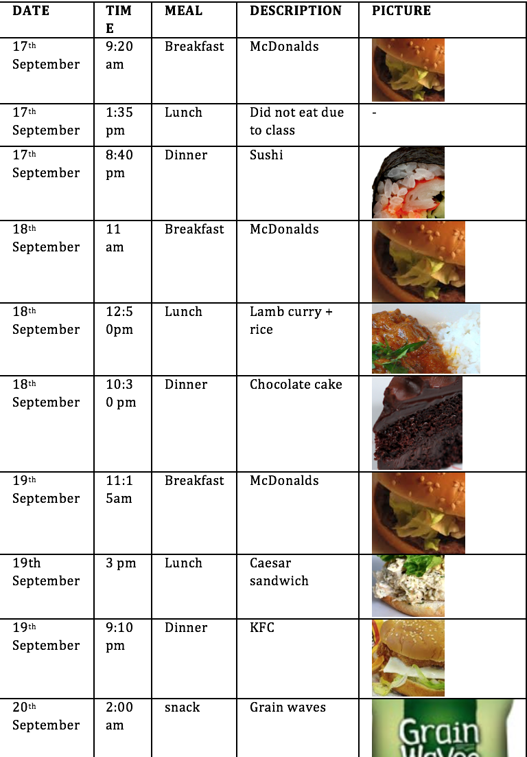
APPENDIX 1 - FOOD LOGS
Student 2: Food log

Slide 42
APPENDIX 1 - FOOD LOGS
Student 2: Reflection
I found that my weekends were very unhealthy and mostly consisted of junk food. Even on weekdays i saw that my breakfast was always from McDonalds which is not a healthy option. Also i found that i was exceeding my fat intake of the day by comparing it to what is required for my body ideally.
I need to focus on eating more vegetables and fruits.

Slide 43
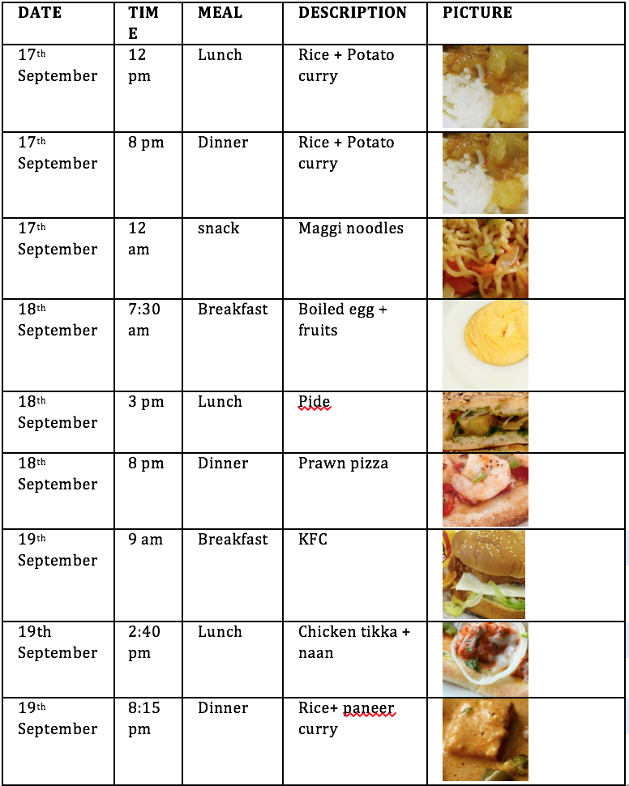
APPENDIX 1 - FOOD LOGS
Student 3: Food log

Slide 44
APPENDIX 1 - FOOD LOGS
Student 3: Reflection
Based on the food I ate, it is clear that my diet lacks the food classes 4 and 5 ; dairy products and fruits respectively.
Another thing I found was that my food intake is more balanced on a weekday when compared to a weekend.
Also, in order to get a more balanced diet and healthy lifestyle I believe that i should have food at more regular intervals and not have 5-6 hour gap between meals.

Slide 45
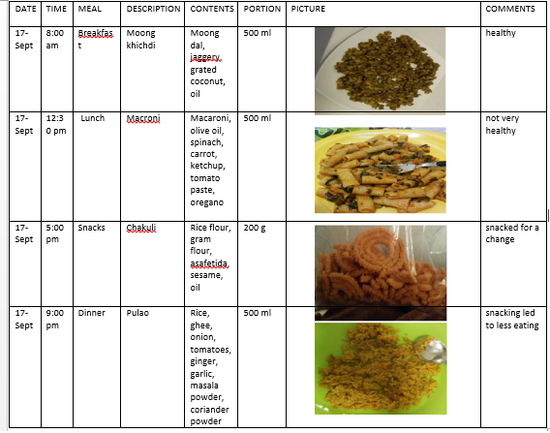
APPENDIX 1 - FOOD LOGS
Student 4: Food log

Slide 46
APPENDIX 1 - FOOD LOGS
Student 4: Reflection
As seen from the table on Day 1, I had two cups of some healthy moong dal khichdi and two cups of vegetable macaroni for lunch. I snacked a little on Chakuli in the evening. However this helped me reduce my intake for dinner where in I had a cup of fried rice. On Day 2, I started my day with some healthy moong dal khichdi left over from the previous day and 2 cups of curd rice for lunch. I binged on few store bought crackers in the evening. I had a very balanced diet containing mixed veggies, macaroni and garbanzo beans for dinner. On Day3 my breakfast comprised of some steamed dhoklas made from ready made mix. My lunch was a cup of simple macaroni in red sauce. A hectic schedule ahead spared me no time for snacking and I ended up overeating for dinner. Dinner was a big spread with fried rice, soya chunks curry and Raita which is curd based.
Some of my observations have been as follows:
1. I ate more healthy on days I had a heavy breakfast and lunch.
2. I ate less when I decorated my plate to send pictures to my family.
3. Lack of sleep and hectic schedule led to cravings and overeating in turn.
4. Light Snacking in the evening led to a more balanced meal during night.

Slide 47
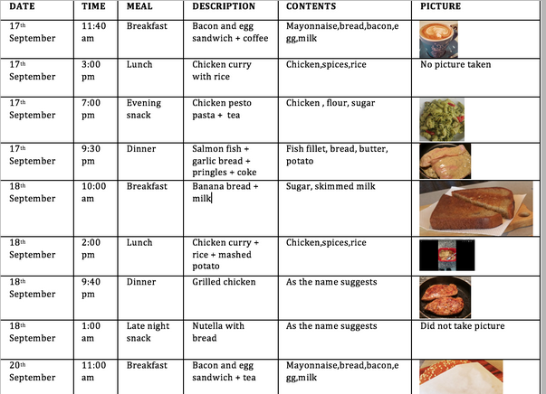
APPENDIX 1 - FOOD LOGS
Student 5: Food log

Slide 48
APPENDIX 1 - FOOD LOGS
Student 5: Reflection
According to my food log, I really love chicken. I have a wide variety of protein intake alternating with chicken, bacon, fish and other food sources. However, there is significantly low intake of any vegetables or fruits. I thought my diet includes these vitamins but clearly it does not. Also, there are a lot of processed foods I eat like flour, bread, mayonnaise, Nutella, etc. which is very unhealthy.
I think I need a big diet change as I need to have whole, natural foods as opposed to processed foods.

Slide 49
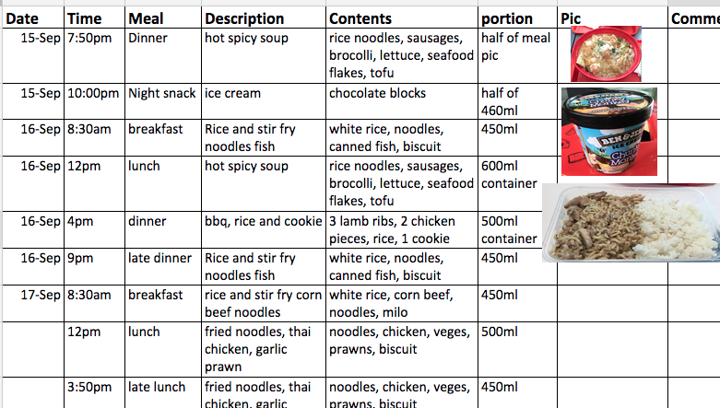
APPENDIX 1 - FOOD LOGS
Student 6: Food log

Slide 50
APPENDIX 1 - FOOD LOGS
Student 6: Reflection
It is clear from the three days of my food log that I critically need a change in my diet. Of the meals I had, approximately 20% is made up of vegetables and fruits. The other 80% is made up of meat and starch. I believe these figures should be the other way round. Also, it appears that I eat more during the weekends than the other days of the week. I seem to have too much sweet food intake like ice cream, fruit salads, cocoa rice. Late night eating is also a habit I need to cut down on because it's not healthy to eat and sleep straight away. All this is evident of my weight and size. I really believe that you are what you eat and maintaining a healthy living is ultimately determined by what you put in your mouth, how much and when. Eating more of natural foods and avoiding processed food is key.

Slide 51
Appendix 2

Slide 52
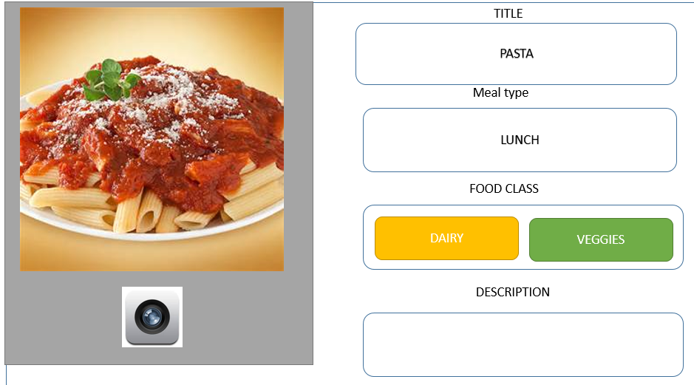
APPENDIX 2 - PROTOTYPE EVOLUTION
Version 1
This was the initial design we came up with but we realised that the interface didn’t provide an option to choose date and also to save the entries.
Notes:
This was the initial design we came up with but we realised that the interface didn’t provide an option to choose date and also to save the entries.

Slide 53
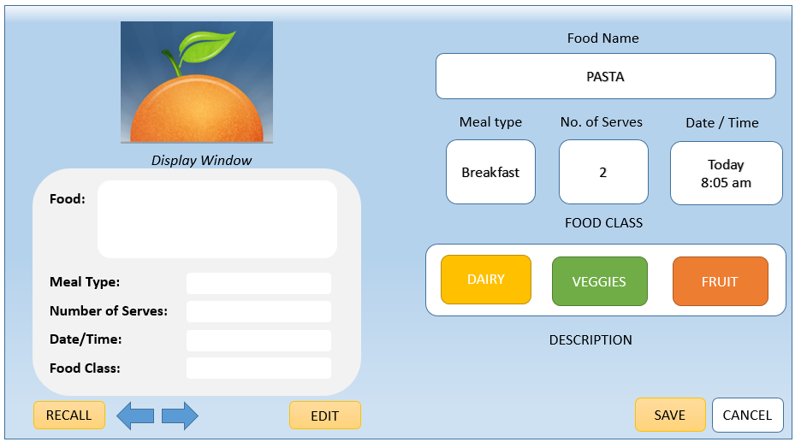
APPENDIX 2 - PROTOTYPE EVOLUTION
Version 2
This version seemed good until we realised that this did have a ‘recall’ feature but wouldn’t create a log with entries corresponding to each day and also meal type and description of food wasn’t really necessary.
Notes:
This version seemed good until we realised that this did have a ‘recall’ feature but wouldn’t create a log with entries corresponding to each day and also meal type and description of food wasn’t really necessary.

Slide 54
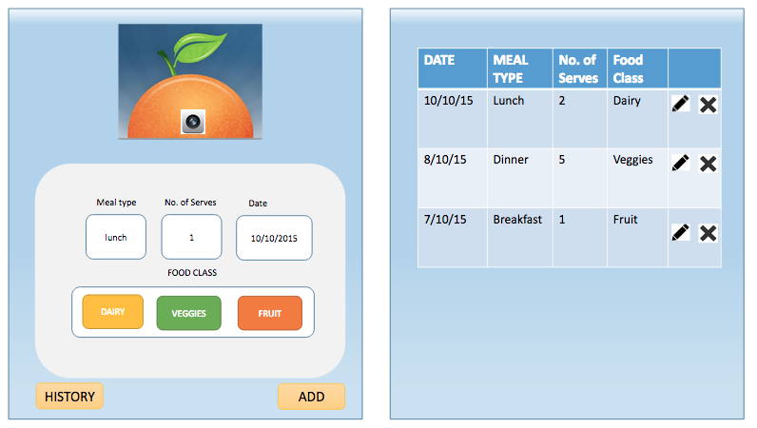
APPENDIX 2 - PROTOTYPE EVOLUTION
Version 3
We implemented this and conducted Think Alouds for this particular interface in the tutorial of week 11. From the Think Alouds and cognitive walkthrough conducted , we inferred that there was still scope to improve this application and make it more simple so as to provide the basic set of features that would help perform the three tasks listed.
Notes:
We implemented this and conducted Think Alouds for this particular interface in the tutorial of week 11. From the Think Alouds and cognitive walkthrough conducted , we inferred that there was still scope to improve this application and make it more simple so as to provide the basic set of features that would help perform the three tasks listed.

Slide 55
APPENDIX 2 - PROTOTYPE EVOLUTION
Informed improvements
Think Aloud
The users were confused between typing and clicking buttons and also there were too many colors. Some users recommended color code matching for color of the food class. One of the users also suggested a pictorial representation of the food class. The system did not inform user of system status (eg. user did not know if input was saved)
Cognitive Walkthrough
System generates multiple entries in the log when user consumes (multiple) serve of different food class on the same day. Thus data redundancy occurs in the first column (date) which reduces readability making the interface (log file display) ambiguous. Two experts pointed out that the picture being uploaded plays no role in the application and hence can be eliminated.

Slide 56

Thanks!
GROUP 3
SOMESHA SRIDHARA
SHILPA SHETTY
ARUN PRASAD
ANUJ CHOPRA
OSHIN DSOUZA
DANIEL CHAN BOON

