Slide 1
UsABILITY EVALUATION OF FOOD LOGGING

Slide 2
Hello!
We are Team 3!
Somesha Sridhara
Shilpa Shetty
Arun Prasad
Anuj Chopra
Oshin Dsouza
Daniel Chan Boon

Slide 3
1.
OVERVIEW OF THE DESIGN

Slide 4
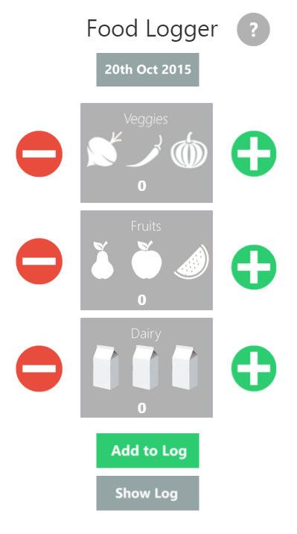
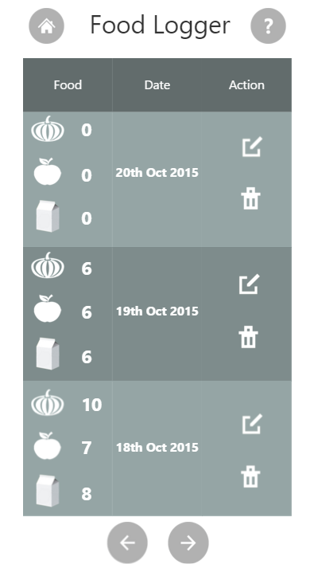
WALKTHROUGH of the design

Slide 5
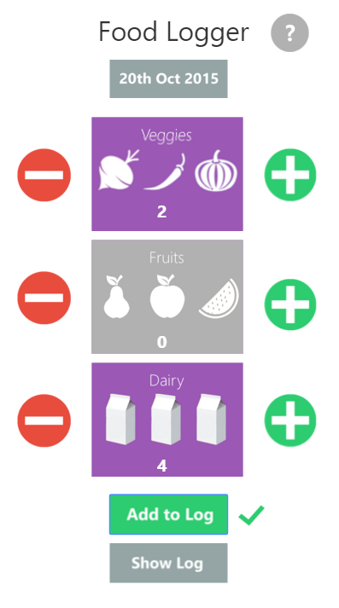
WALKTHROUGH of the design
To utilize the touch interface of a phone or tablet
Colour change to indicate addition of servings
To notify the user of successful addition to the log

Slide 6
WALKTHROUGH of the design
Commonly used icon to represent navigation to home screen
Commonly used icons for Edit and Delete functions
Listing the three categories to make better use of the limited screen
space
Buttons to access previous and next pages

Slide 7
STRENGTHS
Simple User Interface
Touch-friendly interface to allow easy logging of food
Dynamic color-change scheme indicating the user of a successful selection
Pictorial representation of food classes
Easy selectable date picker
Edit/Delete functionality

Slide 8
WEAKNESSES
The log page can be more colorful
Each of the title for food class could have a different color

Slide 9
2.
THINK ALOUD EVALUATION

Slide 10
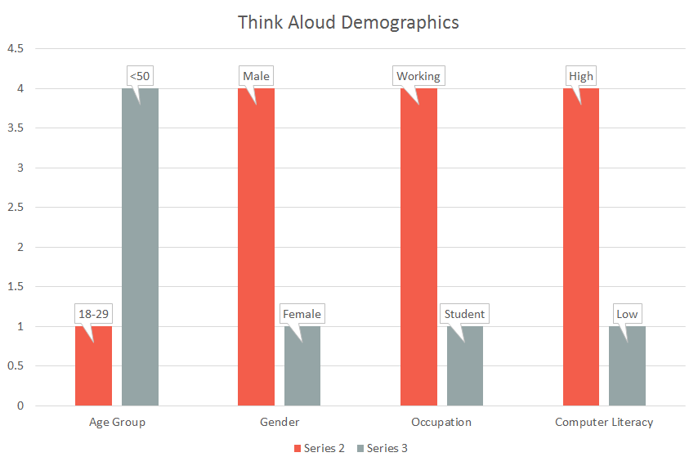
DEMOGRAPHICS

Slide 11
THINK ALOUD - USERS’ COMMENTS
TASKS | USER 1 | USER 2 | USER 3 | USER 4 | USER 5
You recall that you ate 1 serve of fruit today. Log that. | Quite easy to use | Task achieved easily. | Very easy to perform the task | Quite comfortable to make entry | Quite easy to use
You recall that you ate 3 serves of fruit today. Log that | Simple way to log | Number not visible, preferred use of different colors | Very easy to perform the task | Again very easy to add something | Simple way to log
You realize that was a mistake and you actually ate only 2 serves of vegetables. Update the logger for that | Fairly easy | Log page can be a little colorful | Easy to find the history. | Easy to add and then modify the log | Fairly easy

Slide 12
THINK ALOUD - FINDINGS
Simple and aesthetic UI
Shows the user the system status
Pictorial representation - a bonus
Log page could be more colorful
Different colors could be used to represent food classes

Slide 13
3.
Questionnaire Results Highlights

Slide 14
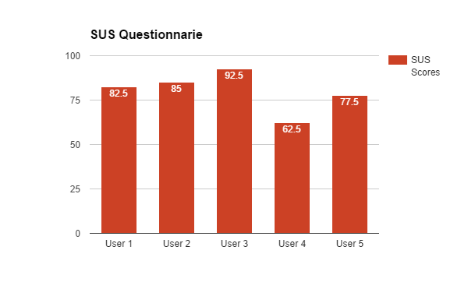
SUS QUESTIONAIRE

Slide 15
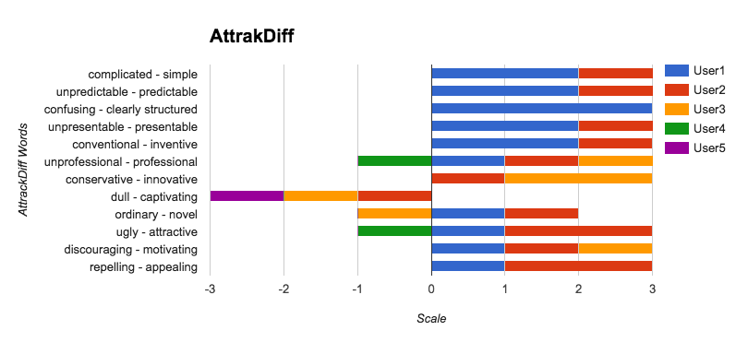
ATTRAKDIFF QUESTIONAIRE

Slide 16
questionnaire findings
Most users found the design to be fairly simple
On average, the SUS score is above 80 which indicated an effective, efficient and satisfying design
A couple of users argued it was partly dull and generic

Slide 17
Thanks!
Any questions?

