Slide 1
Unit: 3
Nagios Monitoring

Slide 2
Syllabus
Nagios Monitoring :
  Continuous Monitoring Concepts: Definition, Importance, and Benefits.
  Introduction to Nagios: Features, Architecture, Plugins, Soft and Hard States,
  Installation of Nagios:
  Using Package Managers (apt-get/dpkg, yum/rpm), Installing Prerequisites, Compiling and Installing,
  Setting up Web Server, Command-Line Interfaces, Nagios Configuration: Monitoring Web Servers,
  Using Built-in Web Interface (Managing Hosts, Services, Downtimes, Comments, Information),
  Deploying a Simple Web Application on Server

Slide 3
Continuous Monitoring Concepts
Definition
  Continuous Monitoring is the automated, real-time process of observing IT systems, applications, services, and infrastructure to detect performance issues, security threats, or failures as they happen.
Importance
  Ensures high availability of services.
  Provides proactive alerts before failures affect end-users.
  Helps in capacity planning by identifying trends.
  Strengthens security posture by continuously auditing.
  Reduces downtime and increases operational efficiency

Slide 4
Continuous monitoring = automated, real-time observation of systems, apps, and networks to detect failures and performance degradation as they happen.
Continuous Monitoring (CM) is the process of constantly observing and analyzing an IT environment to detect performance issues, security threats, or configuration changes in real-time. It ensures that systems are functioning optimally and deviations are immediately reported.
Example scenarios
  E-commerce site: monitor HTTP response time, DB connectivity, disk fill on app servers, and TLS certificate expiry. An alert on page-load time increases can trigger autoscaling or an incident.
  Corporate mail server: monitor SMTP port, queue length, disk availability and certificate validity; schedule downtime during upgrades.
  Data center: monitor switch port status, power supply, temperature sensors.

Slide 5
Concrete benefit example
Problem: web server runs out of disk space → site down during peak hour.
Continuous monitoring: disk-usage alert at 85% → ops cleans logs or triggers provisioning → outage avoided.

Slide 6
Benefits
  Early Issue Detection → Prevents outages and service degradation.
  Improved Reliability → Ensures mission-critical services stay online.
  Compliance & Auditing → Tracks and reports infrastructure changes.
  Cost Savings → Reduces emergency recovery costs.
  Visibility → Single-pane-of-glass for monitoring systems, networks, and apps.

Slide 7
Introduction to Nagios
Nagios is a popular open source monitoring tool.
Nagios is an open-source IT infrastructure monitoring solution that tracks servers, networks, applications, and services to ensure their availability and performance.
It works by running periodic checks using plugins and can send alerts to administrators when issues are detected, and again when they are resolved.
Nagios offers both a basic, command-line-based version (Nagios Core) and enterprise-level solutions like Nagios XI, which provides a more advanced web interface and additional features for businesses.

Slide 8
Nagios Core
Nagios Core is an open-source monitoring engine that executes checks (plugins), tracks state, and sends notifications.
It’s widely used and extensible via plugins and add-ons.
Key features
  Checks hosts & services (active & passive checks).
  Web interface for status, history, scheduling downtimes, comments.
  Extensible plugin architecture (community plugins).
  Event handlers for automated responses.
  Hostgroups, servicegroups, contact & escalation configuration.

Slide 9
How Nagios Works
Monitoring:
  Nagios uses checks (often through plugins) to monitor various IT components, such as server CPU load, memory usage, disk space, and network services like HTTP or SMTP.
Configuration:
  Administrators define hosts, services, contacts, and the checks Nagios should perform using text-based configuration files or the Nagios XI interface.
Alerting:
  If a check reveals a problem (e.g., a server is down or a service is unresponsive), Nagios sends alerts to designated contacts via email, SNMP traps, or script execution.
Reporting:
  Administrators can view the status of their infrastructure through a web-based dashboard, which provides an overview of critical parameters and allows for detailed reporting.

Slide 10
Nagios Ecosystem
Nagios Core:
  The foundational open-source monitoring engine with a basic web display and command-line configuration.
Nagios XI:
  An enterprise-class solution that offers a more user-friendly web interface, advanced features, and increased scalability.
Nagios Network Analyzer:
  A tool specifically designed to monitor and analyze network flow data (NetFlow, sFlow, etc.) to provide insights into network traffic.
Nagios Log Server:
  A solution for centralizing and analyzing log data from various sources to identify security issues and other anomalies.
Nagios Fusion:
  A tool for managing and visualizing monitoring data from multiple distributed Nagios instances, providing a unified view of the entire infrastructure.

Slide 11
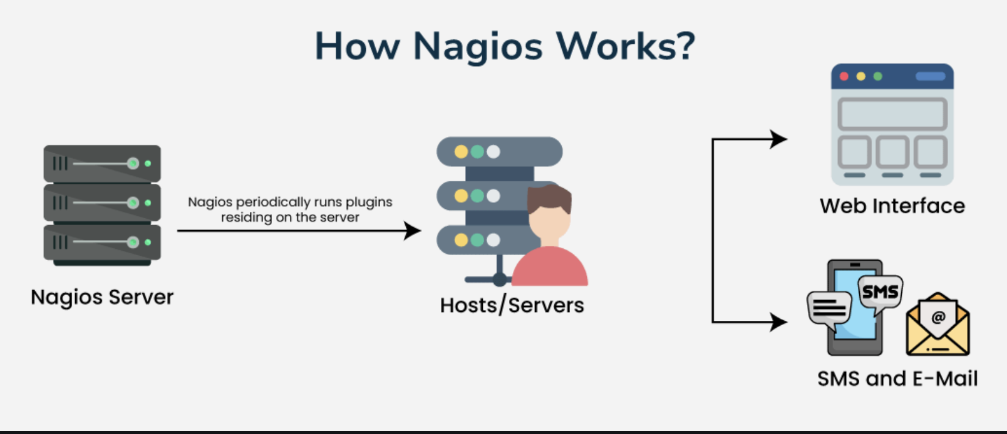
How Nagios works

Slide 12
Nagios is a comprehensive monitoring tool designed to ensure the smooth operation of IT infrastructure.
It offers flexibility with both command-line and web-based interfaces, allowing administrators to monitor systems efficiently.
Here's how Nagios works, step by step:
1. Monitoring Setup: Nagios provides two options for monitoring:
  Agent-based: Independent agents are installed on servers to collect data, which is then sent to the Nagios server.
  Agentless: Uses existing protocols to gather data without installing additional software on servers. Both methods monitor critical system metrics like file system usage, CPU performance, and service status.

Slide 13
Dashboards and Alerts:
  The Nagios dashboard offers a real-time overview of key parameters, making it easy to track system health.
  When predefined thresholds, such as high CPU usage or low disk space, are crossed, Nagios sends alerts via email or SMS.
  This ensures administrators can respond quickly to issues, minimizing downtime.
Plugins and Scripts:
  Nagios runs as a service on a server and uses small scripts or plugins to check the status of hosts and services in your network.
  These plugins, written in languages like Perl or shell script, are executed at regular intervals.
  Results are collected and stored for review.
  If a significant change is detected, additional scripts are triggered, and further actions or notifications are initiated.

Slide 14
Integration with AWS:
  Nagios integrates seamlessly with AWS environments.
  When installed on AWS, it provides scalable and secure monitoring for cloud infrastructure.
  The collected data is accessible through the Nagios web interface, allowing administrators to monitor both local and cloud systems in real-time.

Slide 15
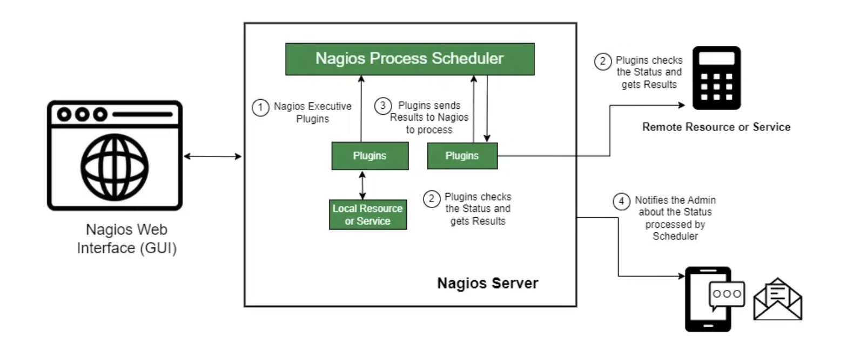
Architecture

Slide 16
This architecture ensures that Nagios can monitor both local and remote resources effectively, offering administrators comprehensive insights into system performance.
Each component works together to provide continuous monitoring, automated alerting, and real-time visibility into the health of the infrastructure.
Below is a detailed explanation of each major component in the architecture diagram.
Nagios Process Scheduler:
  The Nagios Process Scheduler is the core of the Nagios system.
  It regularly schedules checks for all monitored services and hosts in the infrastructure.
  These checks are performed by running specific plugins to retrieve the current status of each monitored resource (both local and remote).

Slide 17
Nagios Executive Plugins:
  The Nagios Executive Plugins are the actual executables or scripts used to check the status of local or remote resources.
  These plugins interact with the system components such as servers, services, and processes to gather important metrics.
Plugins:
  Plugins are small scripts or programs that perform specific tasks like checking if a service is active, monitoring CPU usage, or tracking disk space.
  Each plugin is designed to check a particular resource or service and provides results that show whether everything is working properly or if there are any issues.

Slide 18
Local Resource or Service:
  The Local Resource or Service refers to parts of the system where the Nagios server is running, like CPU usage, memory usage, or services such as Apache or MySQL.
  Plugins check these resources to make sure they are working properly and staying within set limits.

Slide 19
Monitoring Process
Nagios Web Interface (GUI):
  The Nagios Web Interface is a user-friendly dashboard where administrators can see the real-time status of all monitored resources.
  It helps users quickly check the status of different services, get alerts, and track performance over time.
  Accessible through any modern web browser, this interface is crucial for real-time monitoring and fixing issues easily.
Alert Notifications (SMS and Email):
  One of Nagios' key features is its ability to alert administrators when something critical happens.
  These alerts can be sent through SMS or email, based on the settings. If a resource or service reaches a critical point, like low disk space or a service going down,
  Nagios quickly sends a notification to ensure the issue gets addressed right away

Slide 20
Architecture Flow:
Nagios Core schedules and executes checks via plugins.
Plugin results are returned to the core engine.
Based on results, alerts or notifications are generated.
Data is displayed on the web interface for administrators.

Slide 21
What Are the Nagios Plugins?
Nagios plugins are small programs or scripts that check the health and performance of systems, services, or applications.
These plugins help Nagios monitor critical resources like disk space, CPU usage, running services, and network connectivity, ensuring everything runs smoothly in your infrastructure.

Slide 22
Types of Nagios Plugins
Official Plugins:
  These are built and maintained by the Nagios team, included in the standard Nagios package.
  They cover common monitoring needs like CPU, memory, disk usage, and network status for popular services like HTTP, FTP, and SMTP.
  They are stable, frequently updated, and fully compatible with Nagios.
Custom Plugins:
  Developed by users to address specific monitoring needs not covered by official plugins, custom plugins are written in any scripting language (Python, Bash, Perl).
  They offer flexibility for monitoring unique applications or specialized metrics, tailored to an organization’s requirements.

Slide 23
Third-Party Plugins:
  Created by external developers or vendors, third-party plugins provide specialized functionality for enterprise applications or hardware not supported by official plugins.
  They are often shared within the Nagios community or offered commercially.
Agent-Based Plugins:
  These require installing an agent on remote systems to collect detailed metrics like CPU load and disk space.
NRPE (Nagios Remote Plugin Executor):
  NRPE is an agent-based plugin that monitors local metrics on remote servers.
  It runs checks on systems not directly accessible by the Nagios server, ideal for in-depth monitoring within internal networks.

Slide 24
Agentless Plugins:
  These plugins use standard protocols like SNMP, SSH, or WMI to collect data from remote systems without needing an agent. Ideal for monitoring network devices or cloud-based resources.
NRDP (Nagios Remote Data Processor):
  NRDP allows remote systems to send data to Nagios via HTTP/HTTPS, useful when direct access or agent installation isn’t possible, such as in cloud environments or behind firewalls.

Slide 25
Plugins
  Located in /usr/local/nagios/libexec/ (default).
  Written in Bash, Perl, or Python.
Example:
  check_ping – Verifies network connectivity.
  check_http – Tests web server response.
  check_disk – Checks disk space usage.
Soft and Hard States
  Soft State: A temporary issue detected for the first time; not yet confirmed.
  Hard State: The issue persists after multiple checks (retries); an alert is generated.
Example:
  1st failed HTTP check → Soft Down
  3rd consecutive failure → Hard Down → Notification sent.

Slide 26
Installation of Nagios Using Package Managers
Nagios can be installed quickly using your Linux distribution’s package manager.
On Debian/Ubuntu systems:
  sudo apt update
  sudo apt install -y nagios4 nagios-plugins-contrib nagios-nrpe-plugin
On RHEL/CentOS/AlmaLinux systems:
  sudo yum install -y epel-release
  sudo yum install -y nagios nagios-plugins-all nagios-plugins-nrpe nrpe

Slide 27
Explanation:
apt / yum → Package managers for Debian-based and RHEL-based systems.
nagios4 → The Nagios Core engine (monitoring daemon).
nagios-plugins-* → Adds standard monitoring checks (e.g., ping, HTTP, disk usage).
nagios-nrpe-plugin / nrpe → Used for remote monitoring of other systems.

Slide 28
Installing Prerequisites (Before Compiling from Source)
If you want the latest Nagios version or more control, compile from source:
  sudo apt update
  sudo apt install -y autoconf gcc make unzip wget apache2 php libapache2-mod-php \
  build-essential libgd-dev libssl-dev daemon unzip
These packages are essential build tools and dependencies for Nagios:
  apache2, php, libapache2-mod-php → Web interface backend
  gcc, make, build-essential → For compiling source code
  libgd-dev → Enables Nagios to create performance graphs
  libssl-dev → For secure plugin communication
  daemon → Manages background processes

Slide 29
Compiling and Installing Nagios (Manual Method)
Download and Extract Nagios Core:
cd /tmp
wget https://assets.nagios.com/downloads/nagioscore/releases/nagios-4.5.3.tar.gz
tar -xzf nagios-4.5.3.tar.gz
cd nagios-4.5.3

Slide 30
Create Users and Groups
sudo useradd nagios
sudo groupadd nagioscmd
sudo usermod -aG nagioscmd nagios
sudo usermod -aG nagioscmd www-data
Creates a dedicated nagios user and a shared group nagioscmd for Apache (web UI) and Nagios daemon communication.

Slide 31
Configure, Compile, and Install
sudo ./configure --with-command-group=nagioscmd
sudo make all
sudo make install
sudo make install-daemoninit
sudo make install-commandmode
sudo make install-config
sudo make install-webconf
Explanation of targets:
  configure – Prepares the system to build Nagios.
  make all – Compiles all binaries.
  install-daemoninit – Installs Nagios as a systemd service.
  install-commandmode – Allows web interface to send commands.
  install-webconf – Installs Apache configuration for /nagios.

Slide 32
Setting Up the Web Server
Secure Web Access:
  sudo htpasswd -c /usr/local/nagios/etc/htpasswd.users nagiosadmin
Creates a password file for logging into the Nagios web dashboard.
Enable Required Apache Modules:
  sudo a2enmod cgi rewrite
  sudo systemctl restart apache2
cgi module runs Nagios web scripts; rewrite allows dynamic URLs.

Slide 33
Command-Line Interfaces
Nagios can be controlled directly via system commands:
Action | Command | Purpose
Start Nagios | sudo systemctl start nagios | Runs Nagios service
Stop Nagios | sudo systemctl stop nagios | Stops monitoring
Restart Nagios | sudo systemctl restart nagios | Reloads configuration
Verify Config | /usr/local/nagios/bin/nagios -v /usr/local/nagios/etc/nagios.cfg | Checks for syntax errors
Enable Autostart | sudo systemctl enable nagios | Starts Nagios automatically on boot

Slide 34
Nagios Configuration: Monitoring Web Servers
Configuration files are typically in:
  /usr/local/nagios/etc/objects/
Define a Host
Edit or create a file /usr/local/nagios/etc/objects/webserver.cfg:
  define host{
  use linux-server
  host_name webserver1
  alias AWS Web Server
  address 192.168.1.10
  }

Slide 35
Define a Service (Web/HTTP Check)
  define service{
  use generic-service
  host_name webserver1
  service_description HTTP
  check_command check_http
  }
Reload Nagios
  sudo systemctl restart nagios
Explanation:
  The host definition identifies the target machine.
  The service definition tells Nagios what to monitor (check_http tests if a web server responds).
  This is how Nagios continuously monitors servers and their services.

Slide 36
Using the Built-in Web Interface:
Access the dashboard via:
http://<EC2-Public-IP>/nagios

Slide 37
Soft and Hard States
Soft States
Definition: Temporary state that hasn't been confirmed by multiple checks
Characteristics:
  Occurs when a service check returns a non-OK state for the first time
  Nagios will retry the check before considering it a "hard" state
  No notifications are sent during soft states
  Used to reduce false alarms

Slide 38
Hard States
Definition: Confirmed state after multiple consecutive checks
Characteristics:
  Occurs when a service has been rechecked and confirmed to be in a non-OK state
  Notifications are sent for hard states
  Event handlers are executed
  State is logged and appears in reports
State Transition Example
Service OK → Service WARNING (Soft State 1/3)
↓ (recheck)
Service WARNING (Soft State 2/3)
↓ (recheck)
Service WARNING (Hard State) → Notification Sent

Slide 39
1. Installation of Nagios using Docker
Step 1: Create Project Directory
For Windows Command Prompt:
# Create project directory
mkdir nagios-monitoring
cd nagios-monitoring
Step 2: Create Docker Compose File
Create a docker-compose.yml file:

Slide 40
version: '3.8'
services:
nagios:
image: jasonrivers/nagios:latest
container_name: nagios
ports:
- "8080:80"
environment:
- NAGIOSADMIN_USER=nagiosadmin
- NAGIOSADMIN_PASS=password123
volumes:
- ./nagios/etc:/opt/nagios/etc
- ./nagios/var:/opt/nagios/var
- ./custom-plugins:/opt/Custom-Nagios-Plugins
restart: unless-stopped
web-server:
image: nginx:alpine
container_name: test-web-server
ports:
- "8081:80"
volumes:
- ./web-content:/usr/share/nginx/html
restart: unless-stopped

Slide 41
Step 3: Create Directory Structure
For Windows Command Prompt:
# Create necessary directories
mkdir nagios\etc
mkdir nagios\var
mkdir custom-plugins
mkdir web-content
# Create a simple web page for testing
echo ^<h1^>Test Web Server^</h1^>^<p^>This is a test web server for Nagios monitoring.^</p^> > web-content\index.html

Slide 42
Step 4: Start Nagios Container
For Windows Command Prompt or PowerShell:
# Start the containers
docker-compose up -d
# Check if containers are running
docker-compose ps
Step 5: Access Nagios Web Interface
Open your web browser
Navigate to http://localhost:8080/nagios
Login with:
  Username: nagiosadmin
  Password: password123

Slide 43
Step 6: Verify Installation
For Windows Command Prompt or PowerShell:
# Check Nagios logs
docker-compose logs nagios
# Access Nagios container shell
docker exec -it nagios /bin/bash
# Check Nagios configuration (run this inside the container)
/opt/nagios/bin/nagios -v /opt/nagios/etc/nagios.cfg

Slide 44
2. Nagios Configuration
Configuration File Structure
Nagios uses several configuration files:
/opt/nagios/etc/
├── nagios.cfg # Main configuration file
├── cgi.cfg # CGI configuration
├── resource.cfg # Resource definitions
├── objects/
│ ├── commands.cfg # Command definitions
│ ├── contacts.cfg # Contact definitions
│ ├── hosts.cfg # Host definitions
│ ├── services.cfg # Service definitions
│ └── timeperiods.cfg # Time period definitions

Slide 45
1. Host Definition
# Create host configuration
cat > nagios/etc/objects/hosts.cfg << 'EOF'
define host {
host_name test-web-server
alias Test Web Server
address web-server
check_command check-host-alive
check_interval 5
retry_interval 1
max_check_attempts 3
check_period 24x7
notification_interval 30
notification_period 24x7
notification_options d,u,r
contact_groups admins
}
define host {
host_name localhost
alias Localhost
address 127.0.0.1
check_command check-host-alive
check_interval 5
retry_interval 1
max_check_attempts 3
check_period 24x7
notification_interval 30
notification_period 24x7
notification_options d,u,r
contact_groups admins
}
EOF

Slide 46
2. Service Definition
# Create service configuration
cat > nagios/etc/objects/services.cfg << 'EOF'
define service {
host_name test-web-server
service_description HTTP
check_command check_http
check_interval 5
retry_interval 1
max_check_attempts 3
check_period 24x7
notification_interval 30
notification_period 24x7
notification_options w,u,c,r
contact_groups admins
}
define service {
host_name localhost
service_description PING
check_command check_ping!100.0,20%!500.0,60%
check_interval 5
retry_interval 1
max_check_attempts 3
check_period 24x7
notification_interval 30
notification_period 24x7
notification_options w,u,c,r
contact_groups admins
}
EOF

Slide 47
3. Contact Definition
# Create contact configuration
cat > nagios/etc/objects/contacts.cfg << 'EOF'
define contact {
contact_name nagiosadmin
use generic-contact
alias Nagios Admin
email admin@localhost
}
define contactgroup {
contactgroup_name admins
alias Nagios Administrators
members nagiosadmin
}
EOF

Slide 48
4. Command Definition
# Create custom commands
cat > nagios/etc/objects/commands.cfg << 'EOF'
define command {
command_name check_http
command_line /opt/nagios/libexec/check_http -H $HOSTADDRESS$ -p $ARG1$
}
define command {
command_name check_ping
command_line /opt/nagios/libexec/check_ping -H $HOSTADDRESS$ -w $ARG1$ -c $ARG2$
}
define command {
command_name check-host-alive
command_line /opt/nagios/libexec/check_ping -H $HOSTADDRESS$ -w 3000.0,80% -c 5000.0,100%
}
EOF

Slide 49
Localhost.cfg
define service{
use local-service,graphed-service ; Name of service template to use
host_name localhost
service_description HTTP
check_command check_http!80
notifications_enabled 0
}

Slide 50
Configuration Validation
# Restart Nagios to apply changes
docker-compose restart nagios
# Validate configuration
docker exec nagios /opt/nagios/bin/nagios -v /opt/nagios/etc/nagios.cfg

Slide 51
3. Monitoring Web Servers
Setting Up Web Server Monitoring
1. HTTP Service Check
# Add HTTP service check for our test web server
cat >> nagios/etc/objects/services.cfg << 'EOF'
define service {
host_name test-web-server
service_description HTTP Port 80
check_command check_http_port!80
check_interval 2
retry_interval 1
max_check_attempts 3
check_period 24x7
notification_interval 30
notification_period 24x7
notification_options w,u,c,r
contact_groups admins
}
EOF

Slide 52
2. Advanced HTTP Checks
# Add more sophisticated HTTP checks
cat >> nagios/etc/objects/services.cfg << 'EOF'
define service {
host_name test-web-server
service_description HTTP Response Time
check_command check_http_response_time!80!2!5
check_interval 2
retry_interval 1
max_check_attempts 3
check_period 24x7
notification_interval 30
notification_period 24x7
notification_options w,u,c,r
contact_groups admins
}
define service {
host_name test-web-server
service_description HTTP Content Check
check_command check_http_content!80!Test Web Server
check_interval 5
retry_interval 1
max_check_attempts 3
check_period 24x7
notification_interval 30
notification_period 24x7
notification_options w,u,c,r
contact_groups admins
}
EOF

Slide 53
3. Custom Commands for Web Monitoring
define command {
command_name check_http
command_line /opt/nagios/libexec/check_http -H $HOSTADDRESS$ -p $ARG1$ -a nagiosadmin:password123
}
define command {
command_name check_ping
command_line /opt/nagios/libexec/check_ping -H $HOSTADDRESS$ -w $ARG1$ -c $ARG2$
}
define command {
command_name check-host-alive
command_line /opt/nagios/libexec/check_ping -H $HOSTADDRESS$ -w 3000.0,80% -c 5000.0,100%
}
define command {
command_name check_local_load
command_line /opt/nagios/libexec/check_load -w $ARG1$ -c $ARG2$
}
define command {
command_name check_local_users
command_line /opt/nagios/libexec/check_users -w $ARG1$ -c $ARG2$
}

Slide 54
define command {
command_name check_local_disk
command_line /opt/nagios/libexec/check_disk -w $ARG1$ -c $ARG2$ -p $ARG3$
}
define command {
command_name check_local_swap
command_line /opt/nagios/libexec/check_swap -w $ARG1$ -c $ARG2$
}
define command {
command_name check_local_procs
command_line /opt/nagios/libexec/check_procs -w $ARG1$ -c $ARG2$ -s $ARG3$
}
define command {
command_name notify-service-by-email
command_line /usr/bin/mail -s "** $NOTIFICATIONTYPE$ Service Alert: $HOSTNAME$/$SERVICEDESC$ is $SERVICESTATE$ **" $CONTACTEMAIL$ < /dev/null
}
define command {
command_name notify-host-by-email
command_line /usr/bin/mail -s "** $NOTIFICATIONTYPE$ Host Alert: $HOSTNAME$ is $HOSTSTATE$ **" $CONTACTEMAIL$ < /dev/null
}

Slide 55
Testing Web Server Monitoring
# Restart Nagios
docker-compose restart nagios
# Test the web server
curl http://localhost:8081
# Check if monitoring is working
docker exec nagios /opt/nagios/libexec/check_http -H web-server -p 80

Slide 56
6. Using Nagios Web Interface
Accessing the Interface
Open browser and go to http://localhost:8080/nagios
Login with nagiosadmin/password123

