Slide 1
Unit -1
Puppet Basic

Slide 2
Unit -1 Syllabus
Configuration Management System: Configuration Management,
Pull, Push,
Introduction to Puppet: Puppet, Why Puppet, Components of Puppet, Puppet Architecture: Puppet Master: Manifest, Template, Files, Certificate Authority, Puppet Clients: Agent, Facter, Installation of Puppet, Puppet Development in Isolation.

Slide 3
Configuration Management System
Configuration Management (CM) is the practice of handling changes systematically so that a system maintains its integrity over time.
Think of it like a recipe book for your servers - it ensures that every server is configured exactly the same way, every time.

Slide 4
Real-World Analogy
Imagine you own a chain of restaurants. You want every restaurant to have:
  The same menu
  Same cooking procedures
  Same staff uniforms
  Same table arrangements
Configuration management is like having a detailed manual that ensures consistency across all locations.

Slide 5
In DevOps, Configuration Management (CM) plays a central role in automating and standardizing environments to enable continuous integration, delivery, and deployment.
It ensures systems are consistent, scalable, and maintainable, especially across development, testing, staging, and production.

Slide 6
Key Benefits of Configuration Management
Consistency: All servers have identical configurations
Scalability: Easy to manage hundreds or thousands of servers
Reliability: Reduces human errors
Auditability: Track what changes were made and when
Disaster Recovery: Quick restoration of systems

Slide 7
Business Impact Example
Scenario: An e-commerce company with 100 web servers
Without CM: Manual configuration takes 2 hours per server = 200 hours
With CM: Automated configuration takes 30 minutes for all servers = 0.5 hours
Time Saved: 199.5 hours = $19,950 (assuming $100/hour labor cost)

Slide 8
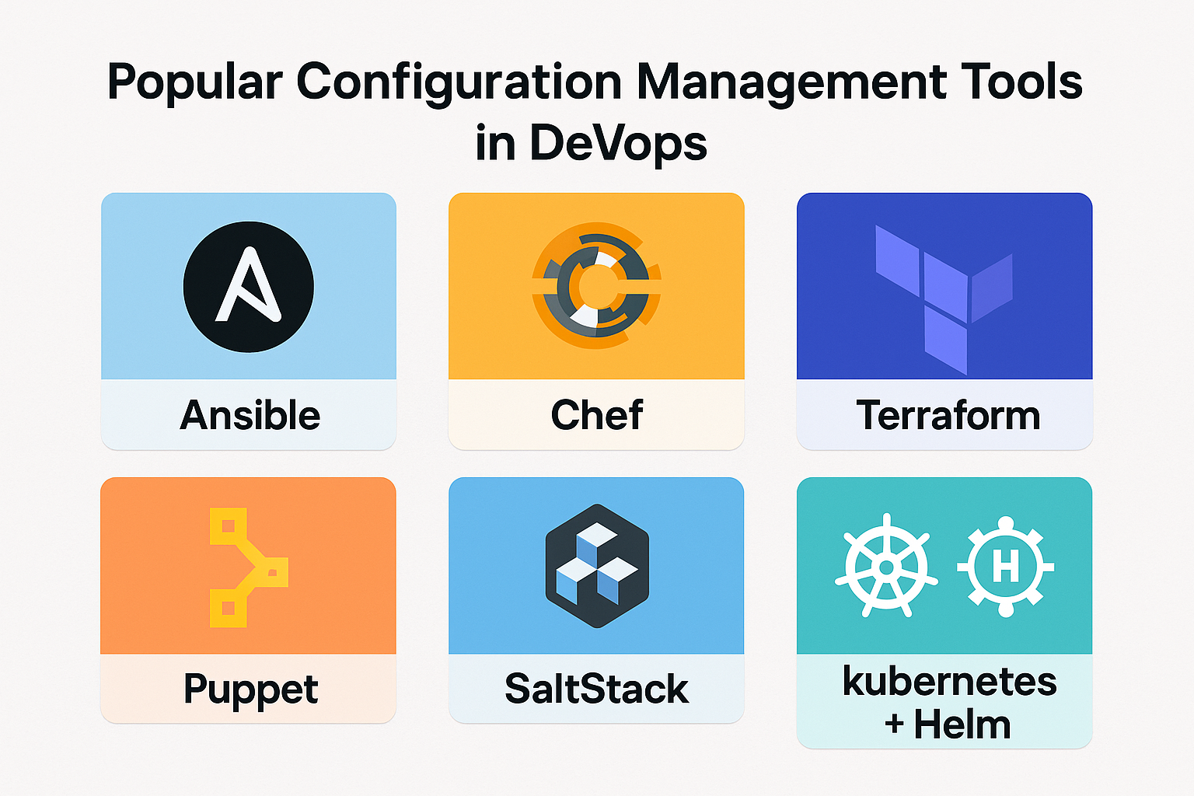

Slide 9
Tool | Description | Language | Use Case
Ansible | Agentless, simple syntax (YAML) | YAML | Provisioning, app deployment, configuration
Puppet | Model-driven, uses declarative DSL | Puppet DSL (Ruby-like) | Complex infrastructure, enterprise CM
Chef | Code-driven, good for complex configs | Ruby | Infrastructure automation, policy enforcement
SaltStack | Fast remote execution and CM | YAML + Jinja | Orchestration and configuration at scale
Terraform | Infrastructure provisioning (not CM strictly) | HCL | IaC to manage cloud infrastructure
Kubernetes + Helm | Manages container configurations | YAML | Declarative config for container orchestration
Notes:
Puppet DSL (Domain-Specific Language)
HCL (HashiCorp Configuration Language)

Slide 10
Configuration Management in DevOps Pipelines
Step-by-step Integration:
Define Infrastructure as Code (IaC): Use tools like Terraform or CloudFormation to describe infrastructure.
Set up Configuration Scripts: Define desired state using Ansible, Puppet, or Chef.
Store in Git: All scripts and configurations are version-controlled.
CI/CD Integration: Use Jenkins, GitLab CI, or GitHub Actions to apply configurations automatically on deploy.
Monitor and Audit: Tools like Prometheus, ELK Stack, or Datadog help track and audit changes.

Slide 11
Link
https://www.puppet.com/docs/puppet/6/puppet_overview#puppet_ecosystem

Slide 12
Configuration Models
Configuration management tools use two primary models to deploy configurations.
  Push
  Pull
These terms describe how configuration changes or updates are applied and distributed across infrastructure.

Slide 13
Push Models
Central control server pushes configurations to target machines/nodes.
Control server/CM tool initiates all communications
Target machines are passive recipients(server/client/nodes)
Examples: Ansible, SaltStack (can work in push mode)

Slide 14
Advantages :
  Immediate control over updates
  Easier to debug (direct command execution)
  No agent required (in Ansible)
Disadvantages:
  Network connectivity issues can block deployments
  Less scalable for large infrastructures
  Requires direct/open access to target systems (e.g., SSH)

Slide 15
Pull Model
Target machines/nodes periodically pulls its configuration or check the central server for updates
Target machines initiate the communication
Central server acts as a configuration repository
Examples: Puppet, Chef

Slide 16
Advantages :
  More scalable for large environments
  Nodes self-heal by periodically checking config
  More secure (central server doesn't need SSH access)
  More resilient to network issues
  Targets can work independently
  Better security (targets initiate connections)
Disadvantages:
  Delayed deployment (depends on pull interval)
  Less immediate control
  Slower to apply urgent changes
  Requires agents and proper scheduling

Slide 17
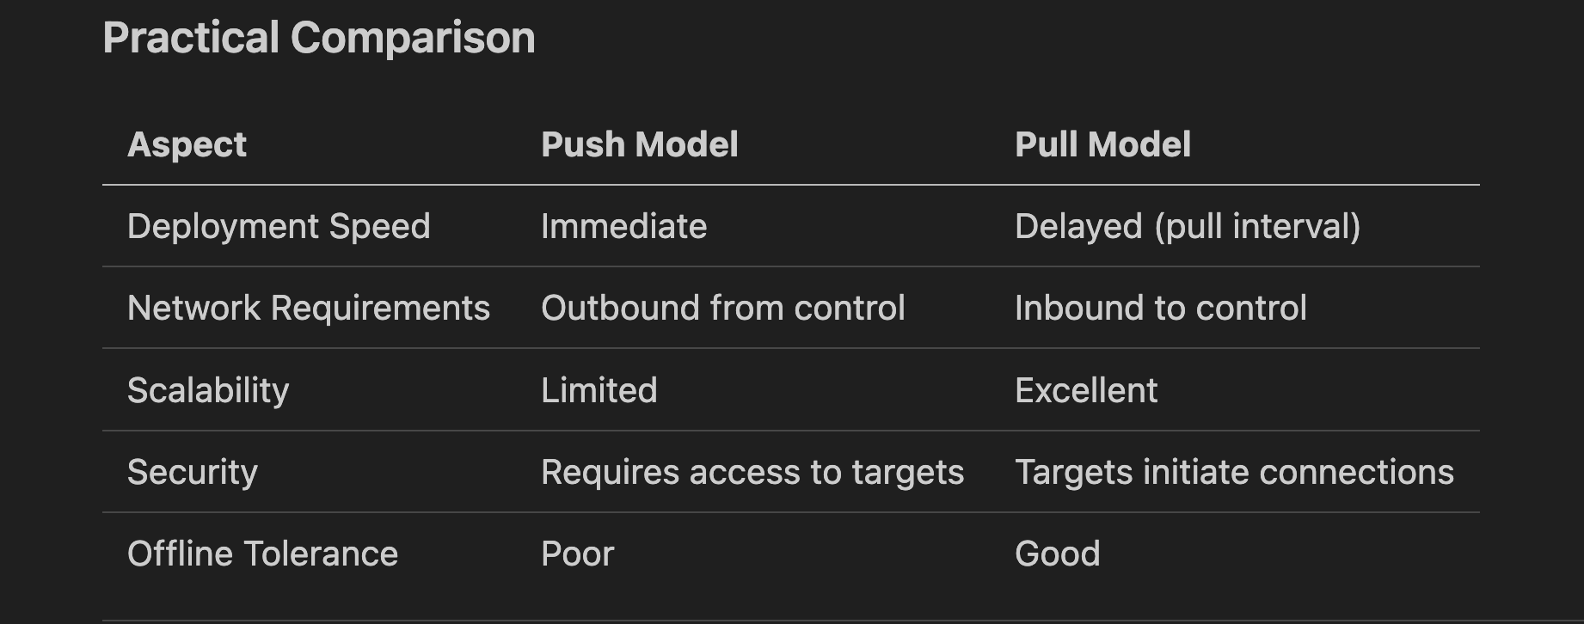

Slide 18
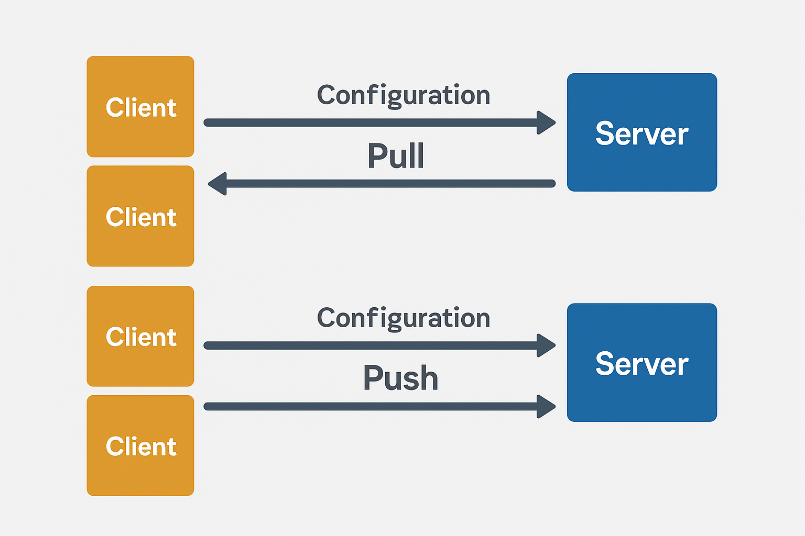

Slide 19
Example Scenario
Push: You want to quickly apply a patch to 10 servers — use Ansible to push it instantly.
Pull: You want 1,000 nodes to stay in a compliant state — use Puppet to have them pull and enforce policies every 30 minutes.

