Slide 1
Unit -1
Puppet Basic

Slide 2
Unit -1 Syllabus
Configuration Management System: Configuration Management,
Pull, Push,
Introduction to Puppet: Puppet, Why Puppet, Components of Puppet, Puppet Architecture: Puppet Master: Manifest, Template, Files, Certificate Authority, Puppet Clients: Agent, Facter, Installation of Puppet, Puppet Development in Isolation.

Slide 3
Puppet Workflow
  Agent requests catalog from Puppet Master
  Master compiles catalog based on manifests and node classification
  Master sends catalog to agent
  Agent applies catalog to local system
  Agent sends report back to master
Link :
  https://www.puppet.com/docs/puppet/5.5/puppet_index

Slide 4
Puppet Agent Configuration on Windows – Troubleshooting Connection to Puppet Master
┌────────────────────────┐ ┌────────────────────────┐
│ Puppet Master (Linux) <────> Puppet Agent (Windows)
└────────────────────────┘ └────────────────────────┘
Port 8140 open Communicates via SSL

Slide 5
Install Puppet Agent on Windows
Step 1: Download the Installer
Download the Puppet Agent for Windows from the official site:
https://downloads.puppet.com/windows/puppet-agent-x64-latest.msi

Slide 6
Step 2: Install Puppet Agent
Run the .msi installer.
During installation, choose default options.
Once installed, open Command Prompt (Admin) and verify:
puppet --version

Slide 7
Important Puppet Paths on Windows
Item | Path
Puppet conf | C:\ProgramData\PuppetLabs\puppet\etc\puppet.conf
SSL certs | C:\ProgramData\PuppetLabs\puppet\ssl\
Executables | C:\Program Files\Puppet Labs\Puppet\bin\

Slide 8
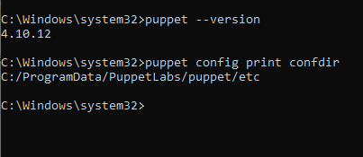
Check Puppet Config Path Dynamically
Run this to get where Puppet expects the config directory:
puppet config print confdir

Slide 9
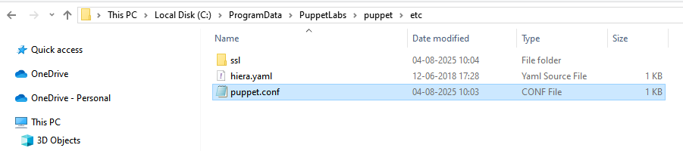
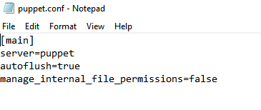

Slide 10
Directive | Description | Real-World Analogy
server=puppet | Specifies the hostname of the Puppet master server (e.g., puppet, puppet.example.com). The agent will communicate with this master. | 📞 “Call this number (server) for work instructions.”
autoflush=true | Forces Puppet to immediately flush logs and reports to disk instead of buffering them. Useful for real-time troubleshooting. | 💧 “Don't store logs in memory—write them instantly.”
manage_internal_file_permissions=false | Prevents Puppet from enforcing file permissions on internal files (like SSL certs). Useful on Windows to avoid file access issues. | 🔒 “Don’t change security settings—we’ll handle it ourselves.”

Slide 11
Real-World Analogy
server=puppet: “This is the boss’s phone number I call for work.”
autoflush=true: “I write down what I’m doing instantly — no waiting.”
manage_internal_file_permissions=false: “I don’t touch file locks — the OS handles it.”

Slide 12


Slide 13
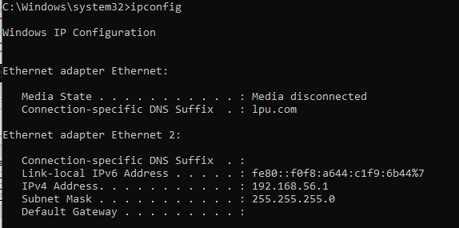

Slide 14
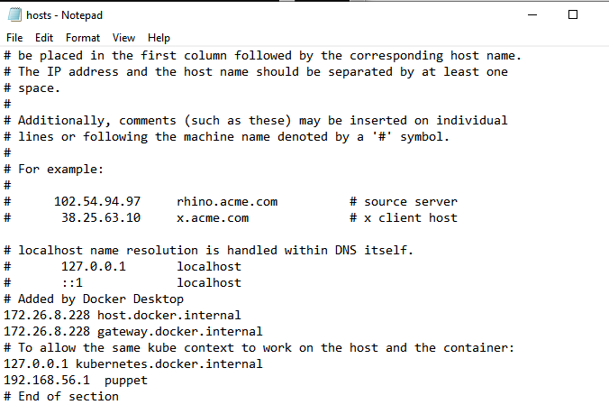

Slide 15
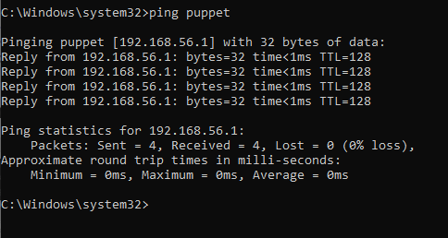

Slide 16
Important Note
Puppet Server (Master) is not supported natively on Windows as a master — it's officially designed to run on Linux systems only (e.g., Ubuntu, CentOS, RHEL).
Windows is supported only for Puppet Agent — not the Master.
So that's likely why nothing is listening on port 8140 — the Puppet Server isn't installed or isn't capable of running on Windows.

Slide 17
 | Installing Puppet Agent on Windows
 | Configuring puppet.conf and hosts File
 | Opening Firewall Port 8140 for Puppet Communication
 | Troubleshooting: Puppet Agent Cannot Connect to Master
 | Why Puppet Master Doesn’t Work on Windows
 | Recommended Setup: Puppet Master on Linux + Windows Agent

Slide 18
macOS Installation
# Using Homebrew
  brew tap puppetlabs/puppet
  brew install --cask puppetlabs/puppet/puppet-agent
After installation, ensure the path is set:
  export PATH=/opt/puppetlabs/bin:$PATH
Verify :
  puppet --version

Slide 19
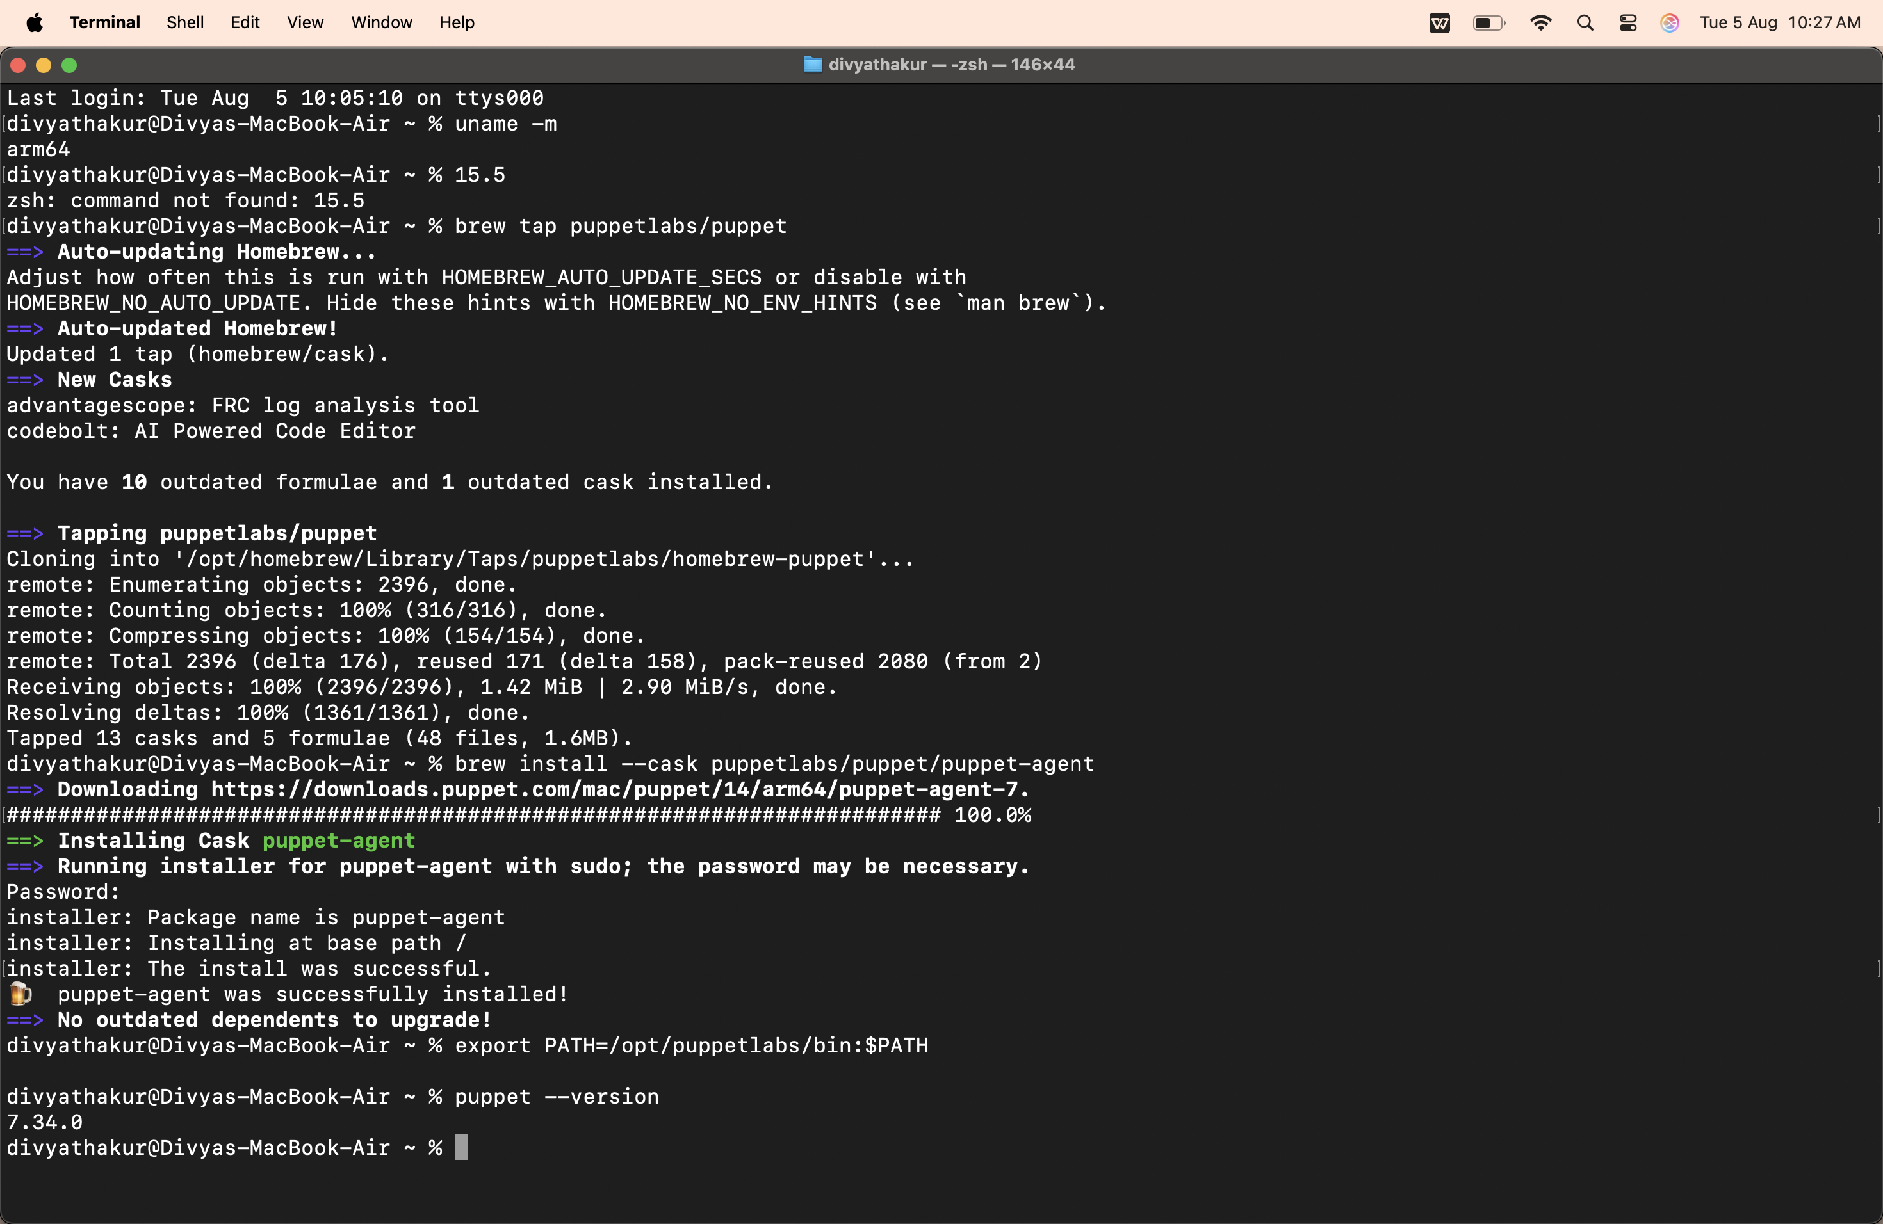

Slide 20
Puppet agent has been successfully installed in windows and mac .
Now to complete your setup, you’ll need to install a Puppet Master (Puppet Server).
The Puppet Master handles:
  Managing configurations (manifests, modules)
  Responding to agent requests over port 8140
  Certificate authority (CA) for agent SSL certificates
The Puppet Master is only supported on Linux — NOT on macOS or Windows.

Slide 21
Recommended Platforms for Puppet Server:
Ubuntu 20.04 / 22.04
Debian 10 / 11
RHEL / CentOS 7 / 8 / 9
Rocky / AlmaLinux (RHEL-compatible)

Slide 22
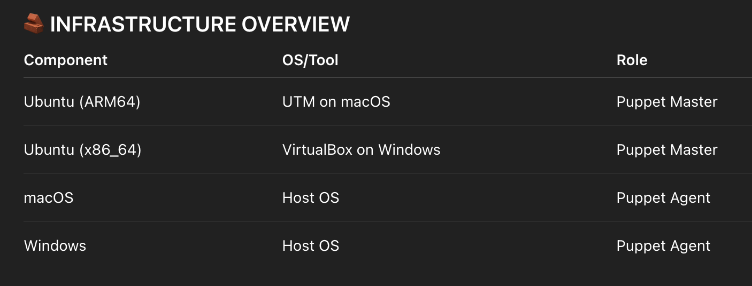
Puppet-master
install a virtual machine , and create a new virtual machine of ubuntu in which we will use puppet-master .
iso file for windows :
  https://ubuntu.com/download/desktop

Slide 23
Run this to get where Puppet expects the config directory(LOCAL):
  puppet config print confdir
on ubuntu (VM):
  sudo apt update
  sudo apt upgrade -y

Slide 24
To ssh in terminal
In VM :
  sudo apt update : to change password
  ls /home : check users
  sudo apt install openssh-server
  sudo systemctl enable ssh
  sudo systemctl start ssh
  sudo systemctl status ssh
On MacOS:
  ssh username@ipaddress
  change password : sudo passwd user or root

Slide 25
Installation of puppet master

Slide 26
# 1. Remove old Puppet completely
  sudo systemctl stop puppetserver
  sudo apt purge -y puppetserver puppet-agent puppet
  sudo rm -rf /etc/puppetlabs /opt/puppetlabs /var/log/puppetlabs /var/opt/puppetlabs
  sudo apt autoremove -y
  sudo apt clean
# 2. Install correct Java
  sudo apt install -y openjdk-17-jdk
  sudo update-alternatives --config java
# 3. Add Puppet 8 repository for Noble
  wget https://apt.puppet.com/puppet8-release-$(lsb_release -cs).deb
  sudo dpkg -i puppet8-release-$(lsb_release -cs).deb
  sudo apt update
# 4. Install Puppet Server
  sudo apt install -y puppetserver

Slide 27
# 5. Lower heap usage just to be safe
  sudo sed -i 's/Xms2g/Xms512m/; s/Xmx2g/Xmx512m/' /etc/default/puppetserver
# 6. Set hostname
  sudo hostnamectl set-hostname puppetmaster.example.com
  echo "127.0.0.1 puppetmaster.example.com puppetmaster" | sudo tee -a /etc/hosts
# 7. Start Puppet Server
  sudo systemctl daemon-reload
  sudo systemctl enable puppetserver
  sudo systemctl start puppetserver
  sudo systemctl status puppetserver

