Slide 1
Unit-2
Advanced Puppet

Slide 2
Syllabus
Puppet Configuration, Managing Packages in Puppet, Puppet Modules,
Monitoring Web Servers, Load Balancing Clusters, Scaling Puppet Environment, Connecting Puppet
Agent with Puppet Master, Making Configuration Dynamic, Extending Puppet, Puppet Classes and
Functions (including Custom Functions), Using Puppet via Command Line,
Managing Resources with puppet apply Command, Puppet Manifests.

Slide 3
Puppet Modules
A Puppet module is a self-contained unit of Puppet code that includes manifests, files, templates, and other resources to manage a particular system configuration or application.
Modules help you organize and reuse Puppet code by enabling you to split the code into several manifests.
Modules = reusable bundles of Puppet code. They group manifests, files, and templates.

Slide 4
Why use modules?
Reusability: Write once, use on multiple nodes.
Organization: Keep related configurations together.
Sharing: Puppet Forge allows you to use community modules.
Example use:
A module called apache can install Apache, start the service, and deploy a website file.

Slide 5
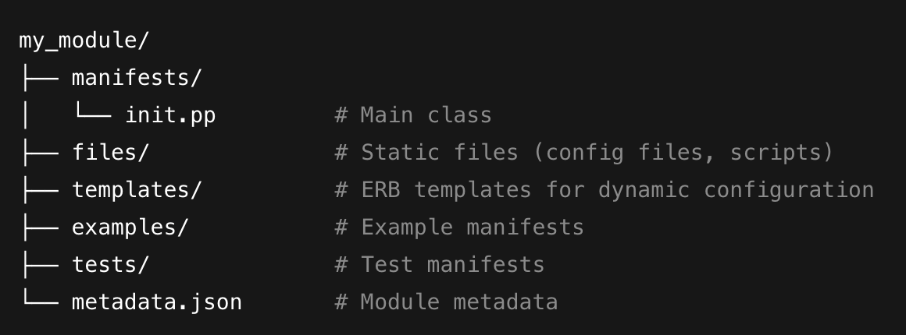
Puppet Module Structure
A typical Puppet module has this structure:
Explanation:
*my_module: module root folder
manifests/: Contains Puppet code (.pp). init.pp defines the main class.
files/: Static files you want to copy to nodes.
templates/: ERB templates for dynamic content.
metadata.json: Describes the module (name, author, dependencies).

Slide 6
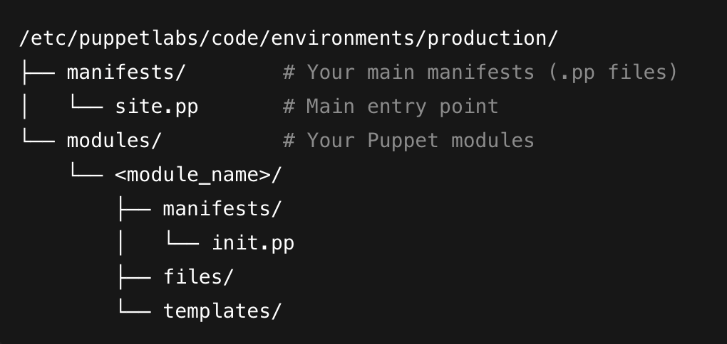
Puppet 8 uses the code directory:
Important: On Ubuntu, if these directories don’t exist, you can create them:
  sudo mkdir -p /etc/puppetlabs/code/environments/production/manifests
  sudo mkdir -p /etc/puppetlabs/code/environments/production/modules

Slide 7
Verify Puppet directories:
Puppet 8 uses this path for environments:
  /etc/puppetlabs/code/environments/production
Check if it exists:
  ls -l /etc/puppetlabs/code/environments
If environments or production doesn’t exist, create it:
  sudo mkdir -p /etc/puppetlabs/code/environments/production

Slide 8
Creating a Module in Puppet 8
Generate a module folder and sub folders :(apache module skeleton):
  sudo mkdir -p /etc/puppetlabs/code/environments/production/modules/apache/{manifests,files,templates}
  cd /etc/puppetlabs/code/environments/production/modules/apache
  ls
  if Permissions issue:
    sudo chown -R $USER:$USER /etc/puppetlabs/code/environments/production/modules
Generate a .pp file :
sudo touch /etc/puppetlabs/code/environments/production/modules/apache/manifests/init.pp

Slide 9
Add the class in init.pp :
            class webserver {
            package { 'nginx': ensure => installed }
            service { 'nginx': ensure => running, enable => true }
            }
Include in site.pp
    File path: /etc/puppetlabs/code/environments/production/manifests/site.pp
            include webserver
The webserver class ensures Nginx is installed/running across all nodes using the module.
Scenario
  A company runs multiple microservices. Each needs Nginx. Instead of repeating the same manifest, they just include the webserver module.

Slide 10
Create the Main Class (init.pp)(ubuntu only)
class apache {
# Install Apache package
package { 'apache2':
ensure => installed,
}
# Ensure service is running
service { 'apache2':
ensure => running,
enable => true,
require => Package['apache2'],
}
# Deploy a custom index.html from module files
file { '/var/www/html/index.html':
ensure => file,
source => 'puppet:///modules/apache/index.html',
require => Package['apache2'],
} }

Slide 11
Add a Static File (index.html)
  File path: /etc/puppetlabs/code/environments/production/modules/apache/files/index.html
  <h1>Welcome to My Apache Server</h1>
Include the Module in site.pp
  File path: /etc/puppetlabs/code/environments/production/manifests/site.pp
    node default {
    include apache
    }

Slide 12
Apply the Module on an Agent:
On the agent node:
  sudo puppet agent -t
Puppet contacts the master, compiles the catalog, and applies it:
  Installs Apache (apache2)
  Starts the service
  Copies index.html

Slide 13
Make your module for macOS
class apache_macos {
# macOS ships Apache (httpd) by default
service { 'org.apache.httpd':
ensure => running,
enable => true,
provider => launchd,
}
file { '/Library/WebServer/Documents/index.html':
ensure => file,
source => 'puppet:///modules/apache/index.html',
}
}

Slide 14
Make your module for Windows
class apache_windows {
# Requires Chocolatey to be installed on the Windows agent
package { 'apache-httpd':
ensure => installed,
provider => chocolatey,
}
service { 'Apache2.4':
ensure => running,
enable => true,
require => Package['apache-httpd'],
}
file { 'C:/Apache24/htdocs/index.html':
ensure => file,
source => 'puppet:///modules/apache/index.html',
require => Package['apache-httpd'],
}
}

Slide 15
Assign the right class in site.pp based on node names:
node 'ubuntu-agent' {
include apache
}
node 'macos-agent' {
include apache_macos
}
node 'windows-agent' {
include apache_windows
}

Slide 16
A single file for all three os .
class apache {
case $facts['os']['family'] {
'Debian': {
package { 'apache2':
ensure => installed,
}
service { 'apache2':
ensure => running,
enable => true,
require => Package['apache2'],
}
file { '/var/www/html/index.html':
ensure => file,
source => 'puppet:///modules/apache/index.html',
require => Package['apache2'],
}
}

Slide 17
cont ..
'Darwin': {
service { 'org.apache.httpd':
ensure => running,
enable => true,
provider => launchd,
}
file { '/Library/WebServer/Documents/index.html':
ensure => file,
source => 'puppet:///modules/apache/index.html',
}
}

Slide 18
cont..
'Windows': {
package { 'apache-httpd':
ensure => installed,
provider => chocolatey, }
service { 'Apache2.4':
ensure => running,
enable => true,
require => Package['apache-httpd'], }
file { 'C:/Apache24/htdocs/index.html':
ensure => file,
source => 'puppet:///modules/apache/index.html',
require => Package['apache-httpd'],
} }
default: {
fail("Apache is not supported on ${facts['os']['family']}")
} }}

Slide 19
How this works:
Puppet will detect the agent OS automatically using facts['os']['family'].
Depending on the OS family, it will:
Ubuntu/Debian → install apache2, configure /var/www/html/.
macOS → enable built-in Apache, configure /Library/WebServer/Documents/.
Windows → install Apache via Chocolatey, configure C:/Apache24/htdocs/.
You only need to include apache in your node definition (no separate files).

Slide 20
site.pp
node default {
include apache
}
Now, when you run the agent:
  On Ubuntu → it applies the Debian block.
  On macOS → it applies the Darwin block.
  On Windows → it applies the Windows block.

Slide 21
Open a browser on your Mac and go to http://localhost/ — you should see your Puppet-managed index.html.

