Slide 1
CSE 493
LINUX SYSTEM ADMINISTRATION

Slide 2
Unit I
Accessing the command line : Accessing command line using local console, Accessing command line using desktop, Executing commands using bash shell
Managing Files From the Command Line : The Linux File System Hierarchy, Locating Files by Name, Managing Files Using Command-Line Tools, Matching File Names Using Path Name Expansion, Managing Files with Shell Expansion
Getting Help in Red Hat Enterprise Linux : Reading Documentation Using man Command,
Reading Documentation Using pinfo Command, Reading Documentation in /usr/share/doc, Getting
Help From Red Hat
Creating, Viewing, and Editing Text Files : Redirecting Output to a File or Program, Editing Text
Files from the Shell Prompt, Editing Text Files with a Graphical Editor
Managing Local Linux Users and Groups : Users and Groups, Gaining Superuser Access,
Managing Local User Accounts, Managing Local Group Accounts, Managing User Passwords

Slide 3


CSE 493: LINUX System Administration
WHAT IS LINUX?
Linux® is an open source operating system (OS) created by Linus Torvalds in 1991. Today, it has a massive user base, and is used in the world’s 500 most powerful supercomputers. Users gravitate toward it for its versatility and security capabilities, among other reasons.
Creation

Slide 4
CSE 493: LINUX System Administration
WHY SHOULD YOU LEARN ABOUT LINUX ?
You are probably already interacting with Linux systems in your daily life
Linux is a critical technology for IT professionals to understand
In application development, Linux hosts the application or its runtime.
In cloud computing, the cloud instances in the private or public cloud environment use Linux as the operating system.
With mobile applications or the Internet of Things (IoT), the chances are high that the operating system of your device uses Linux.
If you are looking for new opportunities in IT, Linux skills are in high demand.
.

Slide 5

CSE 493: LINUX System Administration

Slide 6


CSE 493: LINUX System Administration
Accessing the command line
OBJECTIVES
After completing this section, you should be able to log in to a Linux system and run simple commands using the shell.
INTRODUCTION TO THE BASH SHELL :
A command line is a text-based interface which can be used to input instructions to a computer system. The Linux command line is provided by a program called the shell
When a shell is used interactively, it displays a string when it is waiting for a command from the user. This is called the shell prompt. When a regular user starts a shell, the default prompt ends with a $ character, as shown below :
Can you Spot the difference over here?

Slide 7
CSE 493: LINUX System Administration
Root User | Regular User
1. Full Access: Can access and modify every file and folder in the system. | Limited Access: Can access only their own files and permitted resources.
2. Administrative Tasks: Can install software, create/delete users, and change system settings. | Cannot perform administrative tasks unless given permission using sudo.
3. Prompt Symbol: The terminal prompt ends with #. Example: root@ubuntu:~# | Prompt Symbol: The terminal prompt ends with $. Example: User@ubuntu:~$
4. Risk Level: A wrong command can damage the entire operating system. | Safer: Mistakes usually affect only the user's own files and account.

Slide 8
CSE 493: LINUX System Administration
SHELL BASICS
Commands entered at the shell prompt have three basic parts:
• Command to run
• Options to adjust the behavior of the command.
• Arguments, which are typically targets of the command
E.g Usermod -L user01
command
Options Arguments

Slide 9
CSE 493: LINUX System Administration
LOGGING IN TO A LOCAL COMPUTER
To run the shell, you need to log in to the computer on a terminal. A terminal is a text-based interface used to enter commands into and print output from a computer system. There are several ways to do this.
Physical Console
Directly connected keyboard + monitor plugged into the machine
Virtual Consoles (tty1–tty6)
One physical console → 6 independent login sessions Switch between them: Ctrl+Alt+F1 to F6
Two Types of Logins
Console | Type | What You Get
tty1 | Graphical login screen | Desktop environment
tty2–tty6 | Text login prompt | Shell prompt directly

Slide 10
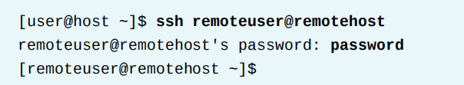
CSE 493: LINUX System Administration
LOGGING IN OVER THE NETWORK
Linux users and administrators often need to get shell access to a remote system by connecting
to it over the network. In a modern computing environment, many headless servers are actually
virtual machines or are running as public or private cloud instances
The most common way to get a shell prompt on a remote system is to use Secure Shell (SSH).
The ssh command encrypts the connection to secure the communication against eavesdropping or hijacking of the passwords and content.
LOGGING OUT : When you are finished using the shell and want to quit Ctrl +D

Slide 11
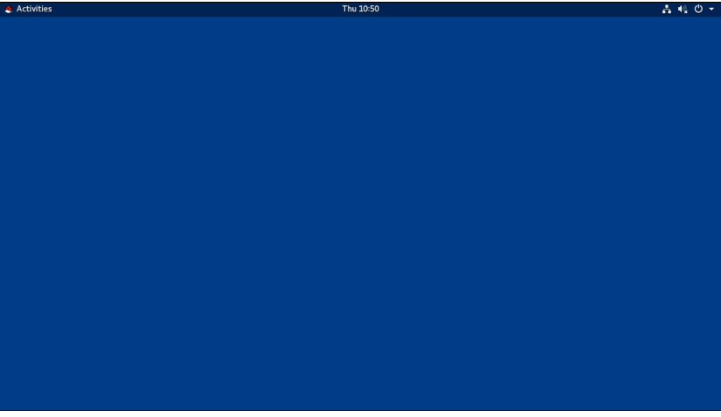
CSE 493: LINUX System Administration
ACCESSING THE COMMAND LINE USING THE DESKTOP
The desktop environment is the graphical user interface on a Linux system. The default desktop environment in Red Hat Enterprise Linux 8 is provided by GNOME 3. It provides an integrated desktop for users and a unified development platform on top of a graphical framework provided by either Wayland (by default) or the legacy Window System.
GNOME Shell is the main interface of the GNOME desktop — and it's customizable.
RHEL 8 uses the "Standard" theme by default; RHEL 7 used "Classic" (older GNOME look).
To switch themes: click the gear icon ⚙️ next to "Sign In" — before entering your password.
Your chosen theme is saved and used every time you log in.
You can quickly start GNOME Help by clicking the Activities button on the left side of the top bar, and in the dash that appears on the left side of the screen, clicking the life ring buoy icon to launch it.
Empty GENOME Desktop

Slide 12
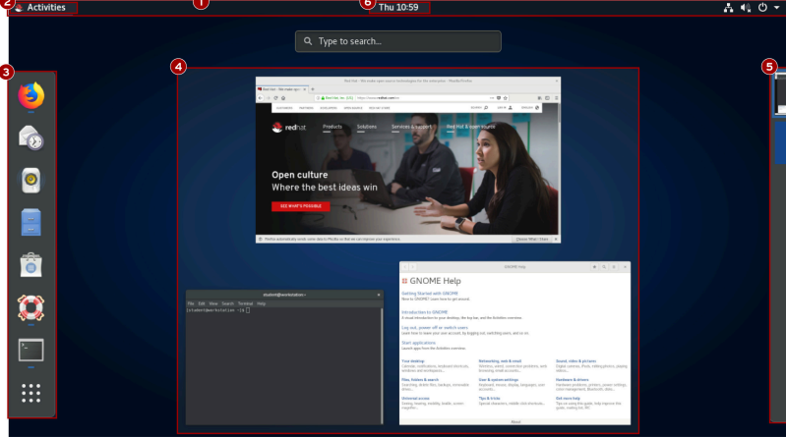
CSE 493: LINUX System Administration
ACCESSING THE COMMAND LINE USING THE DESKTOP

Slide 13
CSE 493: LINUX System Administration
ACCESSING THE COMMAND LINE USING THE DESKTOP
Top Bar: The bar at the top of the screen that provides access to Activities, system status, settings, notifications, and user options.
Activities Overview: A mode for launching applications, viewing open windows, and managing workspaces.
Dash (Dock): A sidebar containing favorite apps, running applications, and the Applications Grid button. Windows Overview: Displays thumbnails of all open windows in the current workspace for easy switching and organization.
Workspace Selector: Shows available workspaces and allows you to switch between them or move windows across workspaces.

Slide 14
CSV 401: System Monitoring
WORKSPACES
Workspaces are separate desktop screens that have different application windows. These can be used to organize the working environment by grouping open application windows by task. For example, windows being used to perform a particular system maintenance activity (such as setting up a new remote server) can be grouped in one workspace, while email and other communication applications can be grouped in another workspace.
There are two simple methods for switching between workspaces. One method, perhaps the fastest, is to press Ctrl+Alt+UpArrow or Ctrl+Alt+DownArrow to switch between workspaces sequentially. The second is to switch to the Activities overview and click the desired
workspace.

Slide 15
CSV 401: System Monitoring
STARTING A TERMINAL
To get a shell prompt in GNOME, start a graphical terminal application such as GNOME Terminal.
There are several ways to do this. The two most commonly used methods are listed below:
• From the Activities overview, select Terminal from the dash (either from the favorites area or by
finding it with either the grid button (inside Utilities grouping) or the search field at the top of
the windows overview).
• Press the Alt+F2 key combination to open the Enter a Command and enter gnome-terminal.
LOCKING THE SCREEN OR LOGGING OUT
To lock the screen, from the system menu in the upper-right corner, click the lock button at the
bottom of the menu or press Super+L (which might be easier to remember as Windows+L).

Slide 16
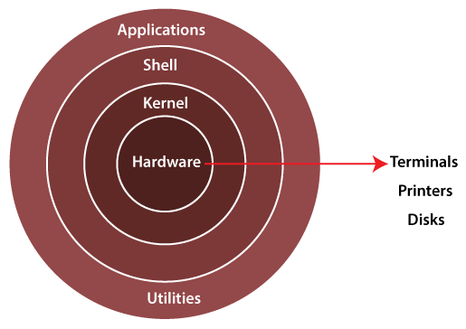
CSV 401: System Monitoring
EXECUTING COMMANDS USING THE BASH SHELL
Kernel is the core component of the Linux operating system that sits between the hardware and user space, managing system resources and ensuring smooth communication between software and hardware.
Shell and Utilities
Command interpreter: A user interface (such as Bash ) that accepts text commands and passes them along to be executed.
System tools: Small programs used by administrators to configure, monitor, and maintain the system
Programs: The topmost layer where user-facing software, office tools, and graphical or command-line programs run isolated from direct hardware access for enhanced stability
Linux Architecture

Slide 17
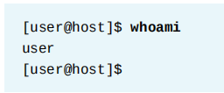

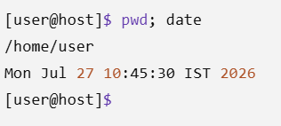
CSV 401: System Monitoring
EXECUTING COMMANDS USING THE BASH SHELL
If you want to type more than one command on a single line, use the semicolon (;) as a command separator
whoami: Displays the username of the currently logged-in user.
Output: user → The current logged-in user's username is user.
Simple Example

Slide 18
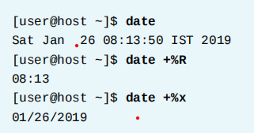
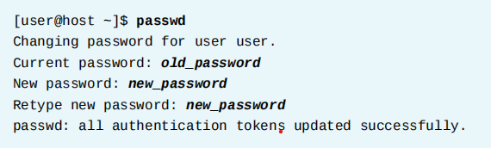
CSV 401: System Monitoring
EXECUTING COMMANDS USING THE BASH SHELL
The date command displays the current date and time. It can also be used by the superuser to set the system clock. An argument that begins with a plus sign (+) specifies a format string for the date command.
The passwd command changes a user's own password. The original password for the account must be specified before a change is allowed. The superuser can use the passwd command to change other users' passwords

Slide 19
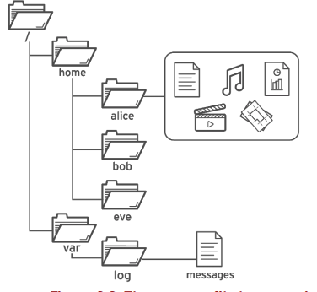
CSV 401: System Monitoring
Absolute Path vs Relative Path

Slide 20
CSV 401: System Monitoring
Absolute Path vs Relative Path
Feature | Absolute Path | Relative Path
1. Starting Point | Starts from the root directory (/) | Starts from your current working directory
2. Begins With | Always begins with / | Never starts with /. It may start with ./, ../, or a folder name.
3. Depends on Current Location? | No. It works from anywhere in the filesystem. | Yes. It only works correctly if you are in the expected current directory.
4. Example | /home/student/Documents/report.txt | Documents/report.txt, ../Documents/report.txt, ./report.txt

Slide 21
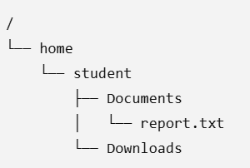
CSV 401: System Monitoring
Absolute Path vs Relative Path
Suppose your current directory is Downloads
-> To open report.txt
Absolute Path will be -> cat /home/student/Documents/report.txt
Relative Path will be -> cat ../Documents/report.txt (..) Why?? Because you are currently in Downloads

Slide 22
CSV 401: System Monitoring
Frequently used Commands
ls | Lis the contents of the fie | ls ,ls –l , ls -a
cd | Changes the current working directory. | cd /home/user/projects
pwd | Displays the full path of the current working directory. | pwd
mkdir | Creates a new directory. | mkdir my_project
rm | Removes files or directories. Use -r for directories. | rm file.txt or rm -r old_folder
cp | Copies files or directories from one location to another. | cp file.txt backup.txt
mv | Moves or renames files and directories. | mv old.txt new.txt
cat | Displays the contents of a file or combines multiple files. | cat README.md

Slide 23
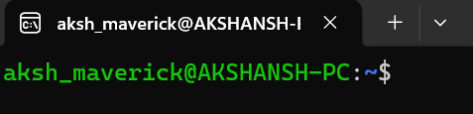
aksh_maverick → Current logged-in user.
AKSHANSH-PC → Computer (host) name.
~ → Current directory is the user's home directory.
$ → Indicates a normal user shell is ready to accept commands.
Description
Command Line

Slide 24
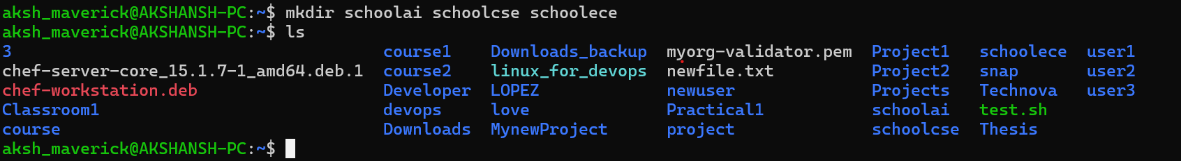
Command Line
Description
Command/Action | Description
mkdir schoolai schoolcse schoolece | Creates three directories (schoolai, schoolcse, and schoolece) in a single command.
ls | Lists all files and directories in the current working directory (~).

Slide 25
Command Line
Description
Command/Action | Description
mkdir schoolai schoolcse schoolece | Creates three directories (schoolai, schoolcse, and schoolece) in a single command.
ls | Lists all files and directories in the current working directory (~).

Slide 26
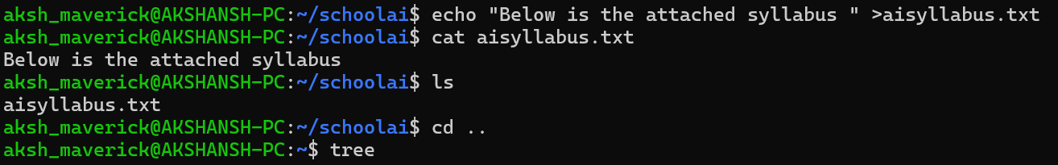
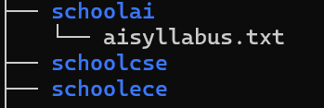
Command/Action | Description
echo "Below is the attached syllabus" > aisyllabus.txt | Creates a new file named aisyllabus.txt and writes the given text into it, replacing any existing content.
cat aisyllabus.txt | Displays the contents of the aisyllabus.txt file on the terminal, confirming the text was written successfully.
ls and cd .. | ls lists the file in the current directory, while cd .. moves one level up to the parent directory before running tree to view the directory structure.
Tree Structure like
display

Slide 27
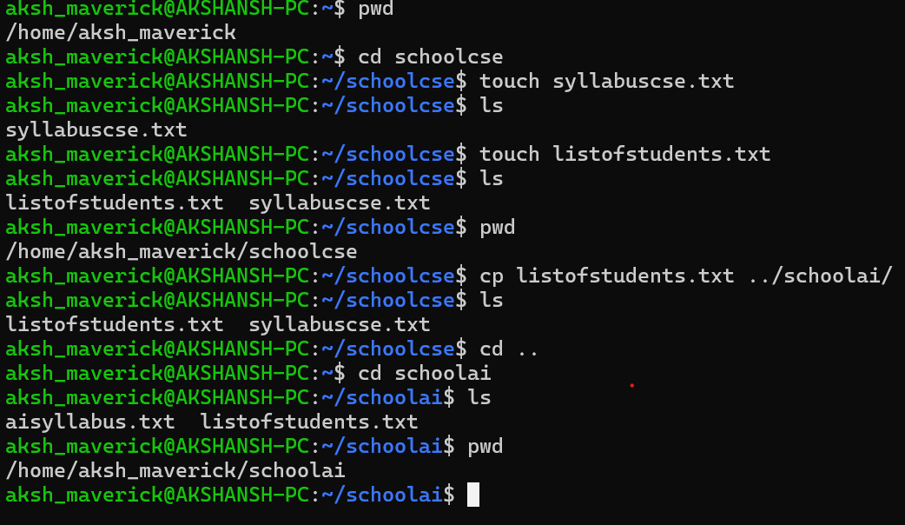
Step | Description
1. Navigate and create files | The user checks the current directory using pwd, enters the schoolcse directory, and creates two files: syllabuscse.txt and listofstudents.txt using the touch command.
2. Verify the files | The ls command is used to confirm that both files have been successfully created in the schoolcse directory.
3. Copy file using a relative path | The command cp listofstudents.txt ../schoolai/ copies the listofstudents.txt file from schoolcse to the sibling directory schoolai using the relative path ../schoolai/.
4. Confirm the copy | The user navigates to the schoolai directory and uses ls and pwd to verify that listofstudents.txt has been copied successfully and to display the current directory path.

Slide 28
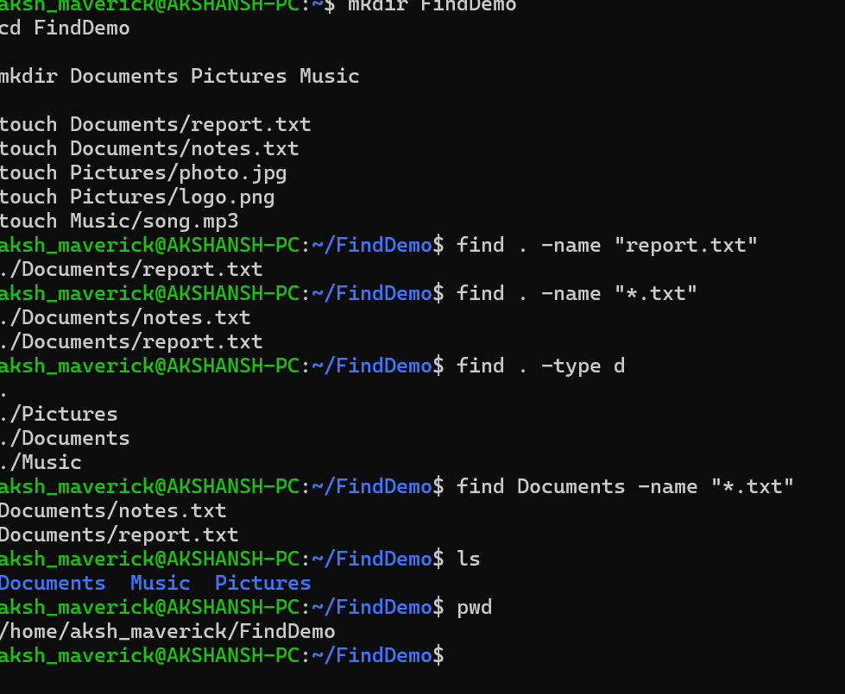
Option | Meaning | Example
. | Search from the current directory. | find . -name "*.txt"
-name | Search by file or directory name. | find . -name "report.txt"
"*.txt" | * matches any number of characters before .txt. | notes.txt, report.txt
-type f | Search only for regular files. | find . -type f
-type d | Search only for directories. | find . -type d

Slide 29
Scenario
You have recently joined LPU Solutions as a Junior Linux System Administrator.
The company has started a new software development project, but the project workspace is not yet organized. Your team lead has assigned you the responsibility of setting up the directory structure, managing files, organizing departmental data, locating important documents, and cleaning up unnecessary files using only Linux command-line tools.
Task 1
Verify your current working directory and examine the existing contents.
Task 2
Create a directory structure for the following departments:
HR Sales IT Finance Projects
Task 3
Create the required files for each department according to their work responsibilities.
Task 4
Insert appropriate sample data into all text files and verify the contents.
Task 6
Copy selected files from one department to another while keeping the original files unchanged.
Task 7
Locate specific files whose locations are unknown without manually browsing the directory structure.
Task 8
Delete unnecessary files, remove empty directories, and clean up obsolete project folders.

Slide 30
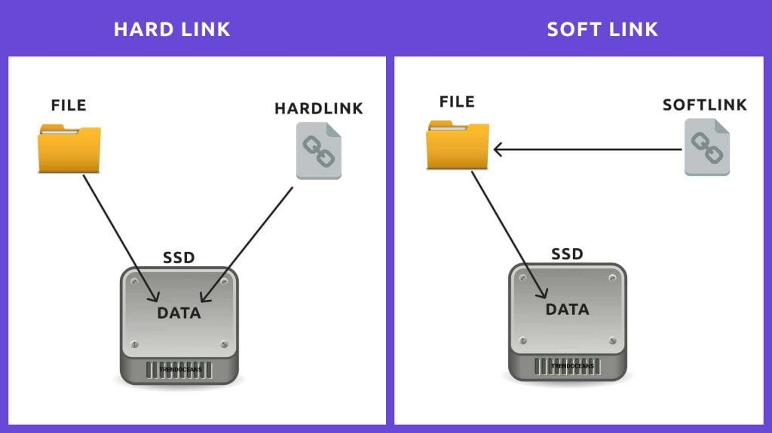
What are Hard Links and Soft Links in Linux
Hard Link
The concept of a hard link is the most basic we will discuss today. Every file on the Linux filesystem starts with a single hard link. The link is between the filename and the actual data stored on the filesystem
How to Create a Hard Link
aksh_maverick@AKSHANSH-PC: echo “text” >file_name.txt
aksh_maverick@AKSHANSH-PC: ln file_name.txt file_name2.txt
If you edit one file ?
The changes will be reflected in both files
Now comes the concept of Inode
Since both are pointing to the same file they will have same inode number

Slide 31
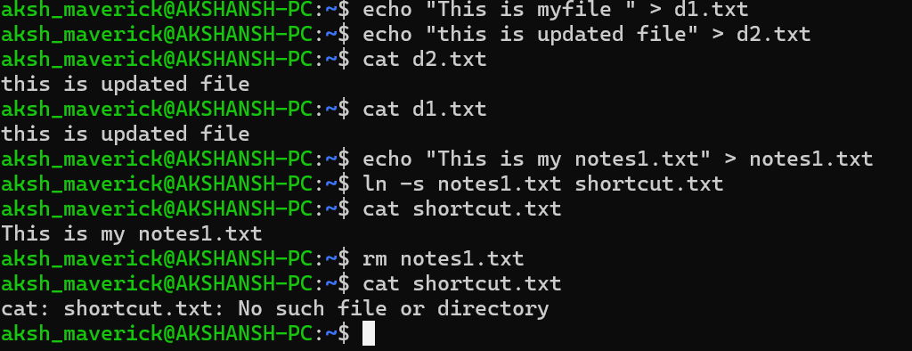
What are Hard Links and Soft Links in Linux
Soft Link
A soft link in Linux is a special file that acts as a shortcut by pointing to the text path of another file or directory. Unlike a hard link, it has a unique inode number and can cross different file systems, but it breaks if the original file is deleted (ln -s file_name link_name)
How to Create a soft Link?

Slide 32
What is the difference betweem Hard Links and Soft Links in Linux
Feature | Hard Link | Soft Link (Symbolic Link)
Concept | Another name for the same file. | A shortcut that stores the path to the original file.
If Original File is Deleted | Still works because the data is still accessible through the hard link. | Becomes a broken (dangling) link because the target file no longer exists.
Directories | Cannot normally be created for directories. | Can be created for both files and directories.
Different File Systems | Cannot be created across different file systems or partitions. | Can be created across different file systems or partitions.

Slide 33
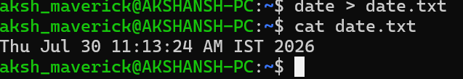
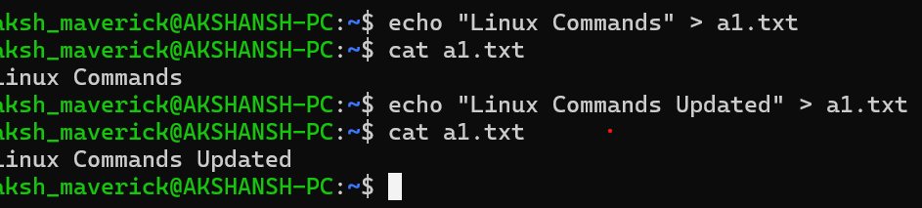
What is Output Redirection?
Normally, every command displays its output on the terminal.
What if I want to save its output?
Rule 1: > Overwrite
If the file already exists, its old content is deleted and replaced.

Slide 34
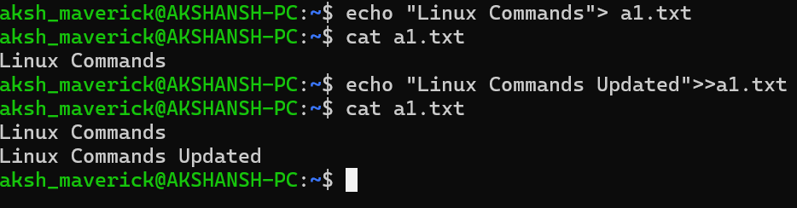
What is Output Redirection?
Normally, every command displays its output on the terminal.
Rule 2: >> Append
Adds new data to the end.

Slide 35
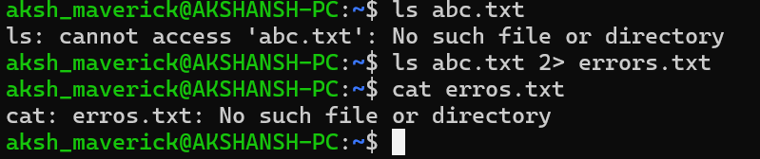
What is Output Redirection?
Normally, every command displays its output on the terminal.
Rule 3: 2> Store Errors
This stores errros in a file.

Slide 36
What is Pipeline?
A pipeline sends the output of one command directly as the input of another command. Denoted by symbol (|)
Why Do We Need Pipelines?
Scenario : Suppose you have 500 files. Someone asks you Just tell me how many files are there
Your Approach
Run Command ls and count manually
Using Pipeline :
ls | wc -l

Slide 37

What is Pipeline?
Find Only HR Employees
Suppose employees.txt contains:
Rahul HR
Priya Sales
Aman IT
Neha HR
Some one Asks?
"Show me only HR employees.“
cat employees.txt | grep HR

Slide 38
Scenario
You have joined LPU solutions. as a Junior Linux System Administrator. Your Team Lead has assigned you a practical test to evaluate your Linux command-line skills
Part 1 – Hard Link
Create a hard link of employees.txt inside the backup directory.
Verify that both files point to the same inode.
Part 2 - Soft Link
Create a symbolic (soft) link of budget.txt inside the reports directory.
Verify that the symbolic link has been created successfully.
Part 3 – Input and Output Redirection
Save the current date and time into a file named daily_report.txt.
Append the current logged-in user's name to the same file.
Part 4 – Pipelines
Display only the lines containing the word ERROR from server.log.

Slide 39
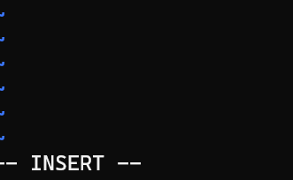
EDITING TEXT FILES FROM THE SHELL PROMPT
A key design principle of Linux is that information and configuration settings are commonly stored in text-based files. These files can be structured in various ways, as lists of settings, as structured XML or YAML, and so on. However, the advantage of text files is that they can be viewed and edited using any simple text editor
EDITING FILES WITH VIM
Edit configuration files: Use a text editor directly from a text-only shell to create, modify, and save text-based configuration files.
Work on local or remote systems: Edit files efficiently from a terminal window or during remote administration using SSH or the Web Console, even without a graphical interface.
Command Mode (Default Mode)
2. Insert Mode ( I )
When you Press I you get to type becomes textNote – When you finish Press ESC to get back to command mode
.

Slide 40
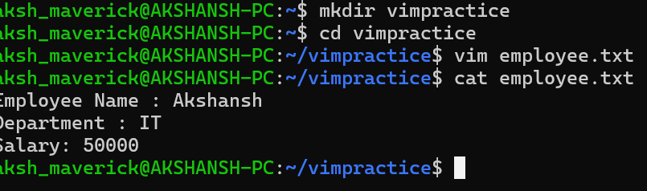
3. Visual Mode (V)
Then you can
->Copy
->Delete
->Move
Character selection : Shift +V
Whole line selection : Ctrl+V
4. Extended Command Mode
Save - :w
Quit - :q
Save and quit - :wq

Slide 41
CHANGING THE SHELL ENVIRONMENT
USING SHELL VARIABLES
Shell variables are used to store values (such as text, paths, or numbers) that can be reused in commands or to change the shell's behavior.
They help reduce typing by storing long commands or frequently used values.
A shell variable exists only in the current shell session.
If you open another terminal or log in again, it gets a separate shell with its own set of shell variables.
You can export a shell variable to make it an environment variable, which is automatically passed to programs started from that shell.

Slide 42
Assigning Values to Variables
You can create a shell variable by using the syntax:
VARIABLE_NAME=value
Viewing All Shell Variables
set
Since the output is very long, it is commonly used with less
set | less

Slide 43
Shell Variables → Used only by Bash (the shell).
Environment Variables → Used by Bash and all programs launched from Bash.
What is a Shell Variable ?
NAME=VARIABLE_NAME
echo $NAME
Output =NAME
Only Bash knows this variable

Slide 44
What is an Environment Variable?
Suppose you want other programs (like Python, Vim, Git, etc.) to also know this variable.
Then export it.
export NAME ->Syntax
Now every program started from this terminal can also access NAME
Why do we need Environment Variables?
Many programs look for certain variables to decide how they should work.
HOME
Run : echo $HOME
/home/name ---- Output
When a program wants to save your settings, it asks:
"Where is the user's home folder?"
It checks the HOME variable.

Slide 45
What is an Environment Variable?
2. EDITOR
Suppose a program wants to open a text editor.
How does it know which editor you prefer?
RUN : export EDITOR=vim
Now programs that use the EDITOR variable will open Vim
3. PATH
Suppose you type
Run : ls
How does Linux know where ls is
It checks the PATH variable.
/usr/local/bin Meaning -> This means:Search for commands in these folders.
/usr/local/bin . Where ls finds it runs it

Slide 46
MANAGING LOCAL USERS AND GROUPSNG LOCAL USERS AND
GROUPS
DESCRIBING USER AND GROUP CONCEPTS
WHAT IS A USER?
A user account is used to provide security boundaries between different people and programs that can run commands.
The system distinguishes user accounts by the unique identification number assigned to them, the user ID or UID
Every process (running program) on the system runs as a particular user.
Super User
System User
Regular User

Slide 47


MANAGING LOCAL USERS AND GROUPSNG LOCAL USERS AND
GROUPS
DESCRIBING USER AND GROUP CONCEPTS
To view information about the current user that is logged in

Slide 48
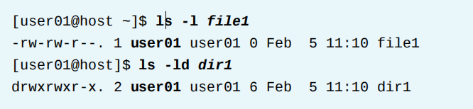
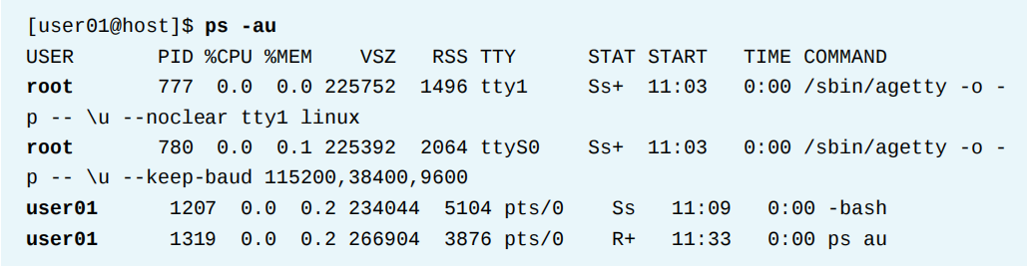
MANAGING LOCAL USERS AND GROUPSNG LOCAL USERS AND
GROUPS
DESCRIBING USER AND GROUP CONCEPTS
To view the owner of a file use the ls -l command. To view the owner of a directory use the ls - ld command
To view process information, use the ps command. The default is to show only processes in the current shell. Add the a option to view all processes with a terminal. To view the user associated with a process, include the u option

Slide 49
MANAGING LOCAL USERS AND GROUPSNG LOCAL USERS AND
GROUPS
DESCRIBING USER AND GROUP CONCEPTS
To view the owner of a file use the ls -l command. To view the owner of a directory use the ls - ld command
To view process information, use the ps command. The default is to show only processes in the current shell. Add the a option to view all processes with a terminal. To view the user associated with a process, include the u option

