Slide 1
CSV 493
LINUX SYSTEM ADMINSTRATION

Slide 2
Unit - II
Controlling Access to Files with Linux File System Permissions : Linux File System Permissions,
Managing File System Permissions from the Command Line, Managing Default Permissions and File
Access
Monitoring and Managing Linux Processes : Processes, Controlling Jobs, Killing Processes,
Monitoring Process Activity
Controlling Services and Daemons : Identifying Automatically Started System Processes,
Controlling System Services
Configuring and Securing OpenSSH Service : Accessing the Remote Command Line with SSH,
Configuring SSH Key-based Authentication, Customizing SSH Service Configuration
Analyzing and Storing Logs : System Log Architecture, Reviewing Sys log Files, Reviewing systemd
Journal Entries, Preserving the systemd Journal, Maintaining Accurate Time

Slide 3
CONTROLLING ACCESS TO FILESTROLLING ACCESS TO
FILES
File permissions control access to files. The Linux file permissions system is simple but flexible, which makes it easy to understand and apply, yet still able to handle most normal permission cases easily.
Files have three categories of user to which permissions apply. The file is owned by a user, normally the one who created the file. The file is also owned by a single group, usually the primary group of the user who created the file, but this can be changed.
The most specific permissions take precedence. User permissions override group permissions, which override other permissions

Slide 4
CONTROLLING ACCESS TO FILESTROLLING ACCESS TO
FILES
Effects of Permissions on Files and Directories
Permission | Effect on Files | Effect on Directories
r (Read) | Contents of the file can be read. | Contents of the directory (the file names) can be listed.
w (Write) | Contents of the file can be changed. | Files in the directory can be created, deleted, or renamed (provided the user also has execute (x) permission on the directory).
x (Execute) | File can be executed as a command or program. | Directory can be accessed. You can cd into the directory, access its files, and retrieve information about them (subject to the files' own permissions).

Slide 5

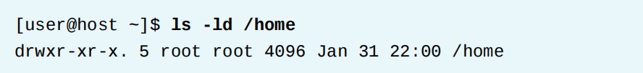
CONTROLLING ACCESS TO FILESTROLLING ACCESS TO
FILES
VIEWING FILE AND DIRECTORY PERMISSIONS AND OWNERSHIP
The -l option of the ls command shows more detailed information about file permissions and ownership
The first character of the long listing is the file type. You interpret it like this:
• - is a regular file.
• d is a directory.
• l is a soft link.

Slide 6
CONTROLLING ACCESS TO FILESTROLLING ACCESS TO
FILES
VIEWING FILE AND DIRECTORY PERMISSIONS AND OWNERSHIP
The -l option of the ls command shows more detailed information about file permissions and ownership
The first character of the long listing is the file type. You interpret it like this:
• - is a regular file.
• d is a directory.
• l is a soft link.

Slide 7

CONTROLLING ACCESS TO FILESTROLLING ACCESS TO
FILES
VIEWING FILE AND DIRECTORY PERMISSIONS AND OWNERSHIP
Changing Permissions with the Symbolic Method
• Who is u, g, o, a (for user, group, other, all)
• What is +, -, = (for add, remove, set exactly)
• Which is r, w, x (for read, write, execute)

Slide 8
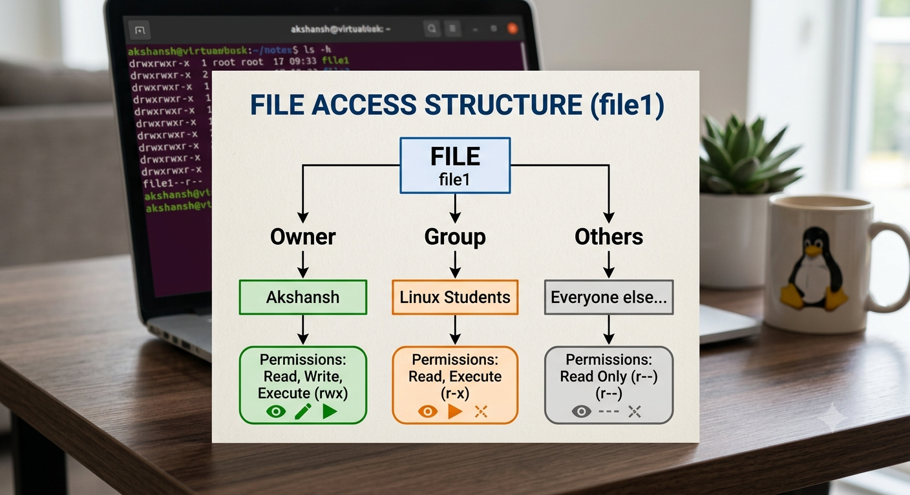
CONTROLLING ACCESS TO FILESTROLLING ACCESS TO
FILES
VIEWING FILE AND DIRECTORY PERMISSIONS AND
OWNERSHIP
chmod u+x file1
Only Akshansh is affected.
chmod g+x file1
Only the Linux Students group is affected.
chmod o+x file1
Only everyone else is affected

Slide 9
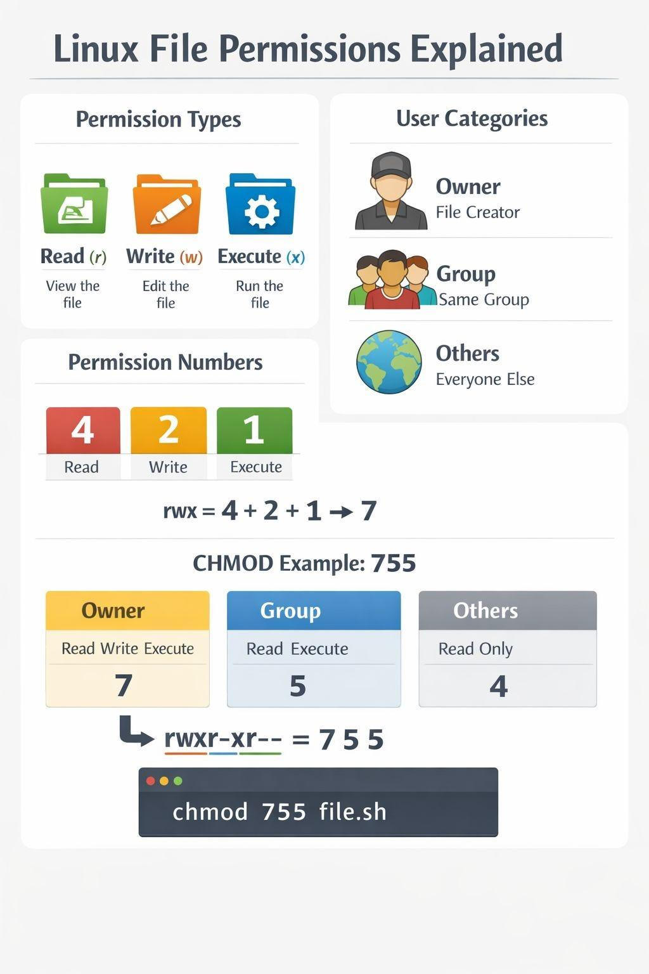
Managing Files permission Numerically
Permission | Calculation | Number
--- | 0 | 0
--x | 1 | 1
-w- | 2 | 2
-wx | 2 + 1 | 3
r-- | 4 | 4
r-x | 4 + 1 | 5
rw- | 4 + 2 | 6
rwx | 4 + 2 + 1 | 7

Slide 10
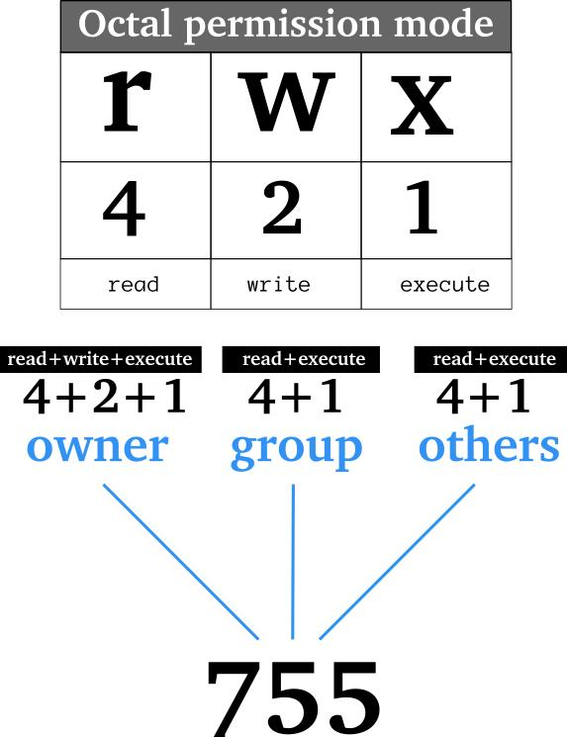
CONTROLLING ACCESS TO FILESTROLLING ACCESS TO
FILES

Slide 11
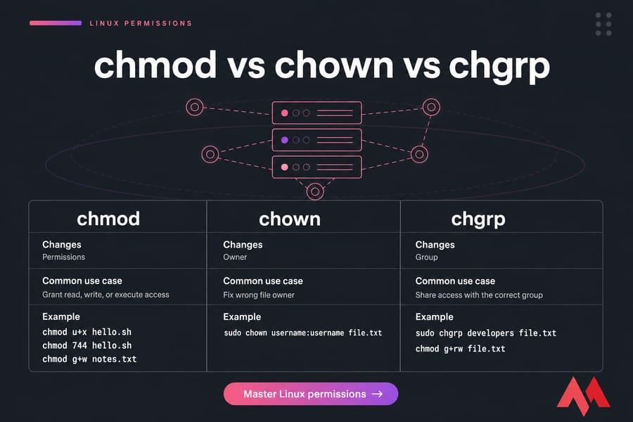
CONTROLLING ACCESS TO FILESTROLLING ACCESS TO
FILES

Slide 12
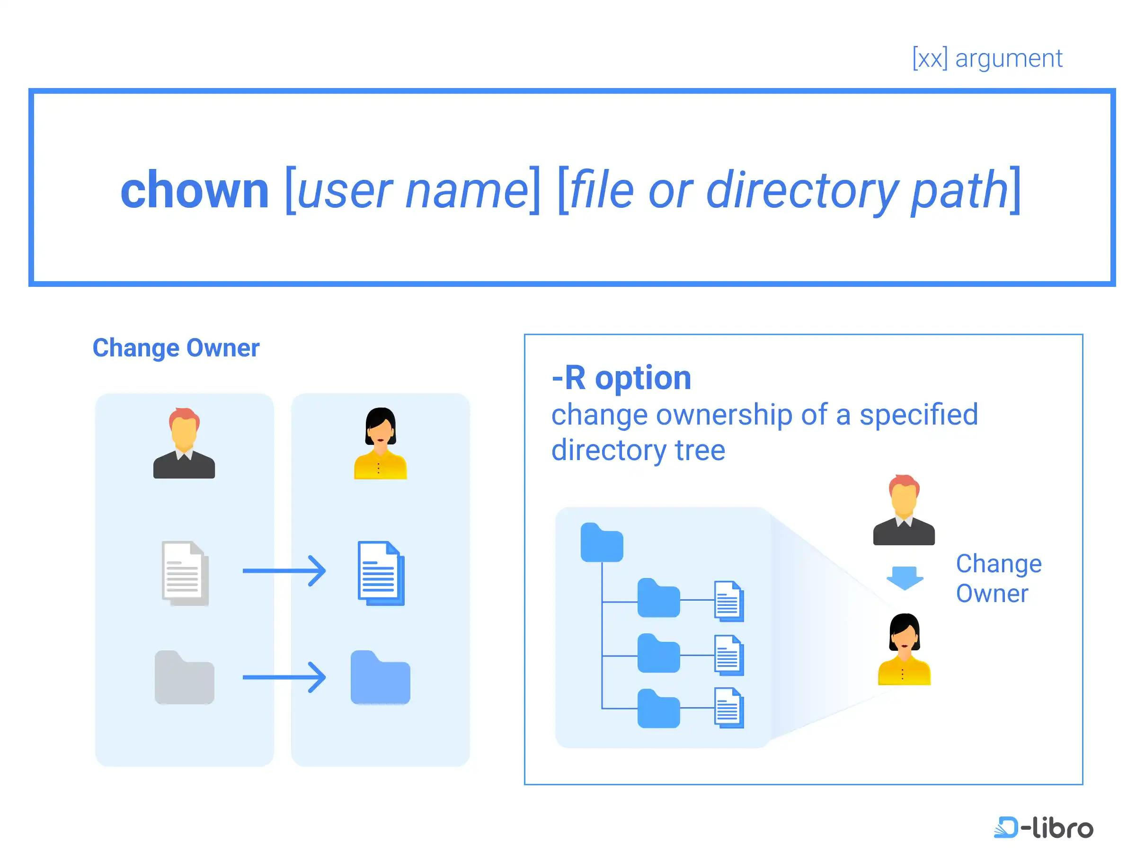
CONTROLLING ACCESS TO FILESTROLLING ACCESS TO
FILES
Recursive — (-R)
change ownership of the directory AND everything
inside it.

Slide 13
CONTROLLING ACCESS TO FILESTROLLING ACCESS TO
FILES
Cross-Group File Access
There are two teams on the Ubuntu server: A,B
Task 1 — Create Users
Task 2 — Create Groups
Task 3 — Assign Users
Task 4 — Create Project File
Task 5 — Configure Ownership
Task 6 — Restrict the File
Task 7 — Test A ‘s Access
Task 8 — Give A’s Access Through Group Membership

Slide 14
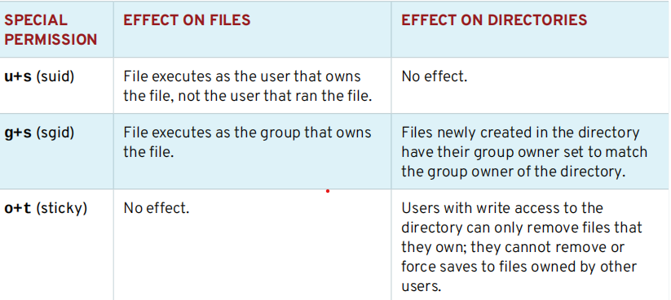
CONTROLLING ACCESS TO FILESTROLLING ACCESS TO
FILES
MANAGING DEFAULT PERMISSIONS AND FILE ACCESS
Special permissions constitute a fourth permission type in addition to the basic user, group, and other types. As the name implies, these permissions provide additional access-related features over and above what the basic permission types allow

Slide 15
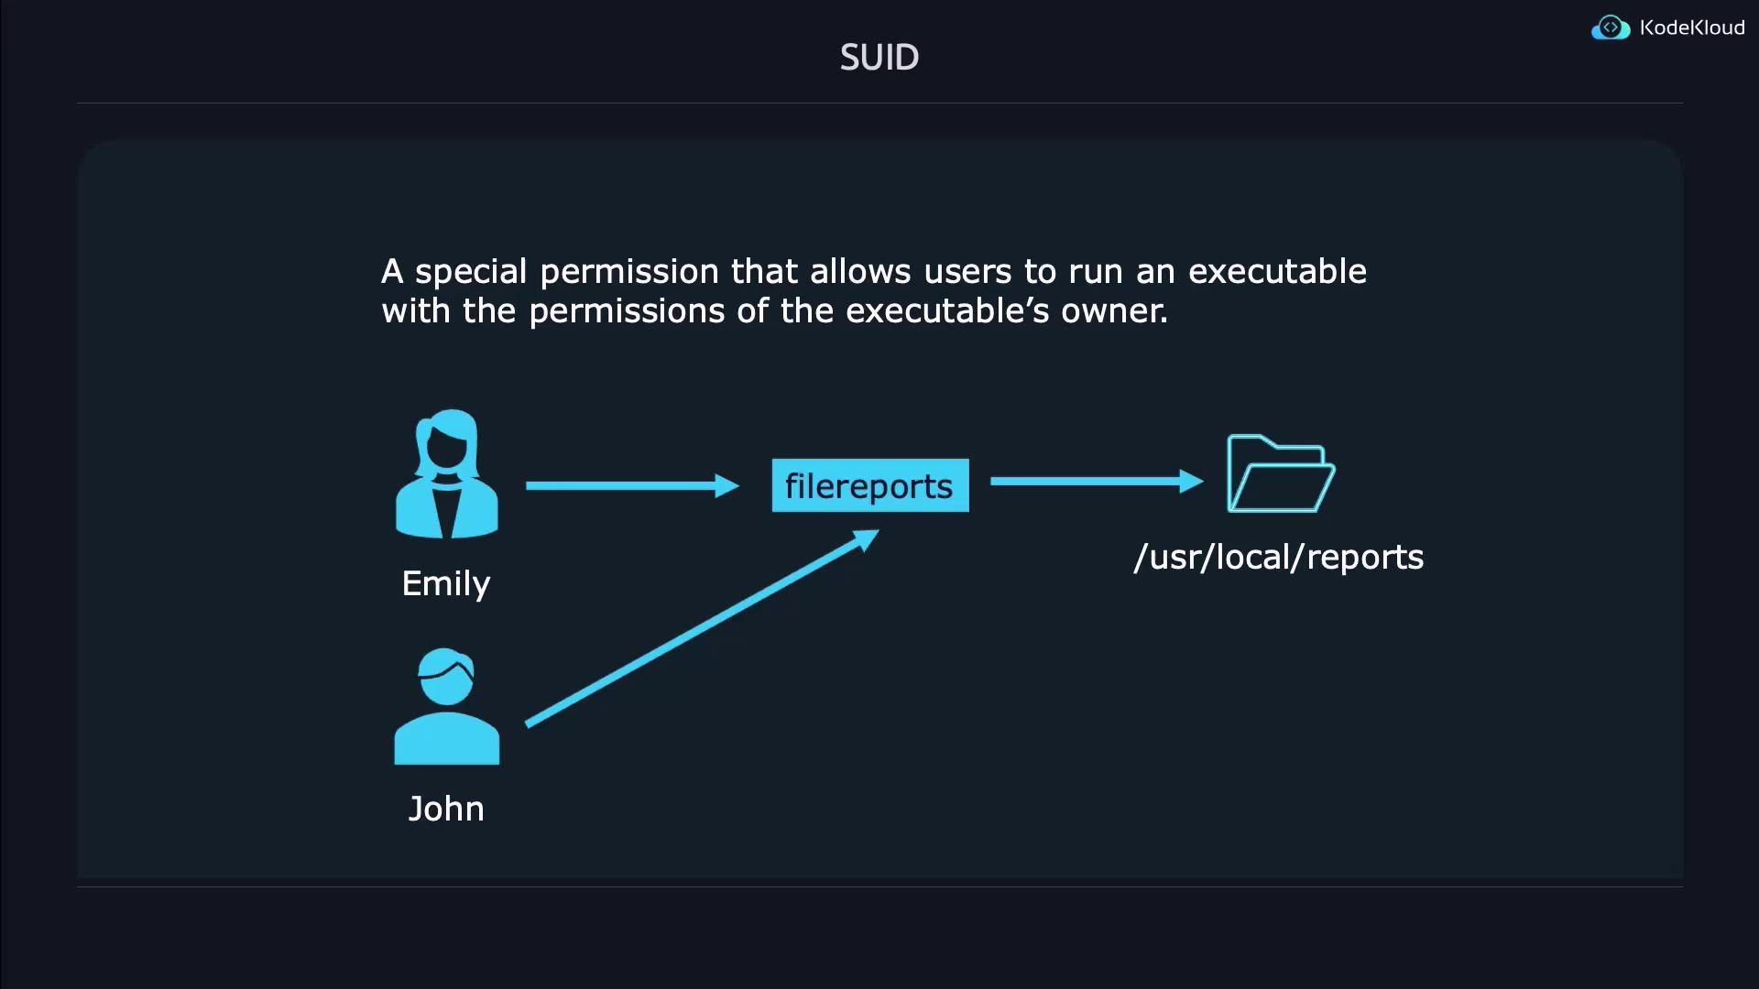
CONTROLLING ACCESS TO FILESTROLLING ACCESS TO
FILES
MANAGING DEFAULT PERMISSIONS AND FILE ACCESS
WITHOUT SETUID
Admin owns the program
change-password
│
Owner = Admin
Now User wants to use it:
User
│
│ runs
change-password
Normally, the program runs using User permissions.
The problem
User may not have permission to change certain protected information.
So how can an ordinary user safely use a program that needs special privileges?
SETUID solves this problem.
SETUID = Run an executable with the permissions of its owner

Slide 16
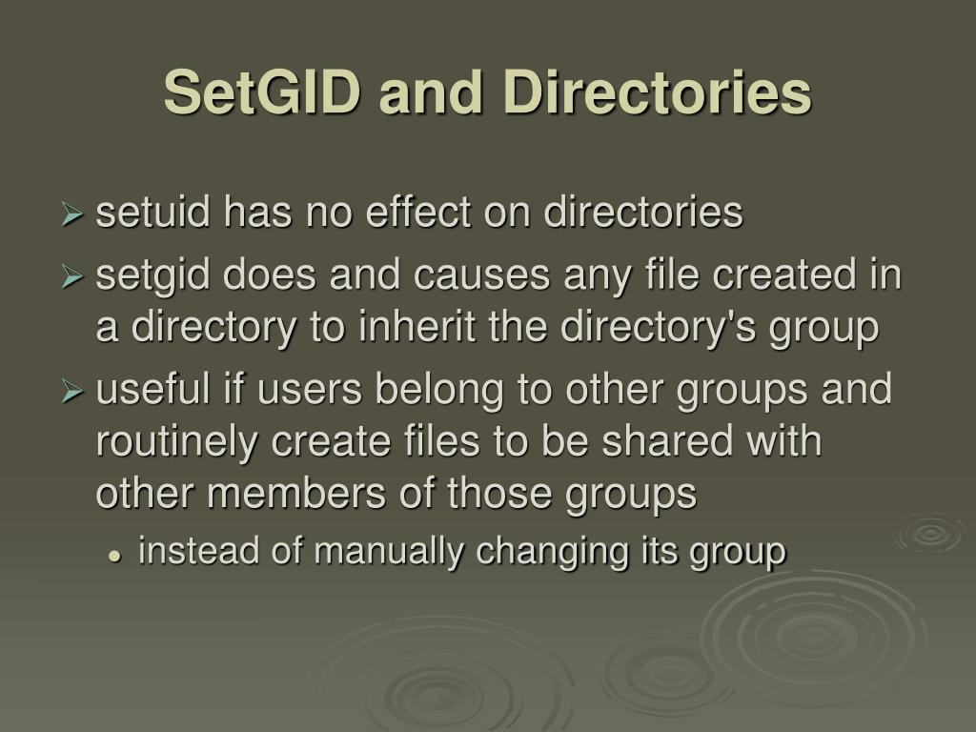
CONTROLLING ACCESS TO FILESTROLLING ACCESS TO
FILES
MANAGING DEFAULT PERMISSIONS AND FILE ACCESS
SETGID : “STAY WITH THE GROUP”
Imagine a college project team.U1,U2,U3
They all belong to the same team:AI-Team
They have a shared folder:
PROJECT/
The folder belongs to:
Group = AI-Team
The problem
U1 creates:
report.txt
Who should the file belong to?
We want:
Owner = U1
Group = AI-Team
Why?Because U2 and U2 are also members of AI-Team. SETGID helps us do this automatically.

Slide 17
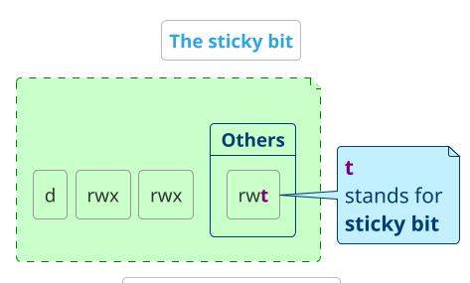
CONTROLLING ACCESS TO FILESTROLLING ACCESS TO
FILES
MANAGING DEFAULT PERMISSIONS AND FILE ACCESS
WITHOUT STICKY BIT
Everyone has permission to use the shared folder.ie u1,u2,u3
SHARED/
│
├── u1.txt
├── u2.txt
└── u3.txt
u3 can access the shared directory.
If the directory permissions allow users to delete entries, u3 may be able to remove:
u1.txt
even though:
Owner = u1
Command : chmod o+t SHARED

Slide 18
MONITORING AND MANAGING LINUX PROCESSES
DEFINITION OF A PROCESS
A process is a running instance of a launched, executable program.
A process consists of:
• An address space of allocated memory
• Security properties including ownership credentials and privileges
• One or more execution threads of program code
• Process state
The environment of a process includes:
• Local and global variables
• A current scheduling context
• Allocated system resources, such as file descriptors and network ports

Slide 19
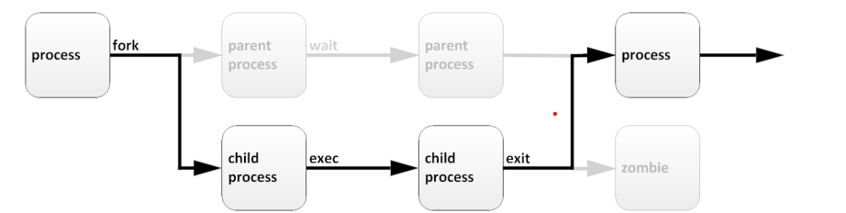
MONITORING AND MANAGING LINUX PROCESSES
An existing (parent) process duplicates its own address space (fork) to create a new (child) process structure. Every new process is assigned a unique process ID (PID) for tracking and security. The PID and the parent's process ID (PPID) are elements of the new process environment. Any process may create a child process.
Through the fork routine, a child process inherits security identities, previous and current file
descriptors, port and resource privileges, environment variables, and program code. A child
process may then exec its own program code. Normally, a parent process sleeps while the child
process runs, setting a request (wait) to be signalled when the child completes. Upon exit, the
child process has already closed or discarded its resources and environment. The only remaining
resource, called a zombie, is an entry in the process table

Slide 20
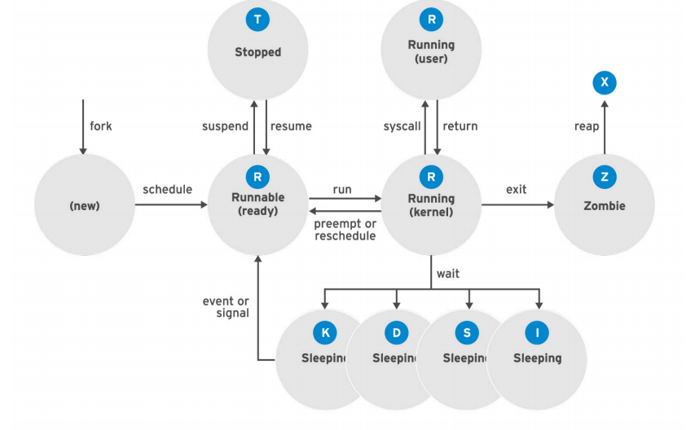
MONITORING AND MANAGING LINUX PROCESSES
In a multitasking operating system, each CPU (or CPU core) can be working on one process at a single point in time. As a process runs, its immediate requirements for CPU time and resource allocation change. Processes are assigned a state, which changes as circumstances dictate.
A zombie process is a terminated child process that remains in the system's process table because its parent process has not yet read its exit status. It uses no CPU or memory, but holds a Process ID (PID) slot

Slide 21
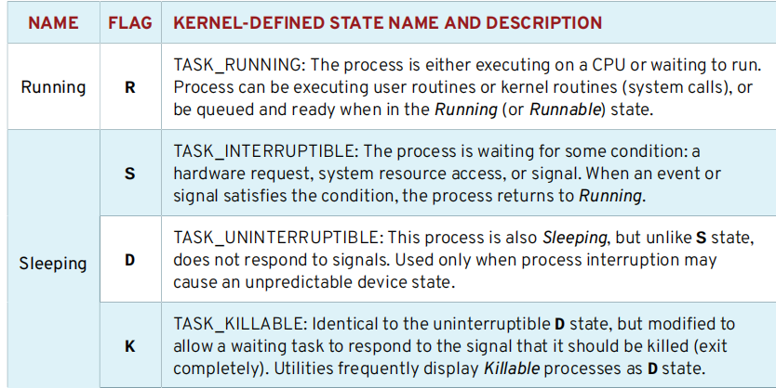

Slide 22
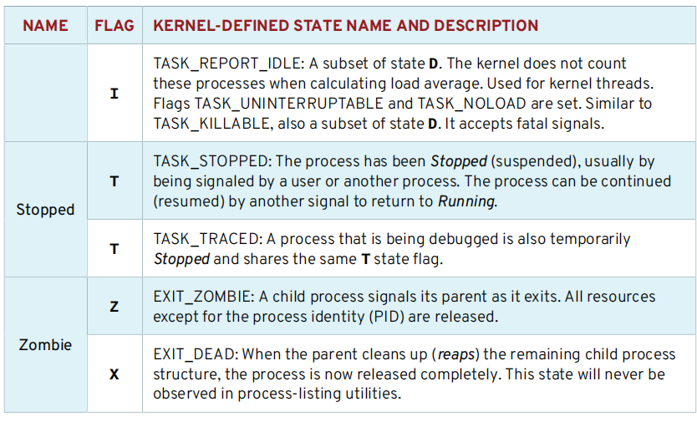

Slide 23
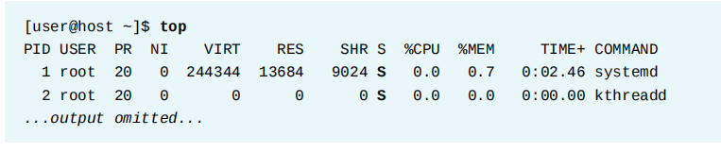
Why Process States are Important
When troubleshooting a system, it is important to understand how the kernel communicates with processes and how processes communicate with each other. At process creation, the system assigns the process a state. The S column of the top command or the STAT column of the ps show the state of each process. On a single CPU system, only one process can run at a time. It is possible to see several processes with a state of R. However, not all of them will be running consecutively, some of them will be in status waiting.
The top command is a real-time system monitoring utility available on Linux systems. It presents a continuously updated view of running processes along with overall system resource usage such as CPU load, memory consumption, and system uptime

Slide 24
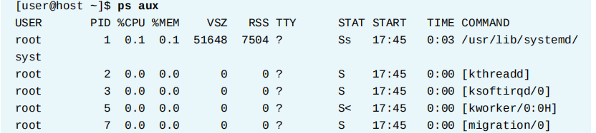
LISTING PROCESSES
The ps command is used for listing current processes. It can provide detailed process information,
including:
• User identification (UID), which determines process privileges
• Unique process identification (PID)
• CPU and real time already expended
• How much memory the process has allocated in various locations
• The location of process stdout, known as the controlling terminal
• The current process state.
The ps aux command in Linux is used to display a comprehensive, static snapshot of all currently running processes on the system. It is one of the most widely used tools by system administrators for monitoring resource usage, troubleshooting system health, and identifying process

Slide 25
Controlling Jobs
DESCRIBING JOBS AND SESSIONS
Job control is a feature of the shell which allows a single shell instance to run and manage multiple commands.
Types of Jobs :
A foreground job is a job that is currently running in the terminal and has control of the keyboard
Foreground = The job currently using the terminal.
A background job is a job that runs without controlling the keyboard, allowing you to continue using the terminal for other commands
Examples
Foreground Job Example: Running sleep 100 or sudo apt update. The terminal stays busy, shows the progress or waits, and does not let you type a new command until it is done or stopped
Background Job Example: Running sleep 500 &. Adding the & symbol tells the system to run the sleep timer in the background, immediately returning your command prompt so you can do other work.

Slide 26
Controlling Jobs
Cron Job: Cron is a time-based job scheduling utility available in Linux and Unix-like operating systems. It runs as a background daemon process and automatically executes scheduled tasks at predefined times without user intervention
Working of Cron :
Cron operates as a background service that continuously monitors scheduled jobs and executes them when their defined time matches the system time
 | Command | Purpose | Example
1 | crontab -e | Create or edit your cron jobs | crontab -e
2 | crontab -l | List/view your existing cron jobs | crontab -l
3 | crontab -r | Remove all cron jobs for the current user | crontab -r
4 | crontab -i | Remove all cron jobs with confirmation | crontab -i
5 | crontab -u username -e | Edit another user's crontab (requires appropriate privileges) | sudo crontab -username -e

Slide 27
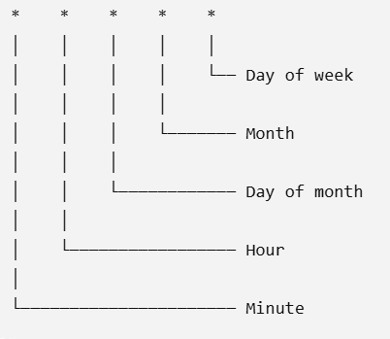
Creating a Cron Job demonstration :
Step 1 — Create a new crontab
crontab –e
Your editor will open.At the bottom, add only this line:
* * * * * echo "Cron is working" >> /tmp/cron_test.txt
Step 2 - Verify the job exists
crontab –l
Step 3 - Wait 1–2 minutes
Then run : cat /tmp/cron_test.txt
cron's basic job is simply:At a specified time, automatically execute this command.
Step 4 crontab –r
To remove job

Slide 28
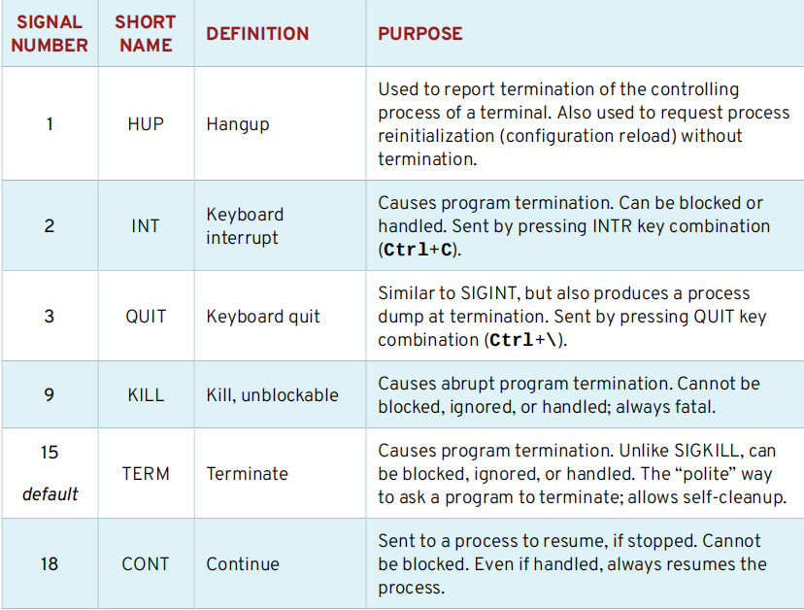
KILLING PROCESSES
PROCESS CONTROL USING SIGNALS
A signal is a software interrupt delivered to a process. Each signal has a default action, usually one of the following:
• Term - Cause a program to terminate (exit) at once.
• Core - Cause a program to save a memory image (core dump), then terminate.
• Stop - Cause a program to stop executing (suspend) and wait to continue (resume).

Slide 29
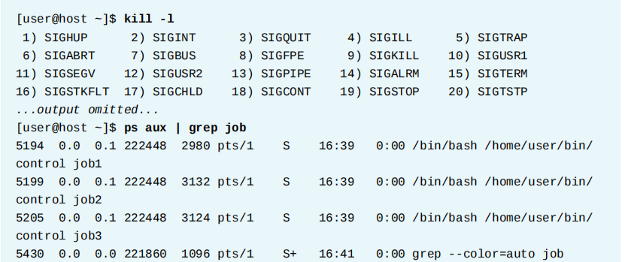
KILLING PROCESSES
The kill command sends a signal to a process by PID number. Despite its name, the kill command
can be used for sending any signal, not just those for terminating programs. You can use the kill
-l command to list the names and numbers of all available signals

Slide 30
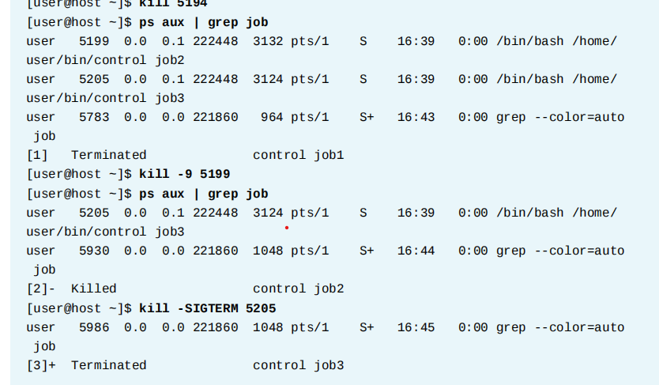
KILLING PROCESSES
The kill command sends a signal to a process by PID number. Despite its name, the kill command
can be used for sending any signal, not just those for terminating programs. You can use the kill
-l command to list the names and numbers of all available signals

