Slide 1
INT332
Docker Swarm

Slide 2
Introduction
Docker Swarm is the native container orchestration tool of Docker that allows you to manage a cluster of multiple Docker hosts as a single system.
It helps you run, scale, and manage containers across multiple machines automatically.

Slide 3
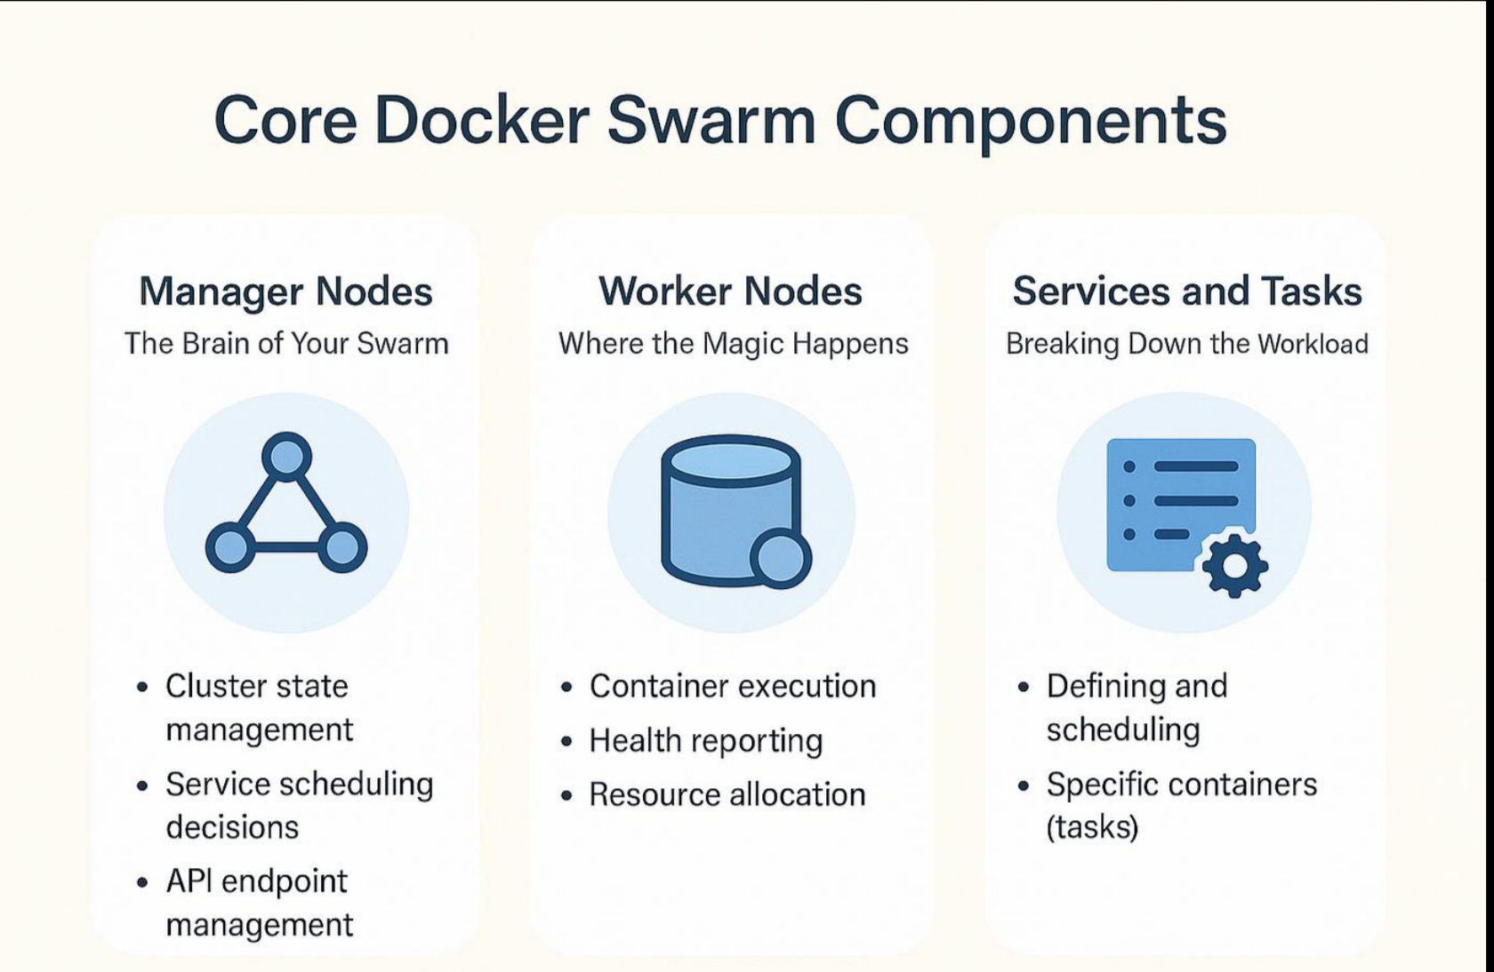
Core Components

Slide 4
Continue...
1. 🔸 Node
A node is a machine (physical/VM) participating in the swarm.
Types:
Manager Node → controls cluster (decision making)
Worker Node → runs containers
2. 🔸 Cluster
A collection of nodes working together.

Slide 5
Prerequisites
Install Docker
Minimum:
1 Manager node
1 Worker node (optional but recommended)
Ensure:
Ports open: 2377, 7946, 4789

Slide 6
Practical
Initialize Docker Swarm (Manager Node)
docker swarm init

Slide 7
Continue..
✔ Output (Important)
You will get a join token, example:
docker swarm join --token SWMTKN-1-xxxxx 192.168.1.10:2377
👉 Copy this (used in next step)

Slide 8
Continue...
3. Add Worker Nodes
Run on Worker machine
docker swarm join --token SWMTKN-1-xxxxx 192.168.1.10:2377

Slide 9
Continue...
Step 3: Move to Worker Node (IMPORTANT)
👉 You do NOT run next command on the same machine
You must:
✔ Go to another system (Worker Node)
Another laptop / VM / server

Slide 10
Create a Service in Docker Swarm
docker service create --name webserver -p 8080:80 nginx
What happens:
Service created
Container deployed automatically

Slide 11
Scale the Service
docker service scale webserver=3
Now:
3 containers running
Load balancing enabled automatically

Slide 12
Check Service Status
docker service ls
docker service ps webserver

Slide 13
Update Service
docker service update --image nginx:latest webserver

Slide 14
Remove Service
docker service rm webserver

Slide 15
Leave Swarm (Shutdown)
docker swarm leave --- Worker Node
docker swarm leave --force ( Manager Node)

Slide 16
Continue..
Expected Output
Swarm cluster running
2 containers deployed
Accessible at:
http://localhost:8081

Slide 17
Core Practical..
To create a Docker Swarm cluster, initialize Docker Swarm, and deploy a service inside the Swarm.

Slide 18
Step 2: Check Docker Version
docker --version
This command checks whether Docker is installed.

Slide 19
Step 3: Check Docker Status
docker info
This shows complete Docker system information.

Slide 20
Part 2: Initialize Docker Swarm Step 4: Initialize Docker Swarm
docker swarm init
This command converts your current machine into a Swarm Manager Node.
Swarm initialized: current node is now a manager.

Slide 21
Part 3: Check Swarm Node Step 5: View Nodes in Swarm
docker node ls
This command shows all nodes available in the Swarm cluster.

Slide 22
Part 4: Create a Service in Docker Swarm Step 6: Create an Nginx Service
docker service create --name my-web-service -p 8080:80 nginx
This command creates a service named my-web-service.
maps port 8080 of your laptop to port 80 of the container.
Docker image used for the service - NGINX

Slide 23
Part 5: Check Running Service Step 7: List Docker Services
docker service ls
This shows all services running in Docker Swarm.

Slide 24
Step 8: Check Service Details
docker service ps my-web-service
This shows the running task/container of the service.
Part 6: Test the Service
Step 9: Open Browser
Open this URL:http://localhost:8080
You should see the default Nginx welcome page.

Slide 25
Part 7: Scale the Service Step 10: Increase Service Replicas
docker service scale my-web-service=3
This creates 3 replicas of the same service.

Slide 26
Step 11: Check Replicas
docker service ps my-web-service
You will see 3 running tasks.

Slide 27
Part 8: Update the Service Step 12: Update Service Image
docker service update --image nginx:alpine my-web-service
This updates the running service from nginx to nginx:alpine.

Slide 28
Step 1: Inspect the Service
docker service inspect my-web-service --pretty
If you see nginx:alpine → Update successful
Step 14: Check Service Removed
docker service ls

Slide 29
Part 10: Leave Docker Swarm Step 15: Leave Swarm Mode
docker swarm leave --force
This removes your machine from Docker Swarm mode.

Slide 30
Pushing Artifacts to Registries using Maven
An artifact is any output file generated during the software build process that is used for deployment, distribution, or further testing.
Common Types of Artifacts
JAR file → Java applications
WAR file → Web applications
EAR file → Enterprise applications
Docker Image → Containerized application (used in Docker)
ZIP/TAR files → Packaged distributions

Slide 31
Part 1: Create Maven Project
mvn archetype:generate \
-DgroupId=com.example \
-DartifactId=maven-registry-demo \
-DarchetypeArtifactId=maven-archetype-quickstart \
-DinteractiveMode=false

Slide 32
Part 2: Move Inside Project
cd maven-registry-demo
ls

Slide 33
Part 3: Build Maven Artifact
mvn clean package
Explanation
clean removes old build files.
package creates the .jar file.
ls target ( Check generated artifact)

Slide 34
Part 4: Create Dockerfile
nano Dockerfile
FROM openjdk:17-jdk-slim
WORKDIR /app
COPY target/maven-registry-demo-1.0-SNAPSHOT.jar app.jar
CMD ["java", "-jar", "app.jar"]
Explanation
FROM selects Java base image.
WORKDIR creates working directory.
COPY copies Maven JAR into Docker image.
CMD runs the JAR file.

Slide 35
Part 5: Build Docker Image
docker build -t maven-registry-demo .
You can check images using: docker images

Slide 36
Part 6: Test Docker Image Locally
docker run maven-registry-demo
You will se Output

Slide 37
Part 7: Login to Docker Hub
docker login

Slide 38
Part 8: Tag Docker Image
docker tag maven-registry-demo yourusername/maven-registry-demo:v1
Use your Docker Hub username:
Tagging prepares the image for upload to Docker Hub.

Slide 39
Part 9: Push Image to Registry
docker push yourusername/maven-registry-demo:v1
This command uploads the Docker image to Docker Hub registry.

Slide 40
Part 10: Verify Image on Docker Hub
yourusername/maven-registry-demo
You Will see Tag

Slide 41
Part 11: Pull Image from Registry
docker pull yourusername/maven-registry-demo:v1

Slide 42
Part 12: Run Pulled Image
docker run yourusername/maven-registry-demo:v1
You Will see Output

